Slide 1
وَمِنْكُمْ مَنْ يُرَدُّ إِلَى أَرْذَلِ الْعُمُرِ لِكَيْ لَا يَعْلَمَ مِنْ بَعْدِ عِلْمٍ شَيْئًا
صدق الله العظيم

Slide 2
DEMENTIA
Nuha Alkhawajah MD

Slide 3
Dementia
Decline in cognition: learning and memory, language, executive function, complex attention, perceptual-motor, social cognition.
Represent a decline from previous level of function
Does not occur exclusively in the context of a delirium
Interferes with daily function and independence
Not explained by another mental disorder (eg, major depressive disorder, schizophrenia)

Slide 4
Wait …..
Its important to differentiate dementia from
Mild cognitive impairment (MCI)
Pseudodementia
Delirium

Slide 5
Normal Aging
Mild changes in memory
Rate of information processing
Not progressive
Not affecting daily function.

Slide 6
Mild Cognitive Impairment
deficit in cognition in at least one domain
absence of dementia
No impairment in activities of daily living
Patients with MCI are at increased risk of dementia
Amnestic MCI has a conversion rate to dementia of 10-15%/year

Slide 7
Depression (pseudodementia)
Subjective complain about memory loss (the patients)
psychomotor slowing
Poor effort on testing (“I can’t do this”)

Slide 8
Delirium
Reversible disturbance of consciousness with reduced ability to focus, sustain, or shift attention.
Not better accounted for by dementia.
Hours to days and is fluctuating
Caused by a medical condition, substance intoxication, or medication side effect.

Slide 9
 | Delirium “acute confusional state” | Dementia
Onset | Acute , sudden Caused by a medical, or environmental condition. | Slowly gradually progressive Loss of brain cells resulting in decline of day-to-day cognition and functioning.
Duration | Hours to days | Months-Years
Consciousness | Fluctuates (sleepy, somnolent, drowsy,) | Preserved
Cognitive Testing | Vary from poor to good depending on time of day. | Gradually worse over months/years
Memory | Recent and immediate memory impaired. Long term lost | Long term preserved in early disease
Sleep/wake cycle | Disturbed or reversed | Normal to fragmented
Hallucination / delusions | Often of a frightening or paranoid nature | Usually absent. Except in advanced causes or DLB
Prognosis | Treatable and reversible | Progression can be slowed but not reversed.
Treatment | Treat underlying cause. Restore sleep/wake cycle Environment | Cholinesterase inhibitors, memeantine Symptomatic treatment

Slide 10
Epidemiology of Dementia
5% of individuals >65 years
35-50% of persons >85 years

Slide 11
Clinical Features of Dementia
Informant mentions memory loss (compare to pseduodementia)
Retaining new information (remembering events)
Handling complex tasks (paying receipts)
Reasoning (coping with unexpected events)
Spatial ability and orientation (lost in familiar places)
Language (word finding)
Behavior

Slide 12
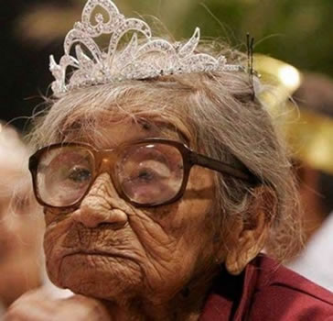
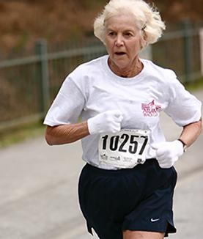
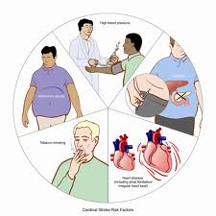
Risk Factors of Dementia
1% for 70-74 years
1st degree relative have a 10-30%
8.4% for 85 years
Higher levels of education are associated with reduced risk of AD
higher cognitive reserve

Slide 13
Dementia syndromes
Reversible, need to be ruled out
Irreversible

Slide 14
Reversible Causes of Dementias
Drug toxicity
Vitamin B12 deficiency
Infections
Alcoholism
Inflammatory states
Hormonal dysfunction
Environmental toxins
Drug abuse
Depression

Slide 15
Reversible Dementia

Slide 16
Irreversible Dementia Syndromes
Alzheimer disease (AD)
Dementia with Lewy bodies (DLB)
Frontotemporal dementia (FTD)
Vascular dementia (VaD)
Parkinson disease with dementia (PDD)

Slide 17
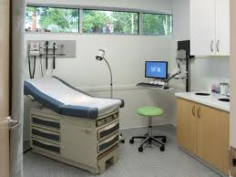
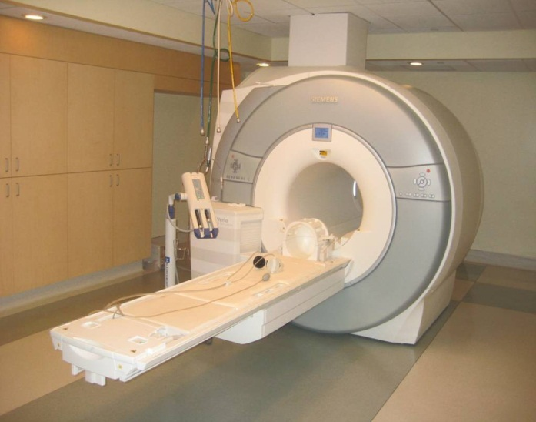
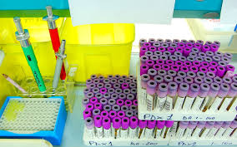
Diagnostic Approach to Dementia

Slide 18
History
Symptoms of dementia
Associated neurologic symptoms
Associated psychiatric symptoms
Course
Other medical conditions

Slide 19
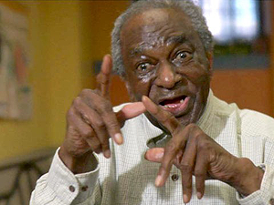
Symptoms of dementia:

Slide 20
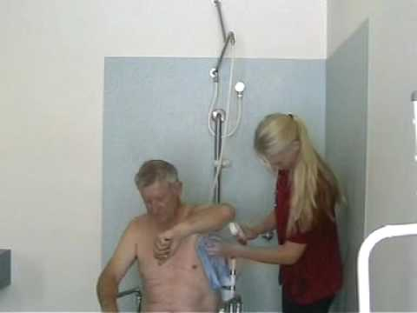
Symptoms of dementia:

Slide 21
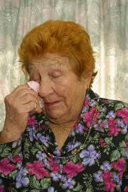

Slide 22
History
Symptoms of dementia
Associated neurologic symptoms
Associated psychiatric symptoms
Course
Other medical conditions

Slide 23
Associated neurological symptoms:
Slurred speech
focal weakness
Walking difficulties
Imbalance

Slide 24
History
Symptoms of dementia
Associated neurologic symptoms
Associated psychiatric symptoms
Course
Other medical conditions

Slide 25
Associated psychiatric symptoms:
Depression: hopelessness, worse in morning, suicidal ideation
Psychotic features: delusions and hallucinations

Slide 26
History
Symptoms of dementia
Associated neurologic symptoms
Associated psychiatric symptoms
Course
Other medical conditions

Slide 27
Course
Very important determinant of the cause
Rapid progressive vs slow gradual decline
Gradual onset of short term memory loss (AD)
Sudden, step wise deterioration (vascular)

Slide 28
History
Symptoms of dementia
Associated neurologic symptoms
Associated psychiatric symptoms
Course
Other medical conditions

Slide 29
Associated medical conditions:
Vascular risk factors: HTN, DM, stroke
Thyroid disorders
Anemia
Depression

Slide 30
B. Cognitive Function Assessment:
Mini-Mental State Exam (MMSE):
The most widely used
Tests orientation, registration, recall, attention, calculation, language
Maximum score is 30 points.
Score of < 24 points is suggestive of dementia or delirium.
Sensitivity of 87% , specificity of 82%
Confounding factors:
Age and education, as well as language, motor, and visual impairments

Slide 31
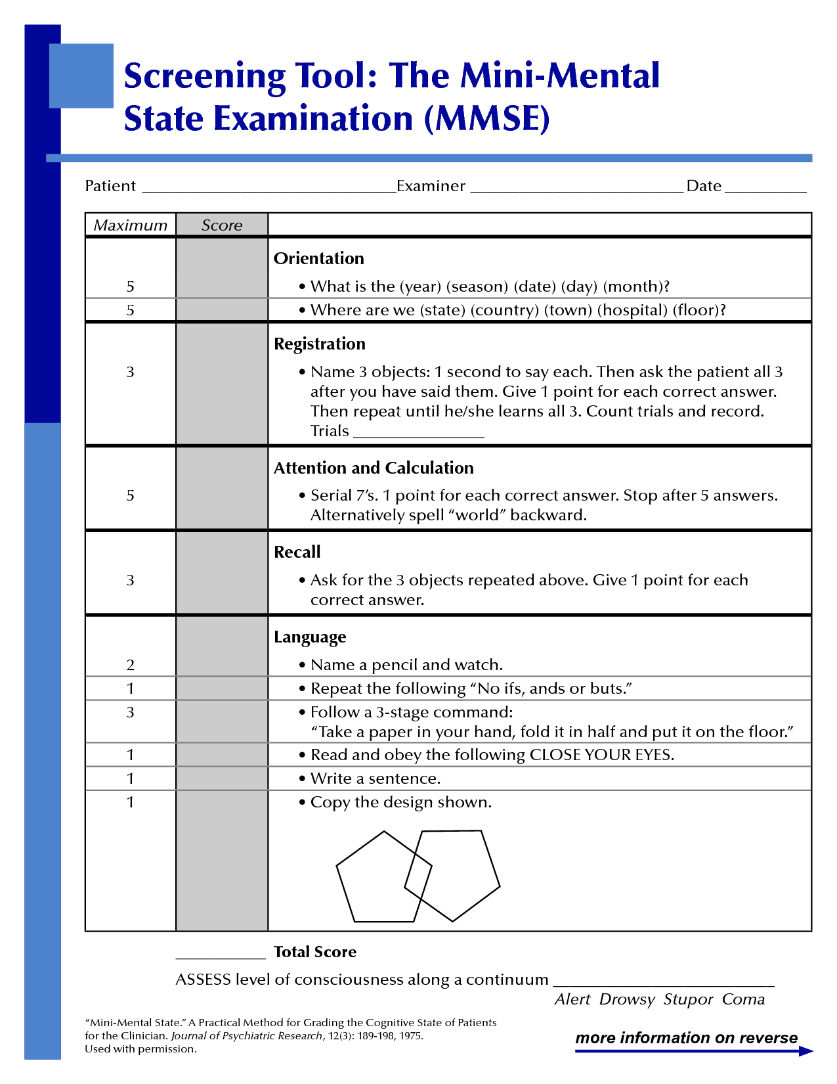

Slide 32
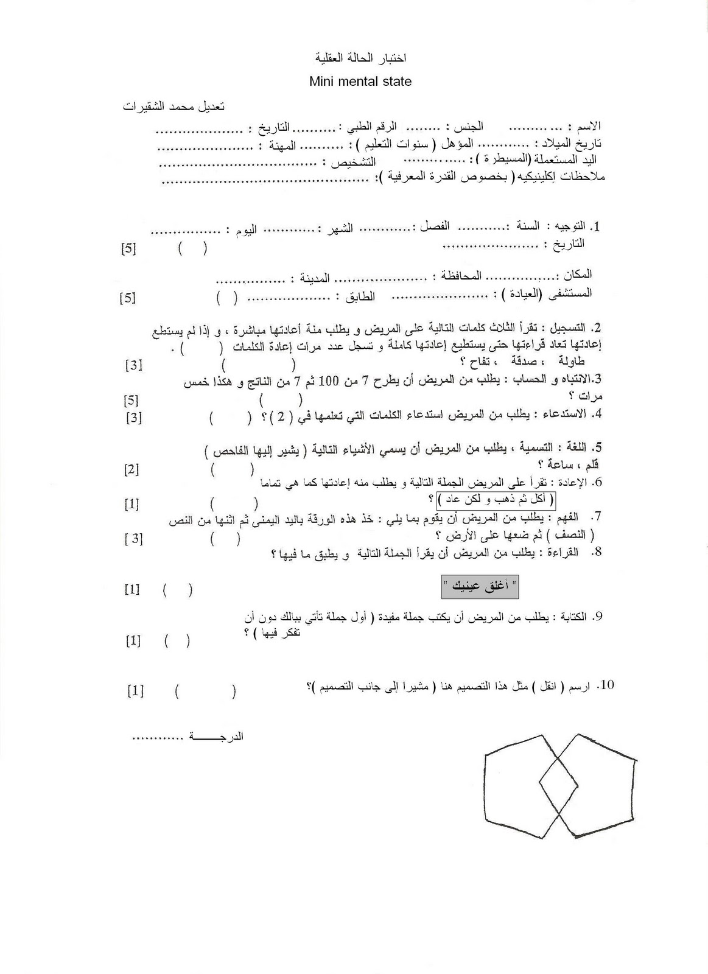

Slide 33
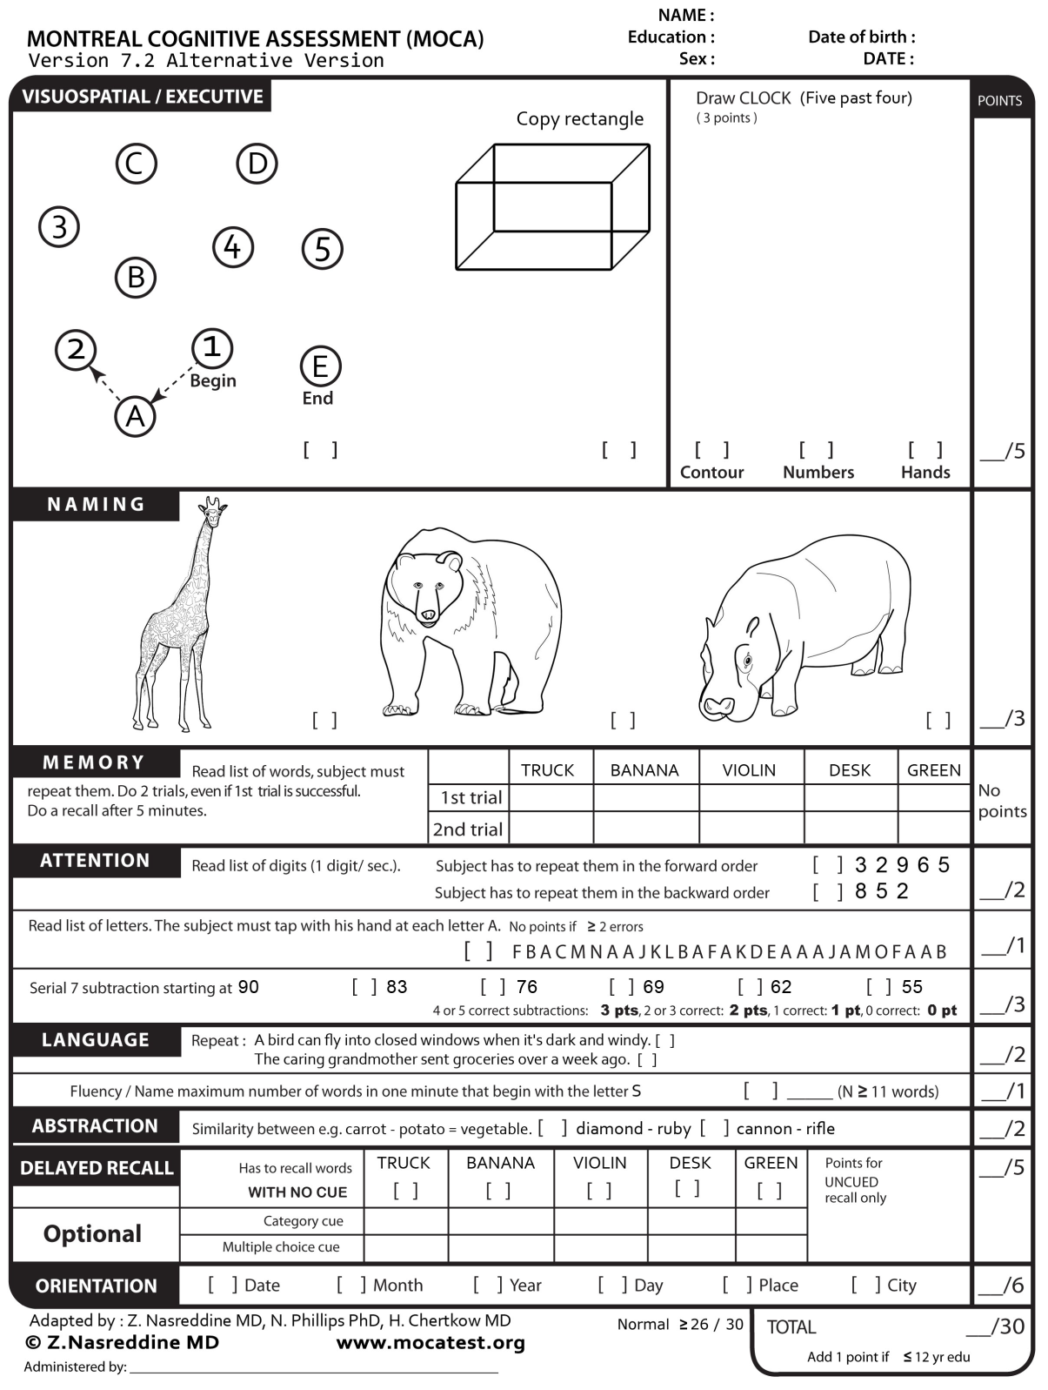
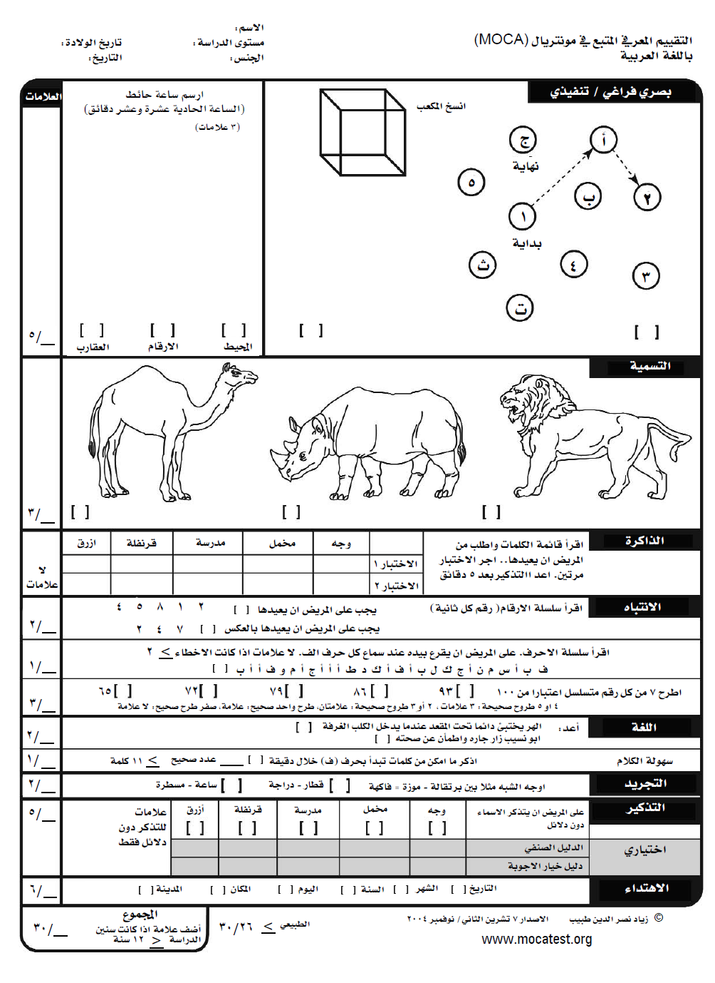
MoCA
Montreal cognitive assessment
http://www.mocatest.org/

Slide 34
B. Cognitive Function Assessment
Informant interview
8 item questionnaire
positive response to two or more questions has a sensitivity of 93% and a specificity of 46%
informants are asked whether the patient :
Judgment difficulties
Reduced interest in hobbies
Repeats questions, stories, or statements
Trouble learning how to use a tool
Forgetting the month or year
Difficulty handling financial affairs
Difficulty remembering appointments
Consistent problems with memory

Slide 35
C. Physical Examination
Focal neurological deficit
Signs of Parkinson disease (PD) (eg, cogwheel rigidity and/or tremors)
Gait (Parkinson, vascular, NPH…)

Slide 36
D. Labs
The aim is to rule out any treatable causes:
CBC , differential (anemia, chronic infection)
Thyroid function test
Vitamin B12, thiamine
Neurosyphilis
CSF

Slide 37
E. Neuroimaging
Brain CT or MRI in the routine initial evaluation for every patient with dementia
To rule out reversible causes
Subdural hematoma
Normal pressure hydrocephalus

Slide 38
Alzheimer Disease
(AD)

Slide 39
Alzheimer Disease
a neurodegenerative disorder of uncertain cause and pathogenesis that primarily affects older adults
most common cause of dementia (55%)
slightly more common in women
incurable conditions that result in progressive loss of function & structure and / or death of neurons

Slide 40
Alzheimer Disease
a disease of older age, rarely occurring <60
5% are inherited, present before 65
main clinical manifestations of AD are selective memory impairment and dementia

Slide 41
Pathology
Neurofibrillary tangles:
Paired helical filaments consisting of hyper-phosphorylated tau protein)
Found early in the entorhinal cortex, then hippocampus and temporal cortex
Plaques:
extracellular loose aggregates of amyloid and preamyloid material
Loss of neurons
Granulovacuolar degeneration: intracytoplasmic vacuoles
Amyloid angiopathy: in small and medium cortical and leptomeningeal arteries

Slide 46
Genetics of AD
Early-onset AD
Accounts for <1% of cases
follows an autosomal dominant inheritance pattern
mutations in three genes: amyloid precursor protein (APP), presenilin 1 (PSEN1), and presenilin 2 (PSEN2)
Late-onset AD
More complex
the most firmly established genetic risk factor is apoprotein E ε4 (APOE ε4)

Slide 47
Clinical Course of AD
AD progresses relentlessly
3 to 3.5 points decline on the MMSE/year
Mean survival ranges from three to eight years

Slide 48
Diagnosis of AD
Clinical cognitive assessment
Imaging:
Hippocampal atrophy
R/O other pathologies
EEG:
Diffuse background slowing
CSF:
Increase tau

Slide 49
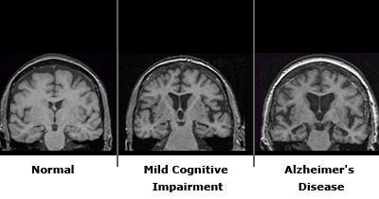

Slide 50
Treatment of AD
There is no cure
Modulate the course of the disease and/or ameliorate some symptoms
Risk factors control
Cognitive rehabilitation
Treatment of associated symptoms: insomnia, depression, hallucinations, agitation
Nutrition

Slide 51
Treatment of AD
Aiming to slow the disease progression
Mild-moderate:
Cholinesterase inhibitors (based on theory that there is selective loss of cholinergic cell bodies)
Donepezil, rivastigmine (available as patches), and galantamine
Vitamin E (cardiotoxic)
Moderate-Severe (MMSE <17):
Add Memantine (NMDA receptor blocker)
Severe (MMSE <10)
Memantine
Palliative care

Slide 52
Vascular Dementia (VD)
More common in males
AD and VaD share risk factors
Evidence of prominent executive dysfunction, stroke history, vascular risk factors & high Hachinski Ischemic Score (>7)

Slide 53
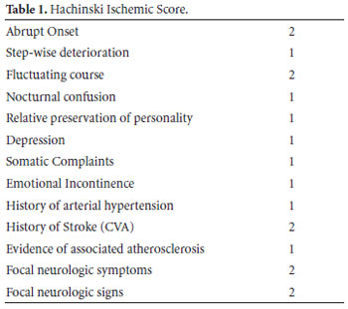

Slide 54
Lewy Body Dementia
Dementia, psychosis, extrapyramidal symptoms and fluctuation in attention
May have transient lapses of consciousness
More common in males
Pathologically charactarized by accumulation of Lewy bodies (eosinophilc inclusions)

Slide 55
Frontotemporal Dementia (FTD)
Rare
Onset in the 6th decade
50% familial
Poor judgment is the hallmark of the disease
Suspect FTD with: early onset, more poor judgment than memory loss, aphasia

Slide 56
Summary
Family members are invaluable resources for providing an adequate history
The MMSE is a useful screening test for dementia; a score of less than 24 points is suggestive of dementia or delirium.
R/O reversible dementia is an important step in assessment
AD is the most common form of dementia

Slide 57
Summary
Genetic testing is available for the known genes in early-onset AD but has not been widely adopted, because of the lack of highly effective preventative or therapeutic strategies
Behavioral disturbances are common in dementia and symptomatic treatment may improve quality of life
Available treatments are not curable

Slide 58
A 70 year-old man began crashing into the walls at night during violent dreams two to three nights per week. He had no cognitive or neurological impairment. Six years later he developed mild cognitive symptoms and very mild Parkinsonian signs and seven years later he began seeing well-formed animals

Slide 59
A 55 year-old woman presented with gradual onset and progression of difficulty finding words and a change in behavior over one year. She was still working without difficulty. She was more anxious and impatient and had decreased regard for the feelings of others. Her MMSE was 25 with 3/3 on delayed recall. She had mild word finding difficulty and a normal sensorimotor exam. Her MRI revealed prominent temporal and frontal lobe atrophy. Her mother had a progressive dementia beginning in her late fifties with a similar pattern of asymmetric atrophy.

