Slide 1
Neuromuscular Junction Disorders
Nuha Alkhawajah MD

Slide 2
Definition of NMJ Disorders
Disorders affecting the junction between the presynaptic nerve terminal and the postsynaptic muscle membrane
Pure motor syndromes
Preferentially affect proximal, bulbar, or extraocular muscles

Slide 4
Physiology of NMJ Transmission
chemical neurotransmitter at the NMJ is acetylcholine(ACH)
ACH is stored in vesicles in the presynaptic terminal in discrete units known as quanta
Each quantum contains 10,000 molecules of ACH
The quanta are located in three separate stores. The primary, or immediately available store, secondary and a tertiary far from the NMJ in the axon and cell body.

Slide 5
Physiology of NMJ Transmission
Action potential invades and depolarizes the presynaptic junction
VGCCs are activated, allowing an influx of calcium
Release of ACH
ACH binds to ACHRs on the postsynaptic muscle membrane
This opens sodium channels
Leading to local depolarization, the endplate potential (EPP)

Slide 6
Physiology of NMJ Transmission
The size of the EPP is proportional to the amount of ACH released
A threshold needs to be reached for the EPP to be produced and muscle fiber action potential to be generated
In normal circumstances, the EPP always rises above threshold, resulting in a muscle fiber action potential
In the synaptic cleft, ACH is broken down by the enzyme acetylcholinesterase

Slide 7
http://www.youtube.com/watch?v=y7X7IZ_ubg4

Slide 8
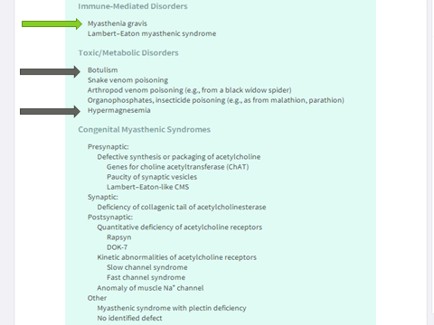
NMJ Disorders

Slide 9
Myasthenia Gravis الوهن العضلي الوبيل

Slide 10
Myasthenia Gravis (MG)
The most common disorder of neuromuscular transmission
Caused by an immunoglobulin G (IgG)-directed attack on the NMJ nicotinic ACH receptor
A post-synaptic NMJ disorder.
Hallmark of the disorder is a fluctuating fatigable weakness

Slide 11
Myasthenia Gravis (MG)
Classification
According to onset
Congenital
Acquired
According to clinical presentation:
Ocular
Generalized

Slide 12
Epidemiology of MG
Prevalence is 200 per million
Bimodal distribution:
Early peak: 2nd and 3rd decades (female predominance)
Late peak: 6th to 8th decade (male predominance)
Neonatal MG: a transient form, due to trans-placental passage of maternal antibodies
Association with other autoimmune diseases as, autoimmune thyroid disease, SLE, and rheumatoid arthritis, neuromyelitis optica

Slide 13
Pathogenesis of MG
Autoantibodies against the AChR
Decrease in the number of active acetylcholine as a consequence of AChR antibody binding
Destruction of receptors occurs via a complement-mediated process
Destruction of the post-synaptic folds
Associated with thymus pathology.

Slide 14
Pathogenesis of MG
60-70% of AChR ab positive patients have thymic hyperplasia and 10-12% have thymoma
Produces AChR subunits that triggers the immune response

Slide 15
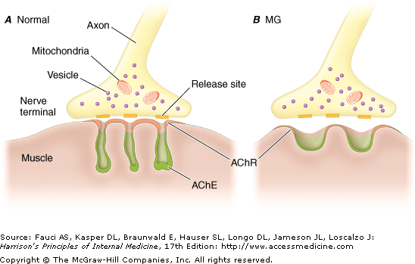
Closer look at the NMJ in MG

Slide 16
Clinical features of MG
worsening contractile force, not tiredness
Fluctuating, intermittent symptoms sometimes with periods of spontaneous improvement
Appearing with repetitive activity and worsening as day progresses
Muscle fatigue and weakness
No abnormality of mental state, sensory or autonomic function
Characteristically affects the extra-ocular, bulbar or proximal limb muscles

Slide 17
Types of Presentation in MG
Ocular presentation 50%
Bulbar presentation 15%
Limb weakness (<5 percent)
Isolated neck (uncommon)
Isolated respiratory (rare)

Slide 18
Ocular-onset MG
the most common
eventually 90%
15% continue to have isolated ocular symptoms
Ptosis (droopy eyelids)
Extraocular weakness frequently begins asymmetrically
Mimics 3rd , 4th , and 6th nerve palsies and, rarely INO
Unlike true 3rd nerve palsies MG never affects pupillary function

Slide 19
The normal eyelid and palpebral fissure
normal eyelid crease is 6 to 7 mm away from the eyelid margin in adults.
upper eyelid covers top 1 mm of the cornea
normal PF measures 9 to 12 mm
distance from a central pupillary light reflex to upper eyelid margin is called the margin reflex distance, normally this measures 4 to 5 mm

Slide 21
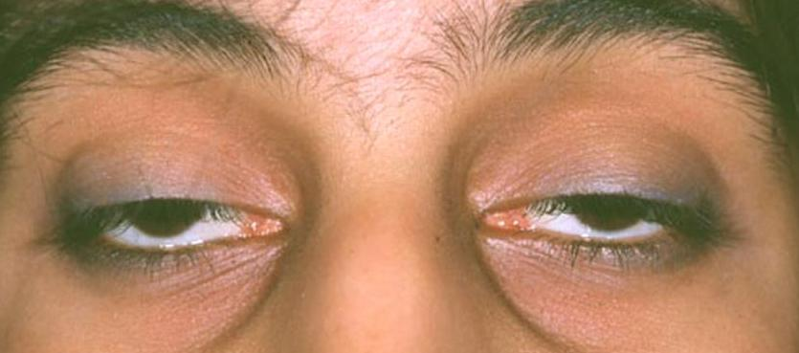
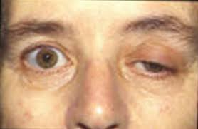
Cont.

Slide 22
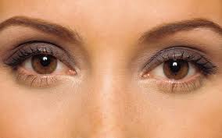

Slide 23
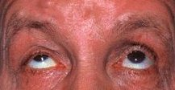
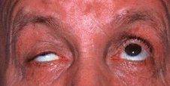

Slide 24
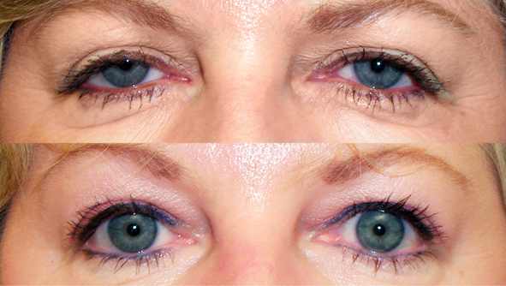

Slide 25
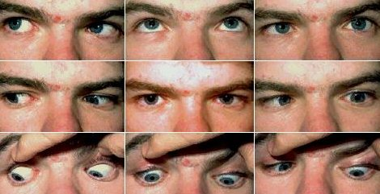

Slide 26
Bulbar-onset MG
Bulbar muscles weakness is the next most common
Dysphagia
Fatigability and weakness of mastication, with the inability to keep the jaw closed after chewing.
Dysarthria: nasal speech, slurred and hypophonic
Nasal regurgitation

Slide 27
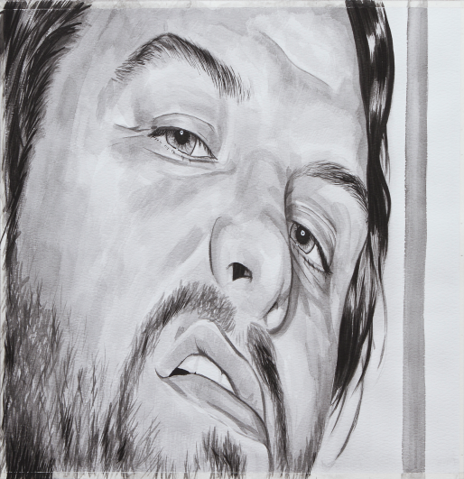
Facial muscles involvement
Facial muscles are frequently involved
Patient appear expressionless
"myasthenic sneer” on attempting to smile where the mid-lip rises but the outer corners of the mouth fail to move

Slide 28
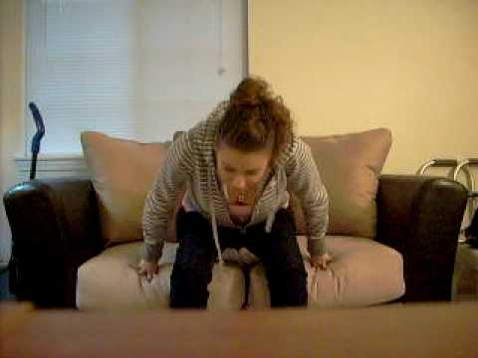
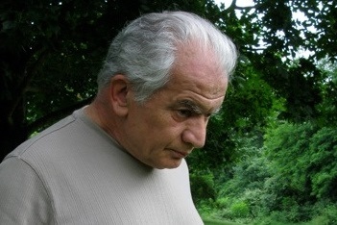
Limb involvement in MG
limbs weakness, usually symmetric and proximal
wrist and finger extensors and foot dorsiflexors are often involved
Rare patients present with an isolated limb weakness and never develop eye movement or bulbar muscle weakness

Slide 29
Respiratory Involvement in MG
Difficulty breathing, SOB
Obstructive sleep apnea
Difficulty sleeping on flat bed

Slide 30
Diagnosing MG
Bed side tests:
Tensilon test: injection of edrophonium (acetylcholinesterase inhibitor) in patients with ptosis or ophthalmoparesis looking for improvement
Ice pack test

Slide 31
Diagnosing MG
Serologic testing:
Antiacetylcholine receptor antibodies (AChR-Ab):
80-90% of generalized MG
50% of ocular MG
Anti Muscle-specific kinase antibodies (MuSK-Ab):
38-50% of generalized MG who are AChR-Ab –ve
much lower frequency of thymic pathology
More common in females
Usually present with severe oculobulbar weakness along or neck, shoulder, and respiratory weakness

Slide 32
Diagnosing MG
Electrophysiological studies:
repetitive nerve stimulation studies
single-fiber EMG the most sensitive test
CT scan of the chest. Why?

Slide 33
Prognosis
Early, the symptoms are often transient, with hours, days, or even weeks free of symptoms
Symptoms typically worsen and are more persistent months later.
Maximum weakness is reached within two years in 82 percent of patients

Slide 34
Prognosis
An active phase with fluctuations and most severe symptoms in the 1st five to seven years. Most myasthenic crises occur in this early period.
More stable second phase, symptoms are stable but persist. They may worsen in the setting of infection, medication taper, or other perturbations.
Followed by 3rd phase, in which remission may occur

Slide 35
Treatment of MG
Crisis: IVIG or Plasma exchange
Symptomatic treatment: cholinestrase inhibitor “Pyridostigmine”
Chronic immunomodulatory and immunosuppressive treatment:steroids, azathioprine, cellcept….
Thymectomy

Slide 36
Myasthenic Crisis
life-threatening condition
Definition: weakness from acquired MG that is severe enough to necessitate intubation
due to weakness of respiratory muscles.
Severe oropharyngeal muscle weakness often accompanies the respiratory muscle weakness, or may be the predominant feature

Slide 37
Cont.
Triggered by infections or certain medications.
A list of medications that affect the NMJ transmission should be given to MG patients to avoid or to use with caution.

Slide 39
Lambert Eaton Myasthenic Syndrome
Presynaptic NMJ disorder
Middle age to old people
50% of cases are associated with malignancy (especially lung cancer)
Fluctuating proximal weakness
Associated with P/Q type voltage gated Ca channels antibodies

Slide 40
Botulism
Presynaptic NMJ disorder
Caused by toxin produced by Clostridium Botulinum
Inhibits the release of Ach from the NMJ, sympathetic and parasympathetic ganglia
Food borne or wound related
Descending weakness and autonomic disturbance

