Slide 1
BACK PAIN
DR.AFSAR SAYEEDA
MRCP(UK)
CONSULTANT & HEAD, CTU
DEPT OF MEDICINE, KKUH,RIYADH

Slide 2
Epidemiology
84% of adults experience back pain at some point in their life.
- ↑ incidence age 35- 55 y.o.
- 90% resolve in 6 weeks
- 7% become chronic
- M/ F equally affected
85% never given precise pathoanatomical dx
5th Leading reason for medical office visits
2nd to respiratory illness as reason for symptom-related MD visits

Slide 3
Back Pain in the Primary Care Clinic
90% of low back pain is “mechanical’
Injury to muscles, ligaments, bones, disks
For many individuals Spontaneous resolution is the rule.
however, back pain is recurrent or chronic, causing significant pain that interferes with employment and quality of life.
Notes:
3

Slide 4
  Rarely, acute back pain is a harbinger of serious medical illness,
  So don’t miss them!
  CAUSES OF NONMECHANICAL/ INFLAMMATORY-
  Spondyloarthropathy
  Spinal infection
  Osteoporosis
  Cancer
  Other systemic disease
  Referred visceral pain

Slide 5
Epidemiology (cont.)
#1 Cause and #1 Cost of work related disability
Healthcare expenditures $100 Billion per year.
- $26.3 Billion attributable to back pain

Slide 6
PROGNOSIS
GOOD
  Acute: 50% are better in 1 week; 90% have resolved within 8 weeks
  Chronic: <5% of acute low back pain progresses to chronic pain
  Back pain has a substantial impact on lifestyle and quality of life
  Psychosocial variables are stronger predictors of long-term disability than anatomic findings found on imaging studies.
  predictors of disabling chronic low back pain at one year follow-up---
  maladaptive pain coping behaviors,
  functional impairment,
  poor general health status,
  presence of psychiatric comorbidities,
  nonorganic signs

Slide 7
RISK FACTORS FOR ONSET OF BACK PAIN
smoking,
obesity,
older age,
female gender,
physically strenuous work(jobs involving lifting, pulling, or pushing objects of at least 25 pounds) ,
jobs involving prolonged periods of standing or walking, especially among women
sedentary work,
psychologically strenuous work,
low educational attainment,
Workers' Compensation insurance,
job dissatisfaction and
psychological factors such as somatization disorder, anxiety, and depression

Slide 8
Important Questions
1. Is systemic disease the cause?
2. Is there social or psycological distress that prolongs or amplifies symptoms?
3. Is there neurologic compromise that requires surgical intervention?

Slide 9
To Answer These Important Questions
1. Careful History and Physical Exam
2. Imaging and Labs WHEN indicated

Slide 10
Mechanical low back pain
Lumbar strain
Degenerative disease Discs (spondylosis) Facet joints
Spondylolisthesis
Herniated disc
Spinal stenosis
Osteoporosis
Fractures
Congenital disease Severe kyphosis Severe scoliosis Possible type II transitional vertebra*
Possible spondylolysis
Possible facet joint asymmetry

Slide 11
Non-mechanical spine disease
Neoplasia Multiple myeloma Metastatic carcinoma Lymphoma and leukemia Spinal cord tumors Retroperitoneal tumors
Infection Osteomyelitis Septic discitis Paraspinous abscess Epidural abscess Bacterial endocarditis
Inflammatory arthritis (often HLA-B27 associated) Ankylosing spondylitis Psoriatic spondylitis Reiter's syndrome Inflammatory bowel disease
Scheuermann's disease (osteochondrosis)
Paget's disease

Slide 12
Visceral disease
Pelvic organs Prostatitis Endometriosis Chronic pelvic inflammatory disease
Renal disease Nephrolithiasis Pyelonephritis Perinephric abscess
Aortic aneurysm
Gastrointestinal disease Pancreatitis Cholecystitis Penetrating ulcer
Fat herniation of lumbar space

Slide 13
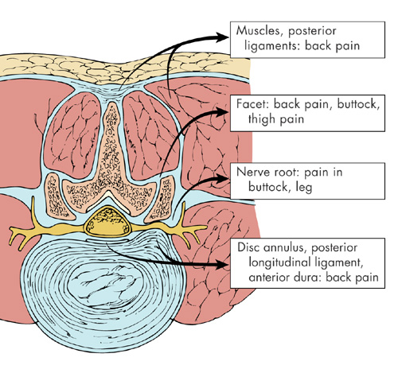
Causes of Back Pain

Slide 14
Clues To Systemic Disease
Age Over 50 years or less than 40
History of Cancer
Fever
Unexplained Weight Loss
Nighttime pain
Injection Drug Use
Chronic Infection Elsewhere
Duration of pain greater than 1 month
and Quality of Pain
-Infection and Cancer not relieved supine
unresponsiveness to previous therapies
h/o inflammatory arthritis elsewhere

Slide 15
Physical Examination
Fever – possible infection
Vertebral tenderness - not specific and not reproducible between examiners
Limited spinal mobility – not specific (may help in planning P.T.
If sciatica or pseudoclaudication present – do straight leg raise
Positive test reproduces the symptoms of sciatica – pain that radiates below the knee (not just back or hamstring)
Ipsilateral test sensitive – not specific: crossed leg is insensitive but highly specific
L-5 / S-1 nerve roots involved in 95% lumbar disc herniations

Slide 16
Imaging
Usually unnecessary & not helpful
Plain Radiography limited to patients with:
-findings suggestive of systemic disease
-trauma
-Age>50years
Failure to improve after 4 to 6 weeks
CT and MRI more sensitive for cancer and infections – also reveal herniation and stenosis
Useful if they have sciatica
Reserve for suspected malignancy, infection or persistent neurologic deficit

Slide 17
Why Not Get Imaging Studies for Acute Back Pain?
Imaging can be misleading: Many abnormalities as common in pain-free individuals as in those with back pain
If under age 60
  Low yield: Unexpected x-ray findings in only
  1 of 2,500 patients with back pain
  May confuse: Bulging disk in 1 of 3
Herniated disks in 1 of 5 pain-free individuals If over age 60 and pain free
  Herniated disk in 1 of 3
  Bulging disk in 80%
  All have age-related disk degeneration
  Spinal stenosis in 1 of 5 cases
Notes:
7

Slide 18
CT SCAN
MRI
Shows bone (e.g., fractures) very well
Good in acute situations (trauma)
Soft tissues (discs, spinal cord) are poorly visualized
CT-myelogram adds contrast in the CSF and shows the spinal cord and nerves contour better
Shows tumors and soft tissues (e.g., herniated discs) much better than CT scan
Almost never an emergency
Exception: Cauda equina syndrome

Slide 19
TERMINOLOGY
terms used to describe conditions related to the back, based upon
radiological findings - (spondylosis, spondylolisthesis, spondylolysis)
physical findings (lumbar lordosis, kyphosis, scoliosis), and
clinical or neurologic features (neurogenic claudication, radiculopathy, sciatica, cauda equina syndrome).
clinical entities that have been associated with low back pain symptoms that are either hard to reliably diagnose or are not clearly associated with symptoms, including the piriformis syndrome, "back mouse," annular tears, and sacroiliac joint dysfunction.

Slide 20
Lordosis, kyphosis, scoliosis:
• Kyphotic curves refer to the outward curve of the thoracic spine (at the level of the ribs).
• Lordotic curves refer to the inward curve of the lumbar spine (just above the buttocks).
• Scoliotic curving is a sideways curvature of the spine and is always abnormal.
A small degree of both kyphotic and lordotic curvature is normal. Too much kyphotic curving causes round shoulders or hunched shoulders (Scheuermann's disease).
Too much lordotic curving is called swayback (lordosis). Lordosis tends to make the buttocks appear more prominent.

Slide 21
Spondylosis: arthritis of the spine. Seen radiographically as disc space narrowing and arthritic changes of the facet joint.
Spondylolisthesis: anterior displacement of a vertebra on the one beneath it. A radiologist determines the degree of slippage upon reviewing spinal x-rays. Slippage is graded I through IV:
• Grade I - 1 percent to 25 percent slip
• Grade II - 26 percent to 50 percent slip
• Grade III - 51 percent to 75 percent slip
• Grade IV - 76 percent to 100 percent slip
Spondylolysis: a fracture in the pars interarticularis where the vertebral body and the posterior elements, protecting the nerves are joined. In a small percent of the adult population, there is a developmental crack in one of the vertebrae, usually at L5.

Slide 22
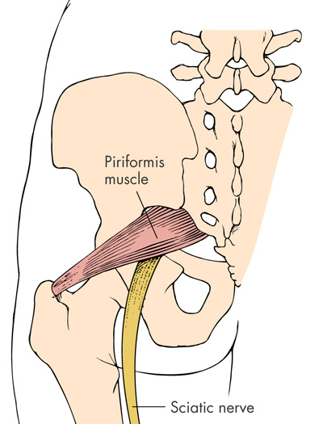
Piriformis syndrome
a condition in which the piriformis muscle compresses or irritates the sciatic nerve passing deep or through it. The piriformis muscle is a narrow muscle located in the buttocks.
Pain on resisted abduction / external rotation of leg

Slide 23
Sciatica
The sciatic nerve is the longest nerve in your body.
It runs from your spinal cord to your buttock and hip area and down the back of each leg.
Sciatica: pain, numbness, tingling in the distribution of the sciatic nerve, radiating down the posterior or lateral aspect of the leg, usually to the foot or ankle.
-herniated disk
-foramenal or spinal stenosis
-ligamentous hypertrophy
-other space filling lesions: cysts, tumor, abscess
-viral or immune inflammation
-can occur w/ peripheral nerve involvement

Slide 24
LUMBOSACRAL RADICULOPATHY
The clinical presentations vary according to the level of nerve root or roots involved.
The most frequent are the L5 and S1 radiculopathies.
Patients present with pain, sensory loss, weakness, and reflex changes consistent with the nerve root involved.

Slide 25
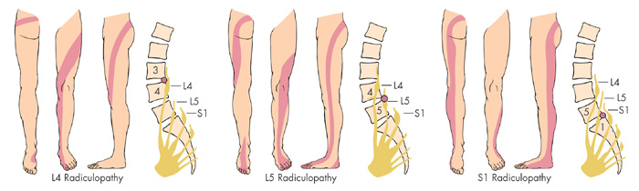
L4/L5/S1 Radiculopathy

Slide 26
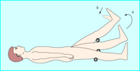
STRAIGHT LEG RAISING TEST
The straight leg raise test is positive if pain in the sciatic distribution is reproduced between 30° and 70° passive flexion of the straight leg. Dorsiflexion of the foot exacerbates the pain

Slide 27
Cauda Equina Syndrome:
Caused by massive midline disc herniation,bony stenosis, or mass compressing cord or( cauda equina bottom-most portion of the spinal canal and spinal nerve roots),
  Rare (<.04% of LBP patients).
  Needs emergent surgical referral.
Symptoms: bilateral lower extremity weakness, numbness in the groin & saddle area of the perineum, or progressive neurological deficit.
Ask about:
  Recent urinary retention (most common) or incontinence?
  Fecal incontinence?

Slide 28
LUMBAR SPINAL STENOSIS
  local, segmental, or generalized narrowing of the central spinal canal by bone or soft tissue elements, usually bony hypertrophic changes in the facet joints and by thickening of the ligamentum flavum.
  Subtle presentation.
  Bilateral radicular signs should alert to possibility.
  radiation to buttocks, thighs, lower legs
-pain increase with extension (standing, walking- worse on flat)
-pain decrease with flexion (sitting, stooping forward shopping trolley sign)
    Can be mistaken for Claudication. neurogenic claudication (pseudo claudication)
    1 or both legs
Admit if progressive / or else CT scan

Slide 29
Management of Spinal Stenosis: Controversial and Evolving
Symptoms of pseudoclaudication without neurologic deficits:
  Epidural corticosteroids
  Progressive exercise program
  Surgical decompression
    May relieve leg symptoms
    May not relieve back pain
With neurologic deficits: Call the surgeon
Notes:
17

Slide 30
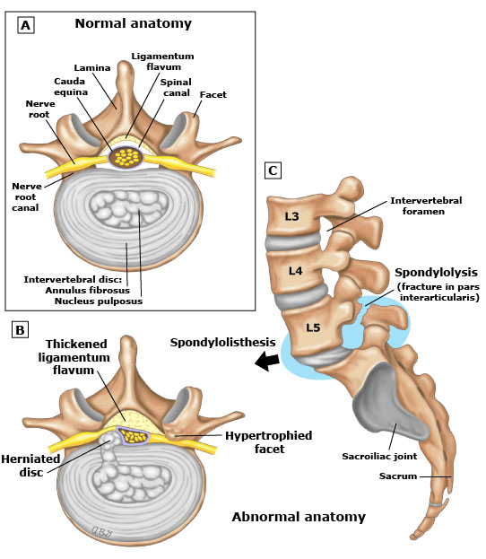

Slide 31
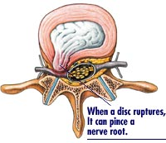
Disc Herniation – Physiology
Tears in the annulus
Herniation of nucleus pulposus
Notes:
31

Slide 32
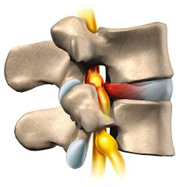
Disc Herniation – Physiology
Compression of the nerve root in the foramen leads to pain
98% disc herniations: L4-5; L5-S1
Impairment: Motor and Sensory L5-S1
  L5: Weakness of ankle and great toe dorsaflexion
  S1: Decrease ankle reflex
  L5 & S1: Sensory loss in the feet
Notes:
32

Slide 33
Why Not Get an Operation for a Herniated Disk?
Spontaneous recovery is the rule: 90% resolve over 6 weeks
Predominant symptoms usually leg pain and tingling with less severe or no back pain
Long-term outcome of pain relief no different with or without surgery
only about 10% considered for surgery after 6 weeks
symptomatic and functional outcome sometimes better
Notes:
19

Slide 34
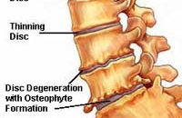
Disc Degeneration – Physiology
With age and repeated efforts, the lower lumbar discs lose their height and water content (“bone on bone”)
Abnormal motion between the bones leads to pain
Notes:
34

Slide 35
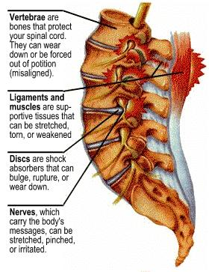
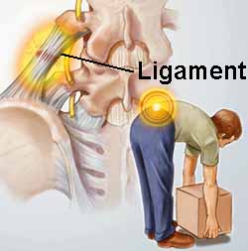
Low Back Pain - natural history
Most episodes of LBP are self limited.(90% in 2wks. – some studies less rapid (2/3 at 7 weeks).
These episodes become more frequent with age.
LBP is usually due to repeated stress on the lumbar spine over many years (“degeneration”),
an acute injury may cause the initiation of pain.
LBP is often attributed to disc degeneration, which is the primary target for many diagnostic approaches.
the importance of imaging findings associated with disc degeneration (osteophytes, disc narrowing, and herniation) remains unclear.
Muscular and ligamentous sources of pain may be equally important.
Notes:
35

Slide 36
Waddell Signs For Non-organic Pain
Superficial non-anatomic tenderness
Pain from maneuvers that should not ellicit pain
Distraction maneuvers that should ellicit pain BUT don’t
Disturbances not consistent with known patterns of pain
Over-reacting during the exam
Not definitive to rule out organic disease

Slide 37
LBP: Case History 1
An obese 65-year-old man presents complaining of back pain that began 5 days ago while shoveling snow. The pain becomes worse when he stands
On exam: The spine is nontender, and pain increases with forward bending. Straight leg raising test is negative, and he has no neurologic deficits
Notes:
5

Slide 38
Management of Acute LBP:
Watchful Waiting
Patient education
  Spontaneous recovery is the rule
  Those who remain active despite acute pain have less future chronic pain
  Exercise has Prevention Power: Muscle strengthening and endurance exercises
Rest: 2 to 3 days or less
Analgesics to permit activity: acetaminophen, NSAIDs, codeine
Reassess if pain worsens
Notes:
6

Slide 39
First Episode Acute LBP: Red Flags for Emergent Surgical Consultation
Cauda equina syndrome
  Bilateral sciatica, saddle anesthesia, bowel/bladder incontinence
Abdominal aortic aneurysm
  Pain pattern is variable
  Bruits
  +/- pulsatile abdominal mass
Significant neurologic deficit
  If they can’t walk, they can’t be sent home
Notes:
9

Slide 40
When the Patient Does Not Improve...
The patient returns in 6 weeks because the pain has not decreased. His legs feel “heavy,” and he has had some incontinence in the last week
On exam: He now has bilateral weakness of ankle dorsiflexion, absent ankle jerks, and saddle anesthesia
Diagnosis – Cauda equina syndrome
Notes:
12

Slide 41
What Are the Red Flags for Serious Low Back Pain?
Fever, weight loss, night sweats
Acute onset in the elderly
Intractable pain—no improvement in 4 to 6 weeks
Nocturnal pain or increasing pain severity
Morning back stiffness with pain onset before
age 40
Neurologic deficits, bilateral or alternating symptoms.
Sphincter disturbance
Immunosuppression
Infection (current/recent)
Claudication or signs of peripheral ischaemia
History of malignancy
Notes:
13

Slide 42
What Should I Be Worried About?
Herniated disk
Spinal stenosis
Cauda equina syndrome
Inflammatory spondyloarthropathy
Spinal infection
Vertebral fracture
Cancer
Notes:
14

Slide 43
LBP: Case History 2
A 32-year-old man complains of severe low back pain of gradual onset over the past few years. The pain is much worse in the morning and gradually decreases during the day. He denies fever or weight loss but does feel fatigued
On exam: There is loss of lumbar lordosis but no focal tenderness or muscle spasm. Lumbar excursion on Schober test is 2 cm. No neurologic deficits
Notes:
20

Slide 44
How to Diagnose Inflammatory
Back Disease
History
  Insidious onset, duration >3 months
  Symptoms begin before age 40
  Morning stiffness >1 hour
  Activity improves symptoms
  Systemic features: Skin, eye, GI, and GU symptoms
  Peripheral joint involvement
  Infections
Notes:
21

Slide 45
How to Diagnose Inflammatory
Back Disease (cont’d)
Physical examination
  Limited axial motion in all planes
  Look for signs of infection
    Staph, Pseudomonas, Brucella, and TB
  Systemic disease (AS, Reiter’s, psoriasis, IBD)
    Ocular inflammation
    Mucosal ulcerations
    Skin lesions
Notes:
22

Slide 46
Testing Spinal Mobility: Schober’s Test
Two midline marks 10 cm apart starting at the posterior superior iliac spine (dimples of Venus)
Premeasure with lumbar spine at maximal flexion
  Less than 5 cm difference suggests pathology
10 15 cm
Notes:
23

Slide 47
Ankylosing Spondylitis: X-Ray Changes
Notes:
24

Slide 48
Management of Inflammatory
Back Pain
Stretching and strengthening exercises
Conditioning exercises to improve cardiopulmonary status
Avoid pillows
NSAIDs
Sulfasalazine
Methotrexate
“biologics”
Notes:
25

Slide 49
LBP: Case History 3
A 40-year-old woman complains of continuous and increasing back pain for 3 months that worsens with movement. She has noted nightly fevers and chills. She is in a methadone maintenance program
On exam she is exquisitely tender over L4 and the right sacroiliac joint with paravertebral muscle spasm. No neurologic deficits. Old needle tracks in both arms
Lab: Hbg 11.5 mg%, WBC 9,000, ESR 80 mm/h
Notes:
26

Slide 50
Red Flags for Spinal Infections
Historical clues
  Fever, rigors
  Source of infection: IV drug abuse, trauma, surgery, dialysis, GU, and skin infection
Physical exam clues
  Focal tenderness with muscle spasm
  Often cannot bear weight
  Needle tracks
Lab clues: Mild anemia, elevated ESR, and/or CRP
Notes:
27

Slide 51
LBP: Spinal Infections
Acute infection
  Bacterial
  Fungal
Chronic infection
  Bacterial
  Fungal
  Tuberculosis
  Brucellosis
Sites of spinal infection
  Vertebral osteomyelitis
  Disk space infection
  Septic sacroiliitis
Notes:
28

Slide 52
LBP: Case 3 — X-Rays
Notes:
29

Slide 53
Approach to Acute Back Pain in the Elderly
Probabilities change
Cancer, compression fractures, spinal stenosis, aortic aneurysms more common
Osteoporotic fractures without trauma
Spinal Stenosis secondary to degenerative processes and spondylolisthesis more common
Increased AAA associated with CAD
Early radiography recommended
Evaluation in older adults
History and physical exam
Immediate X –Ray recommended
Screening laboratory tests
  CBC
  Sedimentation rate (protein electrophoresis if elevated)
Notes:
34

Slide 54
LBP: Case History 4
A 60-year-old man complains of the insidious onset of low back pain that worsens when he lies down, so he sleeps in a recliner. There is a remote history of back injury. He has lost 20 lb
in the past 6 months
On exam he has lumbar spine tenderness but no neurologic deficits
Laboratory: Hgb 9 mg%, WBC 9,000,
ESR 110 mm/h, monoclonal spike on serum protein electrophoresis
Notes:
30

Slide 55
Case 4: Multiple Myeloma
Red flags for spinal malignancy
  Pain worse at night
  Often associated local tenderness
  CBC, ESR, protein electrophoresis if ESR elevated
Notes:
31

Slide 56
Follow-up
The patient improved markedly after chemotherapy and bone marrow transplant. He sold his business and is now playing golf 3 days a week in Southern California
Key point: Nocturnal back pain, weight loss, and ESR >100 mm/h suggests malignancy
Notes:
32

Slide 57
LBP: Case History 5
An 82-year-old woman experienced sudden sharp low back pain while gardening that has persisted and worsened. The pain does not radiate
On exam: She is grimacing in pain; vital signs are normal; thoracic kyphosis, loss of lumbar lordosis, and palpable muscle spasm
Notes:
33

Slide 58
Case 5: Spine X-Ray
Multiple compression fractures
Notes:
35

Slide 59
Features of Acute Compression Fractures
No early warning, often occurs with forward flexion during normal activity or with trivial trauma
Severe spinal pain
Marked muscle spasm
Some relief with recumbency
Notes:
36

Slide 60
Risk Factors for Osteoporosis
Female sex, Caucasian, or Asian race
Maternal hip fracture
Estrogen or testosterone deficiency
Corticosteroid excess
Low body mass
Life-long low calcium intake
Sedentary life style or immobility
Excessive alcohol intake
Smoking
Notes:
37

Slide 61
Management of Acute Compression Fracture
Goal is to resume activity as soon as possible
Lumbar or thoracolumbar support
  Remind the patient not to flex or twist
  Light-weight support tolerated best
Opioid analgesics—prevent constipation with bowel stimulant (do not use psyllium)
Calcitonin: Start with 50 IU sc; increase to 100 then 200 if tolerated. When pain controlled, try nasal spray. Continue daily for 2 to 3 months
Notes:
38

Slide 62
Management of Acute Compression Fracture (cont’d)
Begin long-term osteoporosis treatment
Consider vertebroplasty* (methylmethacrylate)
  Rapid pain relief
  Stabilizes vertebral body
*Jensen, et al. Am J Neuroradiol. 1997;18:1897.
Notes:
39

Slide 63
Osteoporosis: Initial Evaluation
Universal: Hgb, ESR, calcium
Additional labs as indicated:
  TSH, PTH, 25-OH Vitamin D
  Serum protein electrophoresis
  Urine calcium
  Testosterone
Notes:
40

Slide 64
Osteoporosis: BMD Measures
Indications
  Establish baseline bone mineral density
  Guide treatment decisions
  Monitor therapy
Methods
  Dual energy x-ray absorptiometry
  (BEST IN CLASS)
  Quantitative CT
  Single energy x-ray absorptiometry
  Quantitative ultrasound of bone
Notes:
41

Slide 65
Long-Term Treatment of Osteoporosis
Baseline: Measure bone mineral density and height
Discuss hormone replacement or selective estrogen receptor modulator (SERM)
Thiazide if hypercalciuric
Begin calcium and vitamin D
Recommend bisphosphonates
Instruct on progressive walking and strengthening exercises
Notes:
42

Slide 66
Key Points About Acute Back Pain
90% of cases due to mechanical causes and will resolve spontaneously within 6 weeks to
6 months
Pursue diagnostic work-up if any red flags found during initial evaluation
If ESR elevated, evaluate for malignancy or infection
In older patients initial x-ray useful to diagnose compression fracture or tumor*
* Deyo, et al. JAMA. 1992;260:760.
Notes:
43

Slide 67
THANK YOU

