Slide 1
Introduction to 365 rad
Lecturer name: DR ALBADR
Chairman of radiology department
Lecture Date: 2011

Slide 2
Lecture Objectives..
1- to learned different type of radiology modalities.
2- to have the principle of the indication and contra- indication for different radiology investigation .
3- Usage of different type of contrast.

Slide 4
Look to the shadow (image)

Slide 5
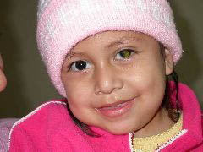
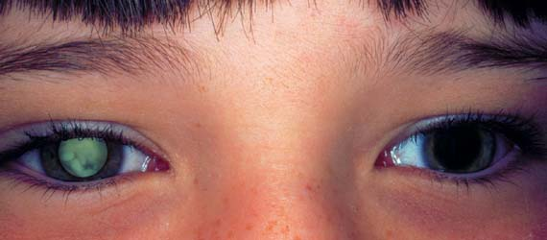
Which eye is affected

Slide 6
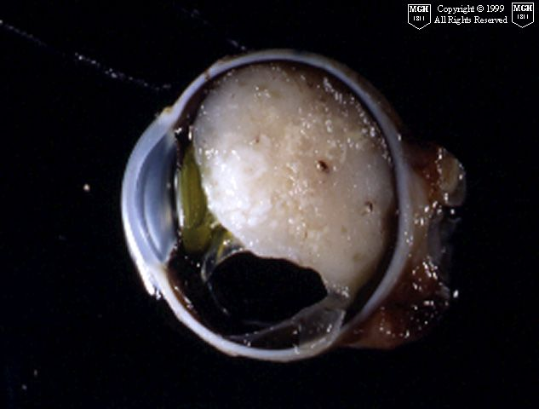
The disease in the globe is (retinoblastoma)

Slide 7
The aim of the physician to reach the diagnosis before surgery

Slide 8
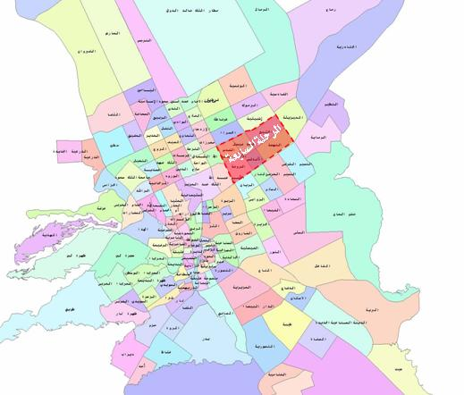
The body is complex simulating a map

Slide 9
WHAT is X RAY ?
ELECTROMAGNATIC RADIATION CAUSING IONIZATION IN THE BODY.
X RAY IS COMING FROM ??? WHERE ?
You need :
1- machine .
2-Patient .
3-detector .

Slide 10
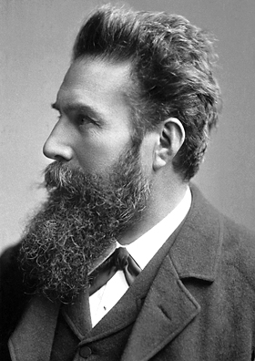
German physicist Wilhelm Röntgen discoverer of X-rays in 1895

Slide 11
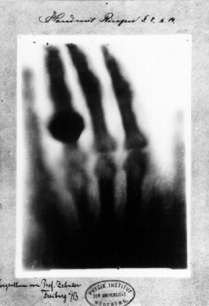

Slide 12
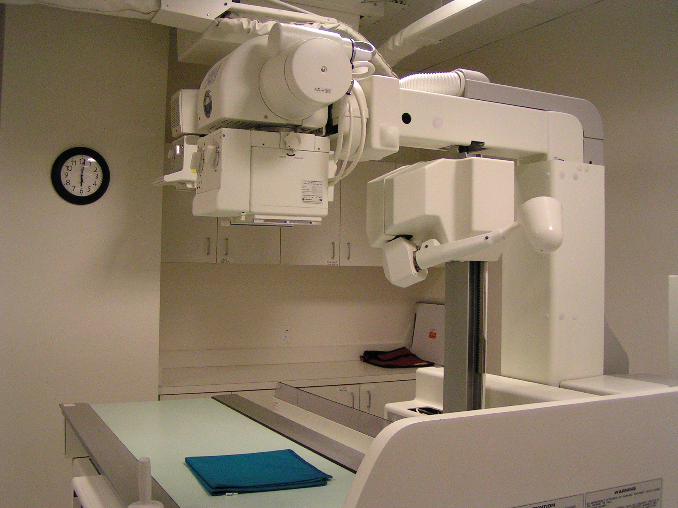

Slide 13
Name the bone
1
1-
2-
3-
4- means right hand
2
3
4

Slide 14
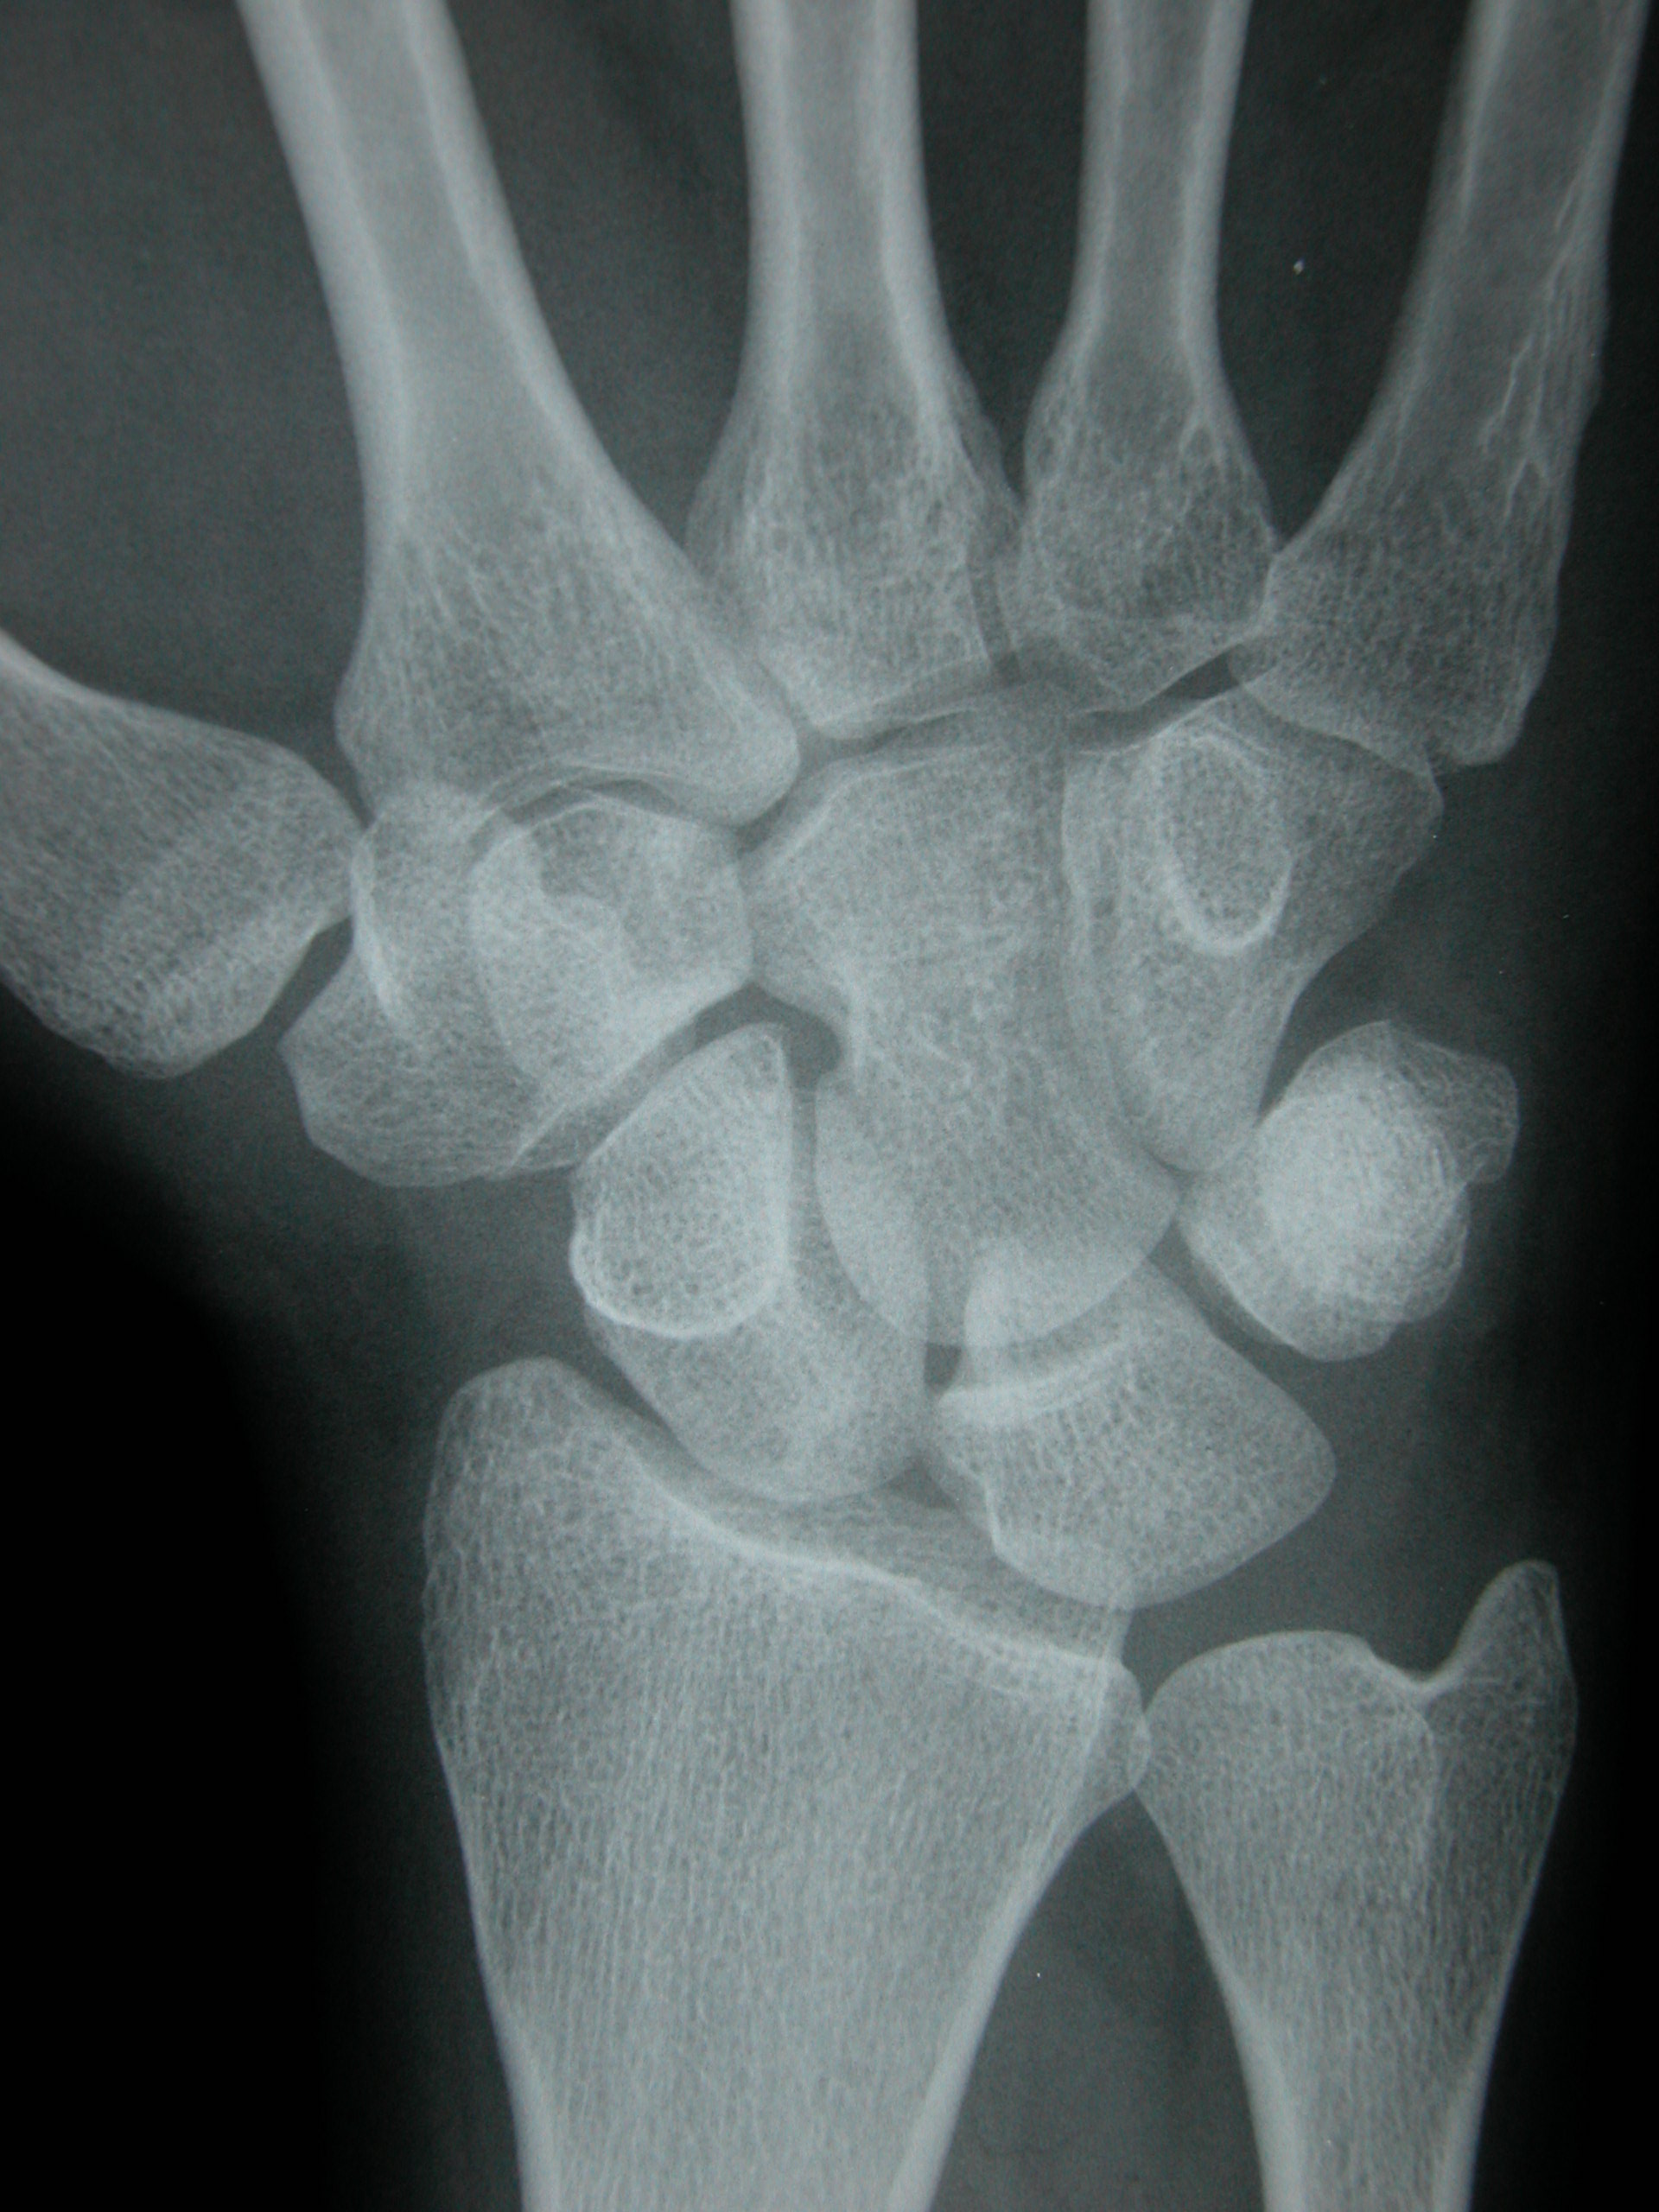
Name the bone
7
5
1
3
2
8
4
6
9
10

Slide 16
Chest x ray (peadiatrics ) 1-endo-bronchial tube allocated where? 2-normal lung is translucent (black) 3-what happened to left hemi-thorax ?pleural effusion ? Collapsed lung.

Slide 17
Name number 1 and two?
1
2

Slide 18
Where is the fracture allocated the image for an adult or pediatrics

Slide 19
Name number 1 and two?
1
2

Slide 20
1-Air is translucent
2- Is the air inside the bowel or outside the bowel

Slide 21
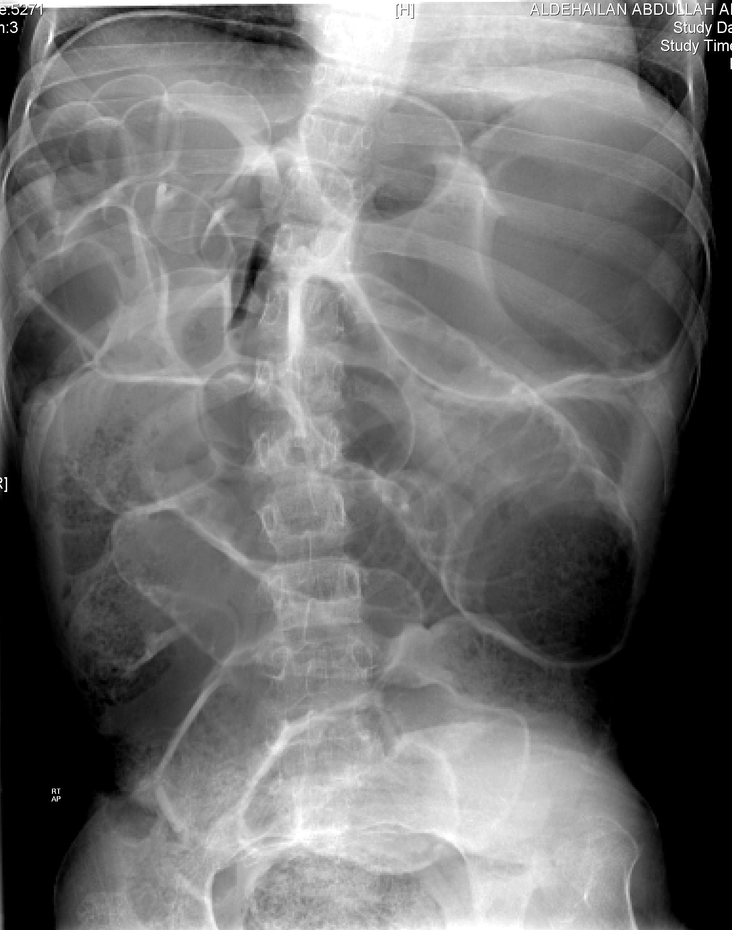
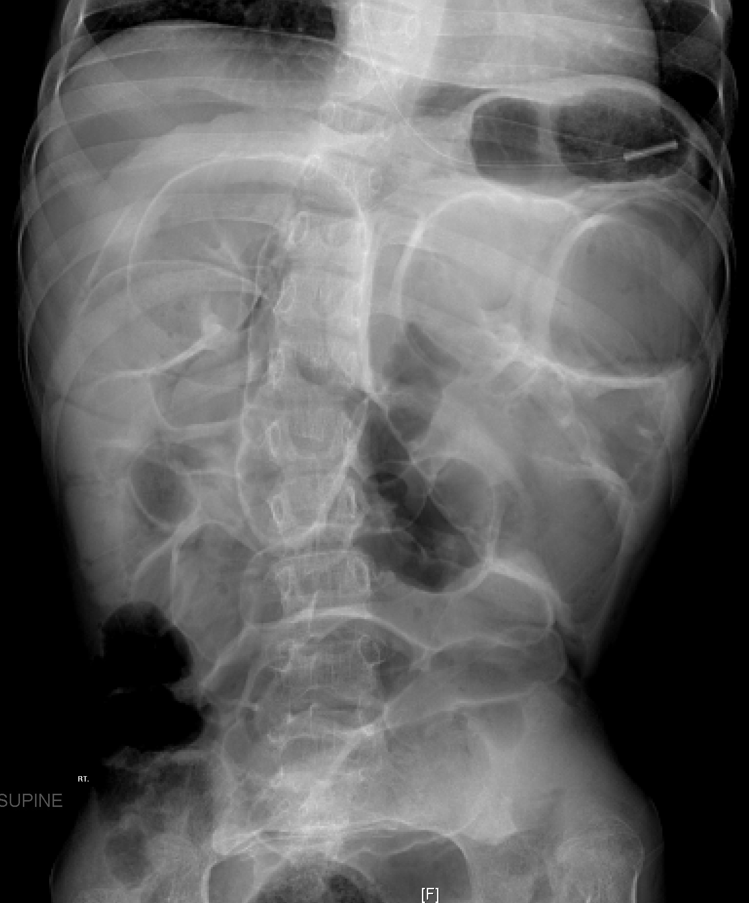

Slide 22
Pneumopertonuim

Slide 23
Pneumothorax :
A pneumothorax is an abnormal collection of air or gas in the pleural space that separates the lung from the chest wall
Pnuemoperitoneum :
Pneumoperitoneum is the presence of air or gas in the abdominal (peritoneal) cavity. It is often seen on X-ray, but small amounts are often missed, and CT is needed...

Slide 24
Contrast study
Oral contrast:
Baruim swallow :A barium swallow (or esophagography) is a medical imaging procedure used to examine the upper GI (gastrointestinal) tract
Baruim meal :A barium meal, also known as an upper gastrointestinal series is a procedure in which radiographs of the esophagus, stomach and duodenum
Baruim enema :A barium enema, or lower gastrointestinal (GI) examination.
I V Contrast :
Angiogram
Angiography or arteriography is a medical imaging technique used to visualize the inside, or lumen, of blood vessels .
Contrast is radio-opaque

Slide 25
What is the organ examined by this test ?
1-Myelogram
2-sialogram
3-mamogram
4-sinogram
5- MRCP
Magnetic resonance cholangiopancreatography
6-ERCP Endoscopic Retrograde Cholangio-Pancreatography

Slide 26
Baruim meal

Slide 27
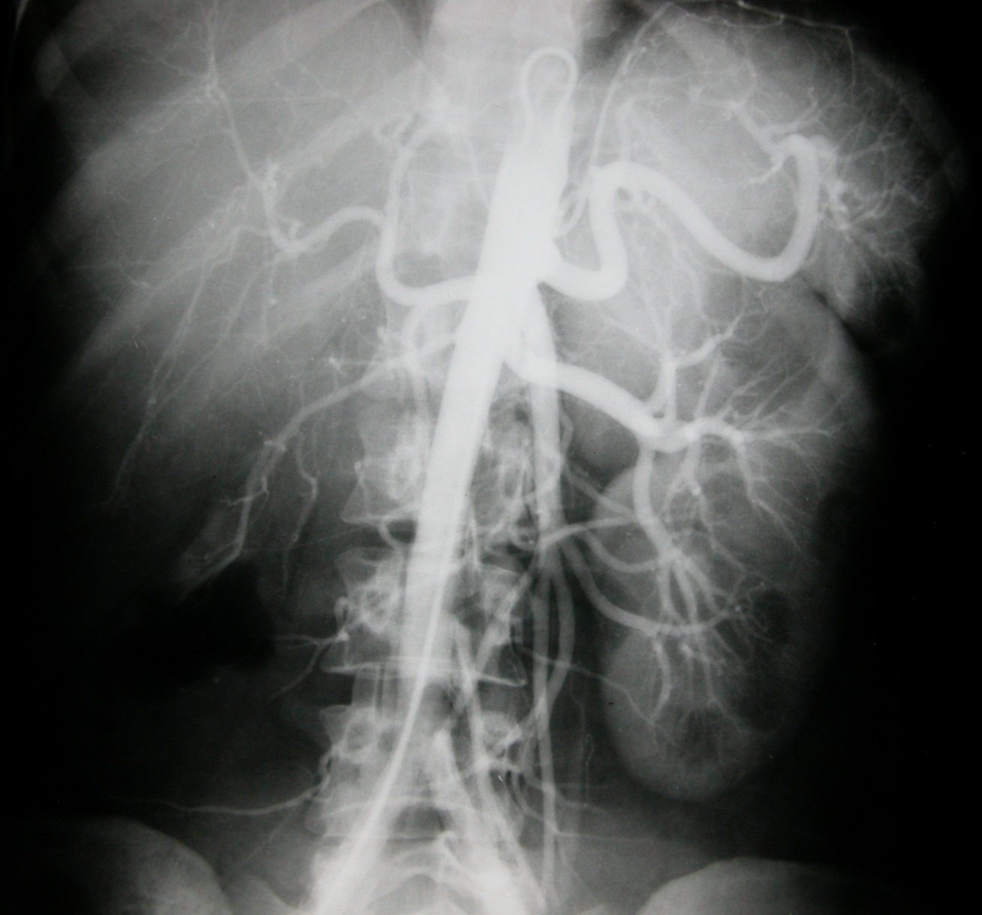
Angiogram :which part of the body
B
1
2
3
5
A

Slide 28
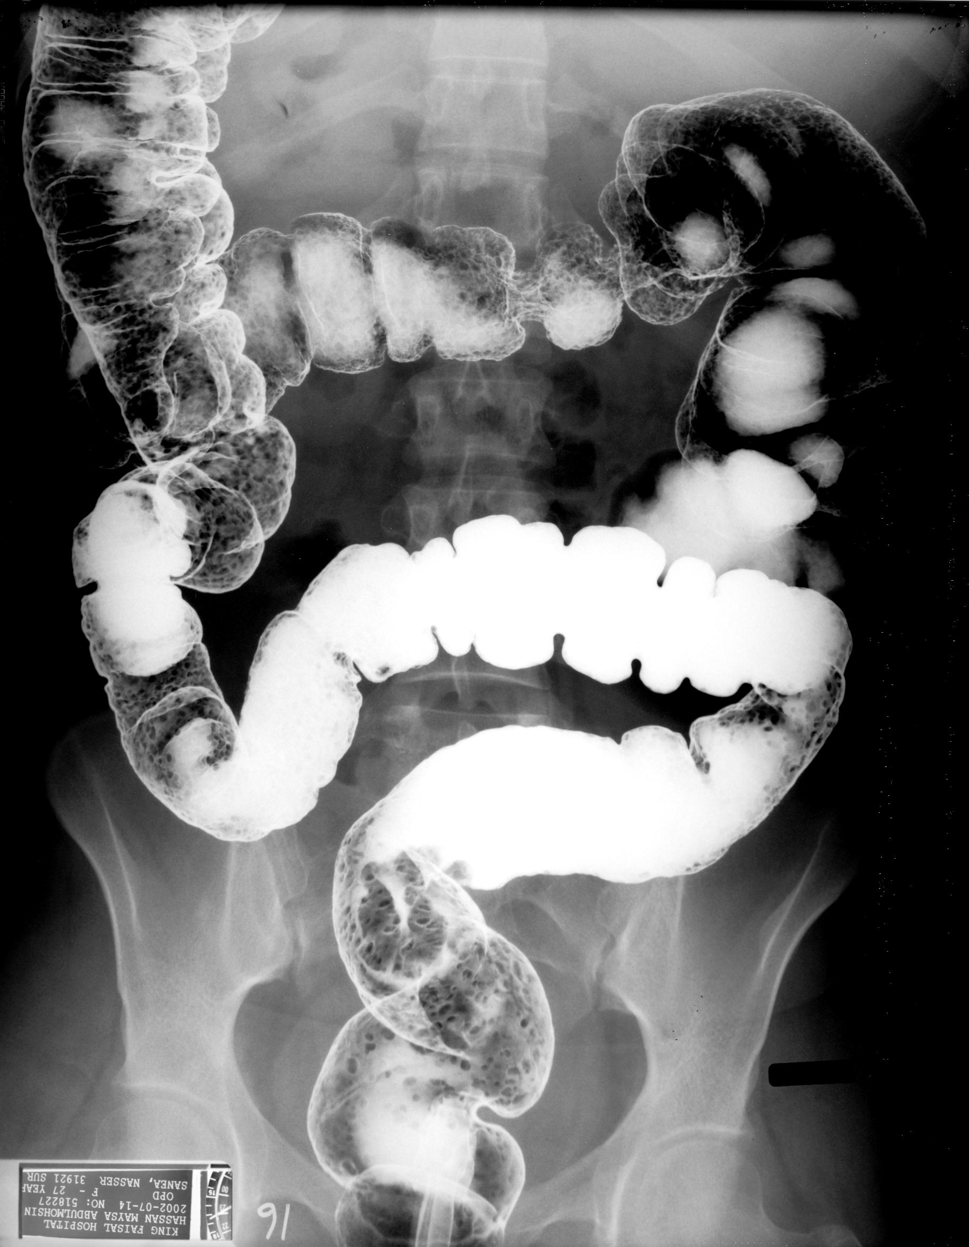
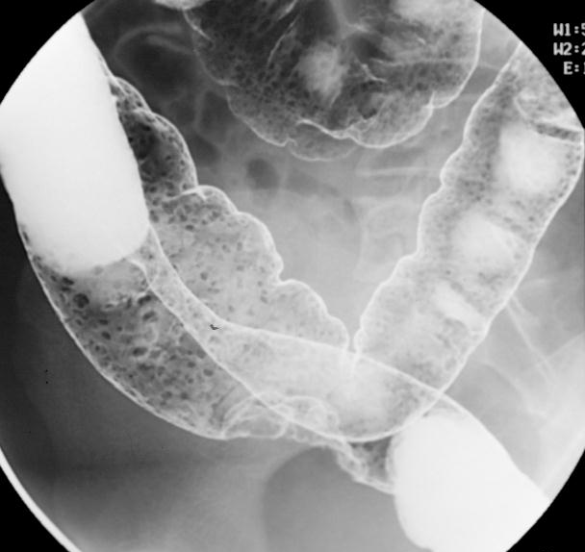
baruim enema double contrast

Slide 29
Ultrasound
An ultrasound machine creates images that allow various organs in the body to be examined.
The machine sends out high-frequency sound waves, which reflect off body structures.
A computer receives these reflected waves and uses them to create a picture. Unlike with an x-ray or CT scan, there is no ionizing radiation exposure with this test.

Slide 30
Ultrasound
Aim
Tech
Advantage vs disadvantage
Organ limitation
Uses

Slide 31
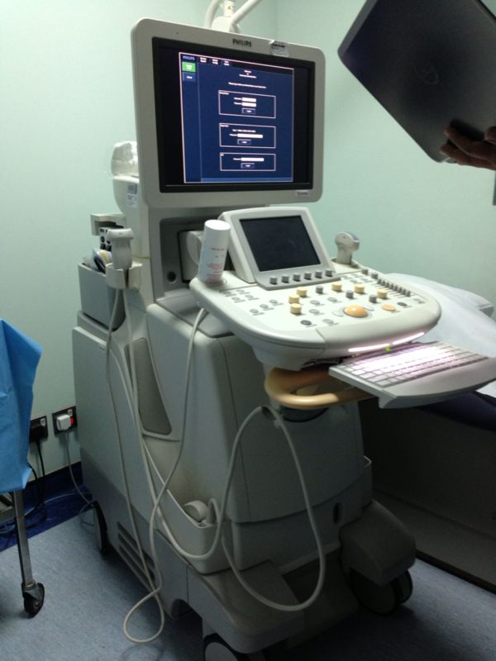
US MACHINE

Slide 33
LIVER AND KIDENY

Slide 34
Us appearance
US cannot penetrate
Bone and air
(skull –lung )
Us is operator
Dependant
Can we do it for
Pregnant patient ?
Hyper –echoic:
Means More bright
Hypo-echoic :
Means Less bright

Slide 36
GALL STONE

Slide 37
CT MACHINE

Slide 38
-Xray computed tomography, also computed tomography (CT scan), computed axial tomography (CAT scan) or computer assisted tomography is a medical imaging procedure that uses computer-processed X-rays to produce tomographic images or 'slices' of specific areas of the body.
These cross-sectional images are used for diagnostic and therapeutic purposes in various medical disciplines.

Slide 39
REMEMBER
THERE IS A LARGE AMOUNT OF RADITION
IN CT EXAMINATION
DURING THE STUDY :
iv CONTRAST IS USEDE
WITH PRECAUTION
ORAL CONTRAST
IS SAFE
RADITION RISK-pregnancy ?
CONTRAST RISK

Slide 40
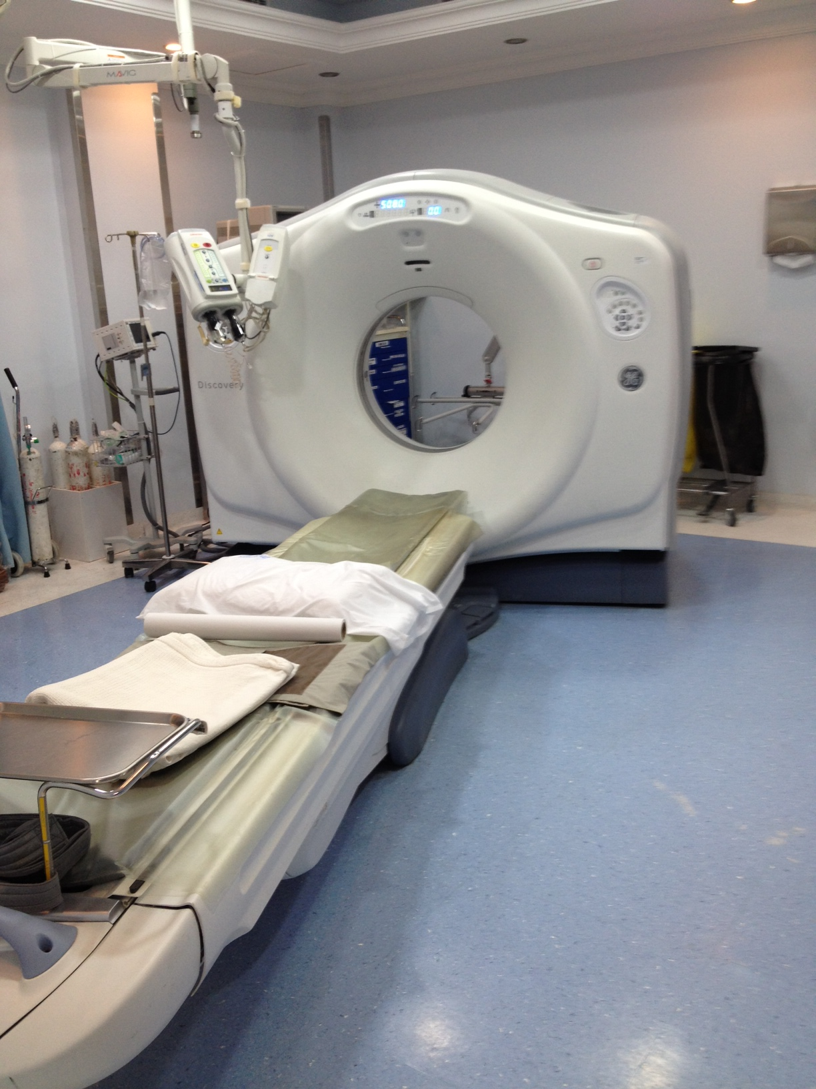

Slide 42
HEMORAGE INSIDE THE BRAIN

Slide 43
NAME NUMBER 1-7

Slide 44
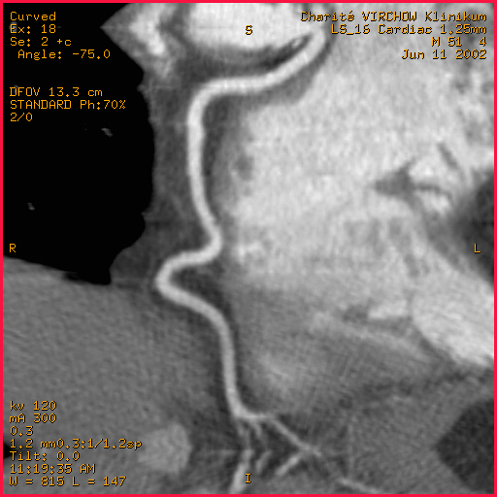
CT CORONARY ANGIOGRAM

Slide 45
CORONAL IMAGE ABDOMEN(CT)

Slide 46
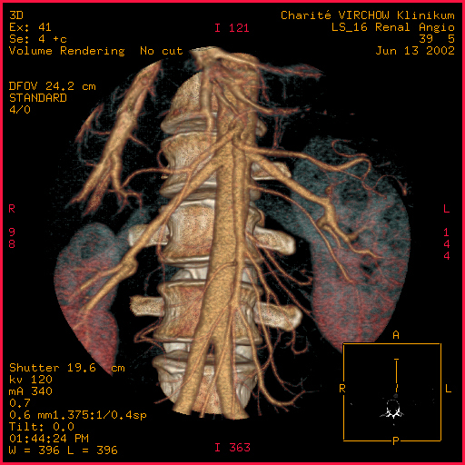
3D ABDOMINAL ANGIOGRAM

Slide 47
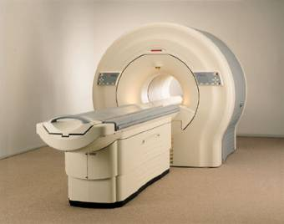
MR MACHINE

Slide 48
MRI
is a Medical imaging used in radiology to visualize internal structures of the body in detail.
MRI can create more detailed images of the human body than are possible with X-rays.

Slide 49
An MRI scanner is a device in which the patient lies within a large, powerful magnet where the magnetic field is used to align the magnetization of some atomic nuclei in the body,
Radiofrequency magnetic fields are applied to systematically alter the alignment of this magnetization.This causes the nuclei to produce a rotating magnetic field detectable by the scanner—and this information is recorded to construct an image .

Slide 50
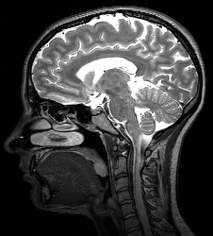
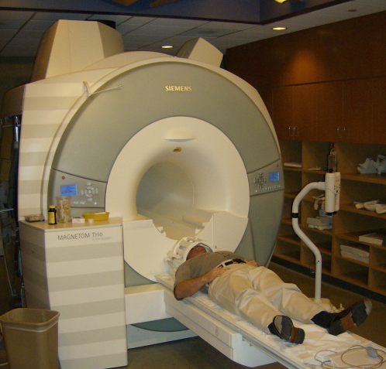
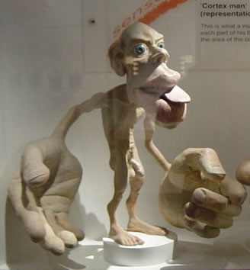
MRI Brain

Slide 51
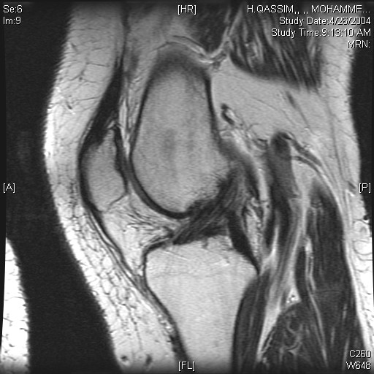
MR KNEE
IN MRI SOFT TISSUE BEETER VISULIASED

Slide 52
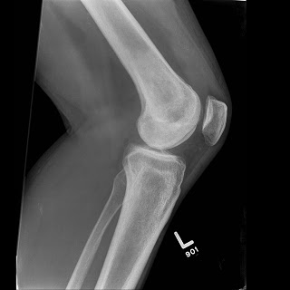
X RAY KNEE
ONLY BONE CAN BE SEEN

Slide 53
MR KNEE
IN X-RAY
YOU CAN NOT SEE
THE LIGMENT
IN MRI SOFT TISSUE BEETER VISUALISED

Slide 54
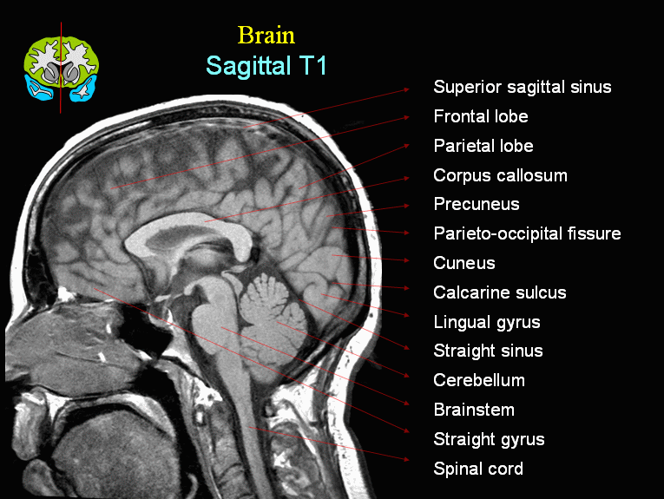

Slide 55
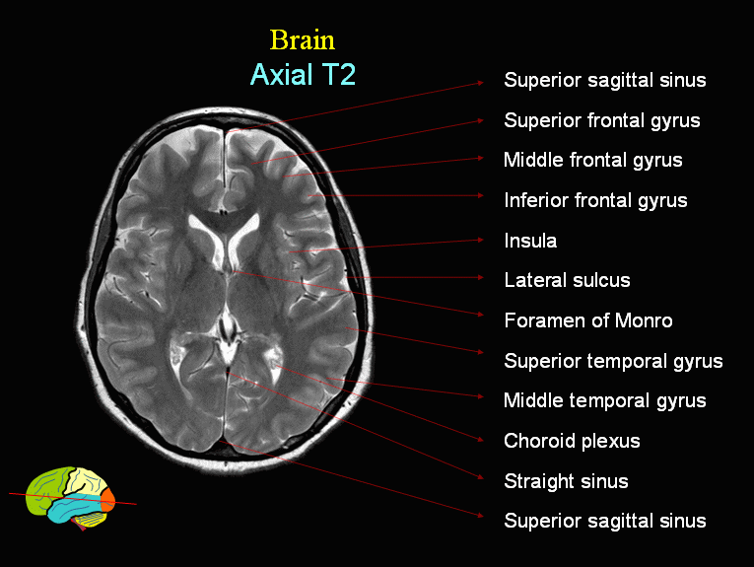
MR BRAIN AXIAL (BETTER TO SEE BRAIN ANTOMY )

Slide 56
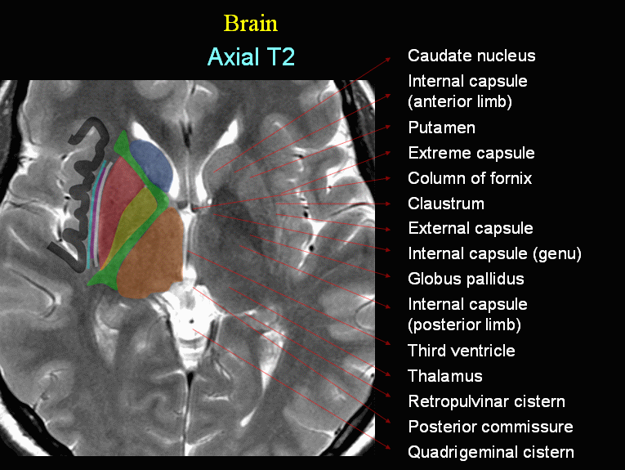

Slide 57
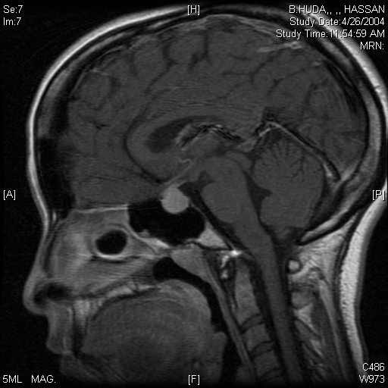
MR BRAIN SAGITALL
WHAT IS THE CONTRA-INDICATION
TO DO MRI BRAIN ?
سوال بالامتحان
1-
2-
3-

Slide 58
Reference book and the relevant page numbers..
Radiology secret page 6-30
Diagnostic imaging
Peter armstrong page 1-13

Slide 59
Thank You ☺

