Slide 1

Radiologic investigation of Chest and CVS diseases
By
Dr Mohamed Sherif El-Sharkawy
ASSOCIATE PROF. and Consultant Radiologist
KKUH
KING SAUD UNIVERSITY
LAST UPDATE
SEPT. 2013

Slide 2
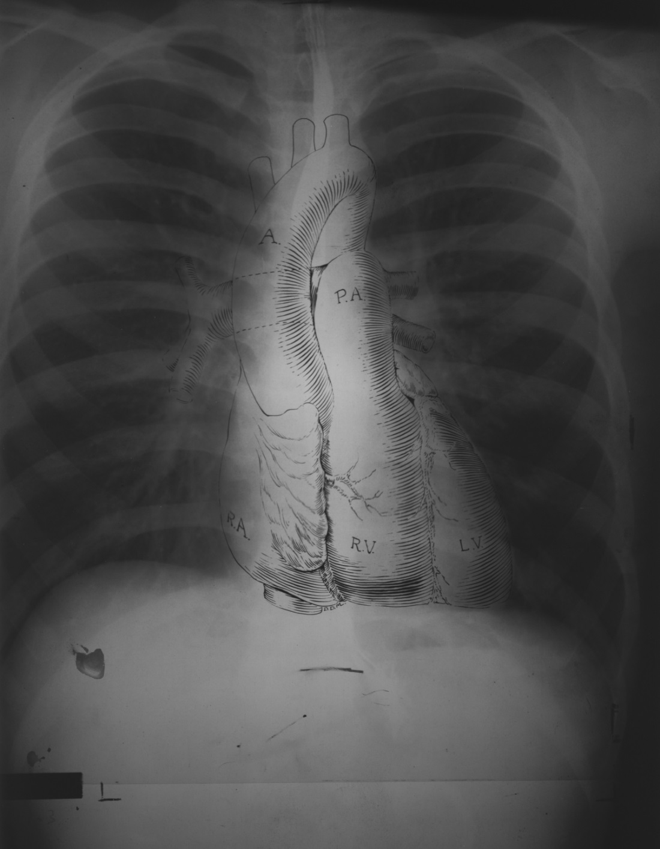
What do we mean by chest
We mean study of thoracic cage contents

Slide 3
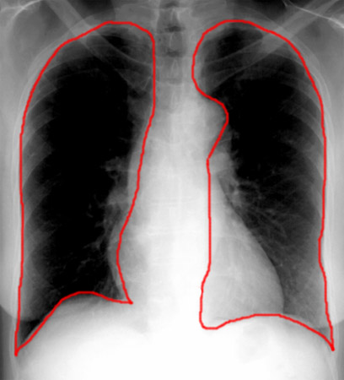
LUNGS

Slide 4
BASIC CHEST EXAMS
PLAIN FILM=CHEST X-RAY(CXR)
CT
HRCT
ANGIOGRAMS

Slide 5
Imaging Modalities for chest and CVS examinations
1-Plain films
2-COMPUTED TOMOGRAPHY
CT LUNGS AND MEDIASTINUM
CT- angiography (CTA)
High resolution CT of the chest (HRCT)
3-Angiography
4- MRI

Slide 6
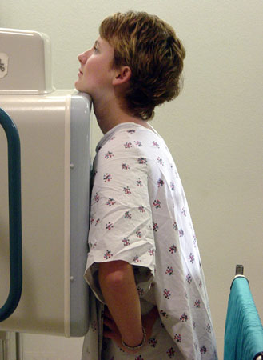
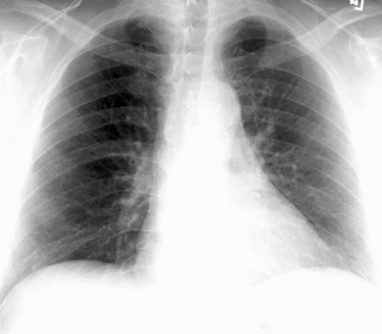
PA VIEW

Slide 7
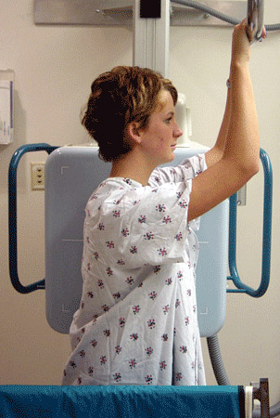
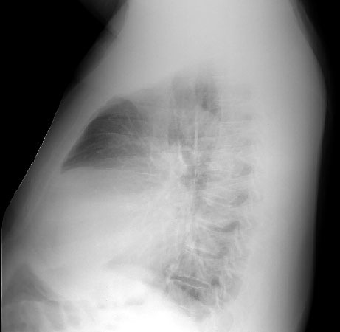
LATERAL VIEW

Slide 8
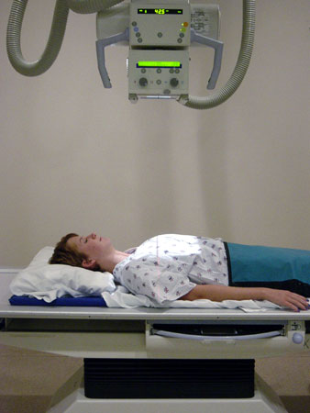
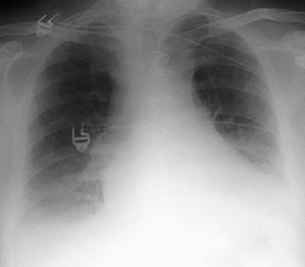
AP VIEW

Slide 9
PA vs. AP
FALSE ELARGEMENT

Slide 10
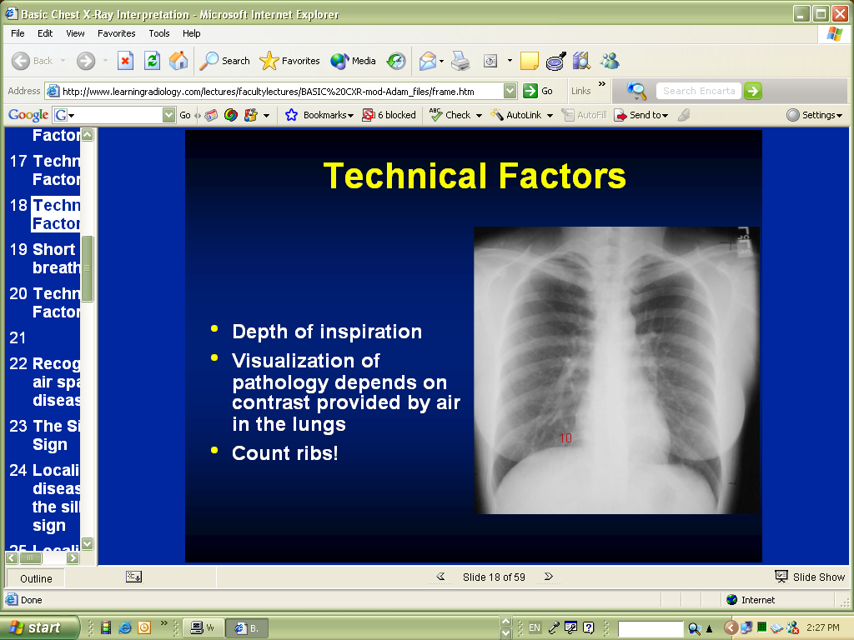

Slide 11
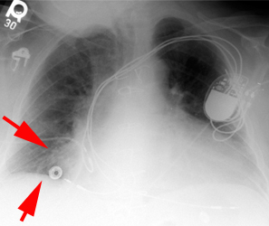
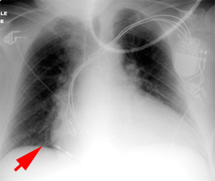
Hypo-inspiratory vs inspiratory

Slide 12
Inspiration
This greatly helps the radiologist to determine if there are intrapulmonary abnormalities.
The diaphragm should be found at about the level of the 8th - 10th posterior rib or 5th - 6th anterior rib on good inspiration.

Slide 13
Rotation
The technologists are usually very careful to x-ray the patient flat against the cassette. If there is rotation of the patient, the
Mediastinum may look very unusual.
One can access patient rotation by observing the clavicular heads and determining whether they are equal distance from the spinous process of the thoracic vertebral bodies.

Slide 14
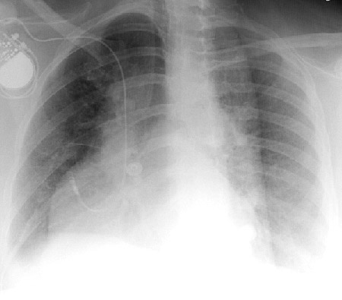
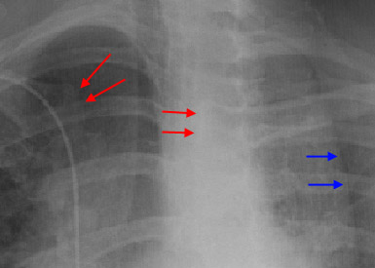
In this rotated film skin folds can be mistaken for a tension pneumothorax (blue arrows).
Notice the skewed positioning of the heads of the clavicles (red arrows) and the spinous processes.

Slide 15
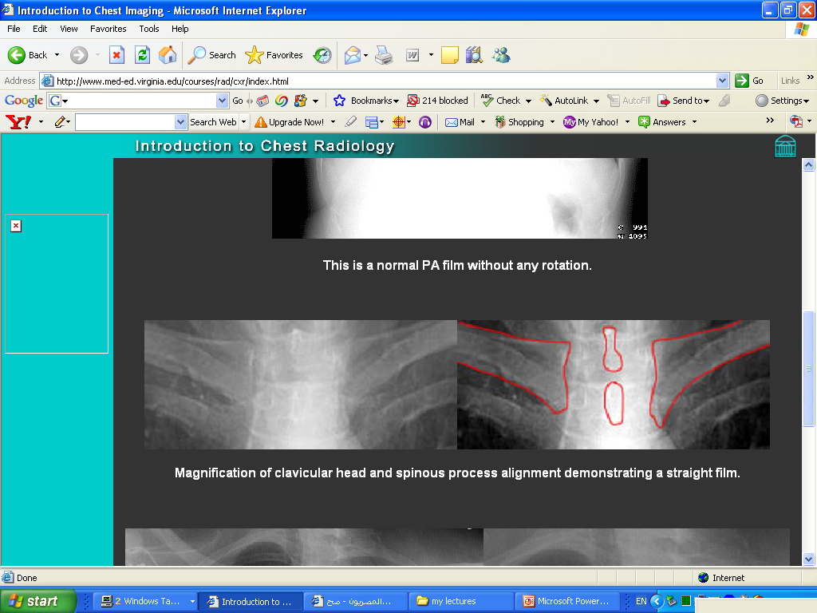
Rotation

Slide 16
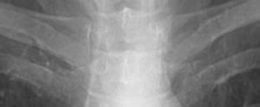
ROTATION

Slide 17
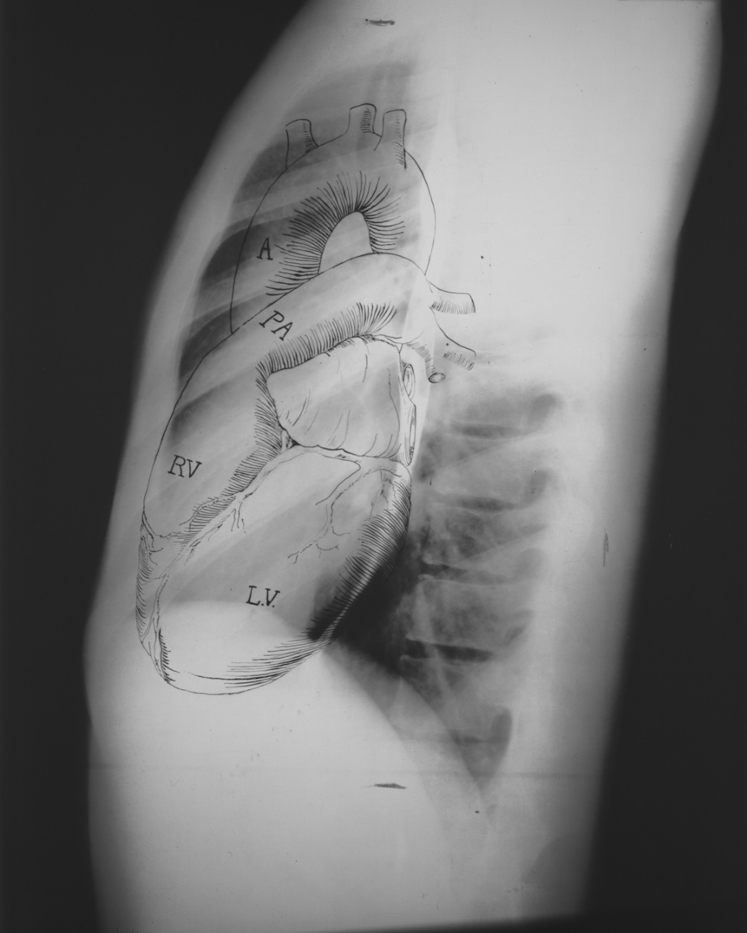
Anatomy on Normal Chest X-Ray
Heart borders and chambers of the heart on PA and lateral views.

Slide 18
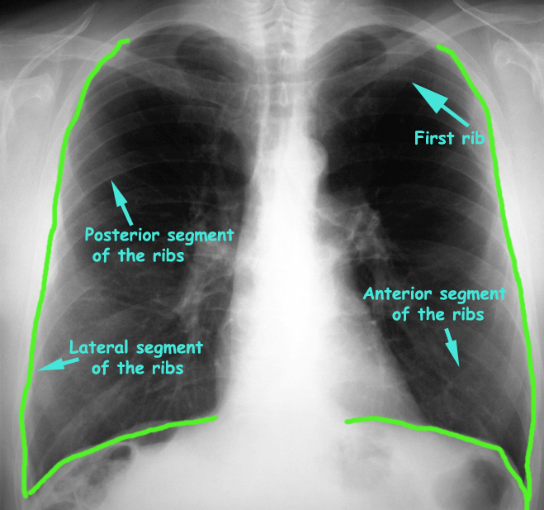
Frontal Chest X-Ray

Slide 19
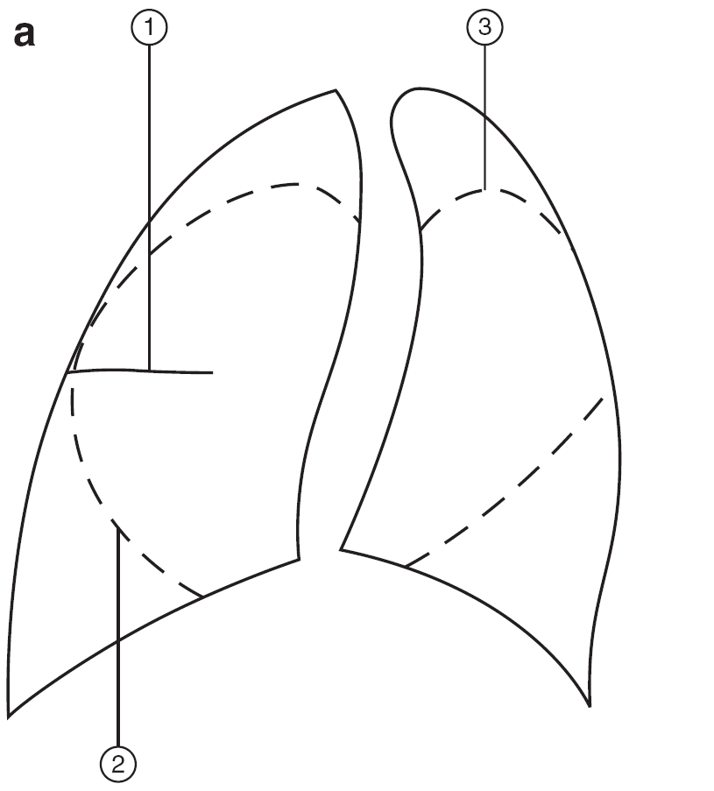
Diagram of lungs showing lobes. The right lung has three lobes, upper, middle and lower. These are separated by the oblique and horizontal fissures. The left lung has two lobes, upper and lower separated by the oblique fissure.

Slide 20
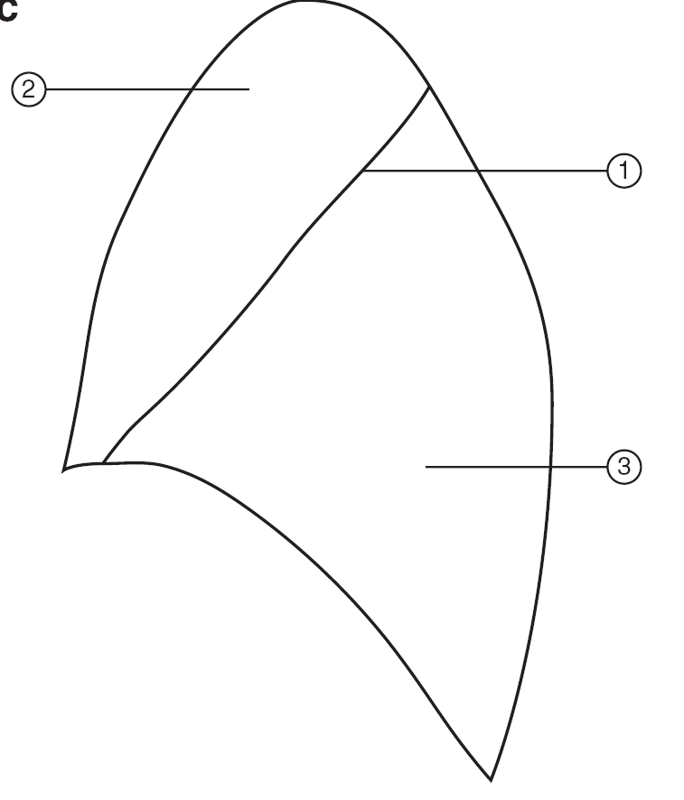
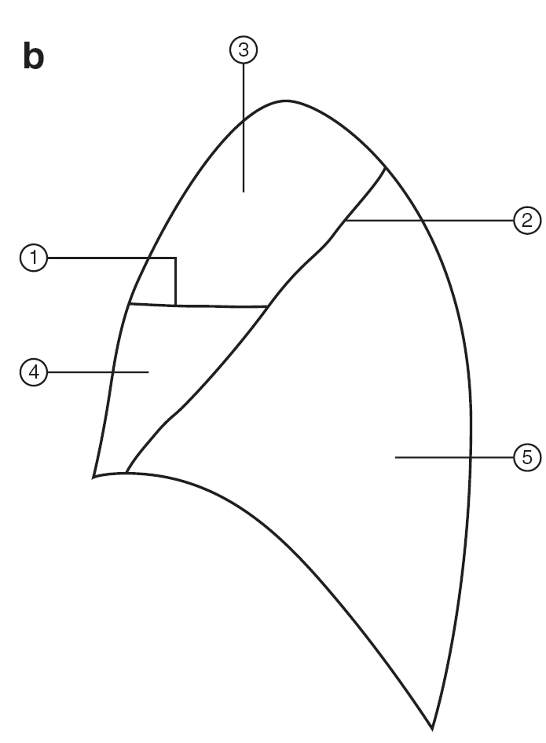

(1) Horizontal fissure
(2) Right oblique fissure, (3) Left oblique fissure. Figure 2.4b
(1) Horizontal fissure (2) Right oblique fissure (3) Right upper lobe
(4) Right middle lobe (5) Right lower lobe. Figure 2.4c (1) Left oblique fissure (2) Left upper lobe (3) Left lower lobe.
Why these lines are important
LEFT LUNG
RIGHT LUNG

Slide 21
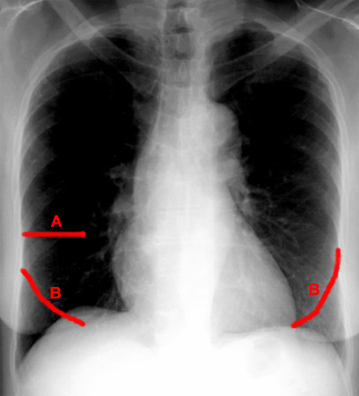
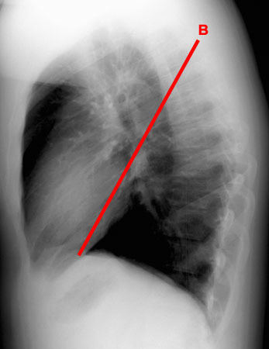
FISSURES
Notes:
21

Slide 22
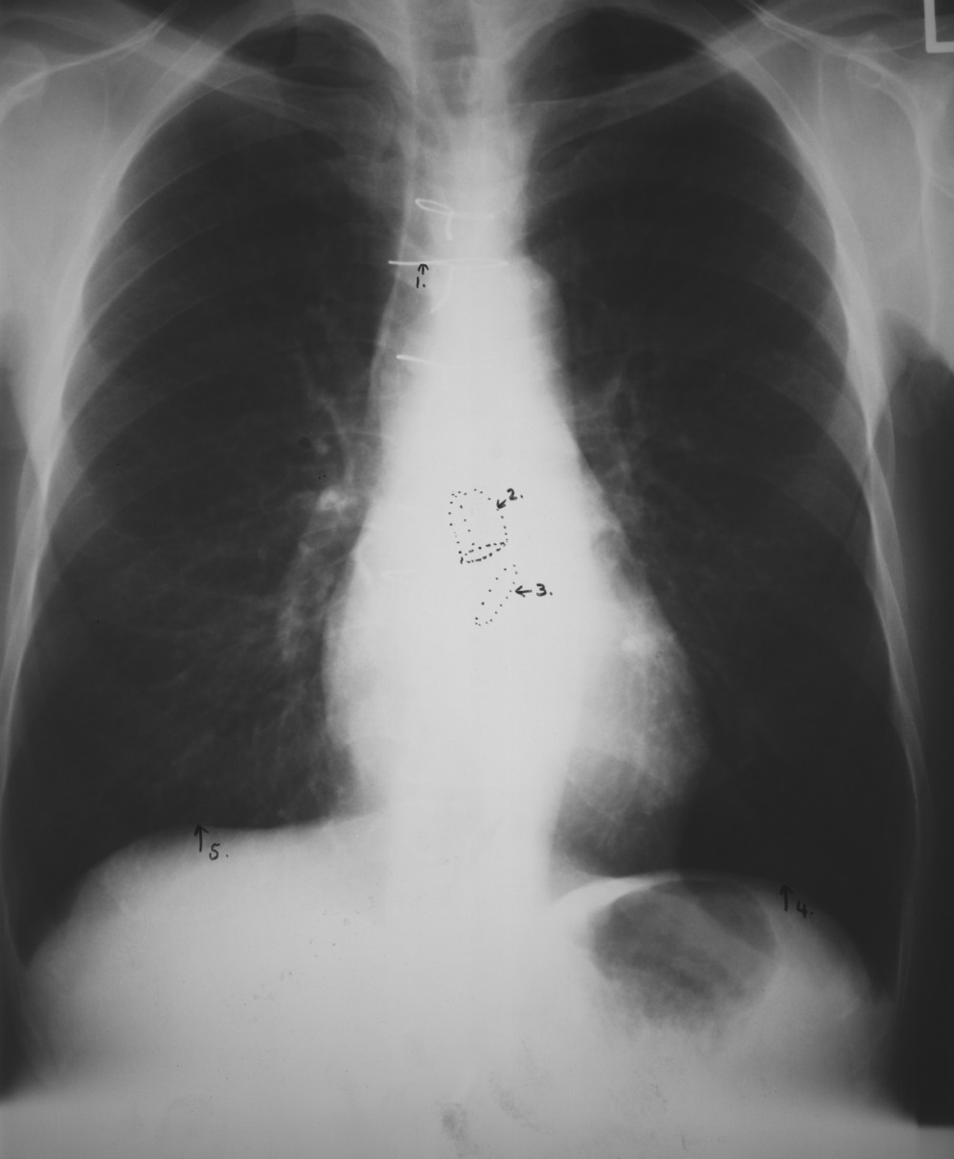
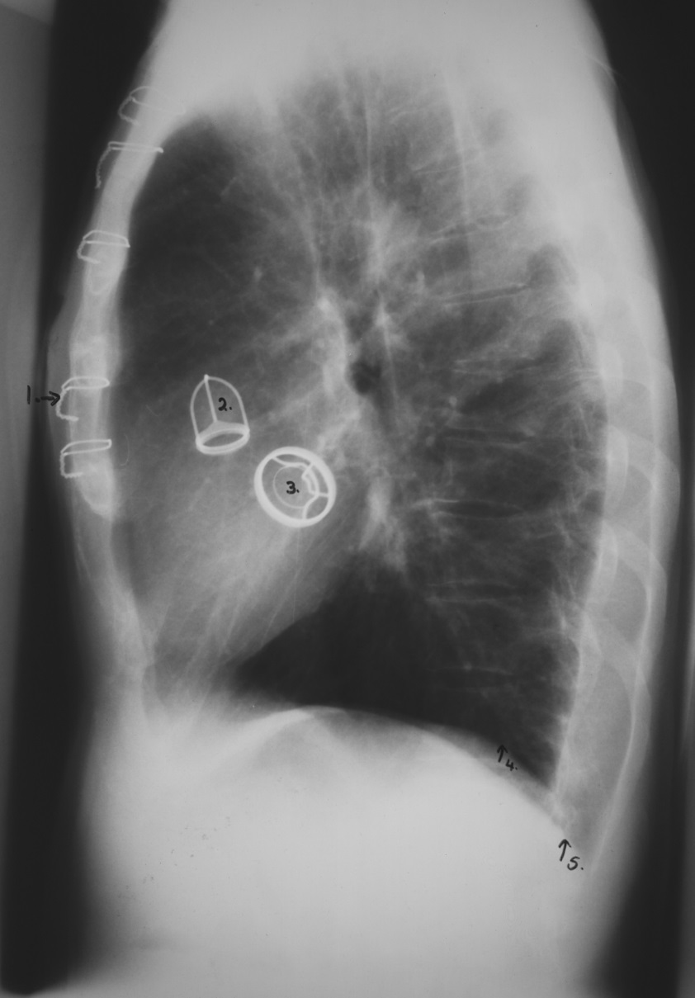
CARDIAC Valves
This patient had a malfunctioning mitral valve (between left atrium and left ventricle) and aortic valve (between left ventricle and aorta) and prosthetic valves were inserted (better seen on lateral)
Frontal CXR
LAT CXR
Key:
Suture material used for repair of vertical incision thru sternum (median sternotomy)
Aortic valve prosthesis
Mitral valve prosthesis
Left hemi diaphragm
Right hemi diaphragm
1
1
2
2
3
3
5
4
4
5

Slide 23
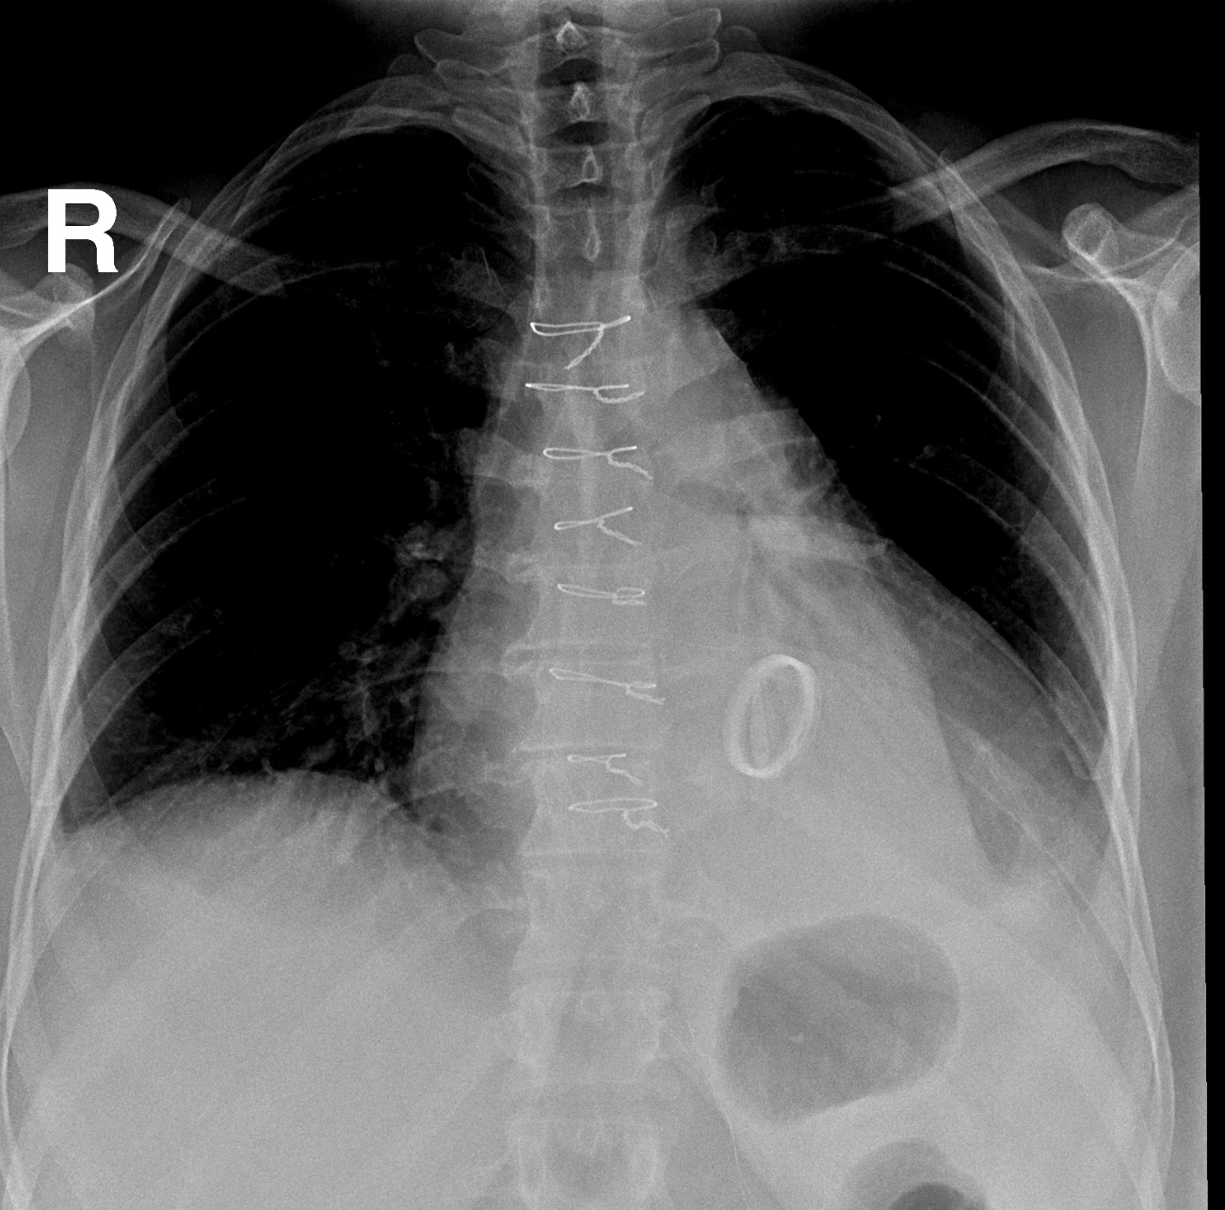
MITRAL VALVE REPLACEMENT
KKUH

Slide 24
MITRAL VALVE REPLACEMENT
LLL COLLAPSE
KKUH

Slide 25
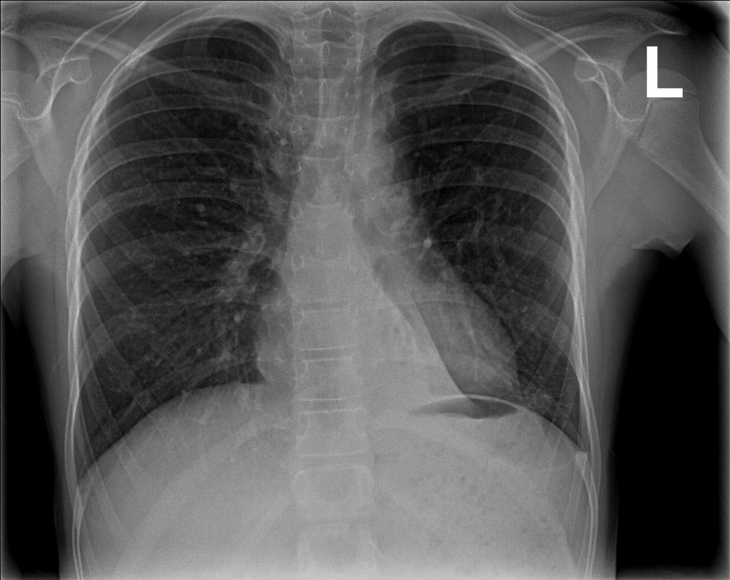
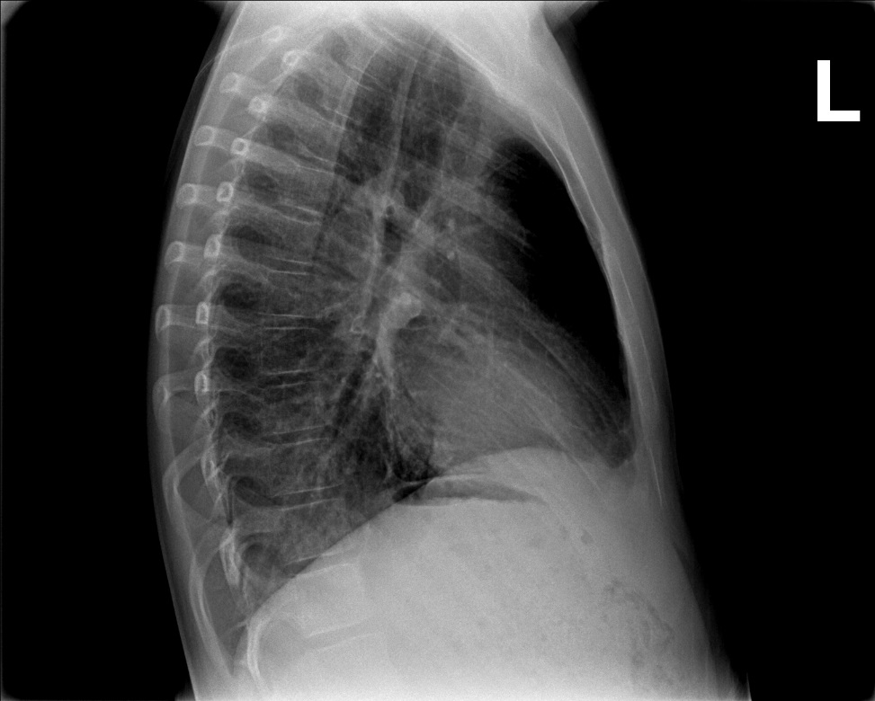
LLL COLLAPSE

Slide 26
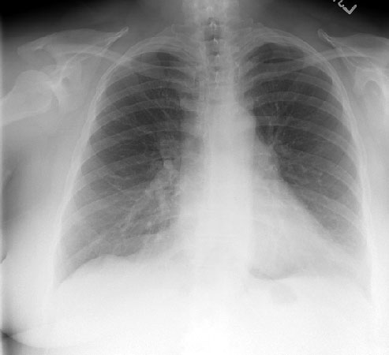
ROUTINE CXR
BREAST SHADOW

Slide 27
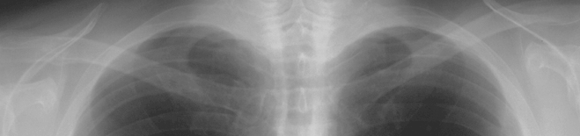
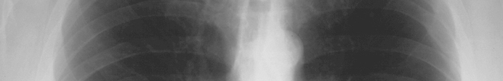
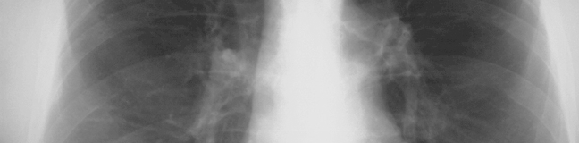

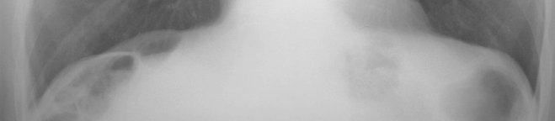
How to read
Frontal Chest X-Ray

Slide 28
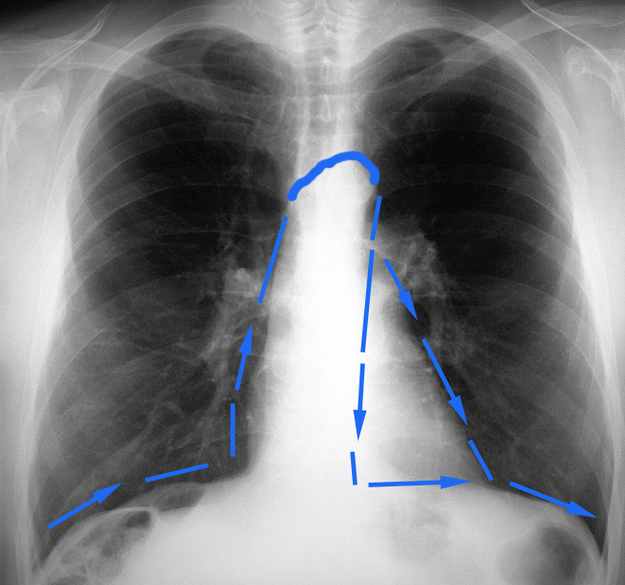
Frontal Chest X-Ray
SILHOUETTE
See
Section on the Silhouette
Sign

Slide 29
LUNGS

Slide 30
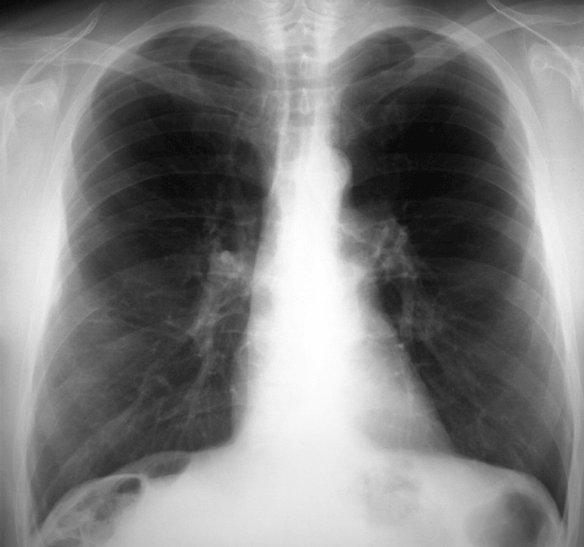
Frontal Chest X-Ray
MEDIASTINUM

Slide 31
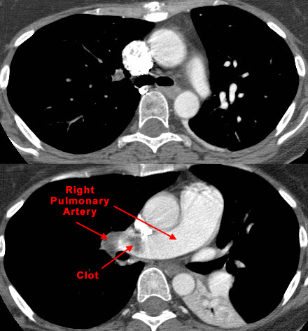
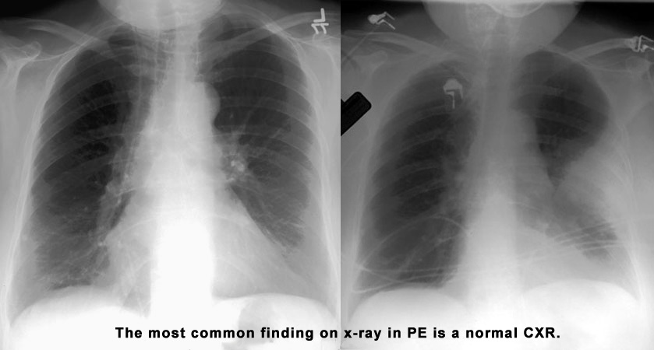
Pulmonary embolism

Slide 32
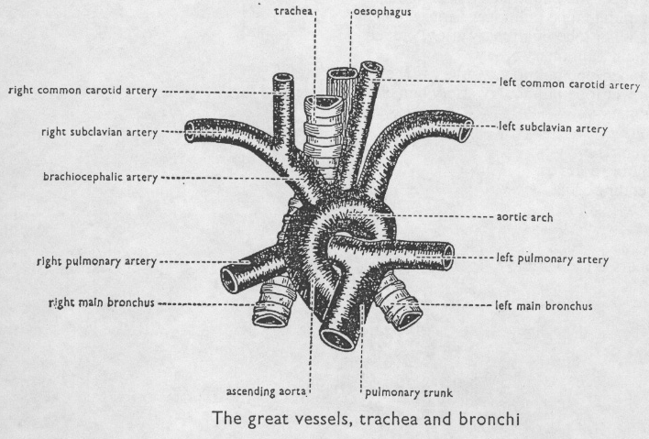
The Aortic arch/great vessels
“Man’s Anatomy by Tobias & Arnold

Slide 33
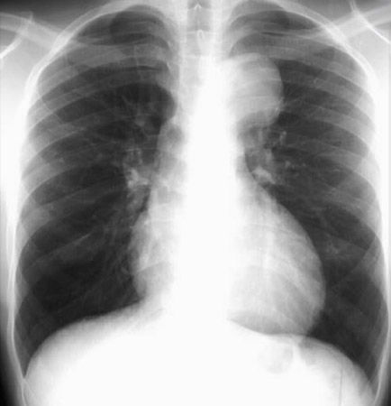
Aortic aneurysm
Aortic knob/knuckle

Slide 34
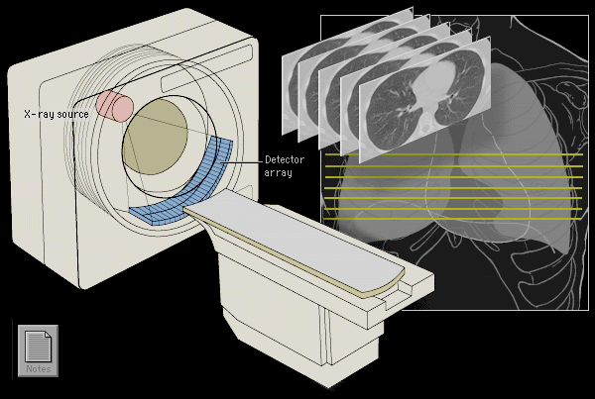
High Resolution CT Scan
HRCT uses very thin slices (1mm) to achieve better spatial resolution & precision.
HRCT is indicated after normal CXR in a symptomatic patient - the setting of high clinical suspicion of disease.
Advantages
  High sensitivity for adenopathy, infiltrates, and architectural distortion.
  HRCT can identify areas of reversible vs. irreversible lung damage.

Slide 35
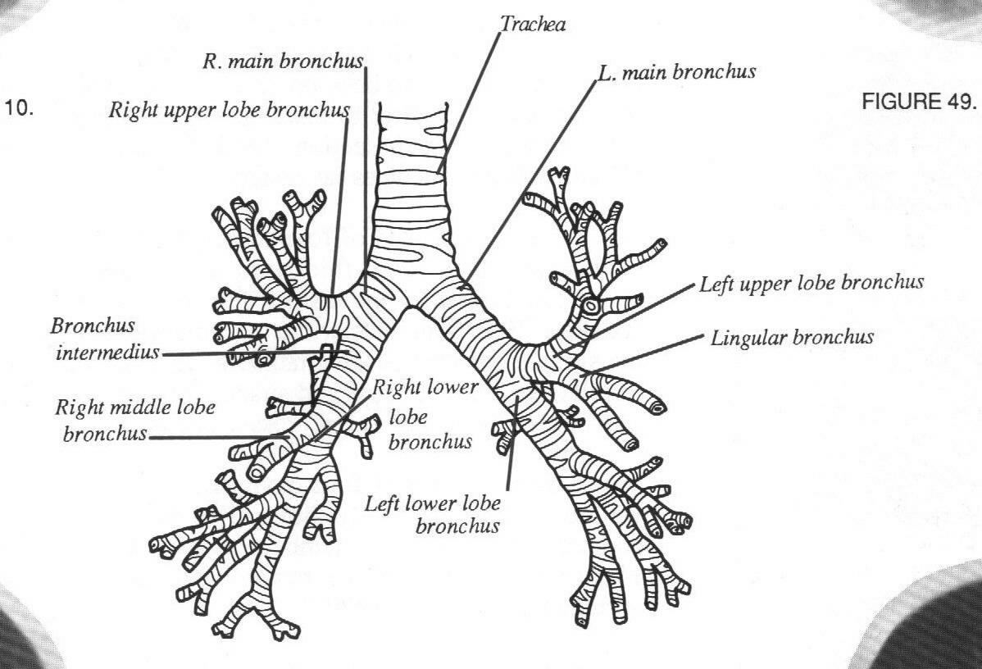
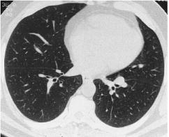
Normal Lung Anatomy
Tracheobronchial Tree
Normal lung at level inferior
pulmonary veins
L inferior
pulmonary
vein
R inferior
pulmonary
vein
Lower lobe
bronchi

Slide 36
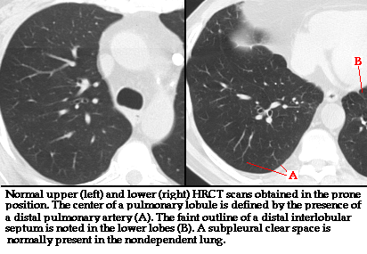
Normal HRCT

Slide 37
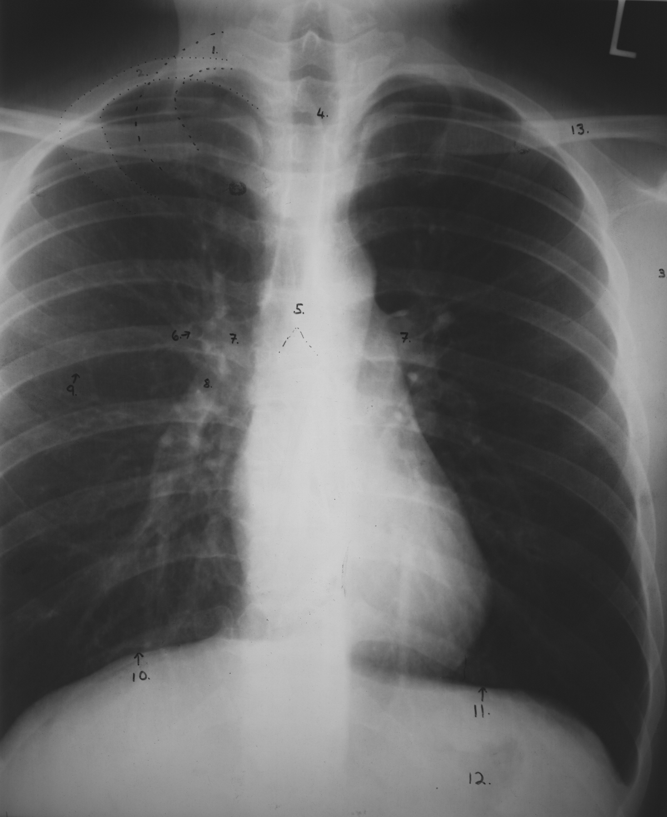
Anatomy on Normal Chest
X-Ray
CXR-PA
1
2
2
4
13
Key:
Right 1st rib
Right 2nd rib
Scapula
Trachea
Carina
Bronchus seen end on
Bilateral hila
Branch of right main descending pulmonary artery
Right minor (horizontal fissure)
Right hemi diaphragm
Left hemi diaphragm
Gastric air bubble
Left clavicle
3
5
6
7
7
9
8
10
11
12

Slide 38
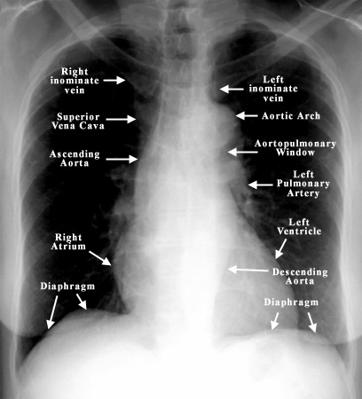
PA VIEW ANATOMY

Slide 39
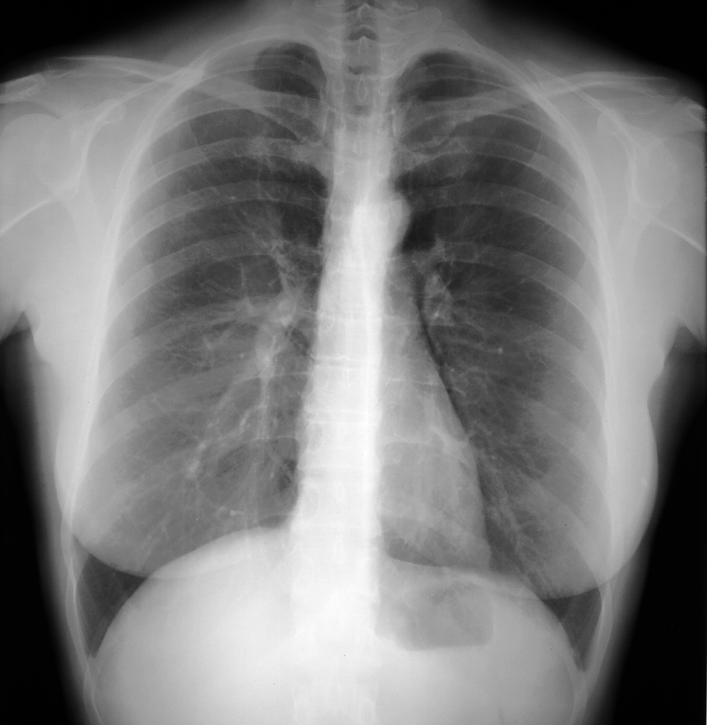
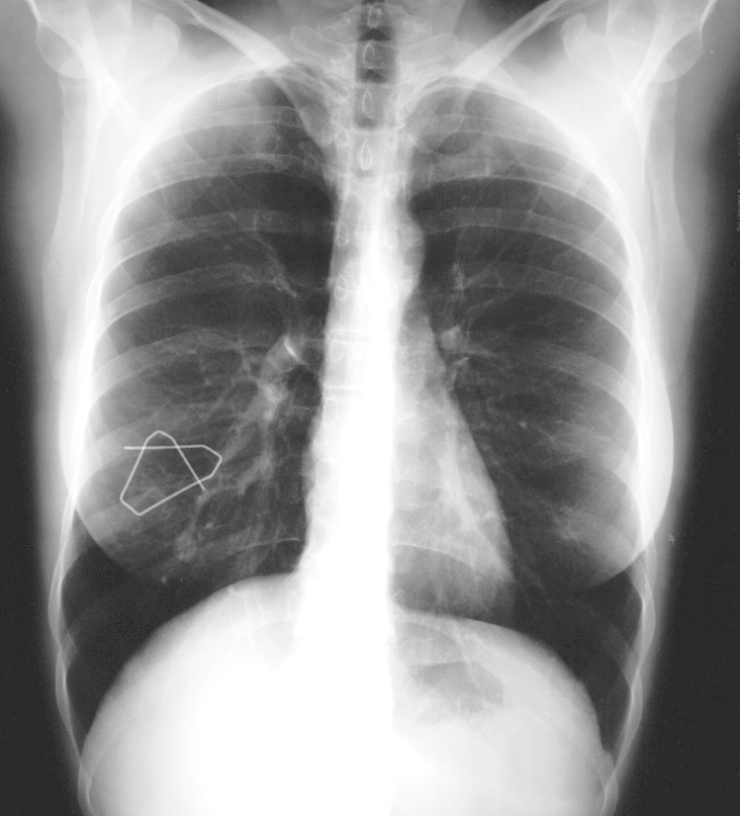
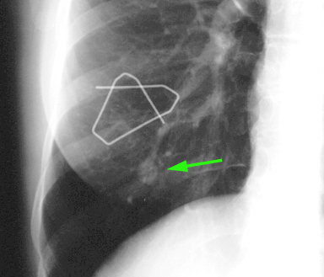
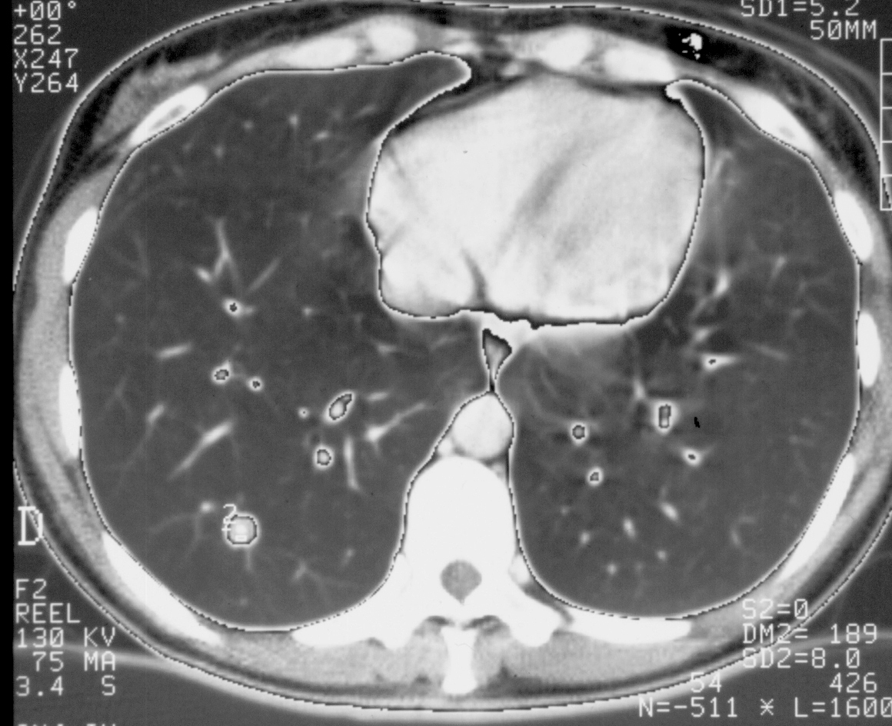
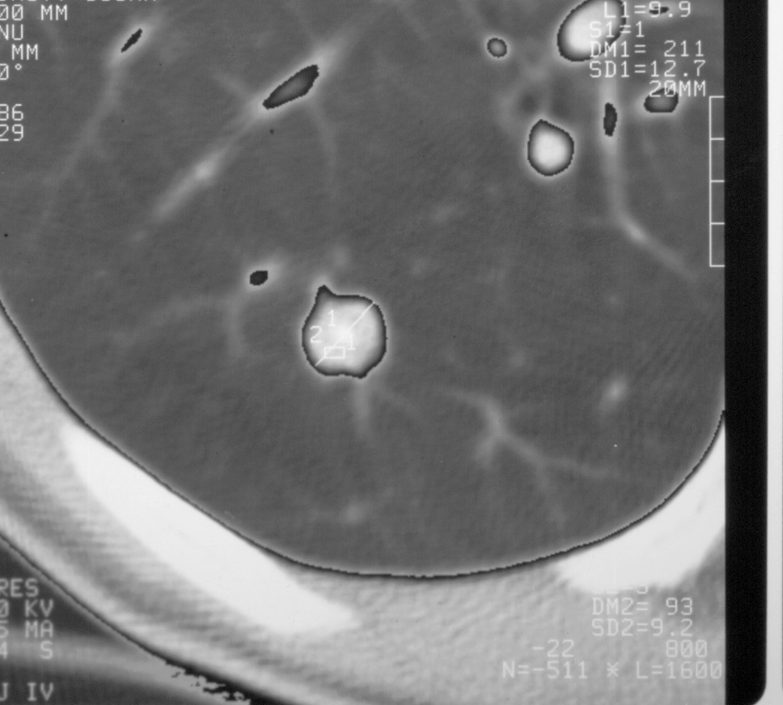
Frontal Chest X-Ray
Intrapulmonary nodule: hamartoma
Nodule or right nipple ?

Slide 40
Remember
It’s a chest x-ray,
not a lung x-ray.

