Slide 1

Radiologic investigation of Chest and CVS diseases
By
Dr Mohamed Sherif El-Sharkawy
ASSOCIATE PROF. and Consultant Radiologist
KKUH
KING SAUD UNIVERSITY
LAST UPDATE
SEPT. 2013

Slide 2
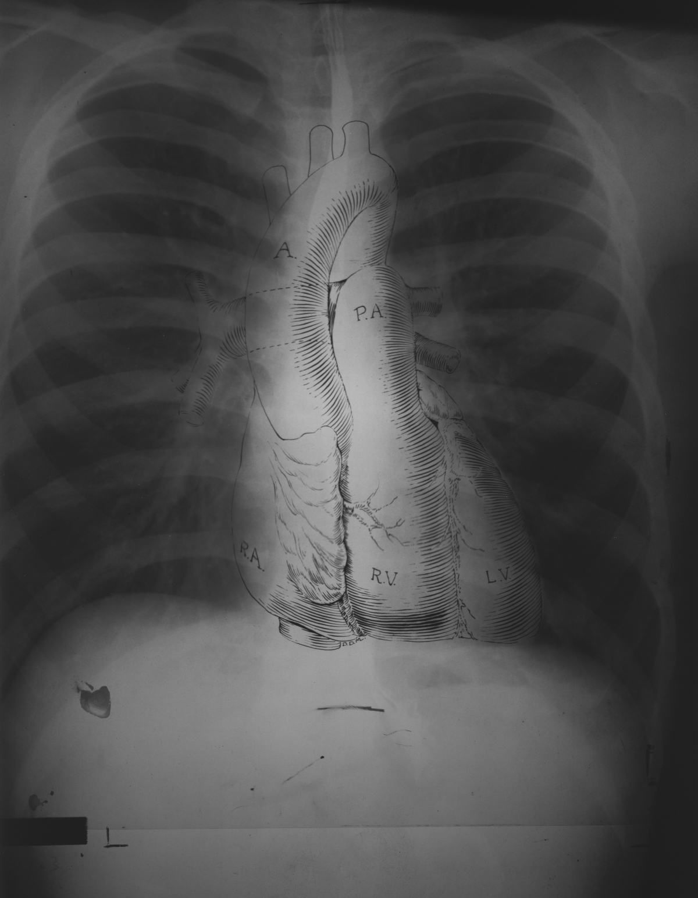
What do we mean by chest
We mean study of thoracic cage contents

Slide 3
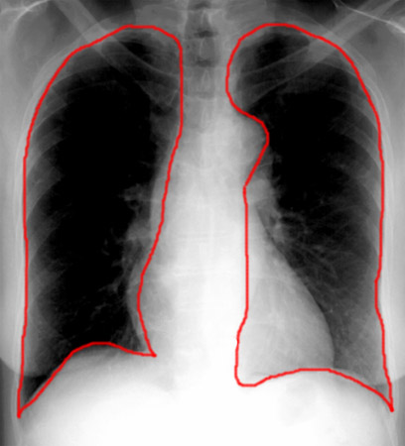
LUNGS

Slide 4
BASIC CHEST EXAMS
PLAIN FILM=CHEST X-RAY(CXR)
CT
HRCT
ANGIOGRAMS

Slide 5
Imaging Modalities for chest and CVS examinations
1-Plain films
2-COMPUTED TOMOGRAPHY
CT LUNGS AND MEDIASTINUM
CT- angiography (CTA)
High resolution CT of the chest (HRCT)
3-Angiography
4- MRI

Slide 6
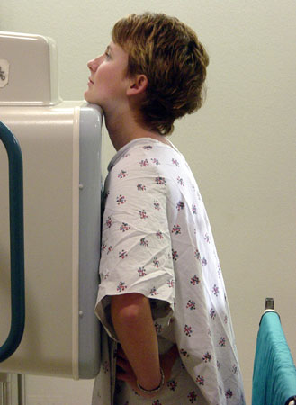
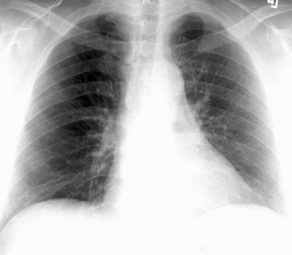
PA VIEW

Slide 7
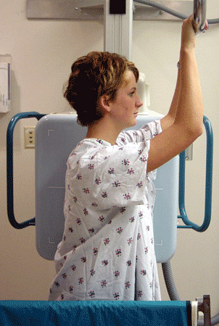
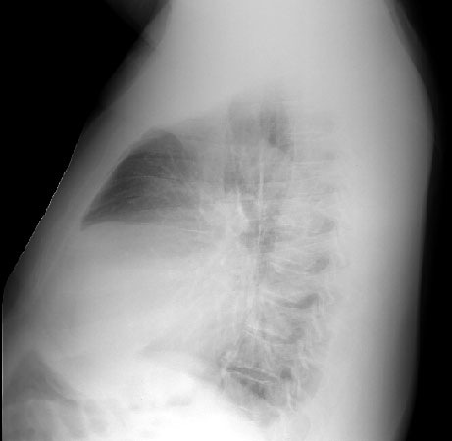
LATERAL VIEW

Slide 8
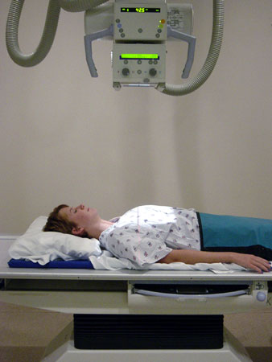
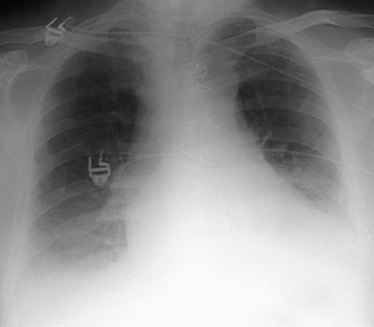
AP VIEW

Slide 9
PA vs. AP
FALSE ELARGEMENT

Slide 10
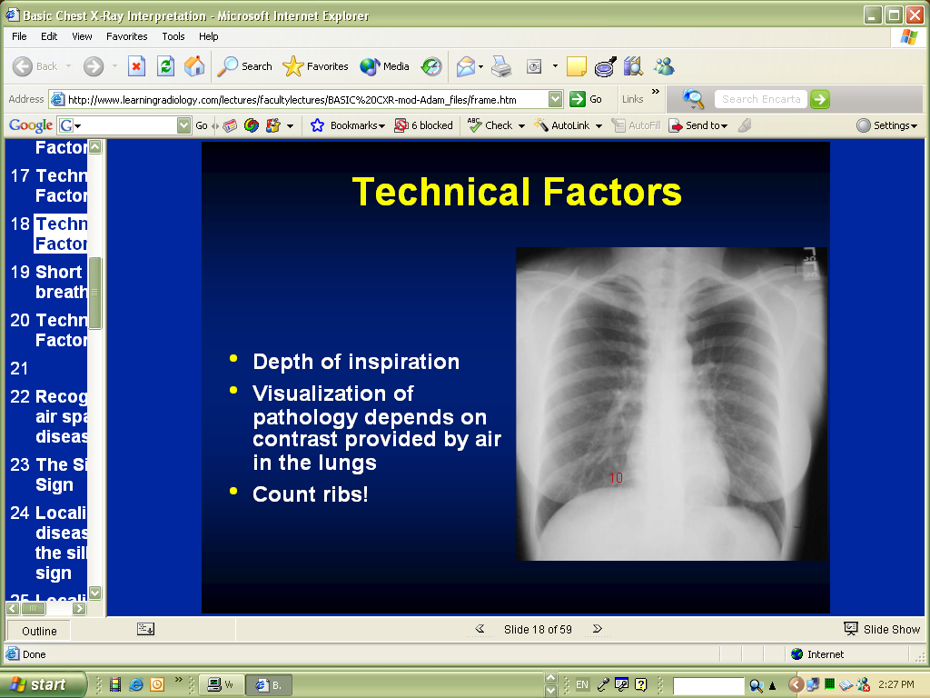

Slide 11
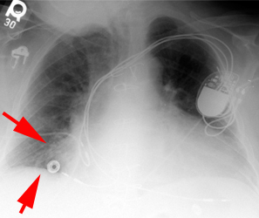
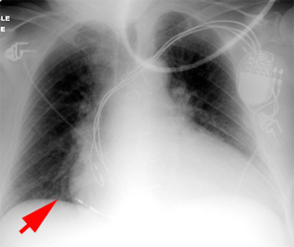
Hypo-inspiratory vs inspiratory

Slide 12
Inspiration
This greatly helps the radiologist to determine if there are intrapulmonary abnormalities.
The diaphragm should be found at about the level of the 8th - 10th posterior rib or 5th - 6th anterior rib on good inspiration.

Slide 13
Rotation
The technologists are usually very careful to x-ray the patient flat against the cassette. If there is rotation of the patient, the
Mediastinum may look very unusual.
One can access patient rotation by observing the clavicular heads and determining whether they are equal distance from the spinous process of the thoracic vertebral bodies.

Slide 14
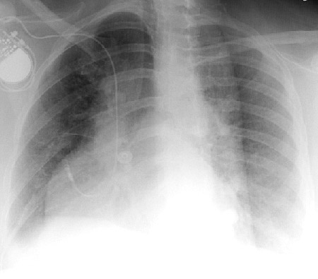
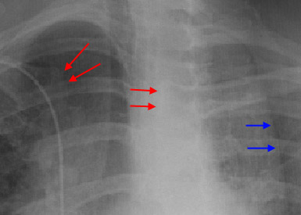
In this rotated film skin folds can be mistaken for a tension pneumothorax (blue arrows).
Notice the skewed positioning of the heads of the clavicles (red arrows) and the spinous processes.

Slide 15
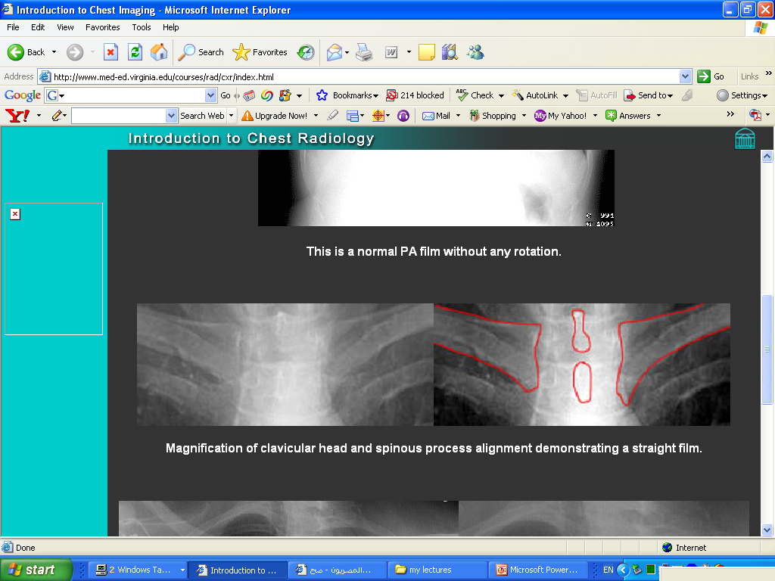
Rotation

Slide 16
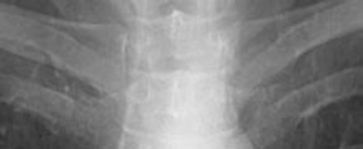
ROTATION

Slide 17
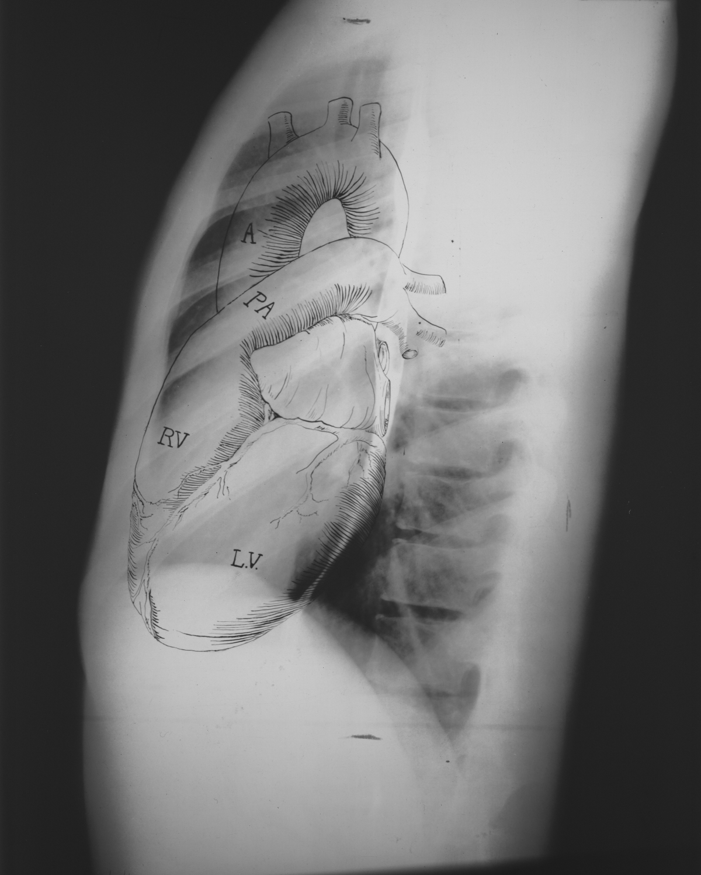
Anatomy on Normal Chest X-Ray
Heart borders and chambers of the heart on PA and lateral views.

Slide 18
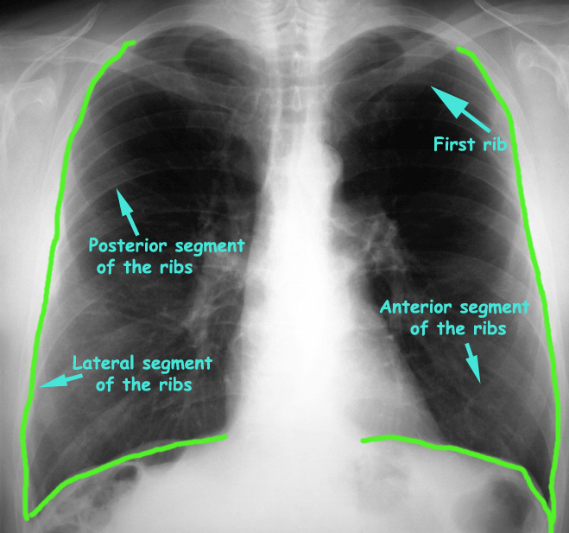
Frontal Chest X-Ray

Slide 19
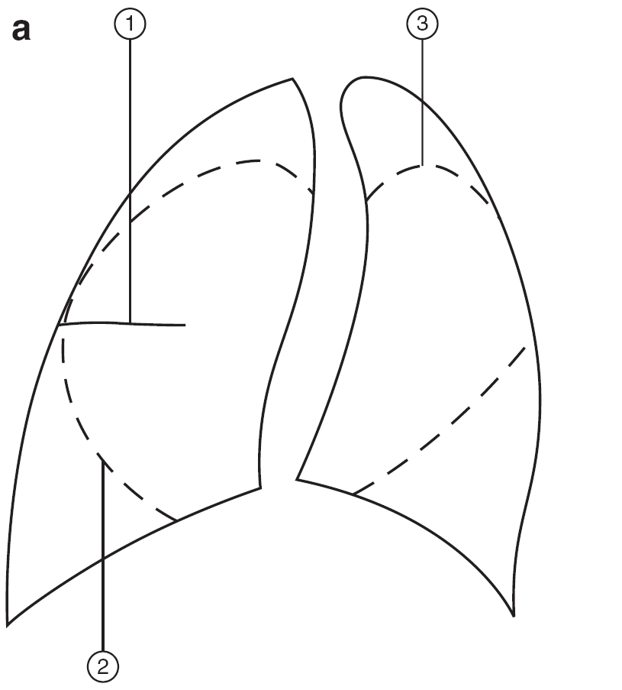
Diagram of lungs showing lobes. The right lung has three lobes, upper, middle and lower. These are separated by the oblique and horizontal fissures. The left lung has two lobes, upper and lower separated by the oblique fissure.

Slide 20
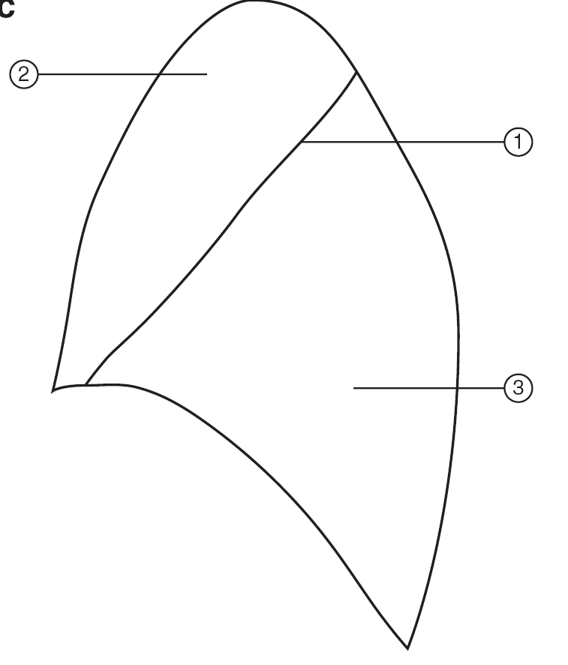
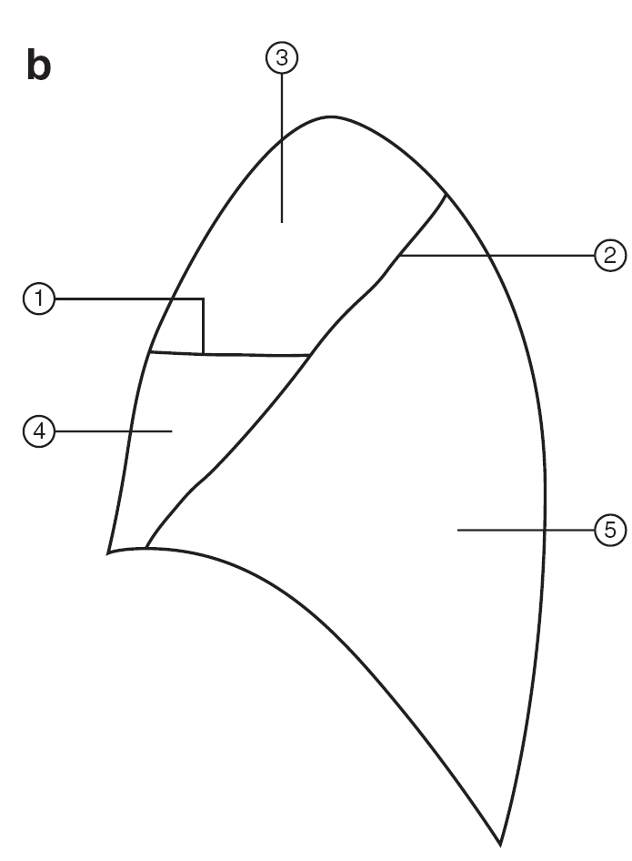

(1) Horizontal fissure
(2) Right oblique fissure, (3) Left oblique fissure. Figure 2.4b
(1) Horizontal fissure (2) Right oblique fissure (3) Right upper lobe
(4) Right middle lobe (5) Right lower lobe. Figure 2.4c (1) Left oblique fissure (2) Left upper lobe (3) Left lower lobe.
Why these lines are important
LEFT LUNG
RIGHT LUNG

Slide 21
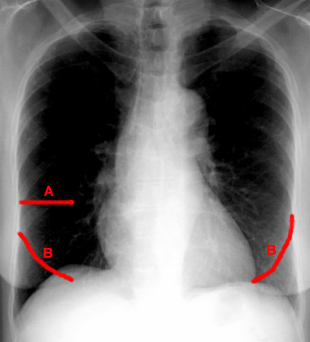
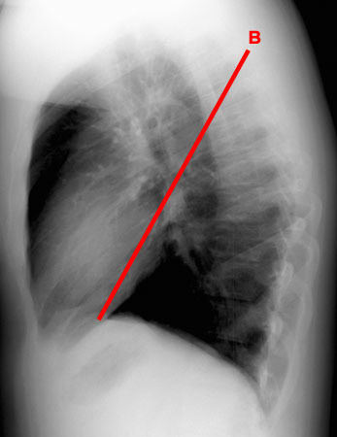
FISSURES
Notes:
21

Slide 22
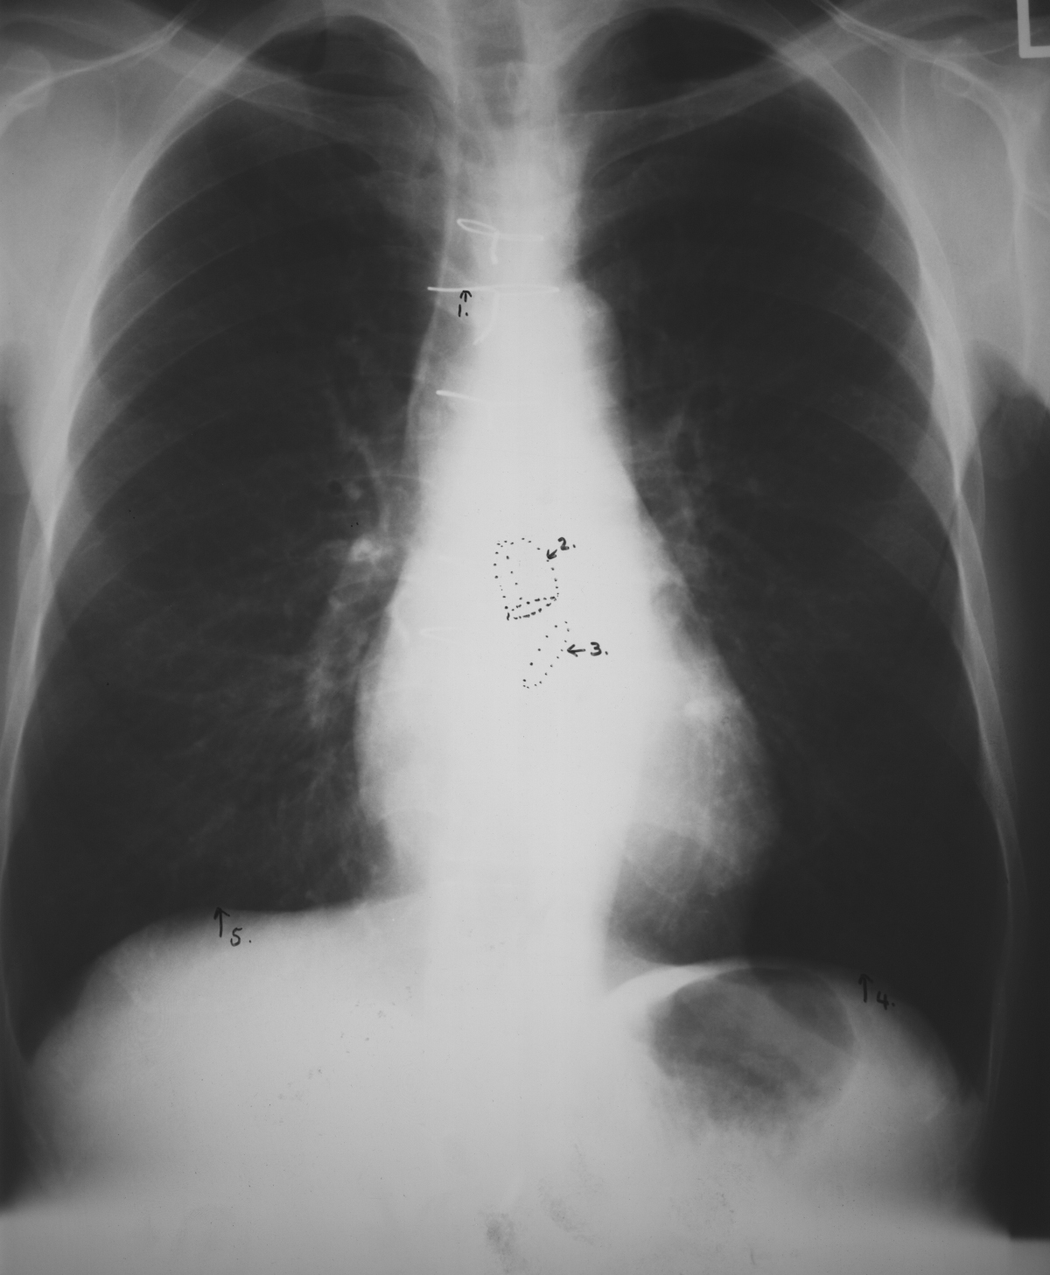
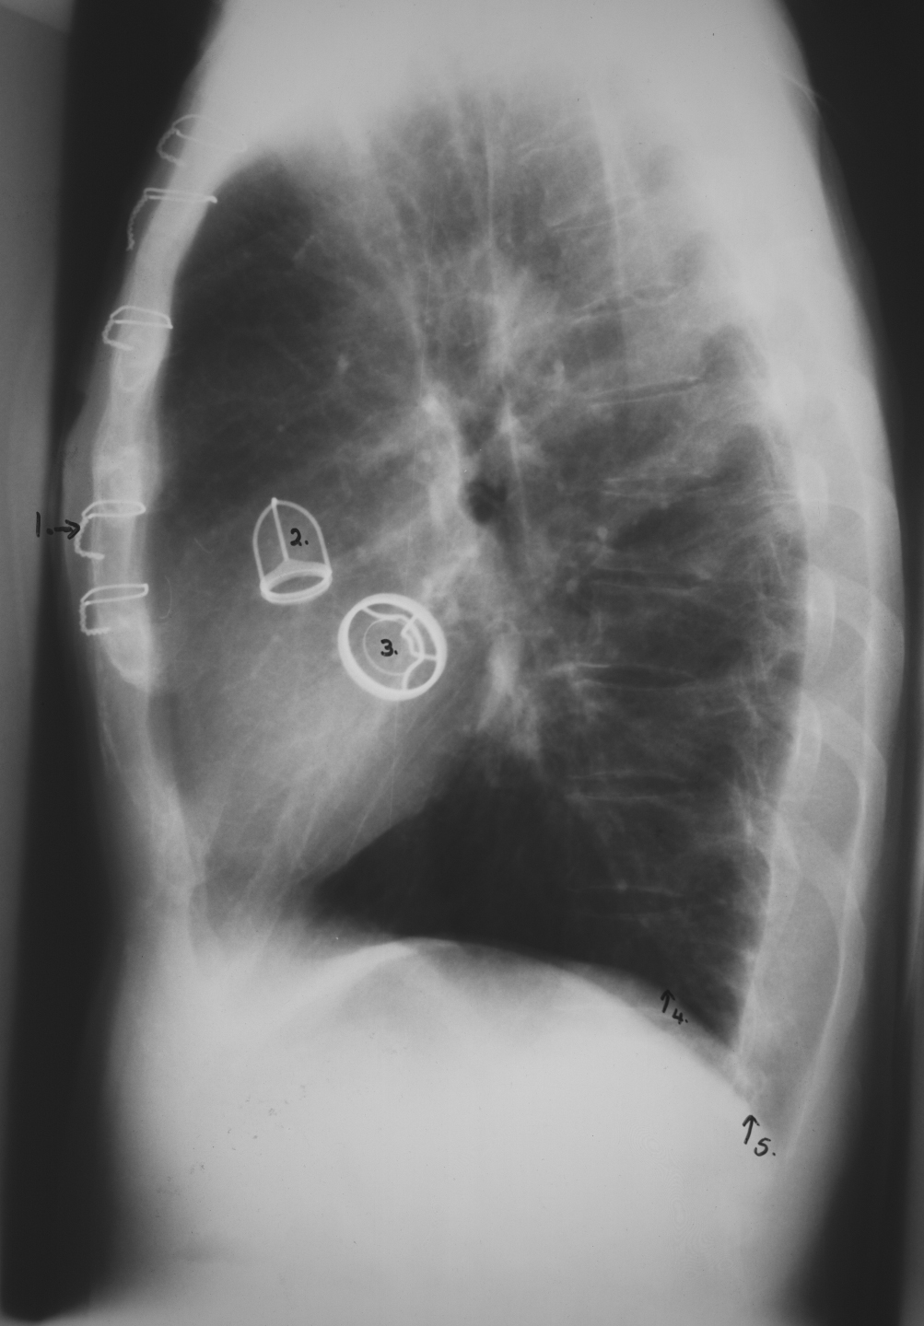
CARDIAC Valves
This patient had a malfunctioning mitral valve (between left atrium and left ventricle) and aortic valve (between left ventricle and aorta) and prosthetic valves were inserted (better seen on lateral)
Frontal CXR
LAT CXR
Key:
Suture material used for repair of vertical incision thru sternum (median sternotomy)
Aortic valve prosthesis
Mitral valve prosthesis
Left hemi diaphragm
Right hemi diaphragm
1
1
2
2
3
3
5
4
4
5

Slide 23
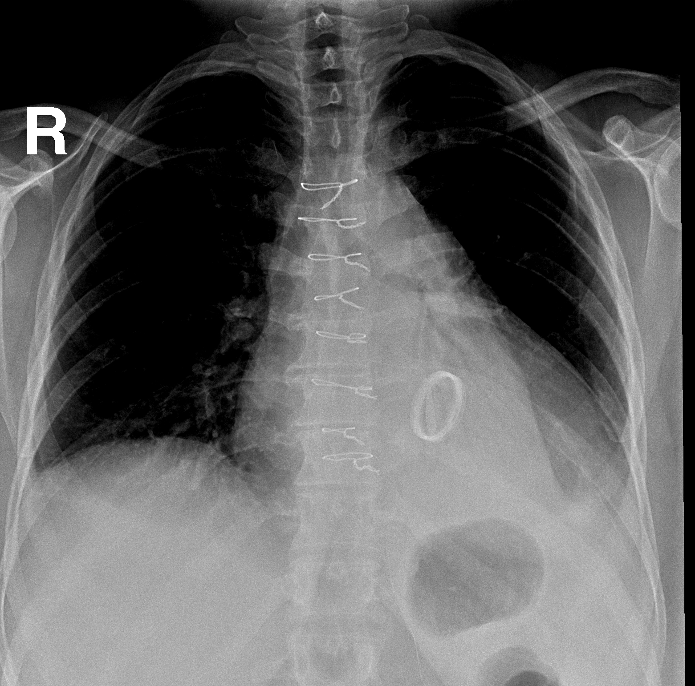
MITRAL VALVE REPLACEMENT
KKUH

Slide 24
MITRAL VALVE REPLACEMENT
LLL COLLAPSE
KKUH

Slide 25
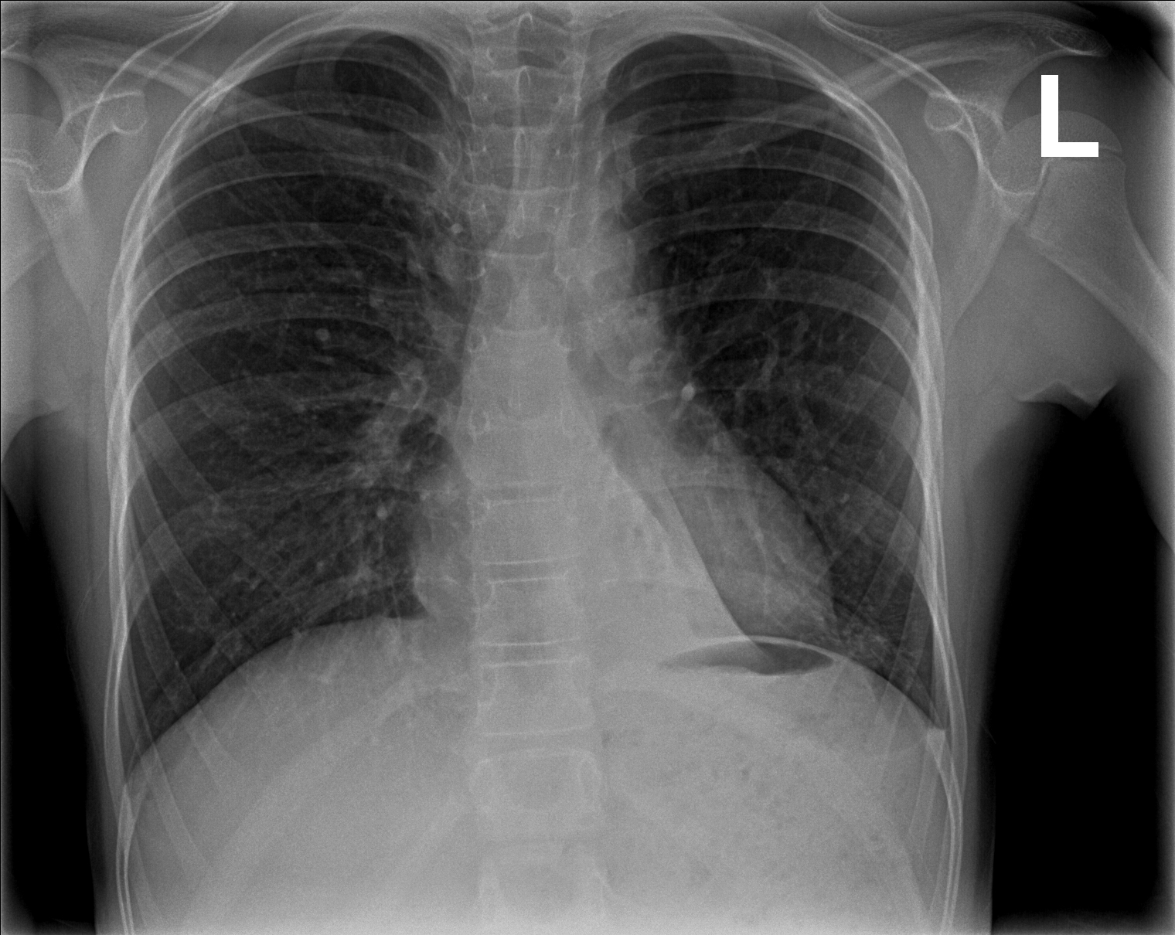
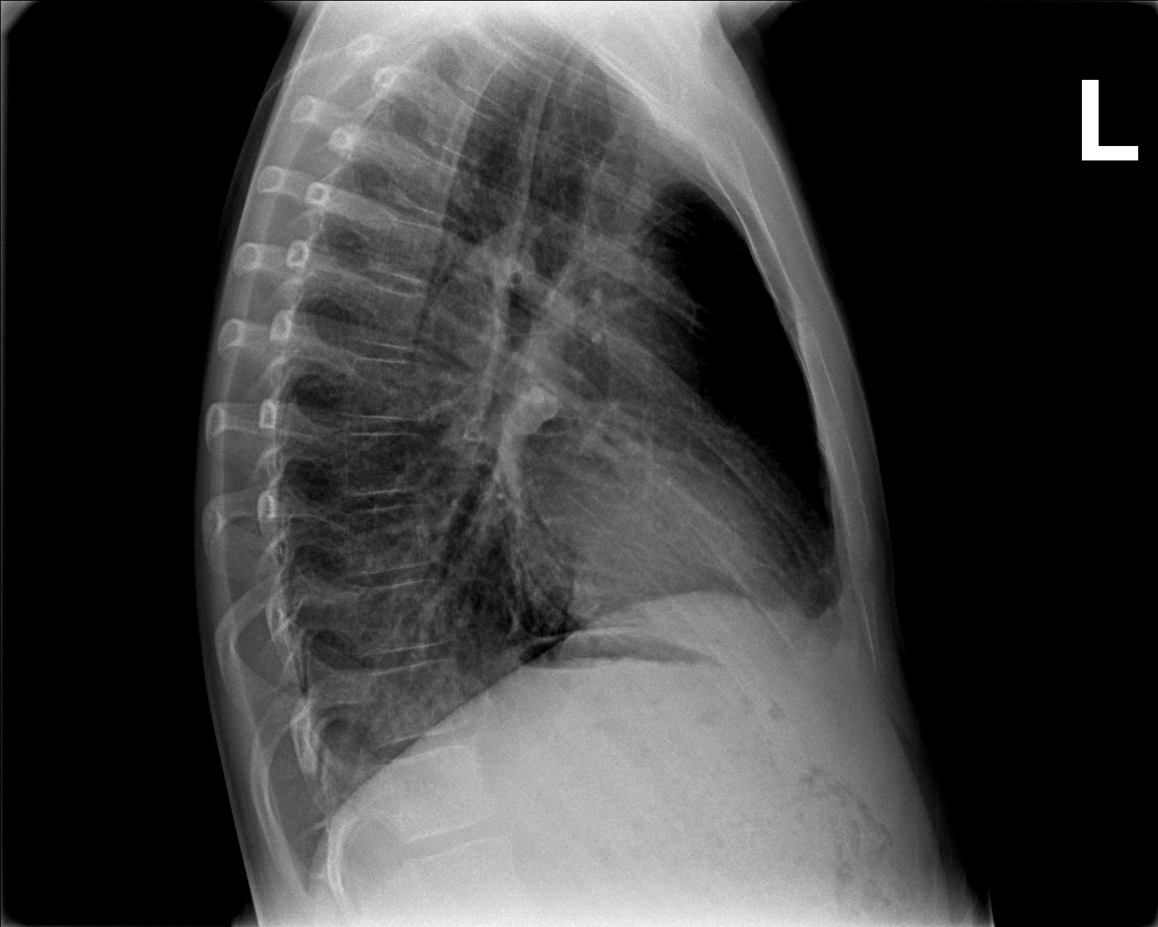
LLL COLLAPSE

Slide 26
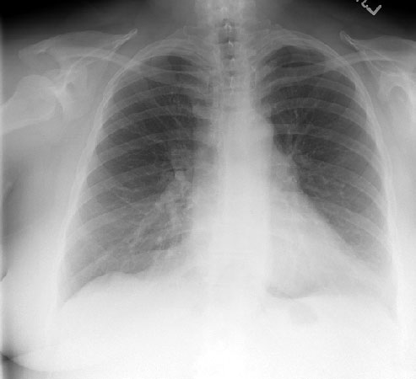
ROUTINE CXR
BREAST SHADOW

Slide 27
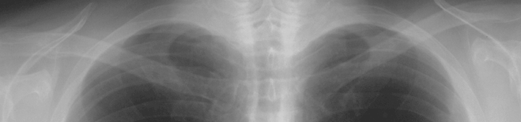
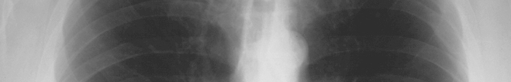
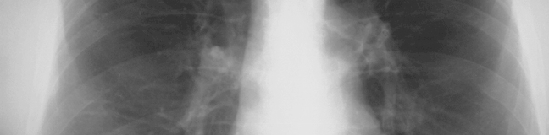

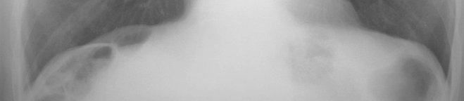
How to read
Frontal Chest X-Ray

Slide 28
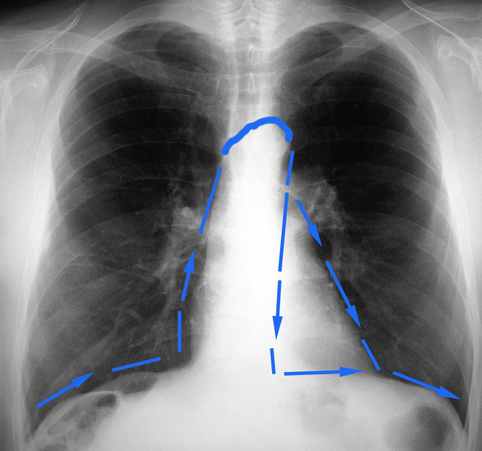
Frontal Chest X-Ray
SILHOUETTE
See
Section on the Silhouette
Sign

Slide 29
LUNGS

Slide 30
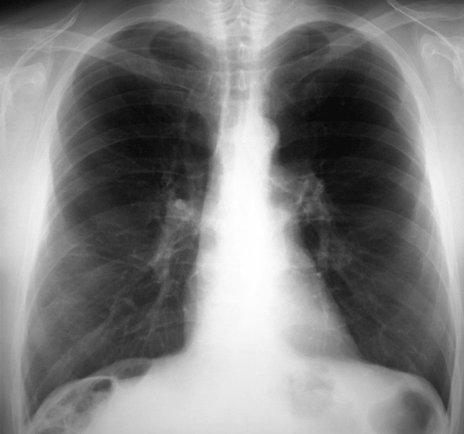
Frontal Chest X-Ray
MEDIASTINUM

Slide 31
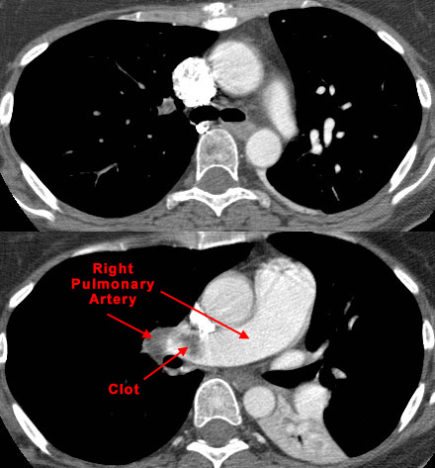
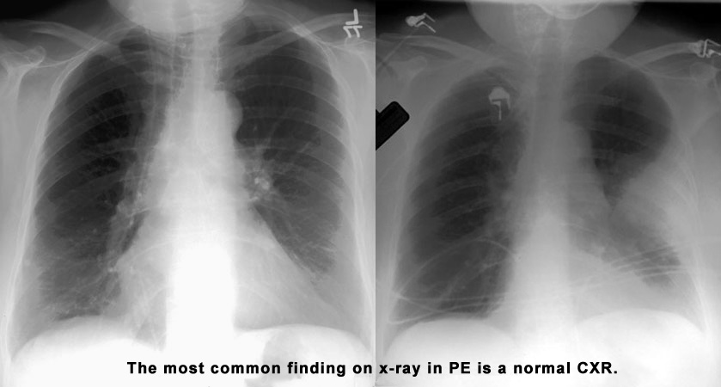
Pulmonary embolism

Slide 32
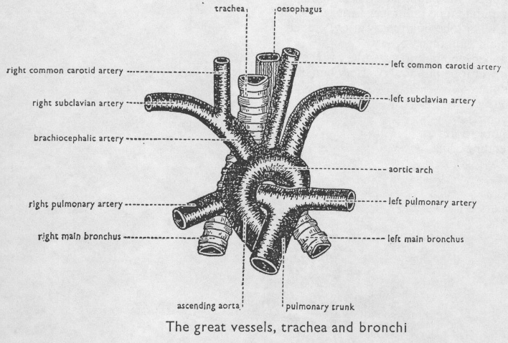
The Aortic arch/great vessels
“Man’s Anatomy by Tobias & Arnold

Slide 33
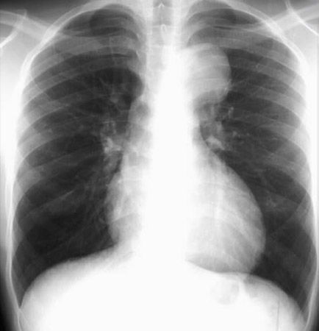
Aortic aneurysm
Aortic knob/knuckle

Slide 34
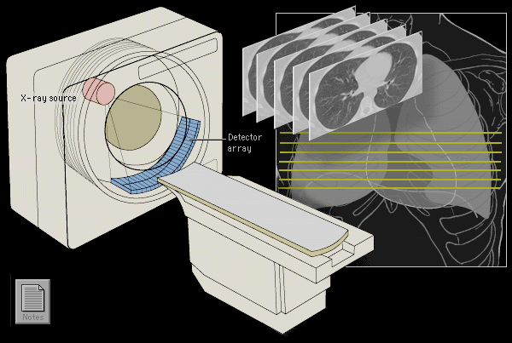
High Resolution CT Scan
HRCT uses very thin slices (1mm) to achieve better spatial resolution & precision.
HRCT is indicated after normal CXR in a symptomatic patient - the setting of high clinical suspicion of disease.
Advantages
  High sensitivity for adenopathy, infiltrates, and architectural distortion.
  HRCT can identify areas of reversible vs. irreversible lung damage.

Slide 35
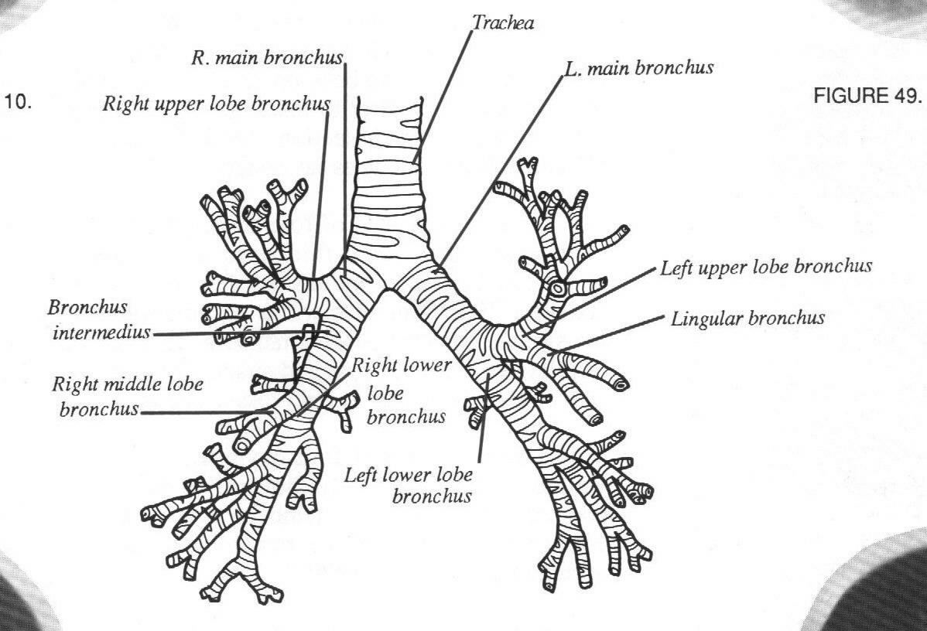
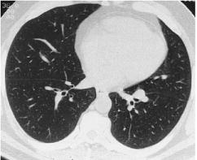
Normal Lung Anatomy
Tracheobronchial Tree
Normal lung at level inferior
pulmonary veins
L inferior
pulmonary
vein
R inferior
pulmonary
vein
Lower lobe
bronchi

Slide 36
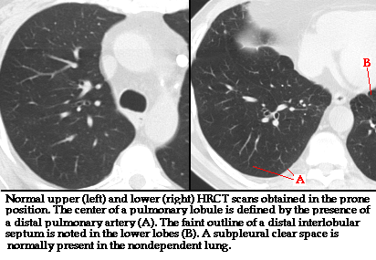
Normal HRCT

Slide 37
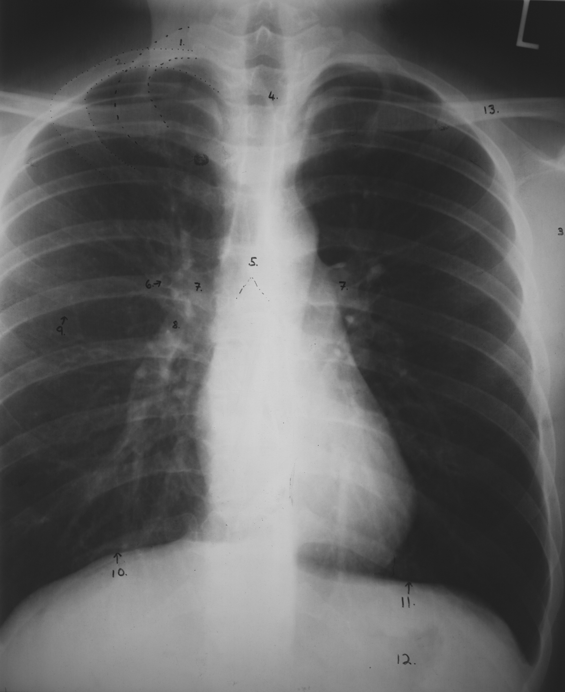
Anatomy on Normal Chest
X-Ray
CXR-PA
1
2
2
4
13
Key:
Right 1st rib
Right 2nd rib
Scapula
Trachea
Carina
Bronchus seen end on
Bilateral hila
Branch of right main descending pulmonary artery
Right minor (horizontal fissure)
Right hemi diaphragm
Left hemi diaphragm
Gastric air bubble
Left clavicle
3
5
6
7
7
9
8
10
11
12

Slide 38
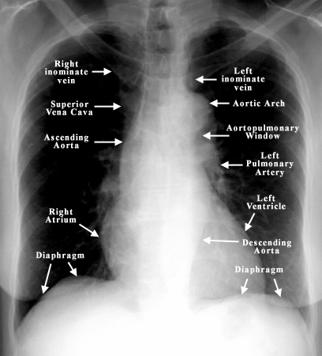
PA VIEW ANATOMY

Slide 39
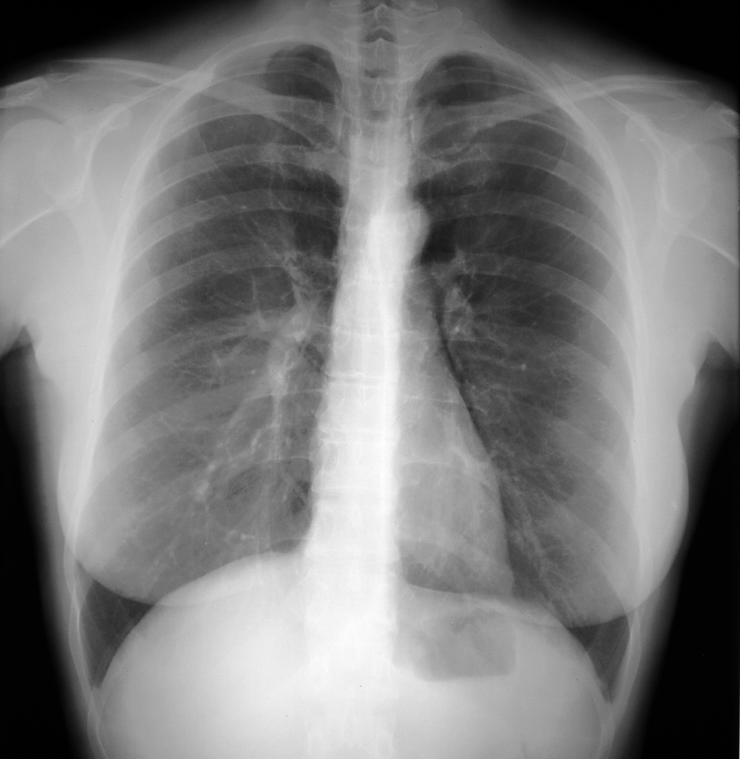
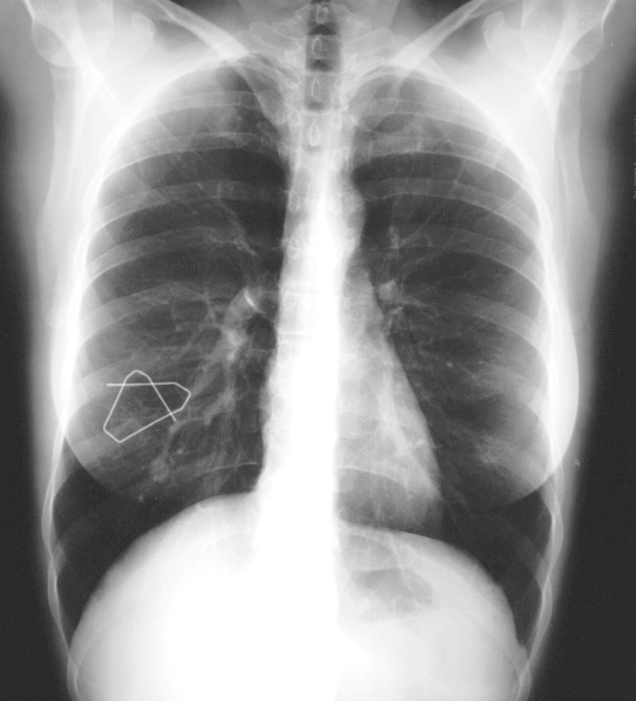
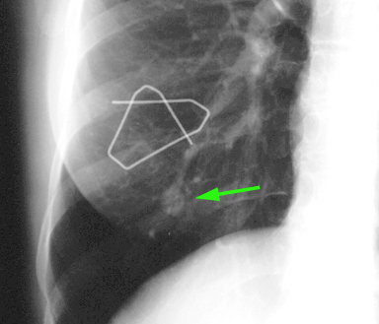
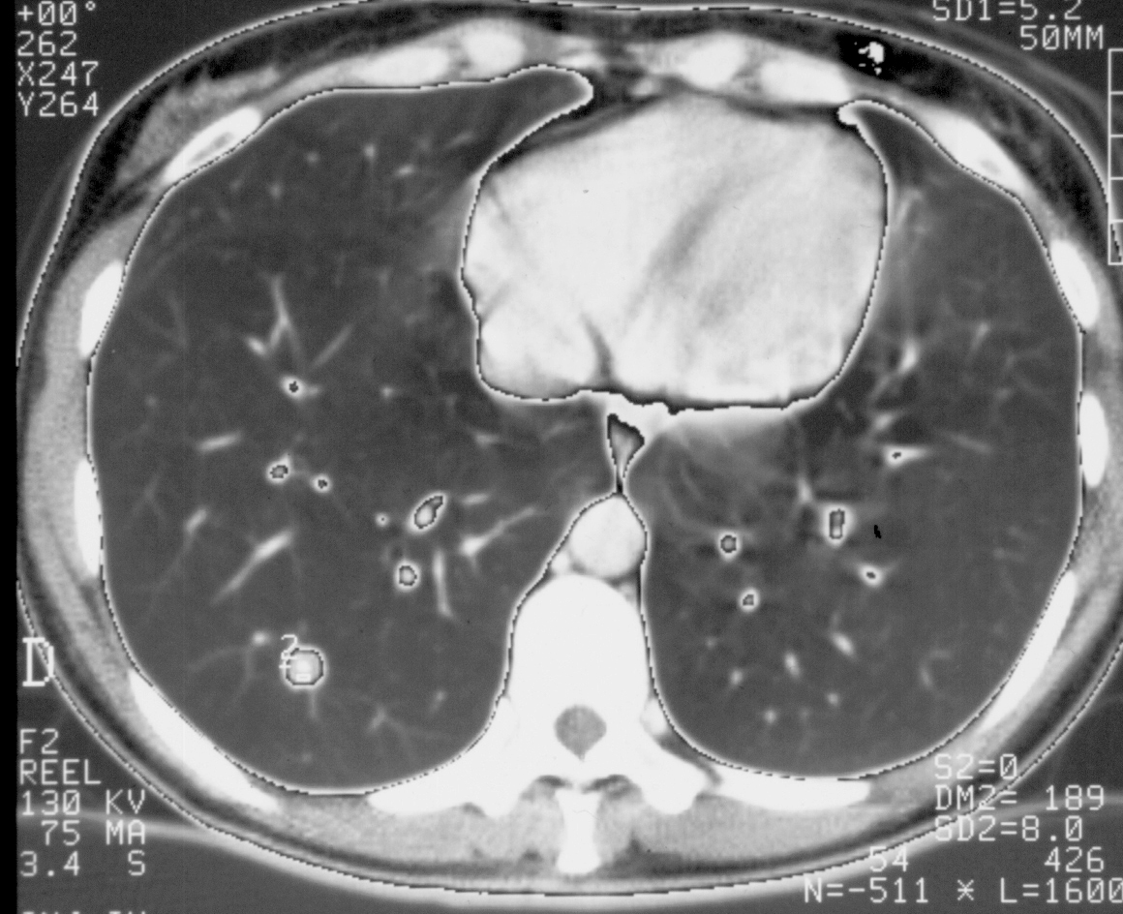
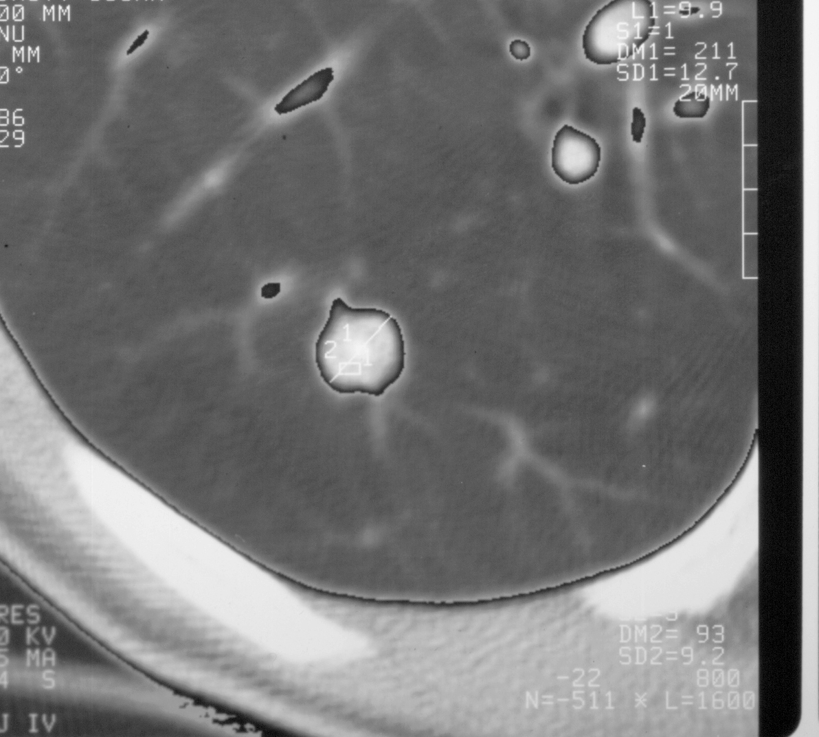
Frontal Chest X-Ray
Intrapulmonary nodule: hamartoma
Nodule or right nipple ?

Slide 40
Remember
It’s a chest x-ray,
not a lung x-ray.

Slide 41
Radiologic investigation of Chest and CVS diseases
By
Dr Mohamed Sherif El-Sharkawy
ASSOCIATE PROF. and Consultant Radiologist
KKUH
KING SAUD UNIVERSITY
LAST UPDATE
SEPT 2013
Notes:
41

Slide 42
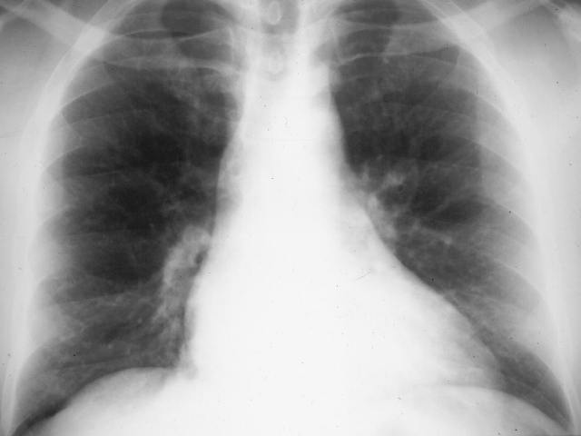
The Cardiac Contours
Aortic knob
Ascending Aorta
Main pulmonary artery
“Double density” of LA enlargement
Indentation for LA
Right atrium
Left ventricle

Slide 43

Cardiac displacement

Slide 44


Cardiac displacement
KKUH
Pectus excavatum

Slide 45


DEXTROCARDIA

Slide 46

FISSURES

Slide 47
FISSURES
Notes:
47

Slide 48


MASS Vs DIFFUSE INFILTERATION
The basic diagnostic instance is to detect an abnormality.
In both of the cases, there is an abnormal opacity.
In each of the cases, there is an abnormal opacity in the left upper lobe.
In the case ABOVE , the opacity would best be described as a mass because it HAS EDGES well-defined 3-D STRUCTURE
The case BELOW has an opacity that is poorly defined. This is airspace disease such as pneumonia.
Notes:
48

Slide 49


solitary nodule in the lung
A solitary nodule in the lung can be totally innocuous or potentially a fatal lung cancer. After detection the initial step in analyis is to compare the film with prior films if available. A nodule that is unchanged for two years is almost certainly benign. Be sure to evaluate for the presence of multiple nodules as this finding would change the differential entirely.
If the nodule is indeterminate after considering old films and calcification, subsequent steps in the work-up include ordering a CT and a tissue biopsy.
Notes:
49

Slide 50



PLEURAL BASED LESION
Notes:
50

Slide 51
DEFINITIONS
ATELECTASIS
Loss of volume of lobe, segment or sub segment of the lung.
Example collapse (lung)
Consolidation
Loss of air in lobe, segment or sub segment of the lung.
Example= pneumonia (lobe)

Slide 52

Major differentiating factors between atelectasis and pneumonia
Notes:
52

Slide 53


PNEUMONIA VS ATELECTASIS
Notes:
53

Slide 54



PNEUMONIA Vs ATELECTASIS
Notes:
54

Slide 55
ATELECTASIS Vs PNEUMONIA
Notes:
55

Slide 56
Recognizing air space disease
Alveolar spaces filled with…something.
Radiologist's report:
  “consolidation”
  “air space opacity”
  “fluffy density”
  “infiltrate”
Nonspecific:
  Atelectasis, pneumonia, bleeding, edema, tumor
Notes:
56

Slide 57
The Silhouette Sign
Indicates air space disease.
Obscuration of a normally seen border, e.g. diaphragm or heart.
Opacity with sharp edge along a fissure.
Notes:
57

Slide 58
Silhouette
1
2

Slide 59

SILHOUATTE SIGN
Notes:
59

Slide 60
Localizing disease from the silhouette sign
RML
Lingula
LLL
RLL
LLL
Notes:
60

Slide 61

Localizing disease from the silhouette sign
UL
RUL
LL
RML
RML or lingula
Notes:
61

Slide 62
Lobar Atelectasis
Best sign – shift of a fissure
Rapid development and clearance
Air bronchograms if non-obstructive
Secondary signs:
  Mediastinal shift
  Elevated diaphragm
  Ribs closer together
  Vague increased density
Notes:
62

Slide 63


RUL Atx
Notes:
63

Slide 64


RML Atx
Notes:
64

Slide 65


LUL Atx
Notes:
65

Slide 66
LLL COLLAPSE
Notes:
66

Slide 67
Pneumonia
Signs:
  Air bronchogram
  Silhouette - “positive” or “negative”
  Dense hilum
  “Spine” sign
All are signs of any air space process
Dx of pneumonia depends on appropriate clinical scenario.
Notes:
67

Slide 68


Air bronchogram sign
Pseudomonas pneumonia
Lung cancer
Notes:
68

Slide 69
Air bronchograms — CT
Pneumonia
Notes:
69

Slide 70


Right middle lobe
Notes:
70

Slide 71


Right upper lobe
Notes:
71

Slide 72


Right lower lobe
Posterior diaphragm silhouetted
Notes:
72

Slide 73

PLEURAL EFFUSION
Notes:
73

Slide 74
COMPARE COSTO-PHRENIC ANGLES

Slide 75

PLEURAL EFFUSION
On an upright film, an effusion will cause blunting on the lateral and if large enough, the posterior costophrenic sulci. Sometimes a depression of the involved diaphragm will occur. A large effusion can lead to a mediastinal shift away from the effusion and opacity the hemithorax. Approximately 200 ml of fluid are needed to detect an effusion in the frontal film vs. approximately 75ml for the lateral. Larger effusions, especially if unilateral, are more likely to be caused by malignancy than smaller ones.
Notes:
75

Slide 76

BLUNTED C/P ANGLE
=PLEUAL EFFUSION?
Notes:
76

Slide 77


PNEUMOMEDIASTINUM Vs PNEUMOTHORAX
A pneumothorax is defined as air inside the thoracic cavity but outside the lung. A spontaneous pneumothorax (PTX) is one that occurs without an obvious inciting incident. Some causes of spontaneous PTX are; idiopathic, asthma, COPD, pulmonary infection, neoplasm, Marfanâs syndrome, and smoking cocaine.
Notes:
77

Slide 78

PNEUMOMEDIASTINUM
Notes:
78

Slide 79

Hydro-pneumo-thorax
Notes:
79

Slide 80


EMPHYSEMA
Emphysema is loss of elastic recoil of the lung with destruction of pulmonary capillary bed and alveolar septa. It is caused most often by cigarette smoking and less commonly by alpha-1 antitrypsin deficiency.
Notes:
80

Slide 81
EMPHYSEMA
Emphysema is commonly seen on CXR as diffuse hyperinflation with flattening of diaphragms, increased retrosternal space, bullae (lucent, air-containing spaces that have no vessels that are not perfused) and enlargement of PA/RV (secondary to chronic hypoxia) an entity also known as cor pulmonale. Hyperinflation and bullae are the best radiographic predictors of emphysema.
Notes:
81

Slide 82
EMPHYSEMA
Emphysema is commonly seen on CXR as diffuse hyperinflation with flattening of diaphragms, increased retrosternal space, bullae (lucent, air-containing spaces that have no vessels that are not perfused) and enlargement of PA/RV (secondary to chronic hypoxia) an entity also known as cor pulmonale. Hyperinflation and bullae are the best radiographic predictors of emphysema.
Notes:
82

Slide 83


CT anatomy
Notes:
83

Slide 84


CT
Notes:
84

Slide 85

Vascular anatomy of the chest
Notes:
85

Slide 86

Vascular anatomy of the chest
Notes:
86

Slide 87


Pulmonary artery
Notes:
87

Slide 88
Pulmonary embolism
Notes:
88

Slide 89
CTA
(Coronal Reconstruction)
Embolus in left main pulmonary artery
Embolus in descending right pulmonary artery
NORMAL HOMOGENOUS FILLING OF THE VESSLES
Notes:
89

Slide 90



Anterior Mediastinal Mass
Anterior mediastinal masses consist of the 4 "T's" (Terrible lymphadenopathy, Thymic tumors, Teratoma, Thyroid mass) and aortic aneurysm, pericardial cyst, epicardial fat pad. Usually CT or fine needle aspiration is needed to make the definitive diagnosis of an anterior mediastinal mass.
Notes:
90

Slide 91
CARDIOVASCULAR IMAGING

Slide 92

AORTIC ARCH ANATOMY
KKUH

Slide 93

Cardiomegaly plus early Congestive Heart Failure (CHF)
Heart and Vessels
Key:
Inferior vena cava (IVC)
Superior vena cava (SVC)
*3. Azygos vein
Carina
Trachea
Right main stem bronchus
Prominent pulmonary vessels
7
5
7
7
7
2
4
3
Any and or all heart chambers may enlarge when the heart becomes diseased. Cardiomegaly = a big heart.
A patient’s heart enlarges due to a number of diseases e.g. valve disease, high blood pressure, congestive heart failure.
1
If the heart fails, the lung often become congested. Early on the pulmonary vessels appear more prominent as in this case. More advanced failure can result in a condition of pulmonary edema which is fluid flooding into the alveoli of the lungs causing the patient marked shortness of breath.

Slide 94
One of the easiest observations to make is something you already know: the cardio-thoracic ratio which is the widest diameter of the heart compared to the widest internal diameter of the rib cage
Cardio-thoracic Ratio
<50%

Slide 95
Sometimes, CTR is more than 50%
But Heart is Normal
Extracardiac causes of cardiac enlargement
  Portable AP films
  Obesity
  Pregnant
  Ascites
  Straight back syndrome
  Pectus excavatum

Slide 96


>50%
Here is a heart that is larger than 50% of the cardiothoracic ratio, but it is still a normal heart. This is because there is an extracardiac cause for the apparent cardiomegaly. On the lateral film, the arrows point to the inward displacement of the lower sternum in a pectus excavatum deformity.

Slide 97
Sometimes, CTR is less than 50%
But Heart is Abnormal
Obstruction to outflow of the ventricles
  Ventricular hypertrophy
Must look at cardiac contours

Slide 98

<50%
Here is an example of a heart which is less than 50% of the CTR in which the heart is still abnormal. This is recognizable because there is an abnormal contour to the heart (arrows).

Slide 99
Anatomy on Normal Chest X-Ray
Heart borders and chambers of the heart on PA and lateral views.

Slide 100
The Cardiac Contours
Aortic knob
Ascending Aorta
Main pulmonary artery
“Double density” of LA enlargement
Indentation for LA
Right atrium
Left ventricle
There are 7 contours to the heart in the
frontal projection in this system.

Slide 101
The Cardiac Contours
Aortic knob
Ascending Aorta
Main pulmonary artery
“Double density” of LA enlargement
Indentation for LA
Right atrium
Left ventricle
But only the top five are really important
in making a diagnosis.

Slide 102
Ascending Aorta
Low density,
almost straight edge
represents size
of ascending aorta

Slide 103


Ascending Aorta
Small
Prominent

Slide 104

Even though we are on the right side of the heart, we can see left atrial enlargement. Normally the left atrium sits right in the middle of the heart posteriorly and does not form a normal border on the frontal film.
Left atrium
forms no border of normal heart in PA view
Left atrium
sits in middle of heart posteriorly
RA
LV
This inset from a CT scan of the chest shows how RA and LV obscure LA from forming a heart border on the frontal film.
LA

Slide 105
When the LA enlarges, it will do something on the left side of the heart we’ll talk about in a minute. And it may produce a “double-density” on the right side of the heart.
“Double Density”
of left atrial enlargement

Slide 106
The last bump on the right side is the right atrium. Since there is no disease in an adult that causes isolated enlargement of the RA, we’ll consider the RA together with the RV later.
Right atrium–not important contour in adults

Slide 107

Aortic Knob
42mm
Enlarged with:
Increased pressure
Increased flow
Changes in aortic wall

Slide 108
Main Pulmonary Artery
Important
The next bump down is the main pulmonary artery and is the keystone of this system.

Slide 109
Finding the Main Pulmonary Artery

Slide 110
Finding the Main Pulmonary Artery
Adjacent to left pulmonary artery
We can measure the main pulmonary artery . . .

Slide 111
Left atrial enlargement
Concavity where L atrium will appear on left side when enlarged

Slide 112
Left atrial enlargement
“Straightening of the left heart border”
Left atrium may enlarge without producing double density

Slide 113
Left ventricle
Left Ventricle

Slide 114
The Pulmonary
Vasculature

Slide 115
Five States of the Pulmonary Vasculature
Normal
Pulmonary venous hypertension
Pulmonary arterial hypertension
Increased flow
Decreased flow

Slide 116
What to Evaluate
2
1
2
3

Slide 117
2. Normal Distribution of Flow
Upper Versus Lower Lobes
In erect position, blood flow to bases > than flow to apices
Size of vessels at bases is normally
> than size
of vessels
at apex
You can’t measure size of vessels at the left base because the heart obscures them

Slide 118
3. Normal Distribution of Flow
Central versus peripheral
Central vessels give rise to progressively smaller peripheral branches
Normal tapering of vessels from central to peripheral

Slide 119
Normal Vasculature - review
2
RDPA
< 17 mm in diameter
Gradual tapering of vessels from central to peripheral
1
3
Lower lobe vessels larger than upper lobe vessels
2

Slide 120



Venous Hypertension
RDPA usually
> 17 mm
Upper lobe vessels equal to or larger than size of lower lobe vessels = Cephalization

Slide 121
The Pulmonary Vasculature
Normal
Pulmonary venous hypertension
Pulmonary arterial hypertension
Increased flow
Decreased flow - mostly unrecognizable even when it is present

Slide 122

CHF
KKUH

Slide 123


ACUTE PULMONARY EDEMA

Slide 124

CLEARED APE

Slide 125

KERELY’S B-LINES

Slide 126
THANK YOU
DR SHARKAWY

