Slide 1
Gastrointestinal Tract
&
Hepatobiliary System
Dr Sadeq Y. Alshami & Nizar Alnakshabandi
Prof. & Interventionist Consultant
KSU & KKUH

Slide 6
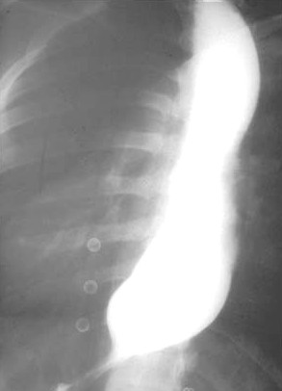
Barium Swallow, Single Contrast
Esophagus
Proximal
Dilatations
Narrowing (Stricture)
Bird Peak Sign
DDx: Achalasia

Slide 7
Lower Esophagus
Barium Swallow, Single Contrast
Benign Stricture:
The transitional Zone looks smooth and free of filling defects
Proximal
Dilatations
Distal Narrowing

Slide 8
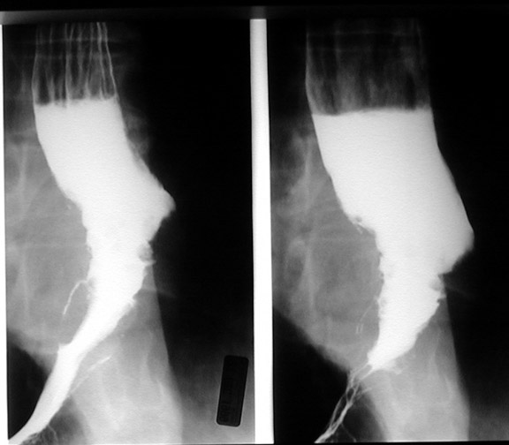
Barium Swallow, Single Contrast
Malignant Stricture:
The transitional Zone looks Irregular & ill defined
Presence of many filling defects
DDx:
Adeno CA
Sq. Cell CA
Filling Defect
It shows an irregularity that almost looks like an apple core lesion in the esophagus. This is typical in carcinoma of the esophagus

Slide 9
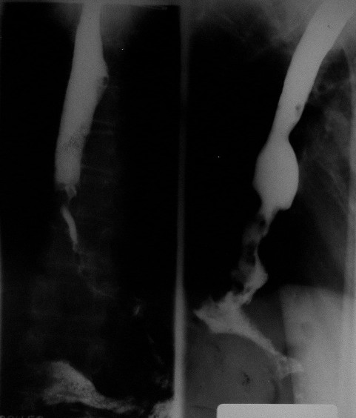
Barium Swallow, Single Contrast
(Oblique)
Filling Defect
Malignant Stricture
Long Irregular Narrowing
It shows an irregularity that almost looks like an apple core lesion in the esophagus. This is typical in carcinoma of the esophagus
Notes:
It shows an irregularity that almost looks like an apple core lesion in the esophagus. This is typical in carcinoma of the esophagus

Slide 10
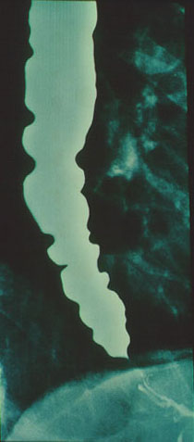
Barium Swallow, Single Contrast
(Oblique)
Irregular Wall & Dilatation:
Tertiary Contraction (Pathological non-propulsive Contraction)
Funnel Shape
(Achalasia)
Barium swallow in this patient with achalasia reveals a smooth distal tapering caused by the hypertensive lower esophageal sphincter that straddles the diaphragm, and multiple non-Peristaltic contractions throughout the body of the esophagus. This radiographic appearance sometimes has been called "vigorous achalasia". This term has little value, however, because recent studies suggest that patients with so-called vigorous achalasia cannot be distinguished clinically from non-vigorous achalasia.
Notes:
Barium swallow in this patient with achalasia reveals a smooth distal tapering caused by the hypertensive lower esophageal sphincter that straddles the diaphragm, and multiple non-Peristaltic contractions throughout the body of the esophagus. This radiographic appearance sometimes has been called "vigorous achalasia". This term has little value, however, because recent studies suggest that patients with so-called vigorous achalasia cannot be distinguished clinically from non-vigorous achalasia.

Slide 11
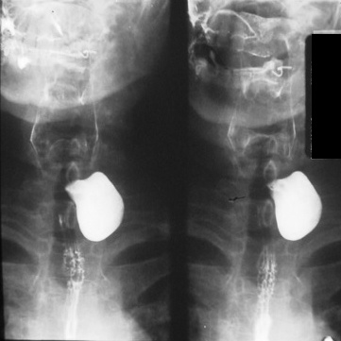
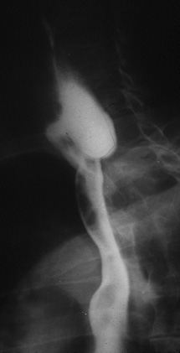
Barium Swallow, Single Contrast
(Oblique)
Well Defined Contrast Filled left cervical level sac
Pharyngeal Pouch
(Zenker's Diverticulum):
occurs in an area of anatomic weakness known as Killian's dehiscence

Slide 12
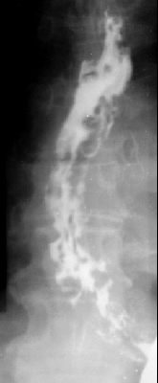
Barium Swallow, Single Contrast
Irregular Multiple Filling Defects
Differential Diagnosis Multiple Esophageal Filling Defects:
Fungal Infx
Polyps
Esophageal Varices (irregular)
Food Particles
Varices Barium swallow examination: AP view: Numerous rounded and elongated smooth-contoured filling defects are present in the inferior two thirds of the esophagus. The contour of the esophagus is irregular and spiculated.
Notes:
Varices Barium swallow examination: AP view: Numerous rounded and elongated smooth-contoured filling defects are present in the inferior two thirds of the esophagus. The contour of the esophagus is irregular and spiculated.

Slide 13
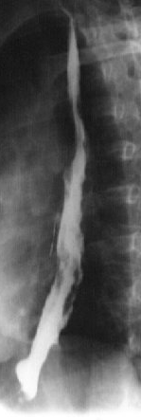
Barium Swallow, Single Contrast
Irregular Multiple Filling Defects
(Esophageal Varices)

Slide 14
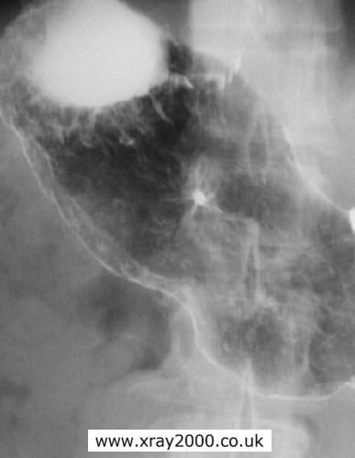
Barium Meal, Double Contrast
Contrast Filled Speculated Lesion
(Gastric Ulcer)

Slide 15
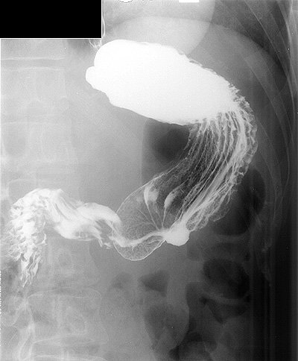
Barium Meal, Double Contrast
Rugae
Contrast Filled Outpouching at the Greater Curviture
(Malignant Gastric Ulcer)

Slide 16
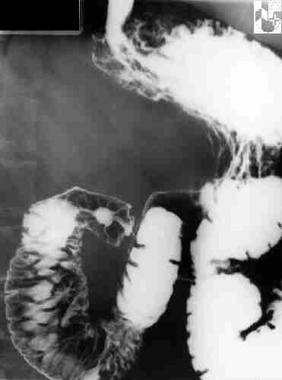
Barium Meal + Follow-Through
Contrast Filled Speculated Lesion
(Duodenal Ulcer)
1st Part of duodenum
2nd Part of duodenum
4th Part of duodenum
3rd Part of duodenum

Slide 17
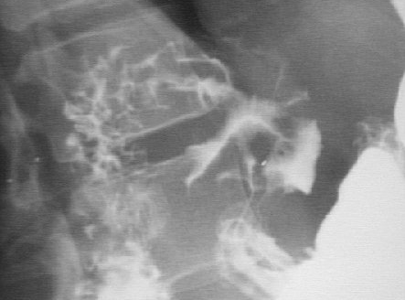
Barium Meal, Double Contrast
Speculated Mass
Ulcer
Pylorus
Stomach

Slide 18
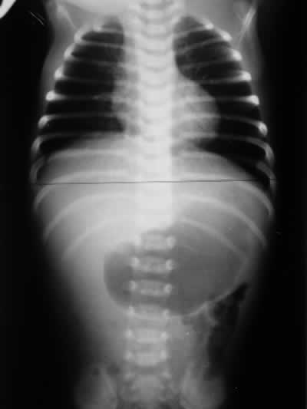
Barium Meal, Double Contrast
Distended Stomach
Single Bubble Sign
DDx: Gastric Output Obstruction (GOO)
(Pyloric Stenosis)
Gas in Descending Colon
(partial obstruction)

Slide 19
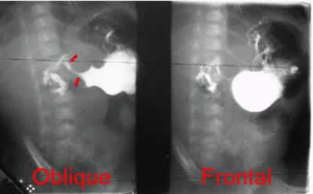
Barium Meal, Double Contrast
(Erect Position)
DDx:
Pyloric Stenosis
Mushroom’s Sign
(or apple core Sign)
String’s Sign
Shoulder’s Sign
For further information refer to “Pediatric Abdomen Radiology” Slides (37-46)

Slide 21
PYLORIC STENOSIS

Slide 22
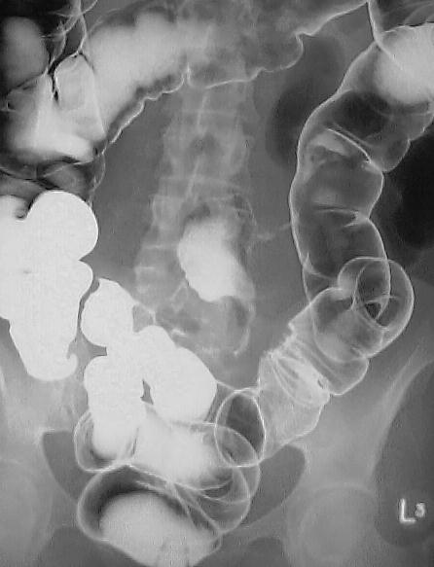
Barium Enema, Double Contrast
(Prone Position)
Normal Segments
Skip Lesions & lesions in Small intestines
DDx: Crohns’ Disease
Strictures in Small intestines
There is a short segment of abnormal descending colon with asymmetrical puckering of the mucosal surface, without stricturing.
Note also however that contrast has refluxed into the terminal ileum and small bowel, and there are several strictures present within it. One of these lies adjacent to the large bowel abnormality.
Notes:
There is a short segment of abnormal descending colon with asymmetrical puckering of the mucosal surface, without stricturing.
Note also however that contrast has refluxed into the terminal ileum and small bowel, and there are several strictures present within it. One of these lies adjacent to the large bowel abnormality.

Slide 23
Differential Diagnosis of Terminal Ileum Narrowing:
Tumor → Lymphoma
Iatrogenic → Adhesion
Inflammatory (IBD)
Cecum
There is smooth narrowing of the terminal ileum and an adjacent loop of more proximal ileum as it crosses to the right side of the pelvis. There is no visible mucosal fold thickening or ulceration.
Notes:
There is smooth narrowing of the terminal ileum and an adjacent loop of more proximal ileum as it crosses to the right side of the pelvis. There is no visible mucosal fold thickening or ulceration.

Slide 24
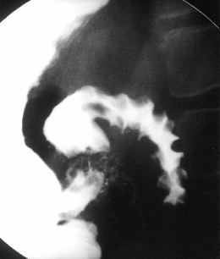
Barium Enema
Multiple Filling Defects
Cobble Stone appearance
DDx: Crohn’s Disease
Cecum
There is abnormal wall thickening, luminal narrowing, and cobblestoning involving a long segment of the distal ileum including the terminal ileum.
Notes:
There is abnormal wall thickening, luminal narrowing, and cobblestoning involving a long segment of the distal ileum including the terminal ileum.

Slide 25
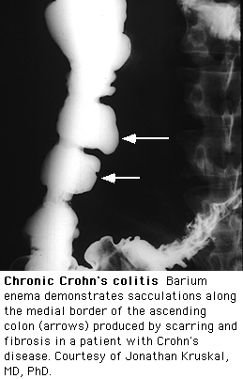
Barium Enema
Ascending colon
DDx: IBD
Pseudopolyps
Pseudodiverticulum

Slide 26
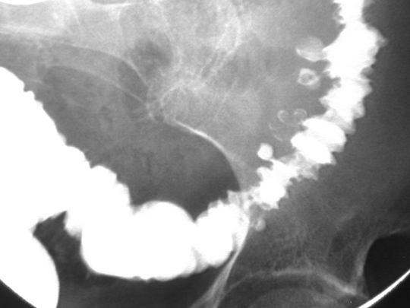
Barium Enema
Contrast Filled Sacs (outside the Lumen)
Diverticulosis in Descending & Sigmoid Colon

Slide 27
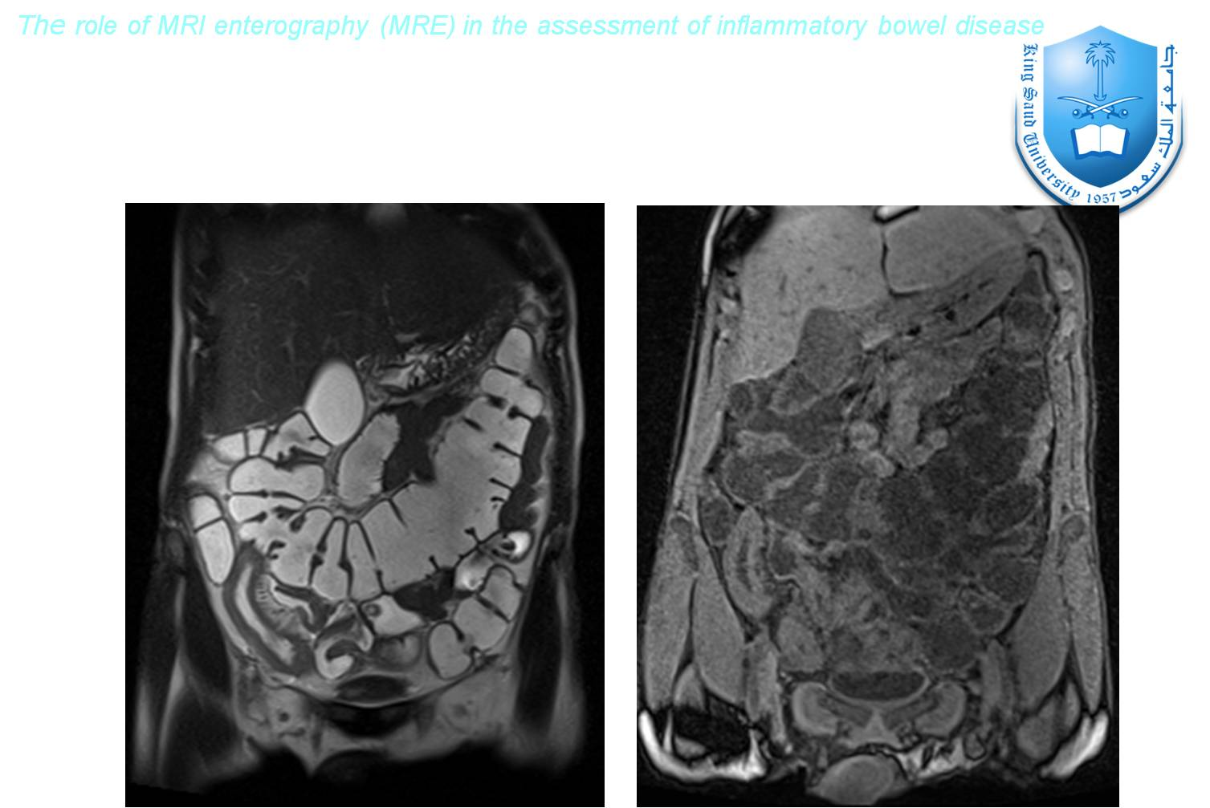

Slide 28
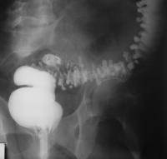
Barium Enema
Diverticulosis

Slide 29
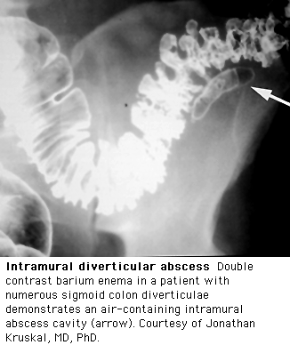
Barium Enema, Double Contrast

Slide 30
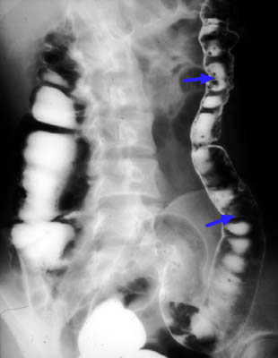
Barium Enema, Double Contrast
Multiple Small & Round Filling Defects
DDx: Multiple Polyps
Notes:
fpc

Slide 31
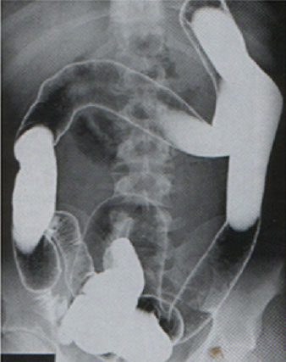
Barium Enema, Double Contrast
Loss of Haustrations
LEAD PIPE SIGN
DDx:
Ulcerative Colitis (Pancolitis)
Cecum
Terminal Ilium

Slide 32
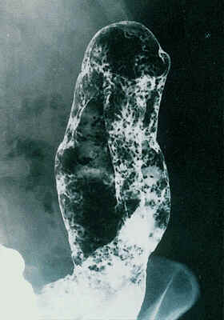
Barium Enema, Double Contrast
Loss of Haustrations
Splenic Flexure
Granular Mucosa
Multiple Filling Defects
DDx:
Ulcerative Colitis
Granular mucosa and complete absence of haustra which confirm total colitis. 2 short strictures are present in the descending colon, but there were no malignant features radiologically
Notes:
Granular mucosa and complete absence of haustra which confirm total colitis. 2 short strictures are present in the descending colon, but there were no malignant features radiologically

Slide 33
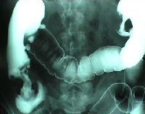
Barium Enema, Double Contrast
Ask the Doctor About these
Multiple Apple Core Sign
DDx:
Colon CA

Slide 34
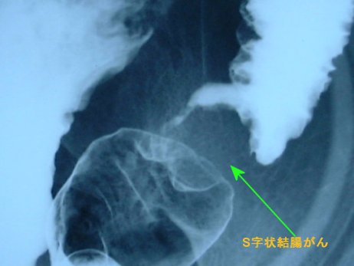
Barium Enema
Stricture
Apple Core Sign
DDx:
Sigmoid Colon CA

Slide 35
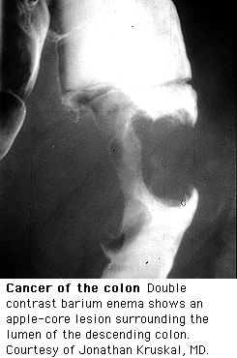
Barium Enema
Apple Core Sign
DDx:
Colon CA

Slide 36
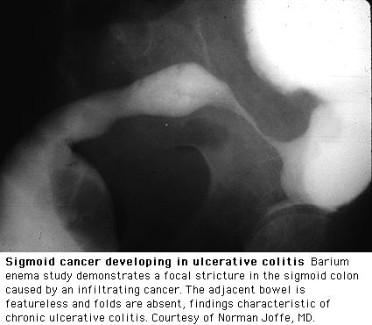
Barium Enema
A Sigmoid Stricture is always considered malignant until proven otherwise

Slide 37
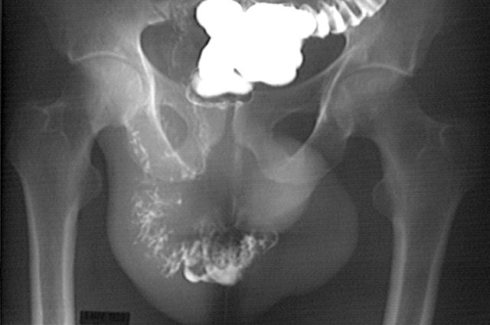
Barium Enema, Double Contrast
A huge right indirect hernia in the scrotum

Slide 38
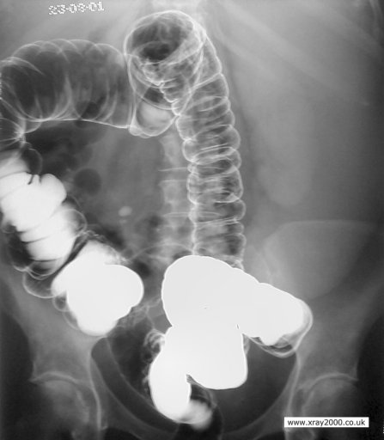
Barium Enema, Double Contrast
A huge mass that has displaced the intestines
(Spleen)
Notes:
splenomegaly

Slide 39
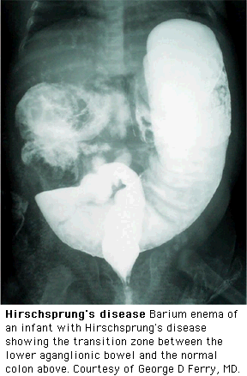
Barium Enema
Meconium
Filling defects & dilated Descending & Sigmoid Colon
Transition Zone
is the term applied to the region in which a marked change in caliber occurs, with the dilated, normal colon above and the narrowed, aganglionic colon below
According to the Transition Zone:
Rectum → Ultra Short
Rectosigmoid → Short
Transverse Colon → Long
Beginning of the Colon→ Total (microcolon)
DDx:
Hirschsprung disease (HD) which is more definitively diagnosed by means of contrast enema examination, which can show the presence of a transition zone, irregular contractions, mucosal irregularity, and delayed evacuation of contrast material, among other findings
Although the hallmark of the diagnosis is the presence of transition zone but it’s absence exclude the disease
For more info visit:
http://emedicine.medscape.com/article/409150-imaging

Slide 71
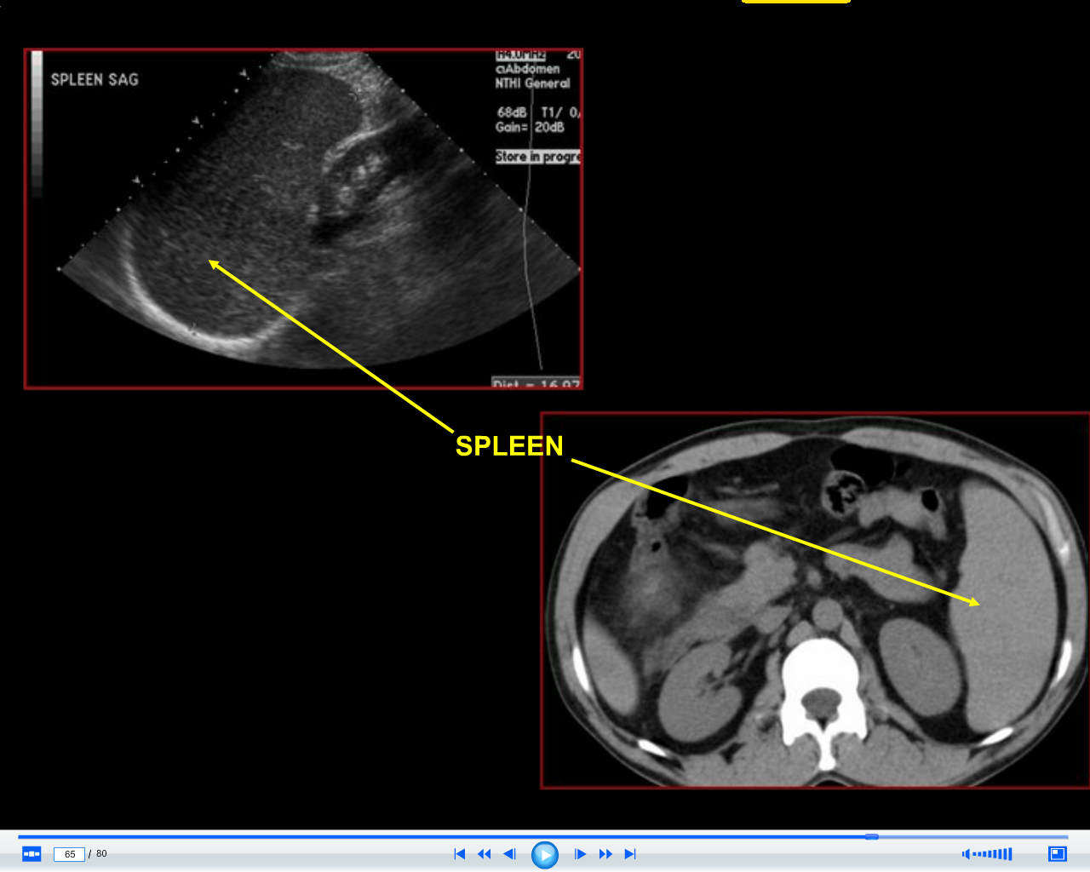

Slide 81
Thank You

