Slide 1
RADIOLOGY OF URINARY SYSTEM DISEASES
DR SADEQ ALSHAMI
ASS.PROF & CONSULTANT IN
DIAGNOSTIC & INTERVENTIONAL
RADIOLOGY

Slide 12
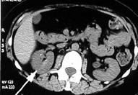
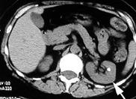
Renal calculus – CT-Scan

Slide 42
Thank You

