Slide 1
Gastrointestinal Tract Radiological Anatomy
&
Investigation
Dr Sadeq Y. Alshami
Assistant Prof. & Interventionist Consultant
KSU & KKUH

Slide 2
OBJECTIVES
To know radiology modalities used in GI tract imaging.
To know advantages and disadvantages of each modality.
To know indications and contraindications of each modality.
To know the radiological anatomy of the GI tract.

Slide 6
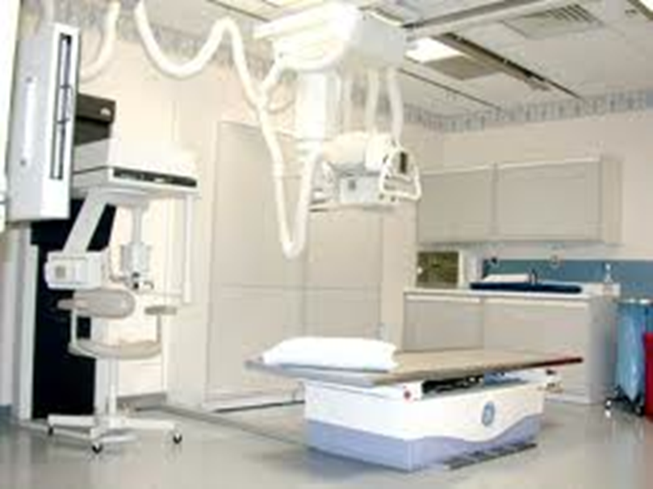
X-Ray

Slide 7
How To Assess The Film
Basic Details [name], [age] [sex]. [date] and appears well/poorly penetrated”
Establish the projection of the film (AP) and whether it is supine or erect.
check left and right
Check Bone, Soft tissue/Solid Organs, Calcification, Gas pattern & Artefacts

Slide 8
Abdominal x-ray
X-ray is a form of radiation, that are focused into a beam
X-ray can pass through most objects including the human body.
When X-rays strike a piece of photographic film, they make a picture.

Slide 9
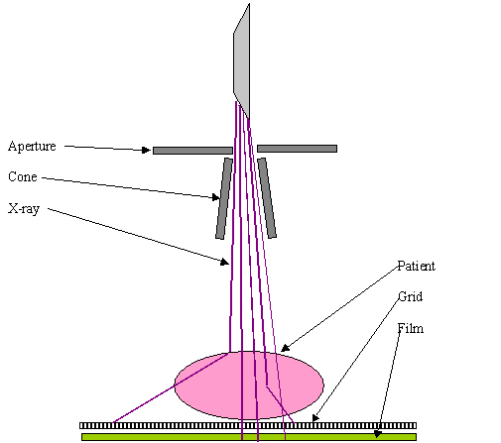

Slide 10
ABDOMINAL X-RAY
White ----- bone and calcification
Grey ------ soft tissue
Black ----- air

Slide 11
ADVANTAGES:
Widely available
Cheap
Excellent in diagnosing free air in the abdomen
Good in diagnosing bowel obstruction & stones/calcifications
DISADVANTAGES:
Radiation
Poor soft tissue details

Slide 12
INDICATIONS
Abdominal pain
Bowel obstruction
Stones
Masses
Trauma
Others, foreign body, supportive lines.. Etc
CONTRAINDICATIONS:
pregnancy

Slide 13
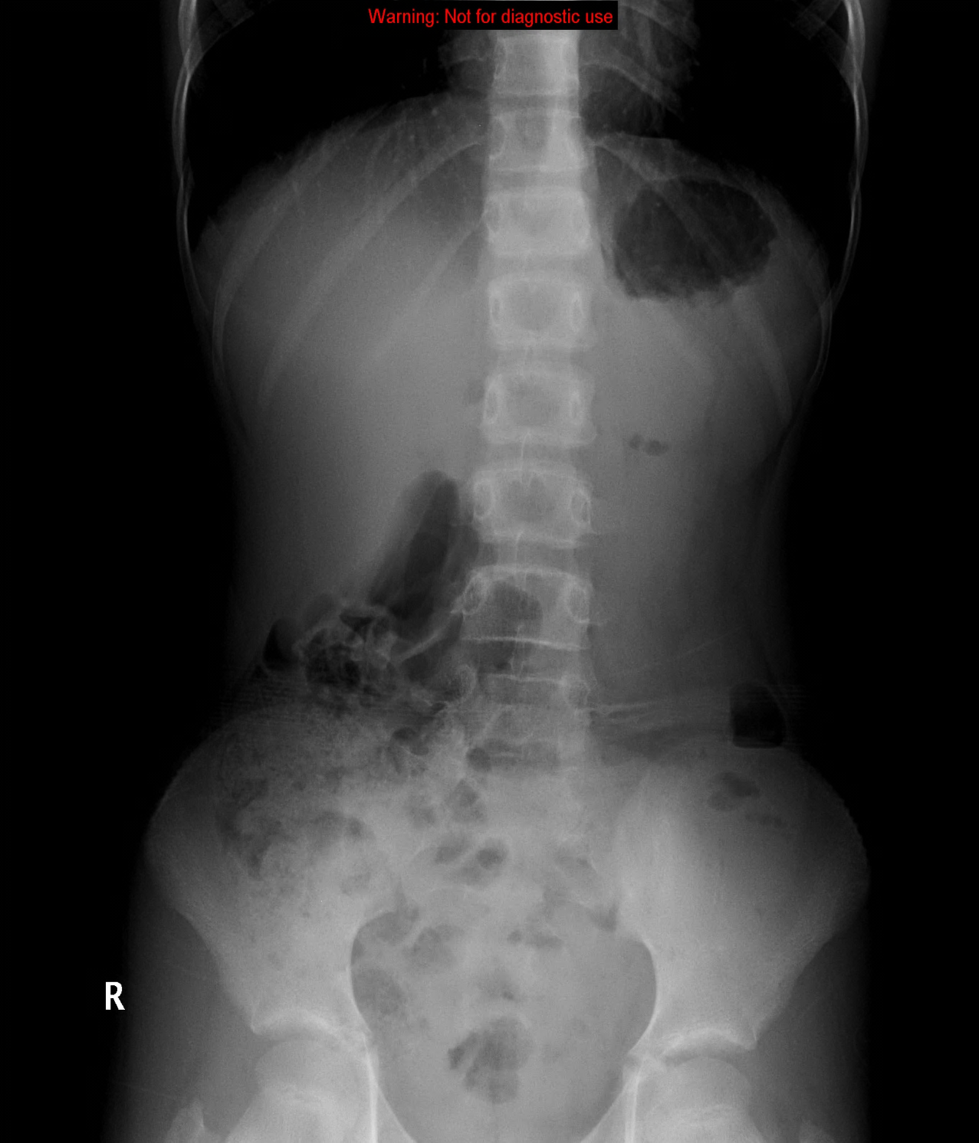
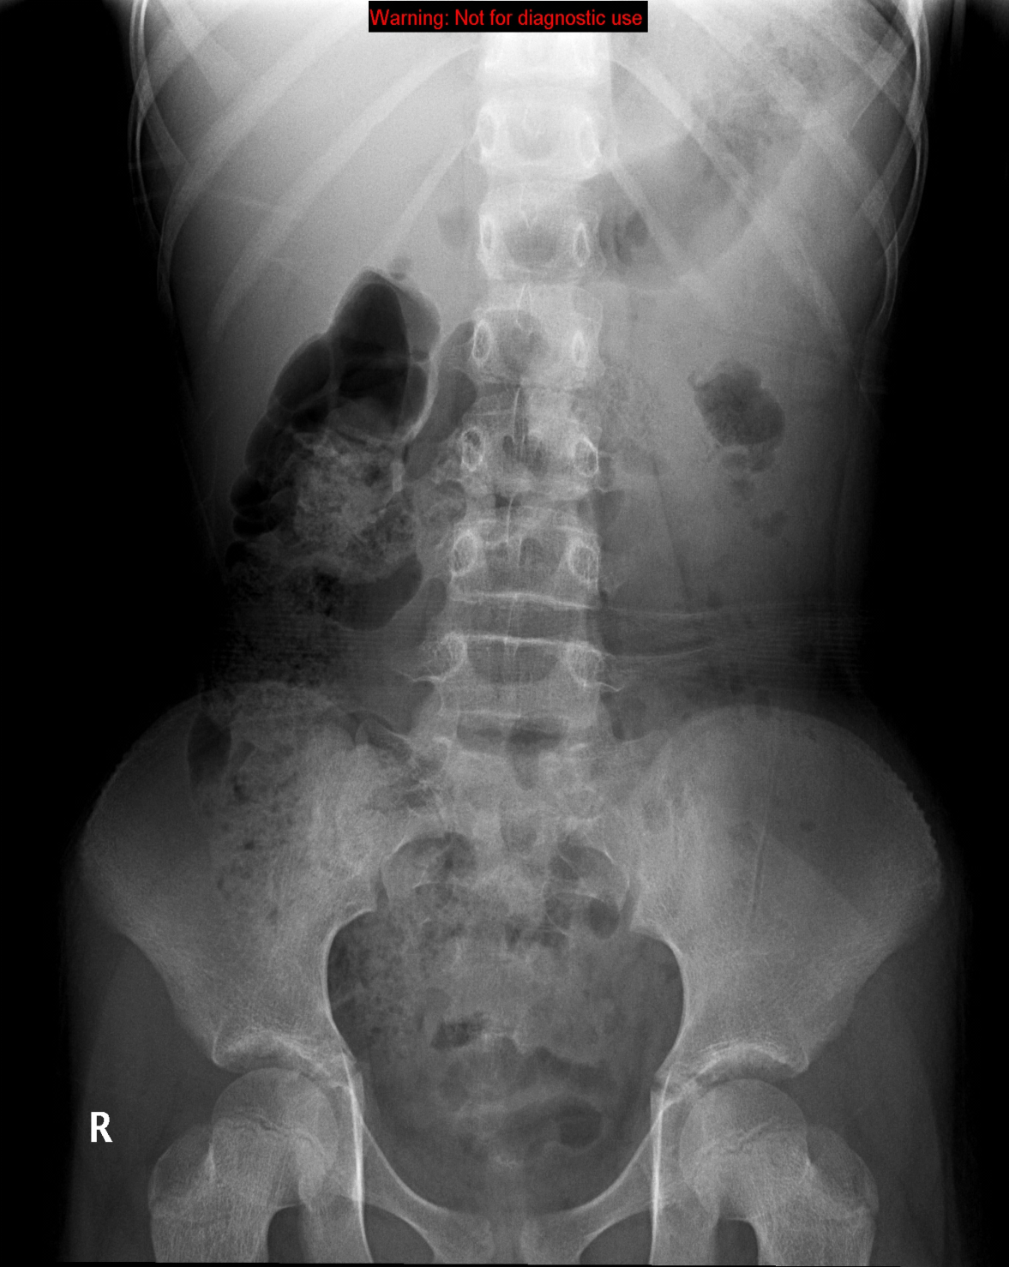
NORMAL ABDOMEN X-RAY
Standing
Supine

Slide 14
How To Assess The Film: Gas
Essentially you’re looking at the bowel here.
Before you start, check that there is gas under the diaphragm (if it is visible)
Look at small bowel and large bowel
SMALL BOWEL:
Because of peristalsis the outline of the gas in the normal small bowel is often broken up into many small pockets
It is generally central in the abdomen
Jejunum has ‘valvulae conniventes’, ileum is characteristically featureless
The calibre of the normal small bowel should not exceed 2.5–3 cm
If small bowel is visible at all, it suggests that it is abnormal

Slide 15
How To Assess The Film: Gas
LARGE BOWEL:
The caecum therefore normally contains semifluid material containing multiple pockets of gas and, like much of the right side of the bowel, assumes a granular appearance on X-rays, creating mottled areas of gas seen best against the background of the iliac bone.
When visible the haustral folds of the colon may be seen, only partially visualised across part of the large bowel lumen.

Slide 16
STOMACH
SMALL BOWEL
LARGE BOWEL
RECTUM

Slide 17
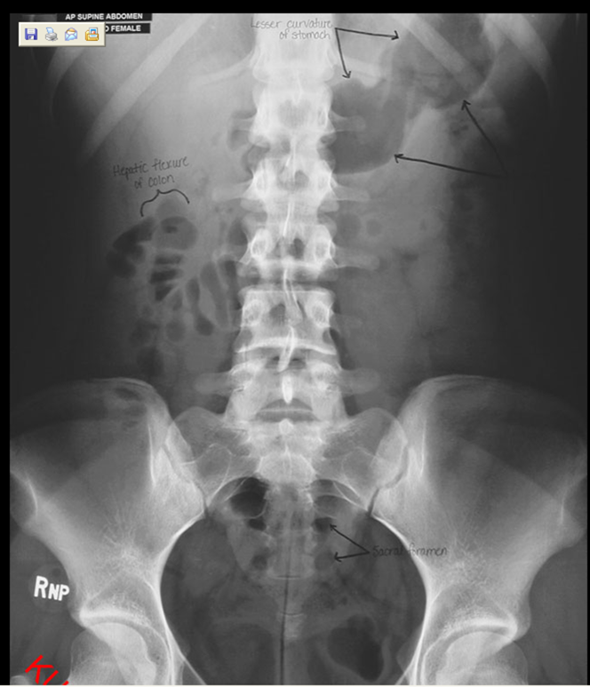
Abdomen X-ray

Slide 19
Abdomen X-ray

Slide 20
Abdomen X-ray

Slide 23
Abdomen X-ray

Slide 24
How To Assess The Film: Bone
Ribs, spine, sacrum, pelvis & hips
Bones may show evidence of malignant disease
Sacro-iliitis may be associated with intestinal problems such as Crohn’s disease
Excessively sclerotic bones may hint at other diseases e.g. Paget’s (which can present as abdominal pain) or GI ulcers (which are associated with sclerotic bone lesions)
Don’t forget to check the spine for conditions such as ank spondy

Slide 25
Abdomen X-ray

Slide 26
How To Assess The Film: Calcification
Calcification occurs in:
Calculi (look in kidney, ureters & bladder)
Phleboliths (usually within pelvis, look like silt)
Appendicoliths (caused by faeces in appendix, may suggest appendicitis)
Lymph nodes
Aortic calcification (aortic calcification is normal as age increases but you must check the aorta as asymmetry of the walls suggests aortic aneurysm)

Slide 27
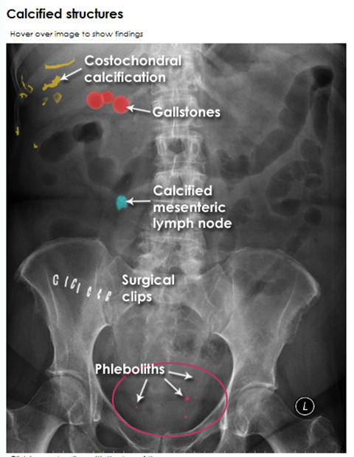
Abdomen X-ray

Slide 28
How To Assess The Film: Calcification

Slide 29
How To Assess The Film: Calcification
Calcified lymph nodes

Slide 30
How To Assess The Film: Calcification
Calcification of a normal aorta

Slide 31
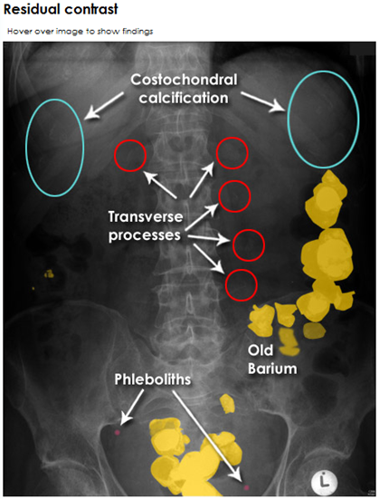
Abdomen X-ray

Slide 32
Abdomen X-ray

Slide 33
How To Assess The Film: Soft Tissue
Trace soft tissue outline for any clues as to pathology (e.g. obesity, trauma sites, abdo drains etc)
Also look for:
Psoas muscles
Kidneys (left is higher and slightly bigger than the right)
Liver (difficult to see but may be identifiable by lack of bowel in RUQ)
Spleen (difficult to see)
Bladder (visible if full, not always visible if empty) – a full bladder may hint that you are looking for an acute problem, rather than a chronic one
Uterus (causes a dent in the top of the bladder on IVU)

Slide 34
Soft tissues
2
1
3
4

Slide 35
Soft tissues
Liver
Spleen
Kidneys
Psoas muscles

Slide 36
Soft tissues
Liver
Spleen
Kidneys
Psoas muscles

Slide 37
Abdomen X-ray

Slide 38
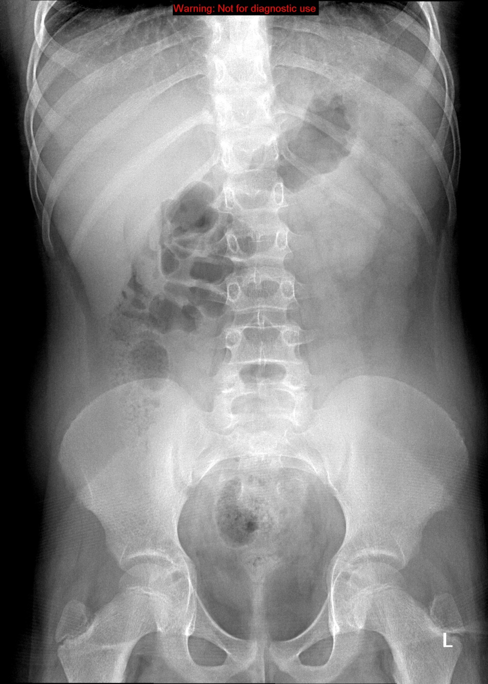
Liver
Spleen
Kidneys
Psoas muscles

Slide 39
Liver
Spleen
Kidney
Psoas muscles

Slide 40
Abdomen X-ray

Slide 41
Liver
Spleen
Kidneys
Psoas muscles

Slide 42
Abdomen X-ray

Slide 43
Abdomen X-ray

Slide 44
Abdominal X-Rays

Slide 45
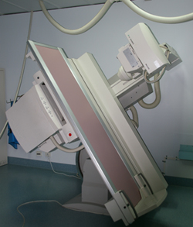
FLUOROSCOPY

Slide 46
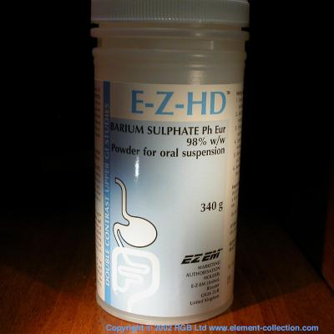
Fluoroscopy
+
ORAL
CONTRAST
X-RAY

Slide 47
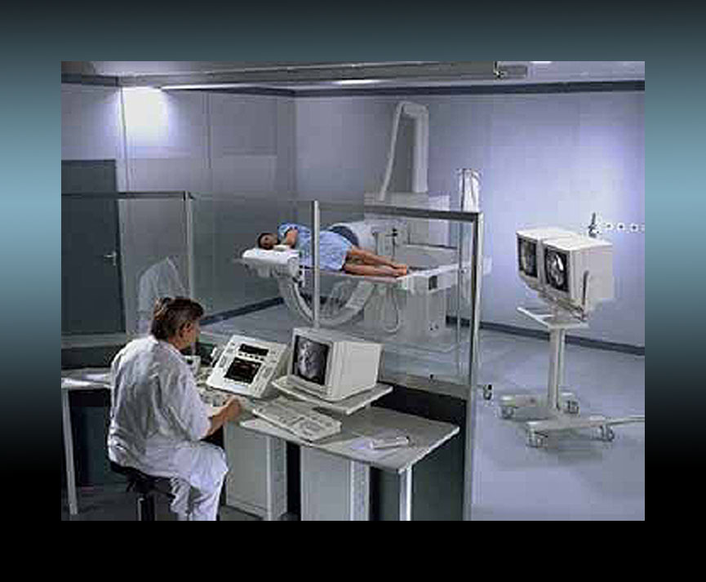
Upper gastrointestinal tract radiography, also called an upper GI, is an x-ray examination of the pharynx, esophagus, stomach and first part of the small intestine (also known as the duodenum) that uses a special form of x-ray called fluoroscopy and a contrast material called barium.

Slide 48
Barium swallow --------------> Esophagus
Barium meal ------------------> Stomach
Barium follow through -----> Small bowel
Barium enema ----------------> Large bowel

Slide 49
ADVANTAGES:
Available
Relatively cheap
Excellent in evaluation the bowel lumen and mucosa
DISADVANTAGES:
Radiation
Poor in evaluating extra luminal pathologies

Slide 50
INDICATIONS
Assessing the mucosal outline
Abdominal pain
Gastro esophageal reflux
Masses
Inflammatory bowel diseases
Post surgical, leak
CONTRAINDICATIONS:
Pregnancy
Bowel obstruction
Bowel perforation (with barium type of contrast)

Slide 51
Barium Swallow
Single contrast study, used manly to look at the oesophagus
Liquid barium is swallowed in an upright and prone position and radiographs are taken during the oesophageal phase of transit

Slide 52
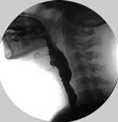
Barium Swallow, Single Contrast
Cricopharyngeus Muscle
At level of C5-C6,
Part of upper esophageal sphincter (UES)
Esophagus

Slide 53
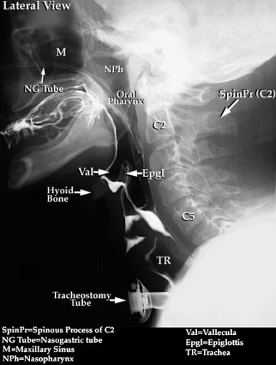
Barium Swallow, Single Contrast
Main Indication:
Dyshagia

Slide 54
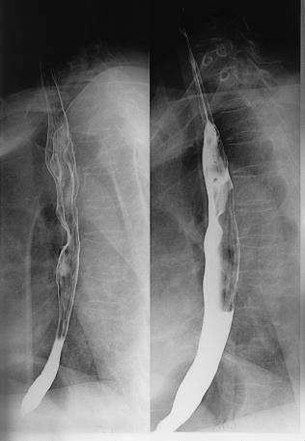
Barium Swallow, Double Contrast
Double Contrast
Identation of A.A
Indentation of L.main bronchus
Single Contrast

Slide 55
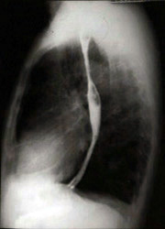
Barium Swallow, Single Contrast
Double Contrast
L.A.
Heart
L.V.

Slide 56
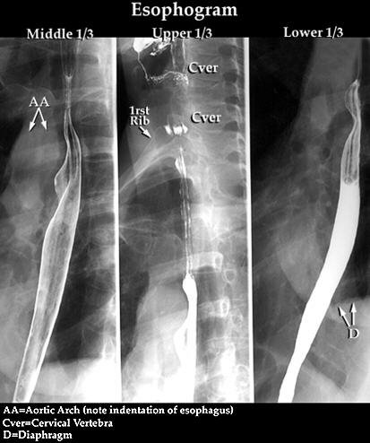
Barium Swallow, Double Contrast
Indentation of L.main bronchus
Double Contrast
Single Contrast

Slide 57
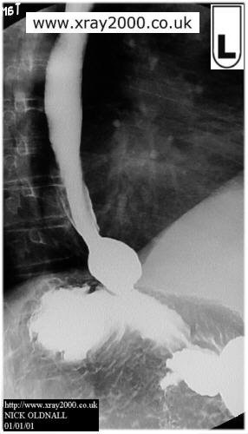
Barium Swallow, Single Contrast
Ampulla
Normal Varient
Fundus
Body

Slide 58
Barium Swallow, Single Contrast
Aortic Arch

Slide 59
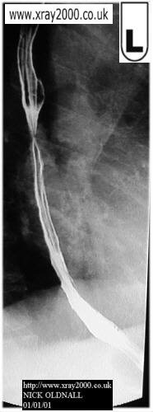
Barium Swallow, Double Contrast
Narrowing:
Could be peristalsis
So other shot is advised

Slide 60
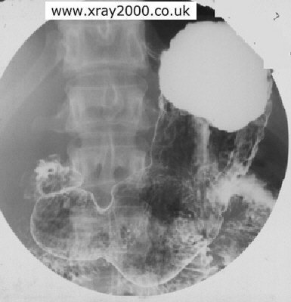
Barium Meal, Double Contrast
(Supine Position)
Supine Position:
Note Barium Distribution in the Fundus due to gravity
Angular Notch
Incisura Angularis
Antrum
Body

Slide 64
Barium Follow-Through
Used to examine duodenum, jejunum and ileum
Like a barium swallow but images taken every 20 minutes or so for 2-3 hours
Small bowel follow-through may reveal evidence of disorders such as Crohn's disease, Coeliac disease or small bowel tumours

Slide 66
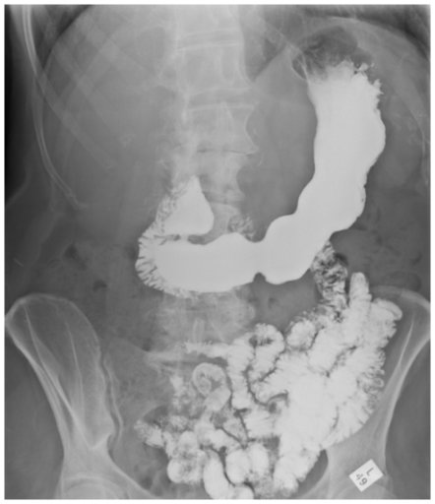
Barium Meal + Follow-Through
(Erect Position)
DJJ:
Normal Position= Left side
Barium Meal
Angular Notch
Incisura Angularis
Duodenal Cap
Pyloric Canal
2nd Part of Duodenum
3rd Part of Duodenum
Jejunum:
Plica Circularis on the outer border
Body
Antrum
Ileum
Barium
Follow-Through

Slide 67
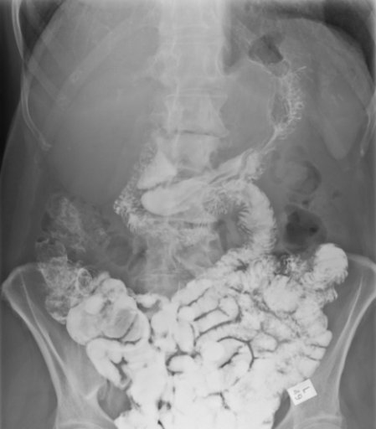
Barium Follow-Through to Cecum
(Erect Position)
DJJ:
Normal Position= Left side
2nd Part of Duodenum
3rd Part of Duodenum

Slide 68
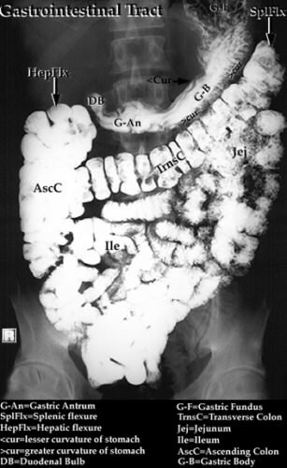
Barium Follow-through

Slide 69
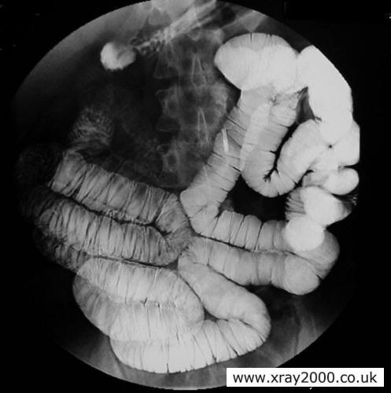
Small Bowel Enema
A Modified Follow-Through which is called Small Bowel Enema note that the bowel is more distended here
This procedure involves inserting a thin tube through the mouth, esophagus and past the stomach to inject barium, methylcellulose and water into the small bowel. This allows for better visualization of the small bowel than can be seen during a small bowel follow-through

Slide 70
Barium Enema
Single or double contrast study.
Double contrast means air fired up after barium – pictures may show coating on the outline of the bowel rather than a white bowel (right)
Patient has to have:
low residue diet for three days before the procedure
laxatives 24 hr before
bowel prep just before
Barium up the bum, patient has to move into different positions to coat to the whole colon. Often the table moves about to help the passage of barium. Serial X-rays are taken
Films can be small and only cover a small area of bowel
This is normal, despite the arrows!

Slide 71
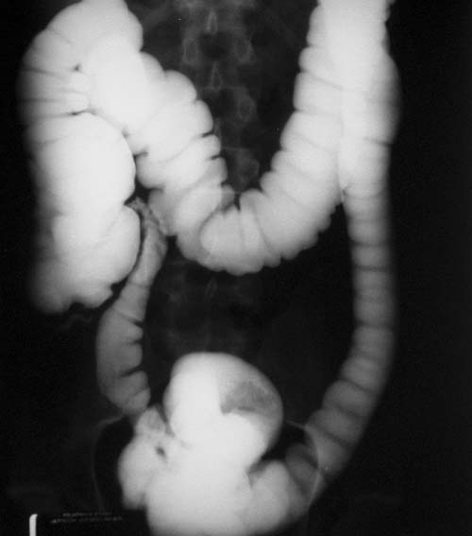
Barium Enema, Single Contrast
Transverse Colon
Ascending Colon
Descending Colon
Cecum
Terminal Ileum
Sigmoid

Slide 72
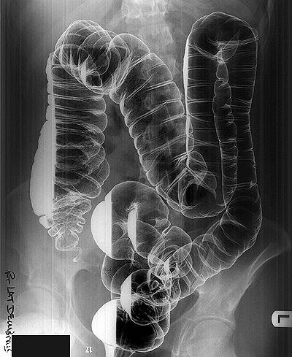
Barium Enema, Double Contrast
(Right Lateral Decubitus)
Hepatic Flexure
Note the effect of gravity

Slide 73
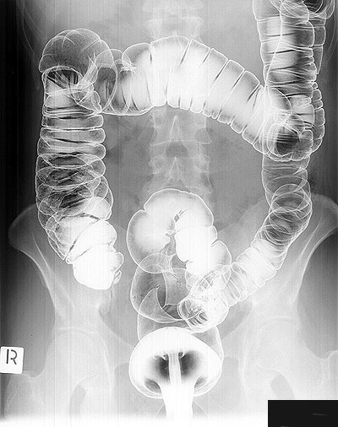
Barium Enema, Double Contrast
(Prone Position)
Note the Haustrations
If lost → UC (IBD)
Cecum

Slide 74
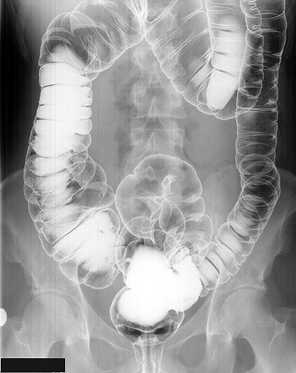
Barium Enema, Double Contrast
(Supine Position)
Rectum

Slide 76
COMPUTED TOMOGRAPHY

Slide 77
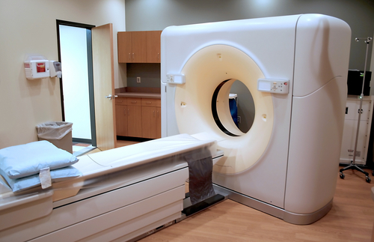
CT scan

Slide 78
ADVANTAGES:
Available
Short scan time
Much more soft tissue and bone details
Excellent in diagnosing extra-luminal lesions
Excellent in diagnosing the cause of bowel obstruction
DISADVANTAGES:
Radiation
Some times need intra venous contrast (renal disease)
Relatively expensive

Slide 79
INDICATIONS
Abdominal pain
To look for bowel obstruction cause
To diagnose intra-abdominal masses
Trauma
CONTRAINDICATIONS:
Pregnancy
No IV contrast in renal failure
Unstable patients (severe trauma/ICU)

Slide 80
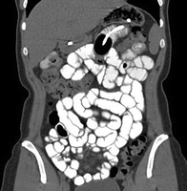

Slide 81
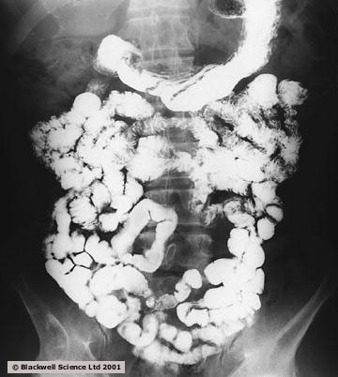

Slide 95
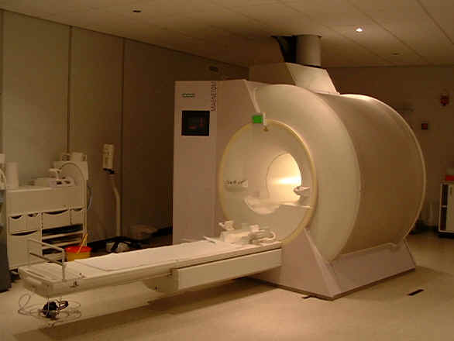
MRI

Slide 96
ADVANTAGES:
Relatively safe in pregnancy (no radiation)
Give much more soft tissue details
Excellent in diagnosing abdominal solid organ lesion: liver, spleen, kidneys
DISADVANTAGES:
Expensive
Long scanning time
Sensitive to motion

Slide 97
INDICATIONS
Abdominal solid organ masses
Inflammatory bowel disease
CONTRAINDICATIONS:
uncooperative patients
Early pregnancy (relative contraindication)
No IV contrast renal failure (relative contraindication)

Slide 99
CT scan
MRI

Slide 109
Angiography

Slide 116
Thank You

