Slide 1
Neuroradiology interactive lecture
366 RAD (Radiology)
Prof. Ibrahim A. Alorainy

Slide 2
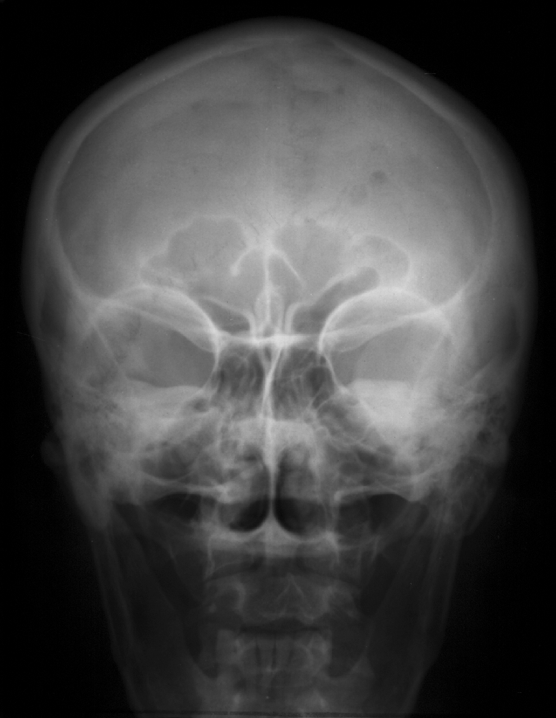
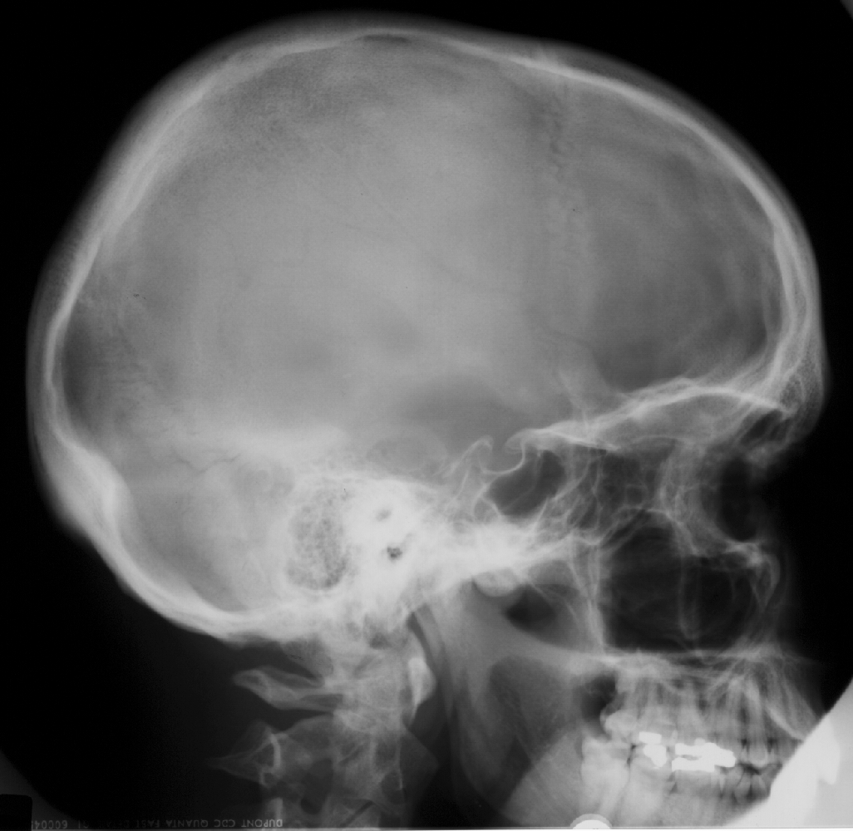
Skull X-RAY LAT. VIEW
Name the structures
L
SKULL PA VIEW

Slide 3
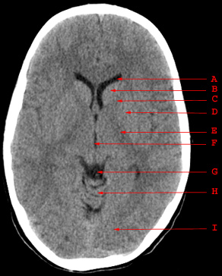
Which is true on this brain CT regarding anatomy:
Internal capsule
Caudate head
Cerebral peduncle
Putamen
Thalamus
4th ventricle

Slide 4
Which is true in CT?
Bone is black
CSF is black
Gray matter is darker than white matter
Gray and white matter can not be differentiated

Slide 5
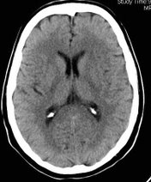
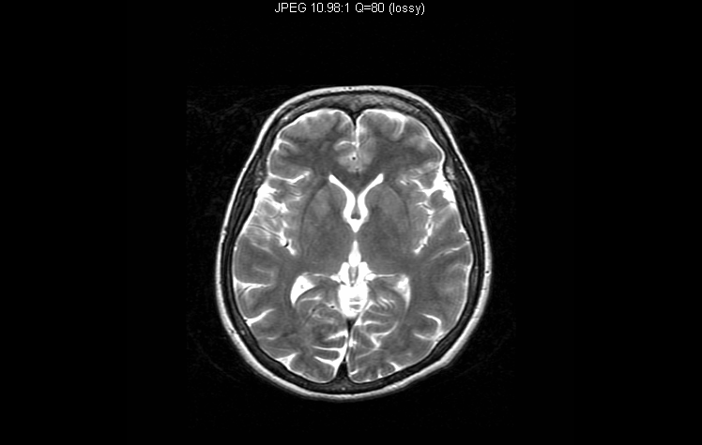

Slide 6
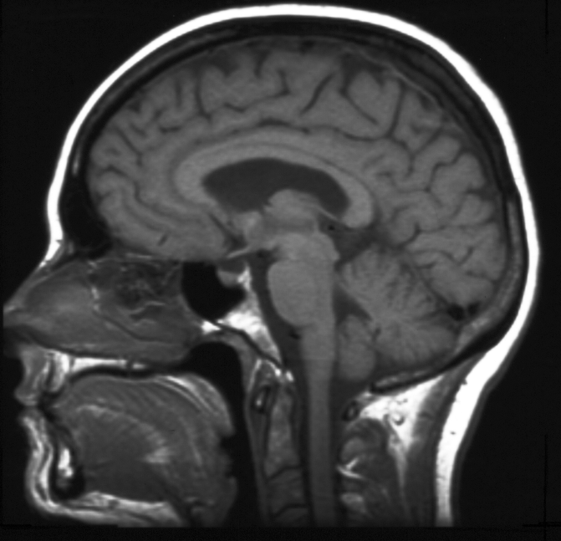
Name the structures

Slide 7
Contraindication of MRI include all the following EXCEPT:
cardiac pacemaker
cochlear implants
metal close to the eye
neurostimulators
pregnancy (3rd trimester)

Slide 8
MRI diffusion (DWI) is particularly helpful in assessment of:
Brain infarction
Brain abscess
Brain tumors
Hydrocephalus

Slide 9
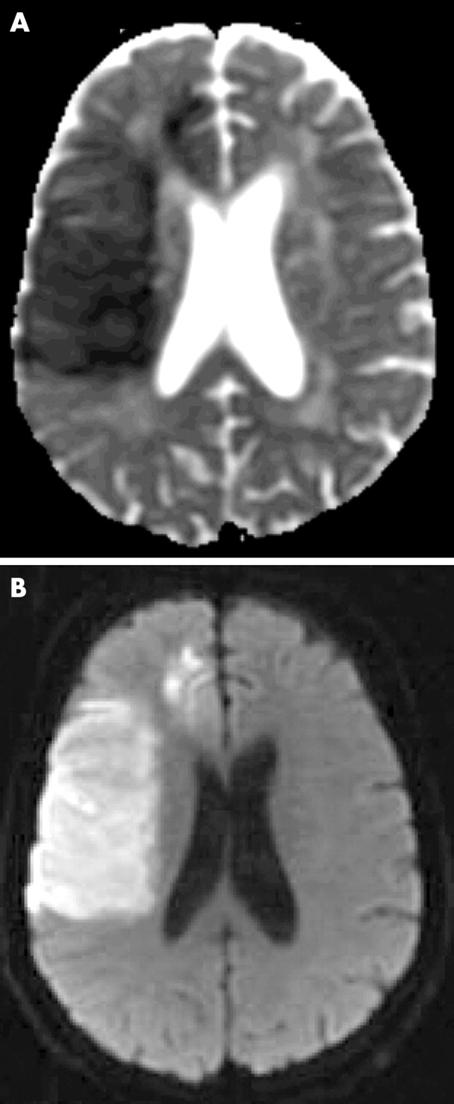
MRI Diffusion..
MR diffusion
Very helpful in assessment of:
Early brain infarction.
Brain abscess.
Certain types of brain tumor.
DWI
ADC map

Slide 10
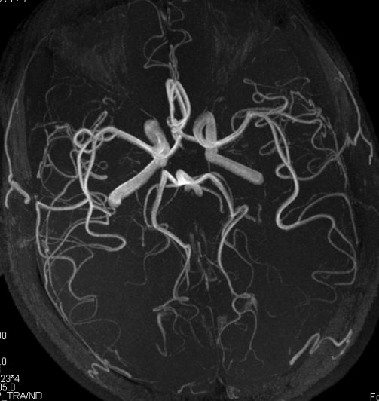
Which of the following is true?
This is CTA study
This is MRA study
This can only be done with contrast
This is good to diagnose cerebral venous thrombosis

Slide 11
An MRI showed intra-axial lesion that is necrotic, irregular, strongly enhancing, and crossing midline.
This lesion is most likely:
Meningioma
Infarction
Multiple sclerosis
Glioblastoma multiforme

Slide 12
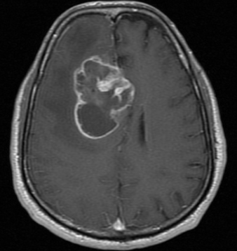
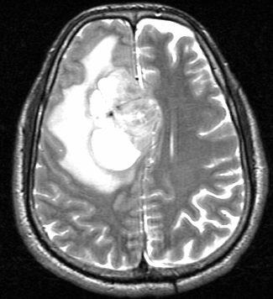

Slide 13
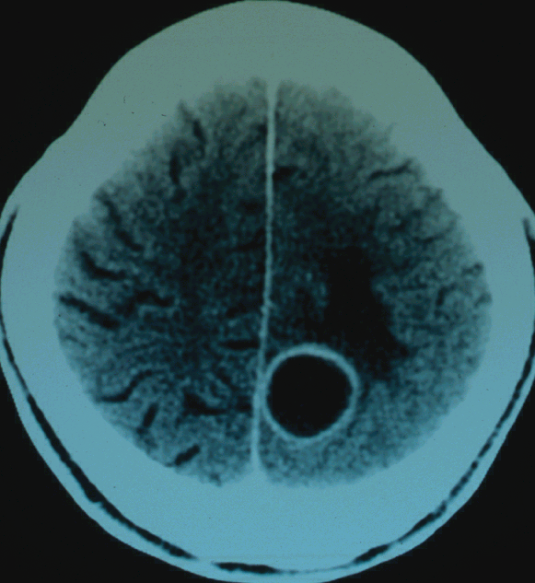
The lesion on this CT is:
Meningioma
Abscess
Multiple sclerosis
Glioblastoma multiforme

Slide 14
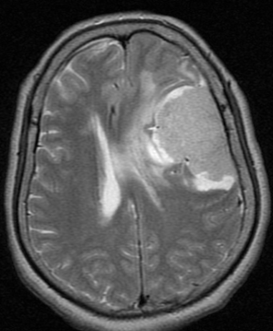
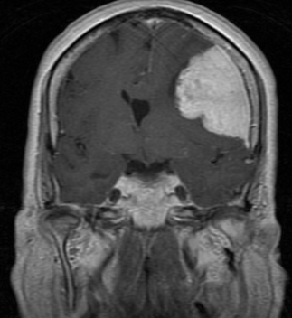
The lesion on this MRI is:
Meningioma
Infarction
Metastasis
Abscess

Slide 15
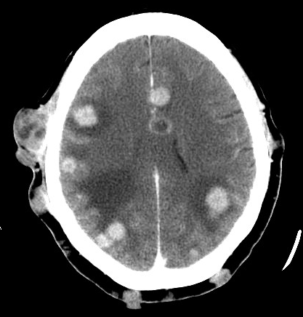
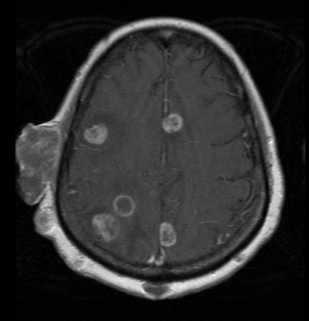
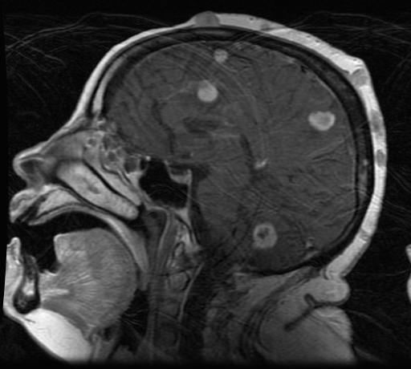
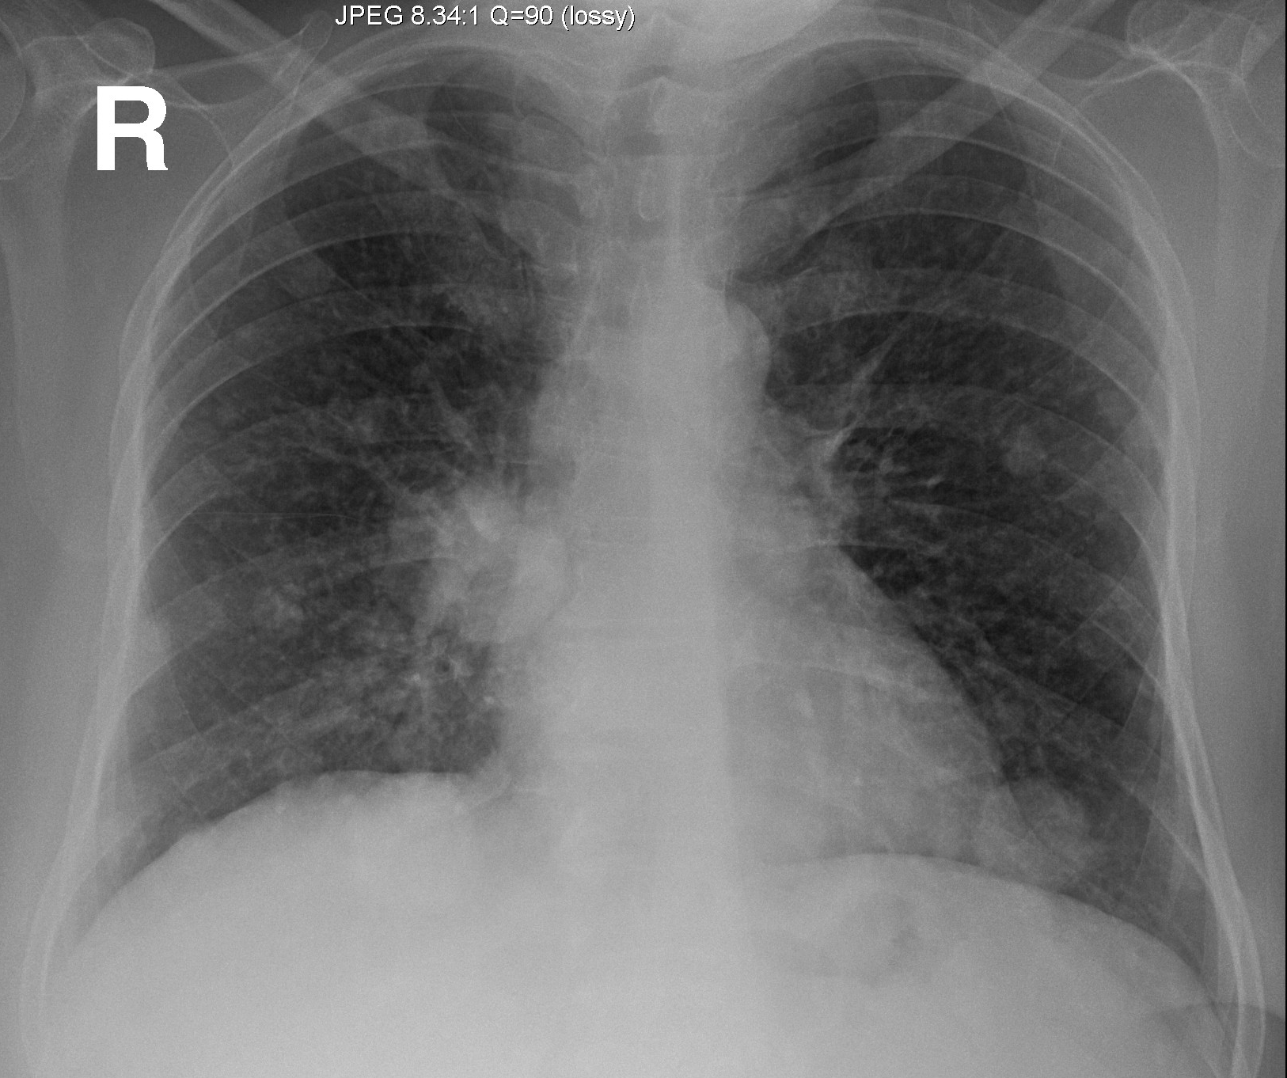
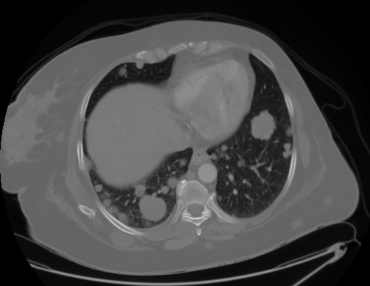

Slide 16
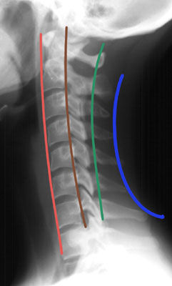
Which of the following is true about the lines of the cervical spine?
Red is intervertebral line
Brown is posterior spinous line
Green is spinolaminar line
Blue is posterior vertebral line

Slide 17
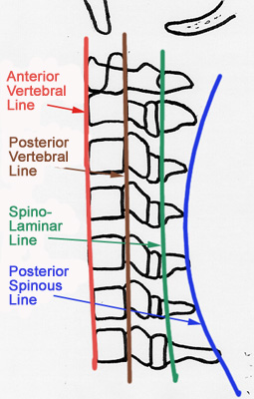

Slide 18
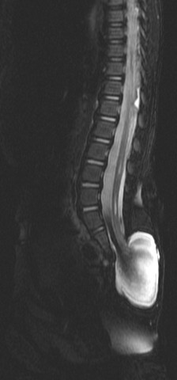
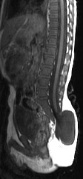
This MRI of the spine shows:
Meningocele
Extradural tumor
Discitis
Vertebral fusion

Slide 19
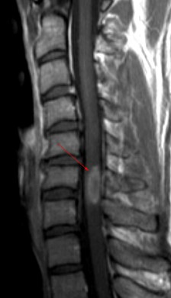
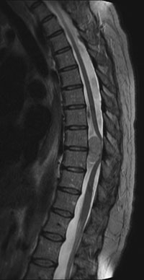
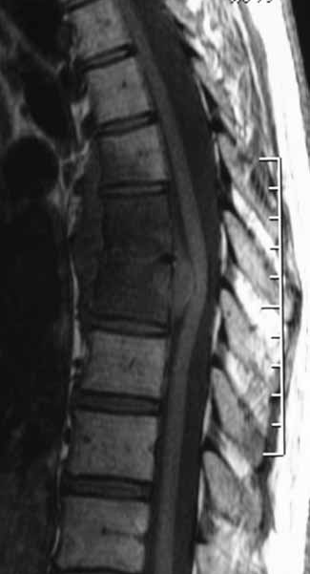
Patient A
Patient B
Patient C

Slide 20
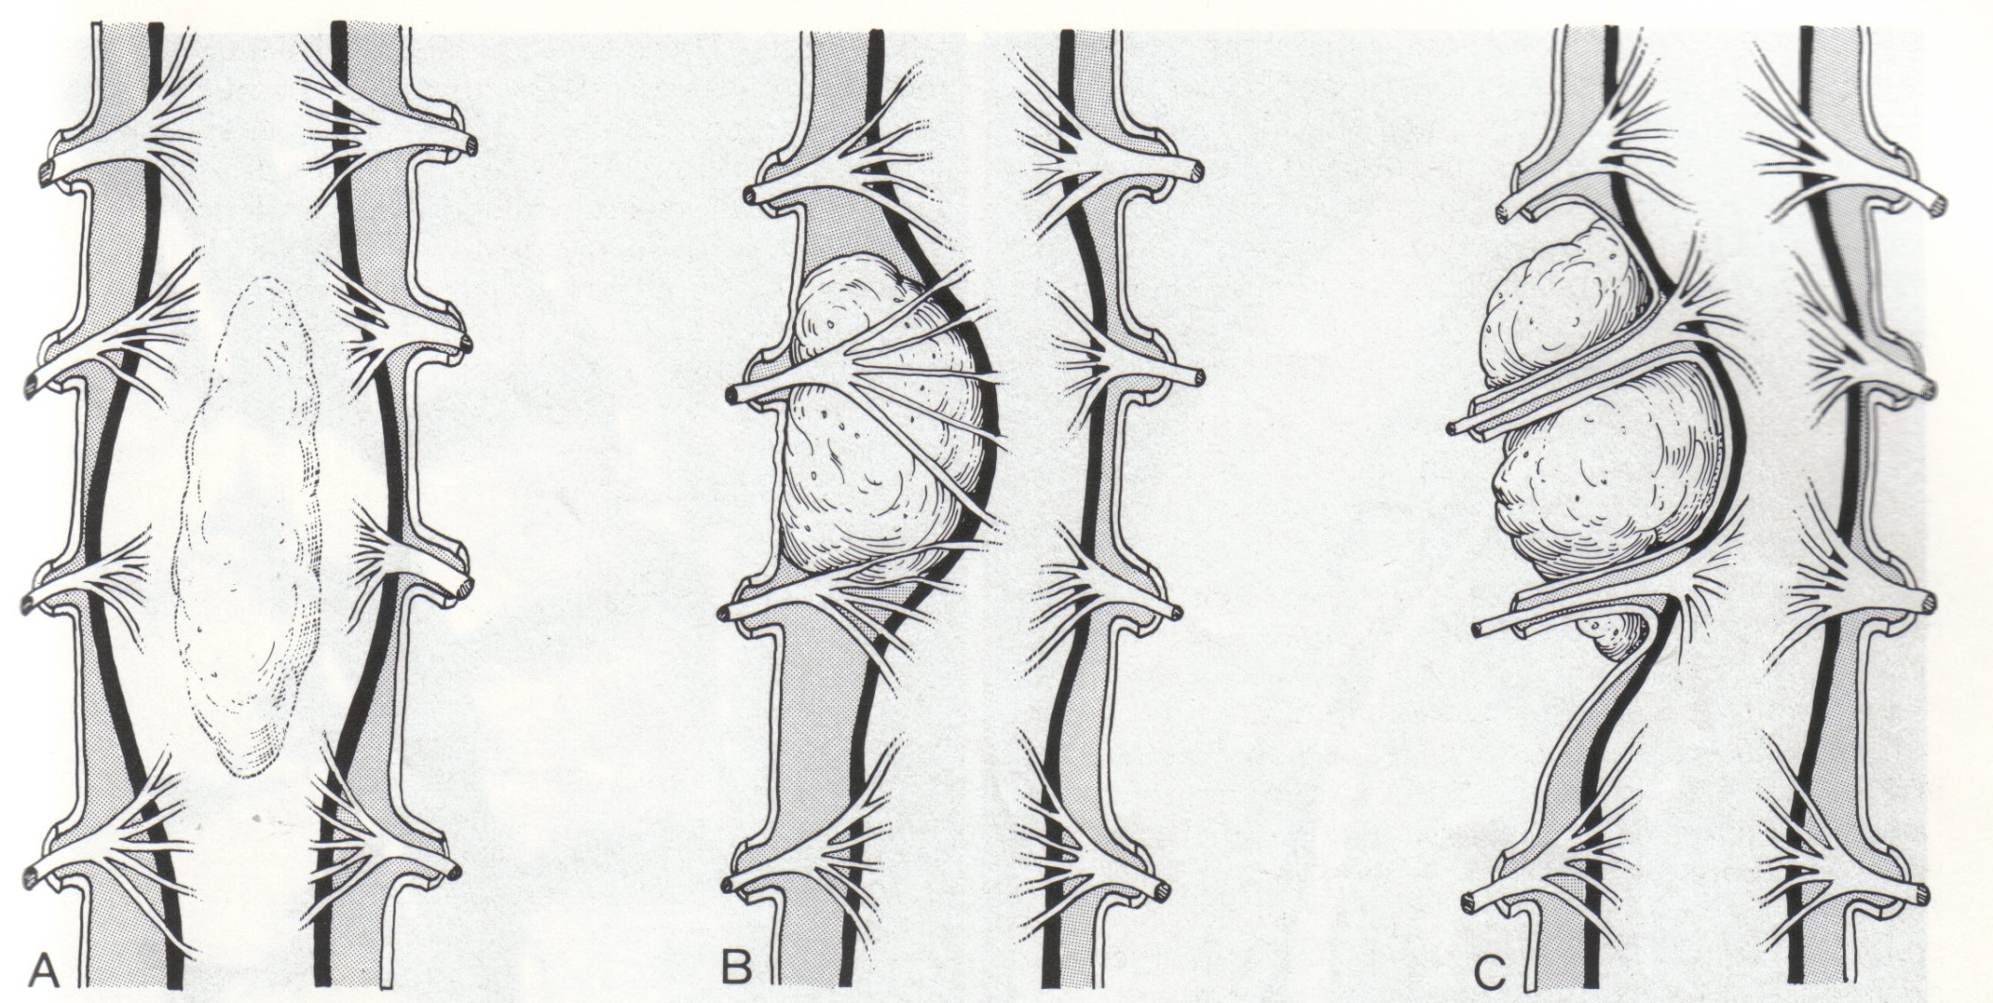

Slide 21
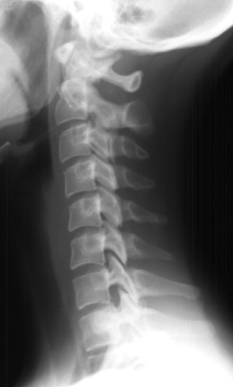
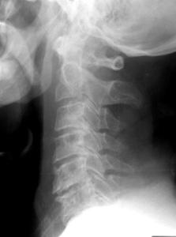
What is the difference?
Normal control
Patient

Slide 22
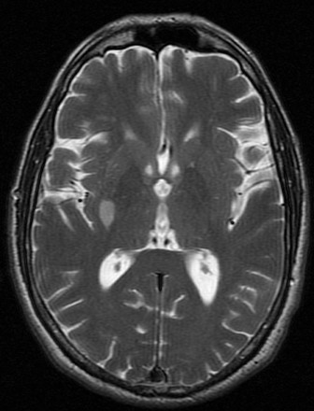
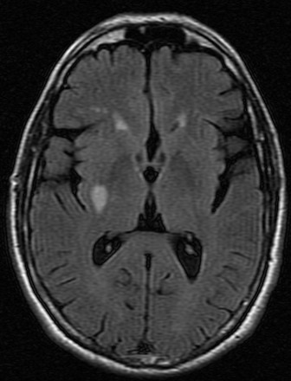
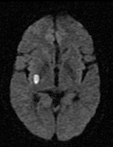
T2WI
FLAIR
DWI
This MRI shows an infarction in the right basal ganglia.
The infarction is:
  Acute (recent)
  Chronic (old)
  Hemorrhagic
  In PCA territory

Slide 23
T2WI
FLAIR
DWI
This patient is most likely to have:
  Left monoplegia
  Left hemiplegia
  Diplegia
  No symptoms

Slide 24
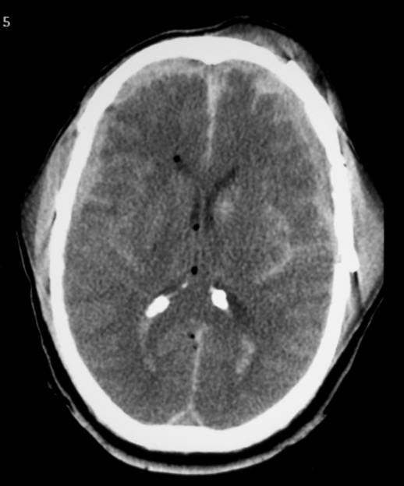
This CT shows:
Subdural hematoma
Subarachnoid hemorrhage
Intraventricular hemorrhage
All of the above

Slide 25
The hematoma pointed by the arrow is:
Acute epidural
Chronic epidural
Acute subdural
Chronic subdural
None of the above

Slide 26
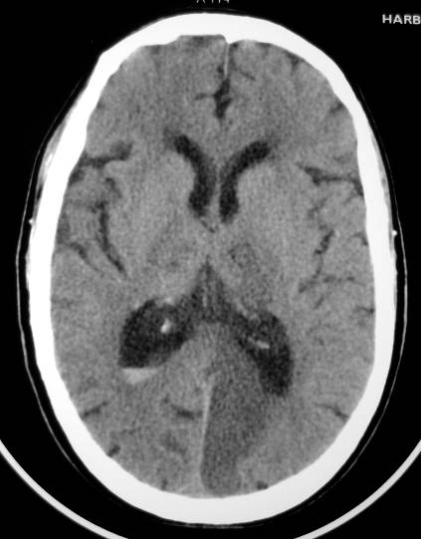
This CT shows:
Acute PCA infarct
Chronic ACA infarct
Subarachnoid bleeding
Meningioma
Abscess

Slide 27
Thank you

