Slide 1

Course CMED 305 Orientation & Introduction to Research methods:
Why do we need research?
Dr Amna Rehana Siddiqui
Associate Professor
Department of Family & Community Medicine
College of Medicine King Saud University
CMED 305 – September 2013

Slide 2
Introduction to Course
Course Objectives
The overall objectives of this course are to enable students understand basic elements of research, design and conduct a study to answer a specific research question.

Slide 3
Learning Methods for the course
  Course Units: ~ 6 academic credits
  Learning methods over the academic year include
  lectures ( ~ 28 contact hours),
  tutorials (~ 30 contact hours), &
  research group works with supervisor ( ~ 38 hours).
    Self initiative and learning is needed from students for a good outcome

Slide 4
Course Concepts taught in lectures & tutorials
How to formulate a research question and development of a study protocol
Designing epidemiological study methods and assessment of risks in comparison to no risk
Ethics in research and avoiding plagiarism
Biostatistics concepts and skills in data management & analysis
Data interpretation, discussion, & presentation of study findings and conclusion

Slide 5
Group Meetings with Research Supervisor
Focus on the entire process of concepts taught in lectures & tutorials to link with a research topic.
The Research Supervisor, who is a faculty or expert in the research & specific topic of interest, will help you to learn subject concepts as well as to formulate the research question, supervising:
-the development of protocol,
-monitor the conduct the study,
-using appropriate scientific & ethical methods

Slide 6
Supervisor Selection
Based on your topic of interest
Initiated during the first week of classes & to complete at the most by the end of first 2 weeks of the first semester.
Important points for selection of supervisor are:
  availability,
  time commitment,
  conforming to schedule, and
  communication methods.
  Change in topic and supervisor is time constrained and usually results in affecting grades, incomplete work, missing deadlines; hence careful selection of topic and supervisor is important.

Slide 7
Supervisor Agreement Form
It is in your manual; Copy, fill it as a group, and explore your interest and supervisor
Copy it and get it signed and submit at the Support Staff at Department of Family & Community Medicine 2nd floor
Ms Jajah for Female groups
Mr. Bader / Mr Ejaz for Male groups

Slide 8
Formation of Research Group
3-6 students per group is fine
Males and females will make separate groups
Consult the list of last years projects too; and avoid “re-inventing the wheel”
The supervisor - supervisee relationship needs to be strengthened with mutually accepted expectations on both sides.
The supervisor provides quality time, while students are expected to observe discipline, give respect and express maximum learning attitude

Slide 9
List of Potential Departments for Selecting Research Supervisors
Anatomy;
Anesthesia;
Cardiac Sciences;
Dermatology;
Emergency Medicine;
ENT;
Family & Community Medicine.
Medical Education;
Medicine;
Obs-Gynecology;
Ophthalmology;
Orthopedics;
Pathology;
Pediatrics;
Pharmacology;
Psychiatry;
Physiology;
Radiology;
Surgery;
Sections & Centers of Research at KSU

Slide 10
Read Your Manual Carefully
All information in details is present in Manual
Responsibilities of supervisors and students
Guidelines to develop protocol and report
Guidelines for collaboration within and outside KSU
Assessment Methods; extempore quizzes will be given during any lecture, or tutorial.
Evaluation forms that will be used by supervisors and Ethical Review Committee

Slide 11
Assessment of Students & Marks Distribution
I. Examinations (40%)
  1. Midterm: 15%
  2. Final exam: 25%
II. Continuous Assessment (60%)
1. Research Project (40%):
    Research protocol by supervisor (10%);
    Ethical Review Committee Clearance (5%);
    Final report by supervisor (20%);
    Presentation by assigned evaluators (5%);
2. Other (20%):
    Assignments (10%); Quizzes (10%)

Slide 12
Introduction to Research methods:
Why do we need research?
Session Objectives
Define Research
Why is medical research important ?
Outline of research protocol
Designing research and drawing conclusions

Slide 13
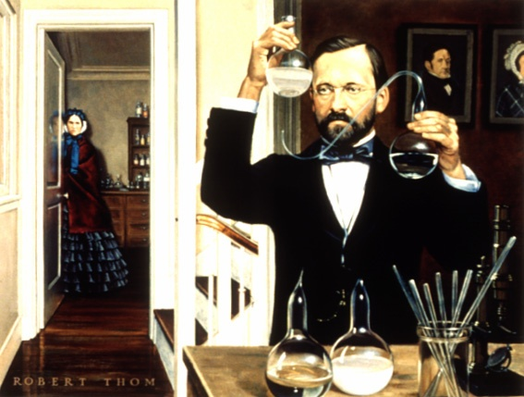
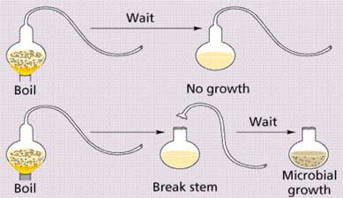
Research Experiments in Laboratories - France 1822
Pasteur ; the chemist who transformed medicine
Notes:
Proof that microbes are reproduced from parent organisms, and do not result from spontaneous generation, came from careful experiments in makeshift laboratories of France's famed chemist and biologist, Louis Pasteur (1822-1895), at the Ecole Normale, Paris.
Behind him are portraies of his father and mother, which he painted during his youth. Mme. Pasteur waits patiently for him to complete an observation." On the table is a replica of the experiment of Lizaro Spalanzani. Pasteur is holding one of his "Swan-necked" flasks. This painting by Robert A. Thom appeared in "Great Moments in Medicine" published by Parke Davis & Company, in 1966. The text quoted is from the same source. Both are reproduced with the permission of Parke Davis & Company.

Slide 14
Purpose of Medical Research
To improve human health
Since World War II a multibillion dollar enterprise is established for biomedical research
Biomedical research involves physiology and patho-physiology of human illness
Clinical Research is the method of validating hypotheses related to human disease
For example what is the patho-physiology behind lipid profile of an individual and whether it affects the cardiovascular disease outcomes in humans ?

Slide 15
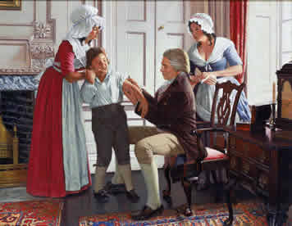
Jenner (1796) giving first small pox vaccine; taking a material from milkmaid infected
with cowpox who is seen taking care of her hand

Slide 16
Defining Clinical Research
National Institute of Health (NIH):
Clinical Research includes following areas of inquiry:
Patient oriented research
Epidemiologic and Behavioral Studies
Outcomes and Health Services Research
Translational research
Clinical Research includes any scientific investigation in which unit of analysis is the person

Slide 17
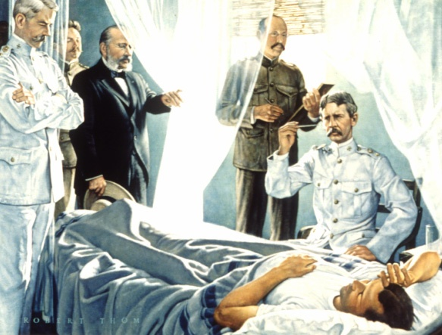
Major Walter Reed a US Army physician 1901 postulated that Yellow fever is caused
by a mosquito bite (a specific species) instead of incorrectly known to be by contact
Notes:
"Methods of controlling and preventing yellow fever resulted from investigations conducted in 1900 at Camp Lazear, Cuba, by a United States Army commission led by Major Walter Reed (1851-1902).
This research proved conclusively that mosquitoes carry the yellow fever from person to person. First volunteer patient to be infected by mosquito bite was Private John Kissinger.
Examining physicians were Major W.C. Gorgas, Havana sanitation officer; Dr. A. Agramonte, pathologist; Dr. Carlos J. Finlay, chairman of the cooperating Cuban Yellow Fever Commission and first man to point to the possible infective role of mosquitoes; Dr. James Carroll, bacteriologist and Dr. Reed, Commission Chairman." This painting by Robert A. Thom appeared in "Great Moments in Medicine" published by Parke Davis & Company, in 1966.

Slide 18
Pace of Change in Medicine
Changing patterns of diseases
Demographic transition & longevity
Variation in patient population and clinical care in various geographical regions differs for many reasons

Slide 19

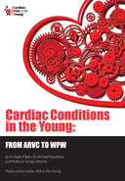

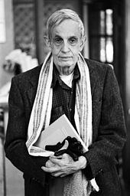

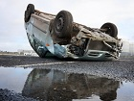
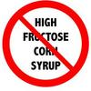
John Nash, A Nobel Laureate in Economics
suffered from Schizophrenia

Slide 20
Research Methodology
Epidemiological Approach consists of
I. Elements of Research (designing )
II. Validity of Research Results / Inferences
(drawing conclusions)

Slide 21
Defining Epidemiology
Epidemiology is a study of distribution (person, place, time) and determinants (risk factors) of disease
Fundamental assumptions
  Disease does not occur at random
  Disease occurrence is a function of its potential determinants
Notes:
A study is a process – documented through out from design to execution that aims to provide empirical evidence on a given issue.

Slide 22
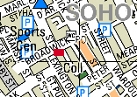
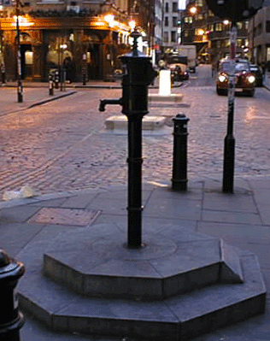
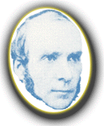
John Snow and the Broad Street Pump
Early epi study of association.

Slide 23
Elements of Research
Research Question: What problem needs an answer
Background and Significance: Why is this question important
Study hypothesis and objectives: Specifically how much can be done and how much of the problem could be solved ?
Design: What methodology will be adopted? Epidemiologic Approach ? What will be the time lines of structuring this study? Prospective in time ?
Description of a problem or finding a cause and effect relationship between two factors

Slide 24
Elements of Research
Study Participants: what type of study participants are needed ? Children, males , diabetics, hypertensive adults, healthy population?
Variables: what measures will be done, height, weight, lipid profile , changing pattern of blood indices, growth
Outcome variable: what are we assessing, death, illness, disability?
Predictor variable : what factors (risk) are responsible /related to the outcome variable ?
Statistical concerns; Sampling, Sample size, testing of hypothesis, tests of significance

Slide 25
Can the results obtained form red houses be applied
to green houses? Sampling & sample size issues

Slide 26
Validity of research results
What is the actual truth in nature about the research question we are going to answer ?
How can we address or minimize the errors in our research study to avoid false results ?
As the results will be applied to the patients / population and ethically “ do no harm”
Example ; use of hormone replacement therapy
correct data management

Slide 27
Validity of research results
Selection of study participants is important; whether all sick individuals were included or more healthy individuals were included? Representative of target population?
High risk versus low risk or no risk groups comparison
Diseases present differently in different populations; Selection bias may lead to false results ( and we may not be aware of that we have false results; which is not the truth in nature)

Slide 28
Validity of research results
Precision in measurements for statistical efficiency. Errors in measurement instruments; questionnaire, untrained data collectors, lead to information bias and false results
Appropriate sampling method and sample size for requirements are necessary for precision

Slide 29
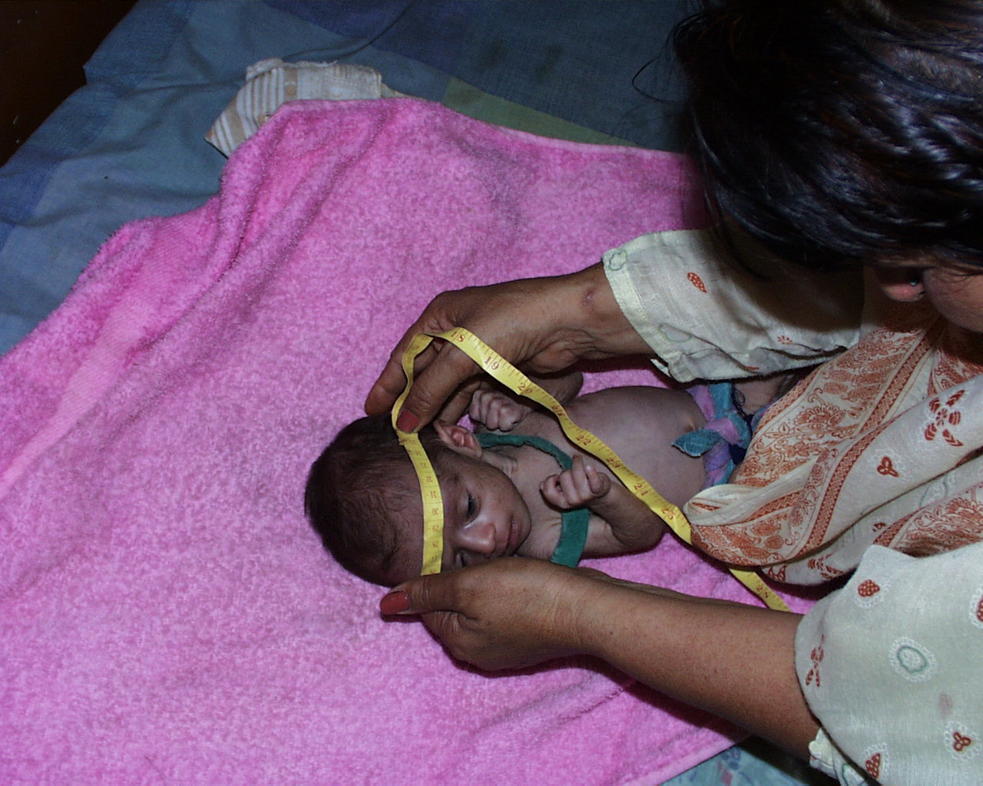
Measurement Error: If x% are > or < normal; due to
Inaccurate measurements may lead to false conclusions

Slide 30
II. Validity of Inference
Internal validity: does the study inference is true for study participants only?
External validity: Does the study results could be applied to persons who were not included in the study

Slide 31
Protocol Development
Research Question
Hypotheses
Objectives
Background
Design
Subjects
Variables
Data Collection
Quality control
10. Data Management
11. Sample size
12. Plan of Analysis
13. Ethical issues
14. Budget
15. Report results
16. Institution capacity
17. Administration
18. Work Plan

Slide 32
References
Stephen B Hulley. Designing Clinical Research. Chapter 1 . Getting Started: The Anatomy and Physiology of Clinical Research . Pages 3-15. 3rd Edition . Wolters Kluwer Health Lippincott Williams and Wilkins 2007
Daniel P Schuster & William J Powers. Translational and Experimental Clinical Research. Introduction: The value of Translational and Experimental Clinical Research. Pages: xv-xxi Lippincott Williams and Wilkins 2005
CMED 305 Manual prepared & compiled by Dr Amna Rehana Siddiqui, Department f Family & Community Medicine

