Slide 1
Research Questions, Objectives and Hypotheses
Lecture by
Dr Amna Rehana Siddiqui
September 2013

Slide 2
SESSION OBJECTIVES
Participants will be able to
Differentiate between goals & objectives
Learn formulation of research question
Define the specific objectives in terms of the stated problem
4. Describe the study hypothesis

Slide 3
GOALS and OBJECTIVES
Goals: long-term benefits
Objectives*: specific, measurable activities
within a time frame to reach
towards your goal
Tasks : detailed steps performed to
achieve research objectives
* ~ Specific Aims
Notes:
Tasks: goals are long term benefits; hence one of the task is to

Slide 4
Example
You are interested in Hazards from smoking ; list them
Why is this important or u r interested?
Because smoking is highly prevalent in Saudi Arabia (SA)
Outcomes of smoking ? read the hazards / diseases / …long list…which outcome you are interested? which is feasible?, common in Saudi Arabia so that you can achieve your goals
You realize; that it may not be feasible to study lung /other cancers , CHD, COPD for studying smoking hazards that are beyond year 3 time… the hazards of second hand smoke (SHS) relatively less studied in SA; as a large population may be exposed to it ?
What type of population is exposed to SHS ? Women? Children?
What are the outcomes reported for SHS in women and children ; e.g. children, sudden infant death syndrome? Respiratory infections? Rhinitis? Pneumonias? asthma ? Low birth weight? …keep learning the topic to learn reading and then formulate question, objectives, and hypothesis

Slide 5
How to Formulate a Research Question ?
Be inspired by observing patients and practices, by attending seminars, conferences, & symposia
Review local, national, and regional problems
Discuss, collaborate and get input from your colleagues - make your team.
Read about the topic, reviews, & research done; to find out gaps in existing knowledge?
Write the question with an outline of the solutions ( methods and expected results); draft an abstract

Slide 6
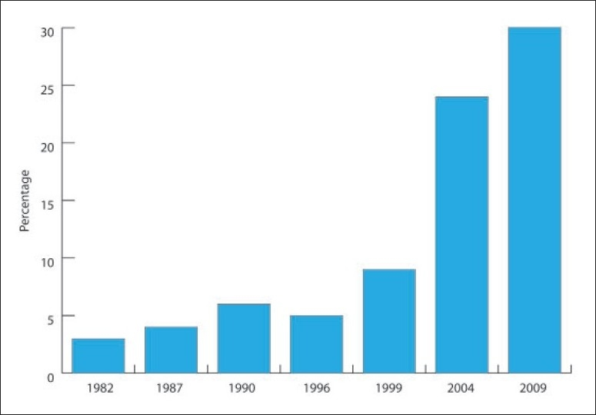
Ref: Prevalence of diabetes mellitus in a Saudi community.
Ann Saudi Med. 2011 Jan-Feb;31(1):19-23

Slide 7
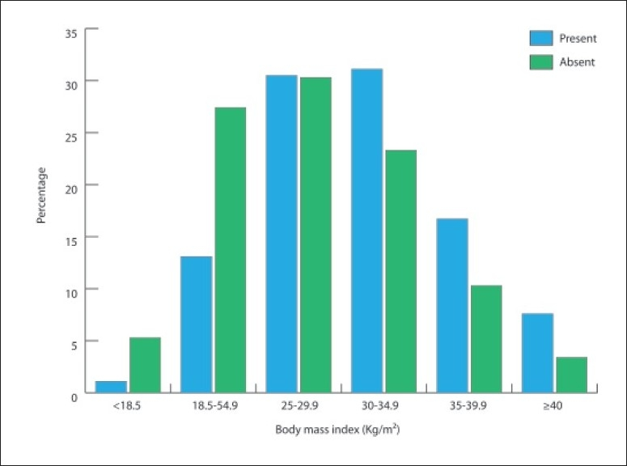
Ref: Prevalence of diabetes mellitus in a Saudi community.
Ann Saudi Med. 2011 Jan-Feb;31(1):19-23

Slide 8
What research questions come to your mind?
For example you are concerned about high prevalence of diabetes mellitus and wish that this disease could be reduced or well controlled in Saudi Arabia? What research questions will come to your mind?
………….(class responds)
All the stated responses will lead towards the goal of reducing the impact of DM in Saudi Arabia and each research question will be answered by stating clear objectives

Slide 9
Ask following questions initially
Do I have the time for this at this point in my life?
Is this really the burning topic for me?
Will this be worth it?
Is this a major and relevant public health problem or is it too esoteric?
Are my goals/objectives too big ? Am I covering too much?
Will available methods answer my questions?
What are the ethical and human subject issues here?

Slide 10
GOOD RESEARCH QUESTION
Feasible:
Logical:
Novel:
Ethical:
Relevant:

Slide 11
FINER criteria: a good research question
F Feasible
• Adequate number of subjects • Adequate technical expertise
• Affordable in time and money • Manageable in scope
I Interesting
• Getting the answer intrigues investigator, peers & community
N Novel
• Confirms, refutes or extends previous findings
E Ethical
• Amenable to a study that institutional review board (IRB) will approve
R Relevant
• To scientific knowledge • To clinical and health policy
• To future research

Slide 12
Research Question
A well-defined and specific research question is the key for making decisions about study design and population and subsequently what type of data will be collected and analyzed.

Slide 13
HOW TO START ?
Outline your idea / thoughts /abstract*
Specific Aims
Background and Significance
Preliminary Studies
Interest:
Risk factors of coronary heart disease.
hypertension ? Obesity ? smoking? Other?

Slide 14
SOURCES OF QUESTIONS
What background information is required
Preliminary studies by researcher (self/supervisor)
Other studies read by researcher
Conferences/presentations/seminars
Verify (validate) predictions of existing theories
Conflicting results from different studies
Qualitative studies
Observation
Curious mind / in search of answers/ a gift
Applying new technology

Slide 15
Evaluation of Research Question
How good and appropriate is the idea ?
Critique appropriateness of your Question
Merit of your question
Relationship of proposal to problem

Slide 16
REQUIREMENTS
What are the items required to support feasibility of my research question ?
Your background knowledge reflects in the question
Background information (critical appraisal) stated in intro/background section

Slide 17
Subject knowledge
Familiarity with the subject helps define an appropriate research question for a study.
Questions arise out of a perceived knowledge deficit within a subject area or field of study. (pathways of current knowledge and uncertainty )
The challenge in developing an appropriate research question is in determining which uncertainties could or should be studied and also rationalizing the need for their investigation.

Slide 18
Types of Research Questions
Descriptive: describing in a group, exploring
Relational: associations between two variables in a group
Comparable: associations between two or more variables in two or more groups (Causality / prediction / intervention)

Slide 19
Relational into Comparable
Is concentration of blood cholesterol directly related to dietary intake of saturated fat in Saudi population?
(hereditary?/ dietary/ metabolic ? Reasons in Saudi Population could differ from other settings)
Is daily saturated fat intake by persons with hypercholesterolemia differ from persons with cholesterol in normal range in Saudi population ?
(physical activity is in the pathway?)

Slide 20
Potential Problems & Solutions
Vague
Not feasible
Too broad
Methods inadequate
Not relevant
Uncertain ethical suitability
Finding importance
Write a plan
Change the methods
Focus / inclusion/excl
Consult/learn/collaborate
Modify research Question
Consult Ethics Review expert
Preliminary (pilot) study

Slide 21
PURPOSE OF OBJECTIVES
TO SPECIFY THE OUTCOME OF YOUR PROJECT
S- I- M- P- L- E

Slide 22
S-I-M-P-L-E
SPECIFIC: Indicate precisely what you intend to change through your project
IMMEDIATE: Indicate the time frame ….
MEASURABLE: proof of project success
PRACTICAL: How each objective is a real solution to a real problem,… realistic & feasible,
LOGICAL: Systematic contribution for goals
EVALUABLE: Indicate how much change has to occur for the project to be effective

Slide 23
Examples
Goal: To reduce risk of cardiovascular diseases in Saudi population by developing evidence based
interventions
Question: Is dietary intake of saturated fats over the past xx weeks related to atherosclerosis in Saudi adult population ?
Question: Is dietary intake of saturated fats over a period of xx months is associated with risk of coronary heart disease in Saudi adult population

Slide 24
Example contd.
Specific Aim 1: To determine the daily intake of saturated fats in the past 4 weeks in Saudi adults
Specific Aim 2: To determine the relationship of diet intake of saturated fats and blood levels of Low density lipoprotein (LDL) in Saudi adults
Specific Aim 3: To determine the association of dietary intake of saturated fats and intimal thickness of coronary artery in Saudi adults

Slide 25
Using the previous example
SPECIFIC: exposure assessment dietary intake, LDL levels, outcome assessment by intimal thickness
IMMEDIATE: average daily consumption, past weeks, months, or follow up in weeks of intervention (if any)
MEASURABLE: diet, LDL, Intimal thickness (valid)
PRACTICAL: % with higher (defined) intake; magnitude of relationship, biological plausibility
LOGICAL: initiates with intake, LDL blood levels, and then intimal thickness (mixture of known and unknown reasons)
EVALUABLE: Cut offs used for fat intake, LDL levels, intimal thickness; when repeated could be confirmed. In addition after a time period a difference in the above could be evaluated for intervention

Slide 26
Question Example
Question: Can reduction in dietary intake of saturated fat over xx months reduce serum cholesterol concentration in Saudi Population ?
Objective: To compare the concentration of serum cholesterol between the two adult groups with hypercholesterolemia ; each one randomized for a routine diet group and a diet reduced in saturated fats by x% over a period of six weeks
Hypothesis: The serum cholesterol concentration will be reduced by x% in the group on reduced saturated fat intake compared to those on routine Saudi diet

Slide 27
PICOT criteria for Experimental studies
Population
- What specific population are you interested in?
Intervention (for intervention studies only)
- What is your investigational intervention?
Comparison group
- What is the main alternative to compare the intervention?
Outcome of interest
- What do you intend to accomplish, measure, improve or affect?
Time
- What is the appropriate follow-up time to assess outcome

Slide 28
Objective formulation
Clarity and concisely written text
Intended outcomes stated; e.g. by how much serum cholesterol will be reduced; the dietary intake of saturated fat in the top two quartiles will be related to hypercholesterolemia/ artherosclerosis
Likelihood that research will lead to generation of new information and basis of further research

Slide 29
Hypothesis formulation
This is based on existing knowledge, deriving it through critical reading of literature and facts
Descriptive:
It is hypothesized that average daily intake of saturated fat in Saudi adult population is more than 20% of recommended intake when measured by xxx test and yyy standards to define dietary saturated fat intake.
Tasks: Saturated fat content of common food items like dairy products, cooking fat, meat, & others will be determined by.......

Slide 30
Hypothesis formulation
Specific Aim: To determine the relationship of dietary intake of saturated fat and intimal thickness of coronary artery
Hypothesis
It is hypothesized that > 20% of recommended saturated fat intake in Saudi population will be associated with 50% increased intimal thickness of coronary artery when compared to the normal intimal thickness measured by XYZ

Slide 31
Descriptive / Systems related
1.Behavioral change: human action anticipated.
Hypothesis: 60% of ICU workers will wash hands
before examining a patient after the establishment
of surveillance for nosocomial infection
2. Performance — A specific time frame within which a behavior will occur, at an expected proficiency level, is expected.
Hypothesis: 80% of first aid workers will be able to give cardiac resuscitation to trauma patients after six months of XYZ training
Define Tasks for type of training

Slide 32
Descriptive / Systems related
3. Process — The manner in which something occurs is an end in itself.
Example: > 70 % of first aid workers will perform cardiac resuscitation when monitored using a checklist by an observer
4.Product — A tangible item results.
Example: A user friendly illustrated manual will be created for cardiac resuscitation in areas stricken with natural disasters

Slide 33
Summary
Perform a systematic literature review to increase knowledge for the topic
Learn about current trends and technological advances on the topic.
Seek careful input from experts, mentors, colleagues and collaborators
Use the FINER criteria in the development of the research question.
Ensure that the research question follows PICOT format if experiment
Develop a research hypothesis from the research question.
Develop clear and well-defined objectives using SIMPLE criteria
Ensure that the research question and objectives are answerable, feasible and relevant.

Slide 34
References
Stephen B Hulley. Designing Clinical Research. 3rd Edition . Wolters Kluwer Health Lippincott Williams and Wilkins 2007
Daniel P Schuster & William J Powers. Translational and Experimental Clinical Research. Introduction: Lippincott Williams and Wilkins 2005

