Slide 1
Ethics in Health Research
Prof. Ashry Gad Mohamed Dr. Aman/Dr. Salwa Tayel
Department of Family and Community Medicine
September 9, 2013

Slide 2
OBJECTIVES OF THE LECTURE
At the end of the lecture students should:
1-Define ethics in health research.
2-Recognize the need for ethics in health
research.
3-Understand the general ethical principles.
4- Understand the role of ethical committee in
health research.

Slide 3
Definition
Ethics are the rules or standards ( moral principles) governing the conduct of a person or the members of a profession in respect to a particular class of human actions or a particular group, culture e.g. medical ethics

Slide 4
Health Research Ethics
The rules or standards ( moral principles) governing the conduct of researchers during planning, implementation, analysis, interpretation and publication of health research.

Slide 5
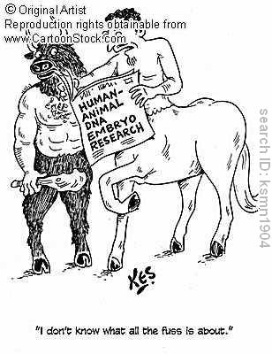

Slide 6
WHY RESEARCH ETHICS IS A CONCERN?
Major expansion of health research.
Significant public & private investment in research.
Increasing need for experimentation on human
subjects.
Increasing acceptance and appreciation of
human rights.
New areas: organ transplantation, assisted
pregnancy, genomics……etc.

Slide 7
Globalization of ethics
Growing collaboration between researchers in developed and developing countries.
Multi-centre trials specially funded by drug companies.
Tissue and information moves across borders.
International networks.
Risks may be taken to countries that do not have or do not enforce high ethical standards. Benefits go other population.
HR as an engine to economic development may push research beyond ethical standards.

Slide 8
examples
2001: Clinical trial of nordihydroguairetic acid ; a chemical with anti-cancer properties was tested in the Indian Kerala for a US-based researcher in 26 cancer patients. Two died and a third one turned critical.
2003: more than 400 women who had been trying to conceive were enrolled without their knowledge or consent to take part in clinical trial to see if a drug called letrozole induced ovulation.

Slide 9
GENERAL ETHICAL PRINCIPLES
1-Respect for persons
Respect for autonomy ((الاستقلال
People capable of deliberation about their personal choices should be treated with respect for their capacity for self determination.
Protection of persons with impaired or diminished autonomy to give them security against harm or abuse.

Slide 10
Privacy should be protected by ensuring confidentiality.
Respect to the community means respecting its values and having its approval for the research.

Slide 11
2-BENEFICENCE ) (الاحسان
Maximize benefits and minimize harms.
Investigators should be competent both to
conduct the research and safeguard the
welfare of research subjects

Slide 12
3-Justice (العدل )
Treat each person in accordance with what is
morally right and proper to him/her.
Equitable distribution of both the burdens
and the benefits of participation in the
research. (distributive justice)
Protect the rights and welfare of vulnerable
persons.

Slide 13
Research project should leave low –resources countries or communities better than previously

Slide 14
RESPONSIBILITY FOR ETHICS IN HEALTH RESEARCH
1-Investigators.
2-Research institution.
3-National Drug Regulatory Agency.
4-Editors of Health journals.
5-Funding agencies and organization.

Slide 15
RESEARCH INVOLVING HUMANS OR HUMAN MATERIALS
Balance between potential risk of harm
to individuals and the possible benefits
to society at large.
During research implementation reviews the ethics at least annually.

Slide 16
INFORMED CONSENT
Written informed consent is required and
should include at least the following elements:
The participant’s legal competence and ability to understand.
Comprehensive information about the proposed research.
The consent must be voluntary not involved by financial reward, duress/pressure in any manner, nor dependent or vulnerable groups.

Slide 17
Free to withdraw at any time.
Those unable to give their own consent proxy consent should be sought from a person with appropriate legal authority.
For children, parent or guardian signature
should be obtained + child’s assent.
WHO developed consent forms .

Slide 18
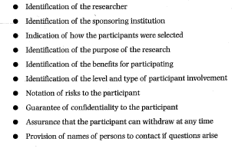
Rights of a study participant: to be addressed when taking informed consent

Slide 19
PAYMENTS FOR PARTICIPATION IN RESEARCH
Any payment, gift of money, goods or services to participants or body or organization assisting in recruitment of participants is unacceptable.
Examples:
Marks for participating students.
Money for instructors allowing data collection in classroom.
Access to Specific health care services.
Reimbursement or participants’ out-of-expenses
is allowed (e.g. transportation).

Slide 20
SURVEYS OF THE GENERAL POPULATION
Local health authority approval
Inform local health practitioners about
the study.
Informed individual consent in physical
or lab investigations. (e.g. IDA)
Inform about any consequences.
Right to withdraw.

Slide 21
Ethics in Clinical Trials
-RCT is the gold standard in the chain of evidence in medical practice.
-Investment in clinical trials is estimated to be around 30 billion $. and is growing 12% annually.
-A quarter of clinical trials is conducted in developing countries and did not undergo strict ethical review.

Slide 22
Tuskegee syphilis experiment (1932-72)
A research project conducted by the U.S. Public Health Service.
Six hundred low-income African-American males, 400 of whom were infected with syphilis, were monitored for 40 years.
Free medical examinations were given; however, subjects were not told about their disease. Even though a proven cure (penicillin) became available in the 1950s, the study continued until 1972 with participants being denied treatment.
In some cases, when subjects were diagnosed as having syphilis by other physicians, researchers intervened to prevent treatment. Many subjects died of syphilis during the study.
The study was stopped in 1973 by the U.S. Department of Health, Education, and Welfare only after its existence was publicized and it became a political embarrassment. In 1997, under mounting pressure, President Clinton apologized to the study subjects and their families.

Slide 23
example
1996: 100 Nigerian children received Trovan (trovafloxacin mesylate) as a part of efforts to determine the effectiveness of that drug. 11 children died and others suffered brain damage and were paralyzed or became deaf.

Slide 24
Cincinnati radiation experiments
Cancer patients (mostly Negroes of below-average intelligence who were charity patients) during 1960-72 in Cincinnati were exposed to large doses of whole body radiation as part of an experiment sponsored by the U.S. military.
None of the subjects gave informed consent, they thought they were receiving treatment for their cancer. Subjects experienced nausea and vomiting from acute radiation sickness, pain from burns on their bodies, and some died prematurely as result of radiation exposure.

Slide 25
Hepatitis in retarded children
Severely retarded children at the Willowbrook State Hospital in New York injected with hepatitis virus. Physician made excuse: fecally-borne viral hepatitis was so prevalent at the Hospital that children routinely became infected 6 to 12 months after admission (because approximately 70% of children had IQ below 20 and were not toilet trained).
This Hospital did not admit new patients after 1964, unless their parents "consented" to the experiment.
Consent forms implied that children were to receive a vaccine against hepatitis, when the protection was actually from a hopefully "subclinical" infection.

Slide 26
HISTORY OF GUIDELINES
Nuremberg Code (1947)
Declaration of Helsinki (1964) & revised 1975, 1983, 1989,1996,2000 & 2008.
Belmont Report (1979).
Universal Declaration on the human Genome and Human Rights, UNESCO 1997.
Operational guideline s for ethics committees that review Biomedical research , World health organization 2000.

Slide 27
Ethical and policy issues in International Research: Clinical trials in developing countries 2001.
Universal Declaration on Bioethics & Human Rights, UNESCO (2005)
Ethics of research related to health care in developing countries: a follow up discussion Report 2005.

Slide 28
Role of Research Ethics Committee (REC).
Does this research have a rationale?
Have risks to the participants been minimized?
Have benefits been maximized?
Has the process of informed consent been optimized?
Would I allow my mother, my child, myself to participate in this research protocol as it has been written?

Slide 29
Composition of national ethics committees in EMRO*
Human Rights Council 13% (2/15)
Bioethicist 13% (2/15)
Journalist 13% (2/15)
Community Member 13% (2/15)
Religious 33% (5/15)
Legal Expert 60% (9/15)
Pharmacy 13% (2/15)
Nurse 20% (3/15)
Epidemiologist 13% (2/15)
Public Health 13% (2/15)
Social Scientist 27% (4/15)
Scientist 33% (5/15)
Medical Doctor 100% (15/15)
National Ministry 40% (6/15)

Slide 30
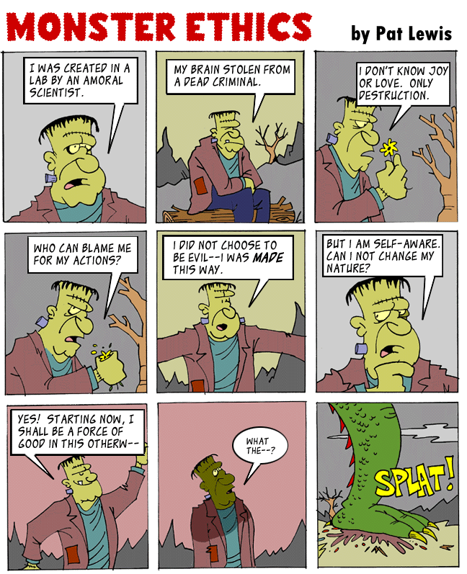

Slide 31
Reference book & page number for the lecture resource
WWW.WHO.INT∕RPC∕RESEARCH_ETHICS
Abou-Zaid A ,Afzal M , Silverman HJ. Capacity mapping of national ethics committees in EMR. BMC Medical Ethics 2009;10:8
Creswell JW. Research Design. Quantitative , Qualitative, and Mixed Methods. 3rd edition. Chapter 3. Writing Strategies and Ethical Considerations. Pages 64-65. Sage Publishers 2003

Slide 32
Thank You

