Slide 1
Measures of Disease Frequency, Effect and Impact
Tutorial CMED 305
September, 2013

Slide 2
OBJECTIVES
Incidence Rate
Prevalence Rate
Attack Rate
Risk Difference
Measures of Association

Slide 3
Important Terms
Exposure (E) ≡ an explanatory factor; any potential health determinant; the independent variable
Disease (D) (Outcome) = the response; any health-related outcome; the dependent variable
Measures of disease frequency = Incidence & Prevalence
Measure of association (syn. measure of effect) ≡ a statistic that quantifies the relationship between an exposure and a disease
Measure of potential impact ≡ a statistic that quantifies the potential impact of removing a hazardous exposure
Notes:
In epidemiology it is common to use the term exposure to denote any explanatory variable
i.E we may speak of smoking as an exposure that causes lung cancer or advanced maternal age at pregnancy as an exposure that causes Down Syndrome
(Prof. G. could you please help me understand the inactive lifestyle E+??)){We arbitrary define the risk factor as “exposure” to an inactive lifestyle. Then we compare the mortality rate in the exposed (inactive lifestyle) and nonexposed (active lifestyle) groups. I’ve added a third bullet to this effect.}

Slide 4
Incidence Rate
Population of the city in Atlantis on March 30, 2003 = 183,000
No. of new active TB occurring between January 1 and June 30, 2003 = 26
No. of active TB cases according to the city register on June 30, 2003 = 264
The incidence rate of active cases of TB for the 6 month period was:
7 per 100,000 population
14 per 100,000 population
26 per 100,000 population
28 per 100,000 population
130 per 100,000 population
Absolute risk
Notes:
Emphasis use of mid year population in large populations

Slide 5
Prevalence Rate
Population of the city in Atlantis on March 30, 2003 = 183,000
No. of new active TB occurring between January 1 and June 30, 2003 = 26
No. of active TB cases according to the city register on June 30, 2003 = 264
The prevalence rate of active cases of TB for the 6 month period was:
14 per 100,000 population
130 per 100,000 population
144 per 100,000 population
264 per 100,000 population
None of the above

Slide 6
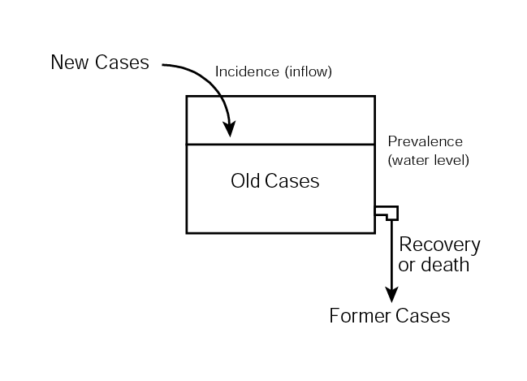
Dynamics of Prevalence Cistern Analogy (p. 185)
Ways to increase prevalence
Increase incidence → increase inflow
Increase average duration of disease → decreased outflow

Slide 7
Risks
Suppose, I am exposed to a risk factor and have a 2% risk of disease.
You are not exposed and you have a 1% risk of the disease.
Of course we are assuming we are the same in every way except for this risk factor.
In absolute terms, I have 2% – 1% = 1% greater risk of the disease
This is the risk difference
Notes:
We compare the weight of a man of 100 kg to the weight of a woman of 50 kg.
-Absolute comparisons are derived by subtraction and using (original units of measure kg)
-{Relative comparisons are derived by division (the division cancels out units, making a unit-free comparison}

Slide 8
Risks
In relative terms we divide
I have 2% ÷ 1% = 2, or twice the risk
This is the relative risk associated with the exposure
Notes:
We compare the weight of a man of 100 kg to the weight of a woman of 50 kg.
-Absolute comparisons are derived by subtraction and using (original units of measure kg)
-{Relative comparisons are derived by division (the division cancels out units, making a unit-free comparison}

Slide 9
Risk Difference
Risk Difference (RD) ≡ absolute effect associated with exposure
where
R₁ ≡ risk in the exposed group R₀ ≡ risk in the non-exposed group
Interpretation: Excess risk in absolute terms
Notes:
Let’s apply arithmetic to risks. These are the formulas. {The formulas are simple: RD is a subtraction and RR is a division. The key is to understand how we interpret the RR and the RD. They both quantify the relation between E and D, but they tell you something different about the association. Going through lots of examples in the book will help understand subtleties.}

Slide 10
Measures of Effect / Measure of Association
Men and women between 30-35 years of age in a city were followed up in program to determine the occurrence of Migraine headaches. The migraine headaches were found in 10 of 1000 women aged 30 to 35 years and in 5 of 1000 men aged 30 to 35 years.
Can you name and interpret a measure of effect?
Relative risk in women is higher than men in this age group
Incidence in Women /Incidence in men ~ 10/1000 = 2
5/1000
Women have a two times greater risk of developing migraine headache than do men in this age group.
Notes:
This is a key slide; u can use any way you like

Slide 11
Inference
A survey was conducted among the non-hospitalized adult population of United States during 1988 . The results are shown below:
Age group Persons with hypertension (%)
18-29 4
30-39 10
40-49 22
50-59 43
60-69 54
70 and older 64
What is the prevalence of hypertension in the age group of >=70 yrs of age?
64% of persons of 70 and more years had hypertension in 1988.

Slide 12
Attack Rate
What is the sore throat attack rate in persons who ate both egg salad and tuna:
60/75
70/200
60/135
60/275
TOTAL | Ate Tuna | Did Not Eat Tuna
Ate Egg Salad | 75 | 100
Did not eat Egg Sla | 200 | 50
With Acute Sore Throat | Ate Tuna | Did Not Eat Tuna
Ate Egg Salad | 60 | 75
Did not eat Egg Sla | 70 | 15

Slide 13
Attack Rate
What is the sore throat attack rate in persons who ate only egg salad:
60/75
70/200
75/100
75/275
TOTAL | Ate Tuna | Did Not Eat Tuna
Ate Egg Salad | 75 | 100
Did not eat Egg Sla | 200 | 50
With Acute Sore Throat | Ate Tuna | Did Not Eat Tuna
Ate Egg Salad | 60 | 75
Did not eat Egg Sla | 70 | 15

Slide 14
Inference from attack rates
What is the inference?
Persons who ate both egg salad and tuna have greater risk of developing sore throat than do persons who ate only egg salad.

Slide 15
Measures of Effect and Impact
Following table describes the data from a study when two groups based on meat consumption were followed up in time for occurrence of Coronary heart disease (CHD) over one year.
What is an exposure here? 3. What is the incidence in exposed?
What is an outcome here? 4. What is the incidence in unexposed ?
5. Calculate Relative Risk and Attributable Risk (optional)
 | Cases of CHD | Non Cases of CHD | Total
Eat Red Meat Daily | 182 | 1449 | 1631
Eat Red Meat once/week | 23 | 779 | 802
Total | 105 | 2328 | 2433
Notes:
Key: 1) Exposure: consumption of red meat daily; 2) Outcome is Coronary Heart Disease ; 3) Incidence in exposed = 182/1631=11.15%
4) Incidence in unexposed = 23/802 = 2.87%
5) RR= 11.15/2.87 = 3.89; AR= Incidence in exposed – incidence in unexposed= 11.15 – 2.87 = 8.6/100
Interpret AR: 8.6% of CHD cases could be prevented by avoiding daily consumption of red meat.

Slide 16
Thank you
Questions?

