Slide 1
Problem:
Assume that among diabetics the fasting blood level of glucose is approximately normally distributed with a mean of 105mg per 100ml and an SD of 9 mg per 100 ml. What proportion of diabetics having fasting blood glucose levels between 90 and 125 mg per 100 ml ?

Slide 2
NORMAL DISTRIBUTION AND ITS APPL ICATION

Slide 3
INTRODUCTION
Statistically, a population is the set of all possible values of a variable.
Random selection of objects of the population makes the variable a random variable ( it involves chance mechanism)
Example: Let ‘x’ be the weight of a newly born baby. ‘x’ is a random variable representing the weight of the baby.
The weight of a particular baby is not known until he/she is born.

Slide 4
Discrete random variable:
If a random variable can only take values that are whole numbers, it is called a discrete random variable.
Example: No. of daily admissions
No. of boys in a family of 5
No. of smokers in a group of 100
persons.
Continuous random variable:
If a random variable can take any value, it is called a continuous random variable.
Example: Weight, Height, Age & BP.

Slide 5
The Normal or Gaussian distribution is the most important continuous probability distribution in statistics.
The term “Gaussian” refers to ‘Carl Freidrich Gauss’ who develop this distribution.
The word ‘normal’ here does not mean ‘ordinary’ or ‘common’ nor does it mean ‘disease-free’.
It simply means that the distribution conforms to a certain formula and shape.

Slide 6
Gaussian Distribution
Many biologic variables follow this pattern
Hemoglobin, Cholesterol, Serum Electrolytes, Blood pressures, age, weight, height
One can use this information to define what is normal and what is extreme
In clinical medicine 95% or 2 Standard deviations around the mean is normal
Clinically, 5% of “normal” individuals are labeled as extreme/abnormal
We just accept this and move on.

Slide 9
Characteristics of Normal Distribution
Symmetrical about mean, μ
Mean, median, and mode are equal
Total area under the curve above the x-axis is one square unit
1 standard deviation on both sides of the mean includes approximately 68% of the total area
2 standard deviations includes approximately 95%
3 standard deviations includes approximately 99%

Slide 10
Uses of Normal Distribution
It’s application goes beyond describing distributions
It is used by researchers.
The major use of normal distribution is the role it plays in statistical inference.
The z score is important in hypothesis testing.
It helps managers to make decisions.

Slide 11
What’s so Great about the Normal Distribution?
If you know two things,
Mean
Standard deviation
you know everything about the distribution
You know the probability of any value arising

Slide 12
Standardised Scores
My diastolic blood pressure is 100
So what ?
Normal is 90 (for my age and sex)
Mine is high
But how much high?
Express it in standardised scores
How many SDs above the mean is that?

Slide 13
Mean = 90, SD = 4 (my age and sex)
This is a standardised score, or z-score
Can consult tables (or computer)
See how often this high (or higher) score occur

Slide 14
Measures of Position
z Score (or standard score)
the number of standard deviations that a given value x is above or below the mean
Notes:
page 85 of text

Slide 15
Standard Scores
The Z score makes it possible, under some circumstances, to compare scores that originally had different units of measurement.

Slide 16
Z Score
Suppose you scored a 60 on a numerical test and a 30 on a verbal test. On which test did you perform better?
First, we need to know how other people did on the same tests.
Suppose that the mean score on the numerical test was 50 and the mean score on the verbal test was 20.
You scored 10 points above the mean on each test.
Can you conclude that you did equally well on both tests?
You do not know, because you do not know if 10 points on the numerical test is the same as 10 points on the verbal test.

Slide 17
Z Score
Suppose you scored a 60 on a numerical test and a 30 on a verbal test. On which test did you perform better?
Suppose also that the standard deviation on the numerical test was 15 and the standard deviation on the verbal test was 5.
Now can you determine on which test you did better?

Slide 18
Z Score

Slide 19
Z Score

Slide 20
Z score
To find out how many standard deviations away from the mean a particular score is, use the Z formula:
Population: Sample:

Slide 21
Z Score
In relation to the rest of the people who took the tests, you did better on the verbal test than the numerical test.

Slide 22
Z score
Allows you to describe a particular score in terms of where it fits into the overall group of scores.
Whether it is above or below the average and how much it is above or below the average.
A standard score that states the position of a score in relation to the mean of the distribution, using the standard deviation as the unit of measurement.
The number of standard deviations a score is above or below a mean.

Slide 23
Interpreting Z Scores
Unusual
Values
Ordinary
Values
Unusual
Values
- 3
- 2
- 1
0
1
2
3
Z
Notes:
This concept of ‘unusual’ values will be revisited several times during the course, especially in Chapter 7 - Hypothesis Testing.
page 86 of text

Slide 24
The Standard Normal Table
Using the standard normal table, you can find the area under the curve that corresponds with certain scores.
The area under the curve is proportional to the frequency of scores.
The area under the curve gives the probability of that score occurring.

Slide 26
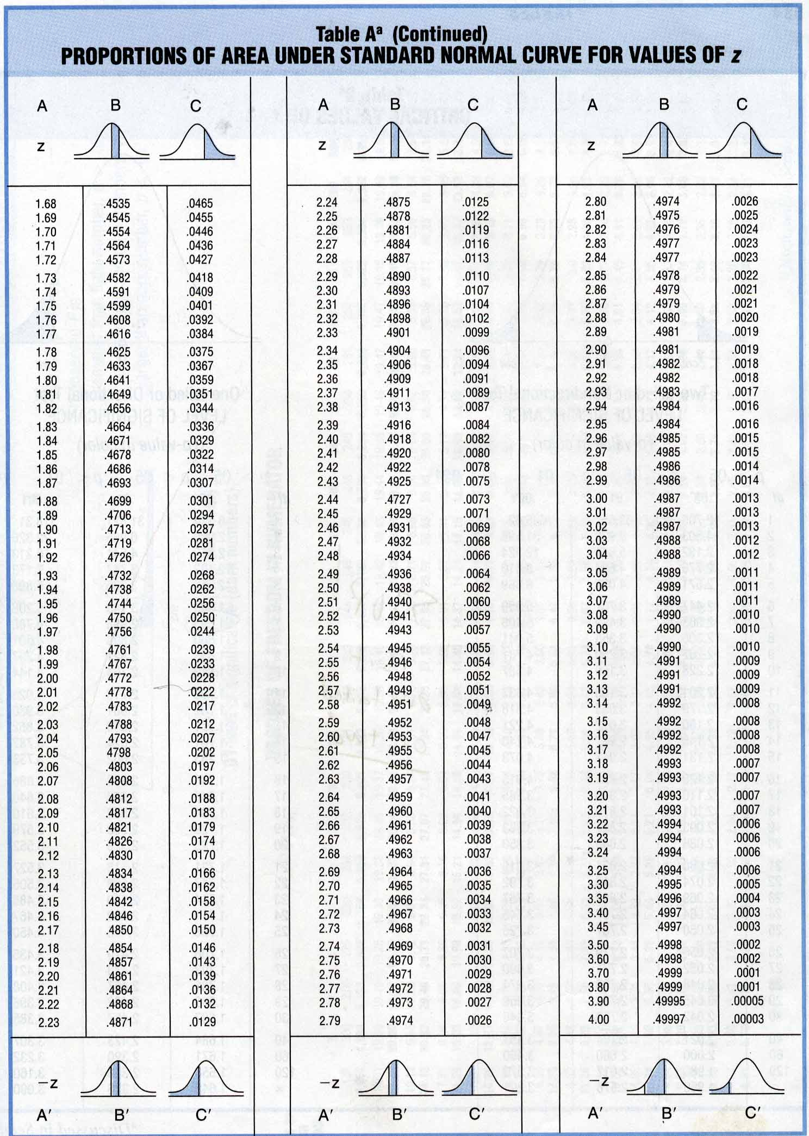
Standard Normal Table

Slide 27
Reading the Z Table
Finding the proportion of observations between the mean and a score when
Z = 1.80

Slide 28
Reading the Z Table
Finding the proportion of observations above a score when
Z = 1.80

Slide 29
Reading the Z Table
Finding the proportion of observations between a score and the mean when
Z = -2.10

Slide 30
Reading the Z Table
Finding the proportion of observations below a score when
Z = -2.10

Slide 31
Z scores and the Normal Distribution
Can answer a wide variety of questions about any normal distribution with a known mean and standard deviation.
Will address how to solve two main types of normal curve problems:
Finding a proportion given a score.
Finding a score given a proportion.

Slide 32
Exercises
Assuming the normal heart rate (H.R) in normal healthy individuals is normally distributed with Mean = 70 and Standard Deviation =10 beats/min

Slide 33
Exercise # 1
Then:
1) What area under the curve is above 80 beats/min?
Notes:
Now we know, Z =X-M/SD Z=? X=80, M= 70, SD=10 . So we have to find the value of Z. For this we need to draw the figure…..and find the area which corresponds to Z.

Slide 34
Diagram of Exercise # 1
34%
13.5%
2.35%
0.15%
-3 -2 -1 μ 1 2 3
0.16 or 16%
Notes:
Since M=70, then the area under the curve which is above 80 beats per minute corresponds to above + 1 standard deviation. The total shaded area corresponding to above 1+ standard deviation in percentage is 15.9% or Z= 15.9/100 =0.159. Or we can find the value of z by substituting the values in the formula Z= X-M/ standard deviation. Therefore, Z= 70-80/10 -10/10= -1.00 is the same as +1.00. The value of z from the table for 1.00 is 0.159. How do we interpret this? This means that 15.9% of normal healthy individuals have a heart rate above one standard deviation (greater than 80 beats per minute).

Slide 35
Exercise # 2
Then:
2) What area of the curve is above 90 beats/min?
Notes:
As in question, proceed by drawing the normal distribution curve and calculate the z value…….

Slide 36
Diagram of Exercise # 2
34%
13.5%
2.35%
0.15%
-3 -2 -1 μ 1 2 3
0.025 or 2.5%

Slide 37
Exercise # 3
Then:
3) What area of the curve is between
50-90 beats/min?

Slide 38
Diagram of Exercise # 3
34%
13.5%
2.35%
0.15%
-3 -2 -1 μ 1 2 3
0.95 or 95%

Slide 39
Exercise # 4
Then:
4) What area of the curve is above 100 beats/min?

Slide 40
Diagram of Exercise # 4
34%
13.5%
2.35%
0.15%
-3 -2 -1 μ 1 2 3
0.0015 or 0.15%

Slide 41
Exercise # 5
5) What area of the curve is below 40 beats per min or above 100 beats per min?

Slide 42
Diagram of Exercise # 5
34%
13.5%
2.35%
0.15%
-3 -2 -1 μ 1 2 3
0.0015
0.0015
Notes:
In this question, we need to calculate Z1 and Z2. Therefore, Z1 =70-40/10, which is equal to 3. The z value of 3 is 0.015.
Similarly, the value of Z2 is 70-100/10 which is equal to -3. Thus, the value of z is 0.015
And so, Z1+Z2 is equal to 0.3%. But how do we interpret this value? Please see the solution/answer #5 slide for its interpretation.

Slide 43
Exercise:
Assuming the normal heart rate (H.R) in normal healthy individuals is normally distributed with Mean = 70 and Standard Deviation =10 beats/min

Slide 44
Then:
1) What area under the curve is above 80 beats/min?
Ans: 0.16 (16%)
2) What area of the curve is above 90 beats/min?
Ans: 0.025 (2.5%)
3) What area of the curve is between
50-90 beats/min?
Ans: 0.95 (95%)
4) What area of the curve is above 100 beats/min?
Ans: 0.0015 (0.15%)
5) What area of the curve is below 40 beats per min or above 100 beats per min?
Ans: 0.0015 for each tail or 0.3%

Slide 45
Problem:
Assume that among diabetics the fasting blood level of glucose is approximately normally distributed with a mean of 105mg per 100ml and an SD of 9 mg per 100 ml. What proportion of diabetics having fasting blood glucose levels between 90 and 125 mg per 100 ml ?

Slide 49
ANY
QUESTIONS

