Slide 1
Dr.Shaikh Shaffi Ahamed, PhD
Associate Professor
Department of Family & Community Medicine
College of Medicine, KSU
Statistical significance using p-value

Slide 2
Why use inferential statistics at all?
Average height of all 25-year-old men (population) in KSA is a PARAMETER.
The height of the members of a sample of 100 such men are measured; the average of those 100 numbers is a STATISTIC.
Using inferential statistics, we make inferences about population (taken to be unobservable) based on a random sample taken from the population of interest.
2

Slide 3
Is risk factor X associated with disease Y?
Selection of subjects
Population
Sample
Inference
From the sample, we compute an estimate of the effect of X on Y (e.g., risk ratio if cohort study):
- Is the effect real? Did chance play a role?
3

Slide 4
Why worry about chance?
Sample 1
Population
Sample 2…
Sample k
Sampling variability…
- you only get to pick one sample!
4

Slide 5
Interpreting the results
Selection of subjects
Population
Sample
Inference
Make inferences from data collected using laws of probability and statistics
- tests of significance (p-value)
- confidence intervals
5

Slide 6
How do we determine if an association is significant?
Significance is in context of “Statistical” significance
  p-values
  Confidence intervals
6

Slide 7
Significance testing
The interest is generally in comparing two groups (e.g., risk of outcome in the treatment and placebo group)
The statistical test depends on the type of data and the study design
7

Slide 8
Significance testing
Subjects with Acute MI
Mortality
IV nitrate
P_{N}
?<
Mortality No nitrate P_{C}
Suppose we do a clinical trial to answer the above question
Even if IV nitrate has no effect on mortality, due to sampling variation, it is very unlikely that P_{N} = P_{C}
Any observed difference b/w groups may be due to treatment or a coincidence (or chance)
8

Slide 9
Obtaining P values
Number dead / randomized
Trial Intravenous Control Risk Ratio 95% C.I. P value
nitrate
Chiche 3/50 8/45 0.33 (0.09,1.13) 0.08
Bussman 4/31 12/29 0.24 (0.08,0.74) 0.01
Flaherty 11/56 11/48 0.83 (0.33,2.12) 0.70
Jaffe 4/57 2/57 2.04 (0.39,10.71) 0.40
Lis 5/64 10/76 0.56 (0.19,1.65) 0.29
Jugdutt 24/154 44/156 0.48 (0.28, 0.82) 0.007
How do we get this p-value?
  Table adapted from Whitley and Ball. Critical Care; 6(3):222-225, 2002
9

Slide 10
Reference article:
Yusuf S, Collins R, MacMahon S, Peto R: Effect of Intravenous nitrates on mortality in acute myocardial infarction: an overview of the randomised trials. Lancet 1988,1:1088-1092.

Slide 11
Null Hypothesis(H_{o})
There is no association between the independent and dependent/outcome variables
  Formal basis for hypothesis testing
In the example, H_{o} :”The administration of IV nitrate has no effect on mortality in MI patients” or P_{N} - P_{C} = 0
11

Slide 12
Hypothesis Testing
Null Hypothesis
There is no association between the predictor and outcome variables in the population
Assuming there is no association, statistical tests estimate the probability that the association is due to chance
Alternate Hypothesis
The proposition that there is an association between the predictor and outcome variable
We do not test this directly but accept it by default if the statistical test rejects the null hypothesis
Notes:
12

Slide 13
The Null and Alternative Hypothesis
• States the assumption (numerical) to be tested
• Begin with the assumption that the null hypothesis is TRUE
• Always contains the ‘=’ sign
The null hypothesis, H0
The alternative hypothesis, Ha
:
• Is the opposite of the null hypothesis
• Challenges the status quo
• Never contains just the ‘=’ sign
• Is generally the hypothesis that is believed to be true by
the researcher

Slide 14
One and Two Sided Tests
• Hypothesis tests can be one or two sided (tailed)
• One tailed tests are directional:
H0: µ1- µ2≤ 0
HA: µ1- µ2> 0
• Two tailed tests are not directional:
H0: µ1- µ2= 0
HA: µ1- µ2≠ 0

Slide 15
When To Reject H₀ ?
Rejection region: set of all test statistic values for which H₀ will be rejected
Level of signiﬁcance, α: Speciﬁed before an experiment to deﬁne rejection region
One Sided : α = 0.05 Two Sided: α/2 = 0.025
Critical Value = -1.64 Critical Values = -1.96 and +1.96

Slide 16
Type-I and Type-II Errors
α = Probability of rejecting H₀ when H₀ is true
α is called significance level of the test
β = Probability of not rejecting H₀ when H₀ is false
1-β is called statistical power of the test

Slide 17
Diagnosis and statistical reasoning
Disease status
Present Absent
Test result
+ve True +ve False +ve
(sensitivity)
-ve False –ve True -ve
(Specificity)
Significance Difference is
Present Absent
(Ho not true) (Ho is true)
Test result
Reject Ho No error Type I err.
1-β α
Accept Ho Type II err. No error
β 1−α
α : significance level
1-β : power

Slide 18
Example of significance testing
In the Chiche trial:
    p_{N} = 3/50 = 0.06; p_{C} = 8/45 = 0.178
Null hypothesis:
    H₀: p_{N} – p_{C} = 0 or p_{N} = p_{C}
Statistical test:
  Two-sample proportion
18

Slide 19
Test statistic for Two Population Proportions
The test statistic for p₁ – p₂ is a Z statistic:
Observed difference
0
Null hypothesis
No. of subjects in IV nitrate group
No. of subjects in control group
where
19

Slide 20
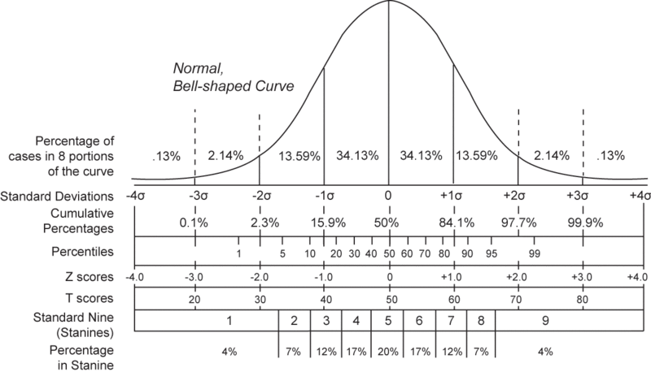
Testing significance at 0.05 level
-1.96
+1.96
Rejection Nonrejection region Rejection
region region
Zα/2 = 1.96
Reject H₀ if Z < -Z α/2 or Z > Z α/2
20

Slide 21
Two Population Proportions
(continued)
where
21

Slide 22
Statistical test for p₁ – p₂
Two Population Proportions, Independent Samples
Two-tail test:
H₀: p_{N} – p_{C} = 0
H₁: p_{N} – p_{C} ≠ 0
a/2
a/2
Since -1.79 is > than -1.96, we fail to reject the null hypothesis.
But what is the actual p-value?
P (Z<-1.79) + P (Z>1.79)= ?
-z_{a/2}
z_{a/2}
Z_{α/2} = 1.96
Reject H₀ if Z < -Z_{a/2}
or Z > Z_{a/2}
22

Slide 23
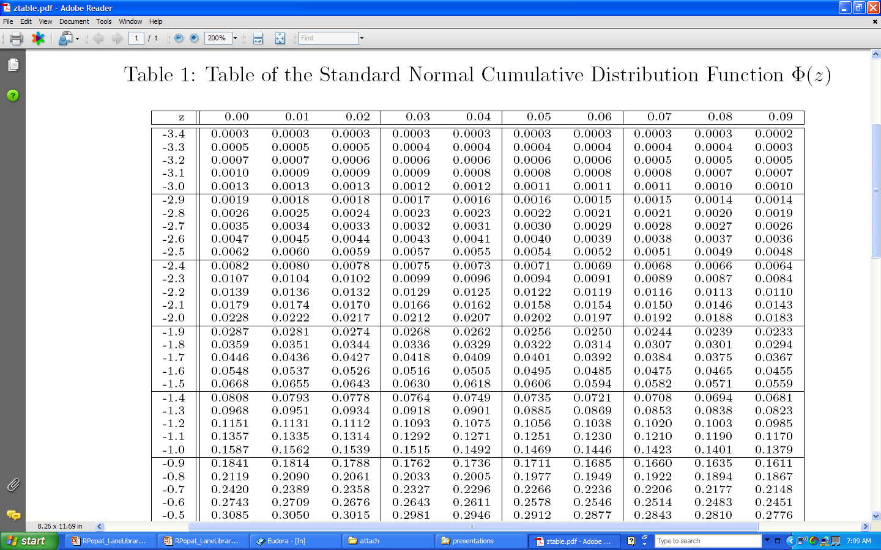
0.04
0.04
-1.79
+1.79
P (Z<-1.79) + P (Z>1.79)= 0.08

Slide 24
p-value
• After calculating a test statistic we convert this to a p-value by comparing its value to distribution of test statistic’s under the null hypothesis
• Measure of how likely the test statistic value is under the null hypothesis
p-value ≤ α ⇒ Reject H₀ at level α
p-value > α ⇒ Do not reject H₀ at level α

Slide 25
What is a p- value?
‘p’ stands for probability
  Tail area probability based on the observed effect
  Calculated as the probability of an effect as large as or larger than the observed effect (more extreme in the tails of the distribution), assuming null hypothesis is true
Measures the strength of the evidence against the null hypothesis
  Smaller p- values indicate stronger evidence against the null hypothesis
25

Slide 26
Stating the Conclusions of our Results
When the p-value is small, we reject the null hypothesis or, equivalently, we accept the alternative hypothesis.
  “Small” is defined as a p-value ≤ α, where α = acceptable false (+) rate (usually 0.05).
When the p-value is not small, we conclude that we cannot reject the null hypothesis or, equivalently, there is not enough evidence to reject the null hypothesis.
  “Not small” is defined as a p-value > α, where α = acceptable false (+) rate (usually 0.05).

Slide 27
STATISTICALLY SIGNIFICANT AND NOT STATISTICALLY SINGIFICANT
Statistically significant
Reject Ho
Sample value not compatible with Ho
Sampling variation is an unlikely explanation of discrepancy between Ho and sample value
Not statistically significant
Do not reject Ho
Sample value compatible with Ho
Sampling variation is an likely explanation of discrepancy between Ho and sample value

Slide 28
What is a p- value?
p ≤0.05 is an arbitrary cut-point
  Does it make sense to adopt a therapeutic agent because p-value obtained in a RCT was 0.049, and at the same time ignore results of another therapeutic agent because p-value was 0.051?
Hence important to report the exact p-value and not ≤ 0.05 or >0.05
28

Slide 29
P-values
Number dead / randomized
Trial Intravenous Control Risk Ratio 95% C.I. P value
nitrate
Chiche 3/50 8/45 0.33 (0.09,1.13) 0.08
Flaherty 11/56 11/48 0.83 (0.33,2.12) 0.70
Lis 5/64 10/76 0.56 (0.19,1.65) 0.29
Jugdutt 24/154 44/156 0.48 (0.28, 0.82) 0.007
Some evidence against the null hypothesis
Very weak evidence against the null hypothesis…very likely a chance finding
Very strong evidence against the null hypothesis…very unlikely to be a chance finding
29

Slide 30
Interpreting P values
If the null hypothesis were true…
Number dead / randomized
Trial Intravenous Control Risk Ratio 95% C.I. P value
nitrate
Chiche 3/50 8/45 0.33 (0.09,1.13) 0.08
Flaherty 11/56 11/48 0.83 (0.33,2.12) 0.70
Lis 5/64 10/76 0.56 (0.19,1.65) 0.29
Jugdutt 24/154 44/156 0.48 (0.28, 0.82) 0.007
…8 out of 100 such trials would show a risk reduction of 67% or more extreme just by chance
…70 out of 100 such trials would show a risk reduction of 17% or more extreme just by chance…very likely a chance finding
Very unlikely to be a chance finding
30

Slide 31
Interpreting P values
Size of the p-value is related to the sample size
Lis and Jugdutt trials are similar in effect (~ 50% reduction in risk)…but Jugdutt trial has a large sample size
31

Slide 32
Interpreting P values
Size of the p-value is related to the effect size or the observed association or difference
Chiche and Flaherty trials approximately same size, but observed difference greater in the Chiche trial
32

Slide 33
P values
P values give no indication about the clinical importance of the observed association
A very large study may result in very small p-value based on a small difference of effect that may not be important when translated into clinical practice
Therefore, important to look at the effect size and confidence intervals…
33

Slide 34
Inference based on Hypothesis
If the null hypothesis is rejected
  conclude that there is a statistically significant difference between the treatments
  the difference is not due to chance
If the null hypothesis is not rejected
  conclude that there is not a statistically significant difference between the treatments
  any observed difference may be due to chance
  the difference is not necessarily negligible
  the groups are not necessarily the same

Slide 35
STATISTICAL SIGNIFICANCE
Vs
MEDICAL/CLINICAL/BIOLOGICAL SIGNIFICANCE
--In Hypothesis testing we concerned about minimizing the probability of making type-I error (rejecting Ho when in fact it is true), since we concerned the size of ‘α’ and formulate the decision rule for rejecting Ho.
--- Sample size ‘n’ (or n1 and n2) occurs in the denominator of the standard error of the sample statistic of interest that the larger the sample size, the smaller the S.Error and so the larger the test statistic regardless of the size of the numerator (the difference between the sample estimate and hypothesized value).

Slide 36
---Thus it follows that one could reject Ho for even very small differences if the sample size is large.
--- This leads to the consideration of a difference between treatment effects or differences between the observed and hypothesized values that are clinically important as well as statistically significant.

Slide 37
Example: If a new antihypertensive therapy reduced the SBP by 1mmHg as compared to standard therapy we are not interested in swapping to the new therapy.
--- However, if the decrease was as large as 10 mmHg, then you would be interested in the new therapy.
--- Thus, it is important to not only consider whether the difference is statistically significant by the possible magnitude of the difference should also be considered.

Slide 38
Clinical importance vs. statistical significance
Cholesterol level, mg/dl
300
220
Standard, n= 5000
R
Clinical
Experimental, n=5000
218
300
p = 0.0023
Statistical

Slide 39
Clinical importance vs. statistical significance
Yes No
Standard 0 10
New 3 7
Absolute risk reduction = 30%
Clinical
Fischer exact test: p = 0.211
Statistical

Slide 40



Reaction of investigator to results of a statistical significance test
Statistical significance
Not significant
Significant
Not
important
Happy
Practical importance of observed effect
Annoyed
Important
Very sad
Elated
40

