Slide 1
Data Analysis using SPSS By Dr.Shaik Shaffi Ahamed Ph.D., Associate Professor Dept. of Family & Community Medicine College of Medicine, KSU

Slide 2
Features of SPSS
Originally developed for the people in Social Science Areas, therefore, no heavy programming background required
Designed as User Friendly and has Pull Down Menus to Execute Statistical Commands
Ability to do Data Management & Manipulations
Ability to Store Analysis Programs & Produce Reports/Graphs

Slide 3
Statistics Package for the Social Science (SPSS)
Starting SPSS: Double Click on SPSS on desktop or Program→SPSS.
Opening a SPSS file: File→Open
MENUS AND TOOLBARS
Data Editor
Various pull-down menus appear at the top of the Data Editor window. The Data Editor menu items (with some of the uses of the menu) are:

Slide 4
Statistics Package for the Social Science (SPSS)
MENUS AND TOOLBARS
FILE used to open and save data files
EDIT used to copy and paste data values; used to find data in a file; insert variables and cases; OPTIONS allows the user to set general preferences as well as the setup for the Navigator, Charts, etc.
VIEW user can change toolbars; value labels can be seen in cells instead of data values
DATA select, sort or weight cases; merge files
TRANSFORM Compute new variables, recode variables, etc.

Slide 5
Statistics Package for the Social Science (SPSS)
MENUS AND TOOLBARS
ANALYZE perform various statistical procedures
GRAPHS create different graphs and charts, etc
HELP to access SPSS Help information

Slide 6
SPSS Program Flow
Outside
Data
Source
Importing
SPSS
Data
File
Data
Modification/
Transformation
Data Analysis
Raw
Data
Direct Entry
Pull-Down
Menu
OR
Syntax
Menu
(Data Steps)
(Analysis Steps)

Slide 7
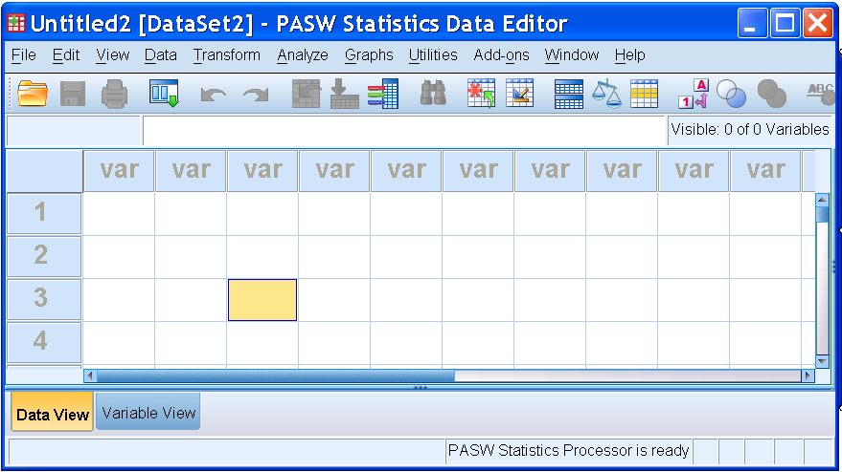
Data View Window - Data Entry Site (Columns=Variables, Rows=Cases)
Help Menu
Pull-down Menu bar
Tool bar
Information bar
Title bar
Variable
Names
Data View window
Active cell
Action bar

Slide 8
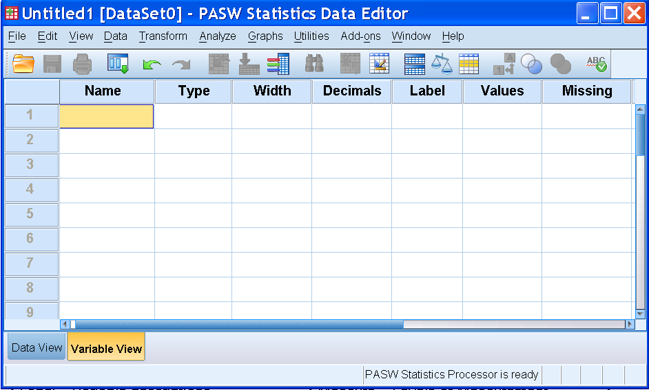
Variable View Window Data Definition Site
64 Characters
Max, No space
Between
Beg letter, @, #, or $
Numeric,
String, &
Others
Length
# of
Decimals
Variable
Description
Value
Code
Description
Missing value
Description
Click here to see this view

Slide 9
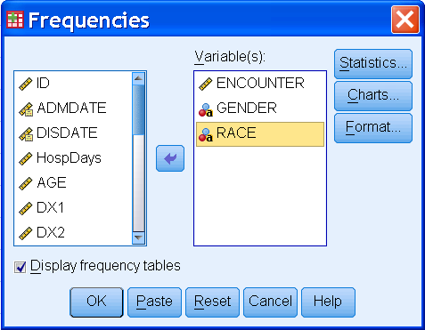
OK
VS.
Paste
buttons
1. OK - results/action
will be executed

Slide 10
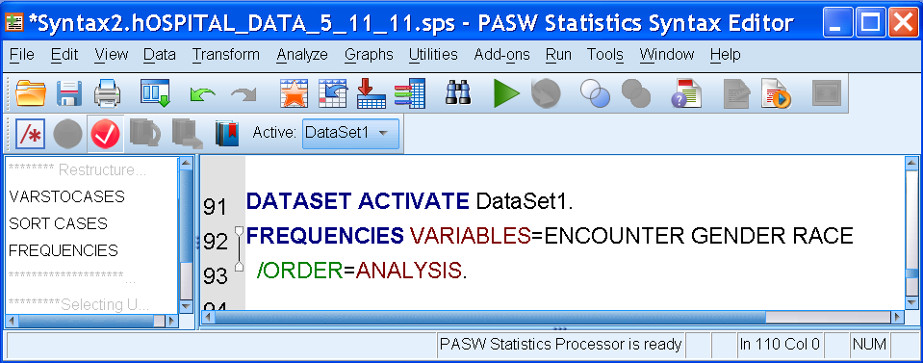
Hit Paste to obtain
Syntax Window
2. Run Syntax
to obtain the
results in the
Output
Window
<Syntax File>

Slide 11
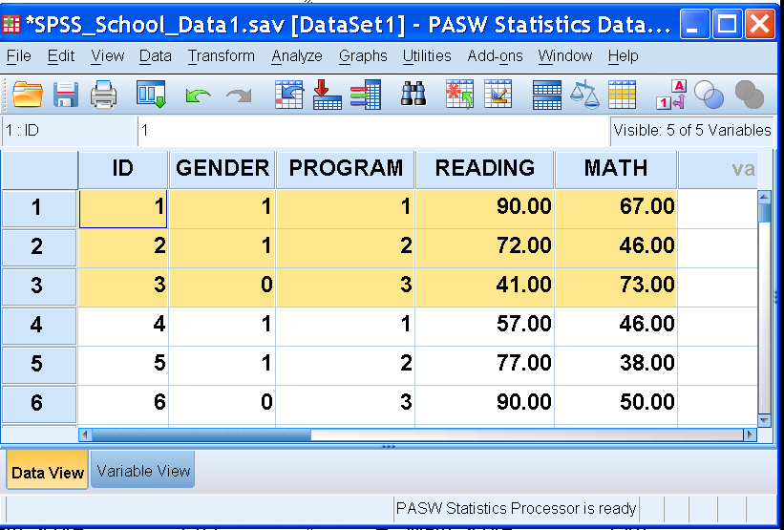
Example - School Data
Raw Data
Subject 1
Subject # (1)
Female (1)
Intensive (1)
Reading (90)
Math (67)
Subject 2
Subject # (2)
Female (1)
Moderate (2)
Reading (72)
Math (46)
Subject 3
Subject # (3)
Male (0)
Basic (3)
Reading (41)
Math (73)

Slide 12
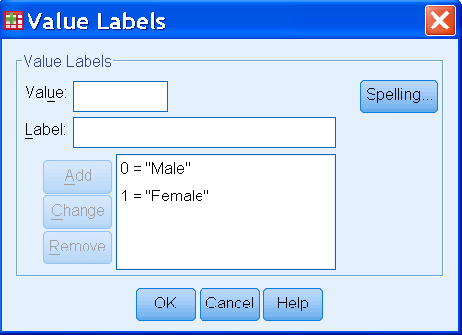
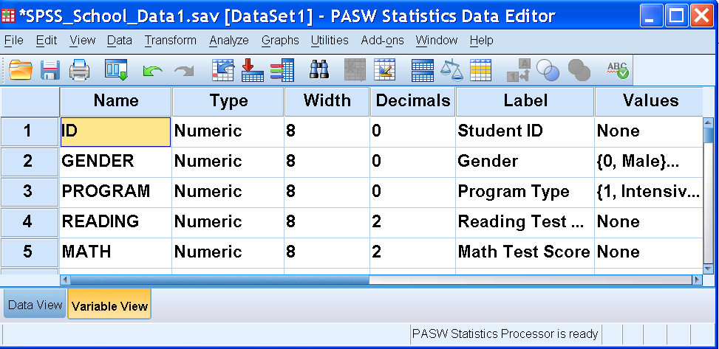
School Data Variable View
Variable View Activated

Slide 13
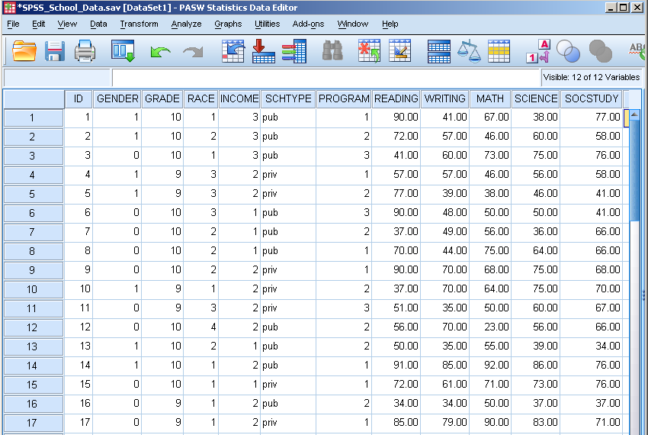
School Data Completed Dataset – Data View

Slide 14
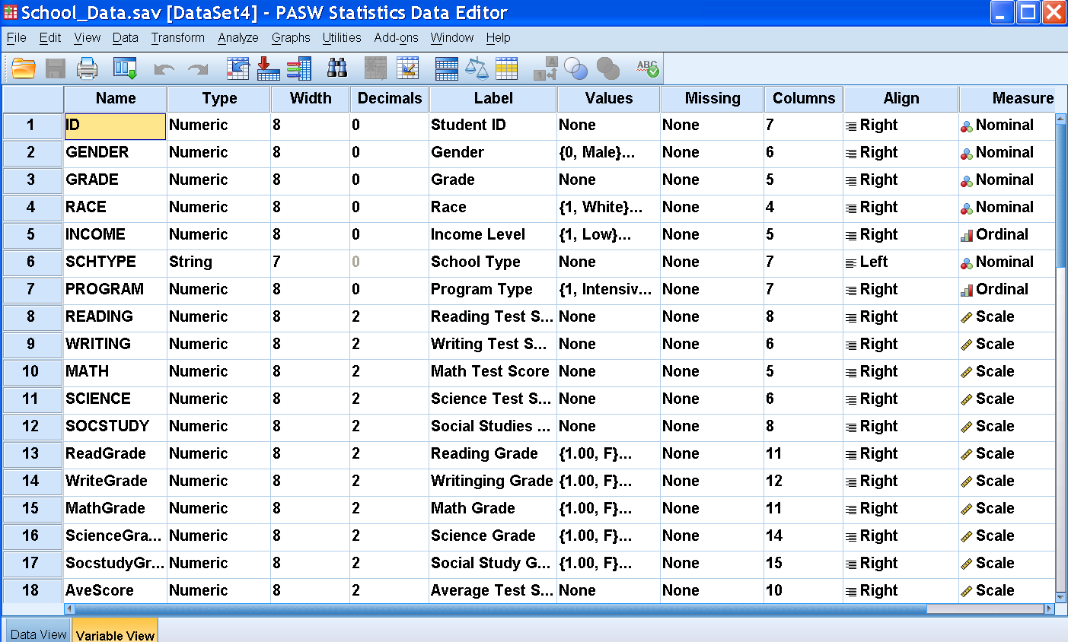
School Data Completed Dataset – Variable View

Slide 15
Importing data from an Excel spread sheet
Data from an Excel spreadsheet can be imported into SPSS as follows:
1. In SPSS click on FILE ⇒ OPEN ⇒ DATA. The OPEN DATA FILE Dialog Box will appear.
2. Locate the file of interest: Use the "Look In" pull-down list to identify the folder containing the Excel file of interest
3. From the FILE TYPE pull down menu select EXCEL (*.xls).
4. Click on the file name of interest and click on OPEN or simply double-click on the file name.
5. Keep the box checked that reads "Read variable names from the first row of data". This presumes that the first row of the Excel data file contains variable names in the first row. [If the data resided in a different worksheet in the Excel file, this would need to be entered.]
6. Click on OK. The Excel data file will now appear in the SPSS Data Editor.

Slide 16
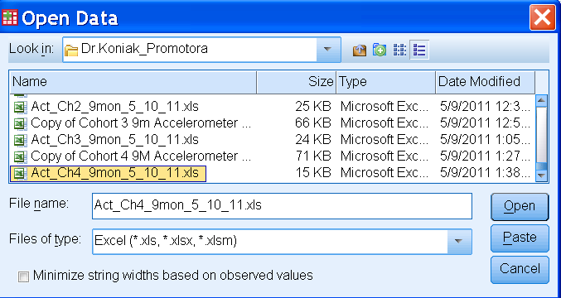
Importing Excel Data file to SPSS
Open the SPSS Data file
2. Go to File Menu
3. Click “Read Text Data”
4. Click Files of type to Excel
& choose Excel file
5. Hit Open
6. Check Worksheet #,
& Hit OK

Slide 17
School Data Completed Dataset – Data View

