Slide 1
cohort design in Epidemiological studies
Prof. Ashry Gad Mohamed
MBCh B, MPH, DrPH
Prof. of Epidemiology
Dr Amna R Siddiqui
MBBS, MSPH, FCPS, PhD
Associate Professor

Slide 2
Objectives
To describe the types of Cohort Study designs with their advantages and disadvantages
2. Calculate and interpret Relative Risk as measure of association.
3. Illustrate the relationship of a confounder with exposure and outcome

Slide 3
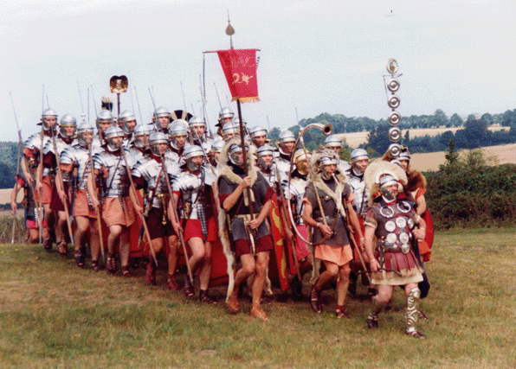
WHAT IS COHORT
Ancient Roman military unit, A band of warriors.
Persons banded together.
Group of persons with a common statistical characteristic. [Latin]
E.g. age, birth date,

Slide 4
An observational epidemiological study in which we attempt to study the relationship between a proposed cause “exposure” and the subsequent risk of developing certain disease.

Slide 5
Do not develop the disease
With the characteristic
Sample free
from
the disease
Develop the disease
Reference population
Develop the disease
Without the characteristic
Do not develop the disease

Slide 6
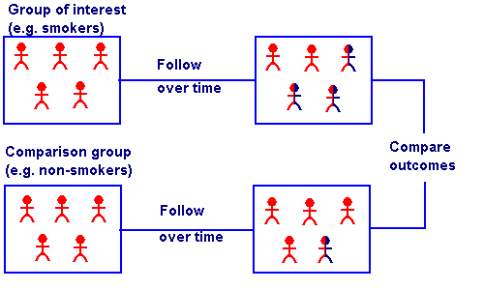

Slide 7
INDICATION OF A COHORT STUDY
When there is good evidence of exposure and disease.
When exposure is rare but incidence of disease is higher among exposed
When follow-up is easy, cohort is stable
When ample funds are available

Slide 8
Selection of cohort
1- Special exposure group
Unusual exposure to suspected causative factor e.g. nuclear explosion.
Unusual life style e. g. new migrants.
Unusual work experience e.g. new employers in silica industry.

Slide 9
General population sample where there is heterogeneity of exposure.
Groups of people selected because of administrative ease e.g. insured persons, volunteers.
Geographical defined area e.g. Framingham study.

Slide 10
Selection of comparison group
Heterogeneous exposure
No need for comparison group (internal comparison).
Homogenous group
Need comparison group

Slide 11
Collection of baseline information:
Baseline information is important to assess exposure status.
Exclude diseased
Establish a basis for follow up.
Obtain data on the important co-variables e.g. age and sex.

Slide 12
Sources of information
Records.
Interview
Examination
Investigation

Slide 13
Interviews:
To interview the cohort members or other informatants through direct personal interview, mailed questionnaire, telephone interviews or computer administered questionnaire (e mail).
Wide variety of topics and allow asking complex questions.
However it is biased if the subject knows the aims of the investigation.

Slide 14
Examinations :
Repeated examinations and investigations are independent valid source of information
Sometimes it is the only method.
However it is expensive and time consuming and
Unless blindly performed it is usually biased.

Slide 15
.
Follow up Duration of follow up It depends on the length of induction period of the outcome in addition to the resources
It should fulfill the following
Uniform and complete for all participants.
Complete ascertainment of the outcome events.
Standardized diagnosis of outcome events

Slide 16
Outcome
Objective and explicit
Assessed blindly (diagnostic-suspicision bias & expectation bias)
Adjust for extraneous prognostic factors

Slide 17
Types of Cohort Study
Prospective cohort study
Retrospective (historical) cohort study
Combination of Retrospective and Prospective cohort study.

Slide 18
Advantages of Cohort Studies
- Can establish population-based incidence
- Accurate relative risk (risk ratio) estimation
- Can examine rare exposures (asbestos > lung cancer)
- Temporal relationship can be inferred (prospective design)
- Time-to-event analysis is possible
- Can be used where randomization is not possible
- Magnitude of a risk factor’s effect can be quantified
- Selection and information biases are decreased
- Multiple outcomes can be studied
(smoking > lung cancer, COPD, larynx cancer)

Slide 19
Disadvantages of Cohort Studies
- Lengthy and expensive
- May require very large samples
- Not suitable for rare diseases
- Not suitable for diseases with long-latency
- Unexpected environmental changes may influence the association
- Nonresponse, migration and loss-to-follow-up biases
- Sampling, ascertainment and observer biases are still possible

Slide 20
ANALYSIS
Calculation of incidence rates among exposed and non exposed groups
Estimation of risk
Comparison of incidence proportion in both groups
Conceptually longitudinal to determine possible causal association between risk (exposure) and disease (outcome)

Slide 21
Incidence rates of outcome
Disease Status
Yes
No
Total
Yes
a
b
a+b
Exposure
Status
No
c
d
c+d
N
a+c
b+d

Slide 22
Incidence rate
Incidence among exposed =
a
a+b
Incidence among non-exposed =
c
c+d

Slide 23
Estimation of risk
Relative Risk
incidence of disease among exposed
RR = ______________________________
Incidence of disease among non-exposed
a/a+b
= _________
c/c+d

Slide 24
Smoking | Lung cancer |  | Total
 | YES | NO
YES | 70 | 6930 | 7000
NO | 3 | 2997 | 3000
 | 73 | 9927 | 10000
Find out RR and AR for above data

Slide 25
Incidence of lung cancer among smokers
70/7000 = 10 per 1000
Incidence of lung cancer among non-smokers
3/3000 = 1 per thousand
RR = 10 / 1 = 10
(lung cancer is 10 times more common among smokers than non smokers)

Slide 26
Obesity & Diabetes
Obesity | Diabetes |  | Total
 | present | absent
Present | 43 | 369 | 412
Absent | 29 | 601 | 630
Total | 72 | b+d | 1042
RR= (43/412) / (29/630) =0.104 / 0.046 =2.26

Slide 27
Cohort study: Tobacco smoking and lung cancer, England & Wales, 1951
Source: Doll & Hill
EPIET (www)

Slide 28
Causal Associations: Bias & Confounding
Need to consider the following when relating causality
Bias
Confounding
Potential Biases in Cohort Studies
Non response
Loss to follow up with time
Measurement errors in exposure

Slide 29
Confounding
A confounding variable is one that is associated with the predictor variable, and a cause for the outcome variable
Confounding bias occurs when two factors are associated (travel together) and the effect of one is confused with or distorted by the effect of the other
Exposure Disease

Slide 30
Exposure - Outcome Model
Simple Model
Exposure
Outcome
Complicated Model
Confounder(s)
Exposure
Outcome

Slide 31
Confounding
The confounding variable is causally associated with the outcome / disease
and
Non causally or causally associated with exposure
but
Is not an intermediate variable in the causal pathway between exposure and outcome

Slide 32
Interpreting associations: Causal & Non Causal
In truth only smoking is associated with Ca Pancreas
Causal (hypothesized)
Coffee consumption
Ca Pancreas
Non Causal (due to Confounding)
Coffee consumption
Smoking
Ca Pancreas
Real
Association
Spurious
association
Real
Association
Ref: MacMohan B. et al NEJM 1981 304:630-33

Slide 37
Thank You

