Slide 1
Literature search Search Engines
Armen Torchyan, Dr Hafsa Raheel
Dept. of Family and Community Medicine, KSU
Thanks to Dr Rufaida Dabab
September, 2013

Slide 2
Objectives of the session
By the end of the session students would;
be oriented to the various search engines used for literature search
be able to identify suitable information sources
access main search engines on the web

Slide 3
Why search literature?
Staying updated with the current advances in medicine
Identifying information and ideas
Increasing breadth of knowledge
Identifying various gaps in literature, and get to new ideas
Avoiding reinventing the wheel
Putting your work into perspective

Slide 4
Examples popular Search Engines

Slide 5
Who has access to the following databases ?
General search engines:
Pub-med (Medline)
Clinical Evidence
Cochrane
Best Evidence
Best Treatment
Trip database
Bandolier
EBM Guidelines:
NICE
PRODIGY
SIGN
Others
Not Enough ?

Slide 6
More databases…
CINAHL - Cum. Index to Nursing and Allied Health Literature
http://www.cinahl.com
ERIC – Education Resources Information Center
http://www.eric.ed.gov
PsycINFO – A database of American Psychological Association
http://www.apa.org/psycinfo
Campbell Collaboration
http://www.campbellcollaboration.org
BEME - Best Evidence Medical Education
www.bemecollaboration.org

Slide 7
What is the difference?
“Literature Review”
“Literature Search”

Slide 8
What is a literature search?
“A systematic and thorough search of published literature in order to collect information about a particular topic.”
The Chartered Society of Physiotherapy, UK

Slide 9
Where to start…?
Internet search/Any search engine
Guidelines review
Database search – PubMed
Reference tracking-references in articles
Expert contacts
General overview
Thorough search
Refining

Slide 10
Evidence Based Guidelines
NICE - National Institute for Health and Clinical Excellence
http://www.nice.org.uk
PRODIGY - formerly CKS
http://prodigy.clarity.co.uk/home
NGC - National Guideline Clearinghouse
http://guideline.gov/
SIGN - Scottish Intercollegiate Guidelines Network
http://www.sign.ac.uk/index.html

Slide 11
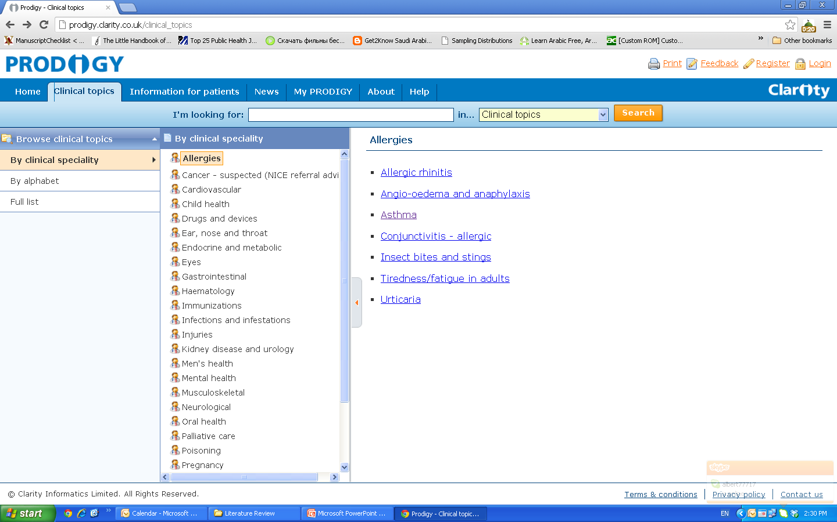

Slide 12
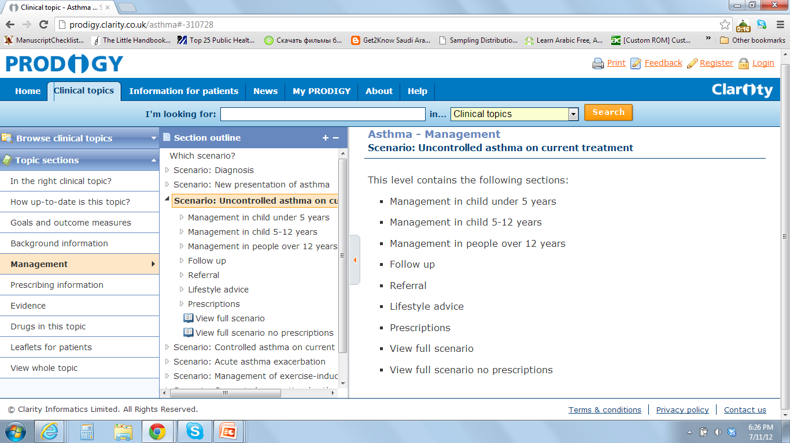

Slide 13
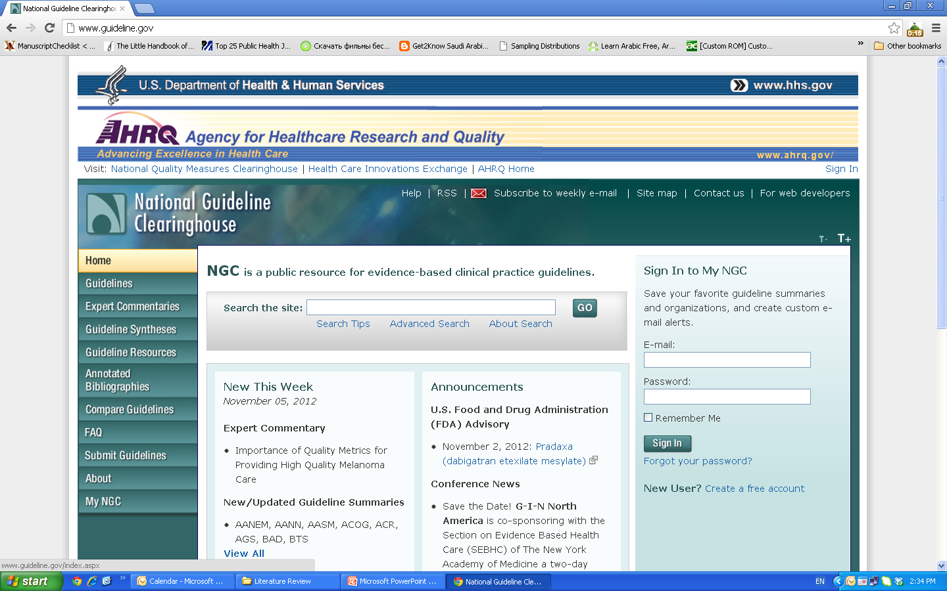

Slide 14
More thorough search?
If you fail to plan,
you plan to fail.
Ben Franklin
Prepare Organize Combine

Slide 15
Prepare
What do we need to know about our topic?
Make a list of all the terms connected with our topic.

Slide 16
Organize
Make a list of the words that are critical to your search
Exchange/add some words if needed
Note terms that you don’t want to appear
Discard the rest

Slide 17
Combine
Use Boolean operators to combine our most important terms.
Use AND to connect the terms we want to see
Use NOT to exclude terms we don’t want
Use OR to include similar terms

Slide 18
What is PubMed?
PubMed is a database developed by the National Center for Biotechnology Information (NCBI) at the National Library of Medicine (NLM) available on the Web.
NLM is the worlds largest medical library
NLM has been indexing the biomedical literature since 1879
MEDLINE is a database of indexes (with citations and abstracts)
PubMed provides access to MEDLINE
PubMed database is more current and comprehensive than MEDLINE ( it includes citations even prior to their indexing with MEDLINE)

Slide 19
Why PubMed ?
Over 20 million citations for biomedical literature from app. 5500 selected journals from over 70 countries
Source:
MEDLINE (NLM database)
Life science journals
Online books
Fields:
Medicine
Nursing
Dentistry
Veterinary medicine
Health care system
Preclinical sciences

Slide 20
Indexing a literature
Journal Publishers
Users
indexing
PubMed
Web
reviewing
NLM
MEDLNE
MeSH indexing

Slide 21
MeSH indexing
Acronym for “Medical Subject Headings”
Similar to key words on other systems
Used for indexing journal articles for MEDLINE
Arranged in hierarchy, from more general to more specific
Used by researchers

Slide 22
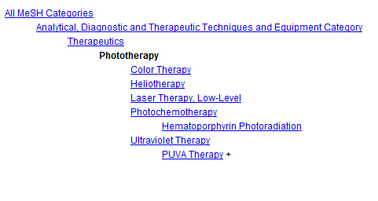
Tree of MeSH database

Slide 23
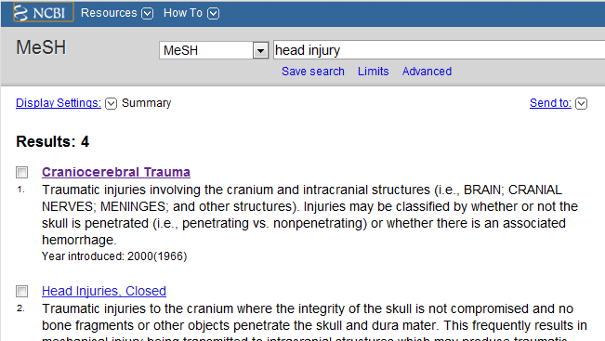
Searching MeSH Term

Slide 24
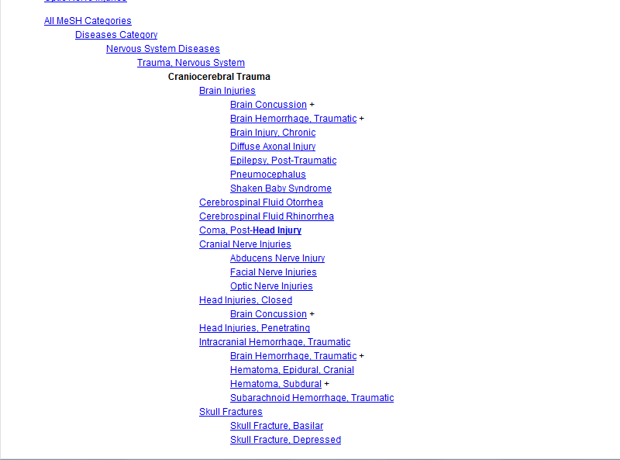

Slide 25
This will help you exclude all other diseases in that category
This will give you fewer articles in your results page!

Slide 26
Keys to Successful Searching
Indexes
Identifying appropriate indexes through clinical questions
Components of “well-built clinical questions.”
PICO
Patient/problem
Intervention
Comparison intervention
Outcome

Slide 27
Try to make a search...
Case example
A 45-year-old man presents with a 10-month history of burning epigastric pain that has not improved with a proton- pump inhibitor. Findings on upper endoscopy are normal, but Helicobacter pylori serology is positive.
Treat Helicobacter pylori or not?
Try to make a search….

Slide 28
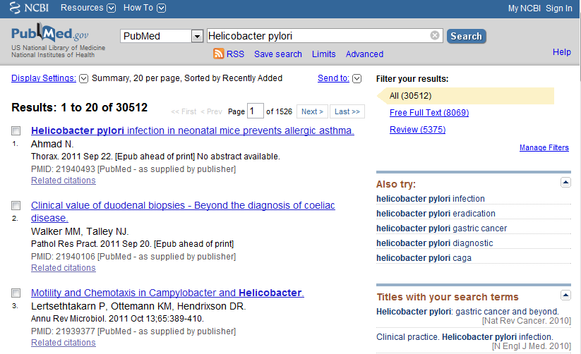
Case example

Slide 29
Case example
A 45-year-old man presents with a 10-month history of burning epigastric pain that has not improved with a proton- pump inhibitor. Findings on upper endoscopy are normal, but Helicobacter pylori serology is positive.
Components of “well-built clinical questions.”
Patient/problem - “non-ulcer dyspepsia”
Intervention - “treatment of Helicobacter pylori infection”
Comparison intervention- “no treatment”
Outcome - “improve symptoms”

Slide 30
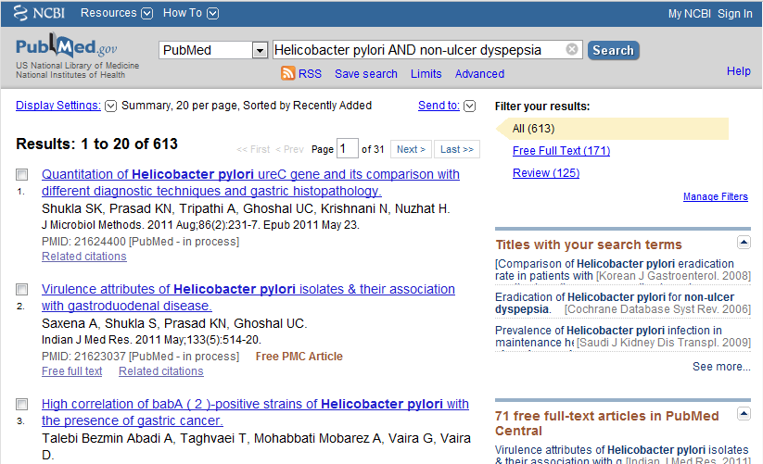
Case example

Slide 31
Case example
A 45-year-old man presents with a 10-month history of burning epigastric pain that has not improved with a proton- pump inhibitor. Findings on upper endoscopy are normal, but Helicobacter pylori serology is positive.
Components of “well-built clinical questions.”
Patient/problem - “non-ulcer dyspepsia”
Intervention - “treatment of Helicobacter pylori infection”
Comparison intervention- “no treatment”
Outcome - “improve symptoms”

Slide 32
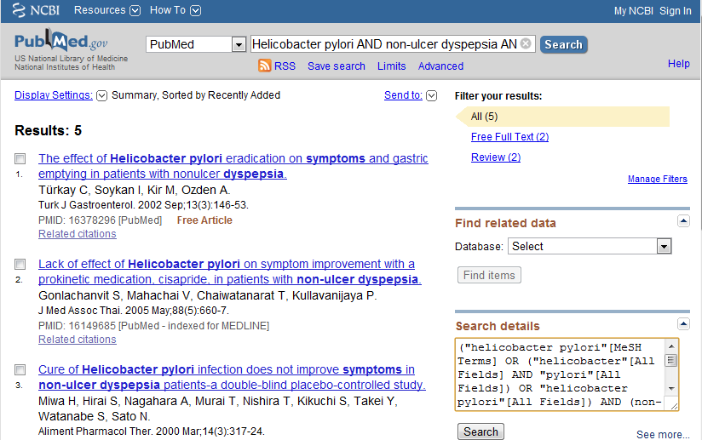
Case example
Boolean Operator

Slide 33
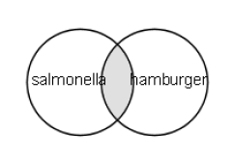
Boolean Operators
AND
Salmonella AND Hamburger
Salmonella - 69432
Hamburger - 2703
Salmonella AND Hamburger - 14

Slide 34
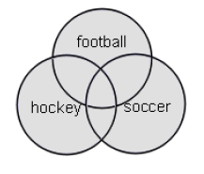
Boolean Operators
OR
Football OR Hockey OR Soccer
Football - 3948
Hockey - 1466
Soccer - 3137
Total - 7538

Slide 35
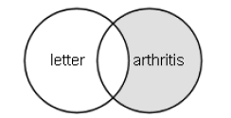
Boolean Operators
NOT
Arthritis NOT Letter
Arthritis - 185375
Letter - 686049
Arthritis “excluding” letter - 176352

Slide 36
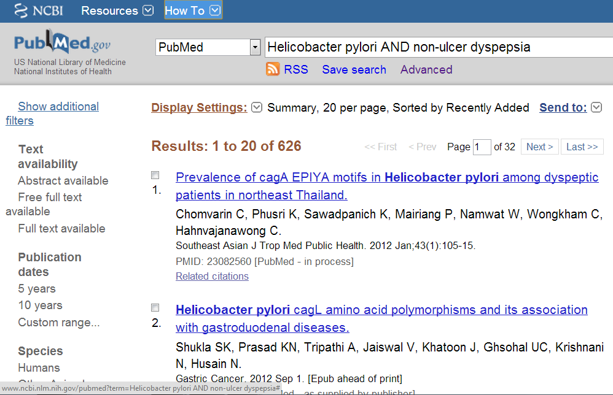
Limits

Slide 37
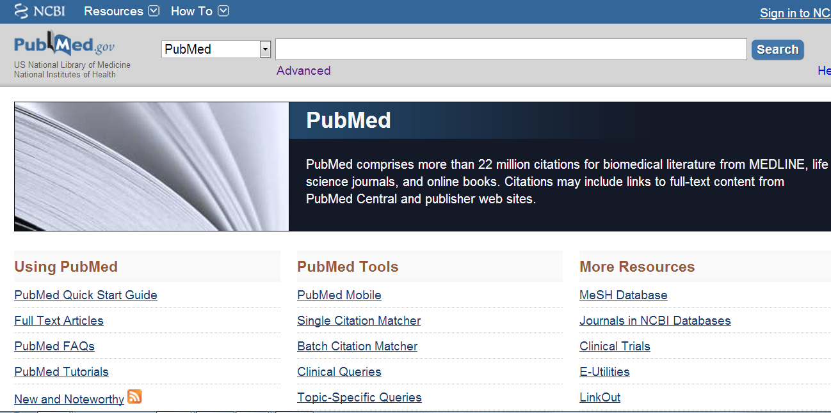

Slide 39
Review Groups
Acute respiratory infections
Airways
Anaesthesia
Back
Breast cancer
Colorectal cancer
Consumers and communication
Cystic fibrosis and genetic disorders
Dementia & cognitive improvement
Depression, anxiety & neurosis
Developmental, psychosocial and learning problems
Drugs and alcohol
Ear, nose and throat disorders
Effective practice and organisation of care
Epilepsy
Eyes and vision
Fertility regulation
Gynaecological cancer
Heart
Hepato-biliary

Slide 40
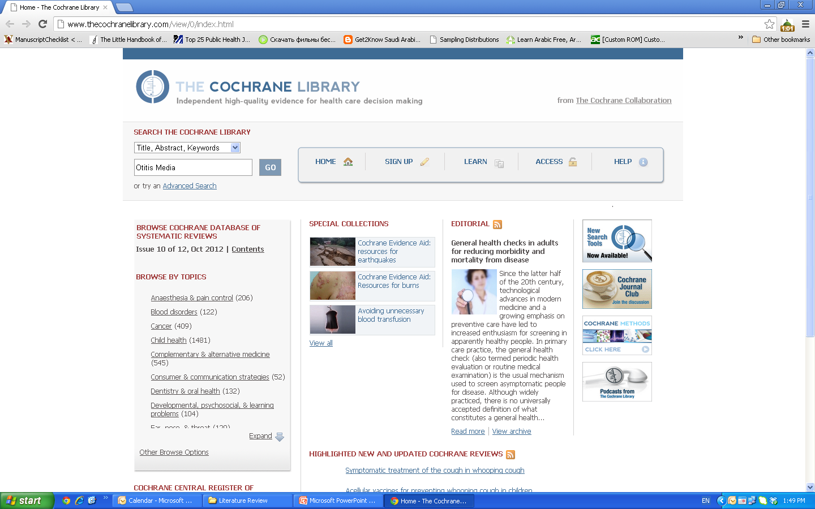

Slide 41
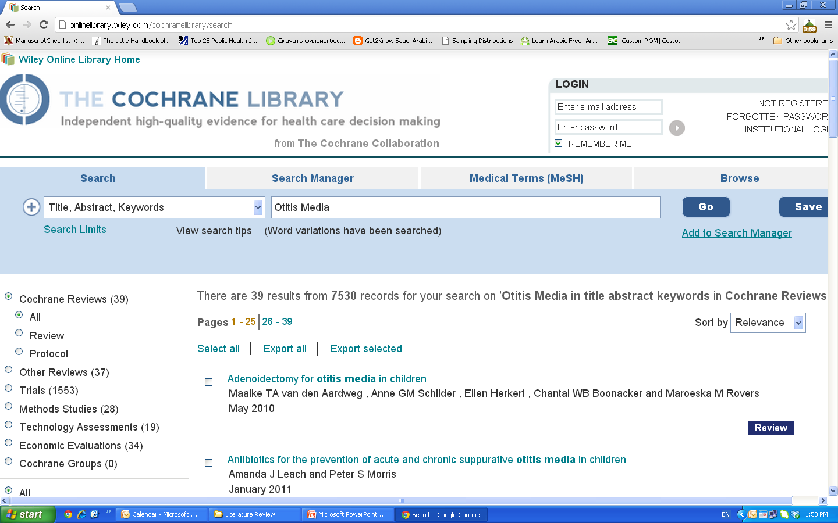

Slide 42
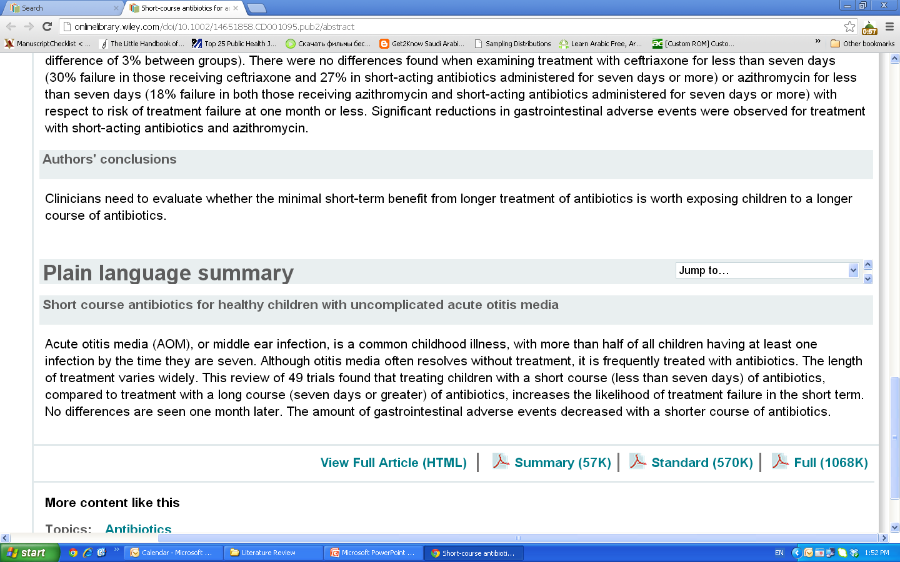

Slide 43
Clinical Scenario
Khalid is a 40 years old smoker, would like to quit smoking, he tried to do that, several times over the last two years, but he could not tolerate the withdrawal symptoms. Recently he read an article reporting that some medications can be used to help smoker to quit, he would like your advise about this issue!

Slide 44
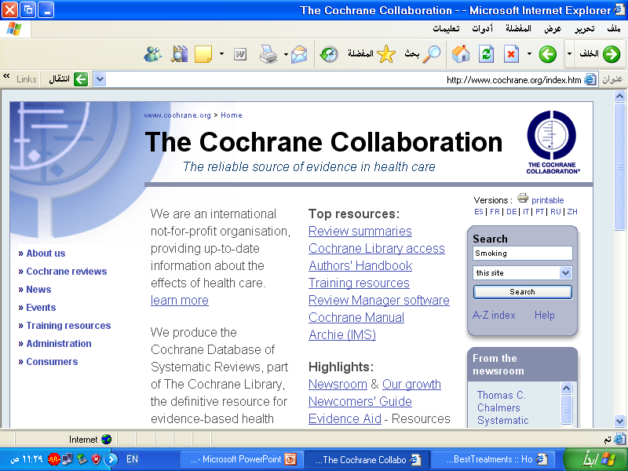

Slide 45
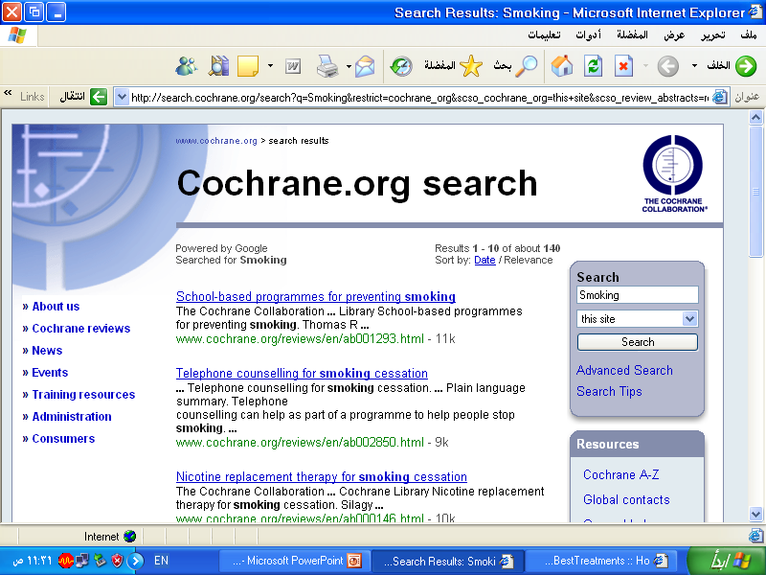

Slide 46
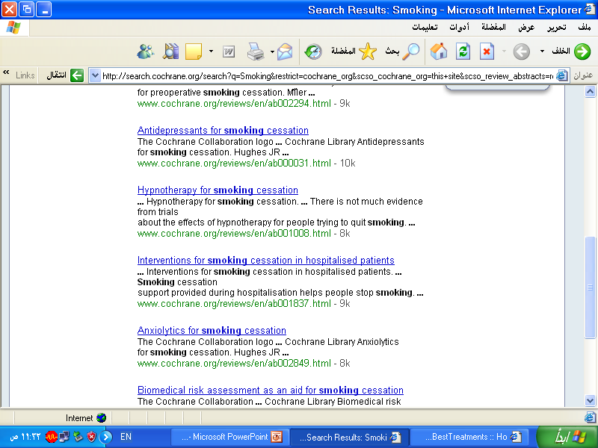

Slide 47
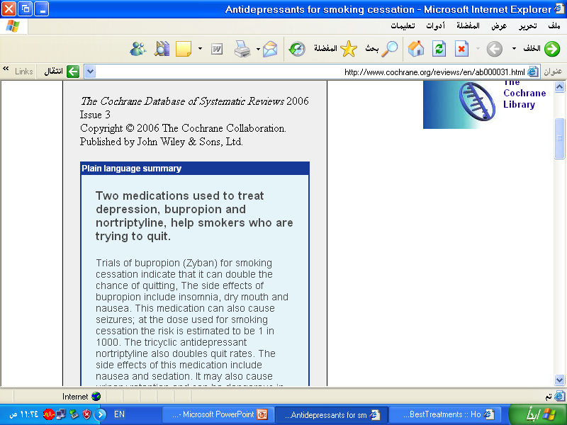

Slide 48
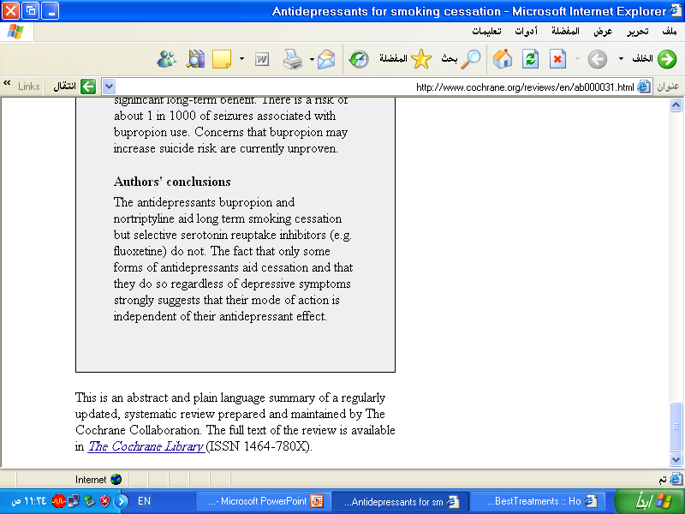

Slide 49
Saudi Digital
Library

Slide 53
Conclusion
Be specific about your questions or search.
Practice using different sites for search
Be familiar with some common sites
Be familiar with secondary resources

Slide 54
References
J. Ebbert, et al, Searching the Medical Literature Using PubMed: A Tutorial, Concise Review for Clinicians, Mayo Clin Proc. 2003;78:87-91
A Sood, AK Ghosh, Literature Search Using PubMed: An Essential Tool for Practicing Evidence- Based Medicine, JAPI, vol. 54, April 2006
NLM training: PubMed, US National Library of Medicine, April 2011
The literature review, Deakin University Library, retrieved on 24.09.2011 http://www.deakin.edu.au/library/findout/research/litrev.php#Bruce, C
H. Abdulghani, Effective Electronic Search, Department of Medical Education, College of Medicine, King Saud University, June 2012

Slide 55
Thank You

