Slide 1
Questionnaire Design
Dr Amna Rehana Siddiqui
Dr Armen Torchyan, MD MPH
October, 2013

Slide 2
OBJECTIVES
Validity and reliability of Instruments
Main mistakes in preparing questionnaires
Types of questions
Types of variables

Slide 3
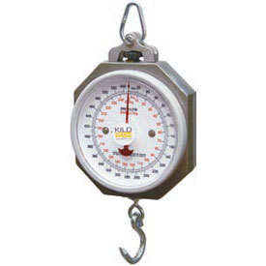
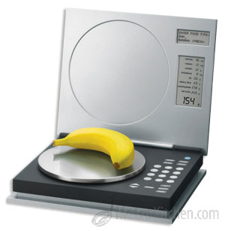
Which one is better?
?

Slide 4
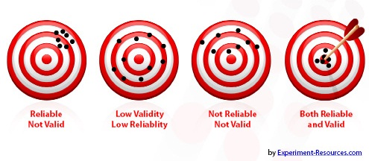
Validity and Reliability

Slide 5
Main Mistakes (Introd.)
An introduction should:
Include the name of the organization conducting the survey, to ensure the validity to the respondent (in some special cases a “blind” survey is required, and the name will not be given)
Let the respondent know how long the interview will take
Let the respondent know that their responses will be confidential and anonymous

Slide 6
Main Mistakes (Q1)
1. Personal information, such as income, should always be kept until the end of the interview
2. Use of pre-coded income categories
1. less than 4000
2. 4000 - 7999
3. 8000-13999
4. 14000 or above
77. Refused
99. Don't know
Categorical Variable
(Ordinal)
For continuous variables like
age, height, weight, etc.
avoid using pre-coded options

Slide 7
Main Mistakes (Q2)
Use simple, clear language
“fitness and recreation opportunities”, or “sports and fitness activities”
Yes
No
77. Refused
99. Don't know
Categorical Variable
(Nominal)

Slide 8
Main Mistakes (Q3)
Avoid asking “aided awareness” questions.
Keep questions short.
Q3. Have you recently seen, read, or heard anything about fitness and recreation programs in your community?
Yes
No
77. Refused
99. Don't know

Slide 9
Main Mistakes (Q4)
Don’t ask two different questions and give one response category
Divide into two questions
Are you currently a member of a gym or fitness club?
Yes
No
77. Refused
99. Don't know
Do you participate in any regular physical fitness program?
Yes
No
77. Refused
99. Don't know
Categorical Variable
(Nominal)

Slide 10
Main Mistakes (Q5)
Use skip pattern if necessary
Q.4 Are you currently a member of a gym or fitness club?
Yes
No ---------> Go to Question 6
77. Refused
Don't know
Q.5 Please tell me what regular physical activity you participate in.
____________________
Open-Ended Question

Slide 11
Main Mistakes (Q6)
Keep related questions together
Don’t use abbreviations (PSA – public service announcement)
Q.6 Where did you read, see, or hear this information?
Radio
TV
Weekly Newspaper
Daily Newspaper
77. Refused
99. Don't know
Categorical Variable
(Nominal)

Slide 12
Main Mistakes (Q7)
Don’t ask two different questions and give one response category
Use the same format for the whole questionnaire
Q.7 How would you rate the quality of the PSA(s) that you saw or heard?
Excellent
Good
Fair
Poor
Terrible
77. Refused
99. Don't know
Categorical Variable
(Ordinal)

Slide 13
Main Mistakes (Q8)
Use simple, common language
Record the “action” in a more objective, direct manner
Q.7 Would you say that after sawing the advertisement in the media you started participating in local physical activity programs more frequently than before?
Yes
No
77. Refused
99. Don't know
Closed-Ended Question

Slide 14
Main Mistakes (Q9)
Don’t use leading questions
Keep related questions together
What do you recall about the information that you read, saw, or heard?
_______________
Open-Ended Question

Slide 15
Main Mistakes (Q10)
The introduction tells that the information they give is confidential. Asking for personal information after ensuring confidentiality needs to be explained clearly, and the respondent reassured that their name will not be associated with their responses.
The best way to do so is to state why you are asking, and then give them the option to provide the information, otherwise it can lead to some hostility.

Slide 16
Reference book & page number for the lecture resource
What's wrong with this questionnaire, The health communication unit, Dalla Lana School of Public Health, Toronto, Canada
Ashry Gad Mohamed, Lecture on Questionnaire Design, College of Medicine & KKUH
B. Hulley, Designing Clinical Research, Second Edition, Lippincott Williams and Wilkins, 2001
Shaikh Shaffi Ahamed, Lecture on Introduction to Biostatistics & Types of data, College of Medicine & KKUH

Slide 17
Thank you
Questions?

