Slide 1

How to Write Study Methods
Armen Torchyan, MD, MPH
Hayfaa A. Wahbi FRCOG, FRCS
KSU Dept. of Family and Community Medicine
November, 2013

Slide 3
Methods
Study design
Study setting
Population under study
Sample Size
Sampling Technique
Data collection method
Pilot study
Data analysis plan
Ethical considerations

Slide 4
What the Methods Section is Not!
Results
Discussion
Summary
Conclusions
Future Work
Introduction
It is a DESCRIPTION of HOW you did your work
Include NO results and NO discussion!

Slide 5
Design
Present key elements of study design early in the paper.
Cross-sectional
Case-Control
Cohort
Experimental
Or mixture
To understand
the basics of the study
+
exactly how and when

Slide 6
Design: Example
Design
“We will use a case-control study design, with a sample that will include women with breast cancer, with a 1:1 age matched with controls without breast cancer. We age-matched women newly diagnosed with breast cancer (cases) and women with benign breast changes (controls) at two referral services for diagnosis and treatment of cancer in Goiânia, (Goiás State capital)”.
Exactly how

Slide 7
Setting
Describe:
Setting (recruitment sites or sources)
Location (countries, towns, hospitals)
Relevant dates
  Periods of recruitment
  Exposure
  Follow-up
  Data collection
Generalizability
of a study’s results

Slide 8
Setting: Example
Setting
Location
“The Pasitos Cohort Study will recruit pregnant women from Women, Infant, and Child clinics in Socorro and San Elizario, El Paso County, Texas and maternal-child clinics of the Mexican Social Security Institute in Ciudad Juarez, Mexico from April 1998 to October 2000. At baseline, prior to the birth of the enrolled cohort children, staff will interview mothers regarding the household environment. In this ongoing cohort study, we will target follow-up exams at 6-month intervals beginning at age 6 months”
Period of recruitment
Enrolment
Follow-up

Slide 9
Study Population
Detailed descriptions of the study participants
Eligibility criteria – age, gender, diagnosis, co-morbid conditions, etc
Sources and methods of selection of participants
Rationale for the choice of cases and controls
Sources and methods of case ascertainment and control selection
Matching criteria and number of exposed and unexposed
Inclusion, Exclusion

Slide 10
How do we pick a study population?
•Convenience and feasibility
•Likely response rate
•Population characteristics
  –Socioeconomic
  –Racial and ethnic
•Generalizability of findings

Slide 11
Study population, source population, Target population
The group studied
The group from whom the
study population is drawn
The group to whom
inferences will be made
Study population
Source population
Target Population

Slide 12
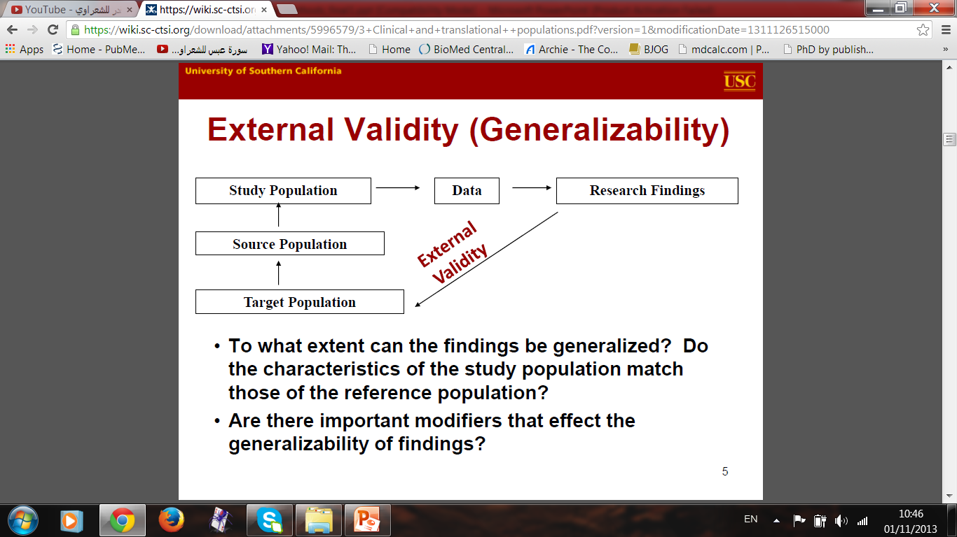

Slide 13
Population: Examples
“Participants in the Iowa Women’s Health Study will be selected by a random sample of all women ages 55 to 69 years derived from the state of Iowa automobile driver’s license list in 1985, which represents approximately 94% of Iowa women in that age group....
“We will aim to select 5 controls for every case from among individuals in the study population who had no diagnosis of autism or other pervasive developmental disorders (PDD) recorded in their general practice record and who are alive and registered with a participating practice on the date of the PDD diagnosis in the case.

Slide 14
Sample size
How to calculate the sample size?
Use the following formula if you know the prevalence or you can get the prevalence of the condition from the literature:
N= (Z 1-α) (P(1-P)/D²)
N= The sample size
Z= Confidence intervals=1- α (1.96)
P= Prevalence of the condition
D= Precision (0.05)

Slide 15
Sample size
“A survey of postnatal depression in the Middle East had documented a prevalence of 19.8%. Calculate the sample size for the prevalence of post natal depression in a population in Saudi Arabia with 0.5% precision and 80% power.

Slide 16
N= (Z 1-α) (P(1-P)/D²)
N= The sample size
Z= Confidence intervals=1- α (1.96)
P= Prevalence of the condition
D= Precision (0.05)
Thus for a condition of prevalence of 20% the sample size will be
N= 1.96x (0.20 (1-0.2)/0.5²)= 246

Slide 17
What if you there are no previous studies?
Conduct a pilot study to have an idea in about the prevalence in your population
Assume that the prevalence is 50% which will give the largest possible sample size

Slide 18
Sampling methods
Probability Sampling – each member has the same chance (equal and independent)
  Simple random sampling
  Systematic sampling
  Stratified random sampling
  Cluster sampling
  Multi-stage sampling

Slide 19
Sampling methods
Non-probability Sampling – each member does not have the same chance
  Convenience sampling
  Snowball Sampling
  Purposive Sampling
  Quota Sampling

Slide 20
Sampling methods
Example
A simple random sampling design will be used.
The mobile phone network of the STC will be chosen as a sampling frame. Computer generated random number list will be generated. STC mobile phone numbers will be the sampling element.

Slide 21
Data collection methods:
  Form [questionnaire/ case report form]
  Measurements [e.g. biometric / anthropometric]
  Laboratory investigations [types, referenced techniques / kits for each]

Slide 22
Data Collection
For each variable of interest, give sources of data and details of methods of measurement. Describe comparability of assessment methods if there is more than one group.
  Report the way of measurement, esp. for different groups
  Report the findings of any studies of the validity or reliability of assessments or measurements
  The materials and methods should describe the study in sufficient detail so that a skilled investigator in the field could replicate the study

Slide 23
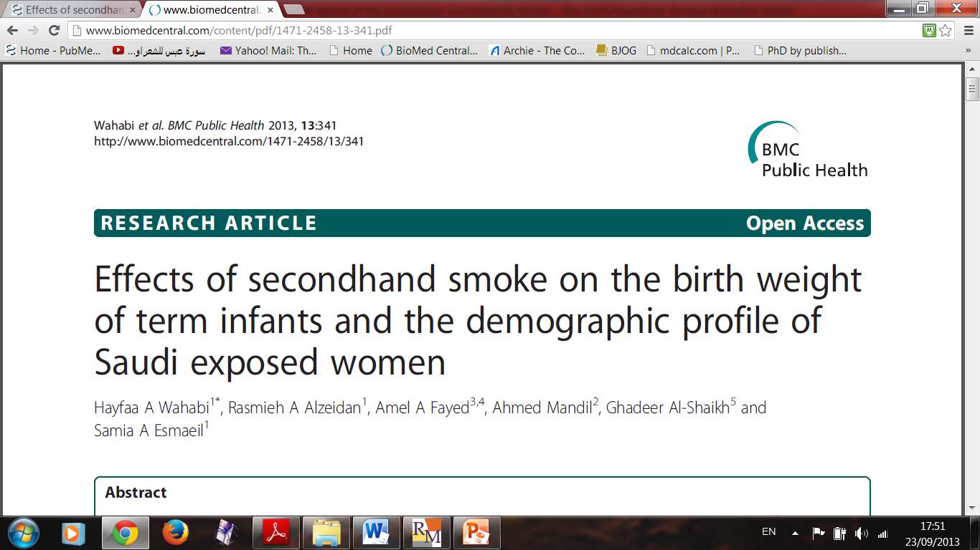

Slide 24
Data on SHS exposure will be collected by self-administered questionnaire, data on the maternal demographic characteristics and obstetric performance will be collected from maternal medical records and data for the neonatal anthropometric measurements which are measured by the attending midwife will be collected from the delivery records. The study will be carried out for 12 months

Slide 25
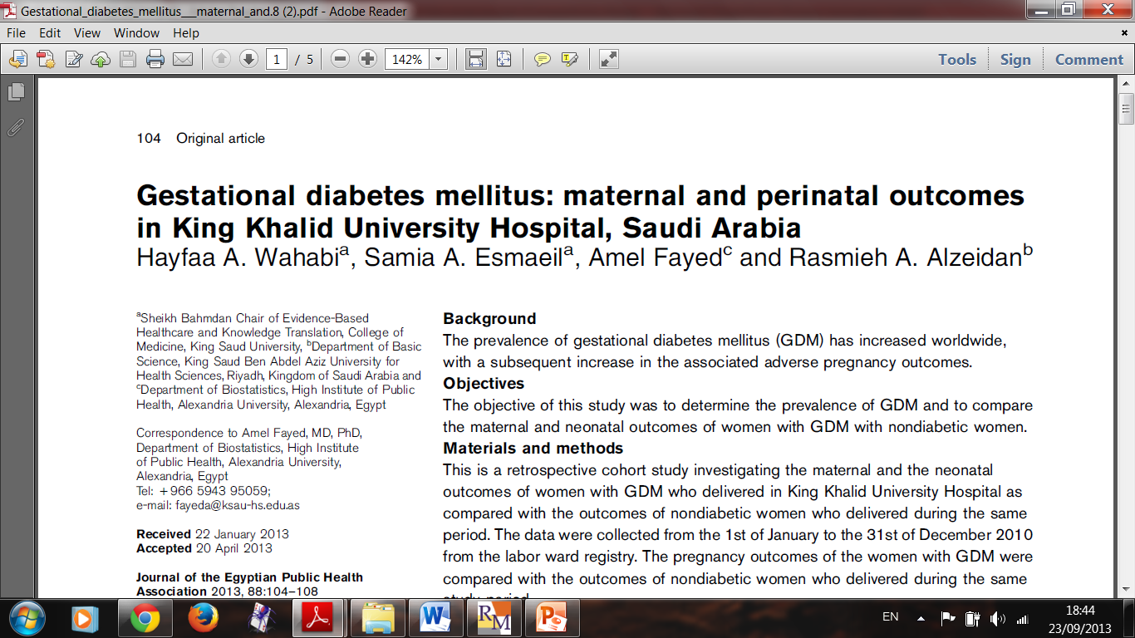

Slide 26
The BMI will be calculated for each subject using the maternal weight and height which will be recorded during the booking visit, according to the following equation; BMI=weight (kg) / height (m) ².

Slide 27
The diagnosis of gestational diabetes will be based on the results of 75g oral glucose tolerance test (OGTT) done between 24-32 weeks gestation and requires that two or more of the venous plasma glucose concentrations exceed the following: fasting, 5.3mmol/l (95 mg/dl), one hour, 10.0mmol/l (180 mg/dl), two hours, 8.6mmol/l (155 mg/dl) and three hours, 7.8mmol/l (140 mg/dl).

Slide 28
Plan for statistical techniques and
methods to be used
  Descriptive
  Analytical
  as related to study objectives / expected outcomes
  The statistical methods should be explained with enough details to enable a knowledgeable reader with access to the original data to verify the reported results

Slide 30
Statistical analysis
Statistical analyses will be performed using SPSS, version 18.0 (SPSS Inc., Chicago, IL, USA). Descriptive statistics will be computed for non-smoking pregnant women exposed and unexposed to SHS. Univariate analyses will be performed to compare the birth weight, infant’s length and head circumference between the two groups as well as to evaluate the baseline characteristics between the groups which we considered as confounding factors. Chi-squared will be used to compare dichotomous outcomes and Student’s t- test will be used to compare continuous outcomes. Stepwise logistic regression models will be used to adjust for potential confounders including maternal age, parity, BMI, GDM and gestational age (37–42 weeks). P value of < 0.05 will be considered statistically significant.

Slide 31
Expectations of Ethical Considerations
Design of a bilingual consent form (for written approval of participants)
Assurance of respect of human rights in research involving human subjects, including:
Benefits outweigh risks
Confidentiality
Anonymity
Voluntary participation

Slide 32
Ethical Consideration
Example
All participants will receive a written consent form. The interviewer will inform all participants about the purpose of the research, why they were chosen, all potential risks and benefits and that they could refuse to participate, or could withdraw from the study at any point in time.
Participants anonymity will be assured by assigning each student with a code number for the purpose of analysis only.
No incentives or rewards will be given to the participants, the purpose of the snack and refreshments is to establish a bond with the students and is offered to all students with no obligation to participate.

Slide 33
The Pilot Study
Purpose of the pilot study:
Estimate the sample size…..????
Examine the logistics
Test the questionnaire administration
Test reliability and validity of the survey…????

Slide 34
Pilot studies should have a well-defined set of
aims and objectives to ensure methodological rigor and scientific validity.
Participants pilot study should not later be included in the main study
The analysis of a pilot study should be mainly
descriptive or should focus on confidence interval
estimation.

Slide 35
Results from hypothesis testing should be treated
as preliminary and interpreted with caution, as no
formal power calculations have been carried out.
The temptation not to proceed with the main
study when significant differences are found
should be avoided.

Slide 36
Important …..Before you Start your Proposal….

Slide 37
You Have to Read Many Studies Addressing the Same Research Q

Slide 38
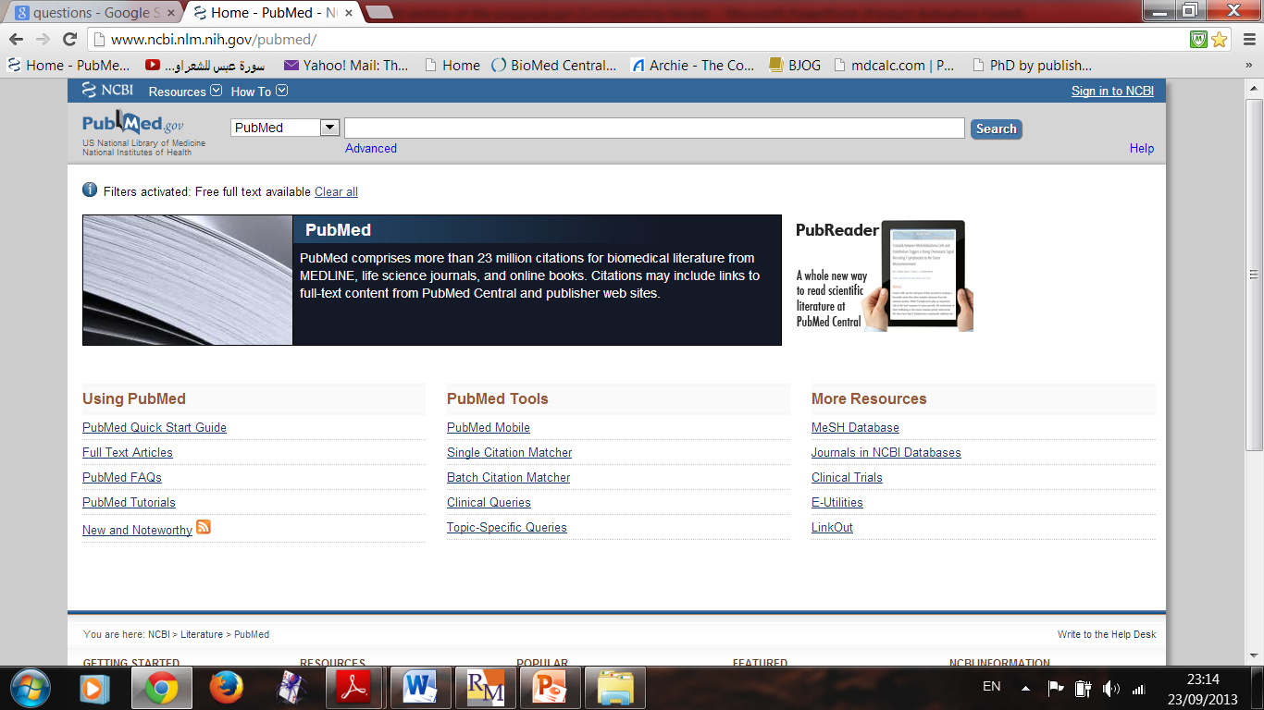

Slide 39
References / Readings
Vandenbroucke, J.P., et al., Strengthening the Reporting of Observational Studies in Epidemiology (STROBE): explanation and elaboration. Ann Intern Med, 2007. 147(8): p. W163-94.
von Elm, E., et al., The Strengthening the Reporting of Observational Studies in Epidemiology (STROBE) statement: guidelines for reporting observational studies. Lancet, 2007. 370(9596): p. 1453-7.
Uniform Requirements for Manuscripts Submitted to Biomedical Journals: Writing and Editing for Biomedical Publication, International Committee of Medical Journal Editors, Updated April 2010.
Ebrahim S, Clarke M. STROBE: new standards for reporting observational epidemiology, a chance to improve. Int J Epidemiol. 2007.
MacMahon B, Weiss NS. Is There a Dark Phase of This STROBE? Epidemiology 2007;18: 791.
Kuller LH, Goldstein BD. Suggestions for STROBE Recommendations. Epidemiology 2007;18: 792-3.

Slide 40


Slide 41


