Slide 1
Writing the “Results” & “Discussion” sections
Awatif Alam
Professor
Community Medicine
Medical College/ KSU

Slide 2
Objectives of the session:
Reviewing the scientific writing style
Focusing on the structure and contents of Results & Discussion sections

Slide 3
Structure & Content
The result section should be written in the past tense.
Avoid long, complex statements - break these down into several subcomponents, each with a separate entity.
Use positive statements and avoid non-committal statements (e.g. use “the data indicate...” rather than “the data could possibly suggest...”).
Avoid non-informative abbreviations such as “etc.”, or “and so on”.
Avoid repeating facts and thoughts.
Be clear, concise and don’t include irrelevant data or discussion or images.

Slide 4
How to write results section?
It constitutes the new knowledge contributed to the reader.
The purpose of this section is to summarize and illustrate the findings in an orderly and logical sequence.
Do not describe methods that have already been described in the M&M section or that have been omitted.

Slide 5
Introduction to the Results
Report the key findings, but does not say why.
Only present facts and observations:
No opinions or interpretations!
Clear and concise summary of the data that was collected and the results of any statistical tests.
Each statistical test has its own format for reporting which should be adhered to.
The results section is one of the most feared sections of the report.
It is the core or heart of the paper.

Slide 6
Content of results:
The results section is purely objective.
It should start with descriptive (summary) statistics (e.g. mean, median, range etc.) before reporting any statistical tests.
A summary table of descriptive statistics can be provided – only display information once and in one format (e.g. Written or table, table or chart).
Use graphs where meaningful.
Ensure axis are consistent, graphs and axis are titled.
Report the statistical tests used in the study.
Each statistical test has its own format for reporting which should be adhered to.

Slide 7
Methods of presenting the data
Directly in the text
In a table
In a figure
All figures and tables must be accompanied by a textual presentation of the key findings.
Never have a table or figure that is not mentioned in the text.
4. Do not include raw data.

Slide 8
Results/Text
The text should:
Guide readers through tables and figures
Summarize most important findings
Stress on the major points
Provide clarifying information
Point to anomalies in the results
Provide appropriate statistical details
Begin each paragraph with a result
Give specific comparisons

Slide 9
Results/Text
Use the text of the paper to state the results of the study, then refer the reader to a table or figure where they can follow the data by themselves.
Describe your data and the patterns, trends, and relationships observed.
Proceed from most general features of the data to more specific results.

Slide 10
Results/Figures:
In drawing figures, make sure to:
Label all axes
Mention all units
Use same scaling for figures that need to be compared
Put caption BELOW the figure
Number the figures sequentially
Include the figure immediately after the first reference to it in the text (unless page layout does not permit)

Slide 11
Figures:
Put all required info on the figure (if possible) not in caption or text.
Avoid crowded figures.
Avoid the unnecessary use of color.

Slide 12
Results/Tables:
Label all columns
Mention all units
Put caption ABOVE the table
Number the tables sequentially
Include the table immediately after the first reference to it in the text (unless page layout does not permit)
Use clear, concise, descriptive titles and explanatory legends for tables and figures

Slide 13
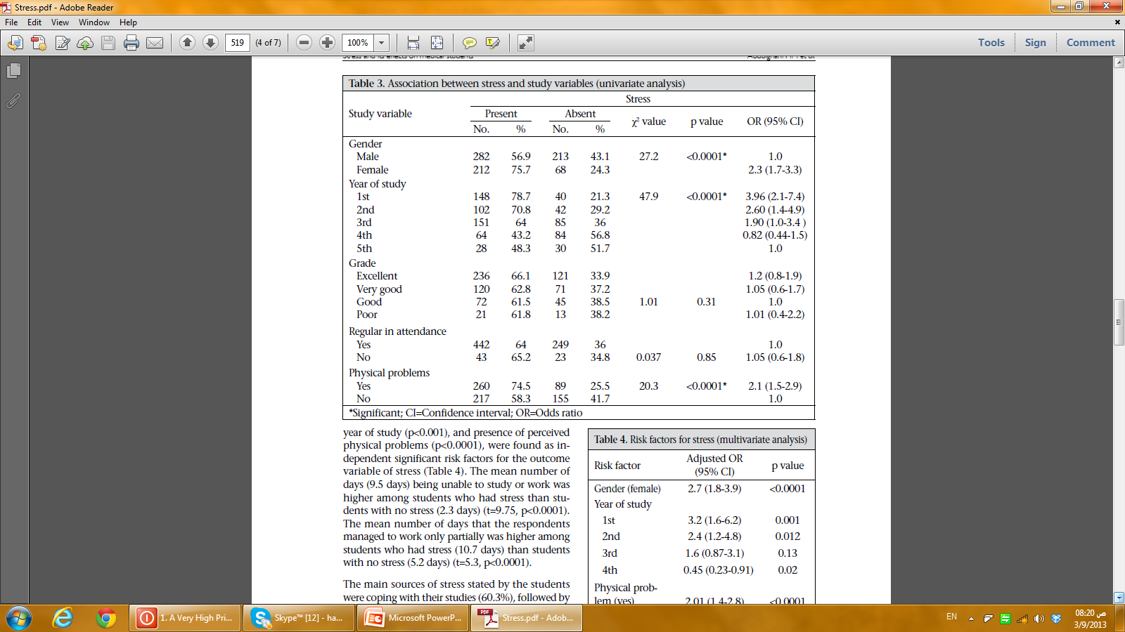

Slide 14
Table or Figure ?
Use EITHER table or figure for a particular subset of results.
Give an estimate of the measurement error.
Present detailed data in figures and tables to keep written data to a minimum.
Also include “negative” results:
- They are often the source of the major discoveries
You must refer in the text to each figure or table in your paper.

Slide 15
Tables & Figures
Tables are appropriate for large or complicated data sets that would be difficult to explain clearly in text.
Figures are appropriate for data sets that exhibit trends, patterns, or relationships that are best conveyed visually.
Any table or figure must be sufficiently described by its title and caption or legend, to be understandable without reading the main text of the results section.
Do not include both a table and a figure showing the same information.

Slide 16
Results “Use the same order as in Methods”
Material & Methods
Study subjects
Study protocol
Calculations
Statistical analysis
Results
Clinical characteristics
Systemic effects
Specific effects
Adverse effects

Slide 17
Visual data
Type of visual | What it summarizes?
Flow charts (algorithms) | Protocols
Tables | Complex data
Line graphs | Response to treatment
Bar graphs | Complex data to compare categories
Pie charts | Percentage of the whole
Diagrammatic illustrations | Simplify or enhance figures

Slide 18
Results:
Include
Don’t Include
Summary of your findings (i.e. averages, trends)
Tables and Figures
References to tables and figures
Raw data
The same information twice
Too many figures
Interpretation of your results
NO “interpretation” of the findings.

Slide 19
Discussion
Opinions can be mentioned
Shows what new things were learned from the experiments/data
No new results? Replication.
What is the relevance of the present results – what did we learn?
Explain, analyze, interpret, compare
Mention the things that are not readily observable from the data

Slide 20
How to write the Discussion?
It is the hardest section to write.
Its primary purpose is to show the relationships among observed facts.
It should end with a short summary or conclusion regarding the significance of the work.

Slide 21
Discussion:
Specific
Address your hypothesis with reference to your results
Explain and put findings in context (references)
Comment on your finding’s significance and potential for future study.
Conclude from the findings
General

Slide 22
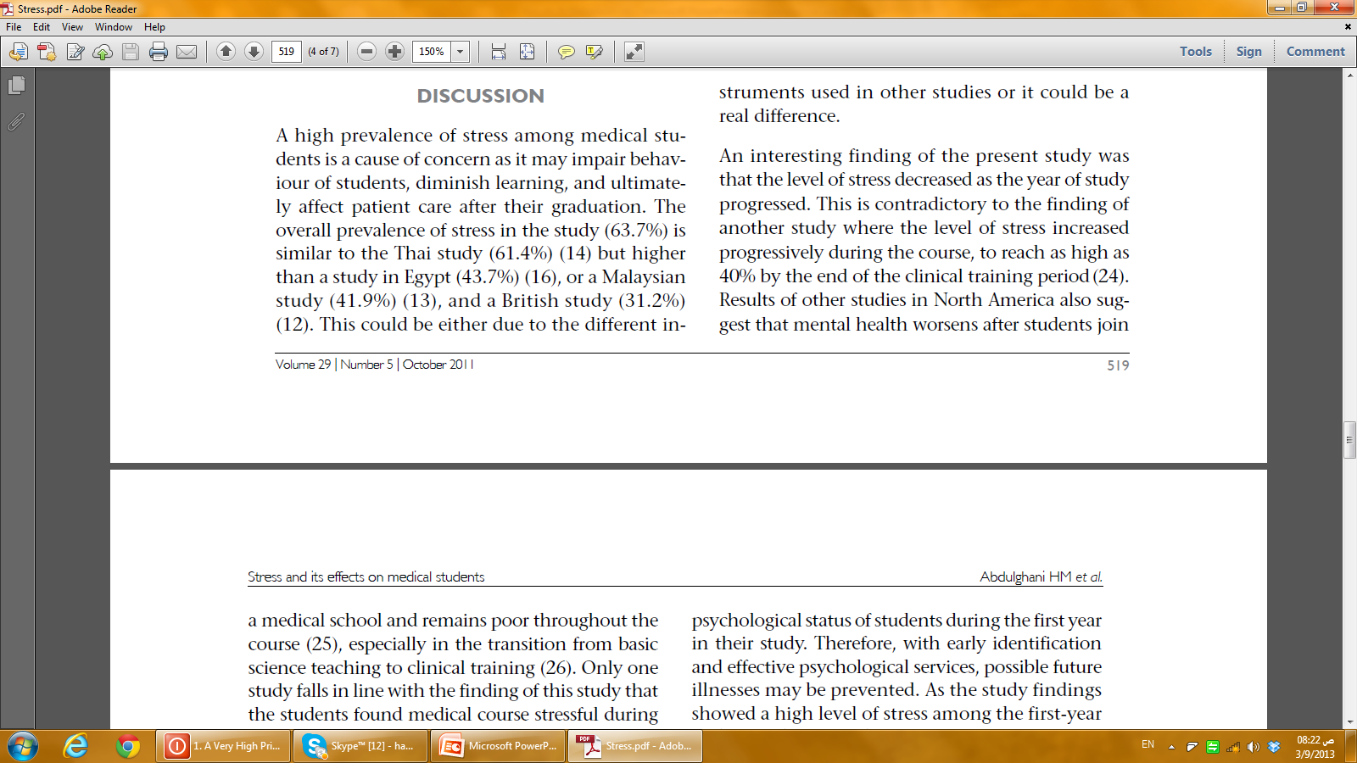

Slide 23
Components of the discussion:
Try to present the principles, relationships, and generalizations shown by the results.
Point out any exceptions or any lack of correlation and define unsettled points.
Show how your results and interpretations agree or contrast with previously published work.
Discuss the theoretical implications of your work, and any possible practical applications.
State your conclusions as clearly as possible.
Summarize your evidence for each conclusion.

Slide 24
Discussion
Include
Don’t Include
Most papers from the introduction
References to tables and figures
Summary / Conclusion
Detailed account of your results
Any new ideas not set up in the introduction

Slide 25
Summary: Discussion
Essential findings.
The findings support or refute the hypotheses.
The results are similar to or different from previous research.
Limitations or problems .
Additional research based on the findings.
Conclusion/Recommendations.

Slide 26
Conclusions
What do you want the reader to remember?
Should be self-contained (no references)
Typically 2-3 paragraphs (1 idea per paragraph)

