Slide 1
Atherosclerosis: A Surgical Look
Badr Aljabri , MD, FRCSC
Associate Professor & Consultant
Vascular Surgery
King Saud University

Slide 2
What is Atherosclerosis?
Clogging, narrowing, and hardening of large and medium-sized arteries

Slide 3
What are the risk factors for Atherosclerosis?
Non-Modifiable Risk Factors:
Male gender
Advanced age
Family history
Modifiable Risk Factors:
Major
Smoking
Hypertension
Diabetes
Hyperlipidemia
Minor
Homocystenemia
Obesity
Hypercoaguable state
Physical inactivity

Slide 4
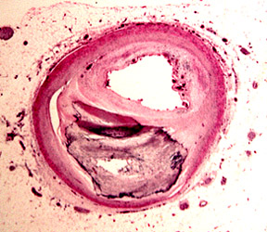
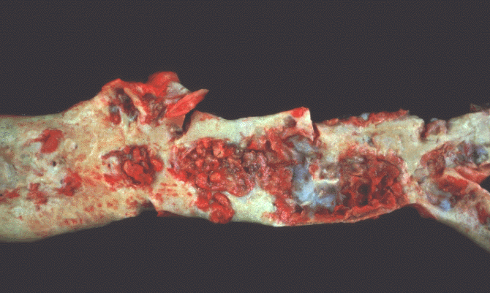
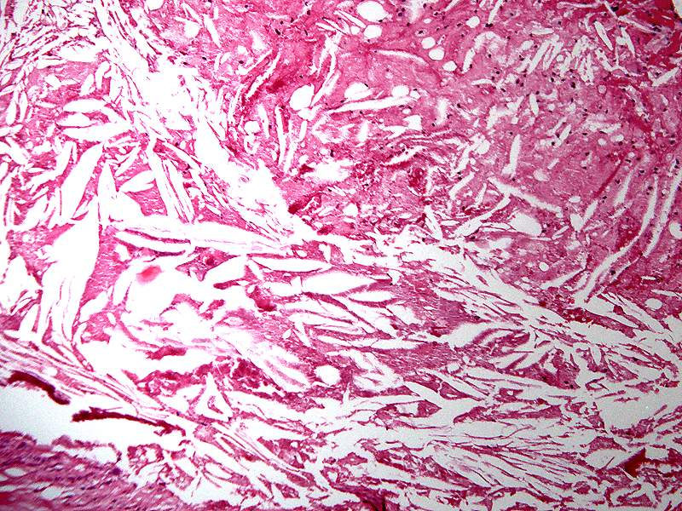
Pathogenesis

Slide 5
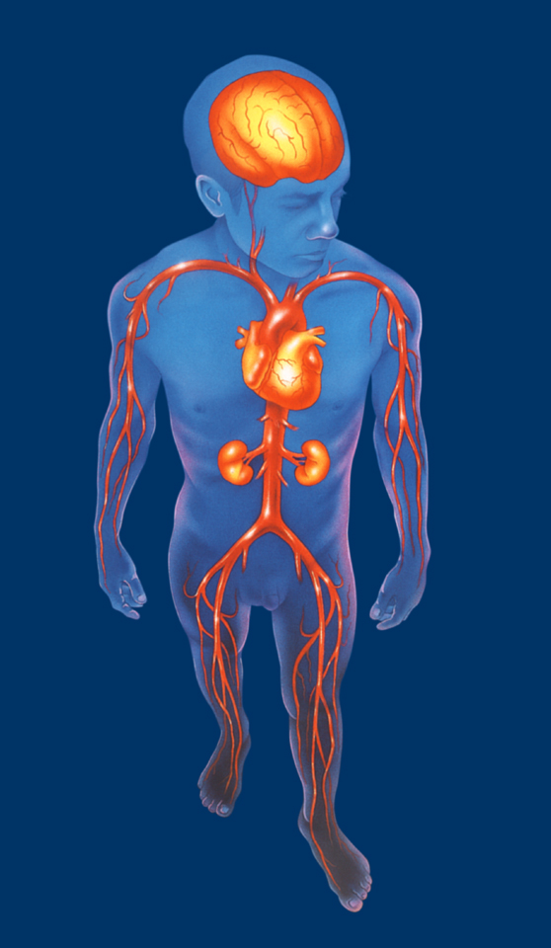
What is the Clinical Spectrum of Atherosclerosis?
Cerebrovascular disease
Coronary artery disease
Renal artery Diseases
Visceral arterial disease
Peripheral arterial disease
Intermittent claudication
Critical limb ischemia

Slide 6
What is the burden of Atherosclerosis?

Slide 7
Let’s Talk about PAD

Slide 8
Why it is important to recognize patients with PAD?
PAD is a marker of systemic atherosclerosis
Patients with either symptomatic or asymptomatic PAD generally have widespread arterial disease

Slide 9
Why it is important to recognize patients with PAD?
Coexisting vascular Disease:
CAD-- 35 % to 92%
CVD-- 25 % to 50%

Slide 10
Why it is important to recognize patients with PAD?
Cause of death:
CAD– 40%-60%
CVD– 10%-20%
Non-cardiovascular causes--Only 20% to 30 %
Patients with PAD have a 6 fold increased risk of cardiovascular disease mortality compared to patients without PAD

Slide 11
Natural History
Annual risk :
- Mortality 6.8%
- MI 2.0%
- Intervention 1.0%
- Amputation 0.4%
Ouriel K, Lancet 2001; 358: 1257-64.

Slide 12
How do patients with PAD present?
Symptomatic
Intermittent claudication
Critical Limb Ischemia
Pain at rest
Tissue loss
Gangrene
Asymptomatic

Slide 13
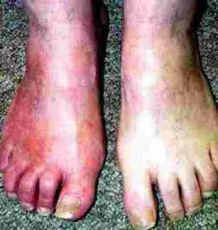
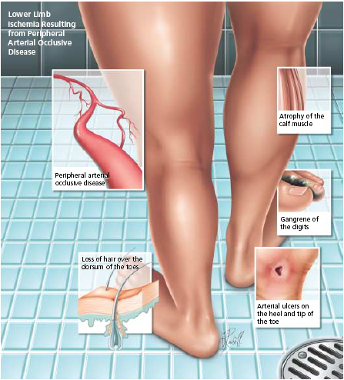
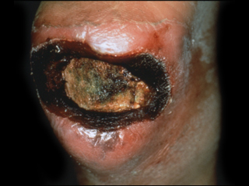
How do patients with PAD present?

Slide 14
How do we diagnose PAD?
Symptomatic
History
Physical Examination
ABI measurement
Non-invasive tests (arterial duplex,
CTA, MRA)
Invasive test (Conventional angiogram)
Asymptomatic
ABI measurement

Slide 15
How do we diagnose PAD?
Symptomatic
10%
Asymptomatic
90%

Slide 16
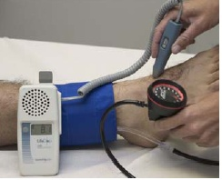
Ankle Brachial Index
ABI= Ankle SBP(PT or DP)/ Highest Arm SBP

Slide 17
Ankle Brachial Index
ABI value | Indicates
<0.9 | Abnormal
0.8- 0.9 | Mild PAD
0.5- 0.8 | Moderate PAD
<0.5 | Severe PAD
<0.25 | Very Severe PAD
The ABI has limited use in evaluating calcified vessels that are not compressible as in Diabetics

Slide 18
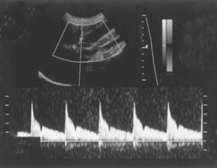
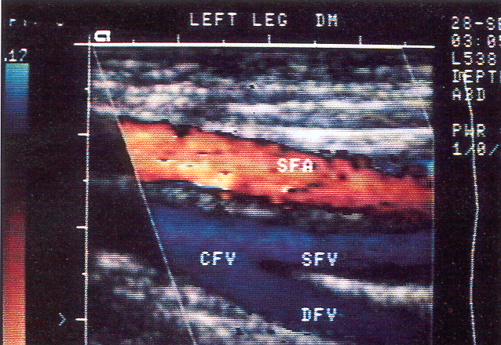
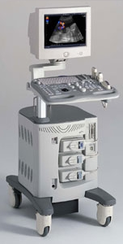
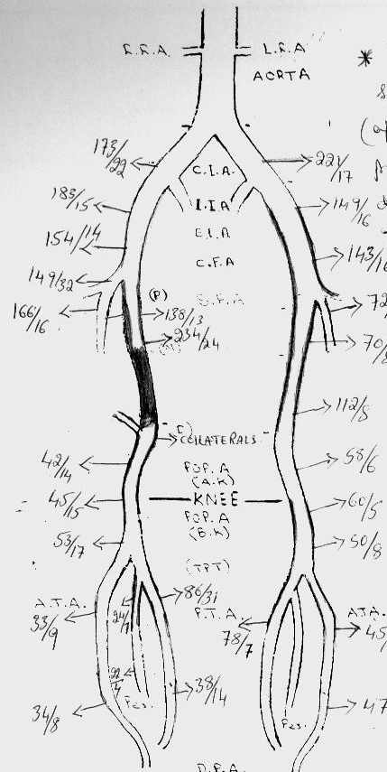
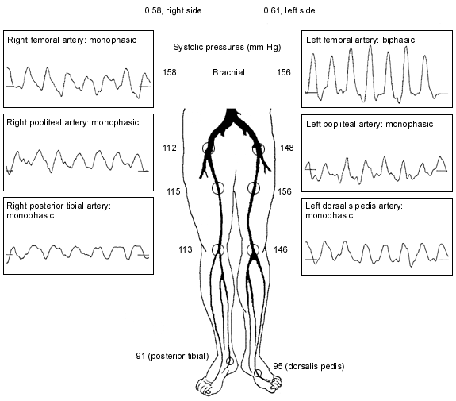
Arterial duplex

Slide 19
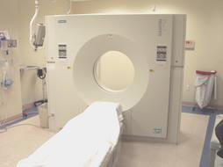
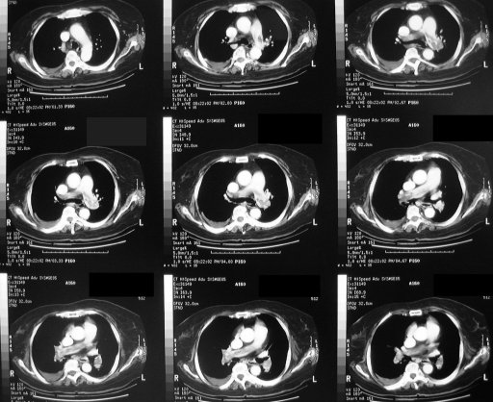
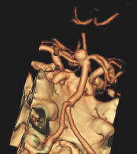
CTA

Slide 20
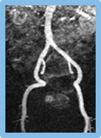
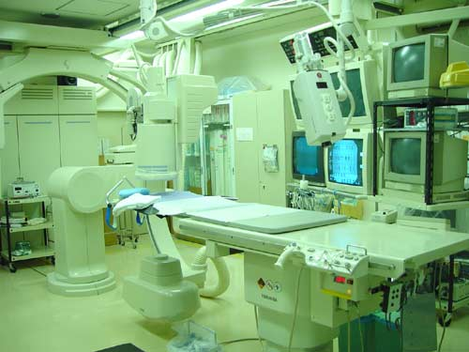
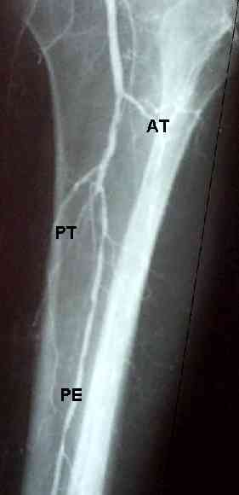
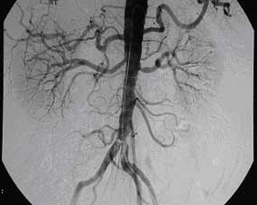
Angiogram

Slide 21
What are the Goals of treating patients with PAD?
Relief symptoms
Improve quality of life
Limb salvage
Prolong survival

Slide 22
Strategies in treating patients with PAD
Risk Factors Modification
Improve Lower Limb Circulation

Slide 23
Risk Factors Modification
Diet and weight control
Exercise
Antiplatlets
Hypertension control
Diabetes control
Lipid control
Smoking Cessation

Slide 24
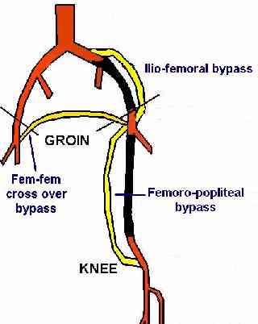
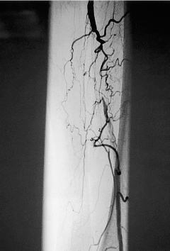
Strategies in treating patients with PAD
Improve Lower Limb Circulation
Conservative (Exercise Program)
Intervention ( Revascularization)
- Angioplasty +/- Stenting
- Surgical Bypass

Slide 25
Percutanous Transluminal Angioplpasty PTA

Slide 26
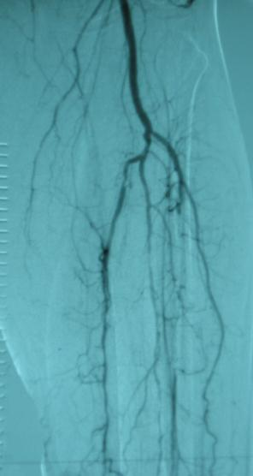
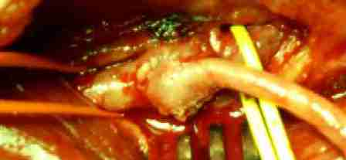
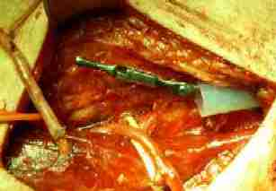
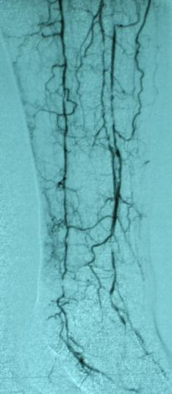
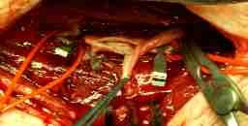
Surgical Bypass

Slide 27
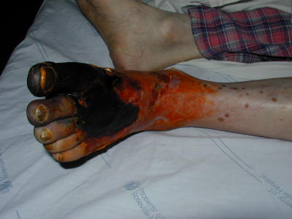
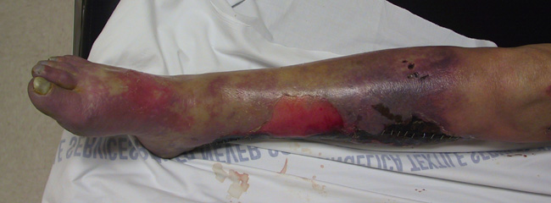
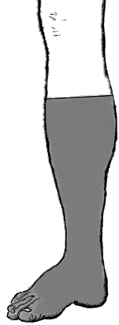
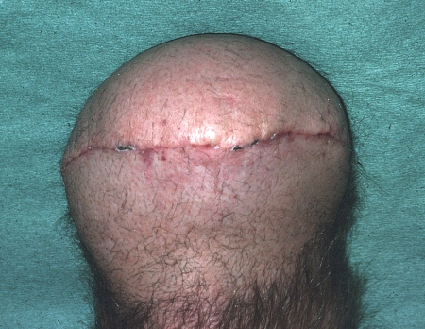
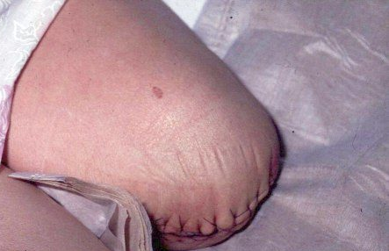
Last Strategy in treating patients with PAD
Major amputation
Primary vs Secondary
Minor vs BKA vs AKA

Slide 28
NOW
Let’s Talk about Carotid Artery Disease

Slide 29
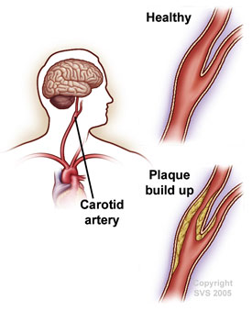
Why it is important to recognize patients with CAS?
Stroke is the third leading cause of death and a principal cause of long-term disability in much of the western countries

Slide 30
How do patients with CAS present?
Symptomatic
Transient Ischemic Attacks (TIA)
Amurosis Fugax (Transient Visual Loss)
Stroke
Asymptomatic

Slide 31
How do we diagnose CAS?
Symptomatic
History
Physical Examination
Non-invasive tests (arterial duplex,
CTA, MRA)
Invasive test (Conventional angiogram)
Asymptomatic
Carotid Bruit
Arterial duplex

Slide 32
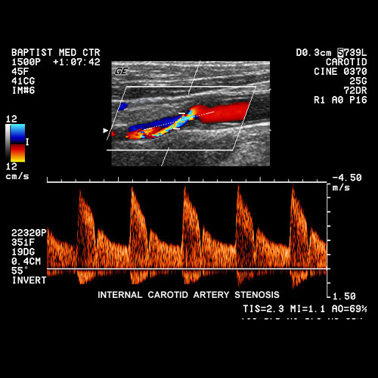
Arterial duplex
Stenosis is determined by measuring Velocities NOT anatomical diameter

Slide 33
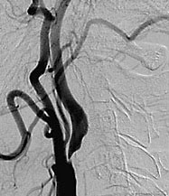
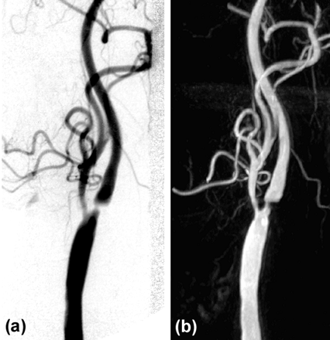
Angiogram

Slide 34
What are the Goals of treating patients with CAD?
Prevent Stroke
Prolong survival

Slide 35
Strategies in treating patients with CAD
Risk Factors Modification
Improve Brain Circulation

Slide 36
Risk Factors Modification
Diet and weight control
Antiplatlets
Exercise
Hypertension control
Diabetes control
Lipid control
Smoking Cessation

Slide 37
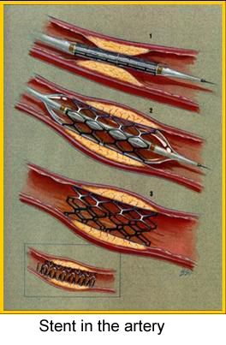
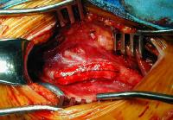
Strategies in treating patients with CAS
Improve Brain Circulation
Intervention ( Revascularization)
- Carotid Endarterectomy
- Angioplasty +/- Stenting

Slide 38
What are the indications to intervene?
Symptomatic
> 70% stenosis- NACET
Decrease Stroke at 2 years from 26% to 9%
50-69% stenosis- marginal benefit, greater for male
Recovered Ischemic Stroke Patients
Asymptomatic
> 60% stenosis- ACAS
Decrease Stroke at 4 years from 11% to 5%
(should be done in high volume centers only)

Slide 39
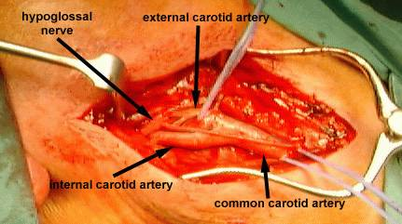
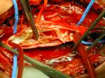
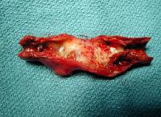
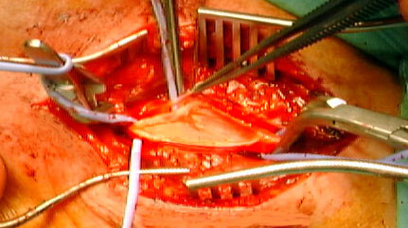
Carotid Endarterectomy: The Standard of Care

Slide 40
Carotid Angioplasty and Stenting
This interventional procedure is currently under investigation
Relative Indications
Hostile Neck
Hostile Carotid Disease
As part of a Randomized Clinical Trial

Slide 41
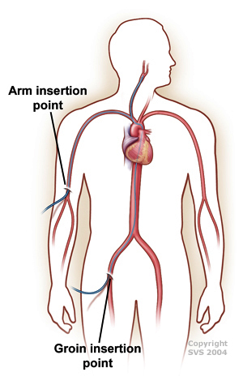
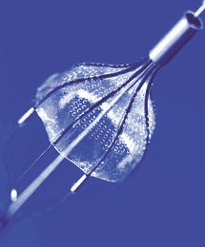
Carotid Angioplasty and Stenting

Slide 42
Carotid Angioplasty and Stenting

Slide 43
Acute Limb Ischemia

Slide 44
What is an Acute Limb Ischemia?
Sudden decrease or worsening in the limb perfusion causing a potential threat to the limb viability resulting from a sudden obstruction of the arterial system

Slide 45
What are the causes of acute arterial occlusion ?
Embolus
Thrombosis
Others
Trauma
Iatrogenic
Arterial dissection

Slide 46
What is the possible source for an embolus?
Spontaneous (80%)
Cardiac source
arrhythmias, MI, prosthetic valve, endocarditis
Non-Cardiac source
Proximal AS plaque, Proximal Aneurysm, Paradoxical emboli
Iatrogenic (20%)
Angiographic manipulation
Surgical manipulation

Slide 47
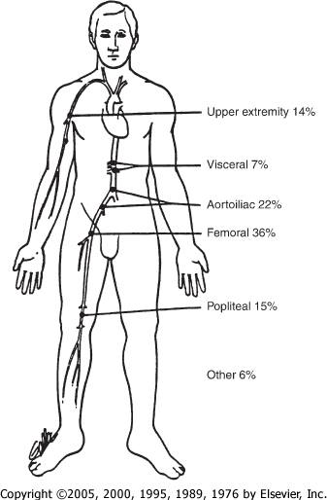
What are the common sites for embolus lodgment in the arterial tree?

Slide 48
How do patients with acute limb ischemia present?
Sudden onset of diffuse and poorly localized leg pain
6 Ps
Paresthesias
Pain
Poikilothermia (coolness)
Pallor
Pulselessness
Paralysis

Slide 49
Investigations
Acute Limb Ischemia is a
CLINICAL DIAGNOSIS
If time allows, especially if atherosclerotic thrombosis is suggested, preoperative angiography is often wise

Slide 50
Goal of treating patients with Acute Limb Ischemia
Rapid restoration of adequate arterial perfusion without the development of morbid local or systemic complications

Slide 51
Treatment
EMEGENCY (Golden time is 6 hours)
ABC
IV Heparin (anticoagulation)
Rapid surgical thromboembolectomy
+/ - surgical bypass
+/- thrombolytic therapy
+/- primary amputation

Slide 52
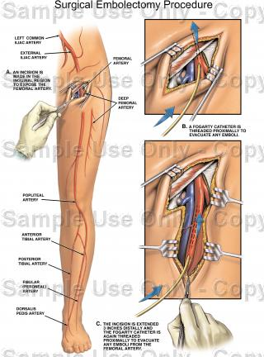
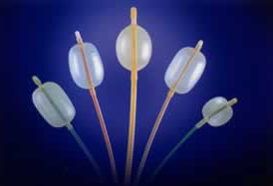
Surgical Thrmboemblectomy Procedure

Slide 53
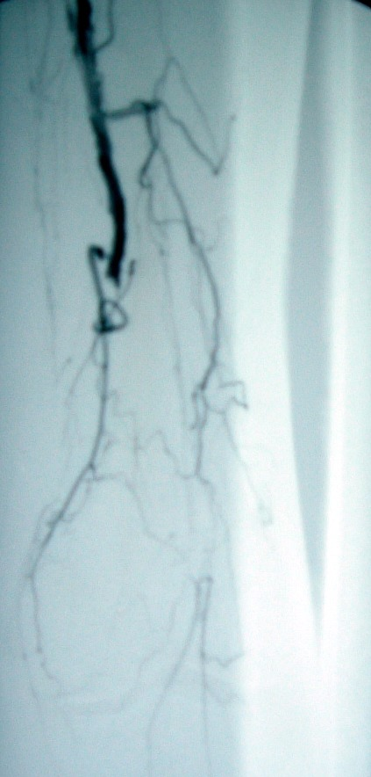
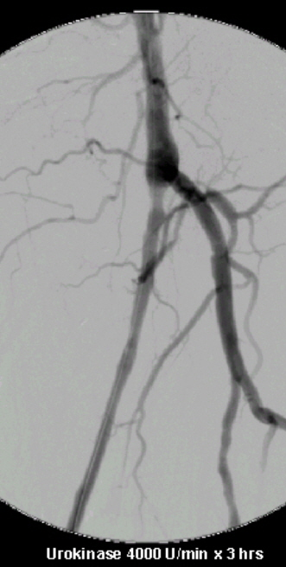
Thrombolysis

Slide 54
What do we worry about after revascularization?
Reperfusion Injury
Local
Compartment Syndrome
Systemic
Hyperkalemia
Acidosis
Myoglobulinuria

Slide 55
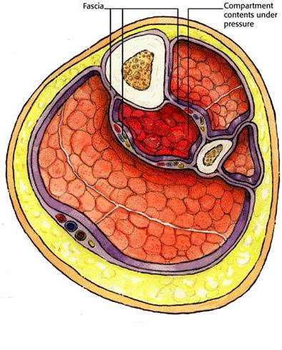
Compartment Syndrome

Slide 56
Thank You

