Slide 1
Surgical Infections
Awadh Alqahtani MD,MSc,FRCSC(surgery)FRCSC(oncology)
FISC
Surgical oncologist and laparoscopic Bariatric surgeon
24/09/2013

Slide 2
Infection
Infection is defined by:
  Microorganisms in host tissue or the bloodstream
  Inflammatory response to their presence.

Slide 3
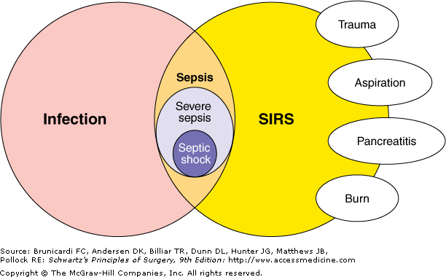

Slide 4
Inflammatory Response
Localized:
  Rubor, Calor, Dolor, Tumor, and functio laesa (loss of function)
Systemic:
  Systemic Inflammatory Response Syndrome (SIRS)

Slide 5
S.I.R.S.
Any Two of the Following Criteria
  Temperature: < 36.0, >38.0
  Heart Rate : >90
  Respiratory Rate: >20
  WBC: <4,000, >12,000

Slide 6
Sepsis
Definition: SIRS plus evidence of local or systemic infection.
Septic Shock
Definition: Sepsis plus end organ hypoprofusion. Mortality of up to 40%

Slide 7
Introduction
Surgery, trauma, non-trauma local invasion can lead to bacterial insult. Once present, bacteria, initiate the host defense processes. Inflammatory mediators (kinins, histamine, etc.) are released, compliment and plasma proteins are released, PMN’s arrive, etc

Slide 8
Risk
Many established factors have a role in infection.
These can be either surgical factors or patient-specific factors.
Patient-specific factors can be further defined as either local or systemic

Slide 9
Surgical Risk Factors
Type of procedure
Degree of contamination
Duration of operation
Urgency of operation

Slide 10
SPREAD OF SURGICAL INFECTIONS
NECROTIZING INFECTION
ABSCESSES
PHLEGMONS AND SURPERFICIAL INFECTIONS
SPREAD OF INFECTIONS VIA THE LYMPHATIC SYSTEM
SPREAD OF INFECTION VIA BLOODSREAM

Slide 11
COMPLICATIONS OF SURGICAL INFECTION
Fistulas and sinus tract
Suppressed wound healing
Immunosuppression and superinfection
Bacteremia
Organ dysfunctionSepsis, and systemic inflammatory response syndrome

Slide 12
CLINICAL FINDIINGS AND DIAGNOSIS
Physical examination
Warmth, erythema, induration, tenderness
Laboratory findings General findings:
- leucocytosis, acidosis, and signs of disseminated intravascular coagulation
- Cultures
Imaging studies
Source of infection

Slide 13
TREATMENT
Incision and drainage
Excision
Antibiotics
Nutritional support

Slide 14
Infections
Two main types
Community-Acquired
Hospital-Acquired

Slide 15
Community-Acquired
Skin/soft tissue Cellulitis:
Group A strep
Carbubcles/furuncle: Staph aureus
Necrotizing: Mixed
Hiradenitis suppurativa: Staph aureus
Lymphangitis: Staph aureus

Slide 16
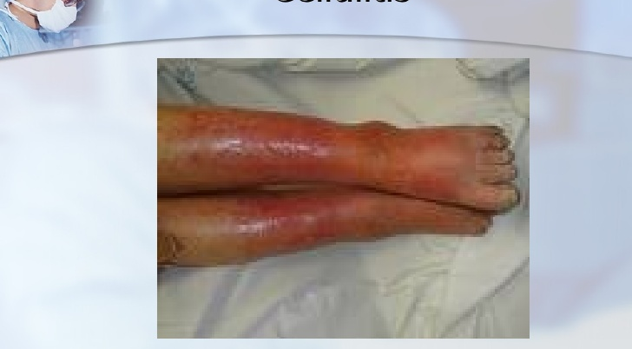
Cellulitis

Slide 17
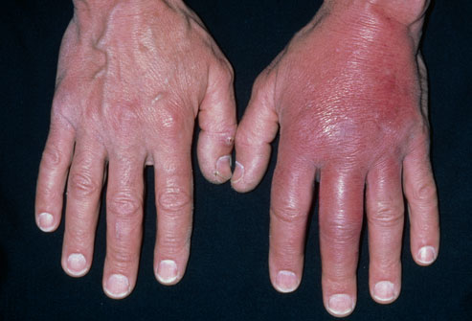
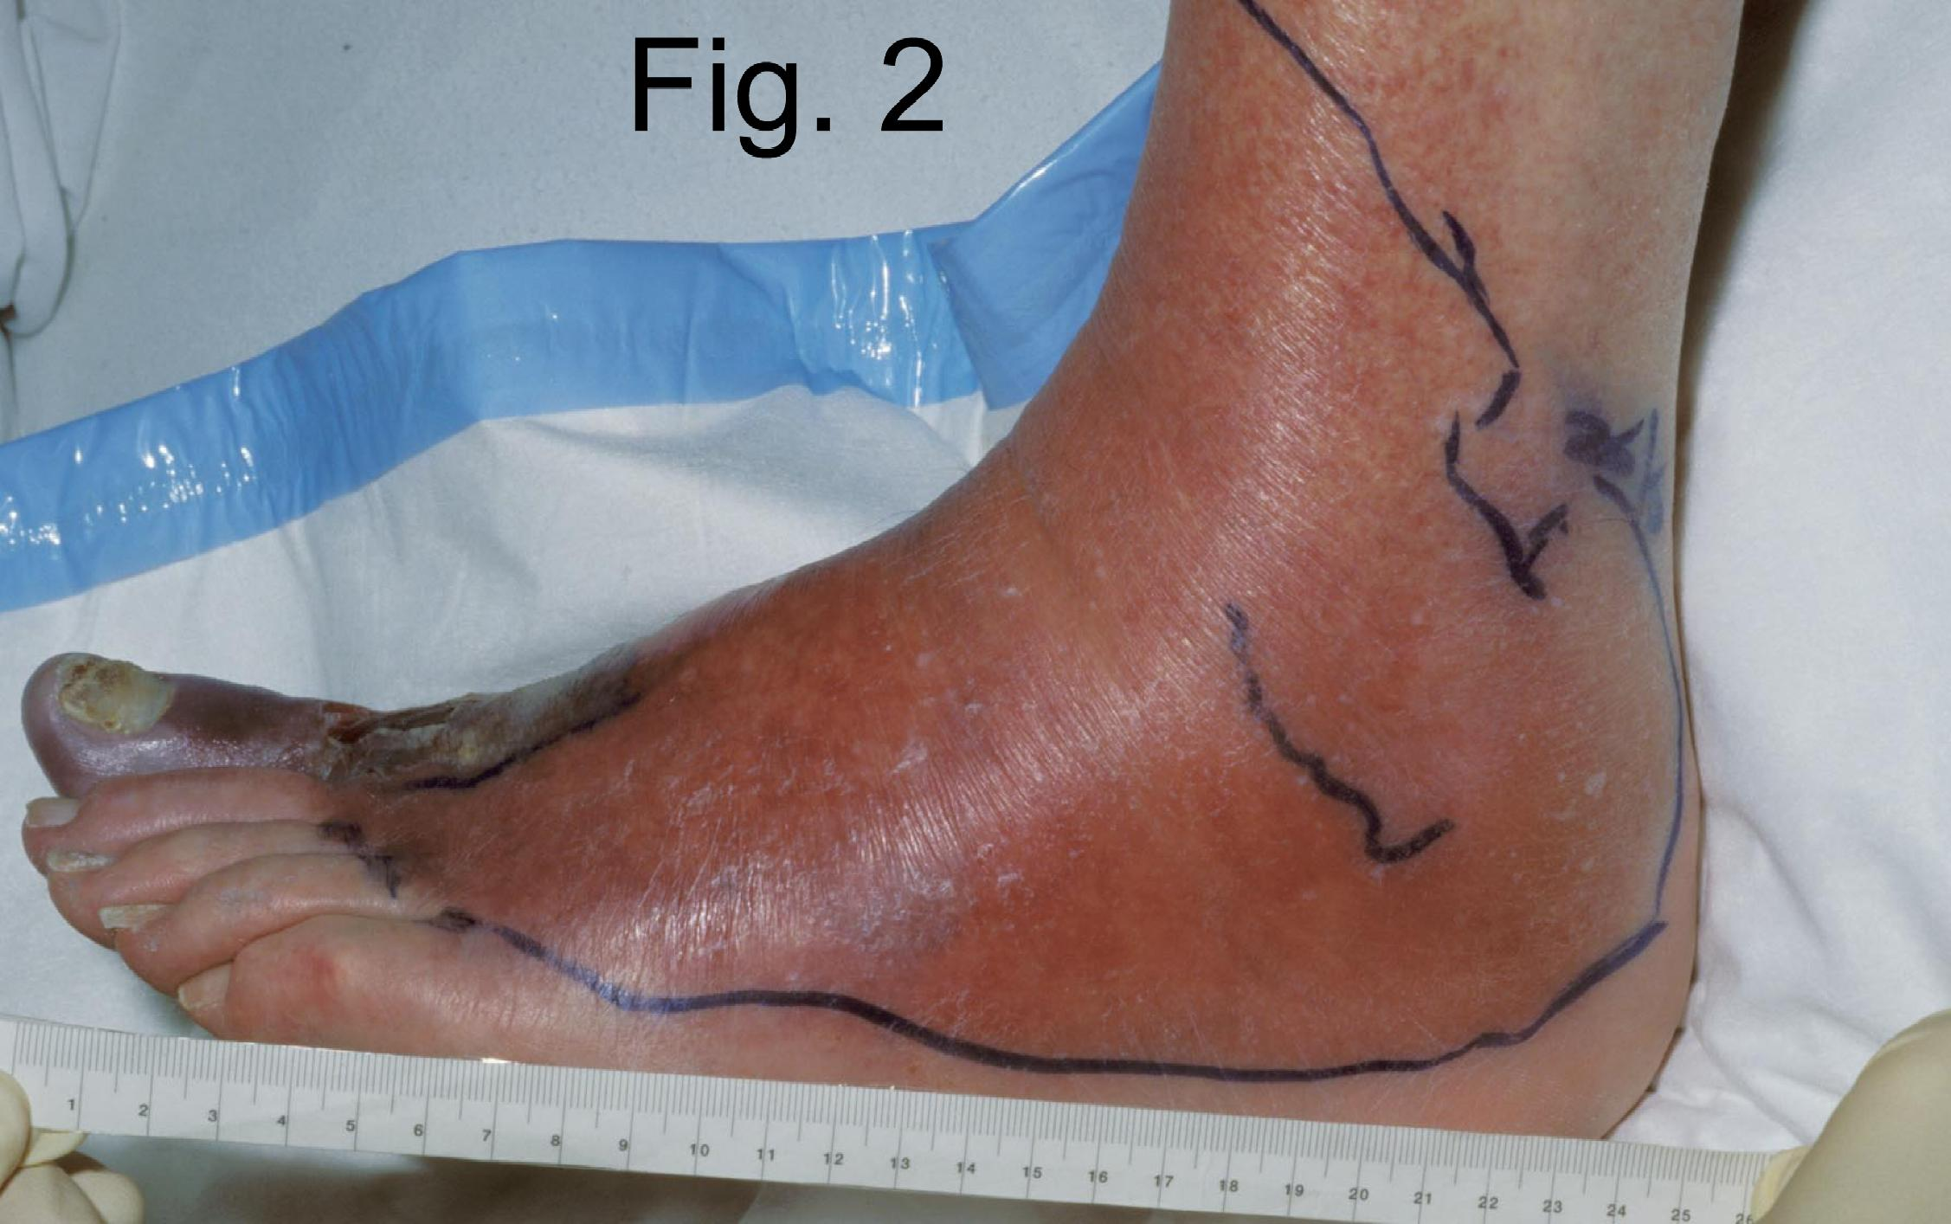
Cellulitis

Slide 18
Cellulitis
Definition: Diffuse infection with severe inflammation of dermal and subcutaneous layers of the skin
Diagnosis: Pain, Warmth, Hyperesthesia
Treatment: Antibiotics.
Common Pathogens: Skin Flora (Streptococcus/Staphylococcus)

Slide 19
FURUNCLES AND CARBUNCLES
Furuncles and carbuncles are cutaneous abscess that begin in skin glands and hair follicles.
If the pilosebaceous apparatus becomes obstructed at the skin level, the development of a furuncle can be anticipate
A carbuncle is a deep –seated mass of fistulous tracts between infected hair follicles.
Funruncles are the most common surgical infections, but carbuncles are rare

Slide 20
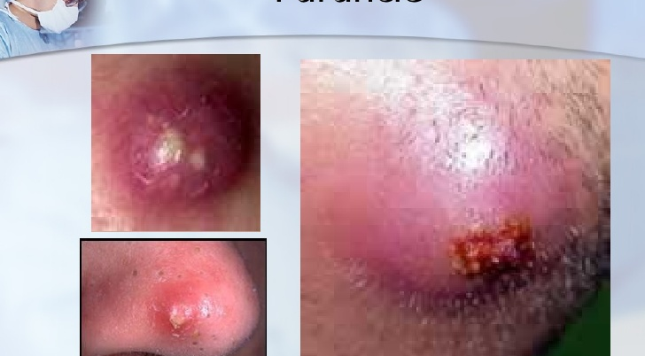
Furuncle

Slide 21
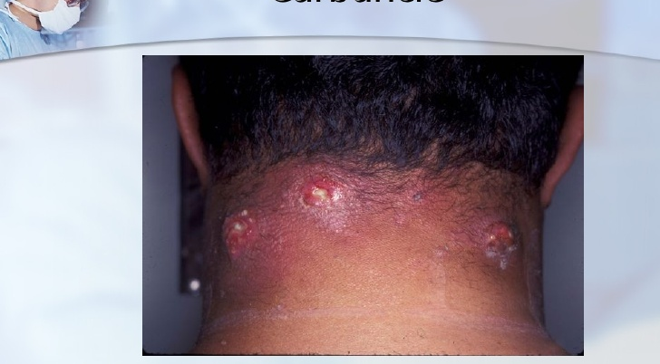
Carbuncle

Slide 22
HIDRADENITIS
Serious skin infection of the axillae or groin Consisting of multiple abscesses of the apocrine sweat glands.
The condition often becomes chronic
The cause is unknown but may involve a defect of terminal follicular epithelium

Slide 23
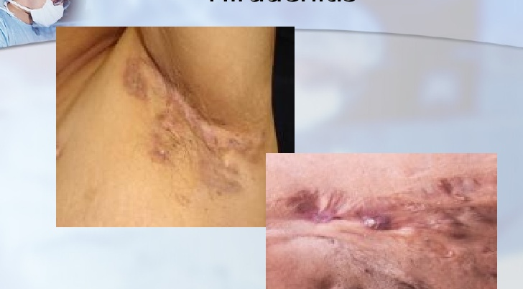
Hiradenitis

Slide 24
TREATMENT
The classic therapy of furuncle is drainage, not antibiotics.
Invasive carbuncles must be treated by excision and antibiotics.
Hidradenitis is usually treated by drainage of the individual abscess and followed by careful hygeine

Slide 25
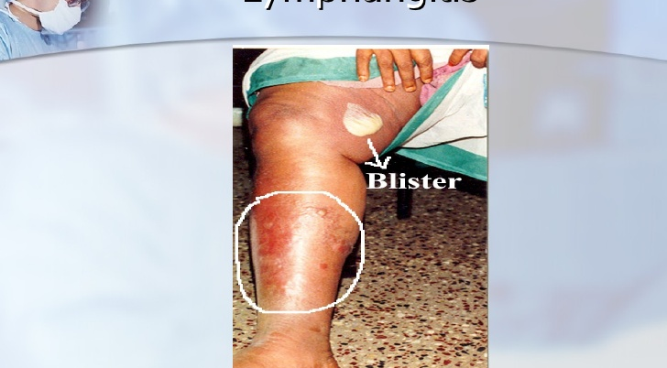
Lymphangitis
Notes:
Lymphangitis arising from cellutitis produces red, warm, tender streaks 3-4 mm wide leading from the infetion along lymphatic vessels to the regional lymph nodes.

Slide 26
Community-Acquired
Breast Abcess
Staphylococcal infection
Usually post-partum
Treatment
MRSA is uncommon

Slide 27
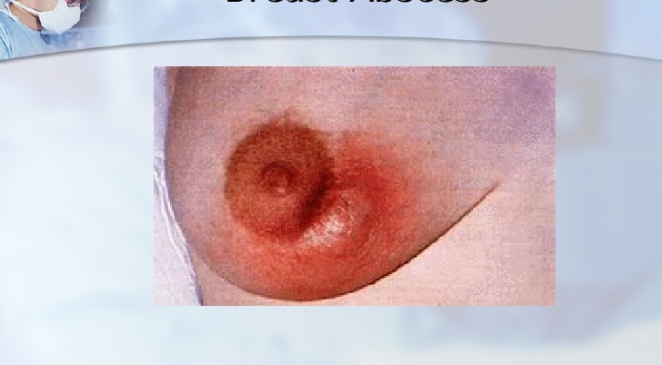
Breast Abscess

Slide 28
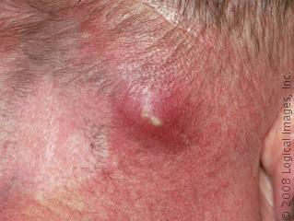
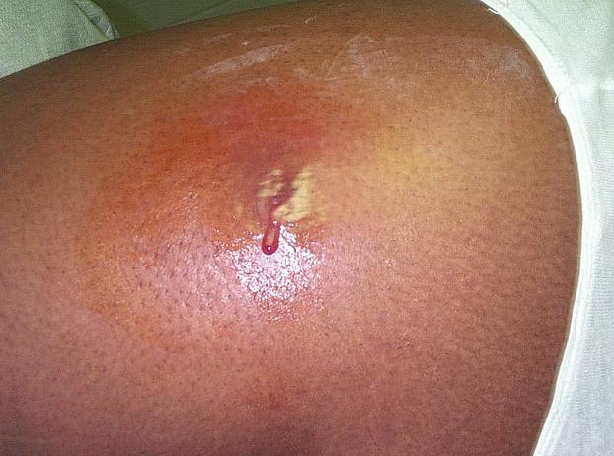
Abscess

Slide 29
Abscess
Definition: Infectious accumulation of purulent material (Neutrophils) in a closed cavity
Diagnosis: Fluctuant: Moveable and compressible
Treatment: Drainage

Slide 30
Community-Acquired
Peri-rectal abcess
Results from infection of the anal crypts Can be extensive
Can result in bacteremia
Treatment

Slide 31
Community-Acquired
Hand Infections
Paronychia
Usually staph
Where?
Treatment
Felon
Where?
Treatment
Both can lead to tenosynovitis

Slide 32
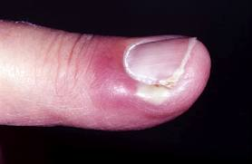
Paronychia
An inflammatory reaction involving the folds of the skin surrounding the fingernail.
It is characterized by acute or chronic purulent, tender, and painful swellings of the tissues around the nail, caused by an abscess of the nail fold.
The pathogenic yeast causing paronychia is most frequently Candida albicans.
The causative bacteria are usually Staphylococcus, Pseudomonas aeruginosa, or Streptococcus.

Slide 33
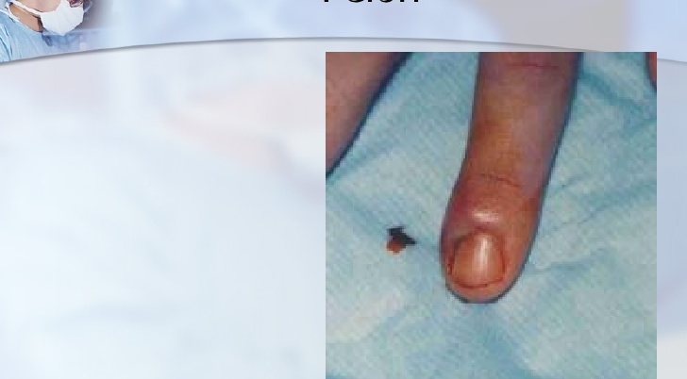
Felon
Notes:
Felons are closed-space infections of the fingertip pulp.

Slide 34
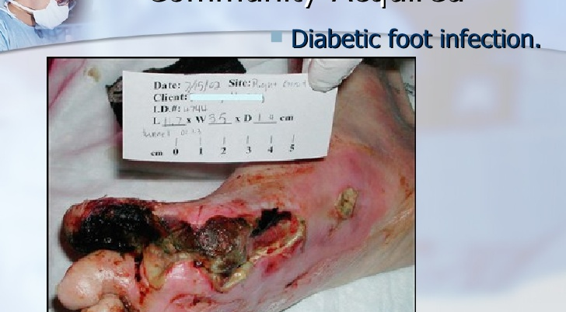
Community-Acquired

Slide 35
DIFFUSE NECROTIZING INFECTIONS
Particular dangerous
Difficult to diagnose, extremely toxic, spread rapidly, often leading to limb amputation

Slide 36
Pathogenic factors
Anaerobic
wound Bacterial exotoxins
Bacterial synergy
Thrombosis of nutrient bridging vessels

Slide 37
Classification of diffuse necrotizing infections
Clostridial
Necrotizing cellulitis
Myositis
Nonclostridial
Necrotizing fasciitis
Streptococcal gangrene

Slide 38
Clostridial Infections
They are fastidious anaerobes
On gram-stain they appear as relatively large, gram-positive, rod-shaped bacteria.
A broad spectrum of disease is caused by clostridia

Slide 39
Clinical Findings
Crepitant abscess or cellulitis
Invasion is usually superficial to the deep fascia and may spread very quickly, producing discoloration.
Delayed debridement of injured tissue after devascularizing injury is the common setting.

Slide 40
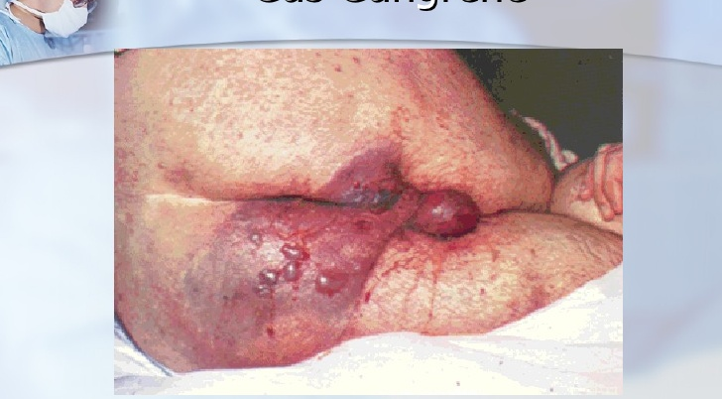
Gas Gangrene

Slide 41
Clinical Findings
Severe pain suggests extension into muscle compartments ( myositis).
The disease progresses rapidly, with loss of blood supply to the infected tissue.
Profound shock can appear early, rapidly leading to organ dysfunction.
Air bubbles often visible on plain radiograph Crepitus may be present, but not reliable to differentiation .

Slide 42
Nonclostridial Infections
Caused by multiple nonclostridial bacterial pathogens.
Microaerophilic streptococci, staphyloccci, aerobic gram-negative bacteria, and anaerobes, especially peptostreptococci and bacteroides.

Slide 43
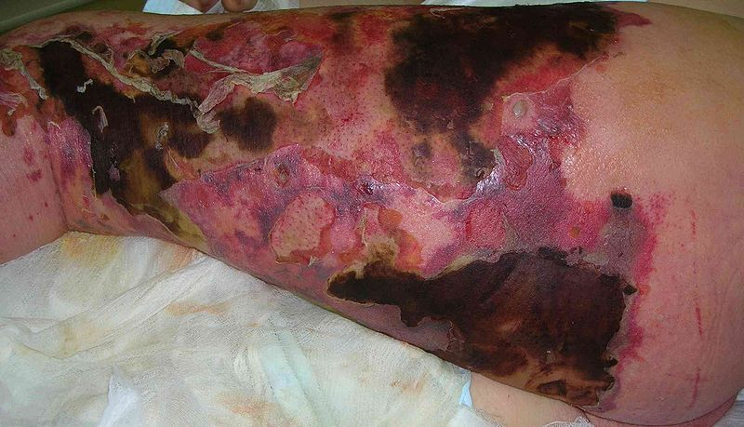
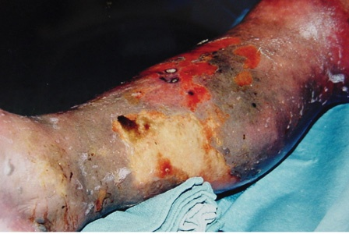
Necrotizing Soft Tissue Infection

Slide 44
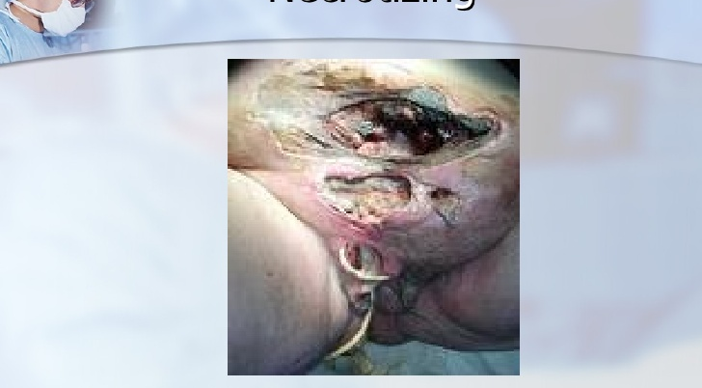
Necrotizing

Slide 45
Clinical Findings
Usually begins in a localized area such as a puncture wound, leg ulcer, or surgical wound.
Externally, hemorrhgic bullae are usually the first sign of skin death
The skin is anesthetic and crepitus is occasionally present.
The fascial necrosis is usually wider than the skin appearance indicates.
At operation, the finding of edematous, dull-gray, and necrotic fascia and subcutaneous tissue confirm the diagnosis.

Slide 46
Streptococcal gangrene Group A
streptococcus is a bacterium frequently found in in the skin and throat.
Streptococcal gangrene is uncommon The sudden onset of severe pain is the most common presenting symptom, usually in an extremity associated with a wound.
Fever and other signs of systemic infection are frequently present at the time of presentation.
Shock and renal dysfunction are usually present within 24 hours.

Slide 47
TREATMENT
Complete debridement and depress tight fascial compartment. Amputation.

Slide 48
TREATMENT
Broad-spectrum antibiotic therapy
Resuscitative therapy
Treat diabetes mellitus aggressively
Hyperbaric oxygenation inhibit bacterial invasion but does not eliminate the focus of infection.

Slide 49
Community-Acquired
Biliary Tract
Usually result from obstruction
Usual suspects:
E. coli, Klebsiella, Enterococci
Acute Cholecystitis
GB empyema
Ascending cholangitis
Diagnosis
Treatment

Slide 50
Community-Acquired
Peritonitis
Causes
Diagnosis
Treatment

Slide 51
Community-Acquired
Viral
Hepatitis
HIV/AIDS

Slide 52
Community-Acquired
Tetanus
C. tetani infection
“ lock-jaw”
Caused by exotoxin
Treatment

Slide 53
Post-Operative Infections
Fever After Surgery
The “Five W’s”
  Wind: Atelectisis
  Water: UTI
  Walking: DVT
  Wonder Drug: Medication Induced
  Wound: Surgical Site Infection

Slide 54
Surgical Site Infections
3rd most common hospital infection
Incisional
  Superficial
  Deep
Organ Space
  Generalized (peritonitis)
  Abscess

Slide 55
SSI – Definitions
Infection
  Systemic and local signs of inflammation
  Bacterial counts ≥ 10⁵ cfu/mL
  Purulent versus nonpurulent
  LOS effect
  Economic effect
Surgical wound infection is SSI
Notes:
Surgical sites are considered infected when there are signs of systemic and local inflammation and bacterial counts are 10⁵ cfu/mL or higher.
Infections are also differentiated by purulence or nonpurulence.
The length of stay for the patient and economic effects of the hospital stay are important factors to consider in SSIs.
It is important to note is that a surgical wound infection is a surgical site infection.

Slide 56
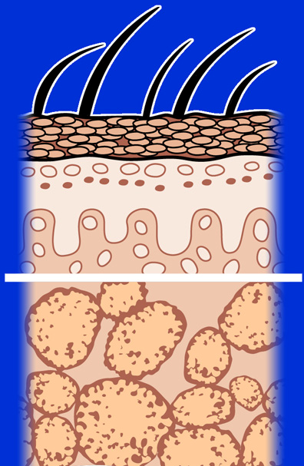
Superficial Incisional SSI
Infection occurs within 30 days after the operation and involves only skin or subcutaneous tissue
of the incision
Skin
Superficial incisional SSI
Subcutaneous tissue
Mangram AJ et al. Infect Control Hosp Epidemiol. 1999;20:250-278.
Notes:
The first type of surgical site infection is the superficial incisional surgical infection which occurs within 30 days post-op and involves only the skin or subcutaneous tissue.

Slide 57
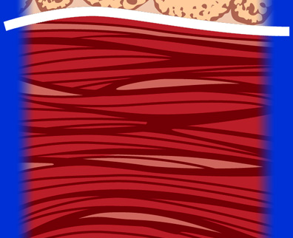
Deep Incisional SSI
Infection occurs within 30 days after the operation if no implant is left in place or within 1 year if implant is in place and the infection appears to be related to the operation and the infection involves the deep soft tissue (e.g., fascia and muscle layers)
Superficial incisional SSI
Deep soft tissue (fascia & muscle)
Deep incisional SSI
Mangram AJ et al. Infect Control Hosp Epidemiol. 1999;20:250-278.
Notes:
A more serious SSI is a deep incisional surgical infection, which extends past the superficial layer. The infection occurs within 30 days post-op only if no implant is left in place or within 1 year if implant is in place and the infection appears to be related to the operation and the infection involves the deep soft tissue, which include the fascia and muscle layers.

Slide 58
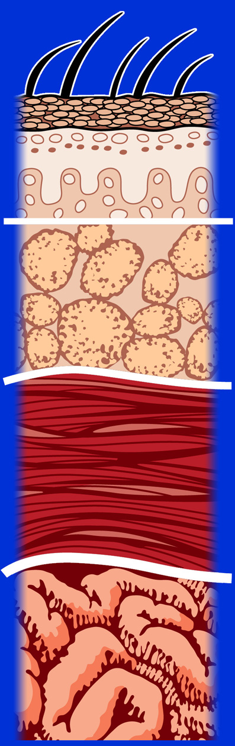
Organ/Space SSI
Infection occurs within 30 days after the operation if no implant is left in place or within 1 year if implant is in place and the infection appears to be related to the operation and the infection involves any part of the anatomy, other than the incision, which was opened or manipulated during the operation
Superficial incisional SSI
Deep incisional SSI
Organ/space
Organ/space SSI
Mangram AJ et al. Infect Control Hosp Epidemiol.
1999;20:250-278.
Notes:
The most extensive of these surgical infections involves the organs and the space surrounding the organs. These infections can occur within 30 days post-op if no implant is left in place or within 1 year if an implant is in place and the infection appears to be related to the operation and the infection involves any part of the anatomy, other than the incision, which was opened or manipulated during the operation.

Slide 59
SSI – Risk Factors
Operation Factors
Duration of surgical scrub
Maintain body temp
Skin antisepsis
Preoperative shaving
Duration of operation
Antimicrobial prophylaxis
Operating room ventilation
Inadequate sterilization of instruments
Foreign material at surgical site
Surgical drains
Surgical technique
  Poor hemostasis
  Failure to obliterate dead space
  Tissue trauma
Mangram AJ et al. Infect Control Hosp Epidemiol. 1999;20:250-278.
Notes:
Both operation factors and patient characteristics may influence the risk of surgical site infection.
Depending on the conditions of the operation a patient can be at an even greater risk of infection. These factors can include duration of surgical scrub, maintenance of body temperature, the use of skin antisepsis, preoperative shaving, duration of the operation, antimicrobial prophylaxis, ventilation of the operating room, inadequate sterilization of instruments, the presence of foreign material at the surgical site, surgical drains, and surgical technique. Poor surgical technique includes poor hemostasis, failure to obliterate dead space, and tissue trauma.

Slide 60
SSI – Risk Factors
Patient Characteristics
Age
Diabetes
  HbA_{1C} and SSI
  Glucose > 200 mg/dL postoperative period
  (<48 hours)
Nicotine use: delays primary wound healing
Steroid use: controversial
Malnutrition: no epidemiological association
Obesity: 20% over ideal body weight
Prolonged preoperative stay: surrogate of the severity
of illness and comorbid conditions
Preoperative nares colonization with Staphylococcus aureus:
significant association
Perioperative transfusion: controversial
Coexistent infections at a remote body site
Altered immune response
Mangram AJ et al. Infect Control Hosp Epidemiol. 1999;20:250-278.
Notes:
This slide shows risk factors for patients who are considered to be at a higher risk for surgical site infection.
High-risk characteristics include advanced age, diabetes, smoking, poor nutritional status, obesity, coexisting infections at a particular body site, and altered immune response, among other factors.
Prolonged preoperative stay is also a risk, depending on the severity of illness and comorbid conditions. There is also a significant association between preoperative nares colonization with Staphylococcus aureus and surgical site infection. Perioperative transfusion remains a controversial issue.

Slide 61
Preoperative preparation

Slide 62
Perioperative Glucose Control
Patients with a blood sugar > 300 mg/dL during or within 48 hours of surgery had more than 3X the likelihood of a wound infection

Slide 63
Pre-operative Shaving

Slide 64
Pre-operative shaving
Shaving the surgical site with a razor induces small skin lacerations
  potential sites for infection
  disturbs hair follicles which are often colonized with S. aureus
  Risk greatest when done the night before
  Patient education
    be sure patients know that they should not do you a favor and shave before they come to the hospital!

Slide 65
Influence of Shaving on SSI
No Hair
Group Removal Depilatory Shaved
Number 155 153 246
Infection rate 0.6% 0.6% 5.6%
Seropian. Am J Surg 1971; 121: 251

Slide 66
Prophylactic Antibiotics
Antibiotics given for the purpose of preventing infection when infection is not present but the risk of postoperative infection is present

Slide 67
Prophylactic Antibiotics
Questions
Which cases benefit?
Which drug should you use?
When should you start?
How much should you give?
How long should antibiotics be continued?

Slide 68
Surgical site prevention
Use antibiotics
appropriately
Avoid shaving
Site
Maintain normal
Body temp
Optimize oxygen
tension
Maintain normal
Blood glucose

Slide 69
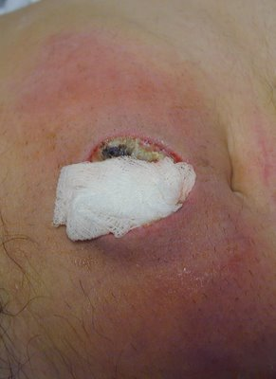
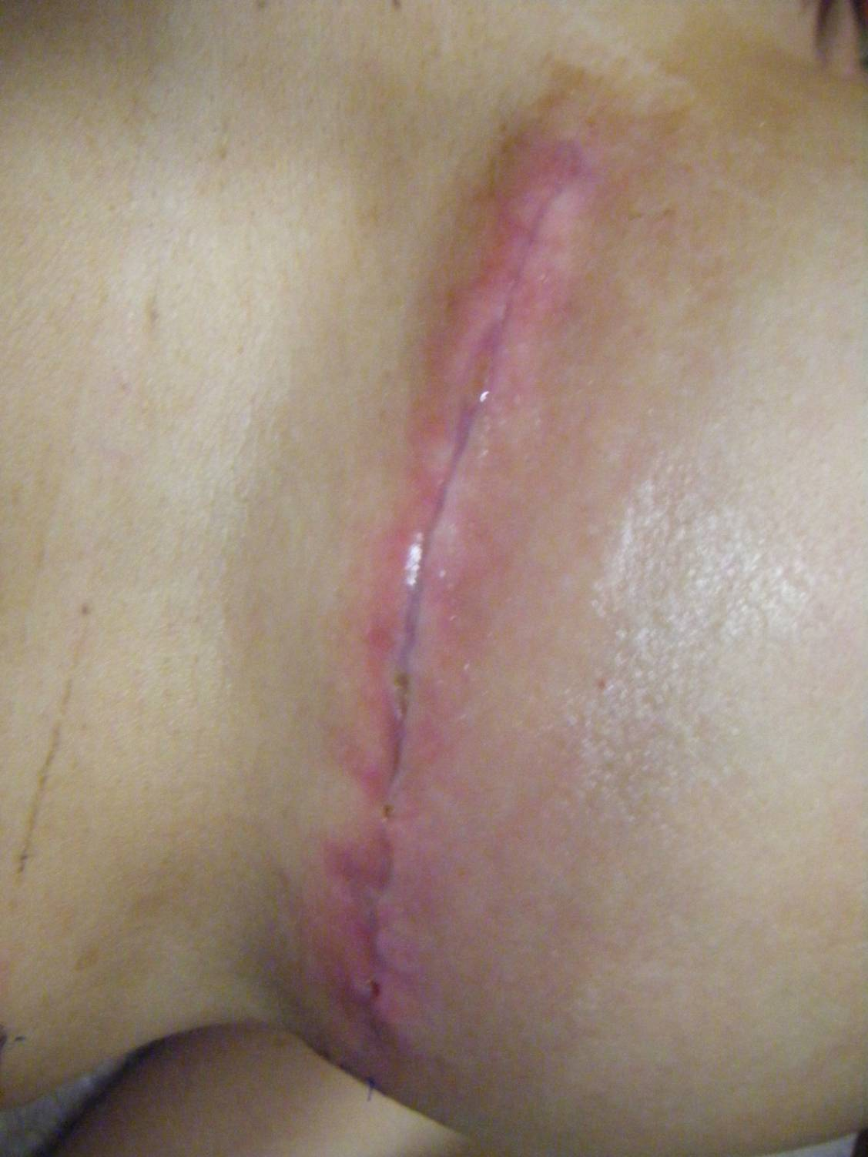

Slide 70
Treatment
Incisional: open surgical wound, antibiotics for cellulitis or sepsis
Deep/Organ space: Source control, antibiotics for sepsis

Slide 71
Types of Surgery
Clean | Hernia repair breast biopsy | 1.5%
Clean-Contaminated | Cholecystectomy planned bowel resection | 2-5%
Contaminated | Non-preped bowel resection | 5-30%
Dirty/infected | perforation, abscess | 5-30%

Slide 72
Operative Antibiotic Prophylaxis
Decreases bacterial counts at surgical site
Given within 30 minutes prior to starting surgery
Vancomycin 1-2 hours prior to surgery
Redose for longer surgery
Do not continue beyond 24 hours

Slide 73
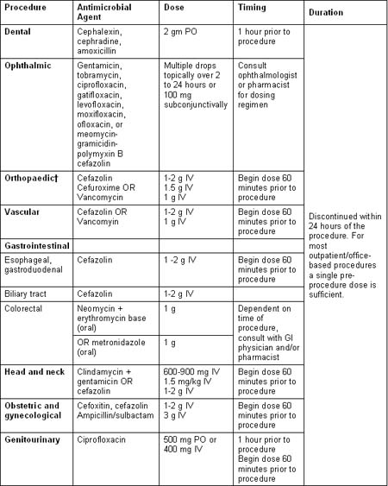

Slide 74
Occupational Blood Bourne Virus Infections
 | HBV | HCV | HIV
Risk from Needle stick | 30% | 2% | 0.3%
Chemoprophylaxis | Yes | No | Yes
Vaccine | Yes | No | No

Slide 75
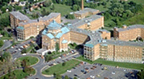
Q

