Slide 1
SHOCK & metabolic response
Awadh Alqahtani
MD,MSc,FRCSC(surgery)FRCSC(oncology)
FISC
Surgical oncologist and laparoscopic Bariatric surgeon
29/09/2013

Slide 2
Objectives
Definition
Approach to the hypotensive patient
Types
Specific treatments

Slide 3
Definition of Shock
Inadequate oxygen delivery to meet metabolic demands
Results in global tissue hypoperfusion and metabolic acidosis
Shock can occur with a normal blood pressure and hypotension can occur without shock

Slide 4
Understanding Shock
Inadequate systemic oxygen delivery activates autonomic responses to maintain systemic oxygen delivery
  Sympathetic nervous system
    NE, epinephrine, dopamine, and cortisol release
      Causes vasoconstriction, increase in HR, and increase of cardiac contractility (cardiac output)
  Renin-angiotensin axis
    Water and sodium conservation and vasoconstriction
    Increase in blood volume and blood pressure

Slide 5
Understanding Shock
Cellular responses to decreased systemic oxygen delivery
  ATP depletion → ion pump dysfunction
  Cellular edema
  Hydrolysis of cellular membranes and cellular death
Goal is to maintain cerebral and cardiac perfusion
  Vasoconstriction of splanchnic, musculoskeletal, and renal blood flow
Leads to systemic metabolic lactic acidosis that overcomes the body’s compensatory mechanisms

Slide 6
Global Tissue Hypoxia
Endothelial inflammation and disruption
Inability of O2 delivery to meet demand
Result:
  Lactic acidosis
  Cardiovascular insufficiency
  Increased metabolic demands

Slide 7
Multiorgan Dysfunction
Syndrome (MODS)
Progression of physiologic effects as shock ensues
  Cardiac depression
  Respiratory distress
  Renal failure
  DIC
Result is end organ failure

Slide 8
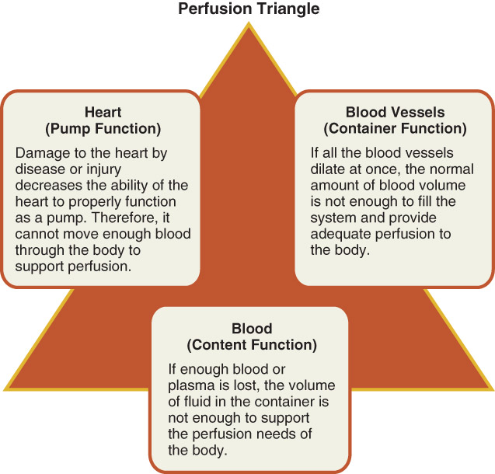
Pathophysiology

Slide 9
Approach to the Patient in Shock
ABCs
  Cardiorespiratory monitor
  Pulse oximetry
  Supplemental oxygen
  IV access
  ABG, labs
  Foley catheter
  Vital signs including rectal temperature

Slide 10

Diagnosis
Physical exam (VS, mental status, skin color, temperature, pulses, etc)
Infectious source
Labs:
  CBC
  Chemistries
  Lactate
  Coagulation studies
  Cultures
  ABG

Slide 11
Further Evaluation
CT of head/sinuses
Lumbar puncture
Wound cultures
Acute abdominal series
Abdominal/pelvic CT or US
Cortisol level
Fibrinogen, FDPs, D-dimer

Slide 12
Approach to the Patient in Shock
History
  Recent illness
  Fever
  Chest pain, SOB
  Abdominal pain
  Comorbidities
  Medications
  Toxins/Ingestions
  Recent hospitalization or surgery
  Baseline mental status
Physical examination
  Vital Signs
  CNS – mental status
  Skin – color, temp, rashes, sores
  CV – JVD, heart sounds
  Resp – lung sounds, RR, oxygen sat, ABG
  GI – abd pain, rigidity, guarding, rebound
  Renal – urine output

Slide 13
Is This Patient in Shock?
Patient looks ill
Altered mental status
Skin cool and mottled or hot and flushed
Weak or absent peripheral pulses
SBP <110
Tachycardia
Yes!
These are all signs and symptoms of shock

Slide 14
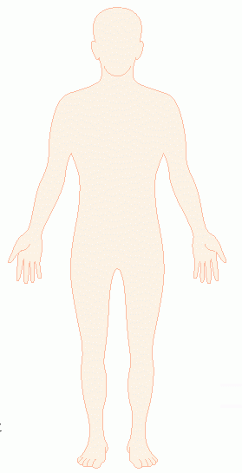
Shock
Do you remember how to quickly estimate blood pressure by pulse?
60
If you palpate a pulse,
you know SBP is at
least this number
70
80
90

Slide 15
Goals of Treatment
ABCDE
  Airway
  control work of Breathing
  optimize Circulation
  assure adequate oxygen Delivery
  achieve End points of resuscitation

Slide 16
Airway
Determine need for intubation but remember: intubation can worsen hypotension
  Sedatives can lower blood pressure
  Positive pressure ventilation decreases preload
May need volume resuscitation prior to intubation to avoid hemodynamic collapse

Slide 17
Control Work of Breathing
Respiratory muscles consume a significant amount of oxygen
Tachypnea can contribute to lactic acidosis
Mechanical ventilation and sedation decrease WOB and improves survival

Slide 18
Optimizing Circulation
Isotonic crystalloids
Titrated to:
  CVP 8-12 mm Hg
  Urine output 0.5 ml/kg/hr (30 ml/hr)
  Improving heart rate
May require 4-6 L of fluids
No outcome benefit from colloids

Slide 19
Maintaining Oxygen Delivery
Decrease oxygen demands
  Provide analgesia and anxiolytics to relax muscles and avoid shivering
Maintain arterial oxygen saturation/content
  Give supplemental oxygen
  Maintain Hemoglobin > 10 g/dL
Serial lactate levels or central venous oxygen saturations to assess tissue oxygen extraction
Notes:
SmvO2 – mixed venous oxygen saturation from a PAC
ScvO2 – central venous oxygen saturation from central line

Slide 20
End Points of Resuscitation
Goal of resuscitation is to maximize survival and minimize morbidity
Use objective hemodynamic and physiologic values to guide therapy
Goal directed approach
  Urine output > 0.5 mL/kg/hr
  CVP 8-12 mmHg
  MAP 65 to 90 mmHg
  Central venous oxygen concentration > 70%

Slide 21
Persistent Hypotension
Inadequate volume resuscitation
Pneumothorax
Cardiac tamponade
Hidden bleeding
Adrenal insufficiency
Medication allergy

Slide 22
Types of Shock
Hypovolemic
Septic
Cardiogenic
Anaphylactic
Neurogenic
Obstructive

Slide 23
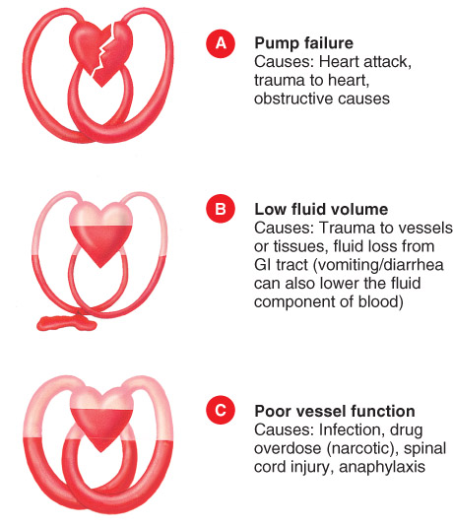
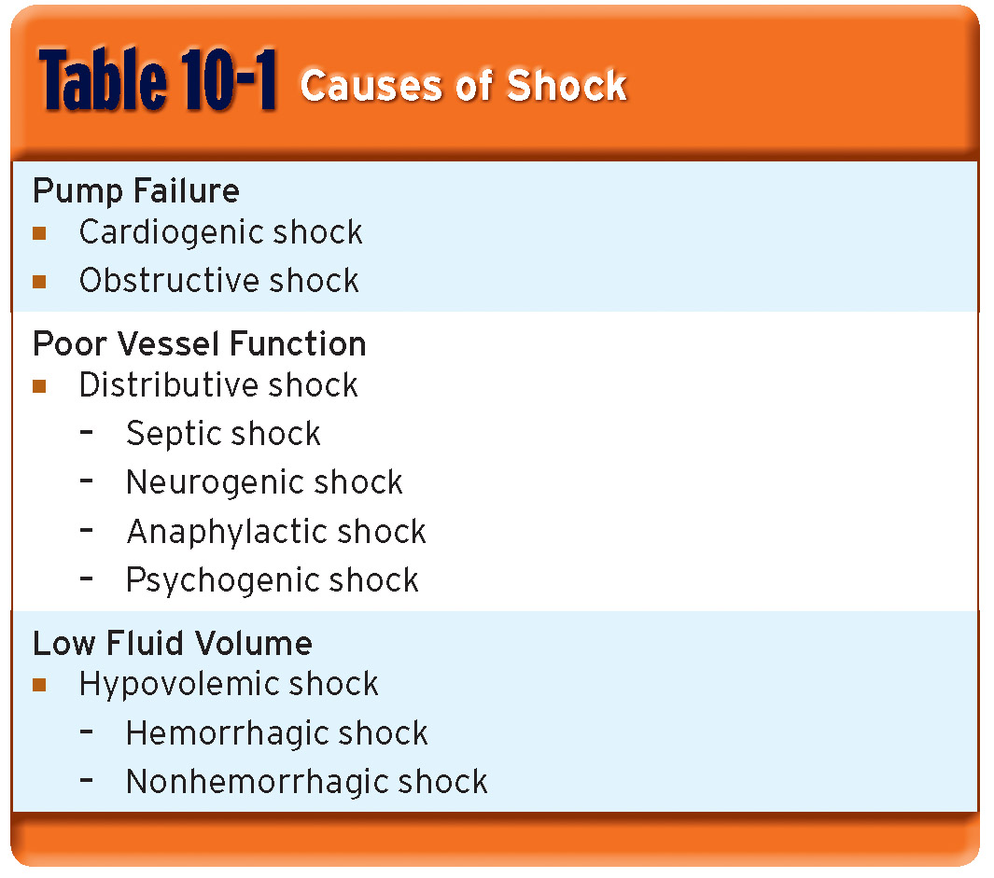
Causes of Shock

Slide 24
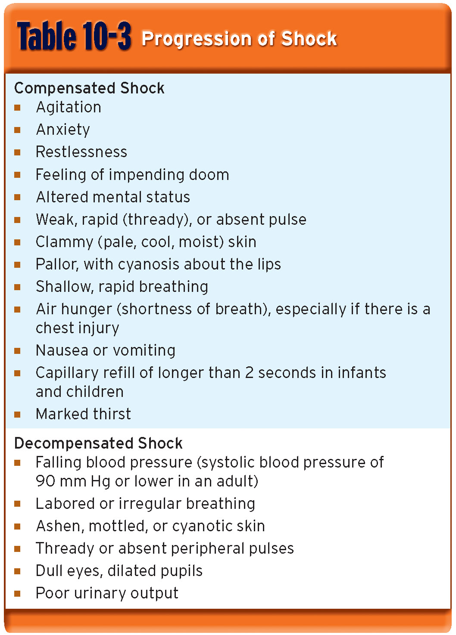
The Progression of Shock
Signs and symptoms

Slide 25
What Type of Shock is This?
Types of Shock
Hypovolemic
Septic
Cardiogenic
Anaphylactic
Neurogenic
Obstructive
68 yo M with hx of HTN and DM presents to the ER with abrupt onset of diffuse abdominal pain with radiation to his low back. The pt is hypotensive, tachycardic, afebrile, with cool but dry skin
Hypovolemic Shock

Slide 26
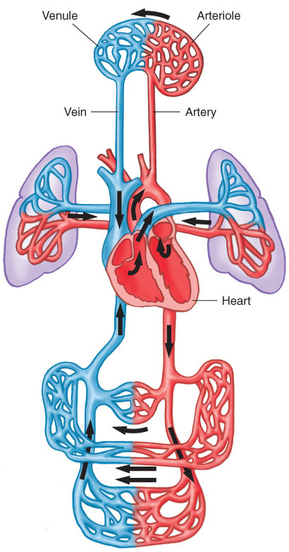
Hypovolemic Shock

Slide 27
Hypovolemic Shock
Non-hemorrhagic
  Vomiting
  Diarrhea
  Bowel obstruction, pancreatitis
  Burns
  Neglect, environmental (dehydration)
Hemorrhagic
  GI bleed
  Trauma
  Massive hemoptysis
  AAA rupture
  Ectopic pregnancy, post-partum bleeding

Slide 28
Hypovolemic Shock
ABCs
Establish 2 large bore IVs or a central line
Crystalloids
  Normal Saline or Lactate Ringers
  Up to 3 liters
PRBCs
  O negative or cross matched
Control any bleeding
Arrange definitive treatment

Slide 29
Evaluation of Hypovolemic Shock
CBC
ABG/lactate
Electrolytes
BUN, Creatinine
Coagulation studies
Type and cross-match
As indicated
  CXR
  Pelvic x-ray
  Abd/pelvis CT
  Chest CT
  GI endoscopy
  Bronchoscopy
  Vascular radiology

Slide 30
What Type of Shock is This?
Types of Shock
Hypovolemic
Septic
Cardiogenic
Anaphylactic
Neurogenic
Obstructive
An 81 yo F resident of a nursing home presents to the ED with altered mental status. She is febrile to 39.4, hypotensive with a widened pulse pressure, tachycardic, with warm extremities
Septic

Slide 31
Sepsis
Two or more of SIRS criteria
  Temp > 38 or < 36 C
  HR > 90
  RR > 20
  WBC > 12,000 or < 4,000
Plus the presumed existence of infection
Blood pressure can be normal!

Slide 32
Septic Shock
Sepsis (remember definition?)
Plus refractory hypotension
  After bolus of 20-40 mL/Kg patient still has one of the following:
    SBP < 90 mm Hg
    MAP < 65 mm Hg
    Decrease of 40 mm Hg from baseline

Slide 33
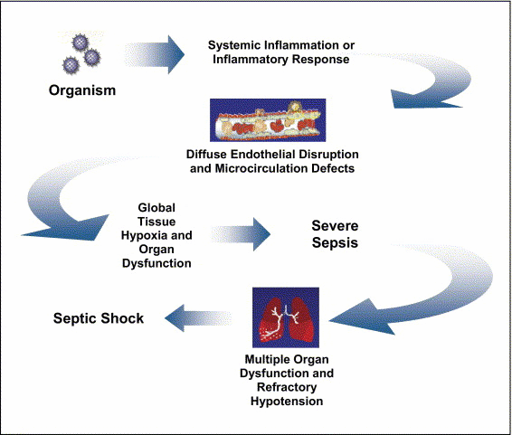
Pathogenesis of Sepsis
Nguyen H et al. Severe Sepsis and Septic-Shock: Review of the Literature and Emergency Department Management Guidelines. Ann Emerg Med. 2006;42:28-54.

Slide 34
Septic Shock
Clinical signs:
  Hyperthermia or hypothermia
  Tachycardia
  Wide pulse pressure
  Low blood pressure (SBP<90)
  Mental status changes
Beware of compensated shock!
  Blood pressure may be “normal”

Slide 35
Ancillary Studies
Cardiac monitor
Pulse oximetry
CBC, Chem 7, coags, LFTs, lipase, UA
ABG with lactate
Blood culture x 2, urine culture
CXR
Foley catheter (why do you need this?)

Slide 36
Treatment of Septic Shock
2 large bore IVs
  NS IVF bolus- 1-2 L wide open (if no contraindications)
Supplemental oxygen
Empiric antibiotics, based on suspected source, as soon as possible

Slide 37
Treatment of Sepsis
Antibiotics- Survival correlates with how quickly the correct drug was given
Cover gram positive and gram negative bacteria
  Zosyn 3.375 grams IV and ceftriaxone 1 gram IV or
  Imipenem 1 gram IV
Add additional coverage as indicated
  Pseudomonas- Gentamicin or Cefepime
  MRSA- Vancomycin
  Intra-abdominal or head/neck anaerobic infections- Clindamycin or Metronidazole
  Asplenic- Ceftriaxone for N. meningitidis, H. infuenzae
  Neutropenic – Cefepime or Imipenem

Slide 38
Persistent Hypotension
If no response after 2-3 L IVF, start a vasopressor (norepinephrine, dopamine, etc) and titrate to effect
Goal: MAP > 60
Consider adrenal insufficiency: hydrocortisone 100 mg IV

Slide 39
What Type of Shock is This?
Types of Shock
Hypovolemic
Septic
Cardiogenic
Anaphylactic
Neurogenic
Obstructive
A 55 yo M with hx of HTN, DM presents with “crushing” substernal CP, diaphoresis, hypotension, tachycardia and cool, clammy extremities
Cardiogenic

Slide 40

Cardiogenic Shock

Slide 41
Cardiogenic Shock
Defined as:
  SBP < 90 mmHg
  CI < 2.2 L/m/m²
  PCWP > 18 mmHg
Signs:
  Cool, mottled skin
  Tachypnea
  Hypotension
  Altered mental status
  Narrowed pulse pressure
  Rales, murmur

Slide 42
Etiologies
What are some causes of cardiogenic shock?
  AMI
  Sepsis
  Myocarditis
  Myocardial contusion
  Aortic or mitral stenosis, HCM
  Acute aortic insufficiency

Slide 43
Pathophysiology of Cardiogenic Shock
Often after ischemia, loss of LV function
  Lose 40% of LV clinical shock ensues
CO reduction = lactic acidosis, hypoxia
Stroke volume is reduced
  Tachycardia develops as compensation
  Ischemia and infarction worsens

Slide 44
Ancillary Tests
EKG
CXR
CBC, Chem 10, cardiac enzymes, coagulation studies
Echocardiogram

Slide 45
Treatment of Cardiogenic Shock
Goals- Airway stability and improving myocardial pump function
Cardiac monitor, pulse oximetry
Supplemental oxygen, IV access
Intubation will decrease preload and result in hypotension
  Be prepared to give fluid bolus

Slide 46
Treatment of Cardiogenic Shock
AMI
  Aspirin, beta blocker, morphine, heparin
  If no pulmonary edema, IV fluid challenge
  If pulmonary edema
    Dopamine – will ↑ HR and thus cardiac work
    Dobutamine – May drop blood pressure
    Combination therapy may be more effective
  PCI or thrombolytics
RV infarct
  Fluids and Dobutamine (no NTG)
Acute mitral regurgitation or VSD
  Pressors (Dobutamine and Nitroprusside)

Slide 47
What Type of Shock is This?
Types of Shock
Hypovolemic
Septic
Cardiogenic
Anaphylactic
Neurogenic
Obstructive
A 34 yo F presents to the ER after dining at a restaurant where shortly after eating the first few bites of her meal, became anxious, diaphoretic, began wheezing, noted diffuse pruritic rash, nausea, and a sensation of her “throat closing off”. She is currently hypotensive, tachycardic and ill appearing.
Anaphalactic

Slide 48
Anaphylactic Shock
Anaphylaxis – a severe systemic hypersensitivity reaction characterized by multisystem involvement
  IgE mediated

Slide 49
Anaphylactic Shock
What are some symptoms of anaphylaxis?
  First- Pruritus, flushing, urticaria appear
  Next- Throat fullness, anxiety, chest tightness, shortness of breath and lightheadedness
  Finally- Altered mental status, respiratory distress and circulatory collapse

Slide 50
Anaphylactic Shock- Diagnosis
Clinical diagnosis
  Defined by airway compromise, hypotension, or involvement of cutaneous, respiratory, or GI systems
Look for exposure to drug, food, or insect
Labs have no role

Slide 51
Anaphylactic Shock- Treatment
ABC’s
  Angioedema and respiratory compromise require immediate intubation
IV, cardiac monitor, pulse oximetry
IVFs, oxygen
Epinephrine
Second line
  Corticosteriods
  H1 and H2 blockers
Notes:
Epi – the single most important step in treatment

Slide 52
Anaphylactic Shock- Treatment
Epinephrine
  0.3 mg IM of 1:1000 (epi-pen)
  Repeat every 5-10 min as needed
  Caution with patients taking beta blockers- can cause severe hypertension due to unopposed alpha stimulation
  For CV collapse, 1 mg IV of 1:10,000
  If refractory, start IV drip

Slide 53
Anaphylactic Shock - Treatment
Corticosteroids
  Methylprednisolone 125 mg IV
  Prednisone 60 mg PO
Antihistamines
  H1 blocker- Diphenhydramine 25-50 mg IV
  H2 blocker- Ranitidine 50 mg IV
Bronchodilators
  Albuterol nebulizer
  Atrovent nebulizer
  Magnesium sulfate 2 g IV over 20 minutes
Glucagon
  For patients taking beta blockers and with refractory hypotension
  1 mg IV q5 minutes until hypotension resolves
Notes:
Methylprednisolone causes less fluid retention

Slide 54
What Type of Shock is This?
Types of Shock
Hypovolemic
Septic
Cardiogenic
Anaphylactic
Neurogenic
Obstructive
A 41 yo M presents to the ER after an MVC complaining of decreased sensation below his waist and is now hypotensive, bradycardic, with warm extremities
Neurogenic

Slide 55
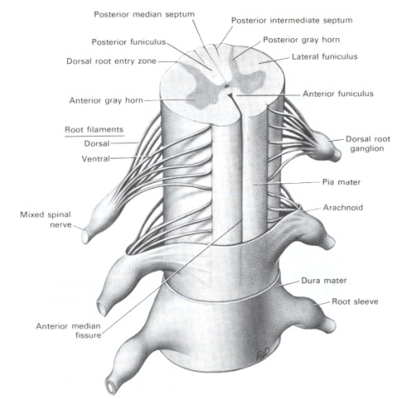
Neurogenic Shock

Slide 56
Neurogenic Shock
Occurs after acute spinal cord injury
Sympathetic outflow is disrupted leaving unopposed vagal tone
Results in hypotension and bradycardia

Slide 57
Neurogenic Shock
Loss of sympathetic tone results in warm and dry skin
Shock usually lasts from 1 to 3 weeks
Any injury above T1 can disrupt the entire sympathetic system
  Higher injuries = worse paralysis

Slide 58
Neurogenic Shock- Treatment
A,B,Cs
  Remember c-spine precautions
Fluid resuscitation
  Keep MAP at 85-90 mm Hg for first 7 days
  Thought to minimize secondary cord injury
  If crystalloid is insufficient use vasopressors
Search for other causes of hypotension
For bradycardia
  Atropine
  Pacemaker

Slide 59
Neurogenic Shock- Treatment
Methylprednisolone
  Used only for blunt spinal cord injury
  High dose therapy for 23 hours
  Must be started within 8 hours
  Controversial- Risk for infection, GI bleed

Slide 60
What Type of Shock is This?
Types of Shock
Hypovolemic
Septic
Cardiogenic
Anaphylactic
Neurogenic
Obstructive
A 24 yo M presents to the ED after an MVC c/o chest pain and difficulty breathing. On PE, you note the pt to be tachycardic, hypotensive, hypoxic, and with decreased breath sounds on left
Obstructive

Slide 61
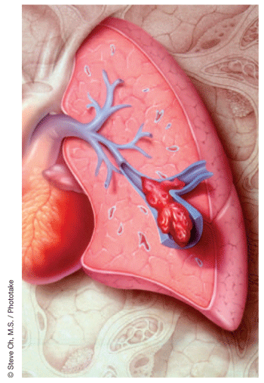
Obstructive Shock

Slide 62
Obstructive Shock
Tension pneumothorax
  Air trapped in pleural space with 1 way valve, air/pressure builds up
  Mediastinum shifted impeding venous return
  Chest pain, SOB, decreased breath sounds
  No tests needed!
  Rx: Needle decompression, chest tube

Slide 63
Obstructive Shock
Cardiac tamponade
  Blood in pericardial sac prevents venous return to and contraction of heart
  Related to trauma, pericarditis, MI
  Beck’s triad: hypotension, muffled heart sounds, JVD
  Diagnosis: large heart CXR, echo
  Rx: Pericardiocentisis

Slide 64
Obstructive Shock
Pulmonary embolism
  Virscow triad: hypercoaguable, venous injury, venostasis
  Signs: Tachypnea, tachycardia, hypoxia
  Low risk: D-dimer
  Higher risk: CT chest or VQ scan
  Rx: Heparin, consider thrombolytics

Slide 65
Obstructive Shock
Aortic stenosis
  Resistance to systolic ejection causes decreased cardiac function
  Chest pain with syncope
  Systolic ejection murmur
  Diagnosed with echo
  Vasodilators (NTG) will drop pressure!
  Rx: Valve surgery

Slide 66
Review
The term “shock” is MOST accurately defined as:
  a decreased supply of oxygen to the brain.
  cardiovascular collapse leading to inadequate perfusion.
  decreased circulation of blood within the venous circulation.
  decreased function of the respiratory system leading to hypoxia.

Slide 67
Review
Signs of compensated shock include all of the following, EXCEPT:
  restlessness or anxiety.
  pale, cool, clammy skin.
  a feeling of impending doom.
  weak or absent peripheral pulses.

Slide 68
Review
A 60-year-old woman presents with a
BP of 80/60 mm Hg, a pulse rate of
110 beats/min, mottled skin, and a temperature of 103.9°F. She is MOST likely experiencing:
  septic shock.
  neurogenic shock.
  profound heart failure.
  a severe viral infection.

Slide 69
The End
Any Questions?

