Slide 1

Presentation and management of cardiac surgical diseases
Division of Cardiac Surgery
Department of Cardiac Sciences
King Khalid University Hospital,
King Saud Univeresity, Riyadh.

Slide 2
Objects of Lecture
Overview of diseases of heart, where surgery can play a role
Understanding of the Basic Principles of Cardiac Surgery
Information regarding pre-operative, operative and post-operative care in cardiac surgery

Slide 3
Cardiac Diseases
Coronary Artery Disease
Valvular Heart Diseases
Congenital Heart Diseases
Miscellaneous :
  Aortic Diseases
  Pericardial Disease
  Cardiac Tumour
  Trauma

Slide 4
Modes of Presentation of Cardiac Diseases
Chest pain
Shortness of Breath
Palpitations
Peripheral Edema
Congestive Cardiac Failure
Cyanosis and Clubbing in Congenital Defects
Uncommon presentations
  Pleural Effusion
  Haemoptysis

Slide 5
Chest pain
Differential diagnosis:
1. Cardiac causes
2. Non-cardiac causes
Approach:
1. History
2. Physical examination
3. Chest x-ray
4. E.C.G.
5. Laboratory investigations

Slide 6
Common Cardiac Operation
Coronary Artery Bypass Grafting (CABG)
Valve Replacement / Repair
Repair of congenital defects like of VSD or ASD

Slide 7
Ischemic Heart Disease
Clinical manifestations:
1. Asymptomatic
2. Symptomatic:
-angina pectoris: stable- unstable
-myocardial infarction
-V.S.D., Ischemic mitral regurge, Ventricular aneurysm, Heart failure, Conduction defects.

Slide 8
Risk factors:
Smoking, Diabetes mellitus, Hypertension, Hyperlipedemia, Hereditary factors.
Laboratory Investigations:
-Routine investigations
-Cardiac enzymes
-E.C.G.
-Echocardiography
-Coronary angiography

Slide 9
Indications of surgery:
1. Failure of medical therapy or percutaneous intervention.
2. Left main disease
3. 3-vessel disease with left ventricular dysfunction
4. Mechanical complications of myocardial infarction.
5. Associated valve disease

Slide 10
Coronary conduits:
1. Arterial: Internal thoracic artery
2. Venous : Long saphenous vein.
Types of surgery:
1. Conventional: using the heart lung machine, and cardioplegic arrest
2. Off-pump (beating heart surgery)

Slide 11
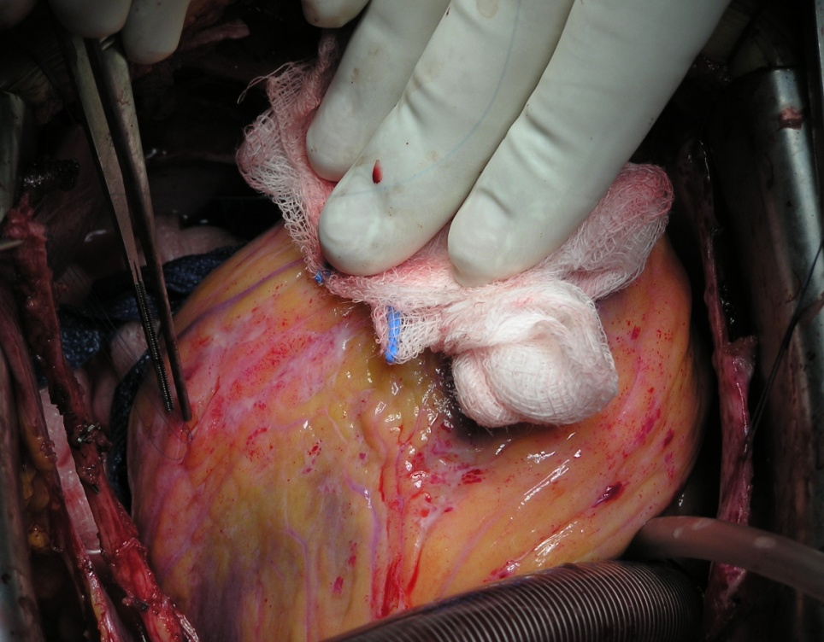
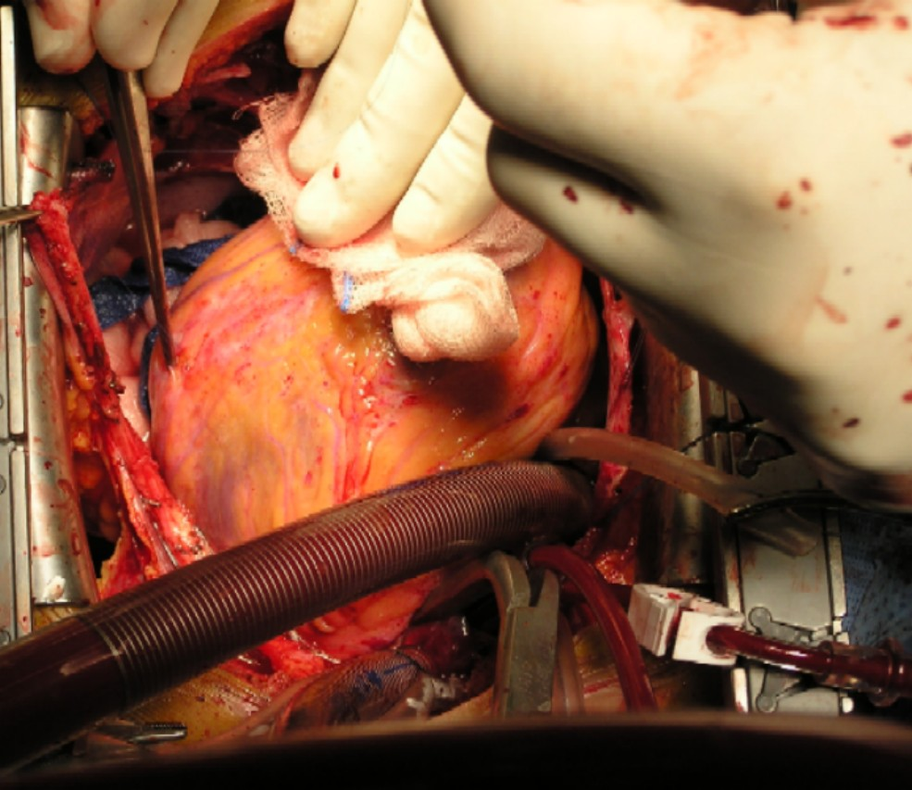
Coronary Artery Bypass Grafting

Slide 12
Valvular Heart Diseases
1. Mitral stenosis:
Etiology: Rheumatic, Congenital
The natural progression of MS causes the mitral valve area to reduce by 0.1-0.3 cm per year.
The progression from the onset of rheumatic fever to onset of signs of MS takes 10-20 years.
The progression from signs of MS to mild symptoms of MS takes 10-20 years.
The progression from mild symptoms to decompensation takes 10-20 years
In patients with severe PH the mean survival is 3 years.

Slide 13
Symptoms of mitral stenosis
1.Asymptomatic for many years.
2. Easy fatiguability.
3. Dyspnea, Orthopnea and PND.
4. Palpitations
5. Dysphagia, compression of left main bronchus

Slide 14
Signs of mitral stenosis
1. Low volume pulse.
2. Irregular pulse.
3. Tapping non-displaced apex beat.
4. Loud S1
5. Mid-diastolic rumbling murmur.
6. signs of PH: central cyanosis, Loud P2, T.R. P.R.

Slide 15
Valvular Heart Diseases
-Indications for surgery:
Symptoms: exertional dyspnea (NYHA III-IV), pulmonary hypertension, hemoptysis when PMBV is not feasible
Severe mitral stenosis: area less than 1 cm.
Left atrial thrombus.

Slide 16
Treatment:
1. Medical
2. Balloon valvuloplasty
3. Closed mitral commissurotomy
4. Open mitral commissurotomy
5. Mitral valve replacement.

Slide 17
2. Mitral Regurgitation:
Etiology: Rheumatic, Degenerative, Endocarditis, Ischemic, Traumatic
Chronic mitral regurgitation: Rheumatic fever, Myxomatous degeneration, ischemic cardiomyopathy.
Acute mitral regurgitation: chordal rupture, infective endocarditis, papillary muscle rupture following MI.

Slide 18
Asymptomatic patients can have a long latent period before the onset of symptoms as chronic M.R is well tolerated if L.V function is still preserved.

Slide 19
Symptoms of mitral regurgitation:
1. asymptomatic
2. fatigue and weakness
3. Dyspnea, Orthopnea, PND
4. Pulmonary hypertension and right heart failure.

Slide 20
Signs of mitral regurgitation:
1. displaced apex beat
2. apical thrill
3. apical pansystolic murmur
4.signs of pulmonary hypertension

Slide 21
Poor prognostic features:
1. symptoms > 1 year
2. age > 60 years.
3. EF < 50%
4. LVEDV > 100ml/m2, LVEDD > 7cm

Slide 22
2. Mitral Regurgitation:
Indications for surgery:
Symptomatic, dilated left ventricle (LVESD >40), diminished ejection fraction (<60%)
Severe MR with AF or PH >50mmHg at rest or 60mmHg with exercise.
Treatment:
1.Medical
2.Mitral valve repair
3.Mitral valve replacement

Slide 23
3. Aortic stenosis:
Etiology: Rheumatic, Congenital, Degenerative.
Symptoms:
Asymptomatic
Chest pain
Syncopal attacks
Dyspnea and CHF

Slide 24
Signs of aortic stenosis:
1. slow-rising pulse
2. small amplitude pulse
3. sustained apical pulse
4. harsh ejection systolic murmur.

Slide 25
Indications for surgery:
1. Symptoms (angina, shortness of breath, syncopaal attacks)
2. Moderate to severe aortic stenosis in patients undergoing CABG.
3. Severe AS with EF< 50%
Treatment:
Medical
Aortic valve replacement

Slide 26
4. Aortic regurgitation:
Etiology: Rheumatic, Endocarditis, Connective tissue disorders, Aortic dissection or aneurysm.

Slide 27
Indications for surgery:
1. severe AR with symptoms
2. severe AR in patients undergoing CABG or other valve surgery.
3. severe AR with EF <50%
4. severe AR with LVEDD > 75mm and LVESD > 50mm.

Slide 28
Types of Prosthetic Valves and their merits and demerits
Tissue Valves (Bio prosthesis)
  No need to use long term anticoagulation.
  Limited and unpredictable durability.
Mechanical Valves
  Anticoagulation
  Prolonged durability

Slide 29
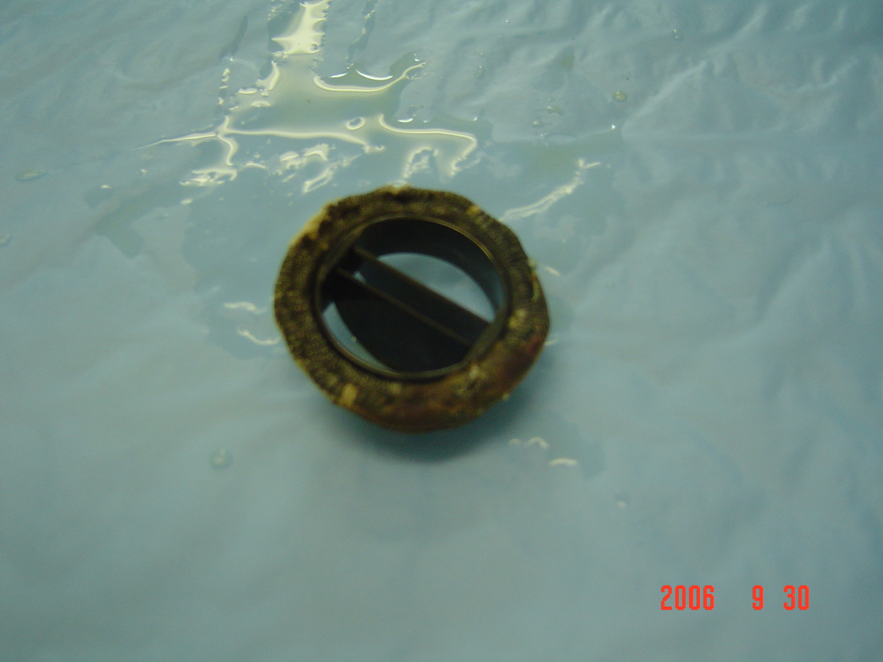

Slide 30
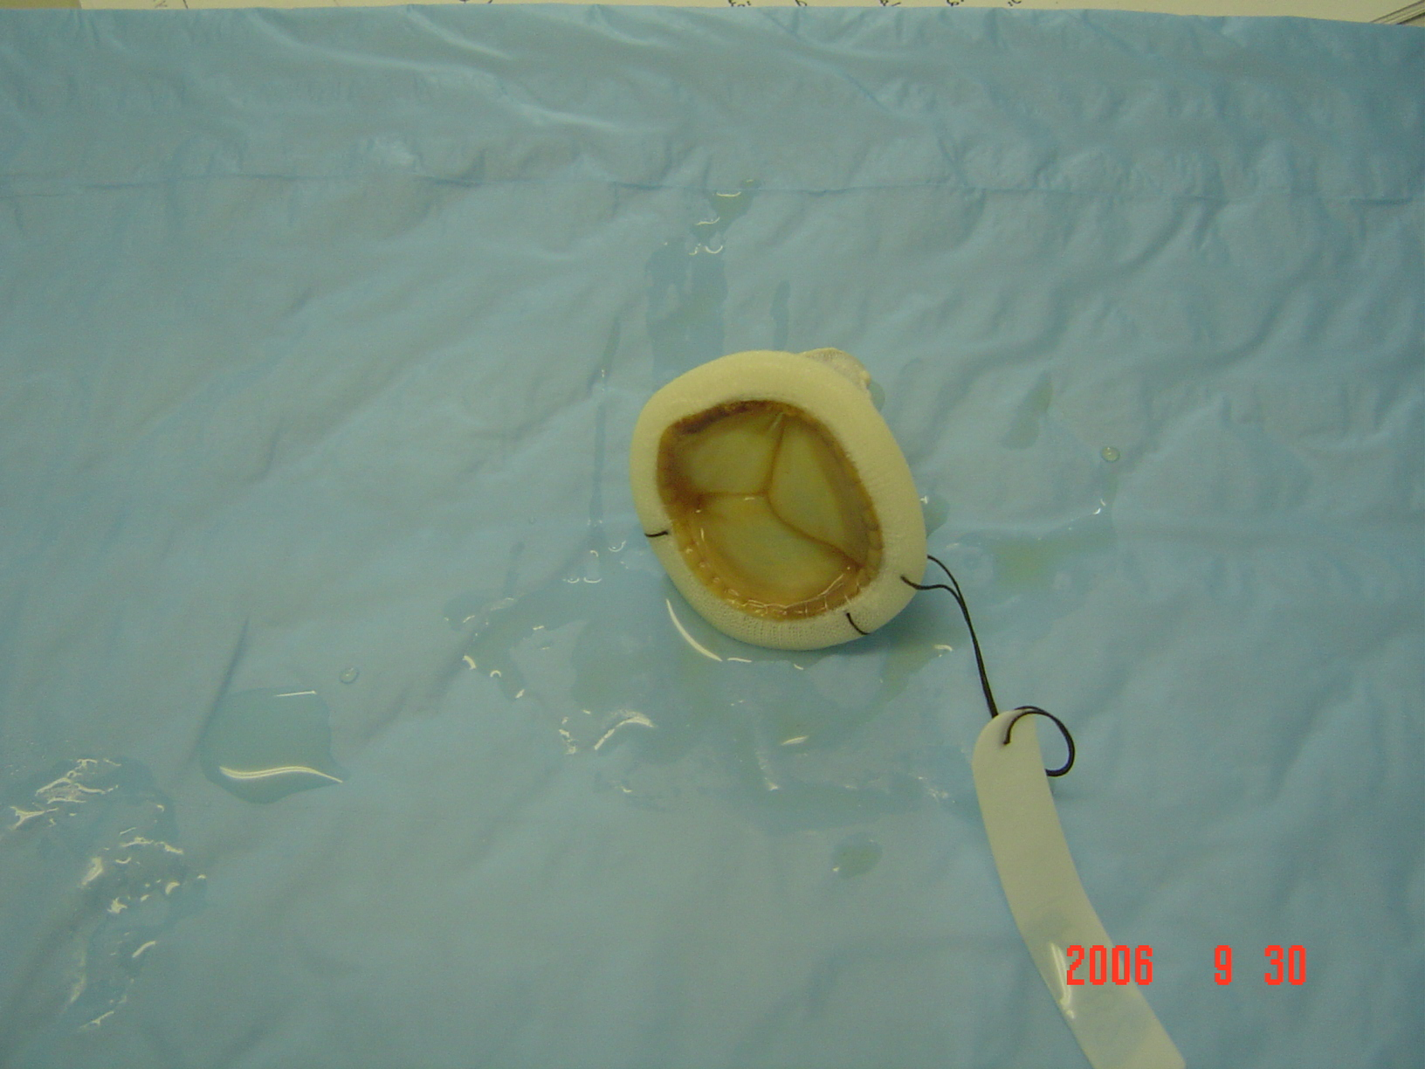

Slide 31
Complications of prosthetic valves:
1. Thrombosis
2. Bleeding complications
3. Infective endocarditis
4. Paravalvular leak
5. Degeneration of biological valves

Slide 32
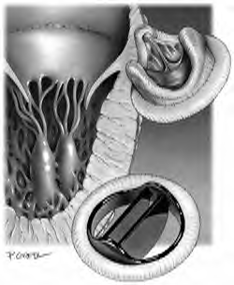
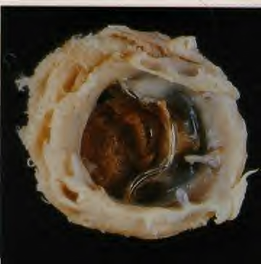
Types of Prosthetic Valves and their merits and demerits

Slide 33
Thoracic Aortic Disease
1. Thoracic aortic aneurysm
Symptoms are usually due to pressure on surrounding stuctures.
2. Aortic dissection:
Tear in the intima allowing blood to enter and flow in a false channel. There are 2 lumens separated by the dissecting membrane

Slide 34
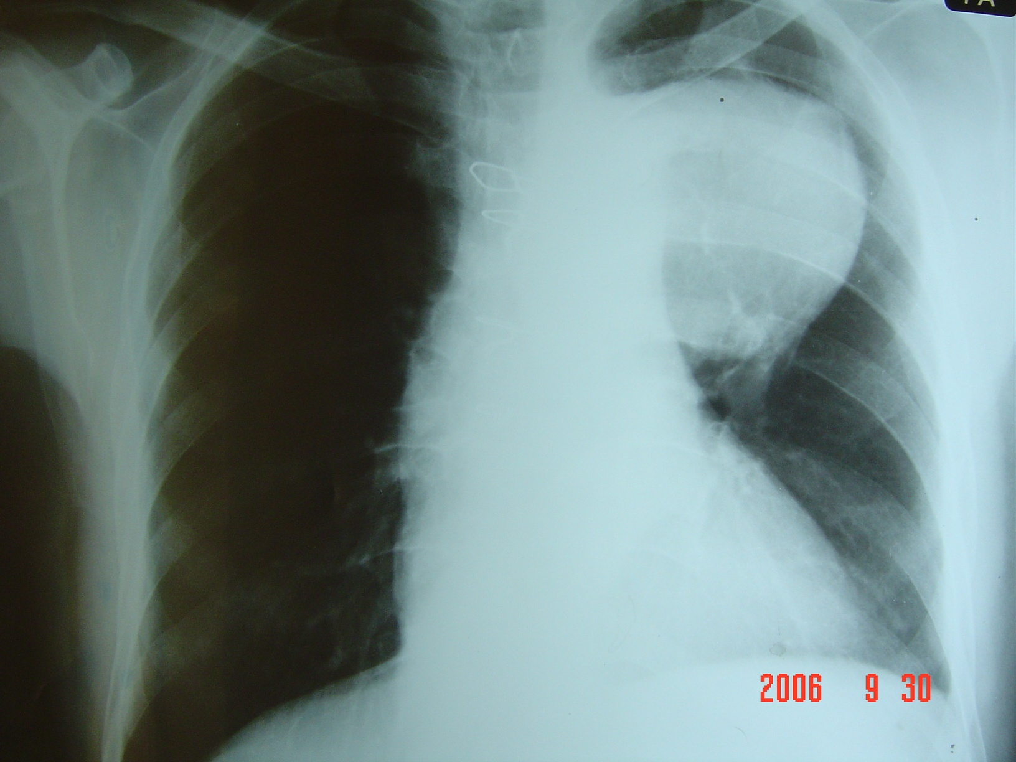

Slide 35
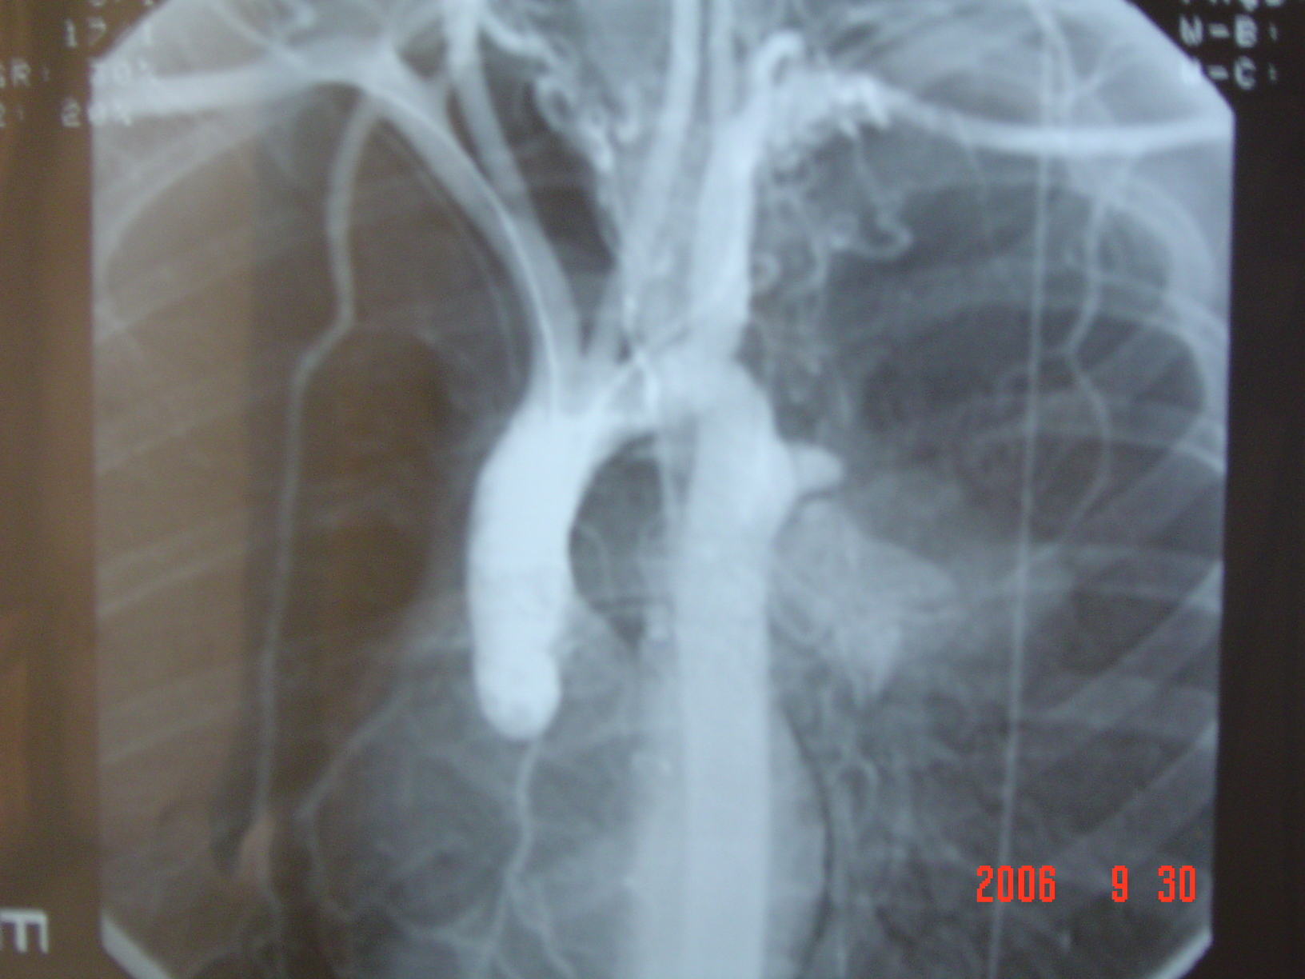

Slide 36
Basic Principles of Cardiac Surgery
Adequate Exposure
  Full or Partial Sternotomy / Thoracotomy / Robotic or Endoscopic
Bloodless Operative Field
  Suction and re-transfusion / Snaring or clamping of bleeding vessels
Static Operative Target
  Cardiac Arrest / Ventricular Fibrillation / Mechanical Stabilizers
Preservation of body perfusion
  Use of Heart Lung Machine / Off-pump Techniques
Preservation of Myocardium
  Off-pump Techniques / Hypothermia / Cardiac Arrest with cardioplegia

Slide 37
Heart Lung Machine
Components :
  Roller pumps
  Blood Reservoir (cardiotomy reservoir)
  Oxygenator
  Heater-cooler unit
  Tubing and Monitoring console etc
Limitation/Problems :
  Requires full anticoagulation
  Can cause micro embolism
  Initiates Systemic Inflammatory Response

Slide 38
Heart Lung Machine
Aims of cardiopulmonary bypass:
The principal aim of CPB is to facilitate cardiac and thoracic aortic procedures by excluding the heart and lungs from the circulation whilst providing:
1. adequate gas exchange
2. systemic organ perfusion
3. controlling body temp.

Slide 39
Complications of CPB
1. systemic inflammatory response due to contact of blood with the foreign surface of CPB circuit resulting in increased capillary permeability, interstitial edema, and subsequent organ dysfunction.
2. coagulopathy caused by platelet dysfunction as well as dilution and consumption of coagulation factors.

Slide 40
3. hemolysis.
4. renal and splanchnic hypoperfusion
5. cerebrovascular accident

Slide 41
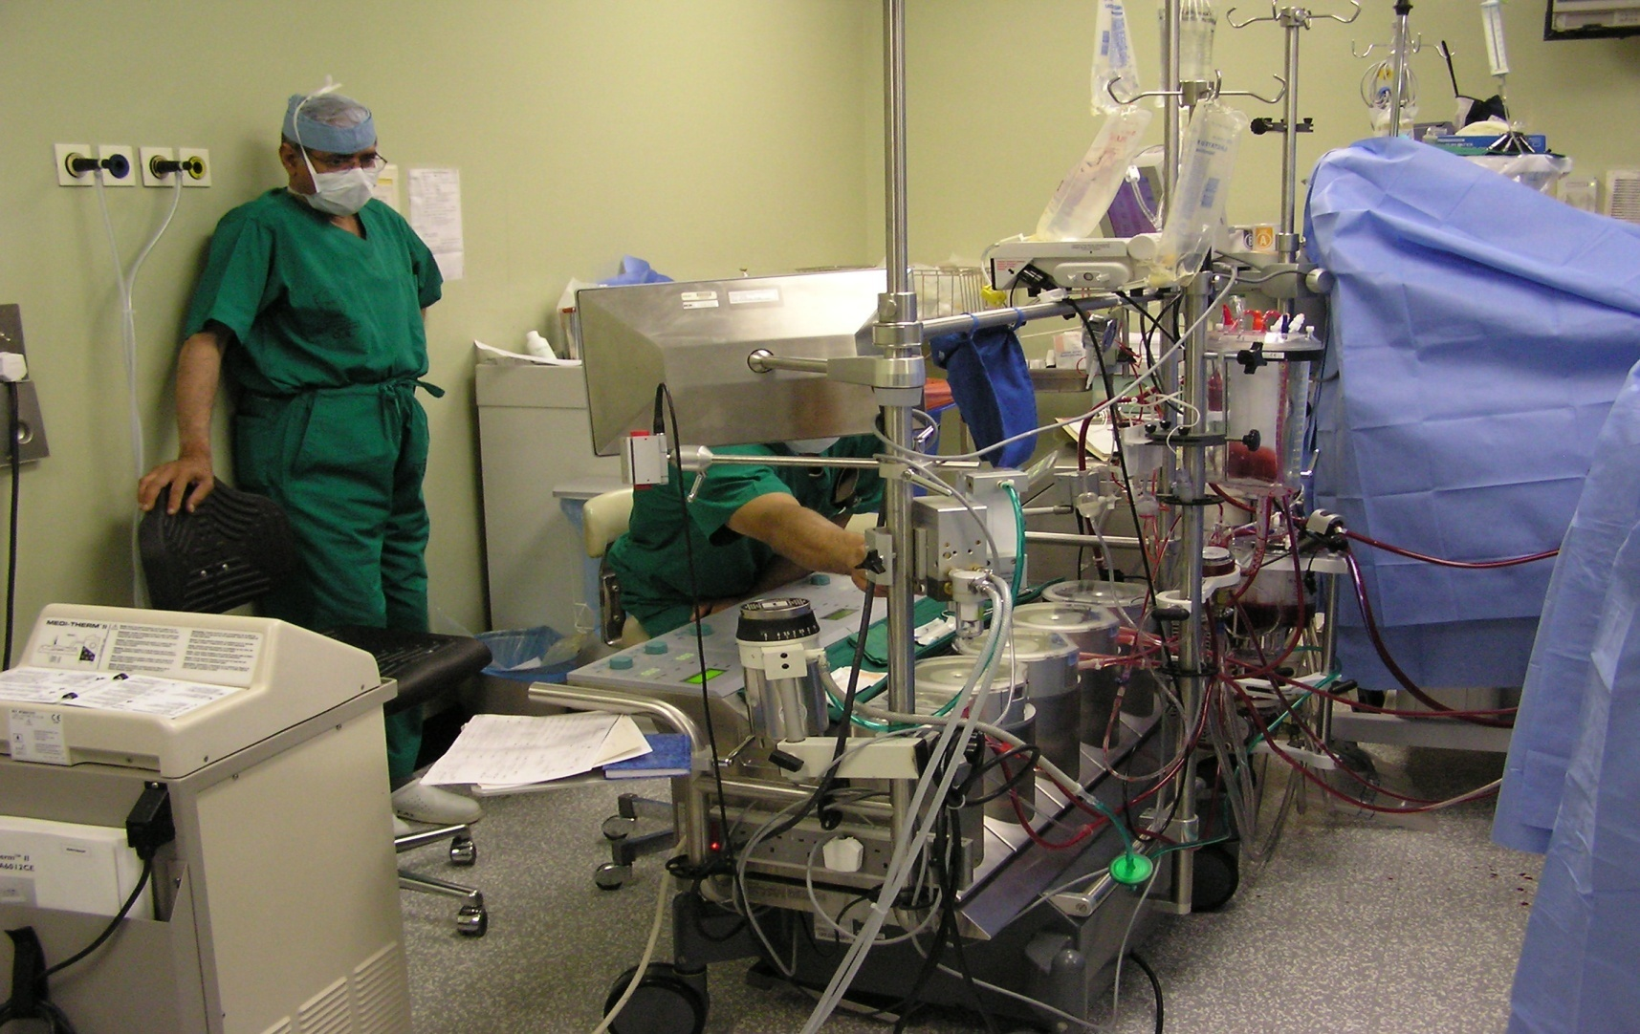
Heart Lung Machine

Slide 42
Usual Duration of Stay in Hospital
One day before surgery
3-6 hours OR time
One day in ICU
4-5 Days in Ward
Total 5-7 days

Slide 43
CardioThoracic Emergency
1. Chest pain:
-Myocardial ischemia
-Pulmonary embolism
-Aortic dissection
-Tension pneumothorax
-Rupture esophagus

Slide 44
2. Acute dyspnea:
-myocardial infarction
-Pulmonary embolism
- spontaneous pneumothorax
- bronchial asthma
-F.B. aspiration
-stuck mechanical valve.

Slide 45
3. Chest trauma:
-flail chest
-traumatic hemo/pneumothorax
-hemopericardium

Slide 46
Pericardial effusion
Progressive accumulation of fluid inside the pericardial cavity, may compress the cardiac chambers.
Etiology:
-Traumatic
-pericarditis
-malignancy
-uremia, post irradiation
-postoperative.

Slide 47
Investigations:
-Plain x-ray chest
-Echocardiography
-CT scan
Management:
- treat the cause
-Aspiration
-Pericardiostomy

Slide 48
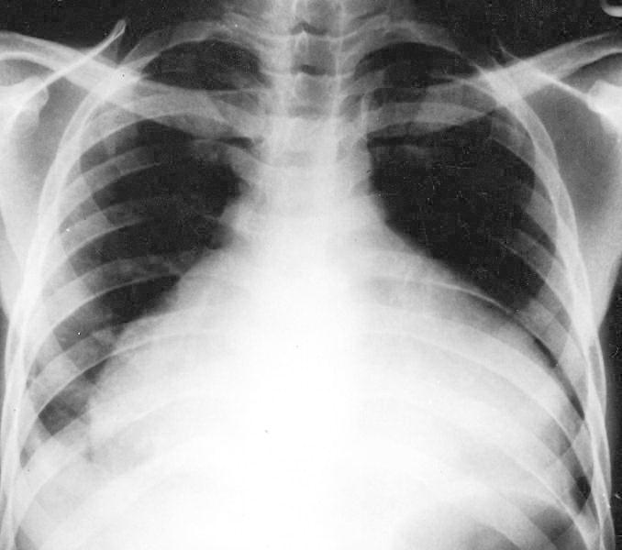

Slide 49
Congenital Heart Diseases
1. Acyanotic:
-Patent ductus arteriosus
-Coarctation of the aorta
-Pulmonary stenosis
-Atrial septal defect
-Ventricular septal defect

Slide 50
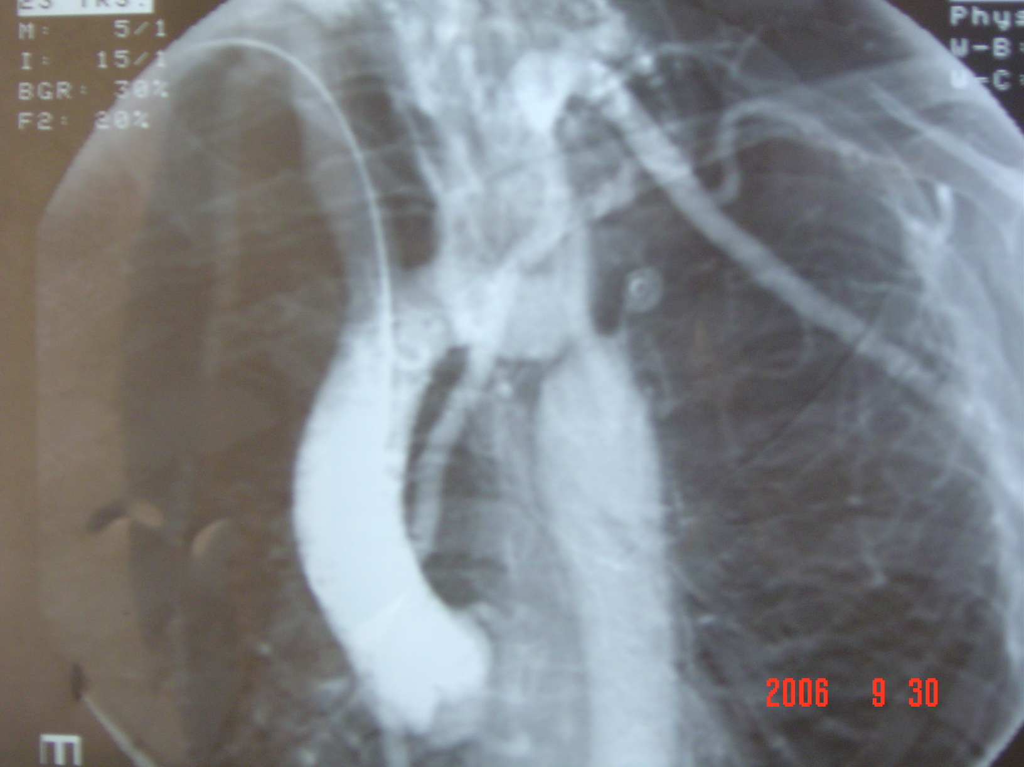

Slide 51
2. Cyanotic:
-Tetralogy of Fallot
-Transposition of the great vessels
-Tricuspid atresia
-Total anomalous venous drainage
-Truncus arteriosus

Slide 52
Pre-Operative Investigations for Cardiac Surgery
Full Blood Count
Blood Biochemistry
ECG
Chest X-ray
Pulmonary Function Tests.
Other test according to systemic review of patient
Echocardiography
Angiography
Carotid Duplex Scan
Peripheral Duplex Scan

Slide 53
Usual Duration of Stay in Hospital
One day before surgery
3-6 hours OR time
One day in ICU
4-5 Days in Ward
Total 5-7 days

