Slide 1
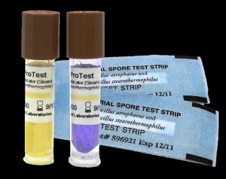
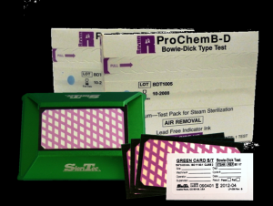
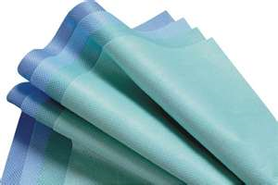
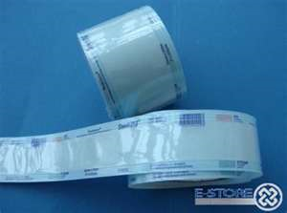
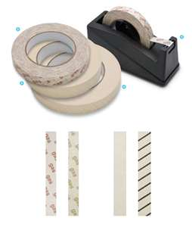
STERILIZATION
&
Operating Room Set Up
By:
Ms. Nida Jerez Salcedo
ADON – O.R.

Slide 2
Main Objectives:
To be able
To acquire knowledge and understanding on the different methods of sterilization as well as the sterilization processes.
To know & get familiarized with the principles of aseptic techniques & apply them in the clinical areas & Operating Room.

Slide 3
Table of Contents:
Methods of Sterilization
Physical Methods
Cool Chemical Methods
Liquid Chemicals
Other Methods
Sterilization Processes
Preparation of items before sterilization
Steam Sterilization Process
Testing the Effectiveness of the Autoclave
Storage of Sterile Packages
Principles of Aseptic Techniques-O.R. Set Up (Sterile Field)
Operating Room Set Up for Patient Safety

Slide 4
Terminologies
Sterilization-process by which all living microorganisms both pathogenic & non-pathogenic including spores are killed.
Sterile-absence of all microorganisms including bacteria, spores and viruses.
Asepsis- freedom from infection or the absence of microorganisms that cause diseases.

Slide 5
Terminologies
Sepsis- generalized reaction to pathogenic microorganism which is evident clinically by signs of inflammation & febrile conditions
Aseptic Techniques-practices that restrict microorganisms in the environment, equipment, supplies & prevention of the normal body flora from contaminating the surgical wound. (Method by which contamination with microorganisms is prevented).

Slide 6
Terminologies
Contamination-introduction of microorganisms to a sterile field.
Antiseptics-substances that renders microorganisms on living tissue inactive by preventing their growth. Used to disinfect body surfaces, skin & tissue. Inhibits the growth of endogenous bacteria. (Combat sepsis)

Slide 7
Terminologies
Disinfection-process by which renders inanimate objects free of pathogenic bacteria.
Disinfectants-agents that kill all growing or vegetative forms of microorganisms thus completely eliminating them from inanimate objects.
Contamination-introduction of microorganisms to a sterile field.

Slide 8
The prevention of infection in health care areas is largely dependent on the following:
Rigorous adherence to the principles of aseptic techniques by all personnel who performs any invasive procedures on patients.
Sterility of all items directly used in such procedures.
Disinfection of all surfaces & other items in the immediate environment.
Other methods – Prevention of SSI-Bundle of Care

Slide 9
Remember:
There is no degree of sterility.
An item is either sterile or non-sterile.
It can never be relatively sterile.

Slide 10
Take Note:
Surgical instruments, devices & heat sensitive items are sterilized by the method recommended by the manufacturer.
No sterile disposable items designed for single use should be reprocessed.
Sterilizing agent should be in contact with every part / surface of the item to be sterilized at specific period of time & temperature.

Slide 11
Methods of Sterilization:
Physical Methods:
1. Dry Heat-Hot air ovens, infra red ovens.
2. Moist heat- Steam Autoclave-(Available in KKUH)
Cool Chemical Methods:
1. E.O. Sterilizer
2. Plasma Sterilizer (Sterrad)- (Available in KKUH)
3. Liquid Chemicals
Other Methods

Slide 12
Physical Method:
Moist heat, at raised atmospheric pressure
  Steam sterilization (steam under pressure) - most inexpensive & effective method of sterilization. Steam under pressure permits permeation of moist heat to porous substances by condensation & results in destruction of all microbial life. . Ex. Steam autoclave
  Method used for sterilizing surgical instruments, dressing, drapes, swabs, laps sponges & culture media.

Slide 13
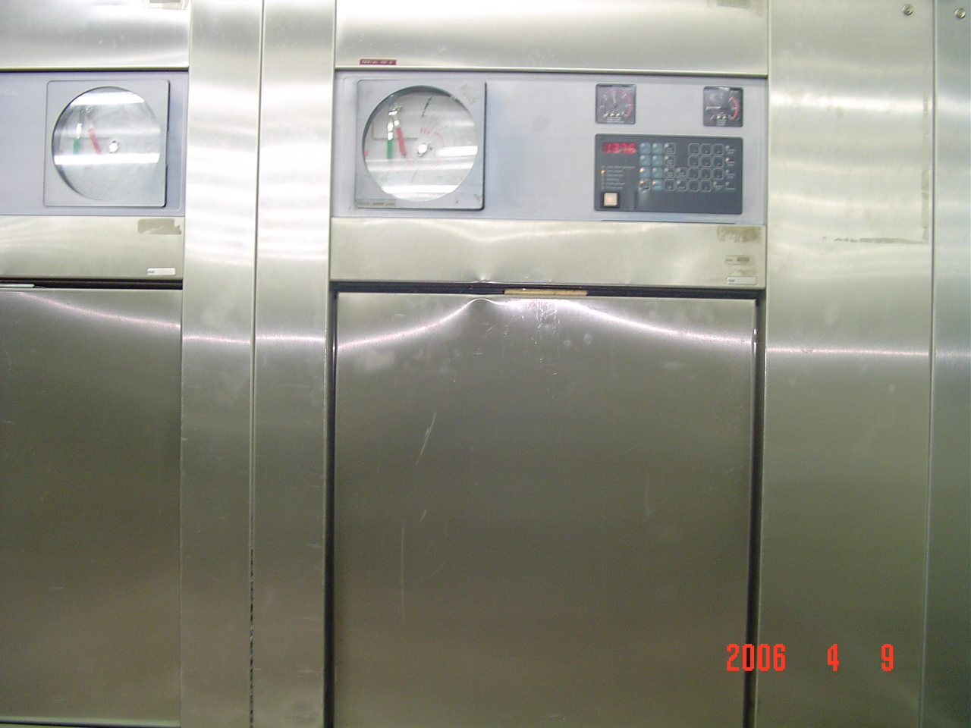
Steam Autoclave
An autoclave is a closed chamber in which items or objects are subjected to steam at high pressure & temperature above 100ºC.

Slide 14
Types of Autoclaves:
Downward Displacement Autoclave-
Air is removed in two stages & sterilization is effected by pure steam.
Minimum exposure time required for sterilizing instruments is 50 minutes at 131ºC or 60 minutes at 136ºC.

Slide 15
Types of Autoclaves:
High Vacuum / High Pressure Autoclave- Air is removed by powerful pump.
Steam penetrates the load & very rapid sterilization of dressings, instruments, raytec swabs, lap sponges, other surgical items & packs is possible in 30 to 40 minutes at 134ºC. (Available in KKUH)

Slide 16
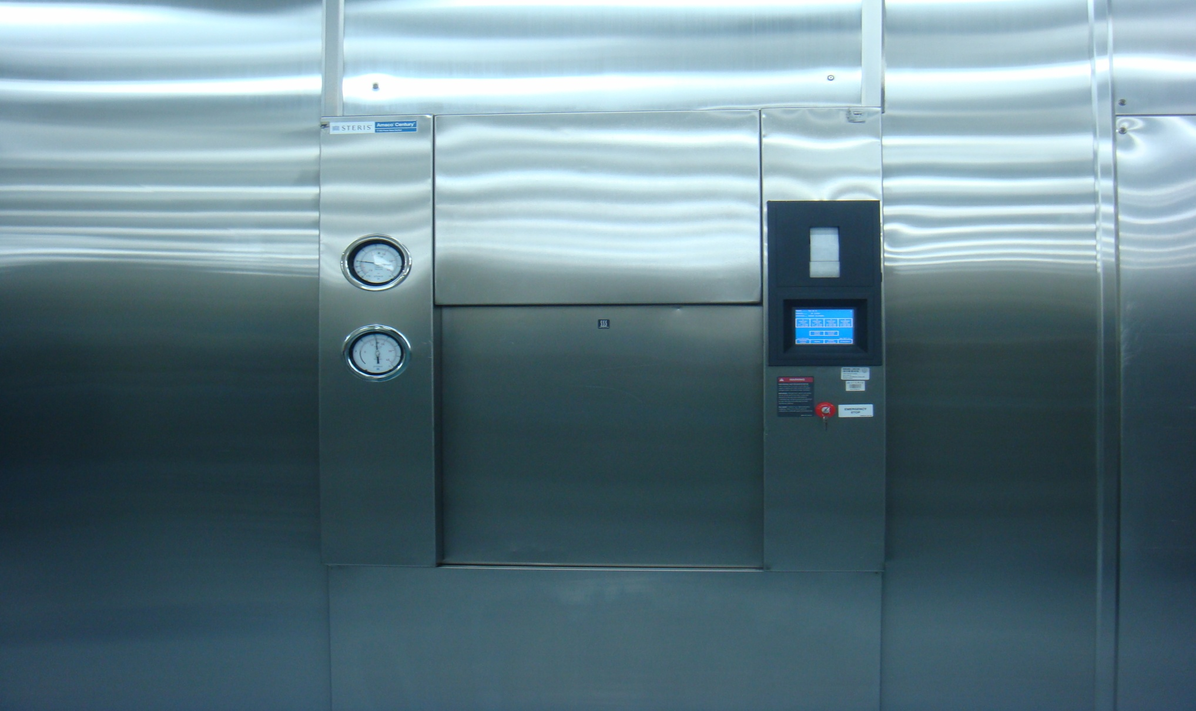
New Steris Autoclave

Slide 17
Preparation Of Items Before STERILIZATION
Decontamination
Disassembly
Washing
Drying
Packing
Loading in sterilizer

Slide 18
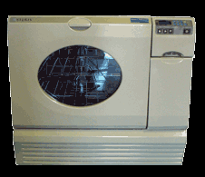
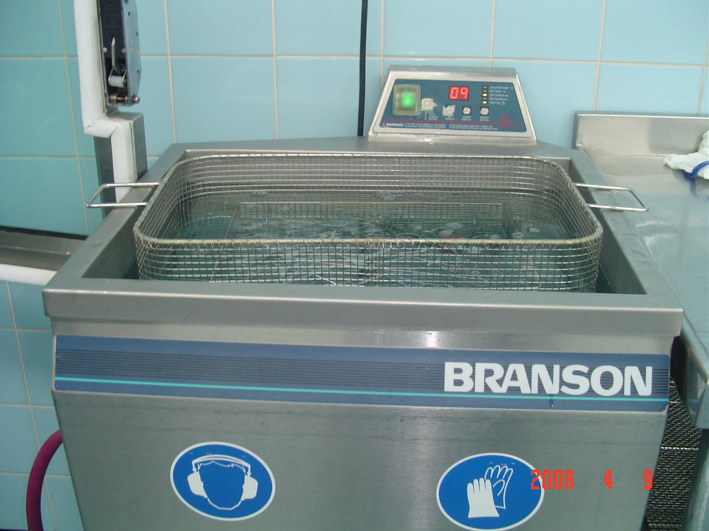
Ultrasonic Washer

Slide 19
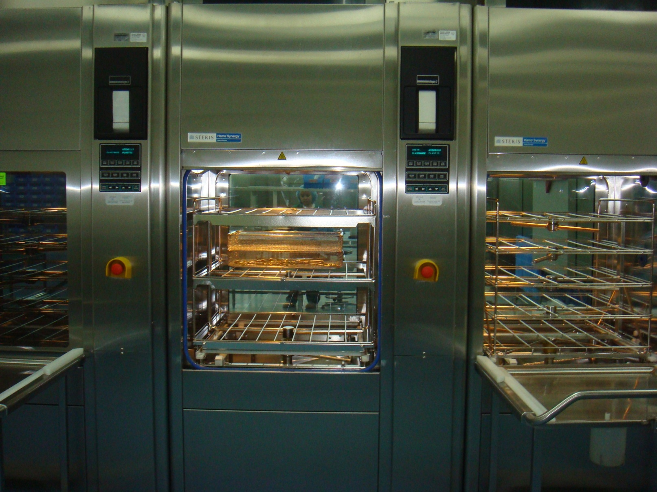
Automated Washer

Slide 20
THE STEAM STERILIZATION PROCESS –
FIVE DISTINCT PHASES:
PHASE I - Loading phase - in which the objects or packs are loaded in the sterilizer.
PHASE II - Heating phase - in which the steam is brought to proper temperature & allowed to penetrate through the objects in the chamber.
PHASE III - Destroying phase or time temperature cycle - in which all microbial life is exposed to the killing effect of the steam.

Slide 21
THE STEAM STERILIZATION PROCESS
PHASE IV - Drying and cooling phase - in which the objects are dried & cooled then, filtered air is introduced into the chamber, door is opened & packs are removed stored.
PHASE V - Testing phase - in which the efficiency of the sterilization process is checked. All mechanical parts of sterilizers, including gauges, steam lines & drains should be periodically checked by a competent biomed engineer.

Slide 22
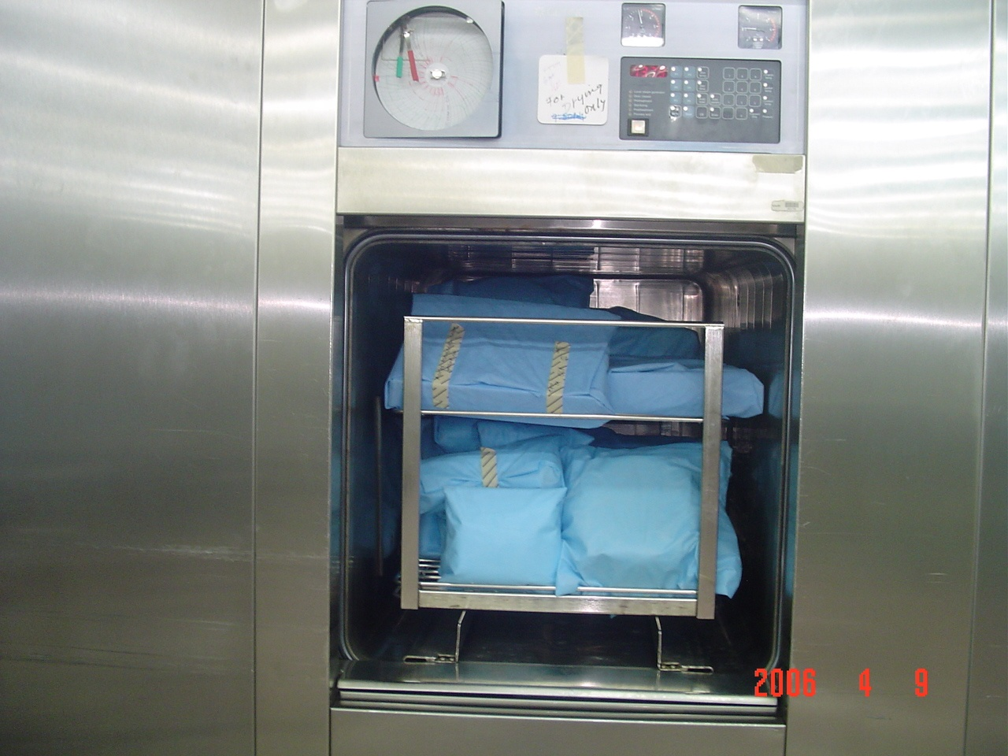
Loading Procedure

Slide 23
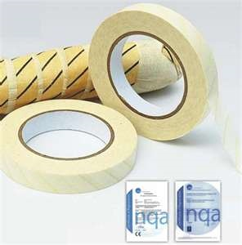

MAKING OF STERILE
PACKS
Should have the following external indications showing that they have been processed:
Autoclave tapes show a pack that has been through a sterilization cycle & should be visible outside every pack sterilized.
Autoclave tape is designed black when specified temperature is reached.
Must be labeled as to its contents with the processing date, autoclave used & load number. This assists locating processed items in case of recall.

Slide 24
STORAGE OF STERILE PACKS
Sterile packs / sets should be left untouched & allowed to be cooled before storage to avoid condensation inside.
Must be handled as little as possible to reduce the risk of contamination.

Slide 25
STORAGE OF STERILE PACKS
Sterile packages should be stored on open shelves.
  The lowest shelf should be 8 to 10 inches off the floor.
  The highest shelf should be 18 inches from the ceiling.
  All shelves should be at least 2 inches from the walls.

Slide 26
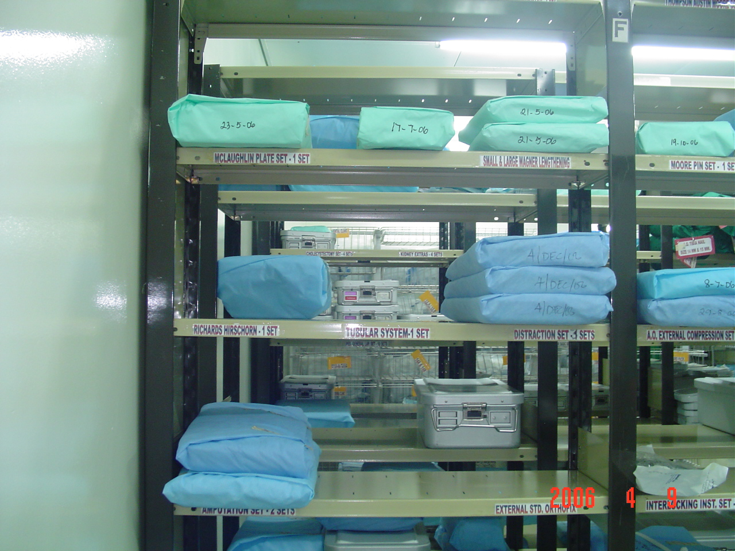
KKUH-CSSD Storage Room

Slide 27
STORAGE OF STERILE PACKS
Either good for 30 days or 6 months to one year depending on how the packages are wrapped & what type of wrappers used.
Shelf life - refers to the length of time a package maybe considered sterile.
Sterile packages must be stored and issued in correct order.
Traceability (Tracking System)

Slide 28
STORAGE OF STERILE PACKS
Storage room-subjected to regular adequate pest control to prevent contamination from rodents, ants & cockroaches.
Traffic is restricted to CSSD personnel & trainees only.
One flow

Slide 29
Causes of failure to produce a sterile load
Faults & errors in the autoclave
  Poor quality steam
  Way it is operated
  Failure to remove air & condensate
  Faulty gauges & timings
  Leaking door seals
  Inadequate air filter
  Excessive layers of wrapping materials
  Large packs, torn & wet packs

Slide 30
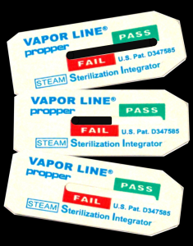
Methods of Testing the
Effectiveness of Autoclaves:
Mechanical- chart & gauges usually carried out by Biomed Engineer.
Chemical- by the use of autoclave tapes, strips and card. A daily test in an empty chamber using a heat sensitive tape. This is for high vacuum/high pressure autoclaves. Ex. Bowie Dick Test Pack- a pack with a chemical indicator both outside & inside to verify that steam has penetrated the pack & to test air leaks.
Biological

Slide 31
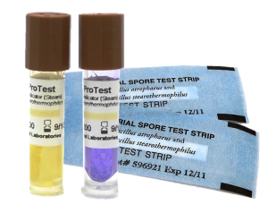
Biological Indicator-
Biological Spore Testing
To test autoclaves regularly with Geobacillus stearothermophilus, which is one of the most heat tolerant species of bacteria.
If sterilization in an autoclave does not destroy the Geobacilus spores, the autoclave is not working properly.

Slide 32


Testing the Effectiveness of Steam Autoclave:
First- Run it empty for one cycle. (Dummy Run) – to warm up the machine.
Second- Put inside in the middle of the chamber, the Bowie Dick Test Pack and run it again and finish the whole cycle. Oh high pressure- to test leaks and presence of air. (Yellow turns black)
Third- Load the items & trays for sterilization ( little bit lower pressure). It is done once daily.
Fourth- Live Organism- done once in every Sunday morning in CSSD, KKUH.

Slide 33
COLD METHOD-Chemicals
Ethylene Oxide (EO)-
*Well established technique for sterilizing heat sensitive articles.
*Colorless gas
* Exposure period of 5 to 7 hours is necessary for complete E.O. sterilization.
*Temperature for sterilizing is 21º C to 60º C (70º F to 140º F).

Slide 34
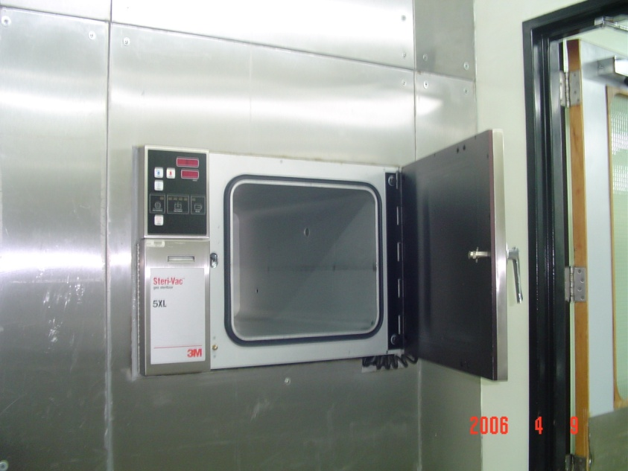
E.O. Sterilizer
Used for sterilizing vascular & bone grafts, delicate instruments, plastic articles such as disposable syringes,bacteriological media & vaccines.

Slide 35
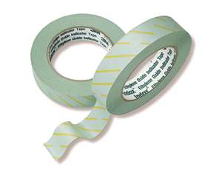
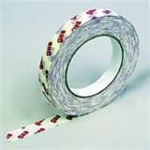
Ethylene Oxide (EO)
Chemical indicators for EO should be used with each pack .
Gas sterilizers should be checked once a week with commercial preparation spores, usually Bacillus Atropheus.
Requires 6-8 hours of aeration.

Slide 36
DISADVANTAGES OF EO
Lengthy process with long aeration periods.
Expensive & more complex process.
Produce serious burns on exposed skin.
Insufficiently aerated materials can cause irritation, burns of body tissues.
Toxic & may cause Cancer. *Precautions should be taken to protect personnel.

Slide 37
Plasma Sterilizer
Plasma Autoclave (Sterrad)-
*Low Temperature Hydrogen Gas Sterilizers. *Used to sterilize delicate instruments that are heat & moisture sensitive, such as micro instruments, cameras, scopes & light cords.
*Gentle patented sterilization process with the use of hydrogen peroxide & generation of low temperature gas plasma.
*Spore testing should be performed at the same interval as testing of other sterilizers.

Slide 38
Plasma Sterilization
104°F-131°F (40°C-55°C). – 45 minutes to I hour.
Advantages of plasma sterilization include speed, safety of use, & no aeration.
Five phases to the “Sterrad” Plasma sterilization cycle: vacuum, injection, diffusion, plasma, vent.

Slide 39
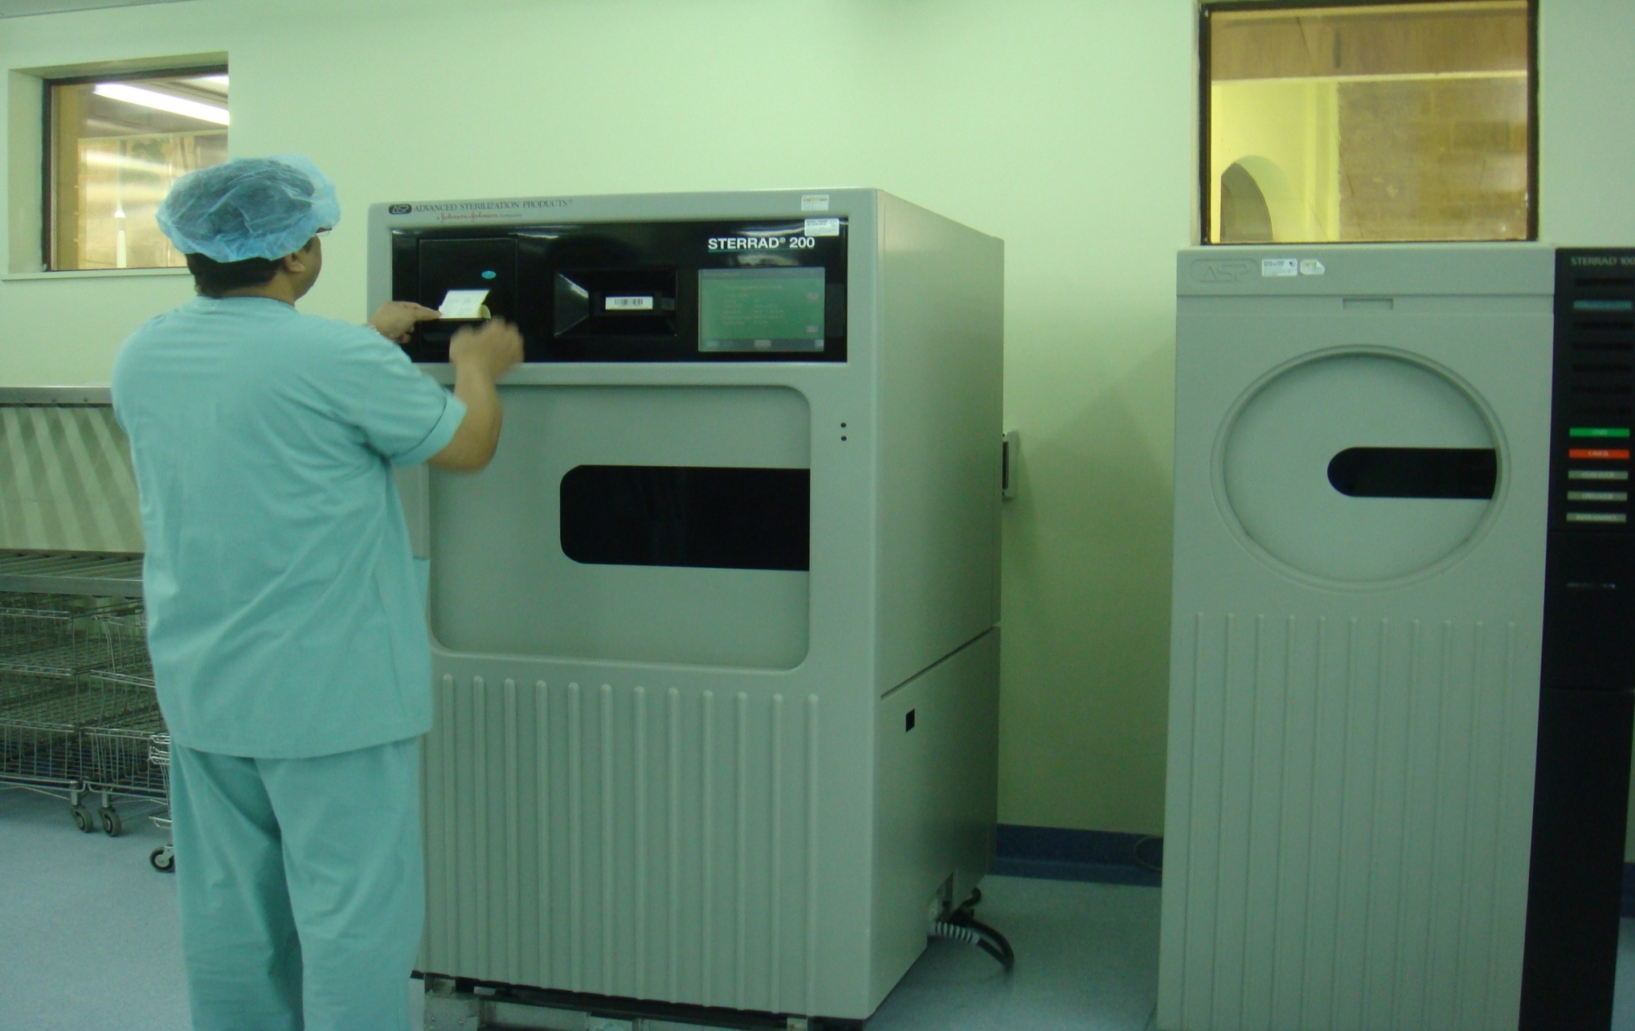
New Sterrad Plasma Autoclave

Slide 40
LIQUID CHEMICAL STERILIZATION
Liquid chemo sterilizers can destroy all forms of microbial life including bacterial, fungal spores, tubercle bacilli & viruses.
Can be used for sterilization when steam, gas or dry heat is not indicated or available.

Slide 41
Common Liquid Chemicals - Capable of causing Disinfection / Sterilization.
  Aqueous Formaldehyde- Oldest chemo sterilizers known to destroy spores; rarely used due to its pungent odor.
  Aqueous Glutaraldehyde- Colorless liquid chemical with pungent odor. (CIDEX)
  *Short soaking period( 20 minutes-30 minutes) only provides disinfection of instruments.
  *Complete immersion in activated glutaraldehyde solution for 10 hours achieves sterilization.
  *After immersion, all surfaces of the instruments must be rinsed thoroughly with sterile water before use.
  *Any immersion of less than 10 hours must be considered as only as disinfection(Spores not killed.
  *Toxic & can cause nasal ( respiratory mucosa), eye & skin irritation.

Slide 42
Common Liquid Chemical Disinfectants
  OPA Cidex-(0.55% ortho-phthalaldehyde)-Clear, pale-blue liquid (pH, 7.5), contains 0.55%the non-glutaraldehyde solution for disinfection of flexible endoscopes and other medical devices.
  Alcohol- 70 % Ethyl Alcohol & 70% Isopropyl Alcohol- Effective & rapidly acting disinfectants. *Alcohol gel preparations today have been introduced & long standing effect, fast in action & more users friendly.( Hand Antiseptics)
  Chlorexidine- Skin antiseptic & highly active against vegetative bacteria.
  Hypochlorite- Broad spectrum chlorine disinfectant effective against viruses, fungi, bacteria & spores. *Disinfectant of choice against hepatitis B virus.

Slide 43
Other Methods of Sterilization:
Gamma Radiation
Gamma Radiation-Radioactive material, such as a Cobalt-60 source, emits radiation(gamma rays).
Gamma Radiation effectively kills microorganisms.
Used on commercial basis for the sterilization of a wide variety of pre-packaged hospital items and devices.
Total sterilizing time is measured in days.

Slide 44
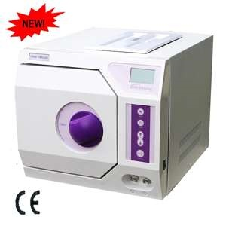
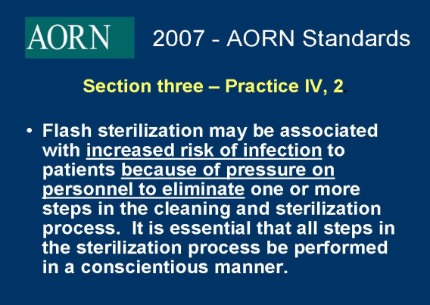
Flash Sterilization
“Flash sterilization” should be used in selected clinical situations & in a controlled manner. *Use of flash sterilizer should be kept to a minimum & only for emergency use.
Flash sterilization should not be used as a substitute for proper sterilization methods.
Flash sterilization should not be used for implantable devices.

Slide 45
Principles of Aseptic Techniques
By: Ms. Nida J. Salcedo
ADON-O.R.
For O.R. Set Up
(Sterile Field)

Slide 46
Aseptic techniques are sets of practices performed under careful, controlled conditions in order to prevent contaminations of pathogens.
Most strictly applied in the O.R. because of direct & extensive disruption of skin & underlying tissues.
Practices that ensure safe & effective ways in establishing & maintaining sterile field in which surgery can be performed safely.
Aseptic techniques help to prevent surgical site infection.

Slide 47
All items used within the sterile field must be sterile.
Point of emphasis:
Sterile items presented to the sterile field must be checked for:
* Package Integrity
* Expiration Date
* Chemical Process Indicator
Tears in barriers & expired sterilization dates are considered breaks in sterility.

Slide 48
Use of unsterile items contaminate the sterile field.
Sterile field is created as well as sterile packages are opened as close as possible to time of actual use.
Moist areas are considered sterile.

Slide 49
Scrubbed personnel should function within a sterile field.
Surgical team is made up of:
* Sterile members or scrubbed personnel-
work directly in the surgical field.
Ex. Surgeons, Scrub nurse, O.R. Technician
* Non-sterile members or unscrubbed
personnel.
Ex. Anesthetists, Circulating nurses,
Anesthesia Technicians, X-Ray Technician

Slide 50
Points of Emphasis:
Surgical team members must wear the scrub suit attire, surgical cap, surgical face mask before performing surgical hand scrub.
First surgical hand scrub should be at least 5 minutes & the subsequent hand, at least 2 to 3 minutes.
Surgical hand scrubbing to be performed prior to donning of sterile gown & sterile gloves.

Slide 51
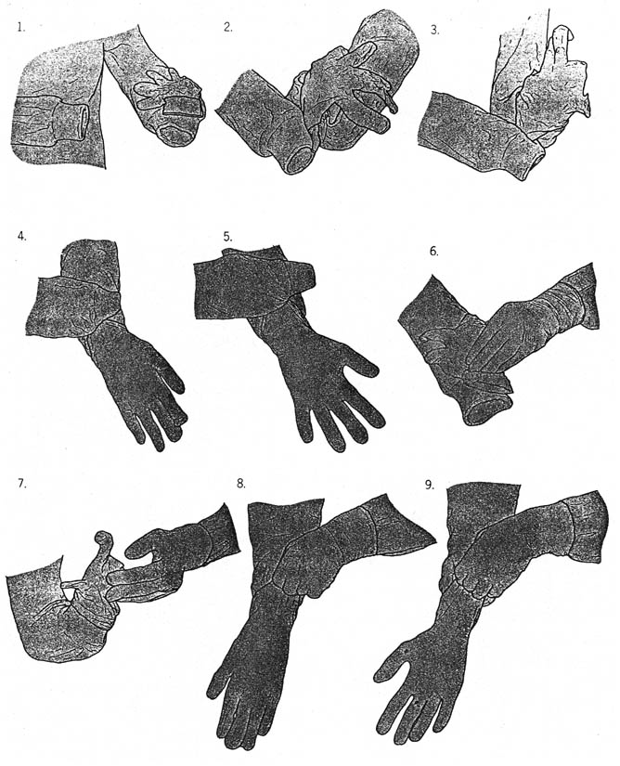
After donning the sterile gown is donning the sterile gloves.(Closed Gloving Technique is recommended in O.R.) Never let the fingers extend beyond the stockinette cuff)

Slide 52
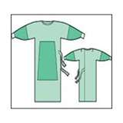
The sterility is limited to the portions of the gowns directly viewed by the scrubbed person.
Gowns are considered sterile only on the:
1. Front of gown from chest to the level of the
sterile field.
2. Sleeves of gown from 2 inches above the
elbow to the cuff.
Note: Cuff should be considered unsterile due
to it tends to collect moisture & it is not an
effective barrier. Therefore, cuff should always
be covered by sterile gloves.

Slide 53
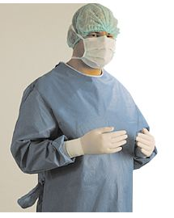
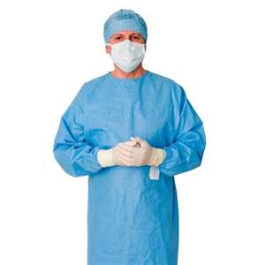
Scrubbed Personnel

Slide 54
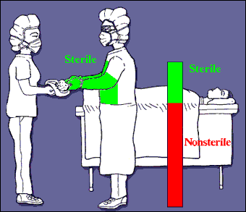
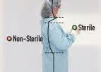
Areas of gown considered unsterile are:
1. Gown’s neckline
2. Shoulders
3. Under the arms
4. Back
Not to allow the hands or any items to fall below the level of sterile field.
No sitting nor leaning against unsterile surface because of great contamination.

Slide 55
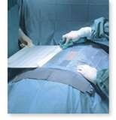
Sterile drapes are used to create a sterile field.
Surgical Drapes are sterile materials used to
maintain the sterility of the operation field.
Surgical Drapes establish an aseptic barrier minimizing the passage of microorganisms from non sterile to sterile areas.
Sterile surgical drapes should be placed on the patient, parts of O.R. table & equipment included in the sterile field, leaving only the incision site exposed.

Slide 56
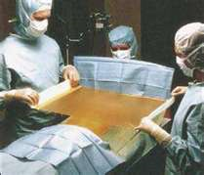
DRAPING PROCESS
Only the scrubbed personnel should handle sterile drapes by cuffing the draping material over the gloved hand.
When draping, it should be compact, held higher than the O.R. table & draped from the prepped incision site to the periphery.
Tables are only sterile at table level.
Once the drape is placed, it should not be moved or re-arranged & only top surface is considered sterile.

Slide 57
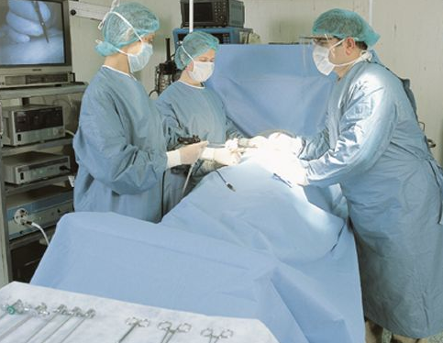

Slide 58
*All items should be dispensed to the sterile field by methods that preserve the sterility of the items & integrity of the sterile field.
Open the sterile items: The unscrubbed person should open the wrapper flap farthest away from him first & the nearest wrapper last to prevent contamination by passing an unsterile arm over a sterile item.
After a sterile pack is opened, the edges are considered unsterile.

Slide 59
Dispensing solution to Sterile Field
Either entire bottle contents should be poured into the receptacle or remainder should be discarded.
Edge of the bottle cap is considered unsterile once opened.
Solution should be poured slowly to avoid splashing.
Splashing can cause strike through & contamination of the sterile field.

Slide 60
A sterile field should be constantly maintained and monitored.
Surgical team members should maintain a vigilant watch on the sterile field & point out any contamination immediately.
When breach of sterility occurs, an immediate action to correct the break in technique.
. Contaminated item must be removed immediately from the sterile field.

Slide 61
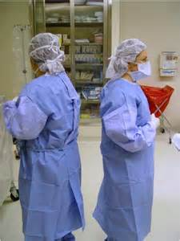
Movement around a sterile field must not cause contamination.
The operative site is the center of the sterile field & all scrubbed personnel should remain close to this area.
Movements can cause contamination to the sterile field.
Surgical team should move only from sterile areas to sterile areas.
Change positions –Should turn back to back or face to face & maintain a safe distance close to the sterile field.

Slide 62

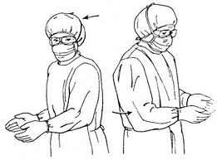
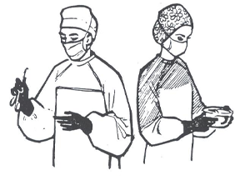
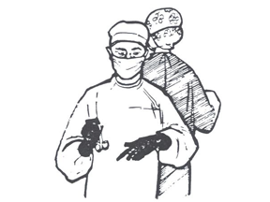
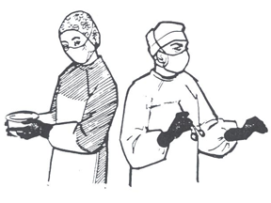

Slide 63
Points of Emphasis-
Scrubbed Personnel
Keep arms & hands within the sterile field at all times to avoid any accidental contact with unsterile areas.
Keep gloved hands in sight & kept at waist level or above because below the waist is contaminated.
Maintain a safe distance when approaching unsterile objects and personnel. Identify safe boundaries.

Slide 64
Un-scrubbed Personnel
Remain in non-sterile area to prevent contamination of the sterile field.
Always face the sterile field on approach and should never walk between 2 sterile fields.
O.R. personnel with colds & URTI should avoid working inside the theater.

Slide 65
Items of doubtful sterility must be considered unsterile.
When a sterile barrier is permeated, it must be considered contaminated.
Once set up, the sterile field should be monitored constantly and not be left unattended.
Non sterile items should not cross above a sterile field.
The margin of safety is generally identified as a minimum of 12 inches.

Slide 66
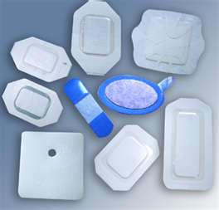
Sterile Wound Dressing
Dressing material should only be opened during wound dressing time.
Wound or surgical site should be cleaned & dried before application of the dressing material.
Applied before surgical drapes are removed to avoid contamination of the incision.

Slide 67

Take note
Surgical team must practice these principles of aseptic technique to prevent the transfer of microorganisms into the surgical wound.
Surgical team members’ responsibility to develop a strong surgical conscience, adhering to the principles of surgical asepsis & correcting any improper technique witnessed in the OR.

Slide 68
King Khalid University Hospital
Operating Room
Operating Room
Set Up
for
Patient Safety
By: Ms. Nida J. Salcedo
ADON-O.R.

Slide 69
Main Objective-To be able
To acquire knowledge & understanding about the Operating Room set up in order to ensure safe environment & safe surgical practices towards patient safety.

Slide 70
Operating Room Set Up
O.R. as a system
Effective flow of information & communication.
Teamwork
Culture of Patient Safety-Safe environment & safe surgical practices.
Just & fair culture
Environment of continuous learning
Cutting edge equipment & supplies – advance technology.

Slide 71
Setting up an Organized Operating Room-Assist the Surgical Team
To work in an efficient & timely manner, which is critical when performing life-saving procedures.
To focus & offer a safe environment & quality surgical services to the surgical patients.

Slide 72
Perioperative Stages
Immediate Pre - operative Stage – O.R. Pre-Op. Holding Area, before entering O.R. theater.
Intra - operative Stage – Inside the theater, during the surgery.
Immediate Post - operative – Post Anesthesia Care Unit (PACU) – After surgery.

Slide 73
O.R. Zones / Areas
Unrestricted Areas - where street clothes are permitted. Ex. Changing Rooms
Semi -restricted Areas – Hallways, corridors, O.R. offices, equipment & instruments’ storage rooms & staff sitting rooms.
Restricted Areas – Sterile Storage Room, Inside Operating theaters.

Slide 74
O.R. Theater Physical Basic Set Up
Operating Room Table & accessories
Operating Room Surgical Light
Anesthesia Machine & Anesthesia Trolley for Intubation & Anesthesia supplies
Physiological Monitor
Suction Machines
ESU (Electro Surgical Unit)
Mayo Table / Instrument Trolleys
Equipment according to specialty

Slide 75
Proper Surgical Attire in the O.R.
Provides barrier between O.R. personnel & patient
Protection of O.R. personnel against exposure to infectious microorganism.
KKUH Policy – All O.R. personnel who enter the semi-restricted areas & restricted areas of O.R. must wear freshly laundered surgical scrub suits intended only to be used within the O.R.

Slide 76
Surgical Attire-2 piece scrub suit,
O.R. Cap / Hood, O.R. Clogs, Surgical Face Mask & other PPE
Scrub Suit
If soiled or wet, must be changed.
Lab coat/cover gown is to be worn whenever leaving the O.R.
Lab coat not to be brought inside the O.R. semi-restricted & restricted areas.

Slide 77
Surgical Attire
O.R. Cap / Surgical Hood / Surgical Mask
Head & facial hair to be covered.
High filtration surgical mask to be used in restricted areas.
Discard surgical mask when not in use.
Leave O.R. without surgical mask hanging on the neck.

Slide 78
Surgical Attire
O.R. Clogs ( O.R. Footwear)
No street shoes to be worn in O.R.
Intended for O.R. use only
Shoe covers may be worn if anticipated splashes may occur
Cleaning & disinfection of clogs to be done when soiled.

Slide 79
Effective Communication in O.R.
“ Communication failure is the root cause of sentinel events in the O.R.”
Sophisticated instruments / state - of the - art equipment.
Transfer of critical information.
Changing nature of patient’s condition.
Uncertainty inherent in surgery.

Slide 80
Ways to Establish Good Communication in O.R.
Eliminate hierarchy
Encourage team approach to care (Teamwork)
SBAR as a tool / Read back technique
Pre-operative Checklist
Surgical Safety Checklist
Time Out Procedure

Slide 81
Causes of Wrong-Site, Wrong- Procedure, Wrong-Person Surgery
Ineffective communication among members of the surgical team.
Improper procedures for verifying operative site.
Lack of patient involvement in site marking
Inadequate patient assessment (Patient Care Plan)
Inadequate medical record review.
Wrong patient identifiers.
Illegible handwriting
Use of abbreviations related to surgical procedure (site or laterality)

Slide 82
Causes of Wrong-Site, Wrong- Procedure, Wrong-Person Surgery
Multiple procedures
Under time pressure
More than one surgeon
Unusual patient characteristics.

Slide 83
Universal Protocol – for Preventing Wrong-site, Wrong-Procedure &
Wrong – Person Surgery( WHO )
Pre-operative verification process
Marking of the surgical site
Time-out before start of procedure

Slide 84
Preoperative Verification Process
At the time procedure is scheduled.
At pre-admission testing & assessment
At the time of admission to the floor
Anytime responsibility of care for patient is transferred to another healthcare provider.
Before patient leaves preoperative area or enters O.R.

Slide 85
Marking the Surgical Site
Write “ Left” or “Right” indicated in the surgical informed consent.
Surgical site is marked with the patient involved, awake & alert if possible.
Mark should be visible after patient has been prepped and draped.
Do not mark any non-operative site.
Marking should be done by the one who will perform the procedure.

Slide 86
Time Out Procedure
Correct patient’s identity
Correct side/site is marked
Accurate & complete signed informed surgical consent
Agreement on procedure to be performed
Correct patient’s position
Availability of correct implants, special equipment or requirements
Images are labeled & correctly displayed
Safety precautions based on patient’s history & medication use

Slide 87
Addressing O.R. Associated Risks / Hazards
Ensuring Fire Safety
Ensuring Infection Control Measures – Waste Management; Sharps Safety
Maintenance of proper Hand Hygiene
Preventing Overbooking of O.R. surgical lists.

Slide 88
Minimize Risks Associated with Fire Triangle
Prepare patients appropriately- Skin preparation should be done properly.
Test equipment before use
Use equipment safely.
Maintain equipment – PPM
Laser Safety.
Control of excess oxygen in the environment
Engage staff in fire prevention – Fire Drills

Slide 89
Responding to O.R. Fire
Shut down medical gases.
Pour saline into surgical site.
Remove burning material
Ventilate with air instead of oxygen.

Slide 90
Infection Control & Prevention
Air quality & ventilation
Effective O.R. cleaning – Terminal cleaning
Effective medical equipment cleaning & disinfection
Effective laundry cleaning

Slide 91
Air Quality & Ventilation
CDC (Center for Disease Control & Prevention) Guidelines
Maintain positive pressure ventilation
Maintain 15 air changes cycle per hour & at least 3-4 fresh air changes
Ensure filtered air
Introduce air from ceiling & exhaust near the floor
Keep theater doors closed always
Use proper O.R. attire in O.R. restricted areas.

Slide 92
Care of Patient with TB
Patient should be intubated in AIIR (Airborne Infection Isolation Room)
Patient wears a surgical mask.
Use surgical N95 mask or respirator.
Use bacterial filter with anesthesia equipment.
Schedule as last surgical case of the day.
Extubate & allow recovery in AIIR.

Slide 93
O.R. Sanitation
Damp dusting before the first procedure.
Proper cleaning in between cases.
Terminal cleaning once every 24 hours.
Use wet vacuum & single use mop.
General cleaning weekly.

Slide 94
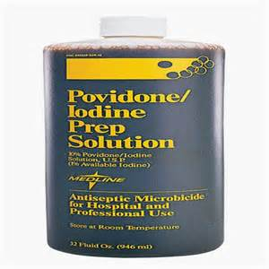
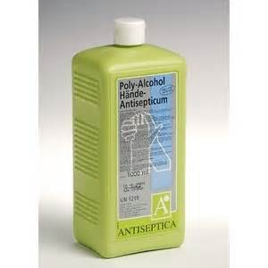
O.R. Antiseptics
Antiseptics to be used in O.R. should be a combination of 2 antiseptics with different mechanisms of action can be better at fighting bacteria than a single antiseptic.
Example: Iodine 10% & Alcohol 70%

Slide 95
Reducing Surgical Site Infections
Use prophylactic antibiotics
Use sterile instruments, aseptic techniques adherence
Remove hair properly through hair clipping.
Ensure glycemic control.
Prevent hypothermia.
Provide supplemental O2 during surgery.
Limit O.R. traffic – Visitor Control Policy, Visitor’s permit
Designate specific rooms and routes – Traffic Pattern
Use of disposable items – No reprocessing is allowed. Follow manufacturer’s instructions.
Monitor staff’s health.

Slide 96
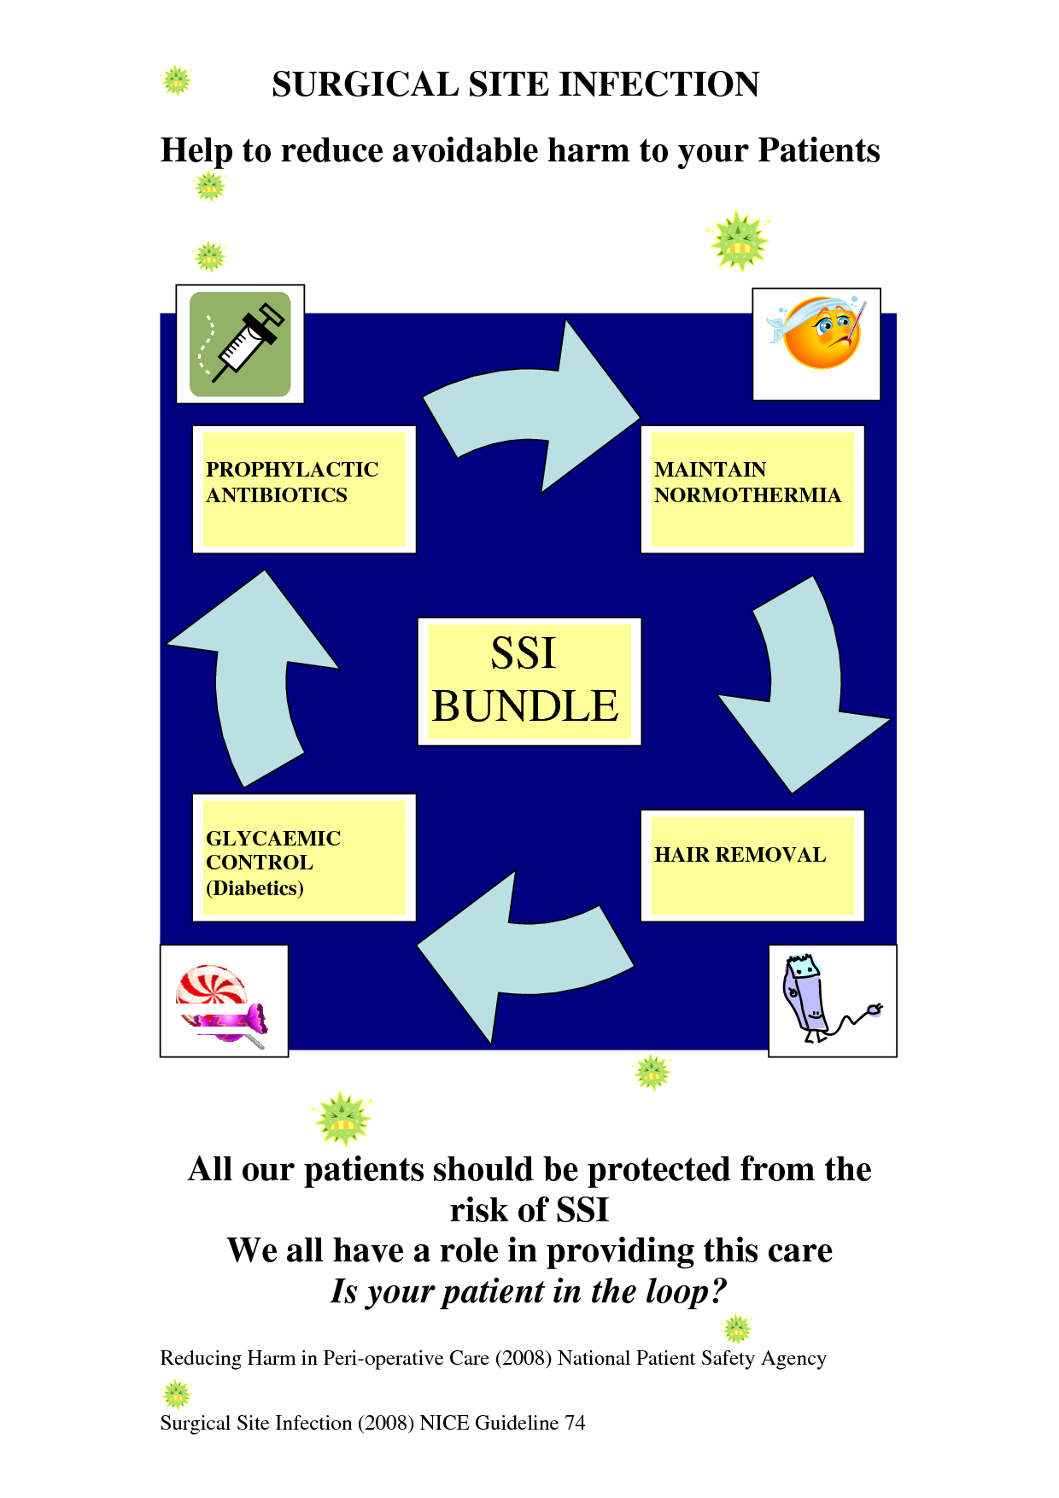
SSI- Bundle of Care

Slide 97
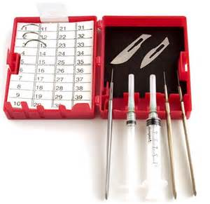
How to reduce Sharp Injuries?
Use a neutral zone.
Practice double gloving
Change surgical gloves
Be very vigilant & stay out of the way

Slide 98
Manage O.R. Block Time Effectively
Set clear rules
Consider O.R. time utilization as a guideline
Review block time regularly
Emergency theater not to be used for elective cases.

Slide 99
Categories of Emergency Cases
Category I- Life threatening very urgent cases, extreme emergencies & cases that need to be done immediately & within 6-12 hours.
Category II- Emergency cases that need to be done within 6 – 12 hours.
Category III- Emergency Cases that need to be done within 12 – 24 hours.

Slide 100
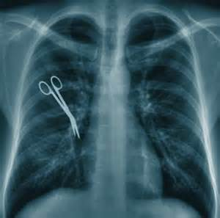
Risk Factors for Retaining Foreign Bodies After Surgery
Emergency surgeries
Complex procedures
Surgeries with unplanned procedures
Surgeries on off hours
Sponges used on retractors & as packing.
Patients with high body mass index

Slide 101
Strategies for Preventing Retention of Foreign Body
Educate staff , regular update for competencies
Review policies & procedures on counting.
Ensure effective communication during the entire surgical procedure.
Minimize rush
Minimize distractions
Perform x-ray on all high-risk patients.

Slide 102
There is nowhere, perhaps, is it more important to preserve the safety of the patients than in the
O.R.
Lives often depend on it…

Slide 103


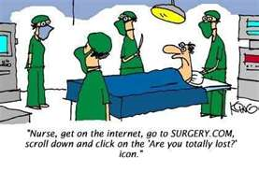
By: Ms.Trinidad Jerez Salcedo ,BSN RN
ADON-O.R., KKUH 2013
Thank You
Shukran

