Slide 1
THE MEDIASTINUM
Anatomy
Boundaries
Divisions
Traditional
Clinical
Access: Mediastenoscopy, mediastenotomy
Mediastinal mass lesions
Anterior mediatinum(5 T’s)
Middle Mediastinum(Cyst)
Posterior mediastinum(Neurogenic)

Slide 7
THYMOMA
Incidence
The commonest tunmor of A.M.
Peak 40-60 y.
M : F (1 : 1)

Slide 8
Pathology
Classification
Epithelial
Lymphocystic
Lymphoepithelial
Spindle cell
Benign vs. malignant
Stages
I, II, III, IV

Slide 9
Clinical Features
Asymptomatic
Symptomatic
Mass effect
Systemic effect
M.G. is the commonest 40-50%
Investigation
C X R
CT Scan
Biopsy
Bronchoscopy }
Esophagoscopy } Selected cases
Angiogram }

Slide 10
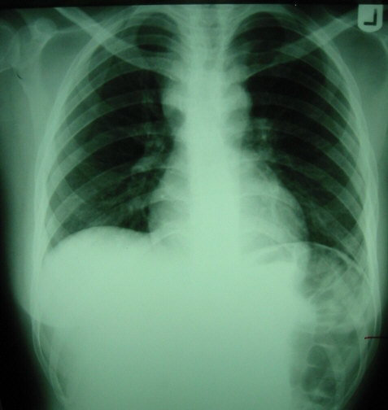
Prognostic Factors And Treatment Outcome of Thymoma

Slide 11
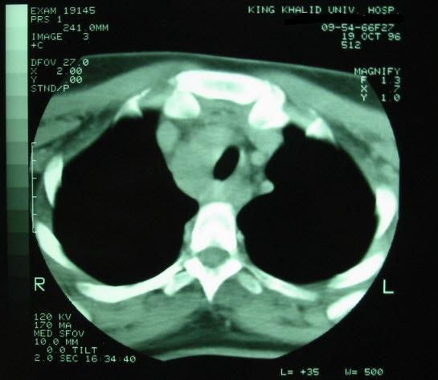
Prognostic Factors And Treatment Outcome of Thymoma

Slide 12
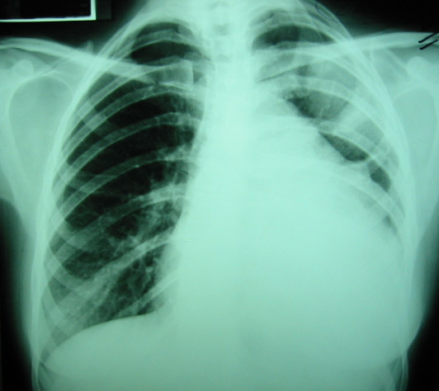
Prognostic Factors And Treatment Outcome of Thymoma

Slide 13
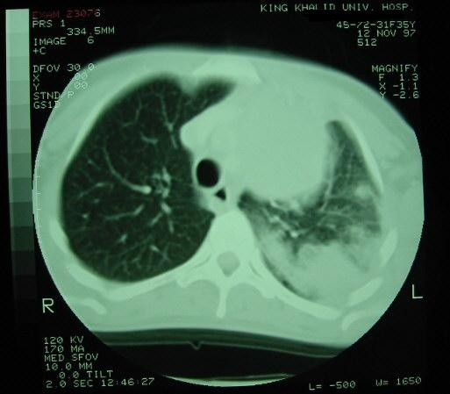
Prognostic Factors And Treatment Outcome of Thymoma

Slide 14
Treatment
Benign  complete excision
Malignant  complete excision if possibal
If non-resectable } post-op
Or } Radiotherapy
Resection incomplete }

Slide 15
Trauma
RTA
Fracture Ribs Simple – Complicated
Haemothorax
Pneumothorax
Flail chest
Lung Contusion and ARDS

Slide 16
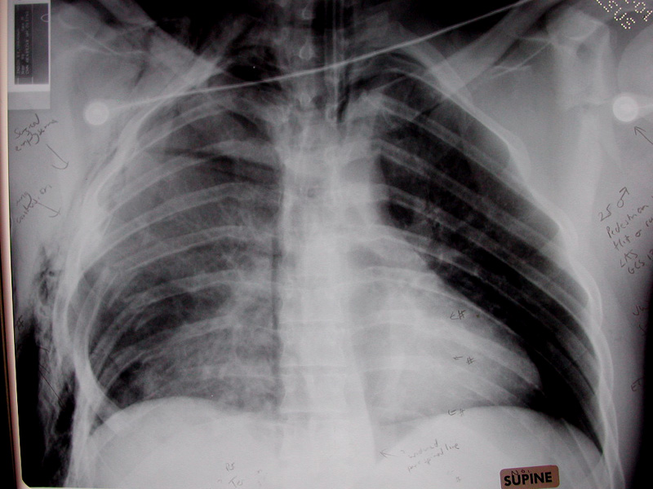

Slide 18
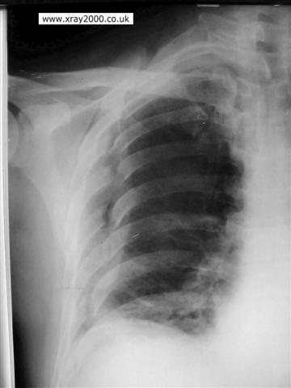

Slide 19
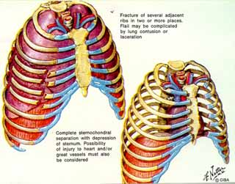
Flial Chest

Slide 20
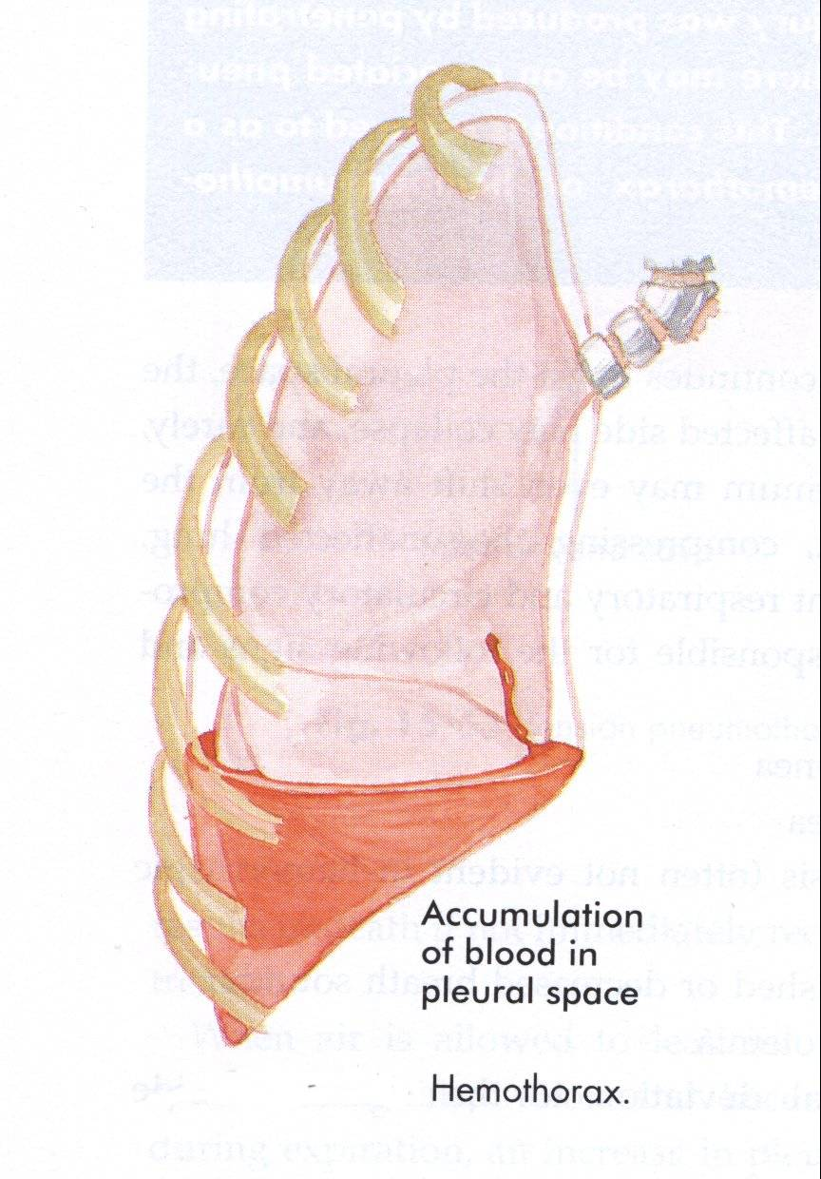

Slide 21
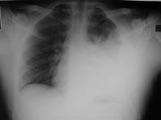

Slide 23
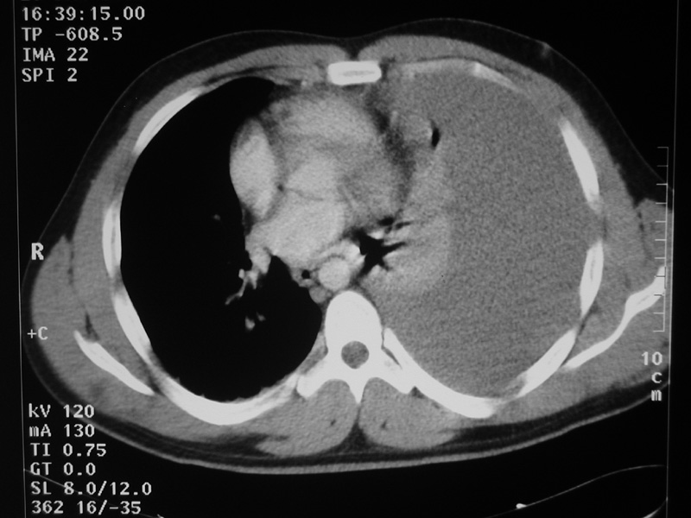

Slide 24
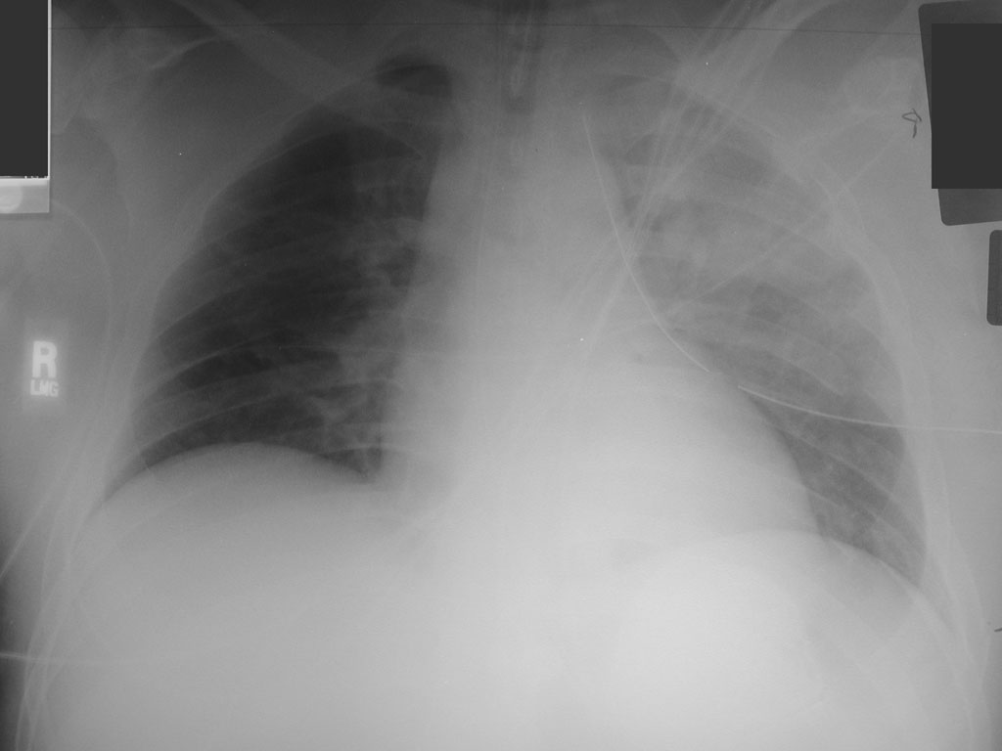

Slide 25
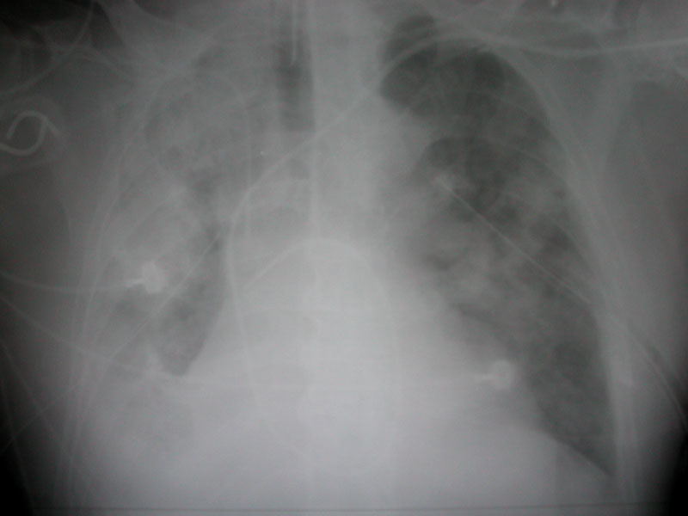

Slide 27
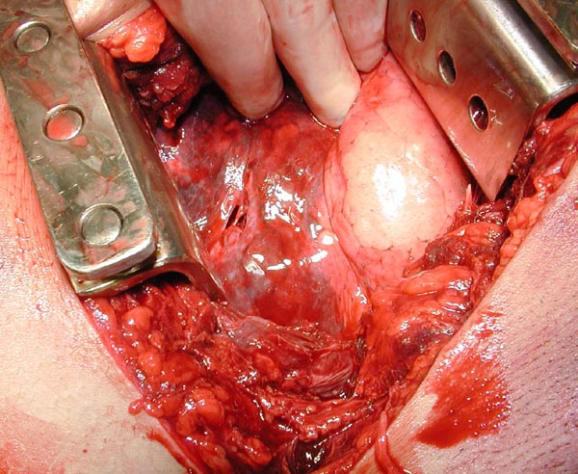

Slide 28
Chest Wall
Deformity:
Pectus excavatum
Pectus Carniatum
Infection
Chest wall tumor
Thoracic outlet Syndrome.

Slide 29
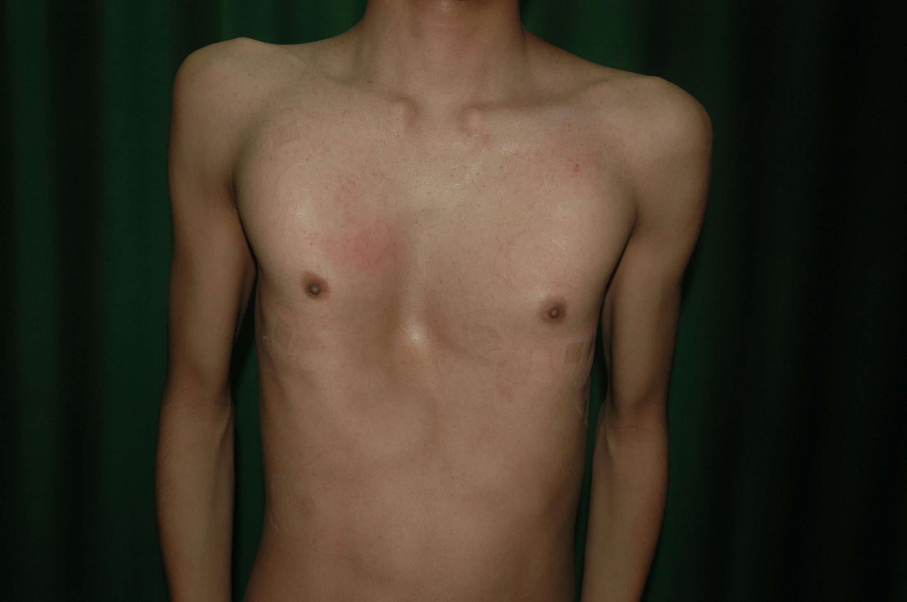

Slide 31
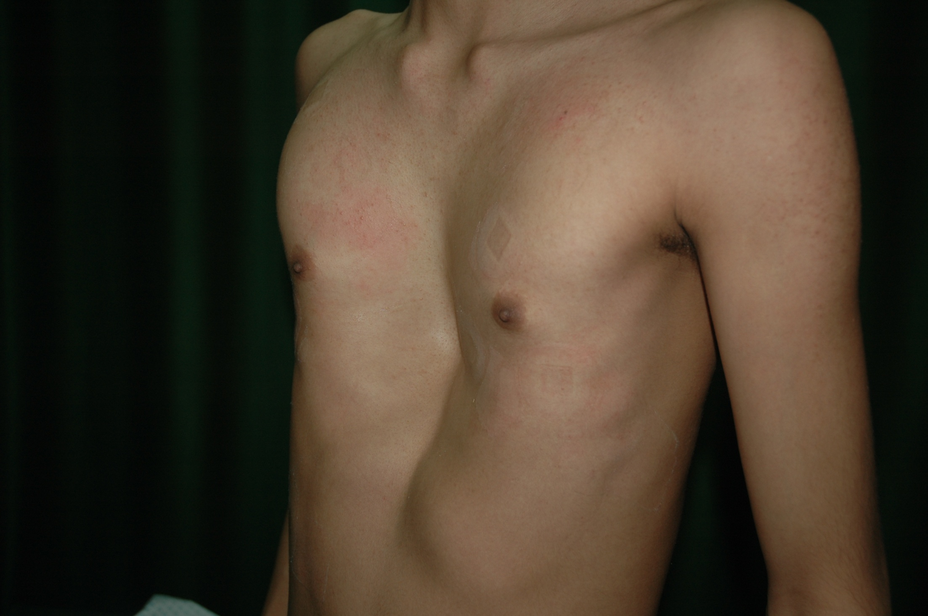

Slide 32
Pleura
Spontaneous preumothorax
Pleural effusion
Empyema
Mesothelioma .

Slide 37
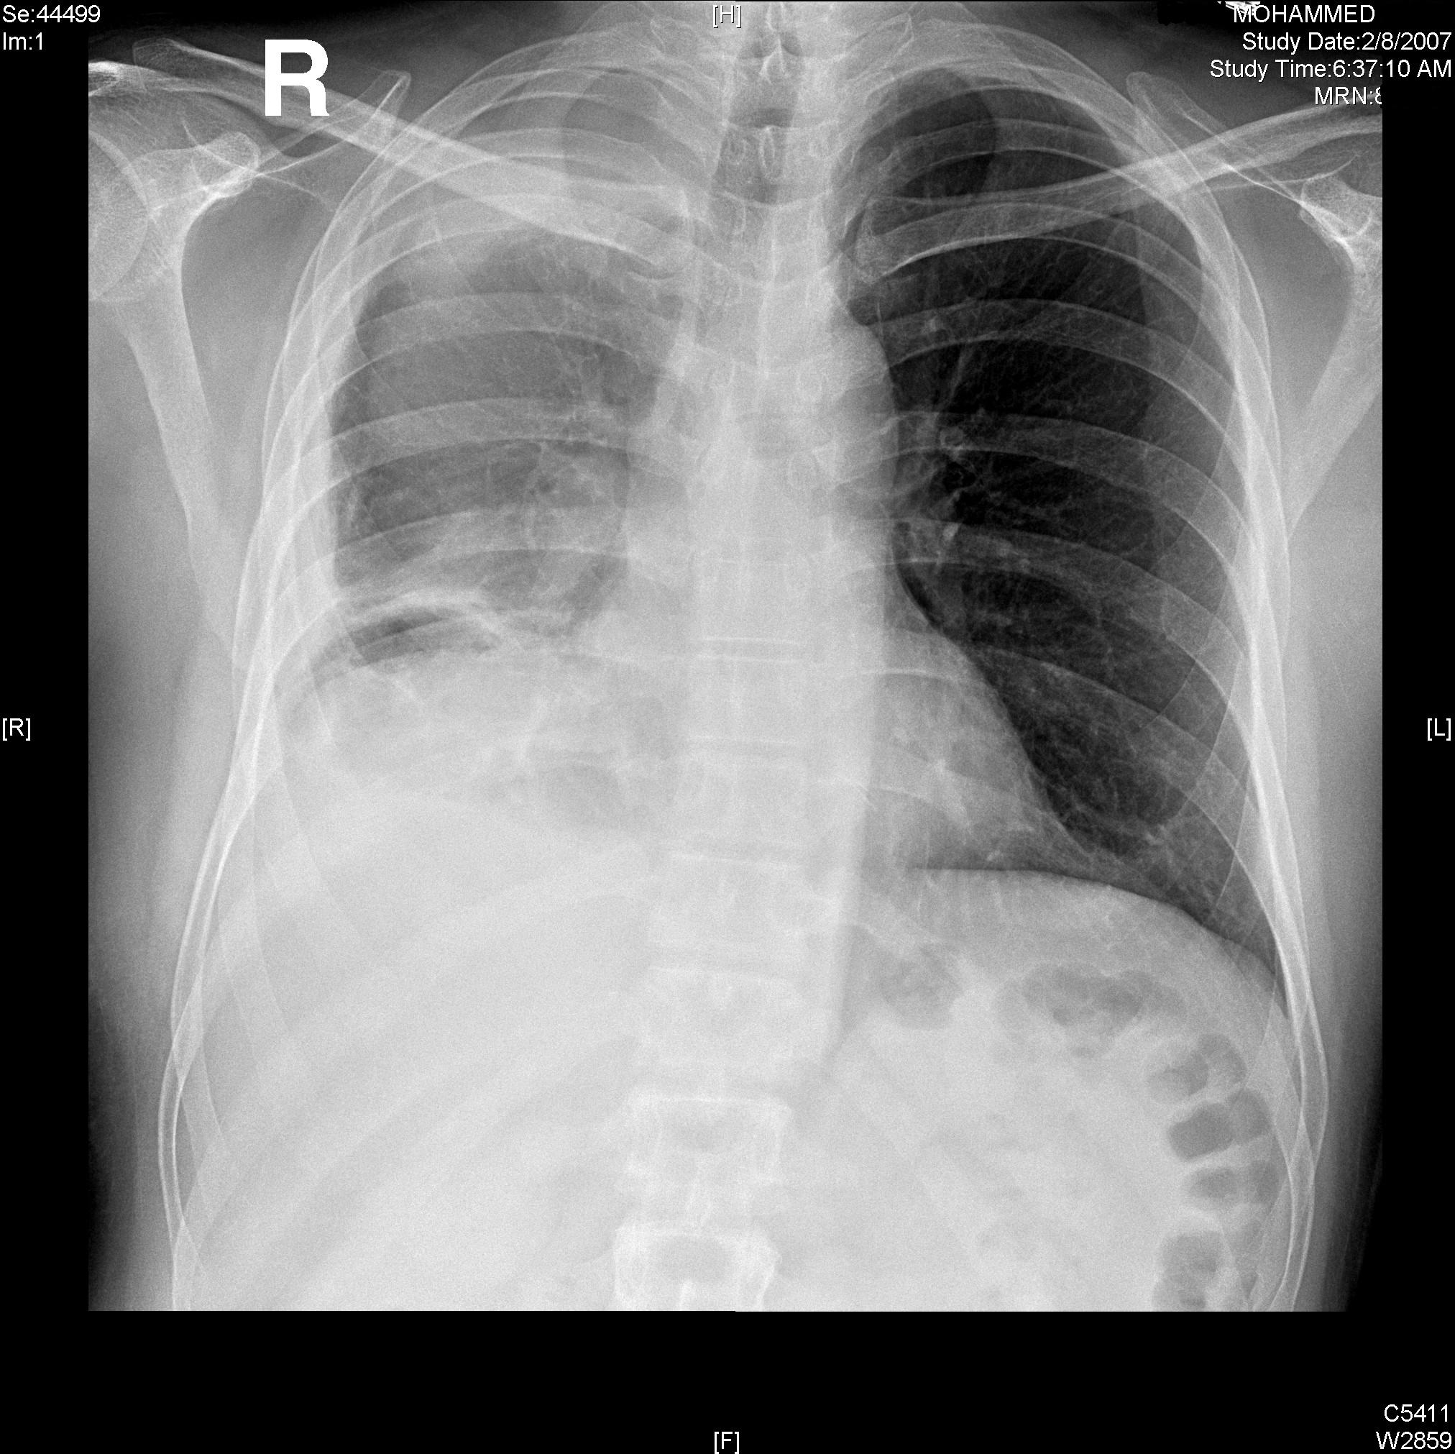

Slide 38
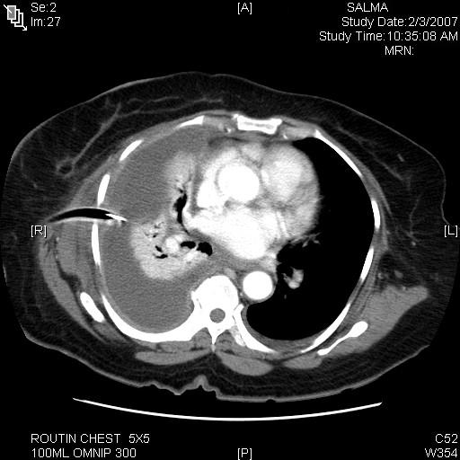

Slide 39
Air-way:
Congenital tracheal anomalies
Tracheal Stenosis
Tracheostomy

Slide 40
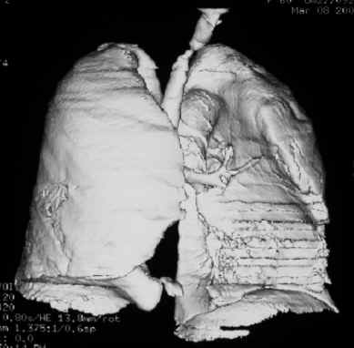

Slide 41
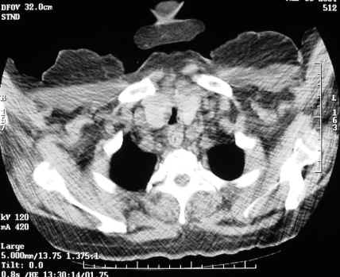

Slide 42
Surgery:
Thoracotomy
Thoracoscopy
Sternotomy
Analgesia

Slide 43
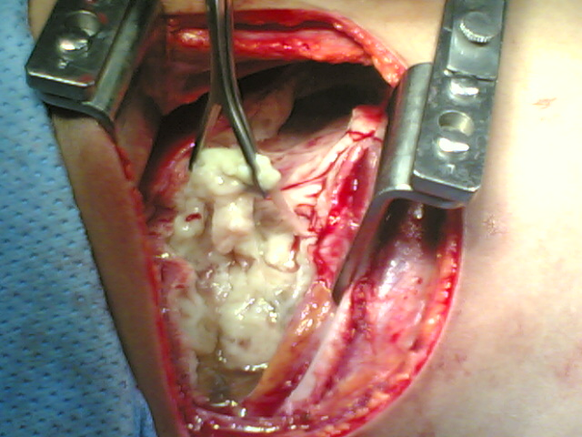

Slide 44
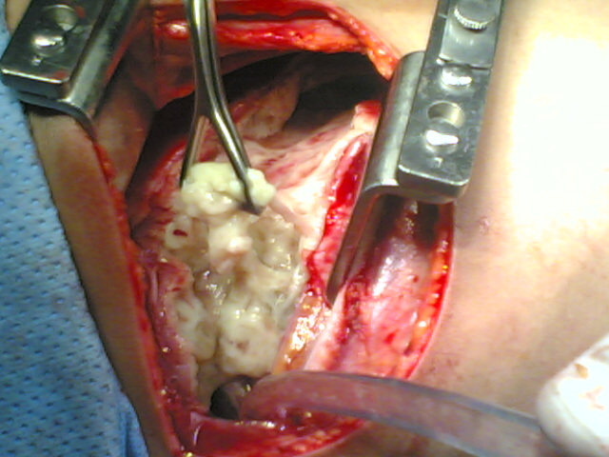

Slide 45
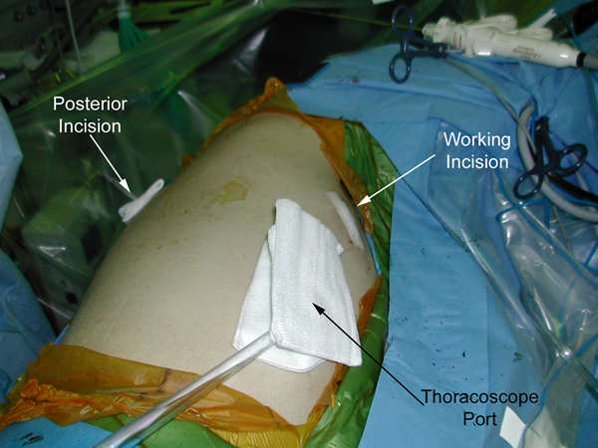
Position of skin incisions, showing camera port and working port anteriorly

Slide 46
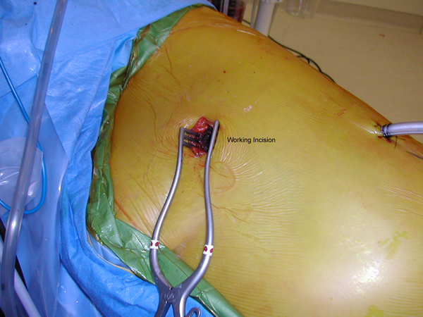
Use of a retractor to hold open the working port.

