Slide 1
Portal Hypertension
Mazen Hassanain

Slide 2
Causes
Cirrhosis
Non-cirrhosis

Slide 3
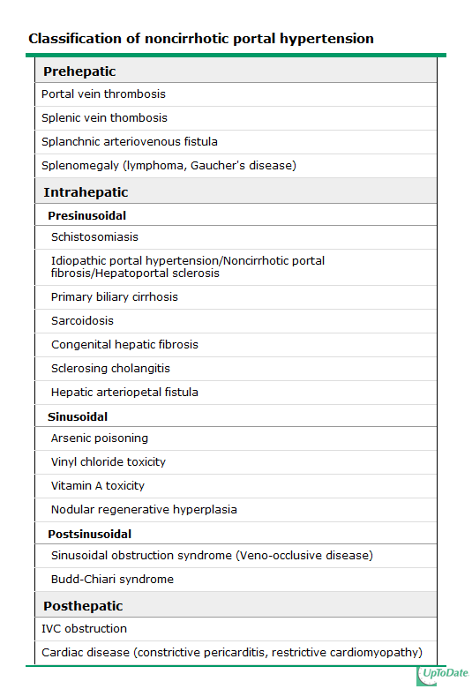

Slide 4
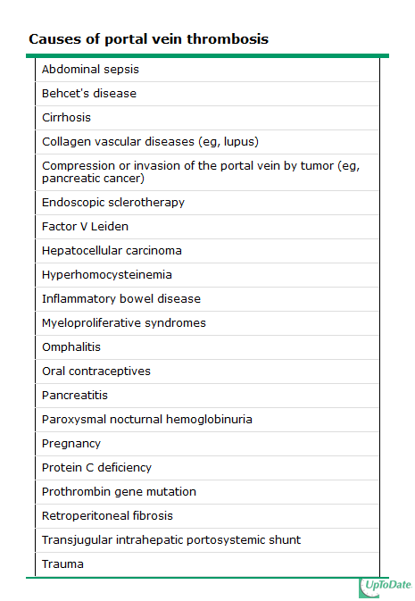

Slide 5
Symptoms
Asymptomatic
Complications
Gastroesophageal varices
Ascites
Splenomegaly
Underlying disease

Slide 6
Treatment of bleeding
Initial therapy: hemodynamic resuscitation, prevention and treatment of complications
Prophylactic antibiotics, preferably before endoscopy (although effectiveness has also been demonstrated when given after).
Suggest intravenous ceftriaxone (1 g IV) or Cipro (400 mg IV BID)
UGD should be performed for diagnosis and possible treatment
Suggest terlipressin in countries where it is available and somatostatin or octreotide (50 mcg bolus followed by 50 mcg/hour by intravenous infusion) where terlipressin is unavailable

Slide 7
continue
Salvage treatment
TIPS (transjugular intrahepatic portosystemic shunt)
Surgery is one with well preserved liver function who fails emergent endoscopic treatment and has no complications from the bleeding or endoscopy.
The choice of surgery usually depends upon the availability, training, and expertise of the surgeon. Although a selective shunt has some physiologic advantages, it may significantly exacerbate marked ascites. Thus, a portacaval shunt would be preferable in patients with marked ascites

Slide 8
Shunt operations can be categorized as follows:
Nonselective — those that decompress the entire portal tree, such as portacaval shunts
Selective — those that compartmentalize the portal tree into a decompressed variceal system while maintaining sinusoidal perfusion via a hypertensive superior mesenteric-portal compartment, such as a distal splenorenal shunt
Partial — those that incompletely decompress the entire portal tree and thereby also maintain some hepatic perfusion
Nonshunt operations generally include either esophageal transection (in which the distal esophagus is transected and then stapled back together after varices have been ligated) or devascularization of the gastroesophageal junction (Sugiura procedure).

Slide 9
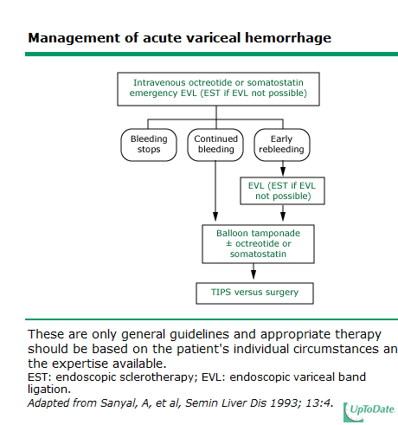

Slide 10
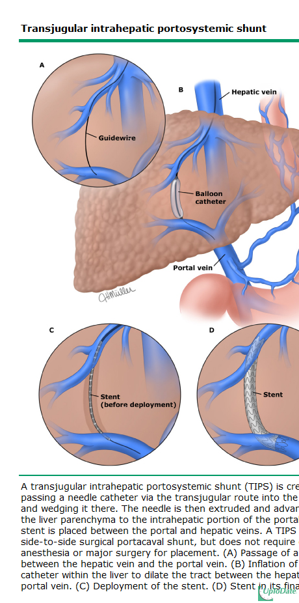

Slide 11
Maintain a hemoglobin of approximately 8 g/dL.
Short-term (maximum seven days) antibiotic prophylaxis should be instituted in any patient with cirrhosis and GI hemorrhage.
Pharmacologic therapy (somatostatin or its analogue octreotide) should start as soon as bleeding is suspected and continue for 3-5 days after confirmation.
Upper endoscopy, performed within 12 hours, should be used to make the diagnosis and to treat variceal hemorrhage either with endoscopic variceal ligation or sclerotherapy.
TIPS is indicated in patients in whom hemorrhage from esophageal varices cannot be controlled or in whom bleeding recurs despite combined pharmacological and endoscopic therapy.
Balloon tamponade should be used as a temporizing measure (maximum 24 hours) in patients with uncontrollable bleeding for whom a more definitive therapy (eg, TIPS or endoscopic therapy) is planned.

Slide 12
Common Surgical problems
Liver resection:
Benign
Hydatid cyst
Abscess
Large adenoma (5 cm)
Intrahepatic biliary stones
Oriental cholangiohepatitis
Heamangioma
Multiple cysts
FNH
Choledochal cyst
Cystadenoma

Slide 13
Common Surgical problems
Malignant
Primary liver cancers
HCC
Cholangiocarcinoma
Secondary liver cancers
Colorectal cancer
Neuroendocrine tumors
Others (isolated, stable, chemo responsive)

Slide 14
Echinococcosis Disease
Parasitic infection
Oral treatment
Surgical resection
Biliary communication

Slide 15
HCC
Cirrhosis
Child A
Non-cirrhosis
Roles of resectability
Survival benefit

Slide 16
Cholangiocarcinoma
Resectability
The role of bile ducts

Slide 17
CRC Metastasis
Portal connection
Survival benefit
Limits of resection
Increase resectability
Decrease disease
Increase volume
Improve function

Slide 18
Liver transplant
Cirrhosis
HCV
EToH
NASH
HCC
Benign disease
PBS

