Slide 1
Pediatric urinary disorders
Dr. Hamdan Al-Hazmi

Slide 2
Objectives
Understand the common congenital anomalies
The definition of each anomalies
The most common radiological investigation used
The common way of tratment

Slide 3
Congenital anomalies of the urogenital system
Most common of all organ system.
10% of population has some type of urogenital
anomaly.
14:1000 birth has antenatal diagnosis of urogenital
anomaly.
Antenatal ultrasound after 28 weeks gestation.

Slide 4
Congenital anomalies of the urogenital system…
Antenatal Hydronephrosis
Anomaly of position, number and rotation
Cystic abnormalities
Prune Belly Syndrome
Hypospadias
Epispadias
Bladder e Exstrophy

Slide 5
Antenatal Hydronephrosis(ANH)

Slide 6
Antenatal Hydronephrosis(ANH)
Causes:
Pelviureteric junction obstruction (41%)
Ureterovesical junction obstruction (23%)
Vesicoureteric reflux(7%)
Duplication anomalies (13%)
Posterior urethral valves (10 %)
MCDK
Others (6%)

Slide 7
ANH

Slide 8
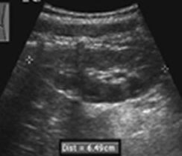
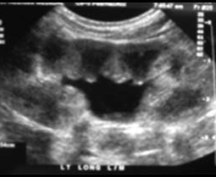
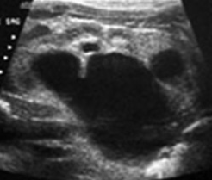
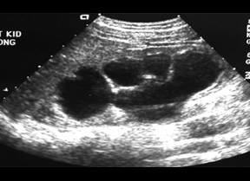
SFU Grading
G0
G1
G2
G3
G4

Slide 9
1-Pelviureteric junction obstruction(PUJO)

Slide 10
PUJO…
Presentation:
Incidental in Neonates
Incidental in Children
Symptomatic:
UTI
Pain
Mass
Hematuria
Stone
Pyeloplasty

Slide 12
2-Ureterovesical junction obstruction (UVJO)
Ureteral reimplantation

Slide 13
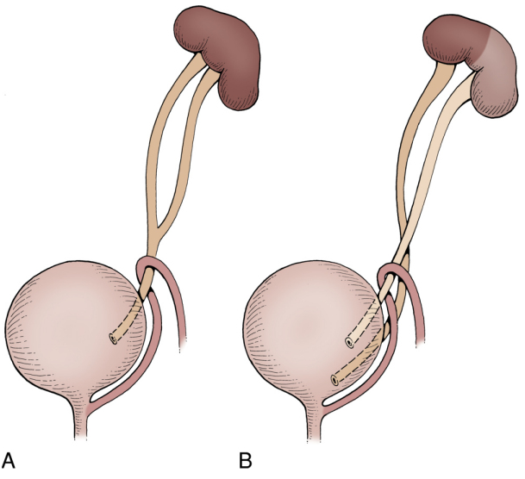
3-Duplication Anomalies
1%,
1.6:1 F:M
85% unilateral.
Complete or incomplete
Associated
reflux 43%
renal dilatation 29%
ectopic insertion 3%
ureterocele.

Slide 14
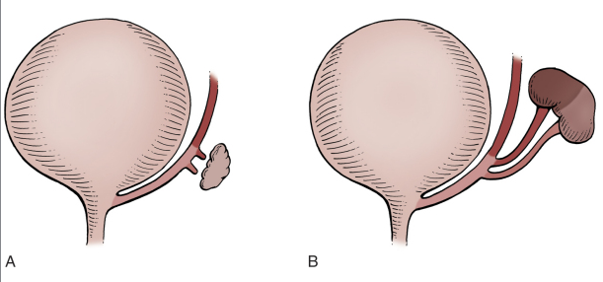

Slide 15
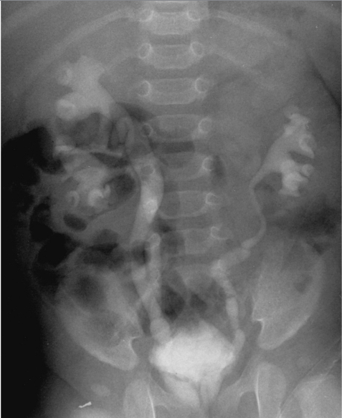
Weiger - Meyer Law

Slide 16
4-Ureterocele

Slide 17
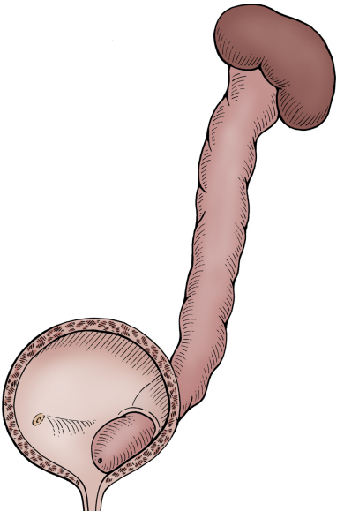

Slide 18
Ureterocele….
Cystic dilatation of the terminal portion of the ureter.
Orthotopic = intravesical=simple=adult type
ureterocele.
Ectopic = extravesical=duplex system= infant type
ureterocele.
In ectopic ureterocele it involve the upper pole
system.
7:1 F:M, 10% bilateral, ectopic: orthotopic 4:1
Commonest cause of urine retention in female
infants.

Slide 19
Ureterocele
Presentation:
Antenatal (U/S)
Urine retention
Infection
Calculus formation

Slide 20
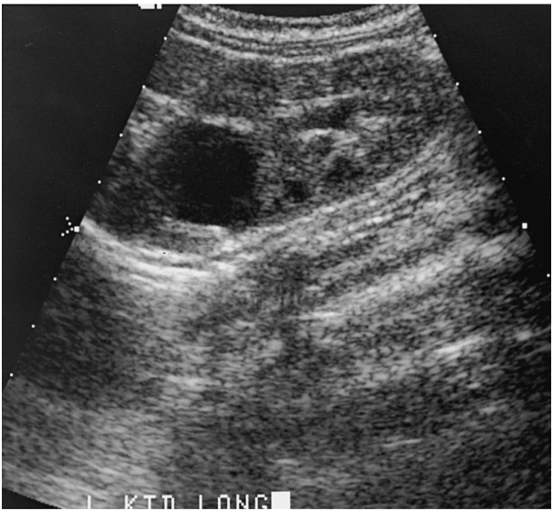

Slide 22
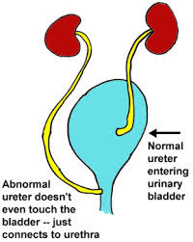
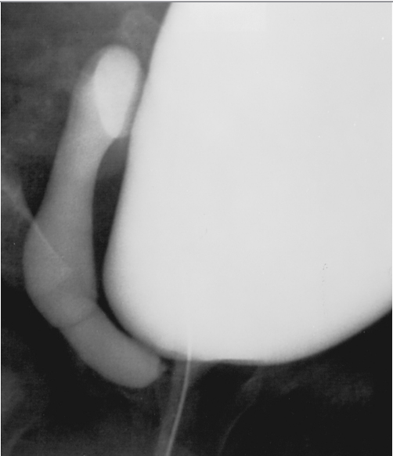
5-Ectopic ureter
Most commonly associated with duplex system and with ureterocele.
Clinical picture depend on: associated anomalies, site and sex of the patient.

Slide 23
6-Vesicoureteric Reflux
MCUG /VCUG

Slide 24
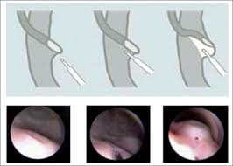
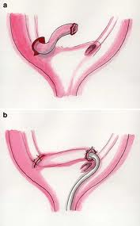
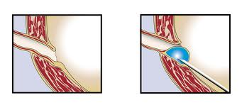
6-Vesicoureteric Reflux….
All patient should started on prophylactic antibiotics
Surgical intervention :
Ureteral reimplantation
Endoscopic correction

Slide 25
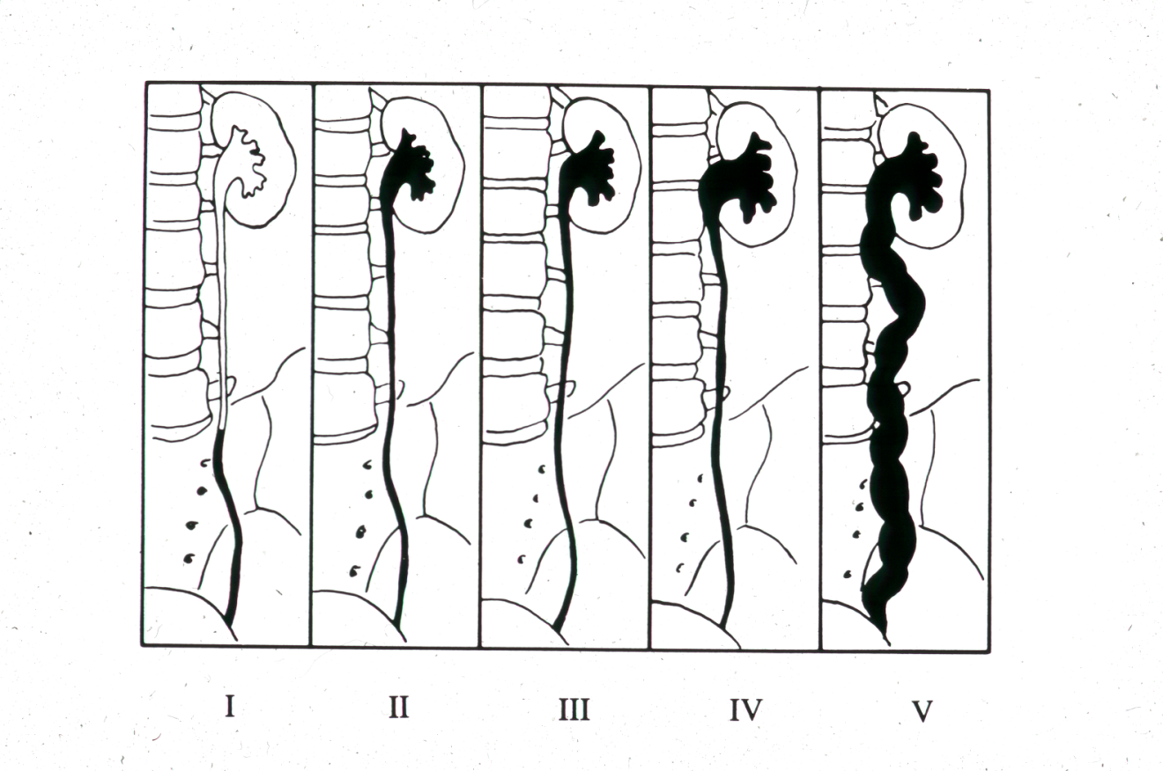

Slide 26
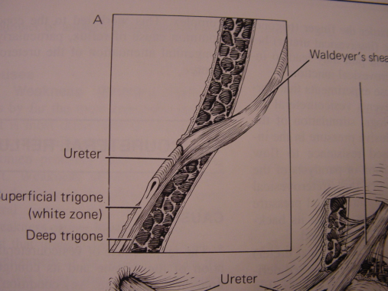
Normal anti-reflux mechanism “Flap valve”
1. Oblique course as it enters the bladder.
2. Proper muscular attachments to provide fixation.
3. Posterior support to enable its occlusion.
4. Adequate submucosal length.

Slide 27
7-Posterior urethral valves (PUV)…

Slide 28
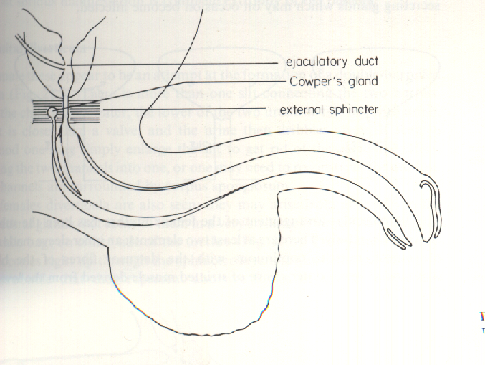
Posterior urethral valves (PUV)….
1:5000 male infants.
most common cause of urine retention in male infants.
50% have renal impairment.
The bladder and the kidneys developed under
high pressure and resistance.

Slide 29
Posterior urethral valves
Associated findings
1. Oligohydramnios
2. Bilateral renal dilatation
3. VUR: 40%
4. Valve bladder
5. Renal impairment

Slide 30
Posterior urethral valves
Presentation
1. Antenatal
2. Urine retention
3. UTI
4. Poor urinary stream
5. CRF

Slide 31
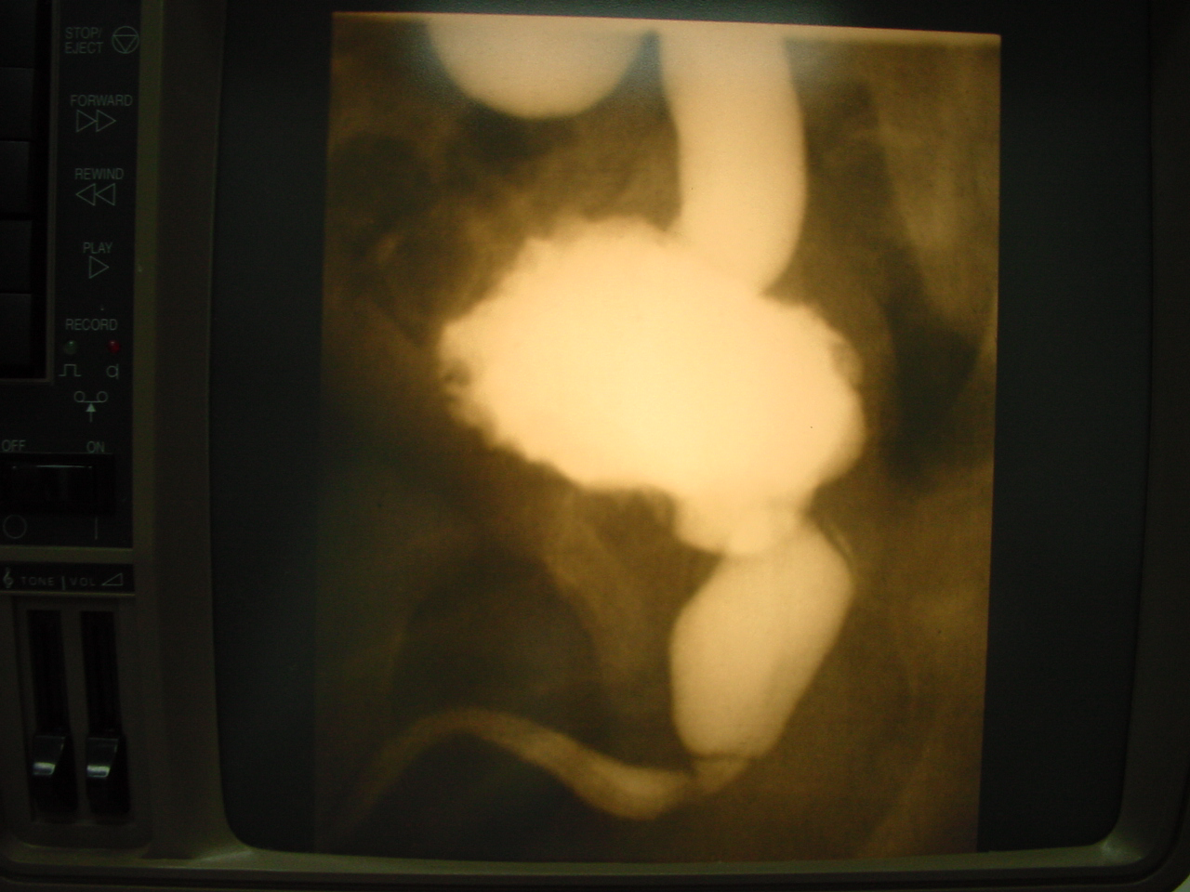

Slide 32
8- Multicystic dysplastic kidney (MCDK)

Slide 34
Kidney Anomalies
Anomaly of position, number and rotation“
1. Simple ectopia:
- A kidney that is outside the renal fossa.
- Pelvic (commonest), lumbar, sacral.
2. Thoracic kidney.
3. Horseshoe kidney
4. Unilateral renal agenesis.
5. Bilateral renal agenesis.
6. Crossed renal ectopia with no fusion.
7. Crossed renal ectopia withfusion.
8. Malrotated kidney.

Slide 35
Renal ectopia

Slide 36
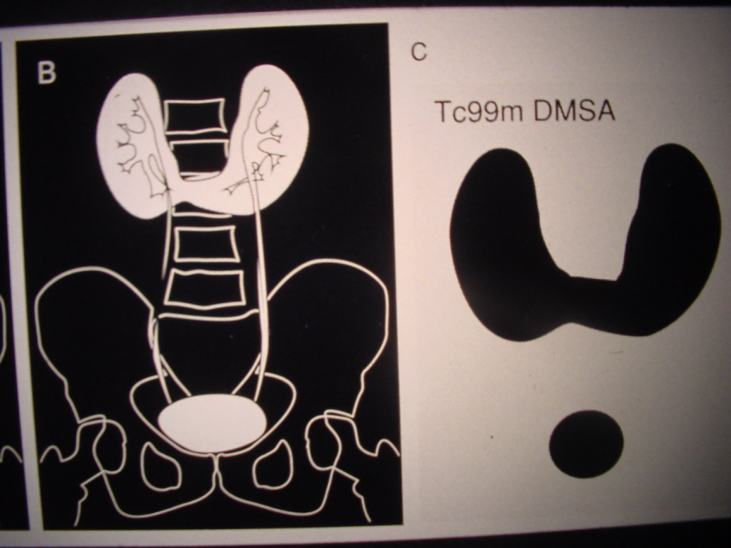

Slide 37
Horseshoe kidney

Slide 38
Kidney…
Cystic abnormalities
1. Renal dysplasia
A) congenital unilateral multicystic kidney.
B) Segmental and focal renal dysplasia.
C) Renal dysplasia associated with congenital lower tract obstruction.
2. Congenital polycystic kidney disease:
A) Infantile type
B) Adult type
3. Simple cyst
4. Calyceal cyst
5.Peripelvic cyst
6. Perinephric cyst

Slide 39
Prune Belly Syndrome
Triad syndrome
fAbsent abdominal wall muscle
Bilateral undescended testis
Urinary tract dilatation

Slide 40
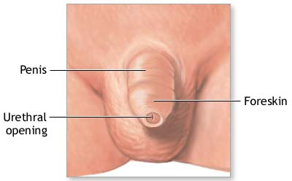
Hypospadias

Slide 41
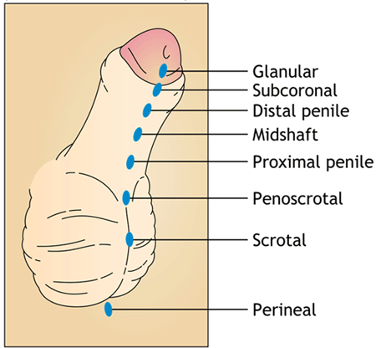
Hypospadias
Abnormal position of the EUM
Distal hypospadias
Proximal hypospadias
NO Circumcision
6 to 9 months repair

Slide 43
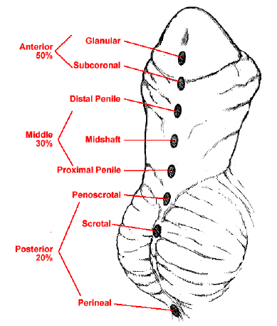
Hypospadias
Abnormal position of the EUM
Distal hypospadias
Proximal hypospadias
NO Circumcision
6 to 9 months repair

Slide 45
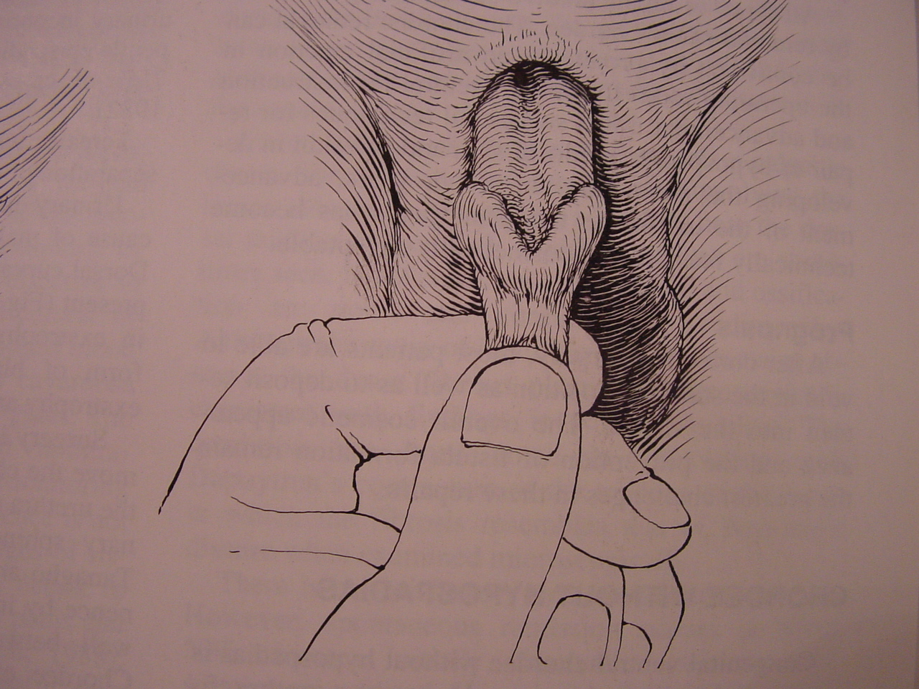
Epispadias

Slide 46
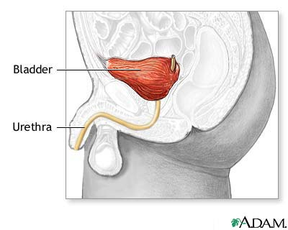
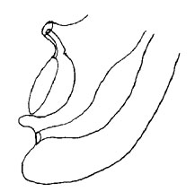
Bladder Exstrophy

Slide 47
THANK YOU

