Slide 1
Breast disease
Dr.Amal Al-Abdulkareem

Slide 2
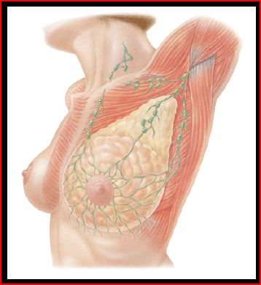
Breast Modified Sebaceous Glands
Upper border
- Collar bone.
Lower border. - 6th or 7th rib.
Inner Border - Edge of sternum.
Outer border
- Mid-axillary line.

Slide 3
Breast Divisions 5 Segments
Four Quadrants - By horizontal and vertical lines.
Tail of Spence
Majority of benign or malignant tumors in the Upper Outer Quadrant

Slide 4
External Anatomy of the Breast
Nipple -Pigmented, Cylindrical -4th inter-costal space * at age 18
Areola -Pigmented area surrounding nipple
Glands of Montgomery -Sebaceous glands within the areola -Lubricate nipple during lactation

Slide 5
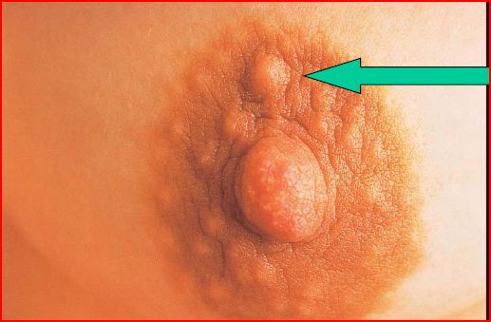
Montgomery’s Tubercles
Blocked Montgomery Tubercle

Slide 6
GLANDULER TISSUE
15-20 Lobes -Radiate around nipple and under areola
Lobe - 20-40 lobules
Lobules - Alveoli cells or acini - Milk producing cells
Lactiferous ducts - Drain milk into nipples

Slide 7
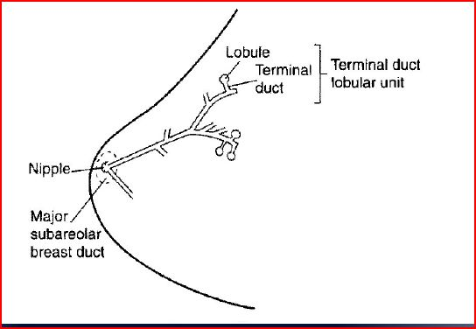
Terminal Lobular Unit and Branching Systems of Ducts

Slide 8
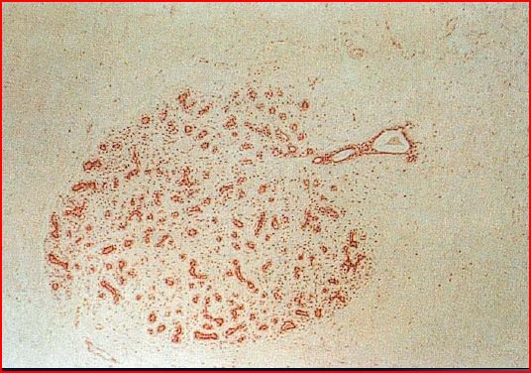
Terminal Duct Lobular Unit

Slide 9
Tissue Types
Glandular Tissue - Milk producing tissue
Fibrous Tissue
Fatty Tissue

Slide 10
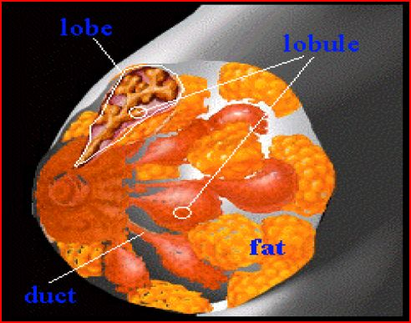
Internal Anatomy of the Breast

Slide 11
Fibrous Tissue
Cooper’s Ligaments -Suspensor ligaments
- Extending through the breast to underlying muscle - Benign or malignant lesions may affect these ligament - Skin retraction or dimpling

Slide 12
Fatty Tissue
Subcutaneous and retro-mammary fat
Bulk of breast.
No fat beneath areola and nipple

Slide 13
Chest Muscles
Pectoralis Major/Minor
Serratus Anterior
Latissimus Dorsi
Subscapularis
External Oblique
Rectus Abdominus

Slide 14
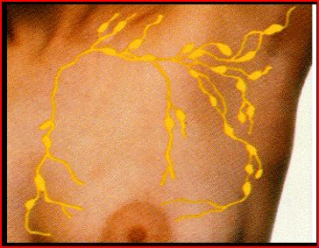
Lymph Nodes
Most drain towards axilla.
Superficial lymphatic nodes drain skin .
Deep lymphatic nodes drain mammary lobules

Slide 15
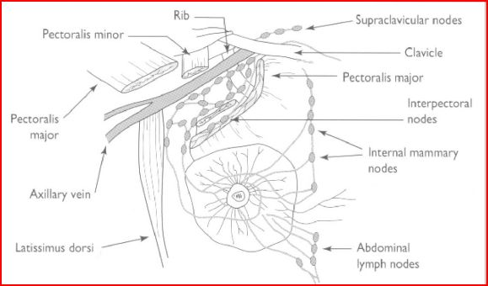
Lymph Drainage of Breast

Slide 16
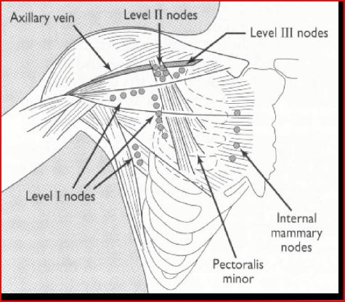
Levels of Axillary Nodes

Slide 17
Lymph Nodes
Palpate ALL nodes - From distal arm to under arm with deep palpation
Axillary
Supraclavicular
Infra-clavicular
Nodes deep in the chest or abdomen
Infra-mammary ridge - Shelf in the lower curve of each breast

Slide 18
Normal Variations of Breast
Accessory breast tissue.
Supernumerary nipples.
Hair
Lifelong Asymmetry

Slide 19
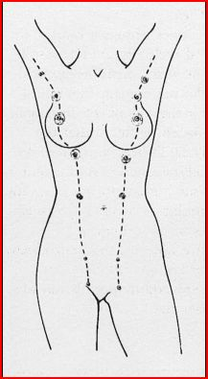
Milk Lines Sites of Accessory Nipples and Breasts

Slide 20
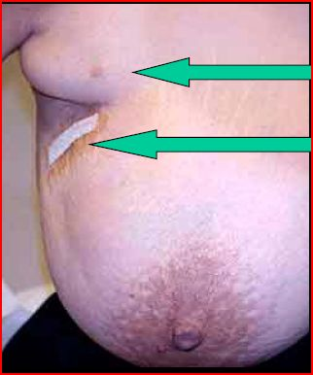
Accessory Beast Tissue
Accessory Tissue
Biopsy

Slide 21
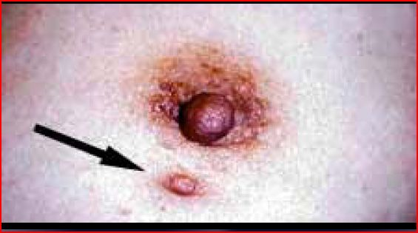
Accessory Nipple

Slide 22
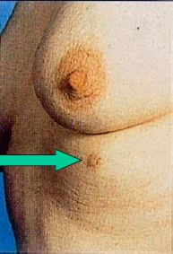
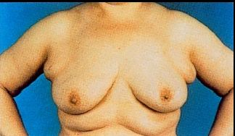
Accessory Nipple and Bilateral Accessory Breasts

Slide 23
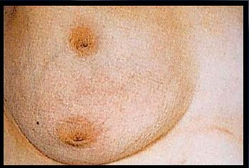
Breast with Two Nipples

Slide 24
Breast Hair

Slide 25
Physiology of Breast
Puberty - Need estrogen and progesterone
Estrogen - Growth and appearance - Milk-producing system
Progesterone - Lobes and alveoli - Alveolar cells become secretory
Asymmetry is common.

Slide 26
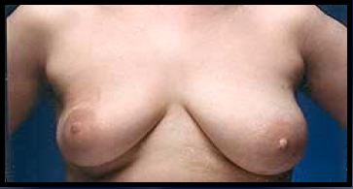
Breast Asymmetry

Slide 27
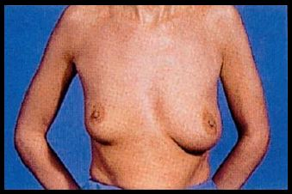
Breast Asymmetry

Slide 28
Physiology of Breast
Menses
Progesterone - 3-7 days prior to menses - Engorgement
Physiologic nodularity - Retained fluid
Mastalgia

Slide 29
Physiology of Breast
Pregnancy and lactation
Glandular tissue displaces connective tissue
Increase in size
Nipples prominent and darker
Mammary vascularization increases
Colostrum present
Attain Tanner Stage V with birth

Slide 30
Physiology of Breast
Aging
Perimenopause
- Decrease in glandular tissue
- Loss of lobular and alveolar tissue
Flatten, elongate, pendulous
Infra-mammary ridge thickens
Suspensory ligaments relax
Nipples flatten
Tissue feels “grainy”

Slide 31
Clinical Breast Exam

Slide 32
Clinical Breast Exam
Inspect Both Breasts - Arms at sides - Arms over head - Arms on hips with valsalva - Leaning forward

Slide 33
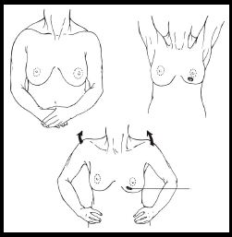
Inspect Both Breasts

Slide 34
Skin Dimpling and Change in Contour
Dimpling due to Carcinoma
Change in contour due to carcinoma

Slide 35
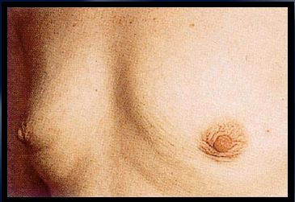
Skin Dimpling Both Breasts Involution Due to Aging

Slide 36
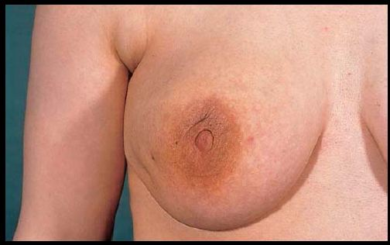
Skin Dimpling Breast Infection

Slide 37
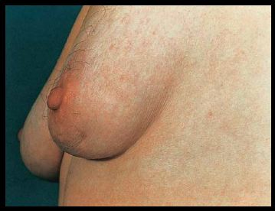
Skin Dimpling Previous Breast Surgery

Slide 38
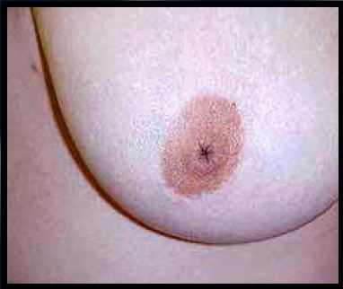
Inverted Nipple Since Puberty

Slide 39
Clinical Breast Exam Palpate
Palpate Sitting
Rest arm in your hand and palpate axilla -Her arm should be relaxed
Palpate supra-clavicular and infra-clavicular nodes

Slide 40
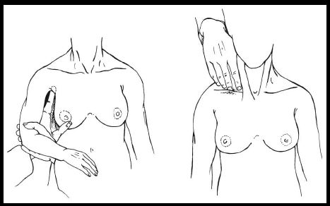
Palpate Axilla and Clavicular Nodes

Slide 41
Clinical Breast Exam
Lay supine
Place pad under shoulder to flatten breast
Raise arm over head
Abnormal finding? Check the other breast!

Slide 42
Clinical Breast Exam Palpate
Using preferred patter
Palpate with pads of three fingers
Palpate in circular fashion
Compress through all layers of tissue
Note any discharge

Slide 43
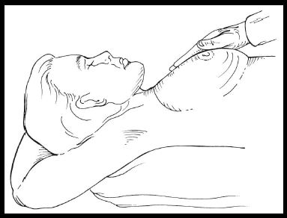
Breast Palpation

Slide 44
Galactorrhea

Slide 45
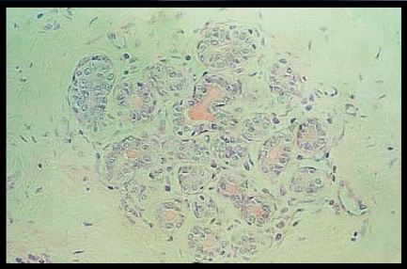
Physiological Secretions in Normal Breast Lobule

Slide 46
Common Benign Breast Disorders

Slide 47
Common Benign Breast Disorders
Fibrocystic changes
Fibroadenoma
Intraductal papilloma
Mammary duct ectasia
Mastitis
Fat necrosis
Phylloides tumor
Male gynecomastia

Slide 48
Fibrocystic Changes
Lumpy, bumpy breasts
50-80% of all menstruating women
Age 30-50 - 10% in women less than 21
Caused by hormonal changes prior to menses
Relationship to breast cancer doubtful

Slide 49
Signs and Symptoms
Mobile cysts with well-defined margins
Singular or multiple
May be symmetrical
Upper outer quadrant or lower breast border

Slide 50
Signs and Symptoms
Pain and tenderness
Cysts may appear quickly and decrease in size
Lasts half of a menstrual cycle
Subside after menopause -If no HRT

Slide 51
Treatment
Aspirate cyst fluid
Imaging for questionable cysts
Treatment based on symptoms
Reassure
‘’Atypical Hyperplasia’’ on pathology report indicates increased risk of breast cancer

Slide 52
Comfort Measures
Eliminate Methylxantines (coffee, chocolate) - May take 6 months for relief
Local heat/cold
Support bra
Low-Sodium diet
Vitamin E - Antioxidant - Do not take more than 1200/day

Slide 53
Medications for Mastalgia
NSAIDS
Monophasic oral contraceptive pills
Spirinolactone

Slide 54
Medications for Mastalgia
Dopamine Agonists -Bromocriptine
Rare or former use - Danazol - Tamoxifen - GnRH agonist (Luprolide)

Slide 55
Fibroadenoma
Second most common breast condition
Most common in black women
Late teens to early adulthood
Rare after menopause

Slide 56
Signs and Symptoms
Firm, rubbery, round, mobile mass
Painless, non-tender
Solitary - 15-20% are multiple
Well circumscribed
Upper-outer quadrant
1-5 cm or larger

Slide 57
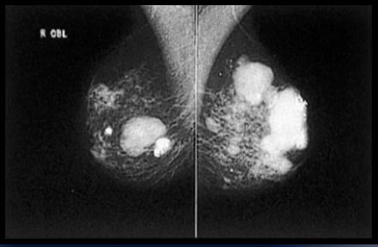
Mammogram Multiple Calcified Fibroadenomas

Slide 58
Treatment
Imaging
Biopsy
Excision
Close follow-up

Slide 59
Intraductal Papilloma
Slow-growing
Overgrowth of ductal epithelial tissue
Usually not palpable
Cauliflower-like lesion
Length of involved duct
Most common of bloody nipple discharge
40-50 years of age

Slide 60
Signs and Symptoms
Watery, serous, serosanguinous, or bloody discharge
Spontaneous discharge
Usually unilateral
Often from single duct - Pressure elicits discharge from single duct
50% no mass palpated

Slide 61
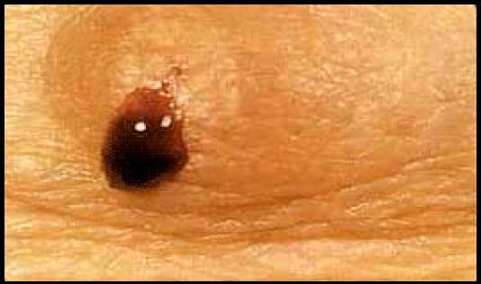
Bloody Breast Discharge

Slide 62
Treatment
Test for occult blood
Ductogram
Biopsy
Excision of involved duct

Slide 63
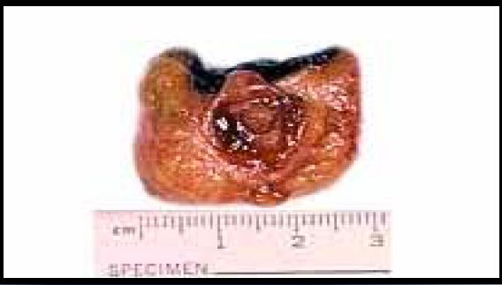
Intraductal Papilloma

Slide 64
Mammary Duct Ectasia
Inflammation and dilation of sub-areolar ducts
behind nipples
May result in palpable mass because of ductal
rupture
Greatest incidence after menopause
Etiology Unclear - Ducts become distended with cellular debris causing obstruction

Slide 65
Mammary Duct Ectasia versus Breast Cancer
Left breast – slit-like nipple characteristic of mammary duct eclasia
Right breast – nipple retraction from carcinoma

Slide 66
Signs and symptoms
Multi-colored discharge - Thick, pasty (like toothpaste) - White, green, greenish-brown or serosanguinous
Intermittent, no pattern
Bilaterally from multiple ducts
Nipple itching
Drawing or pulling (burning) sensation

Slide 67
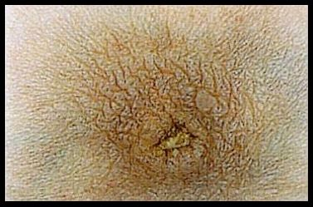
Dried Secretions from Mammary Duct Ectasia

Slide 68
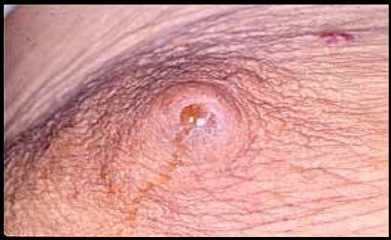
Yellow Breast Discharge Duct Ectasia

Slide 69
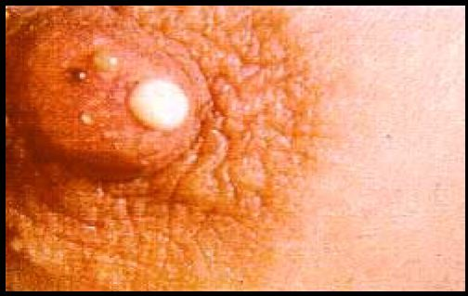
Multi-colored Breast Discharge

Slide 70
Treatment
Test for occult blood
Imaging - Mammogram - Sonogram
Biopsy - Excision of ducts if mass present
Antibiotics
Close follow-up

Slide 71
Mastitis
Breast infection when bacteria enter the breast via the nipple
Ducts infected
Fluid stagnates in lobules
Usually during lactation
Penicillin resistant staphylococcus common cause

Slide 72
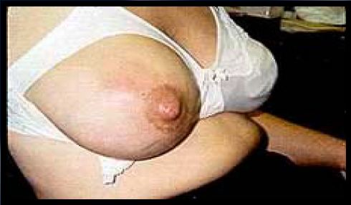
Puerperal Mastitis

Slide 73
Puerperal Mastitis Left Breast

Slide 74
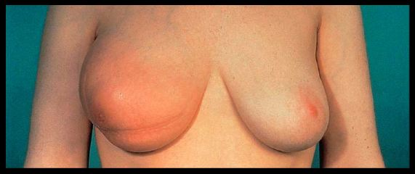
Inflammatory Carcinoma
Erythema and peau d’orange

Slide 75
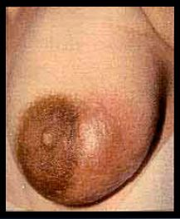
Signs and Symptoms of Mastitis
Pain
Nipple discharge - Pus - Serum - Blood
Localized induration
Fever
Breast Abscess

Slide 76
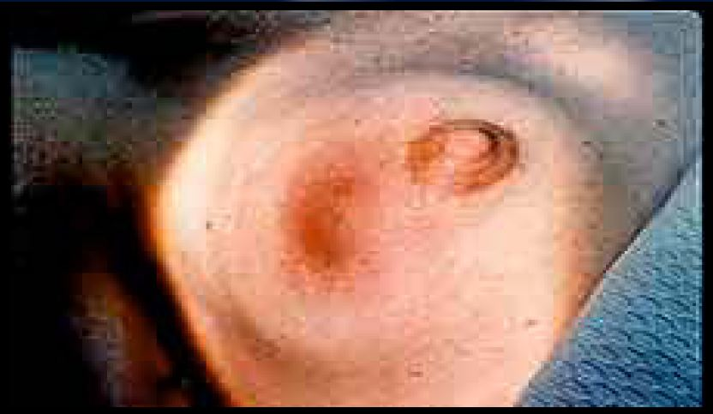
Breast Abscess

Slide 77
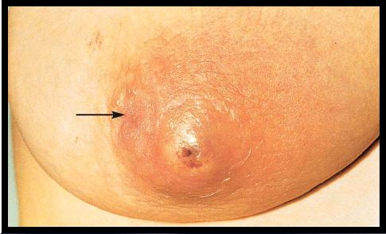
Non-Lactating Breast Abscess
Arrow points to inverted nipple

Slide 78
Treatment
Antibiotics
Empty breast if PP
Incision and drainage of abscess
‘’Oxacillins’’ for PP mastitis
Cephalosporin for other abscesses - Cephalexin - Keflex

Slide 79
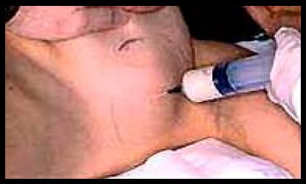
Draining Breast Abscess

Slide 80
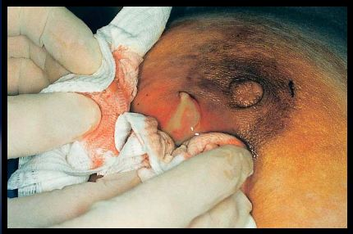
Abscess Drained under Local Anesthesia

Slide 81
Puerperal Breast Abscess
Before treatment
Local anesthetic
After treatment
Abscess occurred during lactation

Slide 82
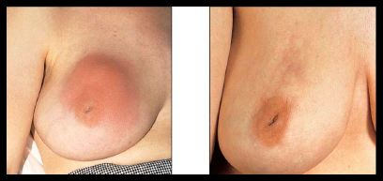
Peripheral Breast Abscess
Left – before management
Right – after recurrent aspiration and antibiotics

Slide 83
Fat Necrosis
Cause - Trauma to breast - Surgery
Necrosis of adipose tissue
Pain or mass - Usually non-mobile mass - Resolves over time without treatment -may be excised

Slide 84
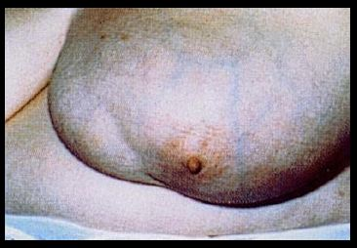
Fat Necrosis
Seat Belt Trauma

Slide 85
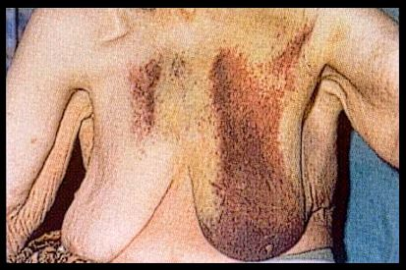
Breast Hematoma

Slide 86
Phylloides Tumor
Giant fibroadenoma with rapid growth
Malignant potential
Often occurs in women aged 40+
Treatment - Excision

Slide 87
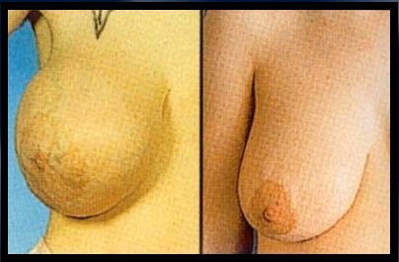
Giant Fibroadenoma
Before Surgery
After Surgery

Slide 88
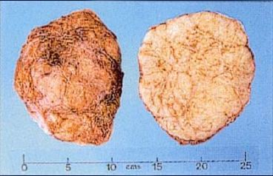
Cross Section of Giant Fibroadenoma

Slide 89
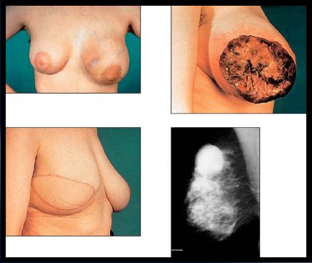
Malignant Phylloides Tumor

Slide 90
Male Gynecomastia
Diffuse hypertrophy of breast
30-40% of male population
Adolescence and older men
Caused by imbalance of estrogen/testosterone
Medical conditions (hepatitis, COPD, hyperthyroidism, TB)
May be associated with genetic cancer families

Slide 91
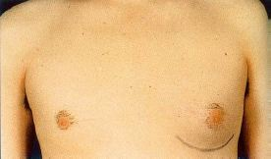
Left-Sided Gynecomastia

Slide 92
Medications Associated with Gynecomastia
Marijuana
Narcotics
Phenothiazines
Diazepams
Anything that affects the CNS

Slide 93
Treatment
If pre-puberty - Wait to see if it resolves
Change medication
Treat underlying illness
Occurs in families with genetic mutation - Colon, prostate cancer

Slide 94
Differential Diagnosis of Nipple Discharge
Common causes in non-pregnant women
Carcinoma
Intraductal papilloma
Fibrocystic changes
Duct ectasia
Hypothyroid
Pituitary adenoma

Slide 95
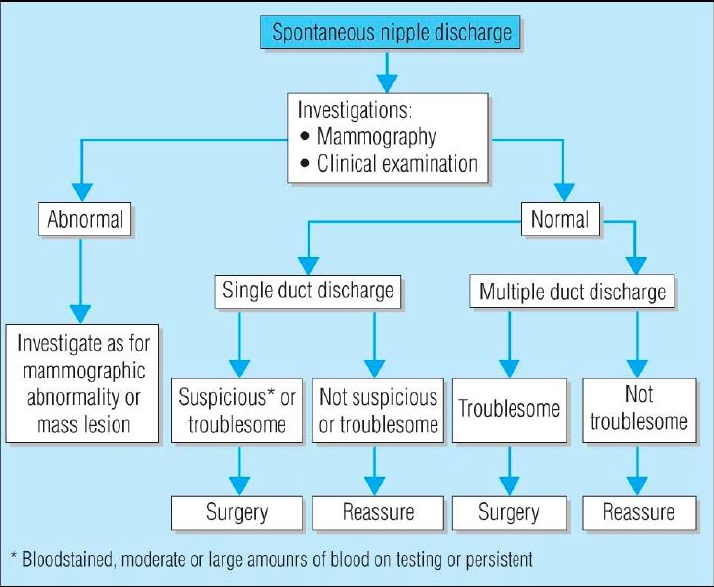

Slide 96
Clinical Characteristic
Physiologic - Usually bilateral - Multiple ducts - Non-spontaneous - Screen for phenothiazine use and stimulation

Slide 97
Physiological Breast Discharge

Slide 98
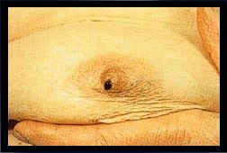
Clinical Characteristic
Pathologic discharge - Spontaneous - Unilateral - Single duct - Discolored discharge
Bloody discharge

Slide 99
Evaluation
Clinical Exam
Test for presence of blood in discharge
Lab tests -Thyroid, prolactin
Imaging

Slide 100
Treatment
Physiologic - Treat cause if present - Follow-up 6 months
Pathologic - Biopsy and excise

