Slide 1
COMMON Hand Injuries
Dr. Abdullah Kattan FRCS(C)
Assistant Professor KSU
Consultant Plastic &
Reconstructive Surgeon

Slide 2
History
5 Important Questions
Hand dominance
Occupations
Previous hand trauma or injury
Smoking
Tetanus
Acute or Chronic
Mechanism of injury, and complaint
Trauma, Laceration, Swelling or lump, Arterial or Venous injury, Dislocation, Infection, Numbness

Slide 3
Examinations
Look
Compare both hands
Dorsum then volar surface
Skin ( Ulcers or lesions )
Swelling
Wasting
Position
Feel Tenderness, sensation, temperature, Cap refill
Move Range of Motion
Passive, Active
Examine FDS, FDP, & extensor tendons

Slide 4
Examinations
Test Specific Nerves (Motor and Sensory)
Median
Ulnar
Radial

Slide 5
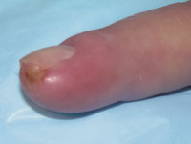
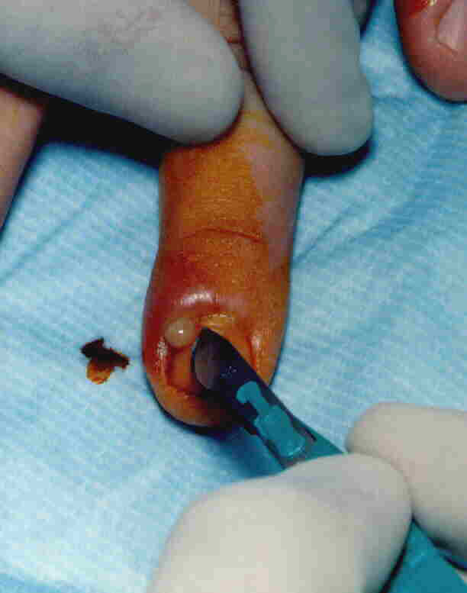
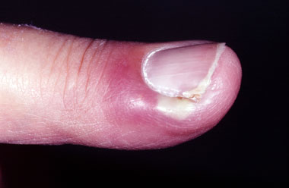
Hand Infection
Paronychial infection due to Staph aureus
Rx Abx, soacking
I&D
Felon
Infection of the finger pulp

Slide 6
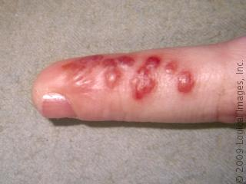
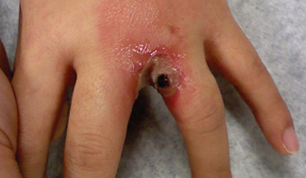
Hand Infection
Herpetic Whitlow
HSV vesicular eruption of the fingertip
Collar Abscess
Abscess of the hand web-Spece

Slide 7
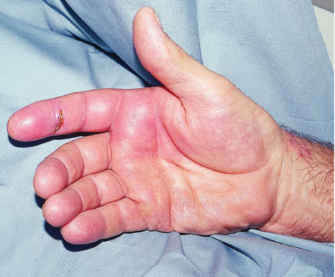
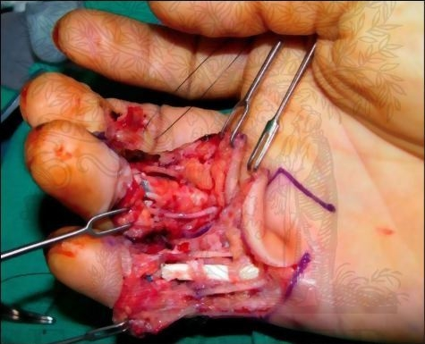
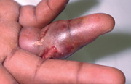
Hand Infection
Flexor Tenosynovitis
4 Sings :
Sausage shape
Flexed position
Pain with passive extension
Tenderness along the tendon sheath
Rx :
Abx
I&D
Catheter irrigation

Slide 8
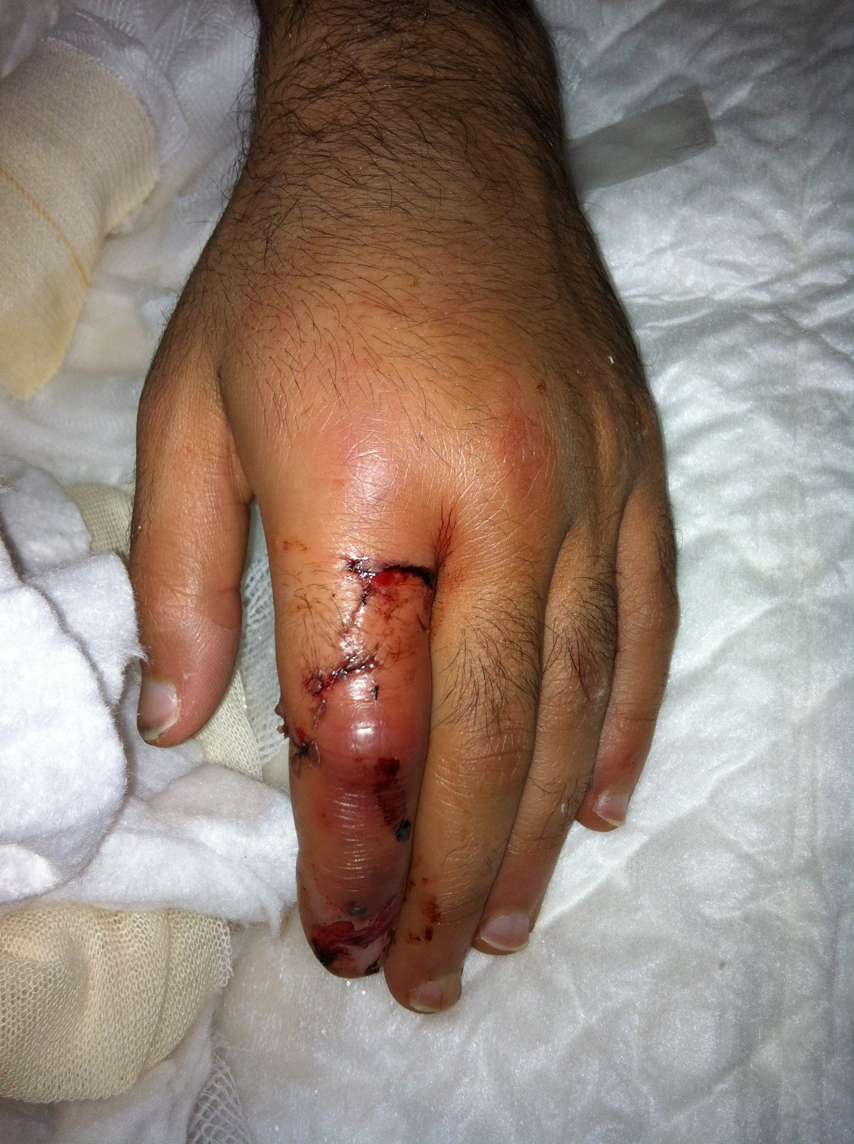
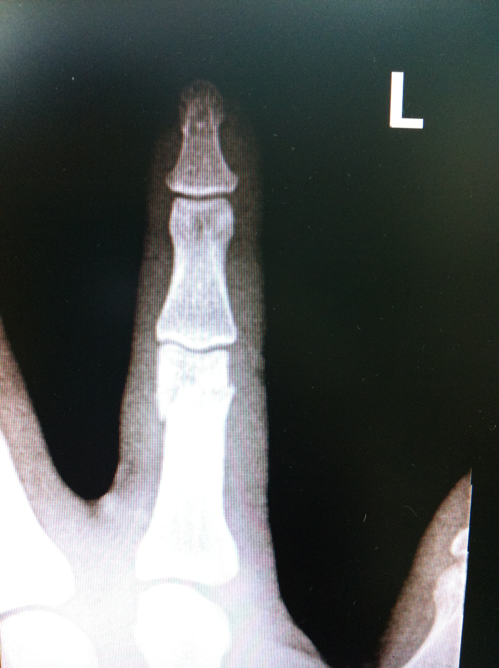
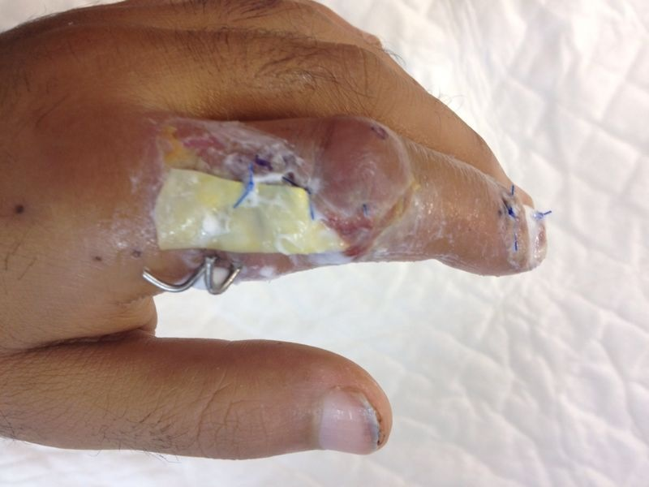
Hand Infection
Hand Bites
Human : Staph, Strep, Eikenella
Dog : Pasteurella Multocida, Staph, Strep
Cat : Pasteurella Multocida
Rx :
Abx
If no Response I&D

Slide 9
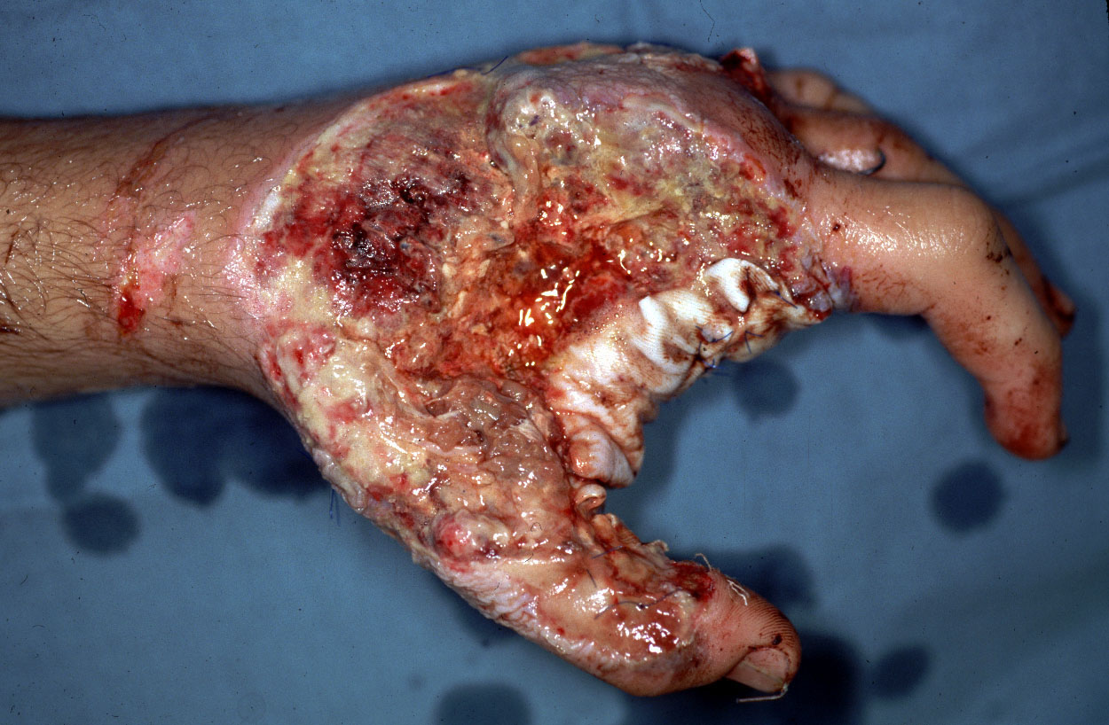
Necrotizing Fasciitis
Flesh eating disease of the soft tissue
Caused by Group A Beta hemolytic strep
Has high mortality rate
Need extensive debridement and IV Abx

Slide 10
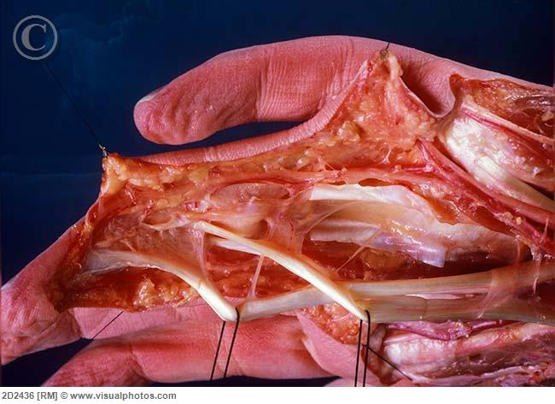
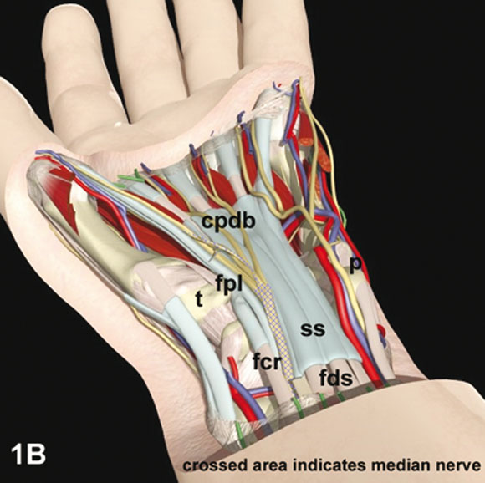
Flexor Tendons Anatomy
There is 8 muscles with almost 12 tendons in the flexor side, (4FDS, 4FDP, FPL FCU, FCR, PL)
Origin, Insertion, Nerve Supply

Slide 11
Flexor Tendons Mechanism of Injury
Closed Vs. Open
Open
Knife is the most common tool for the injury
Crush injury
Degloving injury

Slide 12
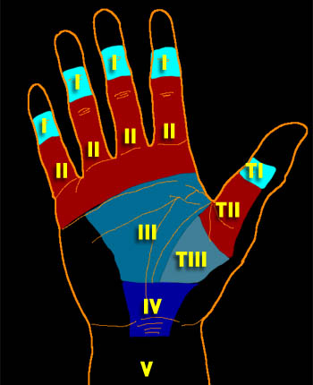
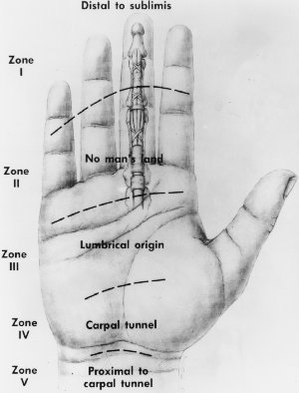
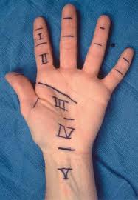
Flexor Tendons Zones
Verdan’s 5 Zones

Slide 13
Flexor Tendons Pully System and Tendon Blood Supply

Slide 14
Flexor Tendons Pully System and Tendon Blood Supply

Slide 15
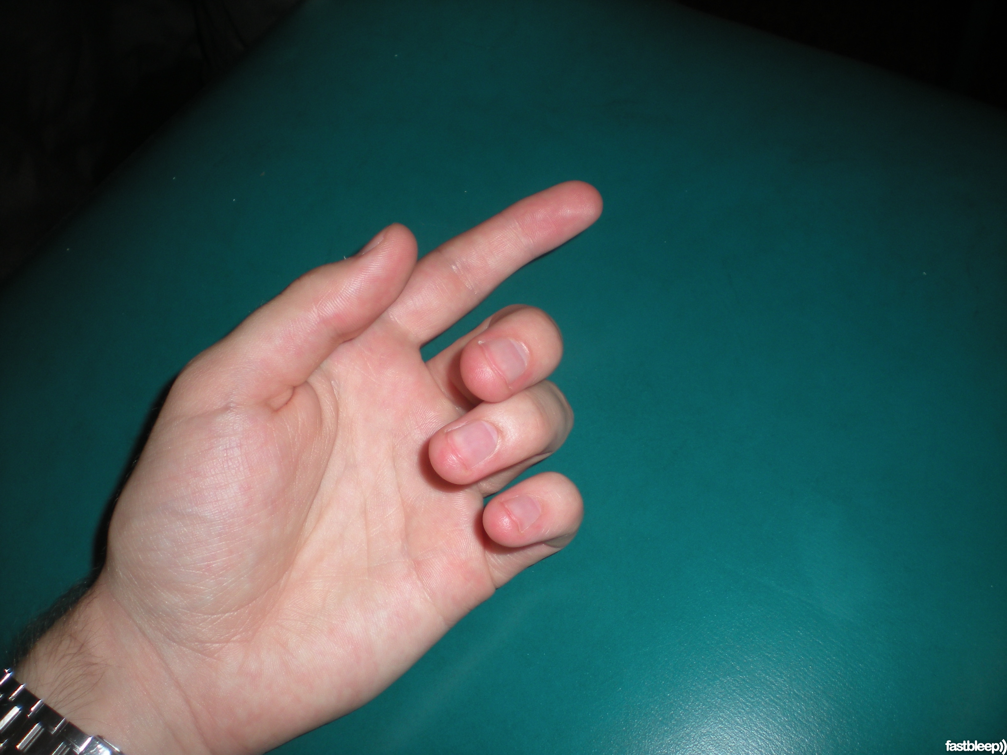
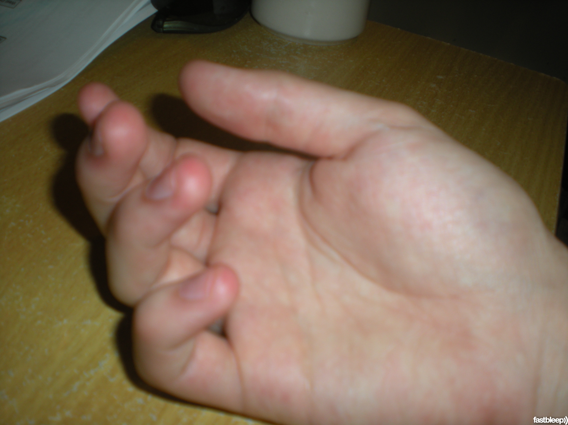
Flexor Tendons Clinical Examination & Finding
Loss of flexion cascade
Open wound most commonly
Tendon could be visible in the wound
Inability to flex the digit at PIP or DIP

Slide 16
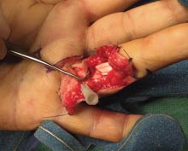
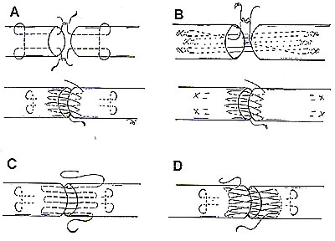
Flexor Tendons Repair
Explore the wound in zigzag fashion
Find the 2 ends of the cut tendon
Repair : > 25 different technique for the repair
Non absorbable suture

Slide 17
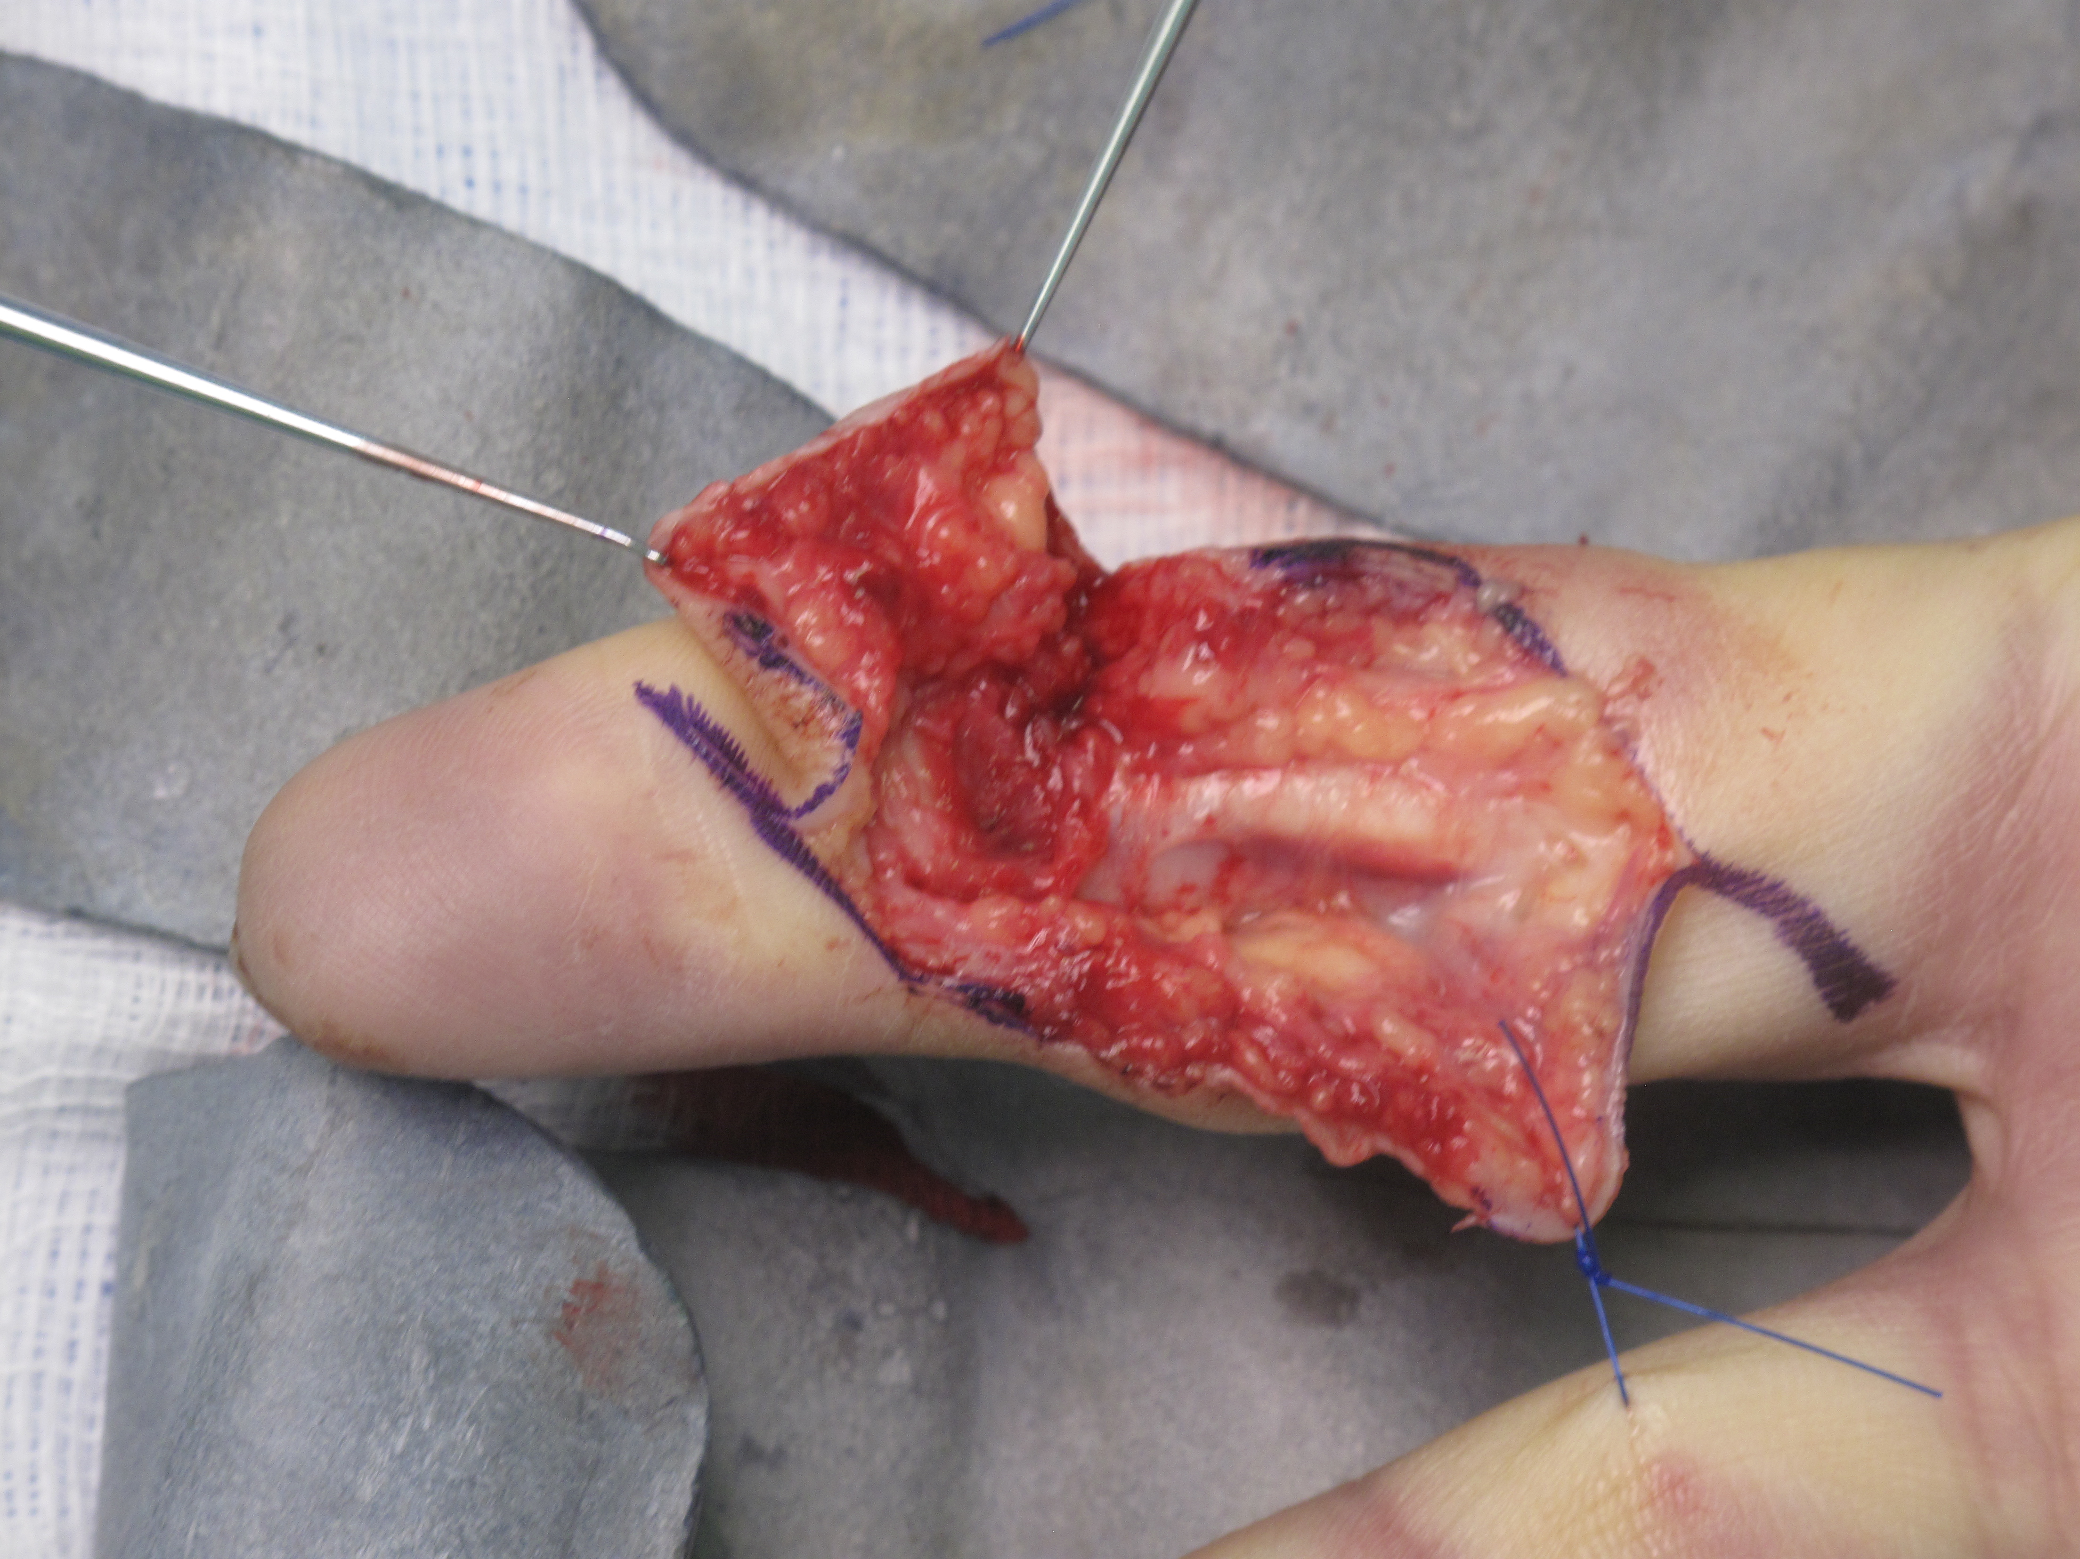
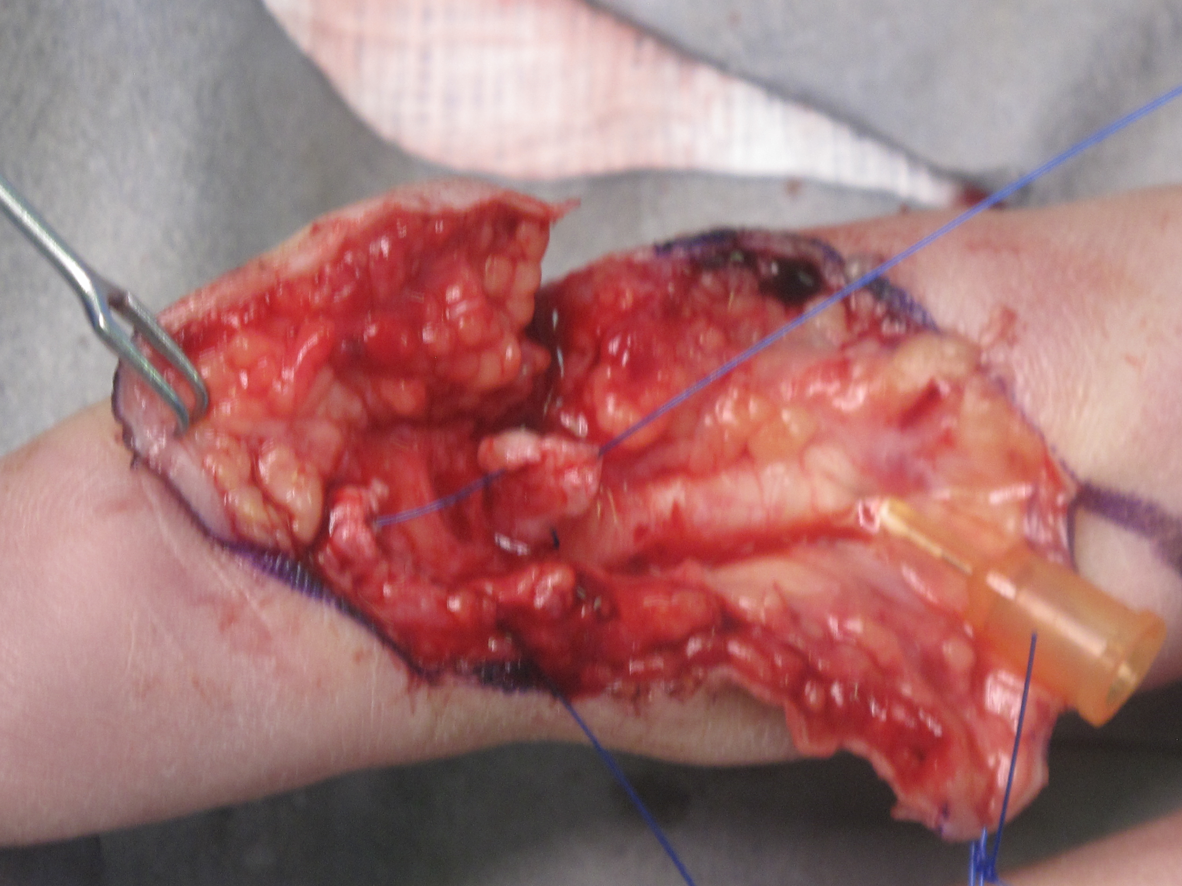
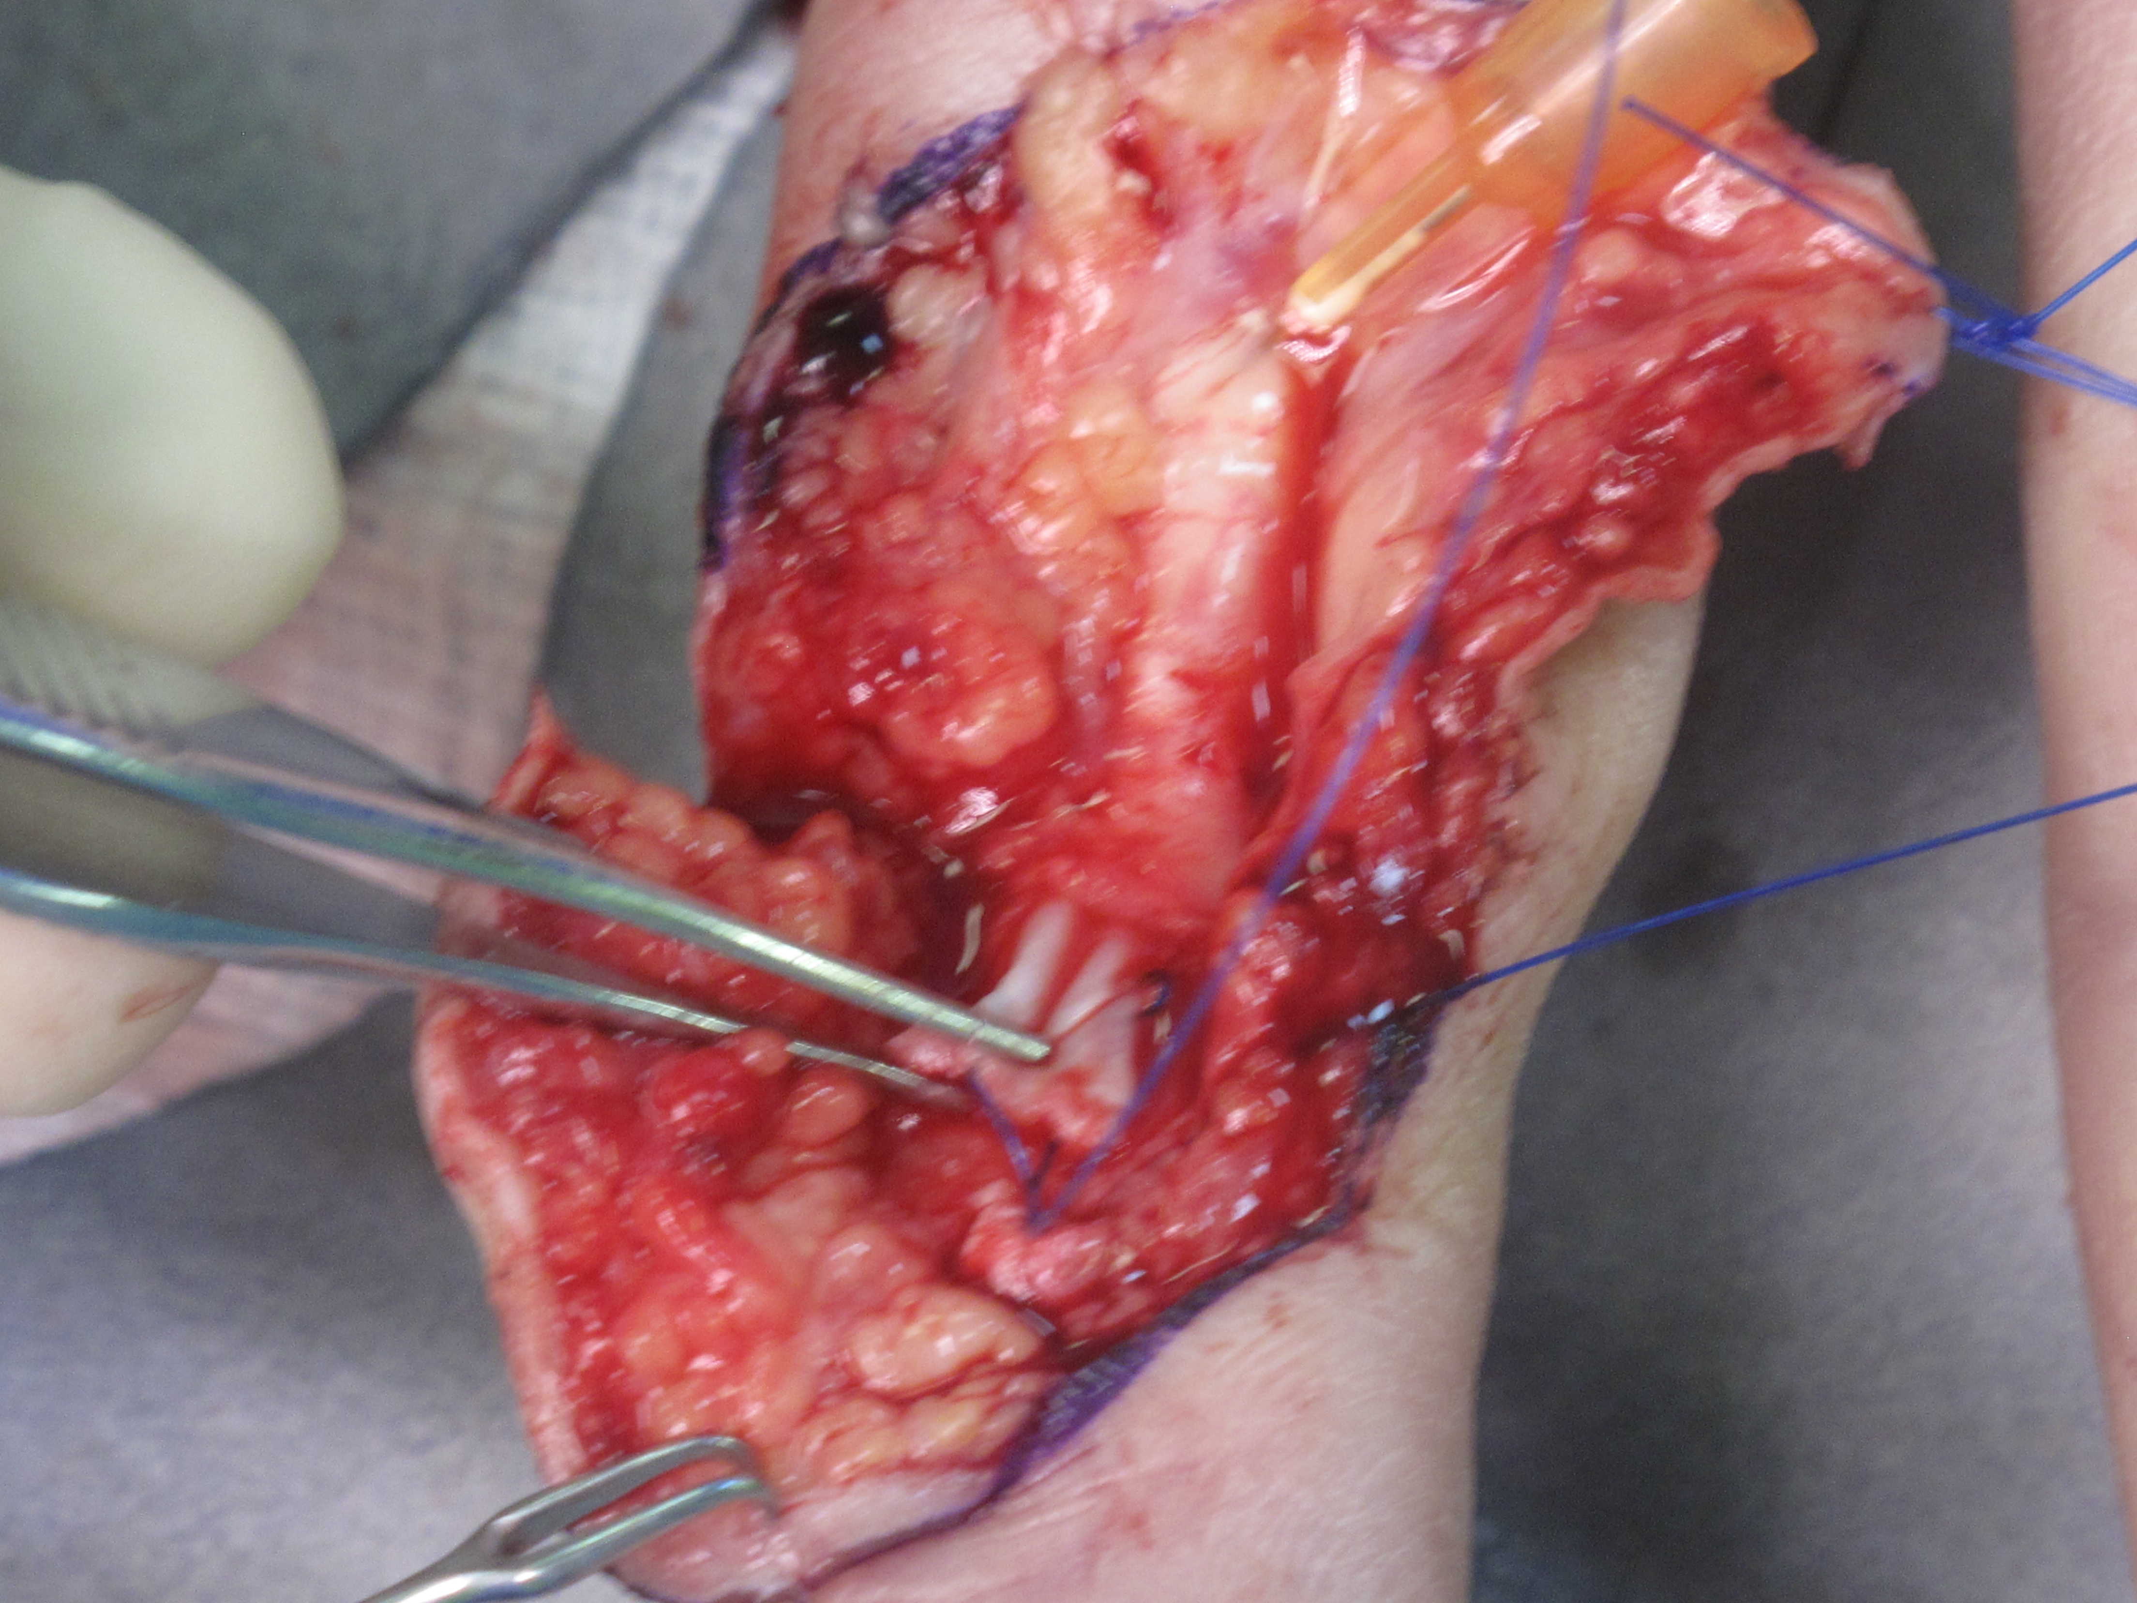
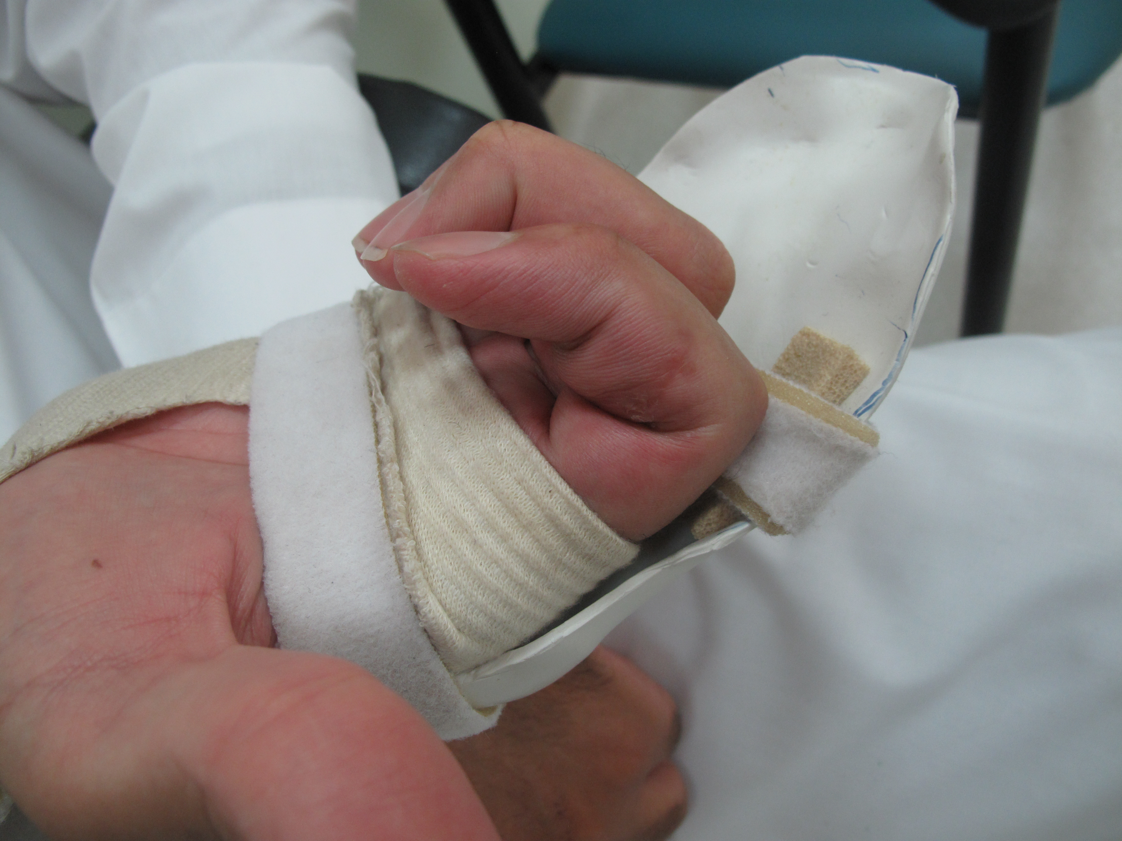

Slide 18
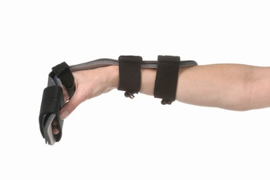
Flexor Tendons Splints

Slide 19
Replantation Indication & Contraindication
Indications
Amputated Thumb
Children
Multiple digits
Partial or whole hand
Contraindications
Life threatening injury
Sever chronic illness
Multilevel injury
Severly crushed injury
Single digit
Sever contamination
Avulsion injury

Slide 20
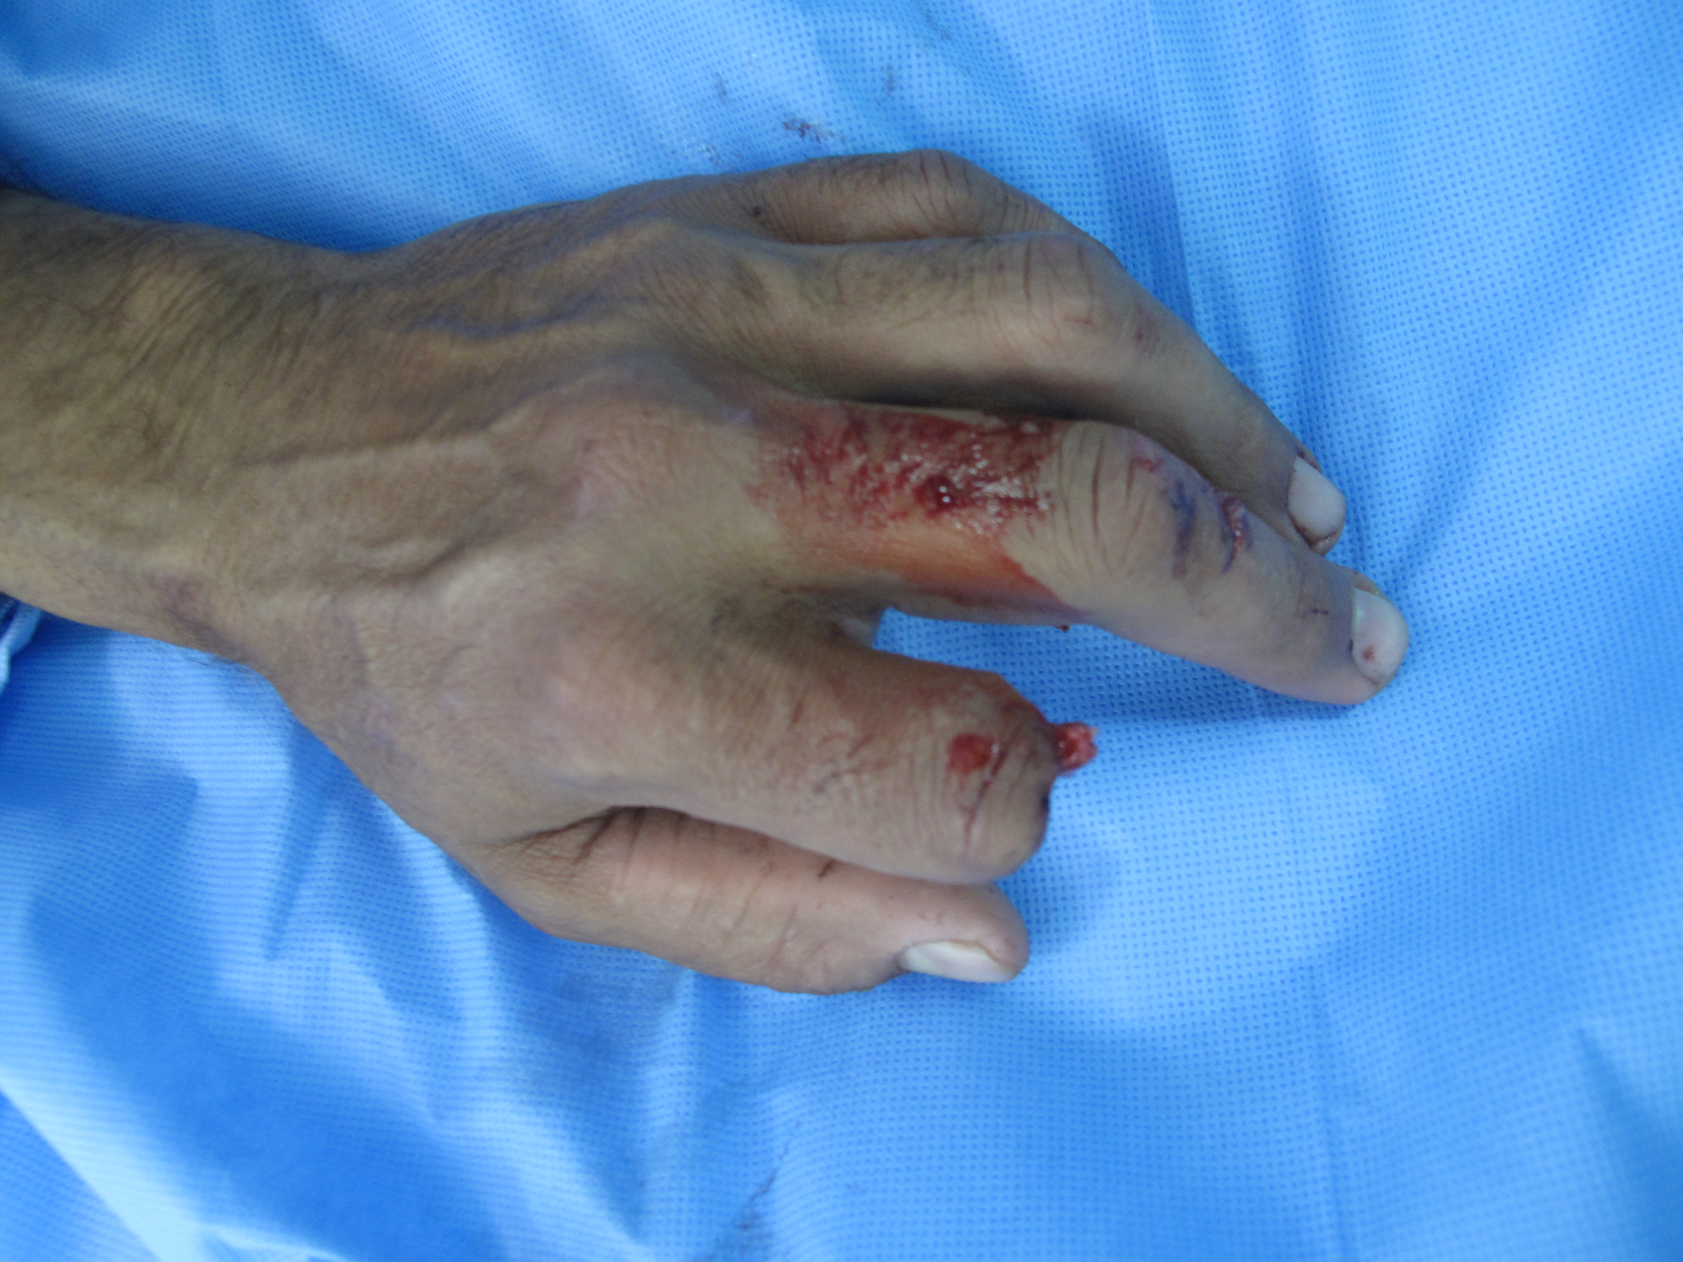
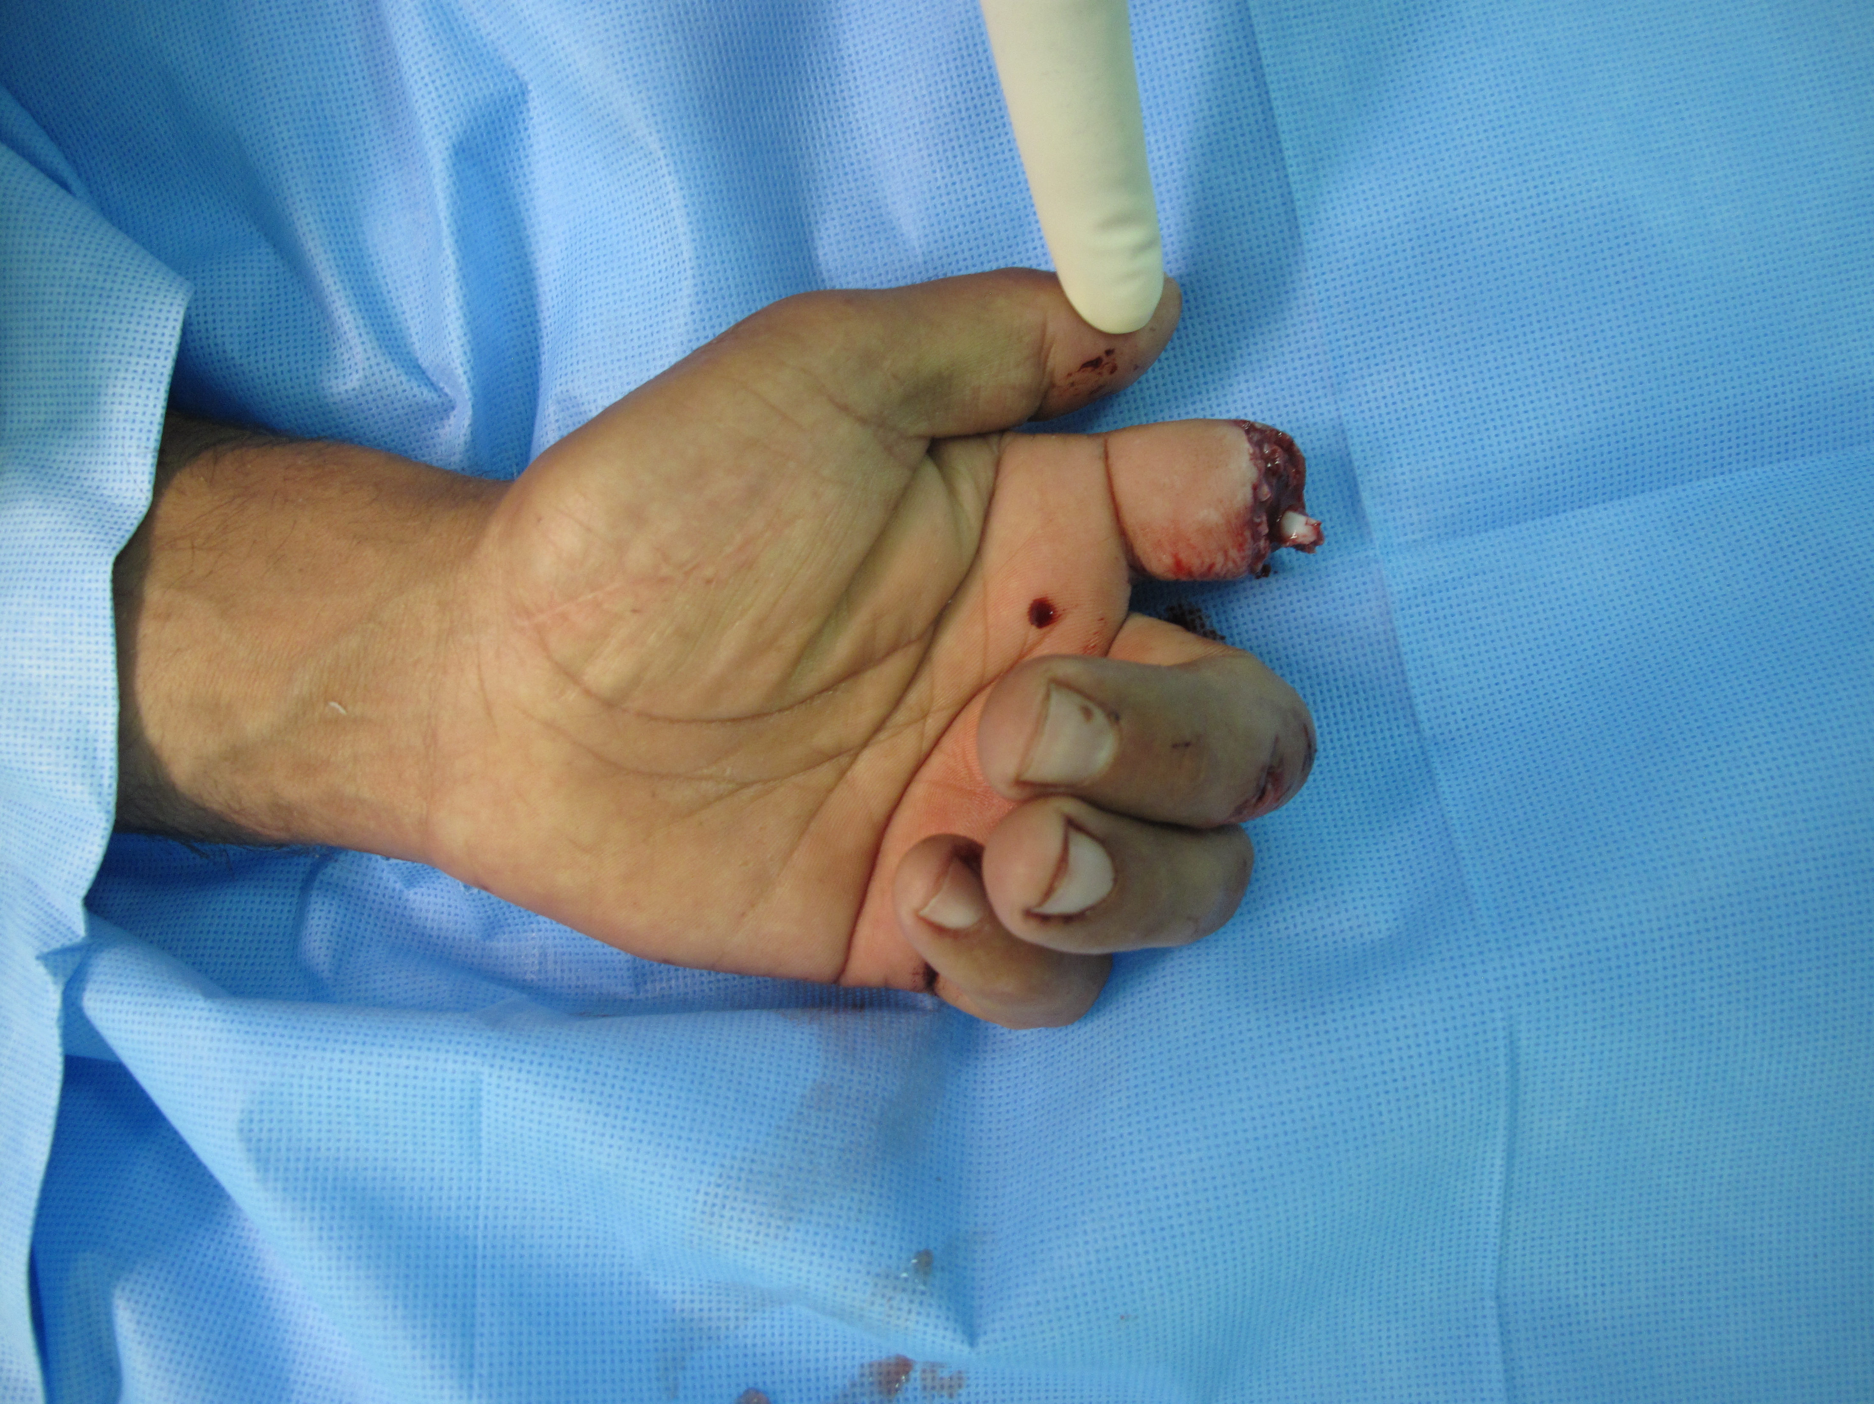

Slide 21
Replantation General Principles
Resuscitate the patient
Keep amputated part in moist gauze in a bad on ice
X-ray the hand and the amputated part
Consent for vein, nerve, tendon, skin graft
Prepare the amputated part
Shorten the bone
Arthrodesis
Repair flexor and extensor tendon
Repair Digital artery vein and nerve
Skin closure +/- skin graft

Slide 22
Replantation Complication
White finger
Ensure pt is worm
Full with fluid
Prevent hypotension
Loosen dressing
Remove sutures
Re-Explore
Blue finger
Elevate limb
Loosen dressing
Remove sutures
Leeches
Remove nail
Heparin injections
Re-Explore

Slide 23
Leeches

Slide 24
Hand Fractures
Unstable fracture
Cannot be reduced closed or cannot be held reduced without fixation
Antibiotics
30% risk of infection in open fracture including open Distal Phalanx fracture
Reduce to 3% with antibiotics
The distal phalanx fracture with subungal haematoma should be considered open
Healing 4/52’s for phalangeal fracture 5-6/52’s for metacarpal fracture

Slide 25
Hand Fractures
Acceptable hand fractures
Tuft distal phalanx
AP displaced metapheseal fracture in children
MC neck fracture
<15 in index and middle finger
<30-40 in ring and little finger
MC base fracture
Adult < 20
Children < 40

Slide 26
Hand Fracture
Unacceptable phalangeal fractures
Rotational angulation
Sever dorsal angulation
Lateral angulation

Slide 28
Pediatric Hand Fractures Solter harris Classifications
Type I – A transverse fracture through the growth plate 6%
Type II – A fracture through the growth plate and the metaphysis, sparing the epiphysis 75% incidence
Type III – A fracture through growth plate and epiphysis, sparing the metaphysis 8%
Type IV – A fracture through all three elements of the bone, the growth plate, metaphysis, and epiphysis 10%
Type V – A compression fracture of the growth plate (resulting in a decrease in the perceived space between the epiphysis and diaphysis on x-ray) 1%

Slide 30
Hand Fracture Indication for Fixation Non-Articular #
Angulation
Rotation
Shortening

Slide 31
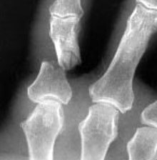
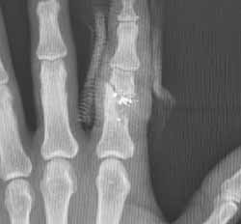

Slide 32
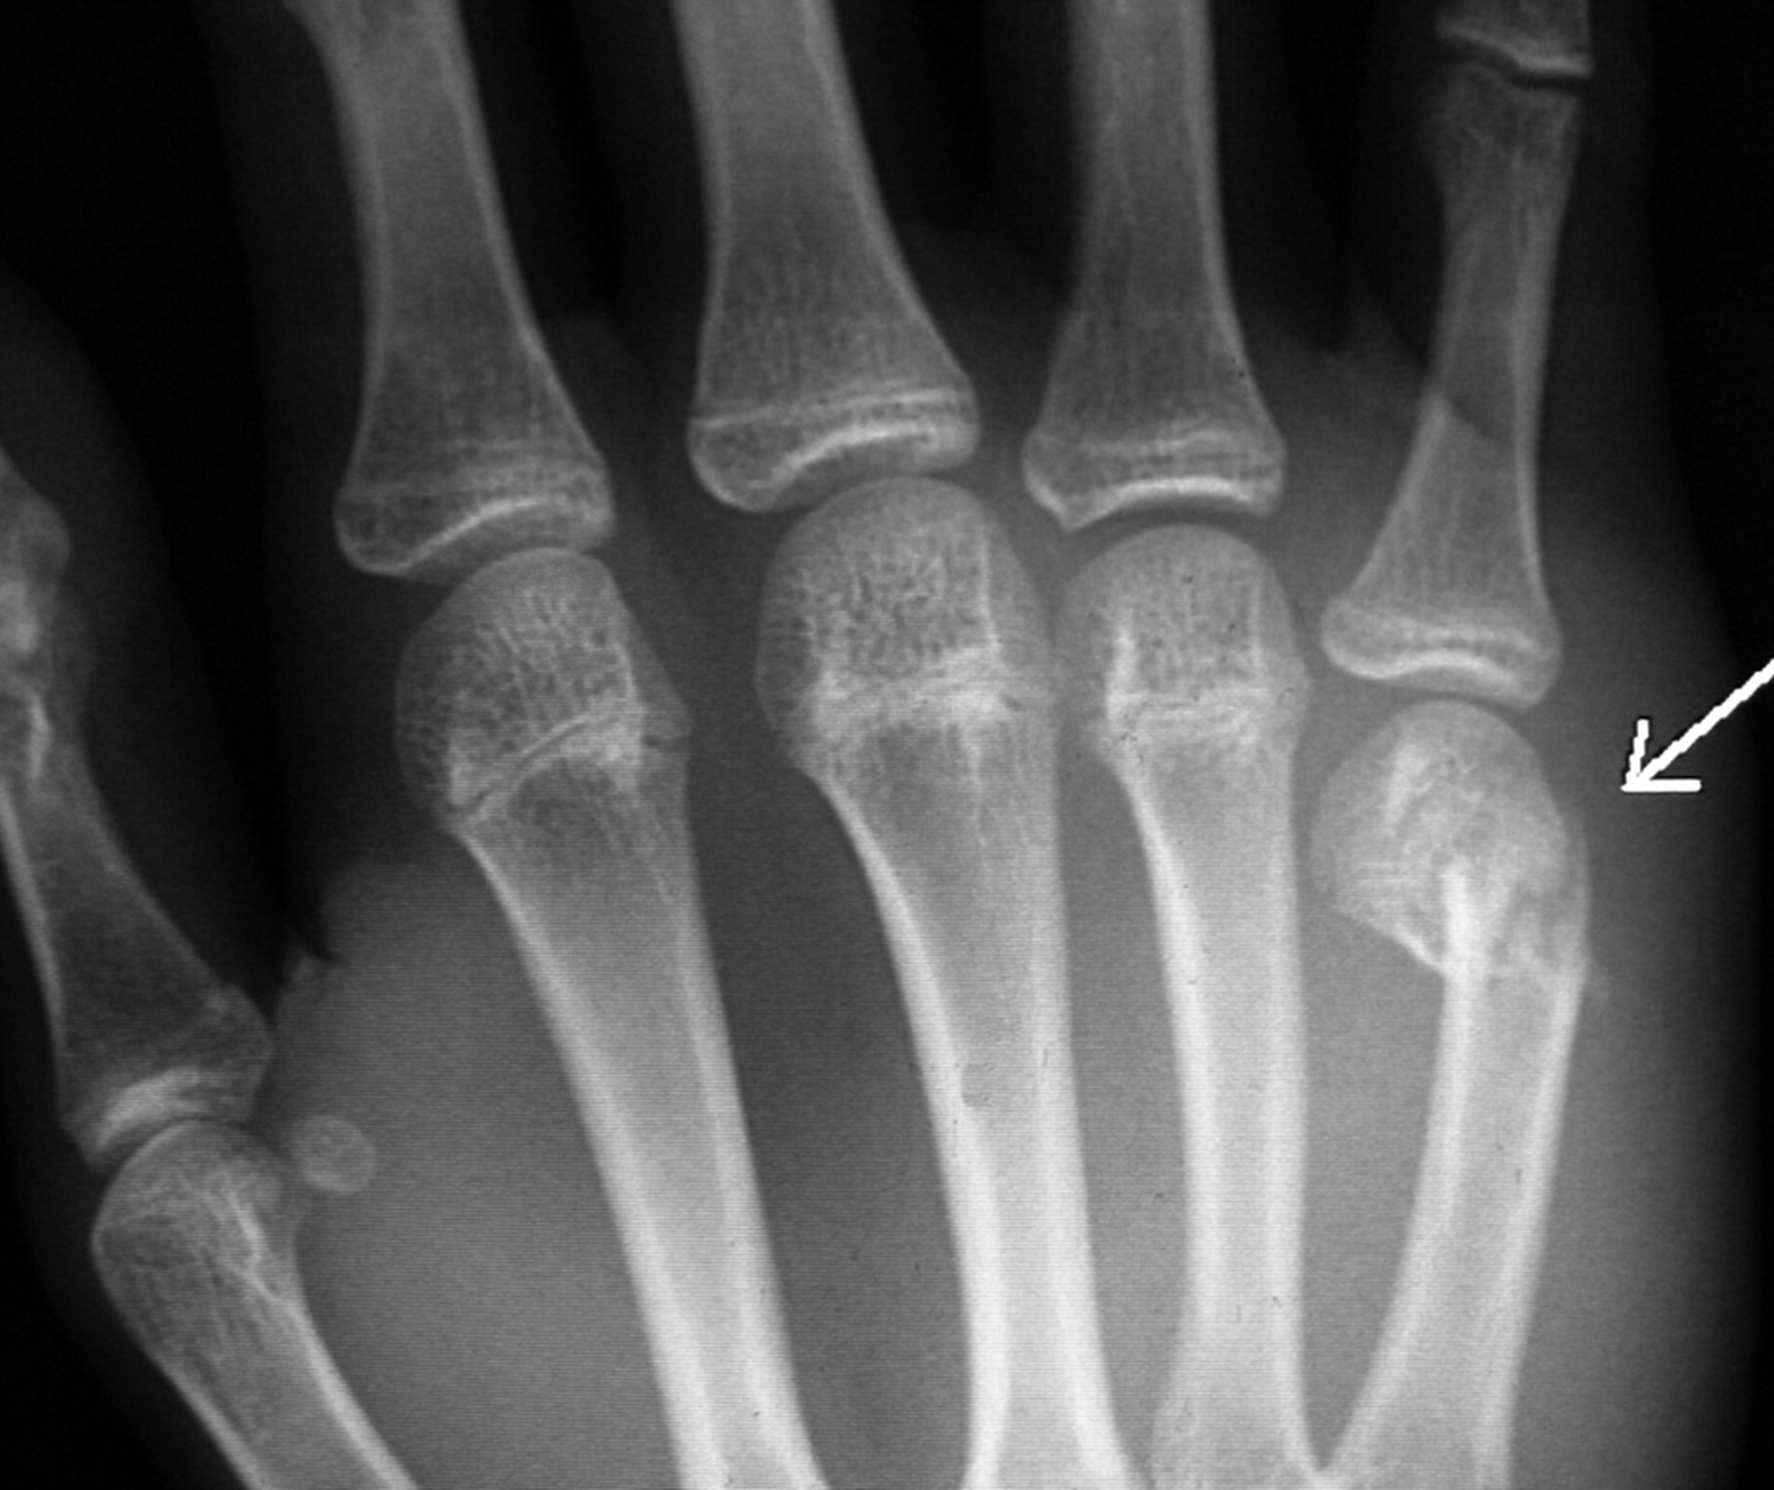
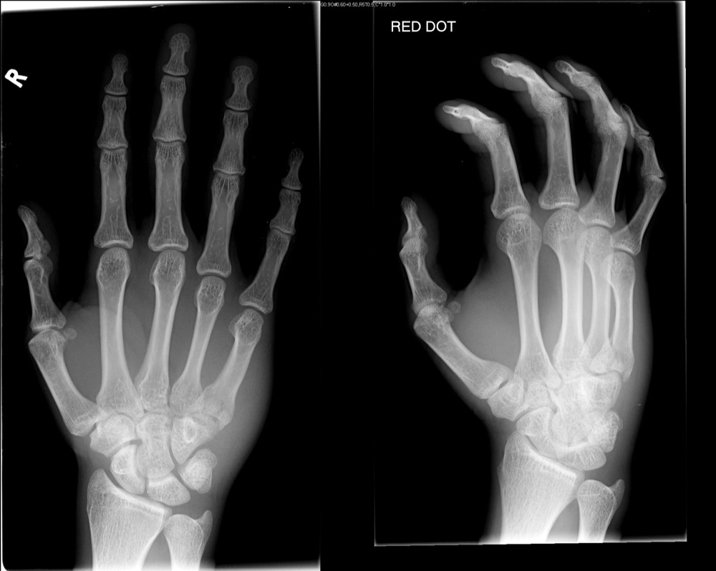

Slide 33
Hand Fracture Technique of Fixation
Close reduction splint
Close reduction K-Wire fixation
ORIF
Lag Screw
Plate
Circulage wire

Slide 34
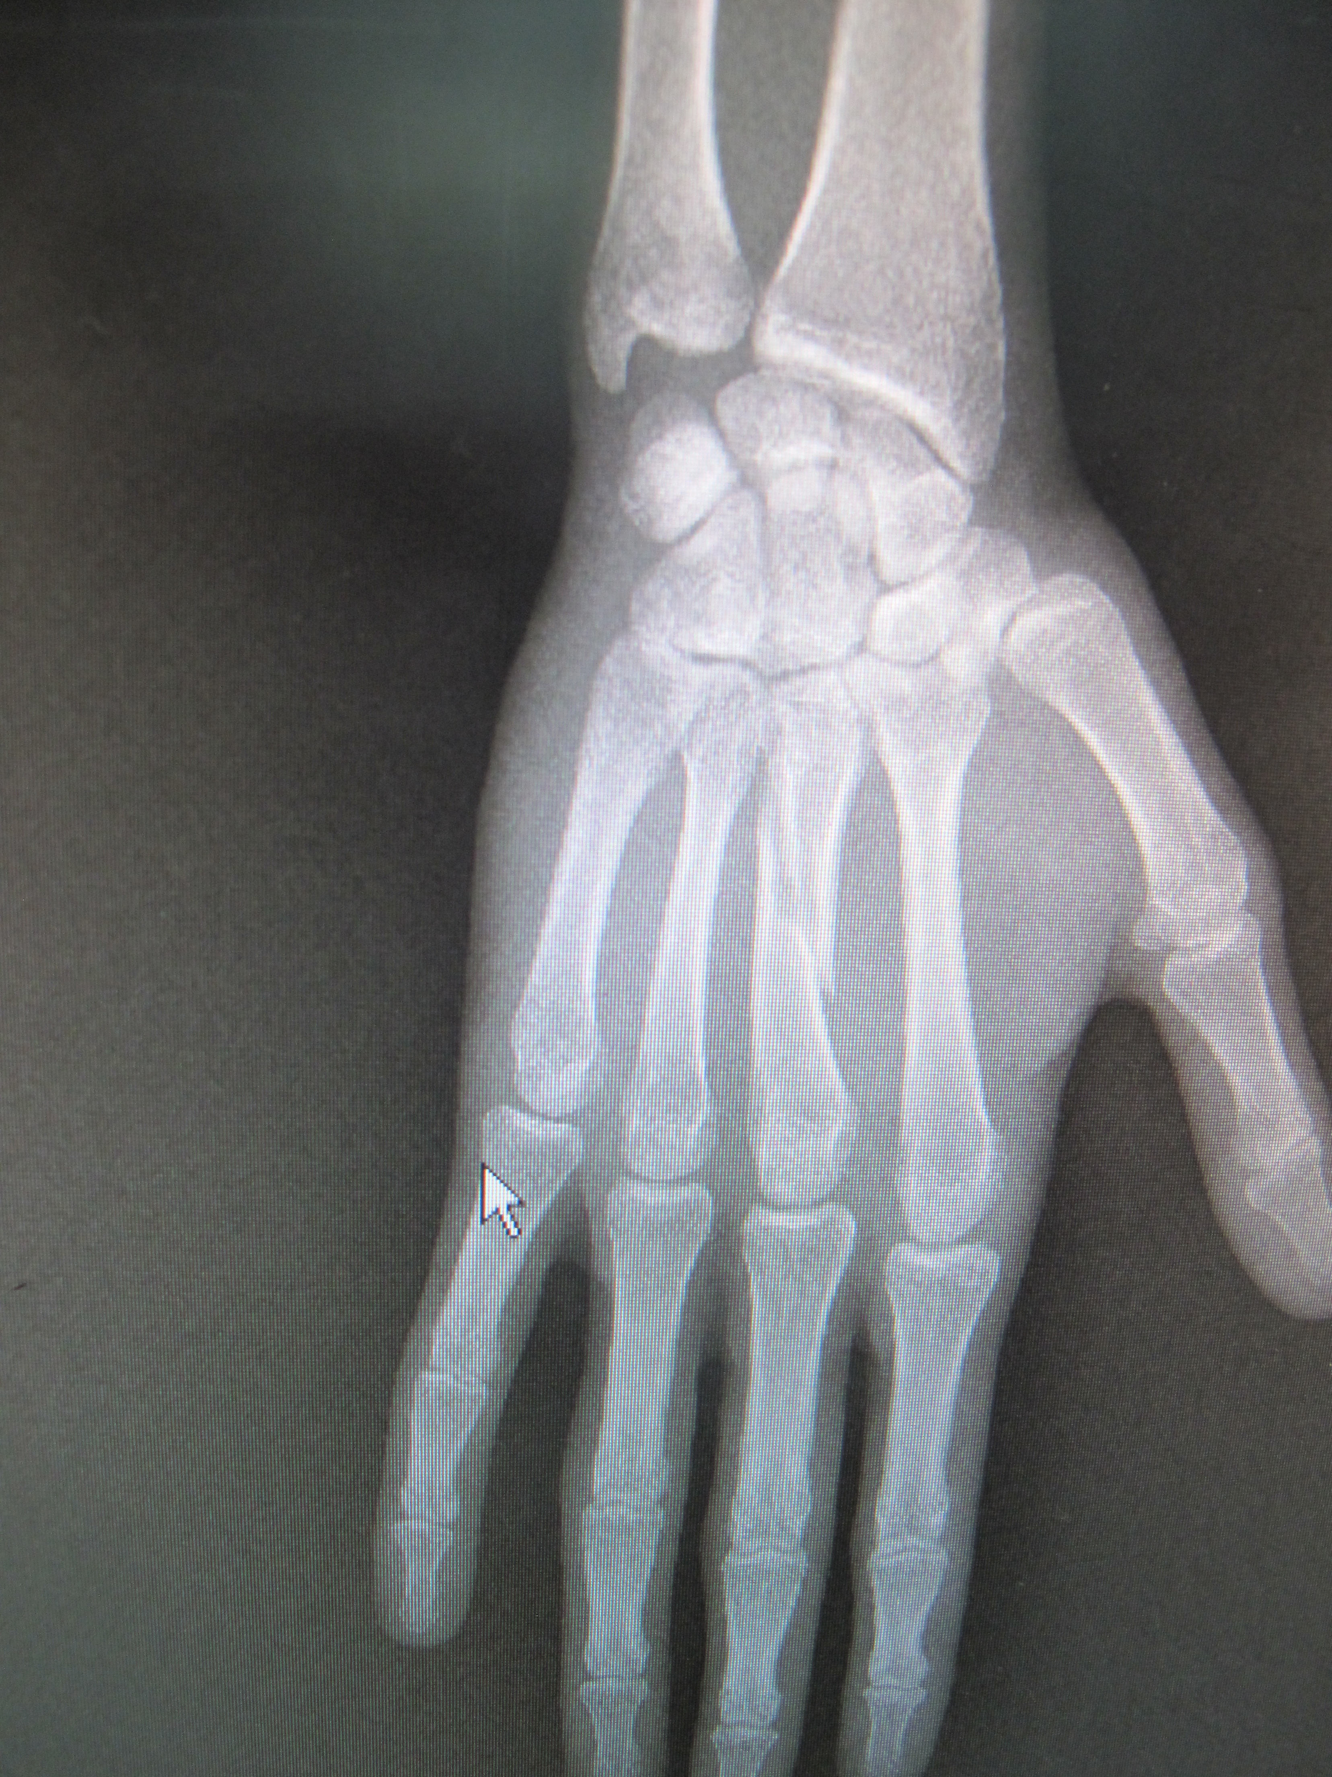
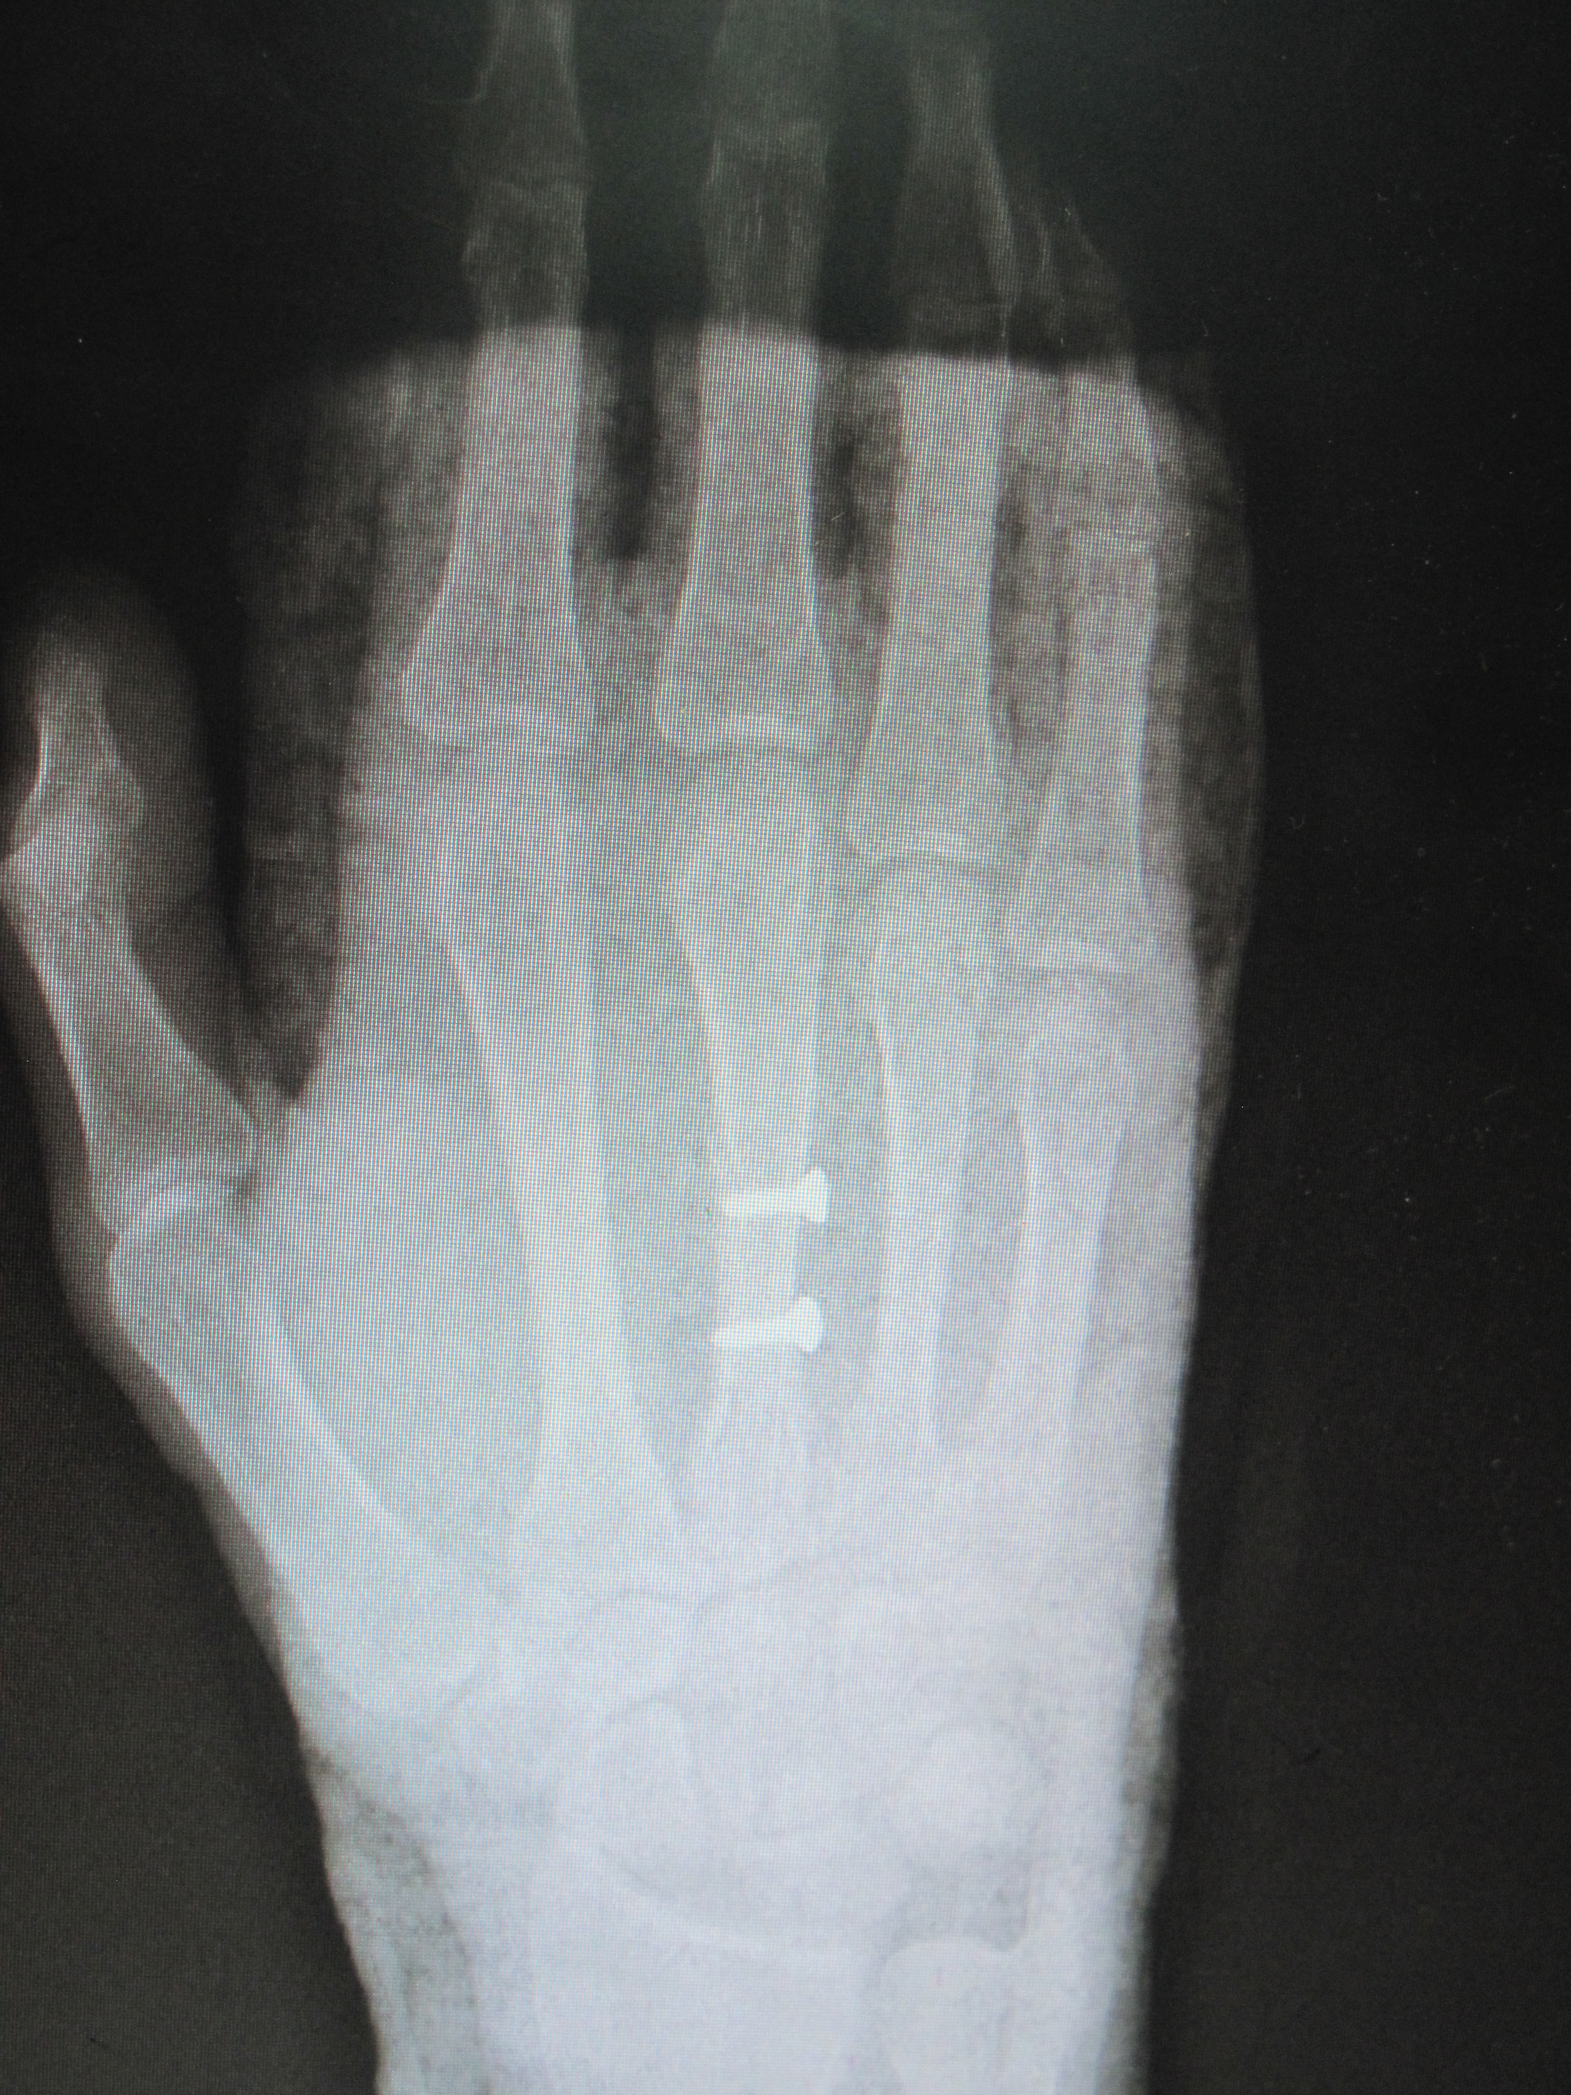

Slide 35
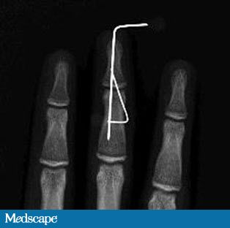
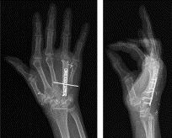

Slide 36
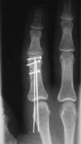

Slide 37
Carpal Tunnel Syndrome Incidence
The most common nerve compression in the upper limb 1 – 10% of the population
? As high as 60% in people with repetitive hand movement
Anatomy
Base is the bony carpal arch
Bridge is the flexor retinaculum
Has 9 flexor tendons and the median nerve

Slide 38
Carpal Tunnel Syndrome Aetiology
Due to increase volume of the content or reduction of the tunnel size
Acromegaly
Trauma
OA
Ganglion, Lipoma
Inflammation Tenosynovitis, gout
DM, Thyrotoxicosis, Pregnancy
Congenital :
Abnormal muscle, Persistant median artery

Slide 39
Carpal Tunnel Syndrome Symptoms
Pain
Numbness
Paraesthesia in the median nerve distribution
Radial 3.5 digits
Night pain
Pain radiate proximally to the shoulder
Weakness
Clumsiness

Slide 40
Carpal Tunnel Syndrome Clinical Features
Weakness, & wasting of the hand thenar muscles
Altered sensation in the median nerve distributions
Positive Tinels sign
Positive Phalan test
Reverse phalan test

Slide 41
Carpal Tunnel Syndrome Investigations
X-Ray
CT scan
MRI
Nerve conduction studies

Slide 42
Carpal Tunnel Syndrome Treatment
Non-Operative
Splint
NSAID’s
Steroid Injections
Operative
All Open technique
Limited incision Technique
Endoscopic Techniques

Slide 43
Carpal Tunnel Syndrome Open Release

Slide 44
Carpal Tunnel Syndrome Open Release

Slide 45
Carpal Tunnel Syndrome Open Release

Slide 46
Thank you

