Slide 1
Principles of Surgical Oncology
Salah R. Elfaqih

Slide 2
Types of Tumors
Benign
Malignant
Carcinoma
Sarcoma
Teratoma
Hamartoma

Slide 3
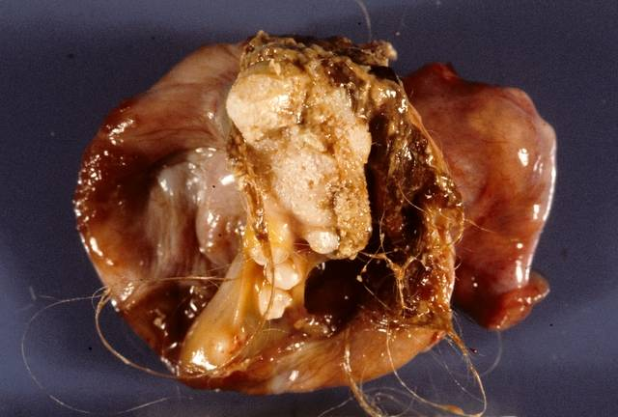
Hamartoma vs Teratoma

Slide 4
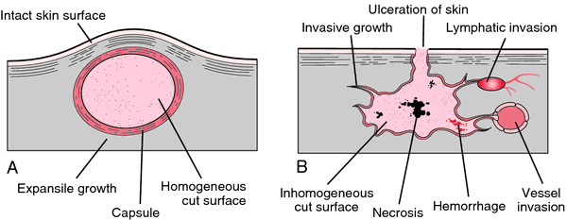
Benign vs Malignant
Benign
Encapsulated
No invasion
No metastasis
Malignant
Non encapsulated
Usually invade
Metastasis

Slide 5
Benign vs Malignant Tumors

Slide 6
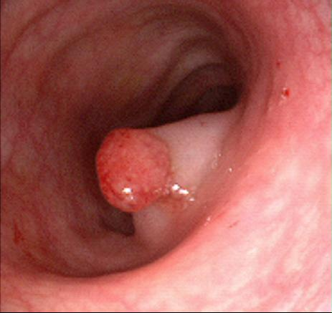
What are the treatment implications
Local excision for benign tumors and radical excision for malignant

Slide 7
Normal cell & malignant cell

Slide 8
Characteristics of malignant cells
Uncontrolled growth and loss of contact phenomenan are the main characteristics of malignant cells

Slide 9
Normal versus Malignant Cells

Slide 10
Tumor Grading & Differentiation
Grading: Describes the histologic characteristics of cancer cells mainly talk about cell layers.
e.g. grade I, II, III.
Differentiation: Describes the characteristics of cancer cells in reference to their resemblance to the cell of origin.
e.g. well differentiated
moderately differentiated
poorly differentiated
anaplastic.
Both describe the histological features of the tumor

Slide 11
Tumor Grading & Differentiation
Tumor grading & tumor differentiation both describe the histological features of the tumor and not the macroscopic features , invasion or metastasis

Slide 12
Why malignant cells are dangerous

Slide 13
Spread Of Malignant Tumors

Slide 14
Spread of Malignant Tumor
Local invasion :
within the organ
adjacent organs
Metastasis :
Lymphatic : Regional & distant lymph nodes.
Haematogenous e.g. liver, lung, bones.
Transcoelomic e.g peritoneal & pleural cavity.
Implantation e.g. needle tracks, wounds.

Slide 15
Local Invasion

Slide 16
Distant Metastasis

Slide 17
STAGING OF MALIGNANT TUMORS
Staging describes the primary tumor, its relation with the organ of origin ,adjacent and distant organs

Slide 18
Types of Tumor Staging
Classical: e.g.
stage I, II, III, IV
TNM:e.g
T1, No, Mo
T – Tumor :
T1,2,3, Tis, Ta, Tb
N – Node :
N0, 1, 2, 3
M – Metastasis:
M0,1,2,3

Slide 19
Why Do We Stage Malignant Tumors?
To decide the treatment
To plan the treatment
To assess the prognosis

Slide 20
Whenever you deal with malignant tumor, always remember that there is primary tumor & there may be secondaries.

Slide 21
Presentation of Malignant Tumors
Asymptomatic
Symptoms related to the primary
Symptoms related to the secondaries
Incidental finding
Weight loss and Cachaxia are late manifestations of most malignant tumors except GI and Lung cancer

Slide 22
Presentation of Malignant Tumors

Slide 23
Investigation of Malignant Tumors
Investigate for the primary
Depends on the site
Define the histology
Define the local extension
Investigate for the secondaries
Look for metastasis
Usually liver, lung and bones
Both will define the diagnosis & stage
So how we define histology?

Slide 24
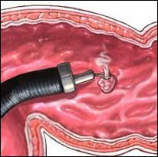
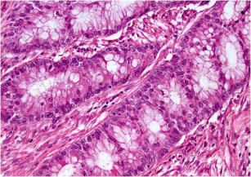
Investigation of Malignant Tumors

Slide 25
Biopsy Cytology

Slide 26
How we obtain material for histology
Cytology : morphology of individual cells.
Exfoliative (urine,sputum,….)
Fluid aspiration (ascitic fluid,pleural fluid)
Fine needle aspiration (FNA)
Biopsy : histological (tissue) characteristics
Incisional biopsy (open, needle, forceps..)
Excisional biopsy

Slide 27
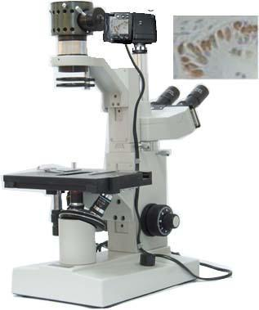
Cytology

Slide 28
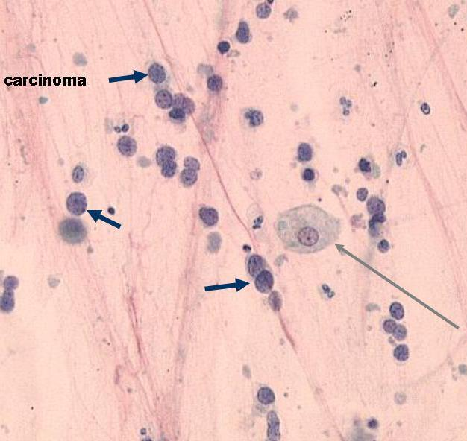
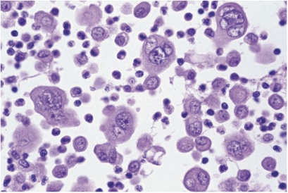
Cytology : Examples

Slide 29
Tissue Biopsy

Slide 30
CT- guided Trucut needle biopsy

Slide 31
Excisional & Incisional Biopsy

Slide 32
Tumor Markers
Substances which if present in the blood or tissues may indicate malignancy.
The concept is very important
There are many tumor markers
Most are non-specific
Important in diagnosis
Important for screening
Important in follow up

Slide 33
Tumor Markers-examples

Slide 34
Tumor Markers in tissues

Slide 35
Tumor Markers-non specific

Slide 36
Tumor Markers-screening

Slide 37
Tumor Markers-diagnosis

Slide 38
Tumor Markers-follow up

Slide 39
Tumor Markers-follow up

Slide 40
Tumor Markers-follow up

Slide 41
Hormones & Cancer
Hormones related to tumor growth:
Usually sex hormones (testosterone,estrogen)
They may have a relation to tumor growth
Hormone receptors
The concept can be used in treatment
Hormones may be produced by tumors:
Originally hormone producing organ e.g. adrenals
Originally non hormone producing organ e.g. lung

Slide 42
Testosterone and Prostate Cancer

Slide 43
Estrogen receptors-breast cancer

Slide 44
Estrogen receptors-breast cancer

