Slide 1
Hydrocephalus & Common Neurosurgical Congenital CNS Malformations
Z. Jamjoom
Professor of Neurosurgery

Slide 2
Hydrocephalus
Hydro = water + cephalus = head
Increased amount of CSF in the head
Usually results in:
Ventriculomegaly
Increased intracranial pressure

Slide 3
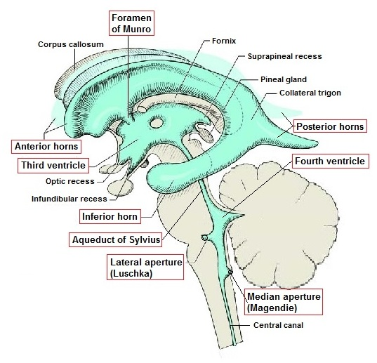
Anatomy: The ventricular system

Slide 4
Physiology: CSF Production
Total volume of CSF in the ventricles ranges from ~10 ml in neonates to ~150 ml in adults.
Produced mainly by the choroid plexus & to a lesser extent by extracellular fluid of the brain.
Rate of production is 0.3-0.4 ml/minute (~500 ml/day).
Only very high ICP will reduce CSF production; usually when brain perfusion is decreased.

Slide 5
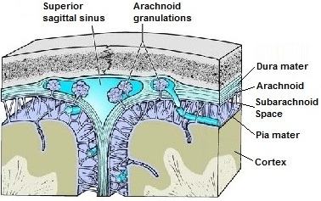
Physiology: CSF Flow & Absorption
CSF Flow: Through anatomical CSF spaces
CSF Absorption: Mainly at the arachnoid granulations

Slide 6
Pathogenesis of Hydrocephalus
Excessive CSF production:
Choroid plexus papilloma
CSF flow obstruction:
Tumors: especially in or near the ventricules
Congenital anomalies
Decreased CSF absorption:
Post meningitic
Post SAH
Decreased brain volume: Brain atrophy: Hydrocephalus ex vacuo

Slide 7
Causes of Hydrocephalus
Developmental anomalies:
Aqueductal anomalies
Dandy Walker malformation
Chiari II malformation
Myelomeningocele
Infections: Meningitis
Tumors
Intracranial hemorrhages
Traumatic brain injury
Chromosomal anomalies (trisomy 13 & 18)

Slide 8
Classification of Hydrocephalus
Based on | Types | Remarks
Etiology | Congenital H. | Present at birth or diagnosed in utero
 | Acquired H. | Develops after birth
Site of obstruction | Communicating H. | Obstruction distal to ventricular system All ventricles dilated
 | Non-communicating (Obstructive) H. | CSF flow obstruction within ventricular system Only parts of ventricular system are enlarged
Intracranial pressure | Hydrocephalus with high pressure | Most symptomatic hydrocephali Symptoms & signs of raised ICP
 | Hydrocephalus with normal pressure | May be asymtomatic NPH: Triads:Dementia, gait disturbance, incontinence

Slide 9
Clinical Presentation: I- Infants & Young Children
Increasing head circumference
Irritability, lethargy, poor feeding, and vomiting
Bulging anterior fontanelle
Widened cranial sutures
McEwen's cracked pot sign with cranial percussion
Scalp vein dilation (increased collateral venous drainage)
Sunset sign (forced downward deviation of the eyes, a neurologic sign almost unique with hydrocephalus)
Epidsodic bradycardia and apnea

Slide 10
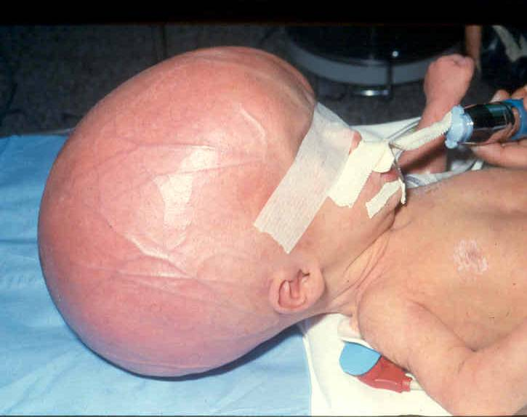
Macrocephalus

Slide 11
Sunset Sign

Slide 12
Clinical Presentation: II- Juvenile & Adult
Symptoms & signs of raised ICP:
Headaches
Vomiting
Visual disturbance
Papilledema
Decreased level of consciousness.
Seizures
Focal neurological deficit
Collection of CSF around previous shunt site

Slide 13
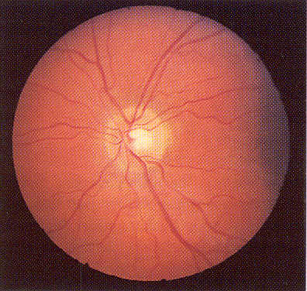
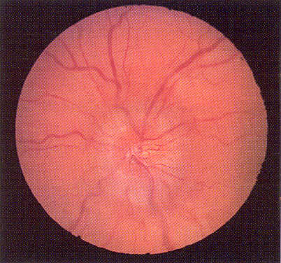
Papilledema
Normal

Slide 14
Radiological Investigations
Plain X-ray
CT – scan
MRI

Slide 15
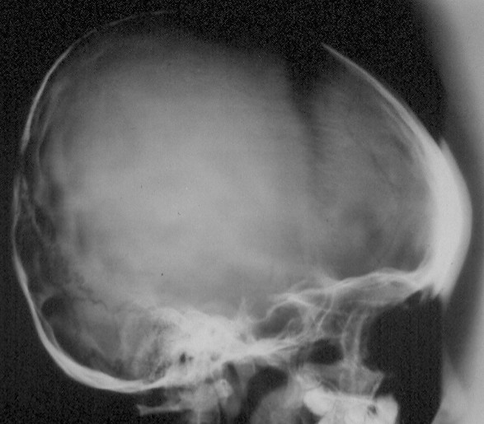
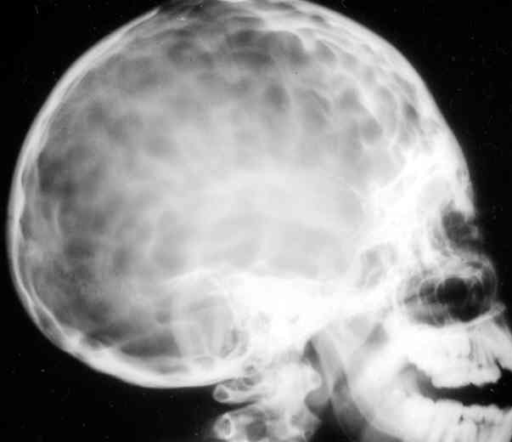
Plain X-ray
Shows longstanding, indirect signs of increased ICP:
Separated Skull Sutures
Silver Beaten Appearance

Slide 16
CT scan
Allows direct visualization of the ventricular system
Shows acute and chronic ventricular enlargement
Often shows site and cause of ventricular obstruction
Method of choice for emergency

Slide 17
MRI
Shows more anatomical details in multiple planes
Allows better visualization of:
Obstructive lesion
Associated brain anomalies
Shortcomings:
Long imaging time
Often anesthesia needed for children
Not routinely available in emergency

Slide 18
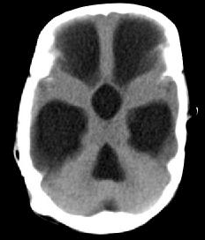
Communicating hydrocephalus

Slide 19
Hydrocephalus caused by colloid cyst obstructing foramen of Munro

Slide 20
Hydrocephalus caused by posterior fossa tumor

Slide 21
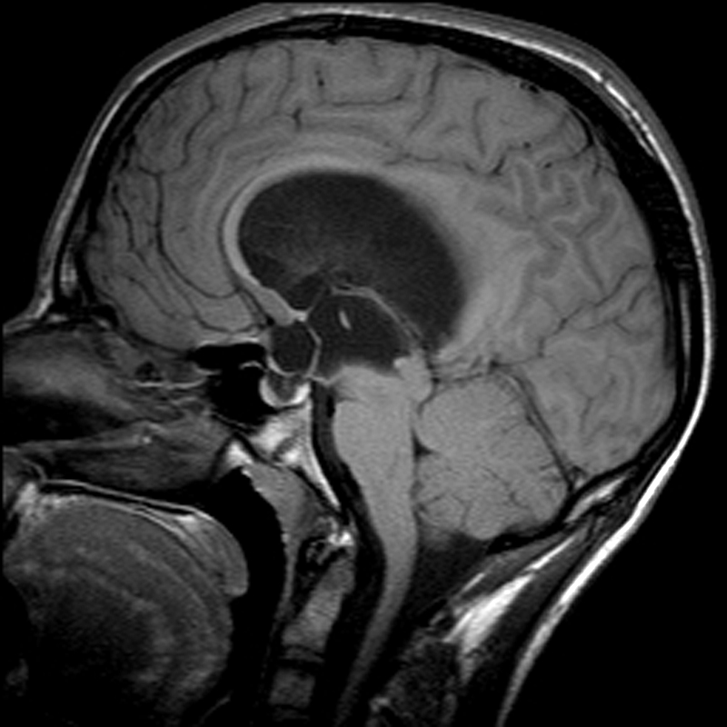
Hydrocephalus caused by aqueductal stenosis

Slide 22
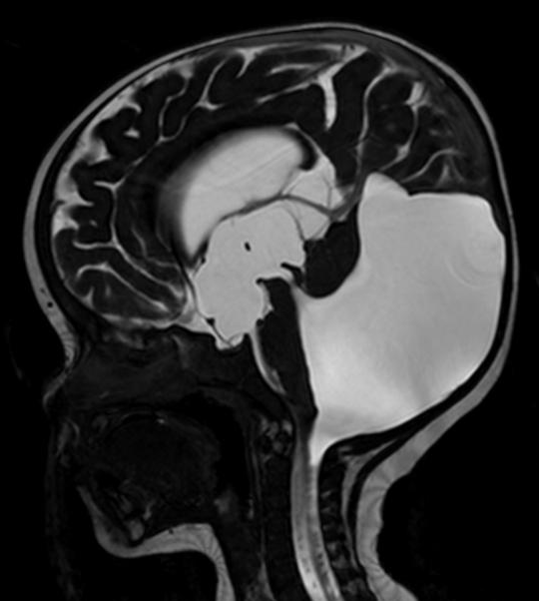
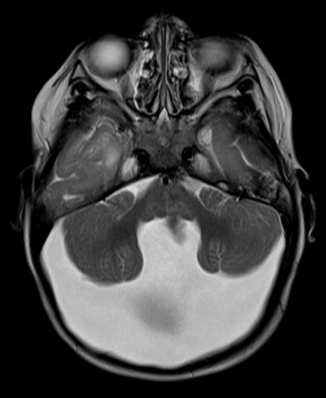
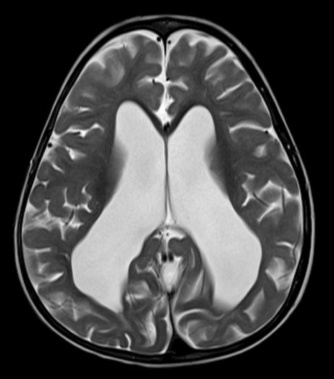
Hydrocephalus caused by Dandy Walker Cyst

Slide 23
Treatment
Removal of obstructive lesion
CSF shunting procedures:
Ventriculo-peritoneal (VP shunt)
Ventriculo-atrial (VA shunt)
Endoscopic 3rd ventriculostomy

Slide 24
Ventriculo-peritoneal Shunt
Diversion of excessive ventricular CSF to the peritoneal cavity
Aim is to normalize the intracranial pressure
Shunt system consists of 3 components:
A Ventricular catheter
A valve that allows unidirectional CSF outflow at a certain pressure range or flow rate
A long peritoneal catheter
Shunts are made of biocompatible silicon & cause no or minimal tissue reaction or intravascular thrombosis

Slide 25
Ventriculo-peritoneal shunt

Slide 26
Complications of VP-Shunt
Immediate operative complications
Shunt malfunction
Shunt infection

Slide 27
Operative Complications of VP-Shunt
Misplacement of:
ventricular catheter
peritoneal catheter
Intracerebral / intraventricular hemorrhage
Injury to abdominal viscera
Pneumothorax
Convulsions

Slide 28
VP-Shunt malfunction
Most common shunt complication
Incidence:
In the first few months after surgery: 25 to 40% of cases
Later 4 to 5 % per year.
Causes:
Obstruction by cell debris, choroid plexus, or blood clot
Accounts for >50% of all shunt malfunctions
Migration, disconnection, or rupture shunt catheter(s)
Shortening of peritoneal catheter as child grows
CSF encystation around the peritoneal catheter
Over drainage:
Subdural fluid collection
Slit ventricle syndrome

Slide 29
VP-Shunt Infections
Occurance: About 5%
Organisms:
Staphylococcus epidermidis : ~40%
Staph aureus: ~20%
Streptococci & gram -ve organisms: less frequent.
Clinical features:
Onset ~8-10 weeks after shunt insertion.
Fever, malaise, headache & irritability + neck stiffness.
Peritonitis is less common.
Diagnosis: By CSF & blood examination & culture
Treatment: Shunt removal, external ventricular drain, antibiotics until CSF is clean followed by new shunt insertion
May result in additional neurological/intellectual impairment

Slide 30
Endoscopic 3rd Ventriculostomy
Suitable for cases with patent external CSF spaces
The endoscope is passed through a burr hole to the third ventricle
The floor of 3rd ventricle is fenestrated just anterior to mamillary bodies to allow for CSF to exit the ventricle

Slide 31
Neural Tube Defects (NTD)
Anomalies arising from: Incomplete or faulty closure of the dorsal midline embryonal structures
Two groups:
Spinal dysraphism: by far larger
Cranial dysraphism

Slide 32
Spinal dysraphism
Various Forms:
Myelomeningocele
Meningocele
Spina bifida occulta

Slide 33
Myelomeningocele
Most important dysraphic disorder
Incidence: 0.2-2/1000 live births
Risk increases to 5% if a sibling is affected
Slight female preference
More common in whites
Etiology:
Uknown
Genetic factors
Teretogens, e.g. sodium valproate

Slide 34
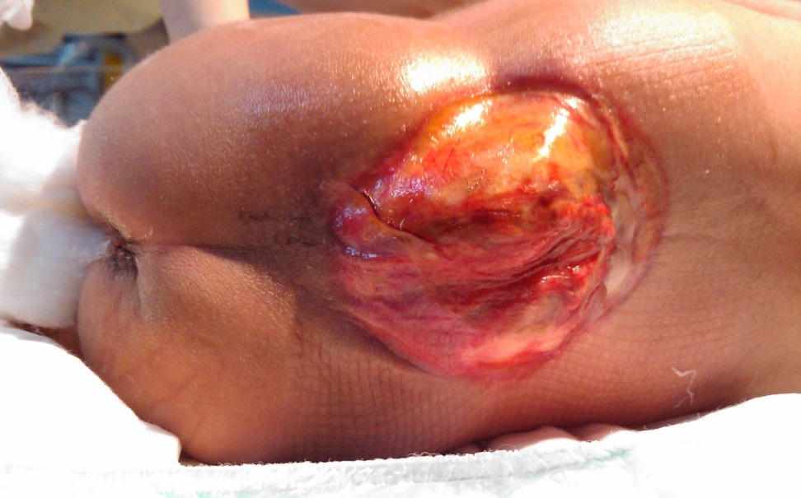
Myelomeningocele – cont.
80% are in lumbosacral region
Spinal cord and roots protrude through the bony defect
They can be:
Closed: neural tissue lies within a cystic cavity, lined with meninges and/oder skin
Open: dysplastic neural tissue is exposed to air
Associated anomalies:
Hydrocephalus
Chiari type II
Aqueduct forking
Many others: Microgyria, ectopic grey matter, platybasia, etc.

Slide 35
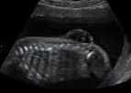
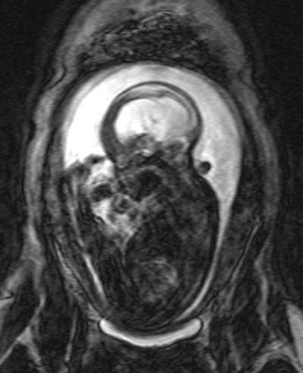
Myelomeningocele
Fetal U/S
Antenatal diagnosis
Fetal U/S
In high risk patients:
MRI
Screening maternal serum/amniotic fluid for alpha-fetoprotein & acetylcholinesterase
Contrast enhanced amniography
Possibility of therapeutic abortion
Fetal MRI

Slide 36
Myelomeningocele: Assessment & Management-I
Careful examination of the lesion for:
Presence of neural elements
Quality of the skin of the sac
Any CSF leakage
Transillumination
Observe limb movements: spontaneous & to pain (degree & level of neurological damage)
Note dilated bladder & patulous annual sphincter
Look for associated anomalies: e.g. hydrocephalus, scoliosis, foot deformities

Slide 37
Myelomeningocele: Assessment & Management-II
Investigations: U/S or MRI
Treatment:
Immediate closure & replacement of neural tissues into spinal canal to prevent infection
Hydrocephalus need to be managed early to prevent CSF leakage from the wound
In patients with multiple serious congenital anomalies; many adopt thoughtful conservative treatment

Slide 38
Myelomeningocele: Long Term Care
Regular follow up in multidisciplinary spina bifida clinic consisting of specialists in urology, orthopedics, pediatrics, neurosurgery, physical therapy, psychology & social services
Goal: Early detection of problems and prompt treatment
Urological: urinary incontinence, vesicoureteric reflux, recurrent UTI, renal impairment
Pediatrics: hypertension and stunted growth
Orthopedic: feet deformity, and tendon transfer, pelvic and spine deformities
Neurosurgery: tethered cord, chiari II malformation, shunted hydrocephalus
Physiotherapy: limb weakness, deformities, contractures
Psychology: emotional stresses on patient & family
Social services: supply of equipment, individual help

Slide 39
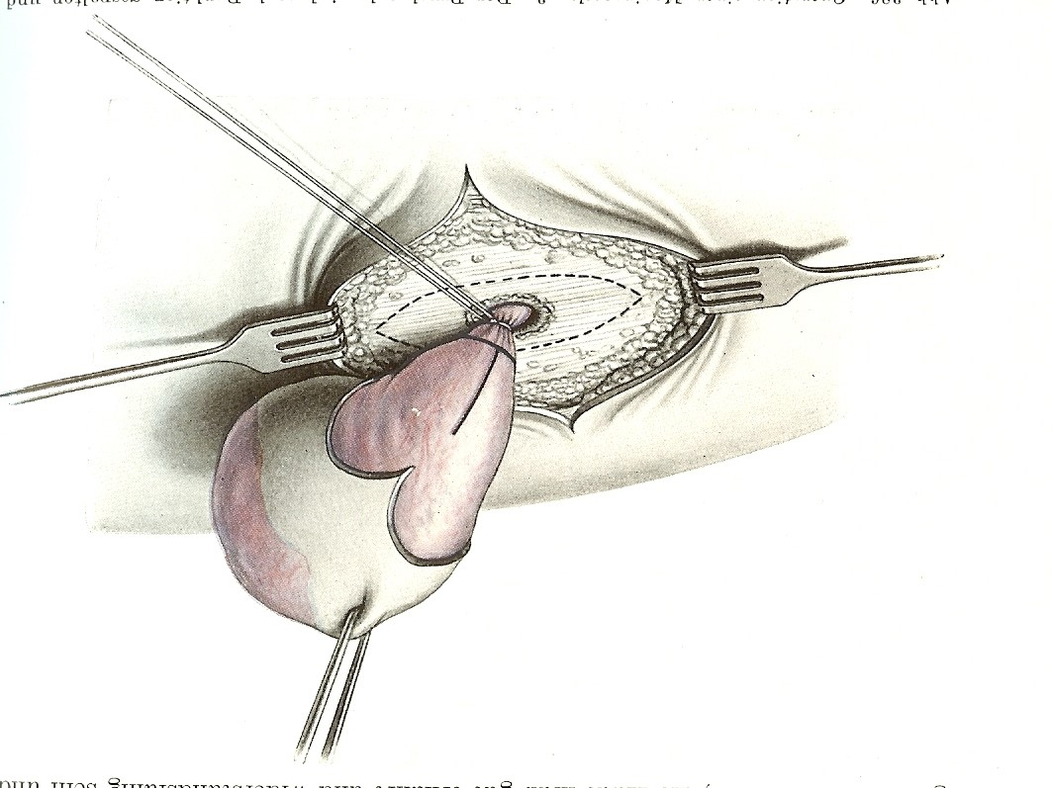
Meningocele
Cystic CSF-filled cavity lined by meninges & skin
Communicates with spinal canal
No neural tissue
Seldom any neurological deficit
Rarely associated with other congenital anomalies
U/S or MRI
Tx: Excision; urgent in case of CSF leak

Slide 40
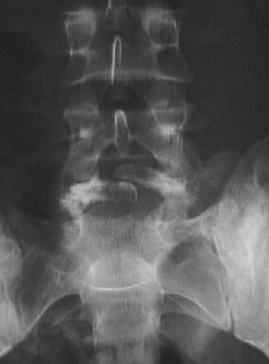
Spina bifida occulta
A bony defect of the lamina
Usually in the lumbosacral region
Affects 5-10% of population
Clinically not significant
No treatment required
But: Rule out associated cutaneous abnormalities

Slide 41
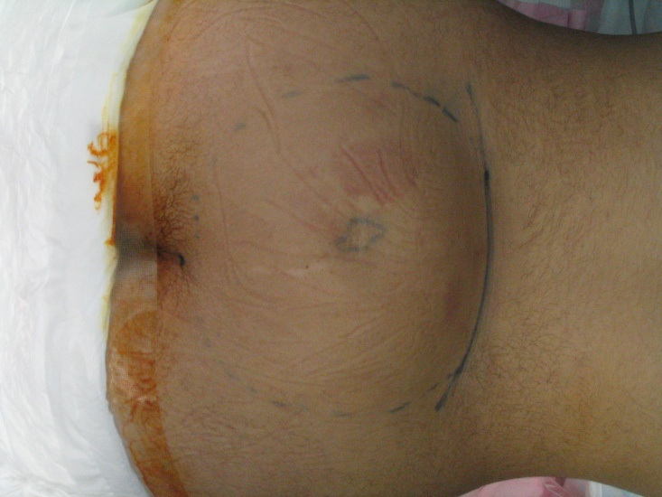
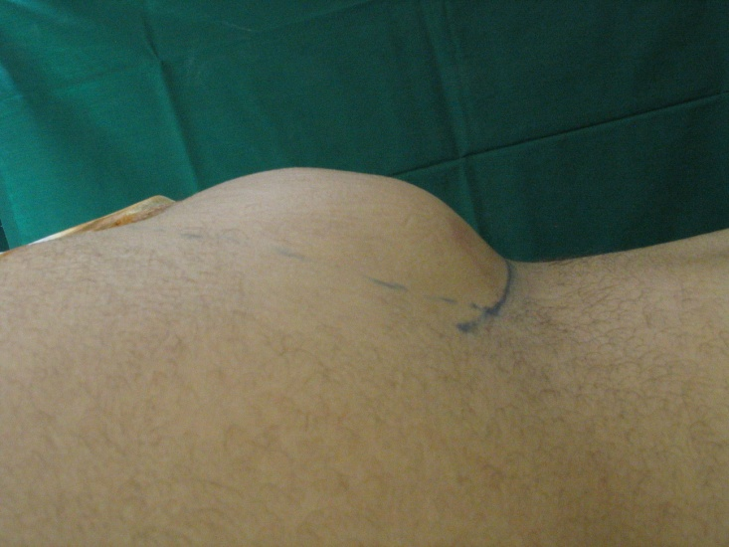
Spina bifida occulta: Caution!
In individuals with additional lumbosacral cutaneous abnormalities:
Tuft of hair
Dimple
Sinus
Port wine stain
Subcutaneous lipoma
High incidence of other occult spinal anomalies:
Diastematomyelia
Intraspinal lipoma
Dermoid tumor
Tethered cord due to thickened filum terminale:

Slide 42
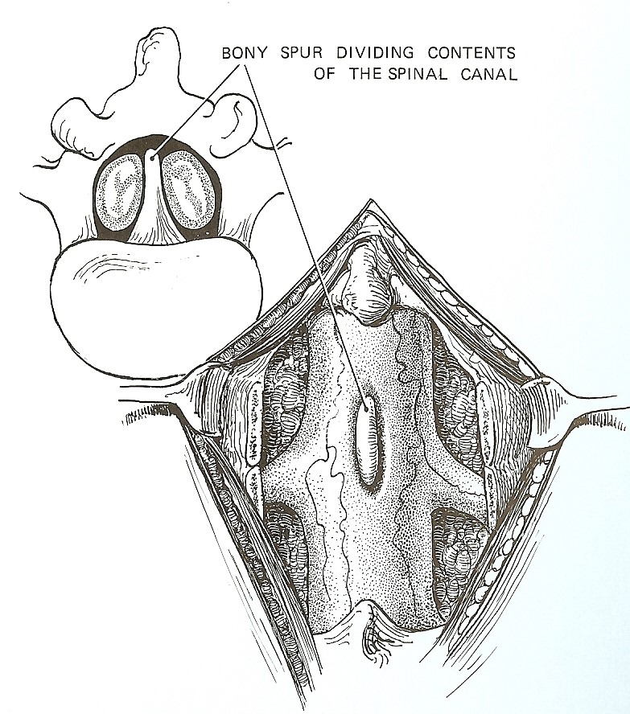
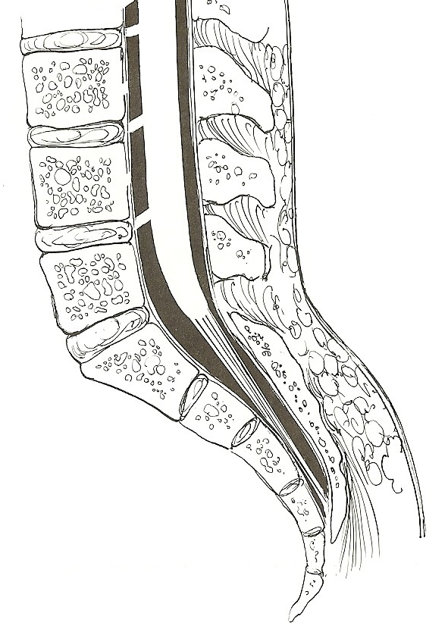
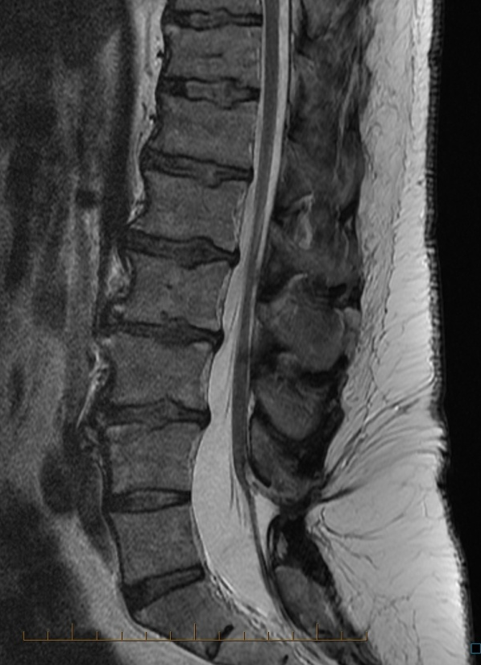
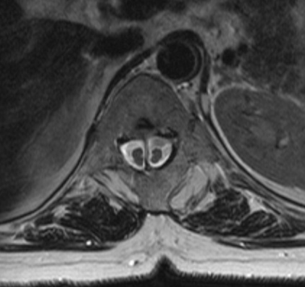
Other Spinal Dysraphic Anomalies
Diastematomyelia
Tethered spinal cord

Slide 43
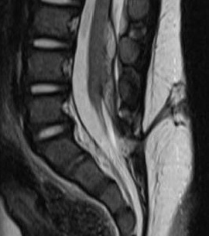
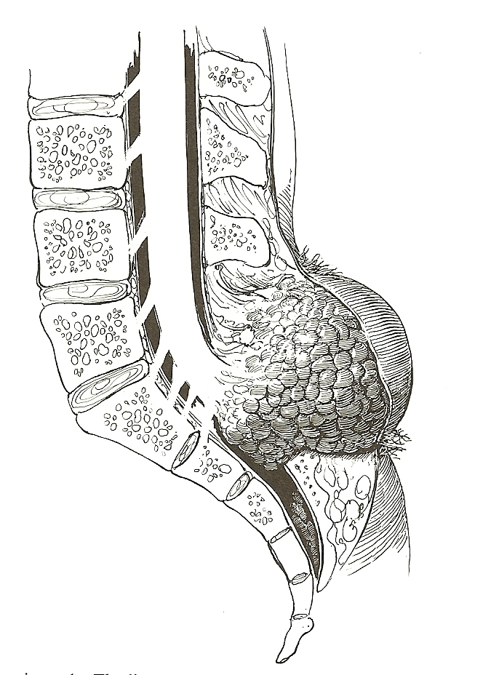
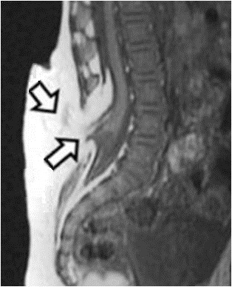
Other Spinal Dysraphic Anomalies
Lipomyelomeningocele
Dermal sinus

Slide 44
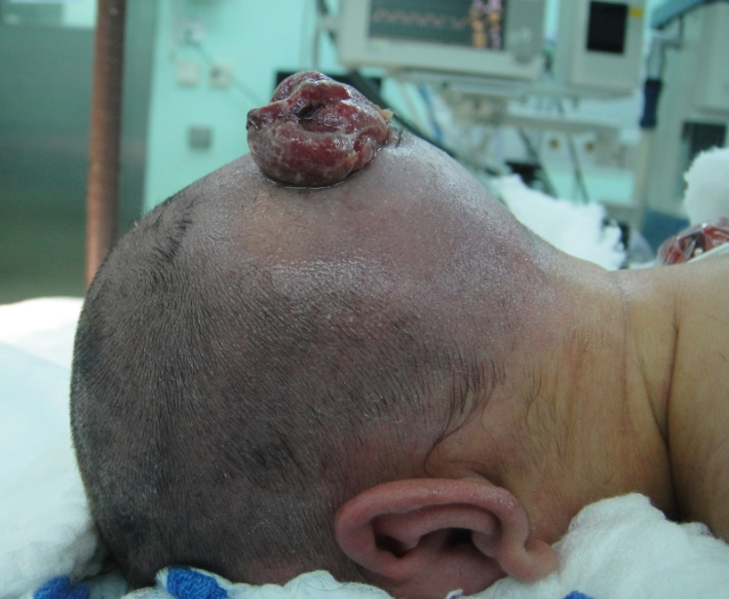
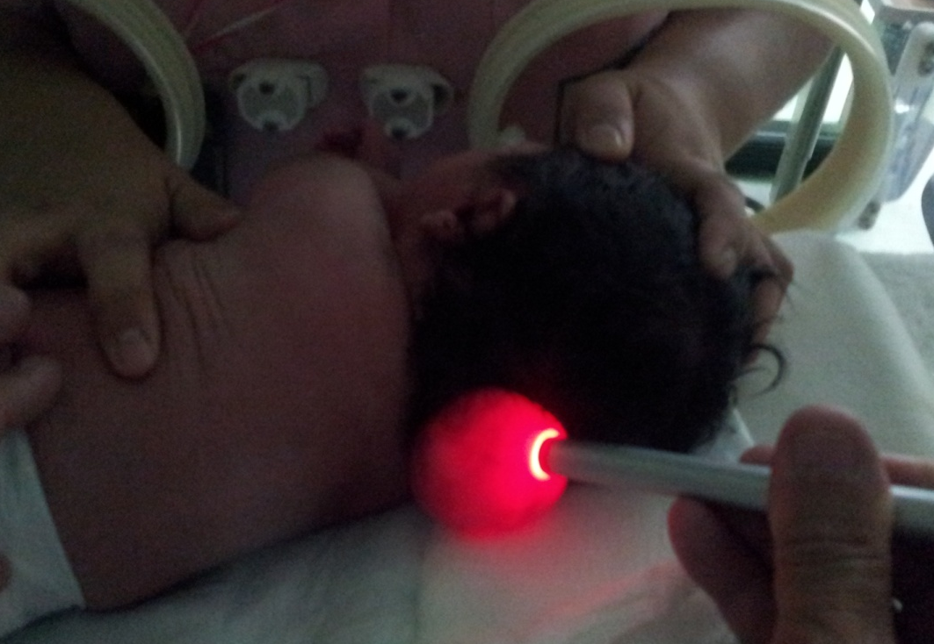
Cranial dysraphysm
Encephalocele
Usually occipital, less often ethmoidal
May contain occipital lobe or cerebellum
Often associated with hydrocephalus
Immediate treatment if ruptured
Outcome depends on contents

Slide 45
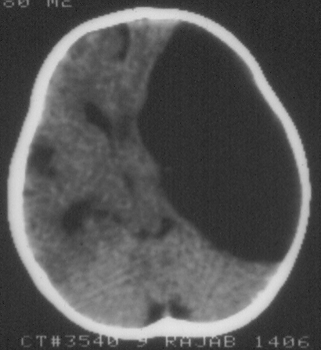
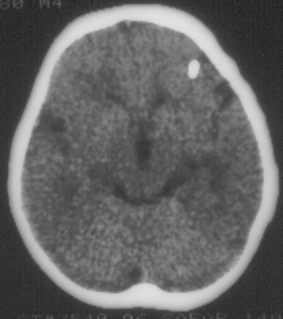
Arachnoid Cysts
Benign developmental CSF containing cysts
Predomenantly (~50%) located in the sylvian fissure
Can cause:
Increase ICP
Convulsions
Neurological defecit
Endocrine dysfunction
Imaging: CT & MRI
Tx: Cystoperitoneal shunt or endoscopic fenestration; rarely excision
CT: Pre & post cystoperitoneal shunt

Slide 46
Chiari Malformation (CM) & Syringomyelia
CM is a complex developmental malformation characterized by caudal displacement to variable degrees of parts of the cerebellum, medulla oblongata and 4th ventricle into the cervical canal
Syringomyelia is cavitation within the spinal cord
Hydromyelia refers to dilatation of the central canal that occurs in associations with CM

Slide 47
Presntation & Management
Chiari malformation:
Occipital headache
Nystagmus
Spastic paresis of upper/lower limbs
Ataxia
Lower cranial nerve defecits
Dx: MRI
Tx: Decompression of craniovertebral junction
Syringo/hydromyelia:
Dissociated sensory loss in “cape-like” distribution
Wasting of small hand muscles
Dx: MRI
Tx: Syringostomy, syringo-subdural shunt

Slide 48
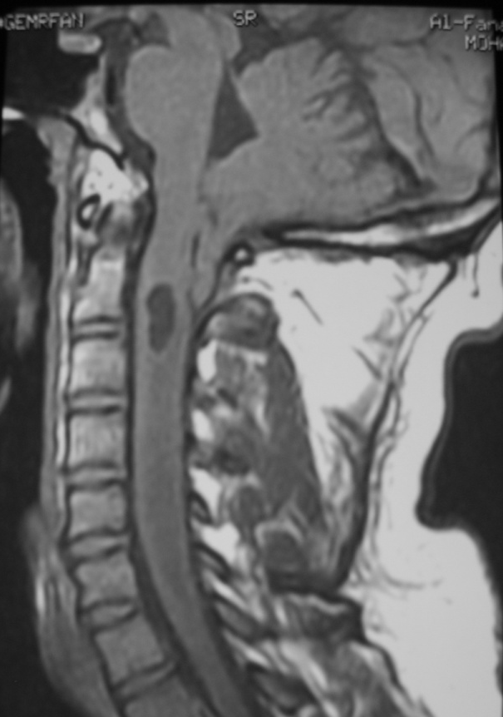
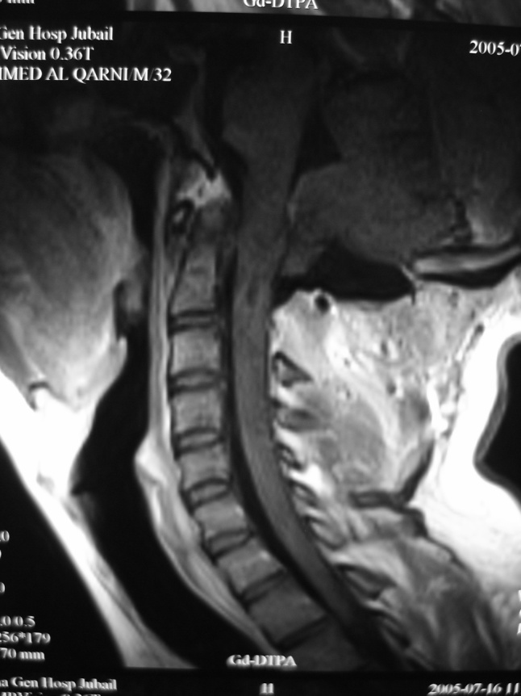
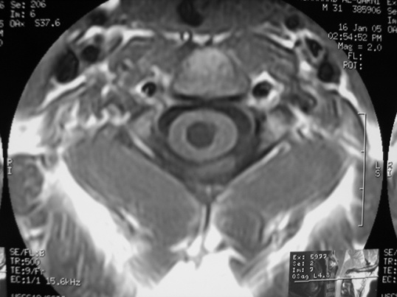
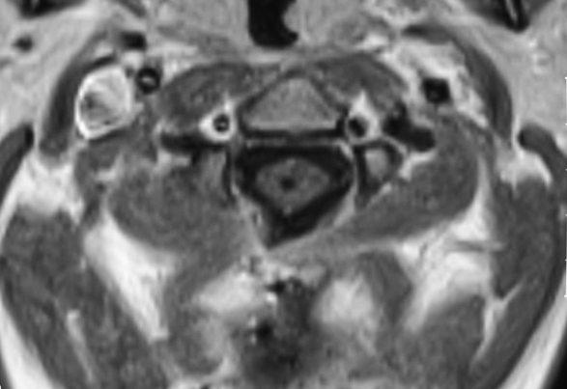
Chiari Malformation with hydromyelia treated by decompression of CVJ
Preoperative MRI
MRI after decompression of CVJ

Slide 49
Cranial Synostoses

Slide 50
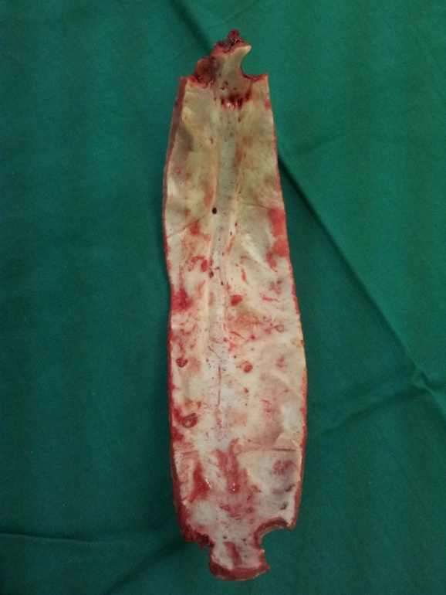
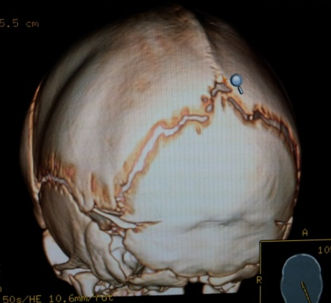
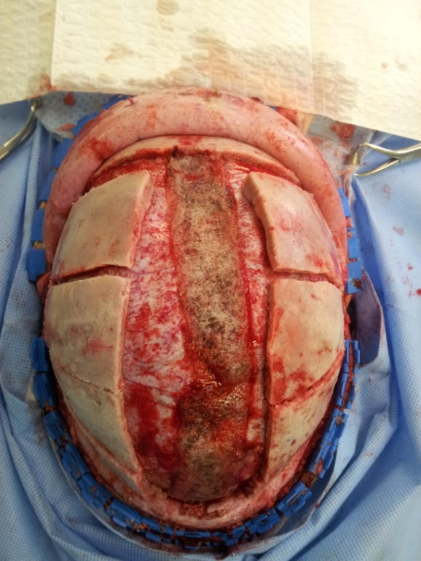
Sagittal suture synostosis:
Scaphocephaly

Slide 51
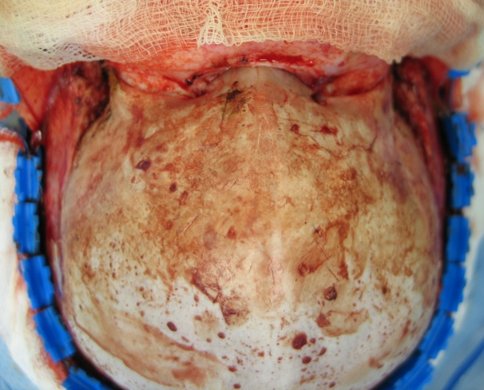
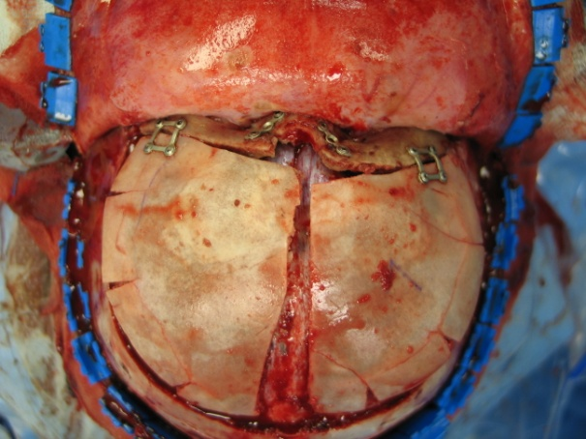
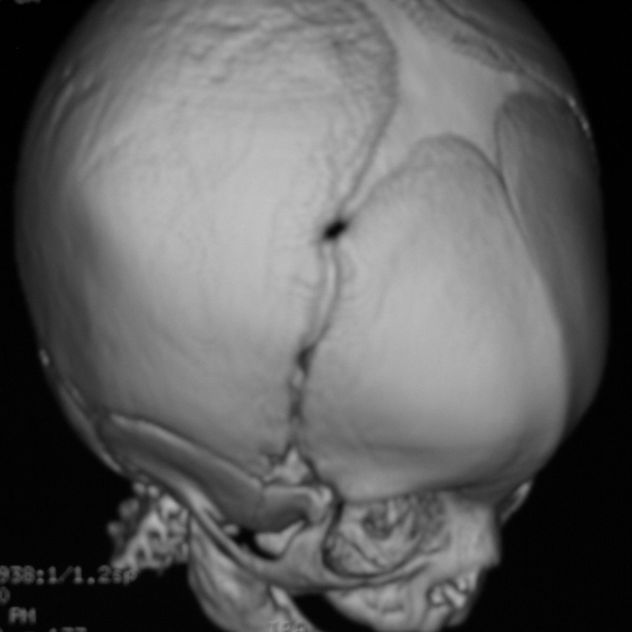
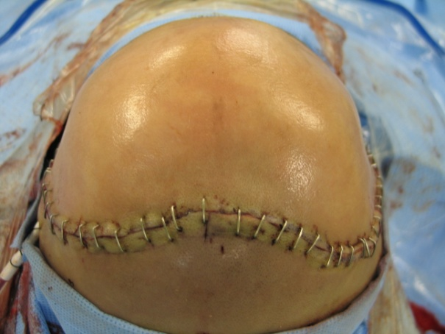
Metopic suture synostosis
Trigonocephaly

Slide 52
References
Essential Neurosurgery
by: Andrew Kaye
3rd Edition, Blackwell Publishing
Neurology and Neurosurgery Illustrated
by: Lindsay - Bone – Callander
3rd Edition, Churchill Livingstone

Slide 53
?
Questions

