Slide 1
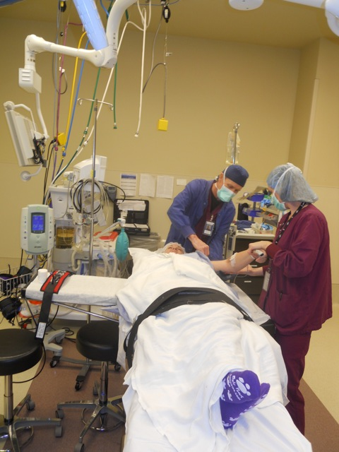
General Complications of Surgery
Dr Awad Alqahtani MD,MSc,FRCSC(Surgery)FRCSC(Oncology),FICS
Laparoscopic Bariatric Surgeon and Surgical Oncologist

Slide 2
Pre&Post Operative Care and Surgical Complications
Pre Operative evaluation :
History & Physical Examinations
Investigations and Radiologic diagnostic Tools
Routine lab, EKG, etc.

Slide 3
Pre-operative Preparation
Testing
Determines ability to sustain surgical insult
Determines type of anesthesia delivery
Blood Pressure, Diabetes, EKG, Liver function, CBC, Chest X-ray, UA
Medications
Day before surgery, anti-inflammatory
Day of surgery, antibiotics
Post op pain meds
Smoking cessation?

Slide 4
Patient/Procedure Confirmation
Surgical Consent
Pre-operative marking
“Time Out” in the operating room

Slide 5
Types of Injuries
Wrong site, wrong procedure
Wrong medication
Skin breakdown/decubiti
Burns
Nerve damage
Ischemia
Eyesight

Slide 6
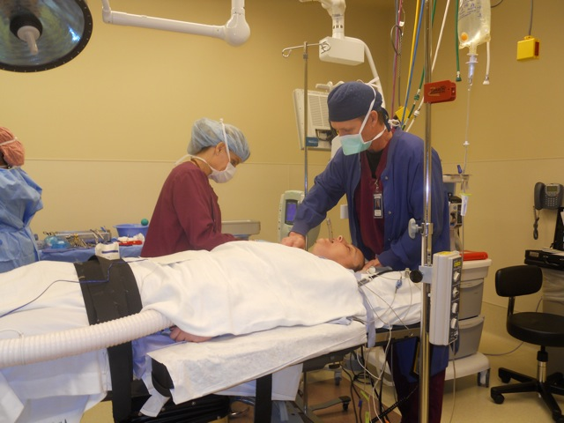
Anesthesia Choices
Goals of anesthesia
Exposure, Relaxation
Keep patient alive
Pain free, unaware, stable
Local Anesthesia
Regional Anesthesia
Conscious Sedation
General Anesthesia
LMA vs. Intubation
Many photos courtesy of John DiPaola, MD

Slide 7
Surgical Positioning
Goals
Exposure for surgeon
Immobilize patient
Injury prevention
Maintain circulation
Maintain anatomic alignment
Prevent pressure points

Slide 8
Surgical Positioning
Considerations
No movement for minutes to hours
No ability to identify pain
Sometimes exposure wins out over comfort
Even supine can be injurious

Slide 9
Classification of Post Operative Complications
Avoidable (Preventible, non Preventible)
- Physiological, Biochemical ; Anemia, Coagulopathy
- Related to timing

Slide 10
Related to timing
Immediate 0-24 Hrs.
Anesthesia
Pain
Bleeding
Shock, Renal failure
Intermediate 1-30 days [avr. 7 day] (LOS)
Organ
Systems
Other Systems
Late > 30 Days, after D/C.

Slide 11
Complications of surgery may broadly be classified as those
_{Due to Anesthesia}
_{Due to Surgery}

Slide 12
_{Due to Anesthesia}
. The anesthetic complications depend upon the mode (General, Regional & Local) and types of anesthetic (the anesthetic agent toxicity).

Slide 13
Specific (Procedure Related):
COMPLICATIONS OF SURGERY:
Perioperative:
Haemorrhage, organ damage, electro-cautery related etc…
Postoperative complications which may be considered under 2 headings:
I. Immediate OR early
II. Late

Slide 14
IMMEDIATE OR EARLY
POSTOPERATIVE COMPLICATIONS:
Respiratory:
➢ Collapse, consolidation, aspiration etc.
Cardiovascular:
➢ Haemorrhage (Primary, Reactionary, Secondary)
➢ Shock (Hypovolemic, septic, cardiogenic, neurogenic)
➢ Myocardial infarction
➢ Deep venous thrombosis

Slide 15
Thromboembolic
Septic:
➢ Wound, abscess collections
Gastrointestinal:
➢ Intestinal obstruction
➢ Anastomotic leakage, intraabdominal abscess formation, enterocutaneous fistulae
Wound complications:
➢ Infections, dehiscence, etc.

Slide 16
Renal:
➢ Oliguria, acute renal failure
Hepatic:
➢ Jaundice, hepatocellular dysfunction/ insufficiency
Cerebral:
➢ Psychological, Neuropsychiatric complications (delirium, etc.)
Drug-related:
➢ Anesthetic, antibiotics, specific medical disease treatment toxicity
Nerve injuries:
➢ Compression, traction, cautery, severed, etc.

Slide 17
LATE
POSTOPERATIVE COMPLICATIONS:
Wound:
➢ Hypertrophic scar, keloid, wound sinus, implantation dermoids, incisional hernia
Adhesions:
➢ Intestinal obstruction, strangulation
Altered anatomy/Pathophysiology:
➢ Bacterial overgrowth, short gut syndrome, postgastric surgery syndromes, etc.
Susceptibility to other diseases:
➢ Malabsorption, incidence of cancer, tuber- culosis, etc.

