Slide 1
Skin and Soft Tissue Tumors
Dr. Jamaleldin Hassainan

Slide 2
Arise from any histological structures that make up skin
Epidermis
Connective tissue
Glands
Muscle
Nerves

Slide 3
CLASSIFICATION
Benign
Premalignant
Malignant

Slide 4
Common Benign Tumors
Heamangiomas :
Involuting
Non- involuting

Slide 5
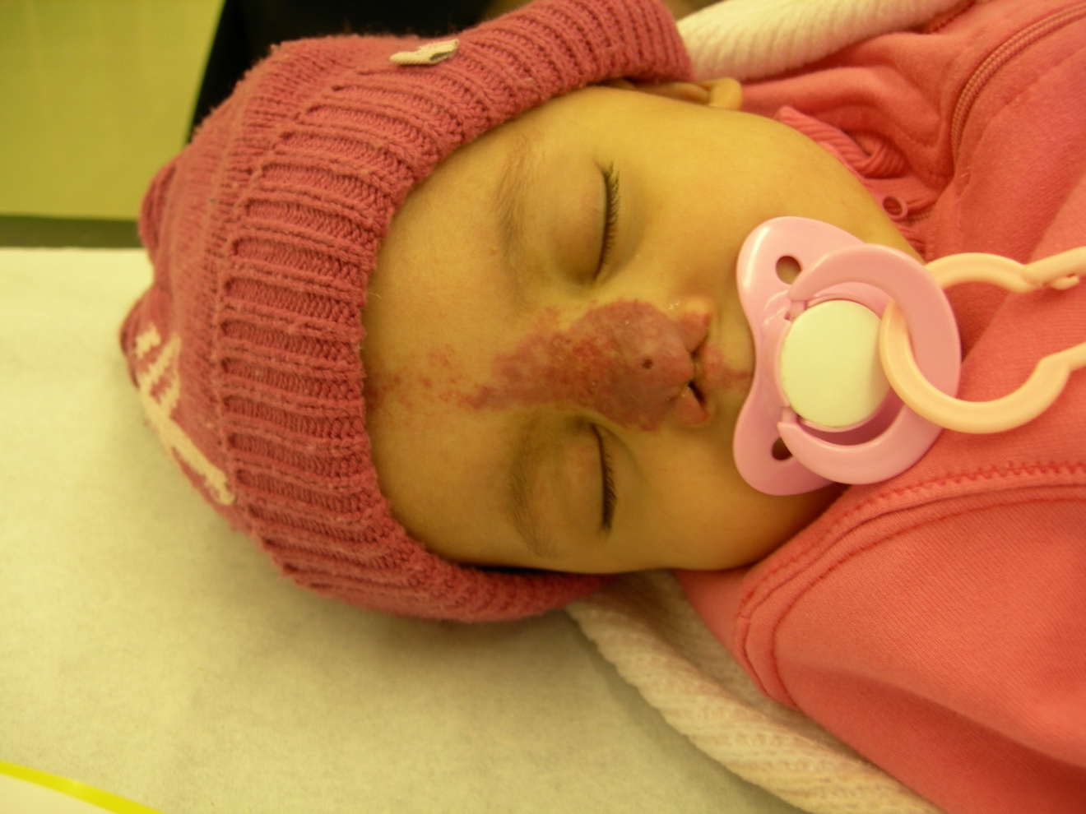

Slide 6
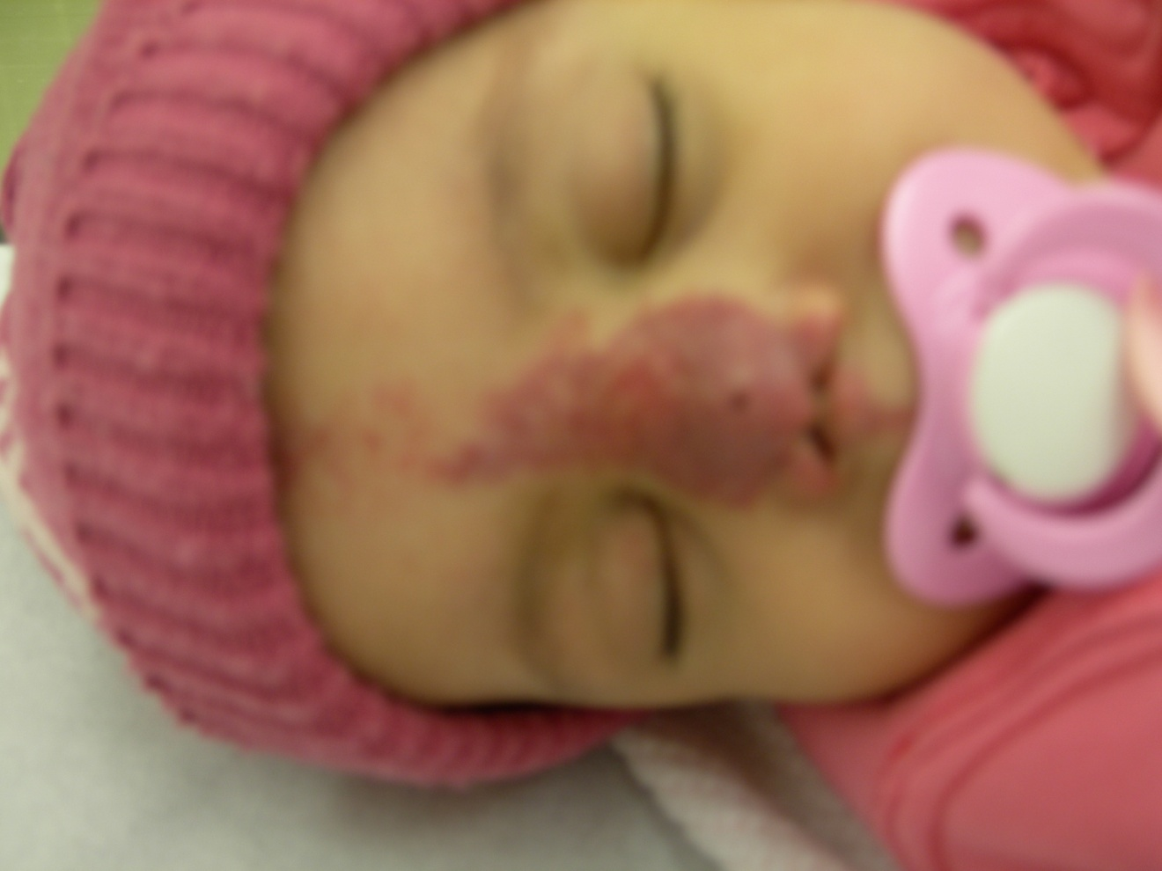

Slide 7
Involuting Heamangiomas
Heamangiomas of childhood
95% of all heamangiomas
Not a true neoplasm
Neoplasm of endothelial cells
Undergo complete spontaneous involution

Slide 8
Involuting Heamangiomas (cont.)
Present at birth or appears 2-3 weeks after birth
Grows rapidly 4-6 months
Spontaneous involution complete 5-7 yrs

Slide 9
Classification Involuting
Superficial
Combined
Deep

Slide 10
Superficial Involuting
Strawberry nevus
Nevus vasculosa
Capillary heamangioma Appearance :
Sharp demarcated red
Slightly raised lesion & irregular surface

Slide 11
COMBINED
Strawberry
Capillary & Cavernous
Appearance :
A firm bluish tumor , may extend deeply into sub cutaneous surface

Slide 12
Deep Involuting
Cavernous
Appearance :
Blue tumor covered by normal skin
Treatment :
Requires no treatment involving vital organ eg. lid

Slide 13
Non Involuting Heamangiomas
Usually present at birth
No rapid growth
Growth is proportion to growth of child
Persists into adulthood
Causes severe aesthetic problems
May cause arterio venous fistula , eventually lead to cardiac failure.
Treatment :
Not satisfactory

Slide 14
Port Wine Stain
May involve any portion of the body
When present in face as a flat patch correlating to sensory branch of 5th nerve
Microscopic appearance :
Thin walled capillaries distributed throughout the dermis lined by thin mature endothelial cells
Treatment :Unsatisfactory
- Tattooing - Laser -Radiotherapy

Slide 15
Malignant Tumors
Basal cell carcinoma
Squamous cell carcinoma
Malignant Melanoma

Slide 16
Basal Cell Carcinoma (Rodent ulcer)
Most common malignant carcinoma
Predisposing factors :
Age >40 yrs
Ultraviolet light exposure
Fair skin , blond hair & blue eyes living in tropical climate i.e. westerners living in Saudi Arabia .

Slide 17
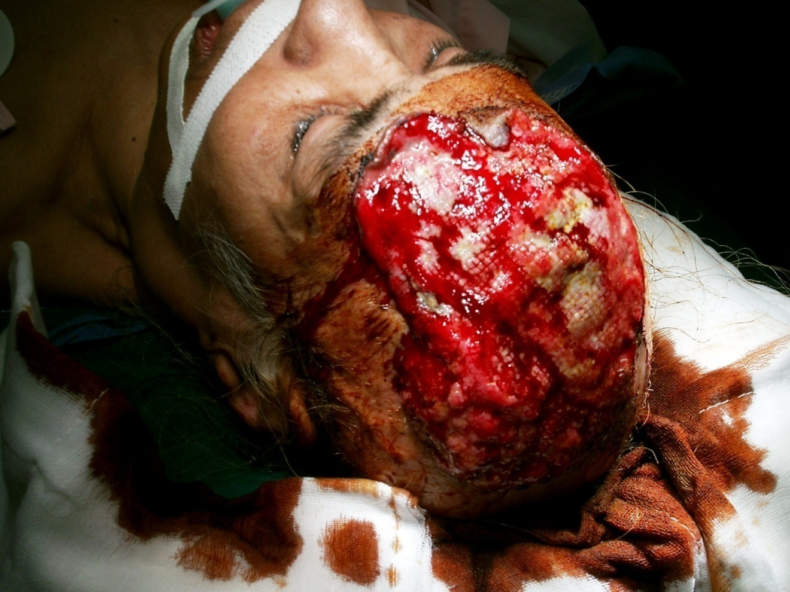

Slide 18
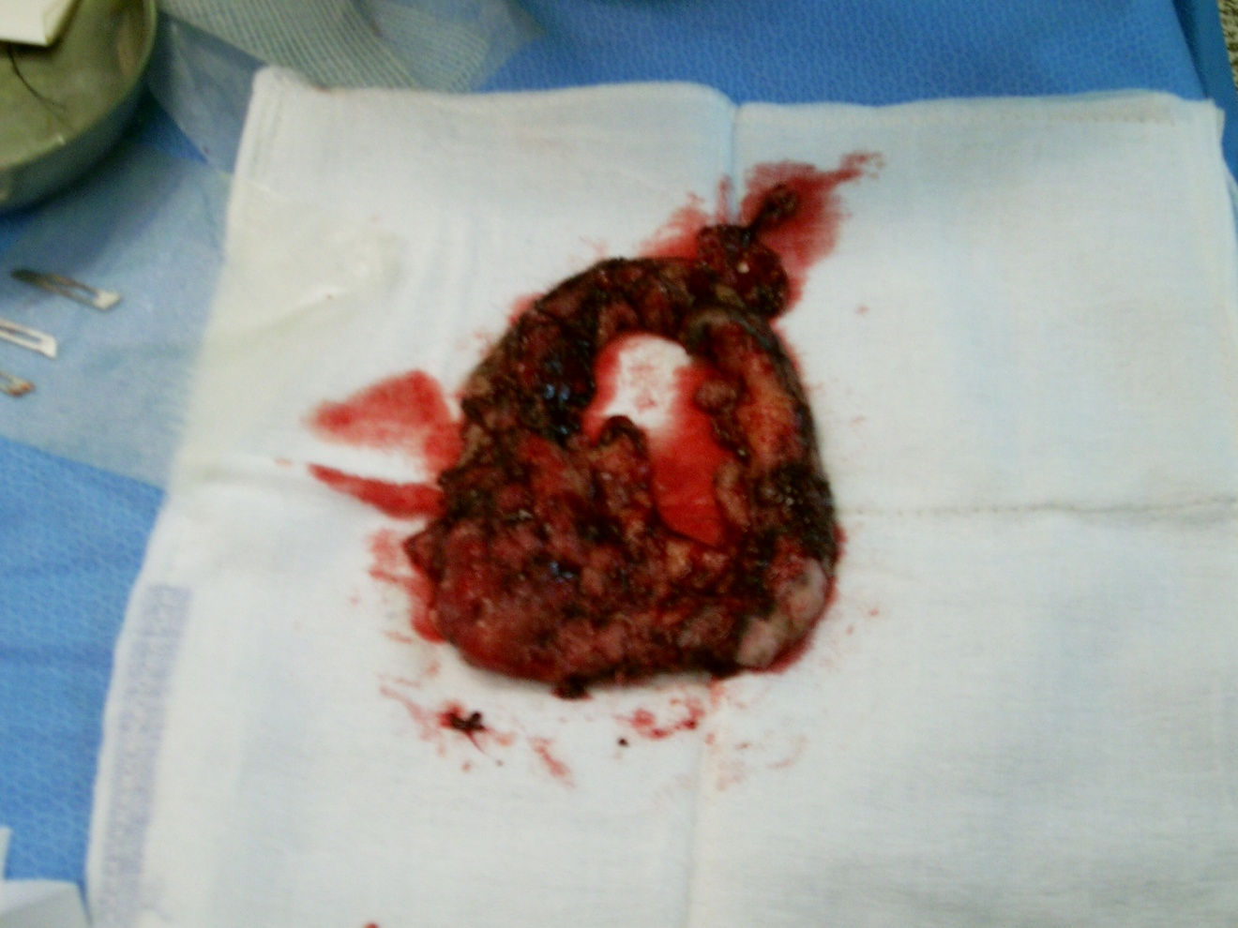

Slide 19
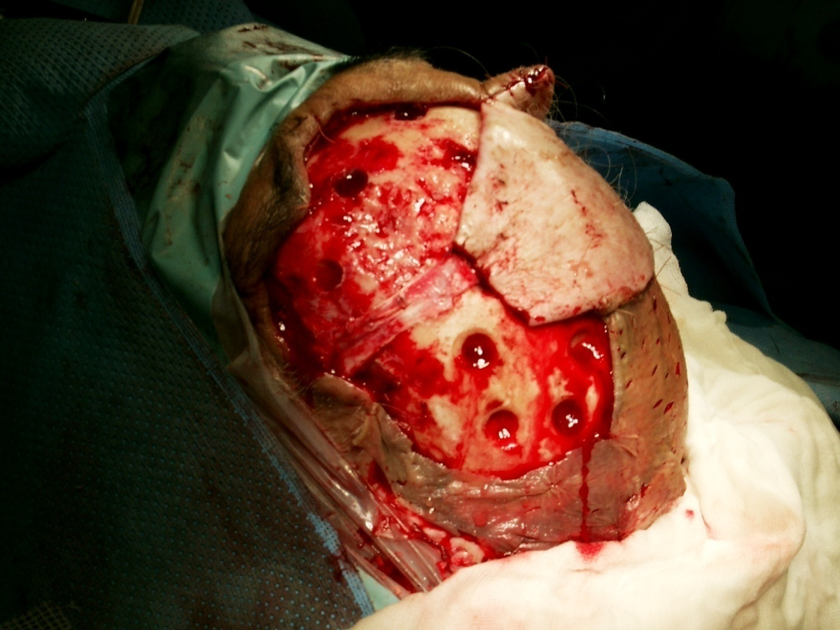

Slide 20
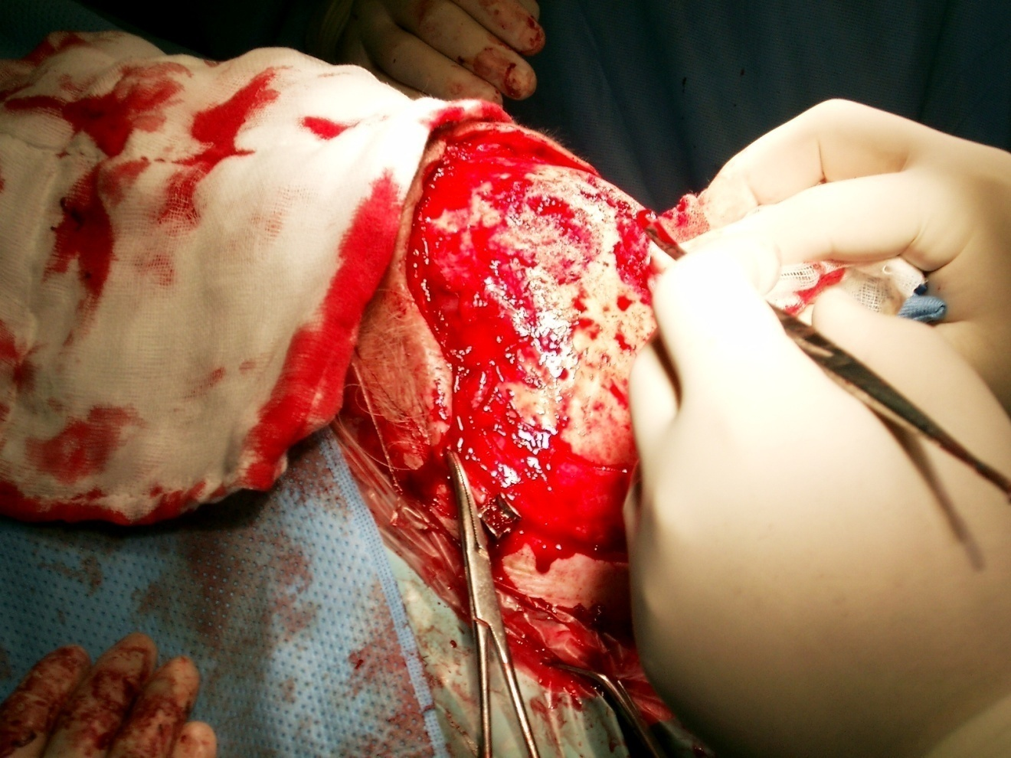

Slide 21
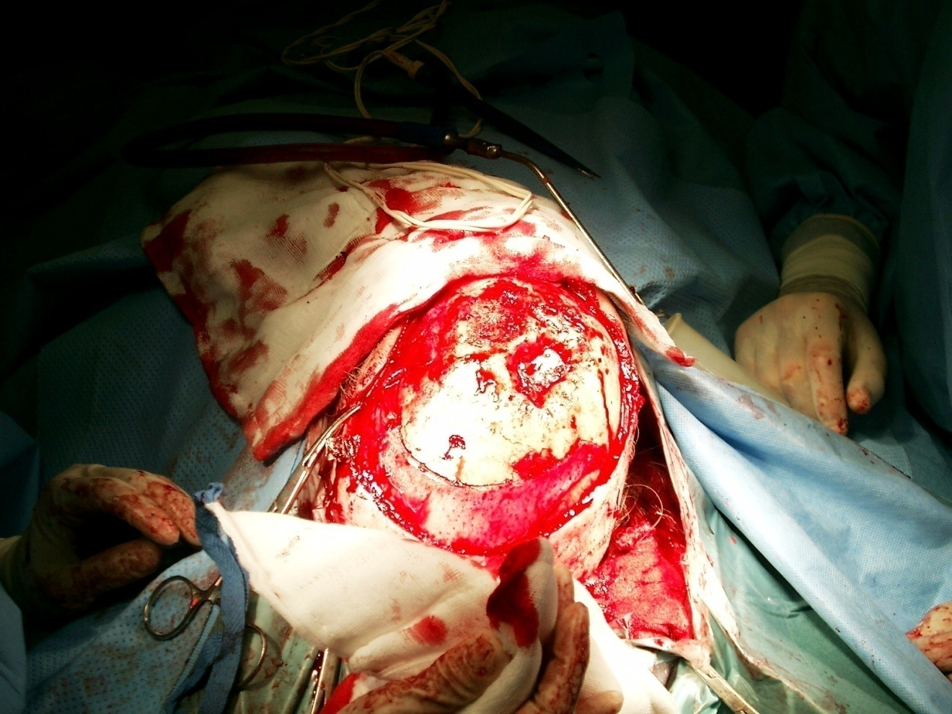

Slide 22
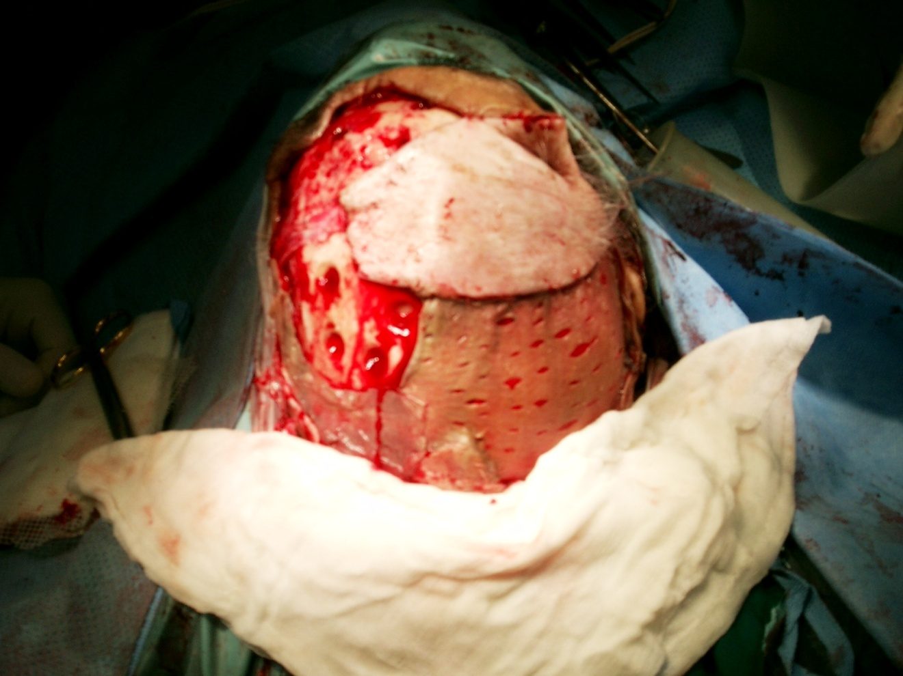

Slide 23
Predisposing Factors (cont.)
Growth is slow , steady & insidious. Several years may pass before patient becomes concerned.
Invade adjacent tissue , massive ulcerations .
Rarely metastases & death may occur by invading deeper extension into intracranial or major blood vessels.

Slide 24
APPEARANCE
Small , translucent skin elevated nodule
Rolled pearly edges
Telangiactic vessels occur commonly on surface

Slide 25
Sclerosing Morphia
Less common
Elongated strands of basal that infiltrate the dermis .
Flat & whitish or waxy appearance and firm palpation

Slide 26
Erythromateous Basal Cell Carcinoma
Body basal occurs most frequently on the trunks.
Appears reddish plaques with atrophic center
Smooth slightly raised borders.

Slide 27
Pigment Basal
Sometimes mistaken for melanoma

Slide 28
Treatment
Radio therapy :
Good in treatment of structures that are difficult to reconstruct . Should not be used in pt. under 40 y , or in pt. who failed to respond to radiation therapy
Treatment : 4-6 weeks

Slide 29
Treatment
Curettage & Electro desiccation : Excise 2-3 mm margin
Surgical excision : small moderate size lesion down to subcutaneous tissue

Slide 30
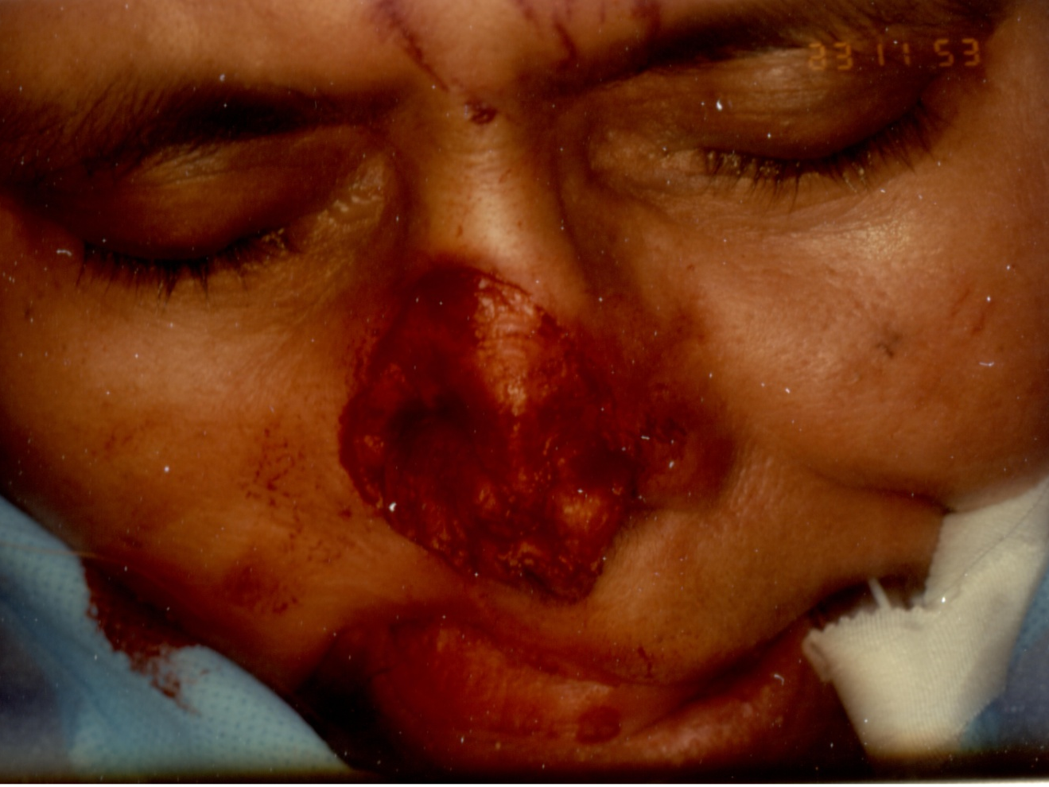

Slide 31
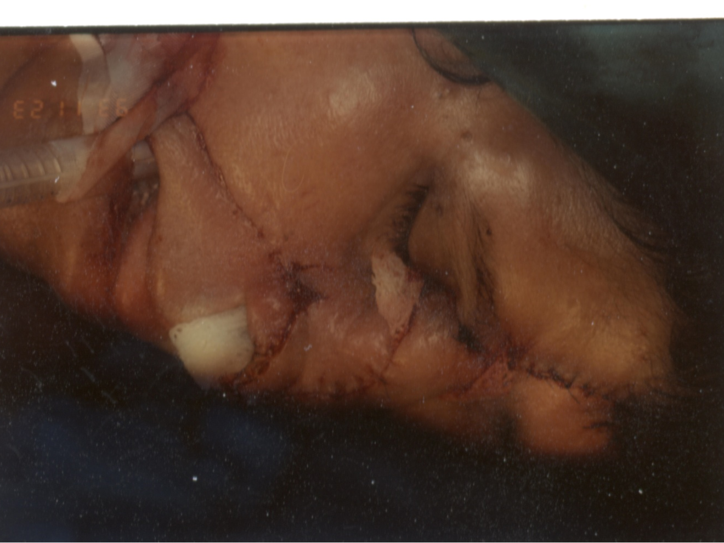

Slide 32
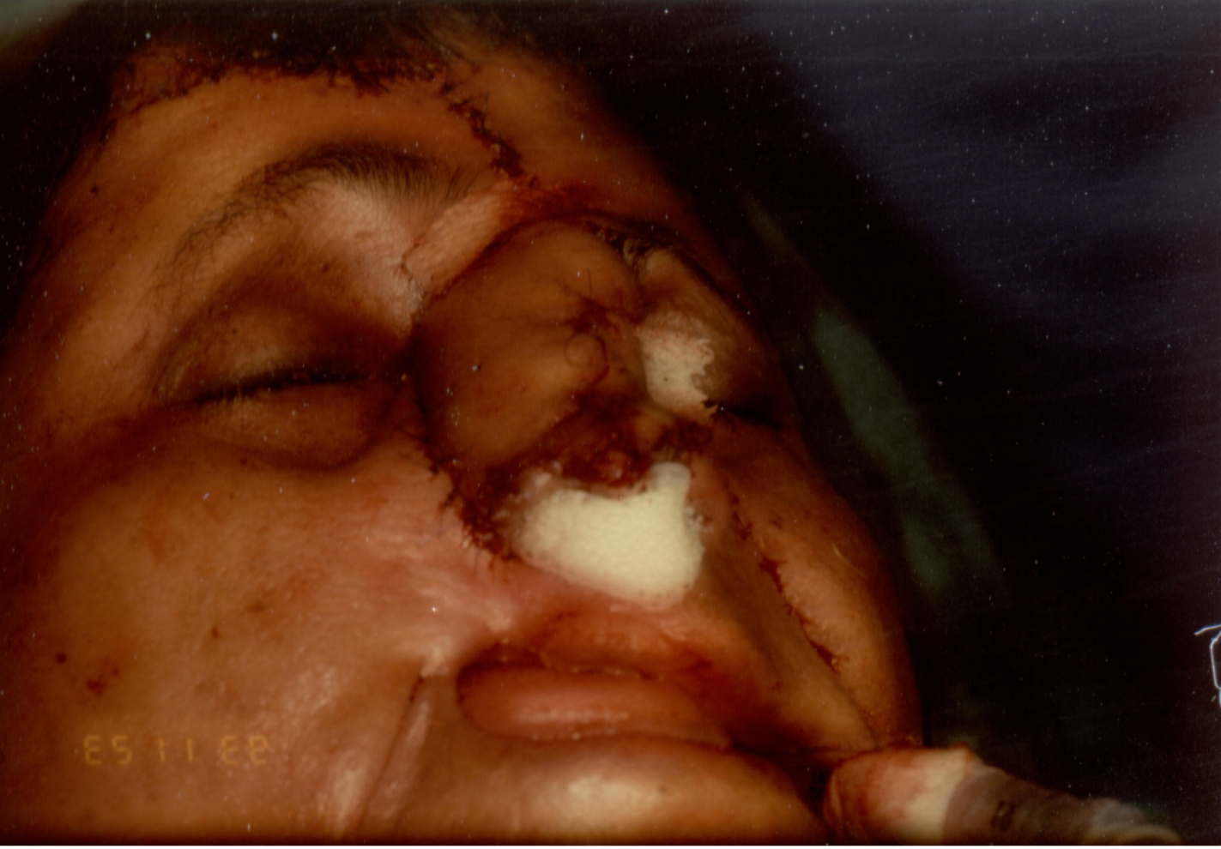

Slide 33
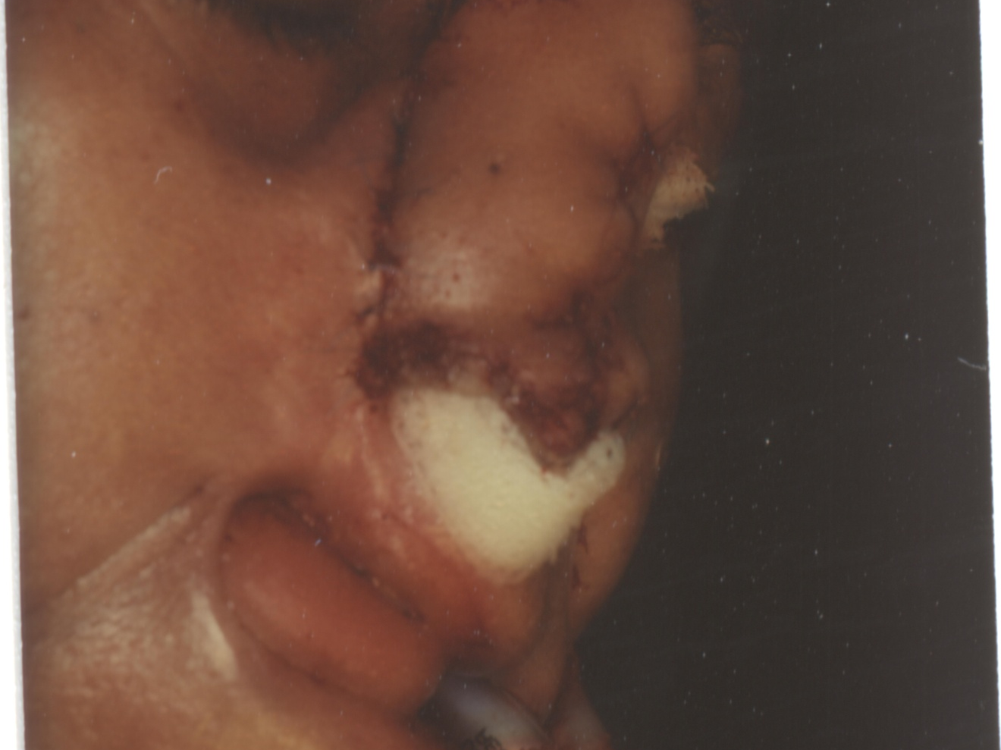

Slide 34
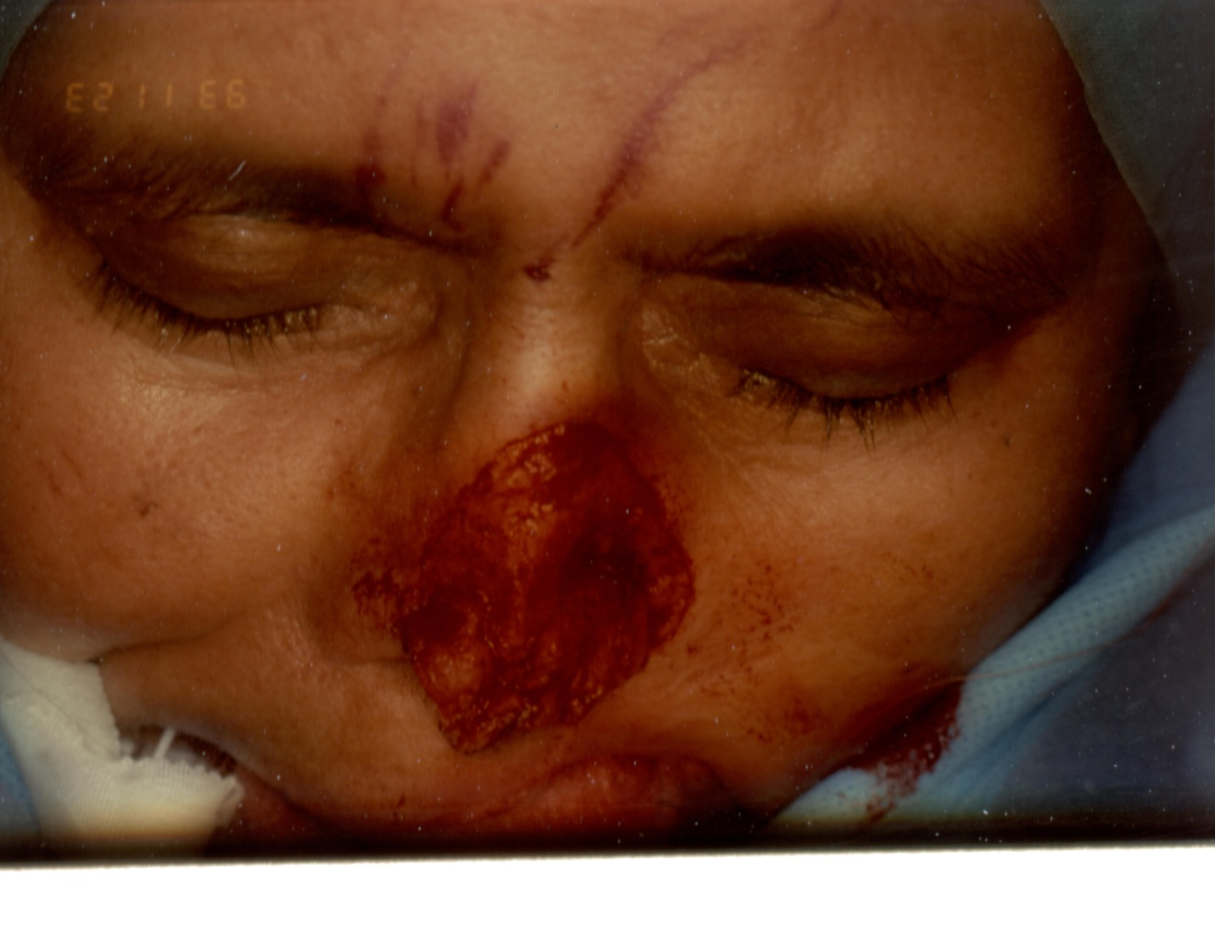

Slide 36
Squamous Cell Carcinoma
1st most cancer in dark skinned people
2nd most cancer in light skinned group
Causative agents same as basal cell carcinoma .
Most common sites are the ears , cheeks , lower lip & back of the hands.

Slide 37
Squamous cell (cont.)
Other causative agents are chronic contact with tars hydrocarbons & exposure to ionizing radiation .
Also chronic ulcers , thermal burns healed with fibrosis ( Marjolins ulcer )
These are aggressive tumors , does not usually metastasize , as fibrosis & initial burns has already destroyed lymphatic

Slide 38
Presentation
Locally invasive without metastasizing from premalignant tumors eg. Bowens disease , chronic radiation dermatitis.
Rapidly growing widely invasive with metastasizes especially squamous cell tumors arising from normal skin .

Slide 39
Presentation (cont.)
Grows initially starts as a erythomatous plaque or nodule with indistinct margins.
Surface may be : - Flat - Verocous - Ulcerative
Histopathology : Malignant epithelium cell are seen extending down into the dermis like horn pearls .
Treatment : - Surgery -Radiation

Slide 40
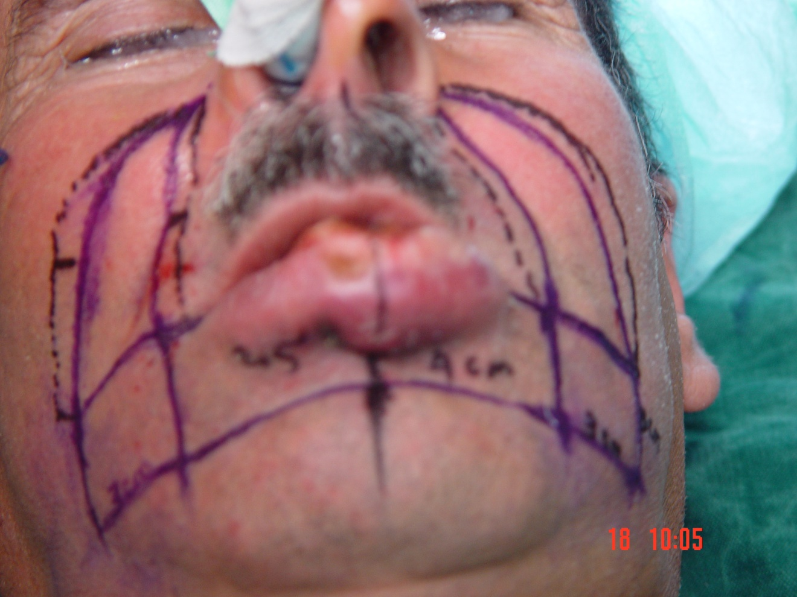

Slide 41
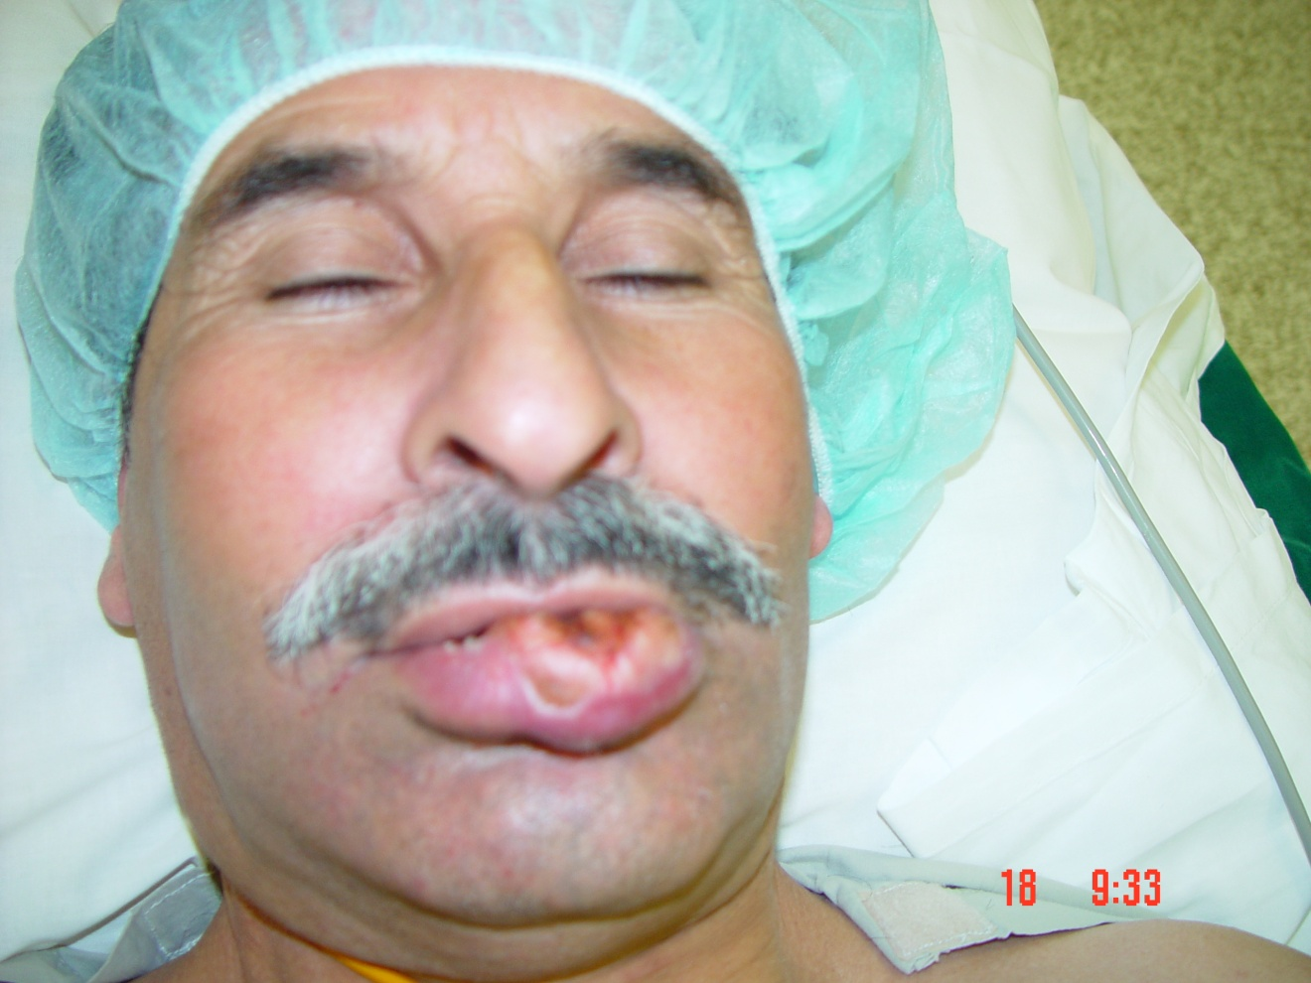

Slide 42
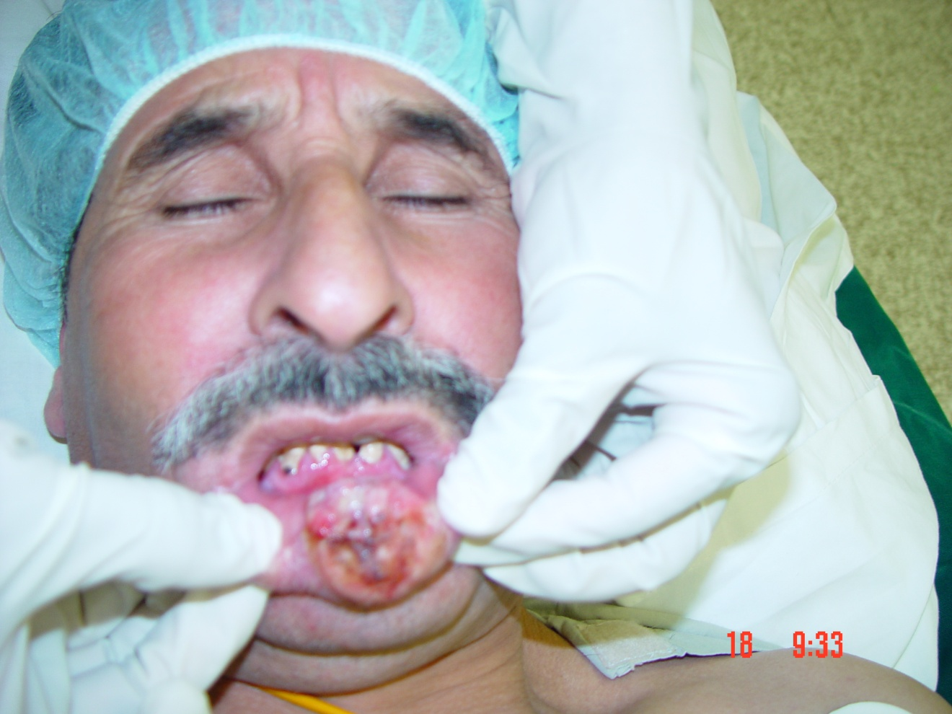

Slide 43
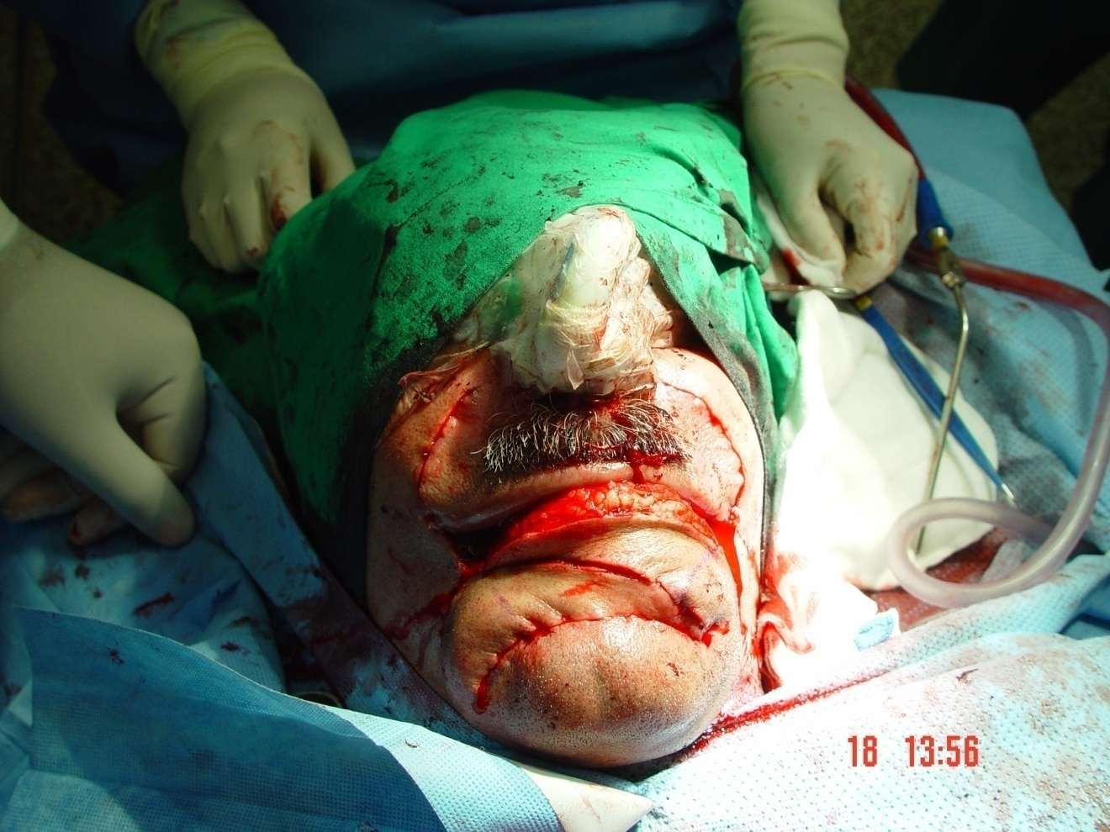

Slide 44
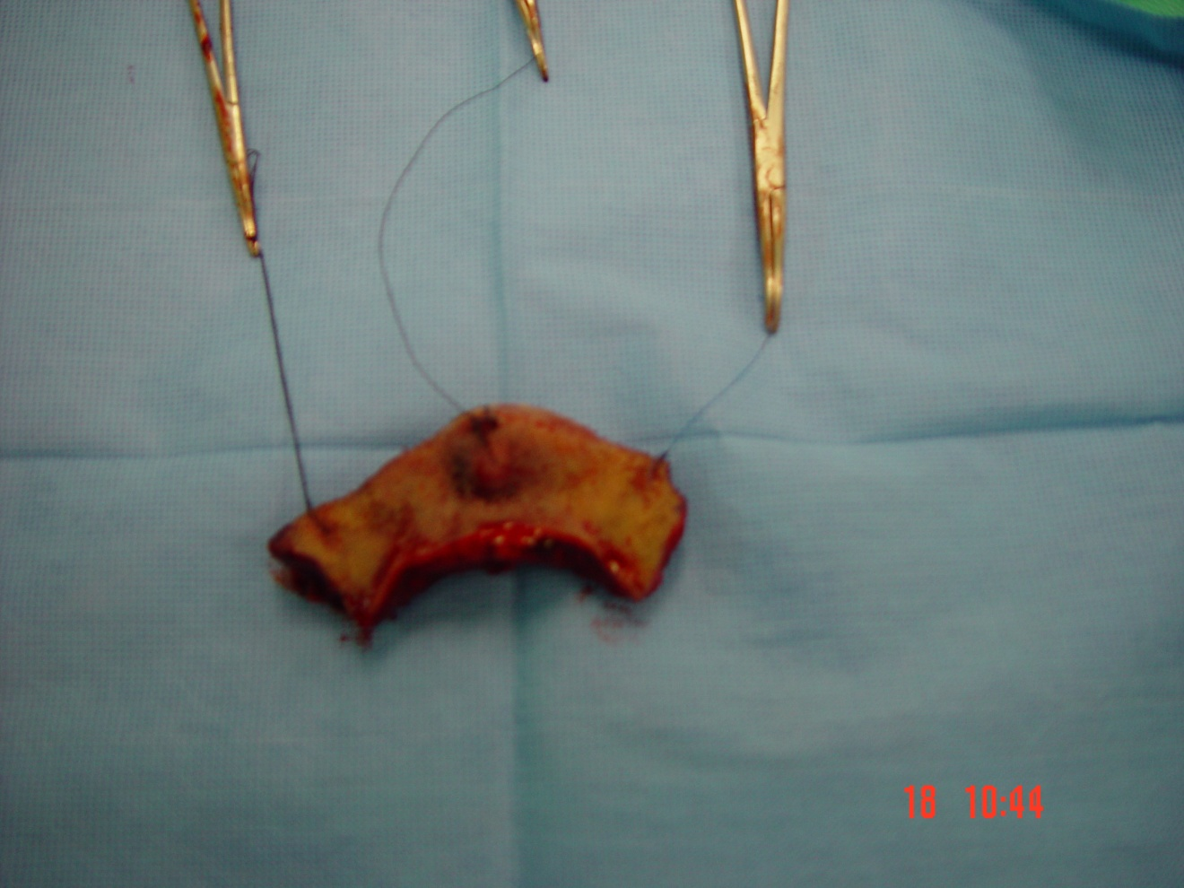

Slide 45
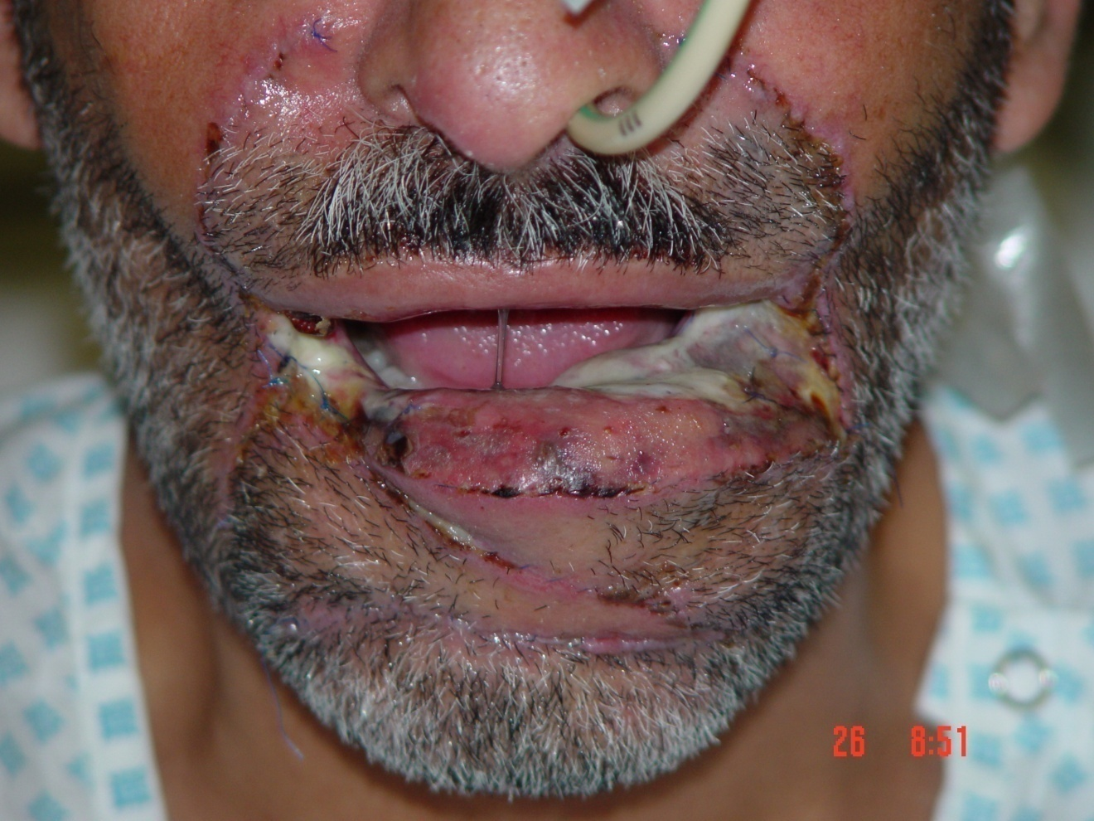

Slide 46
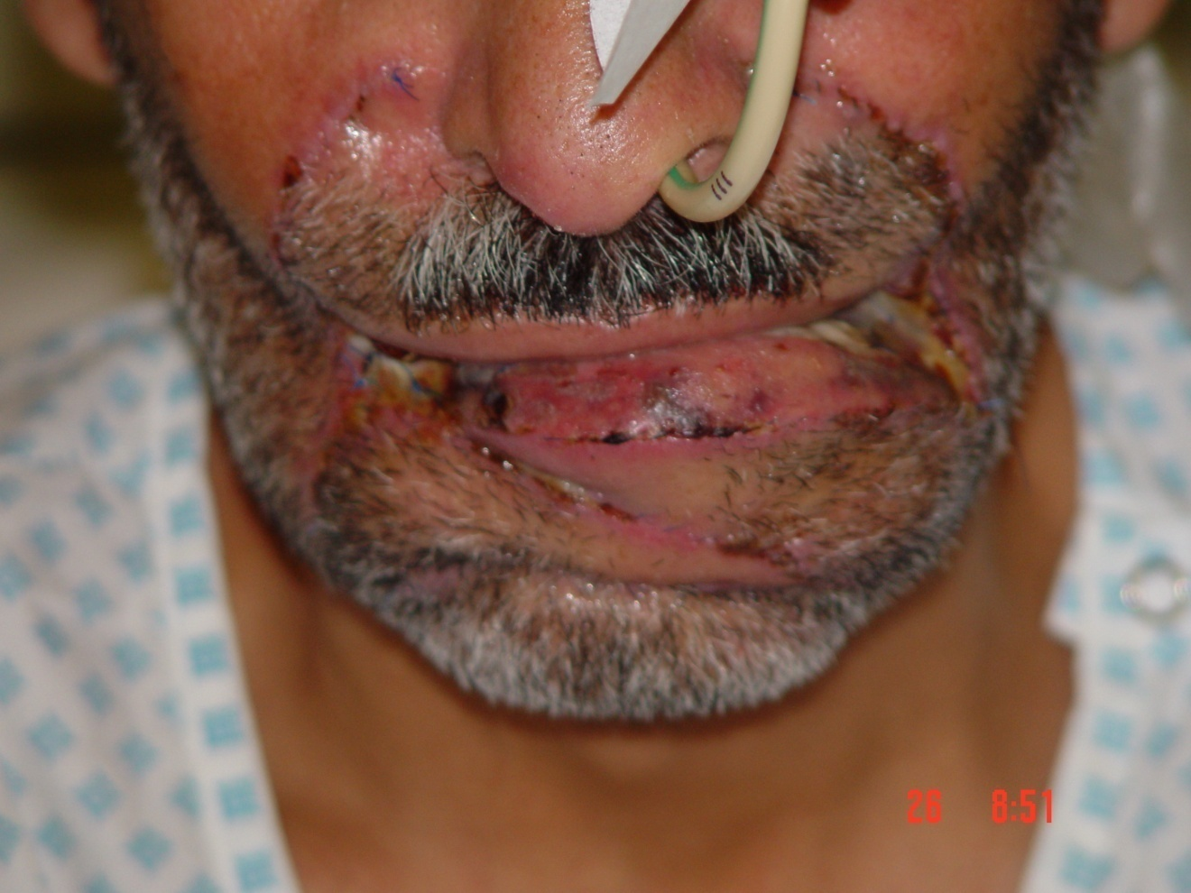

Slide 47
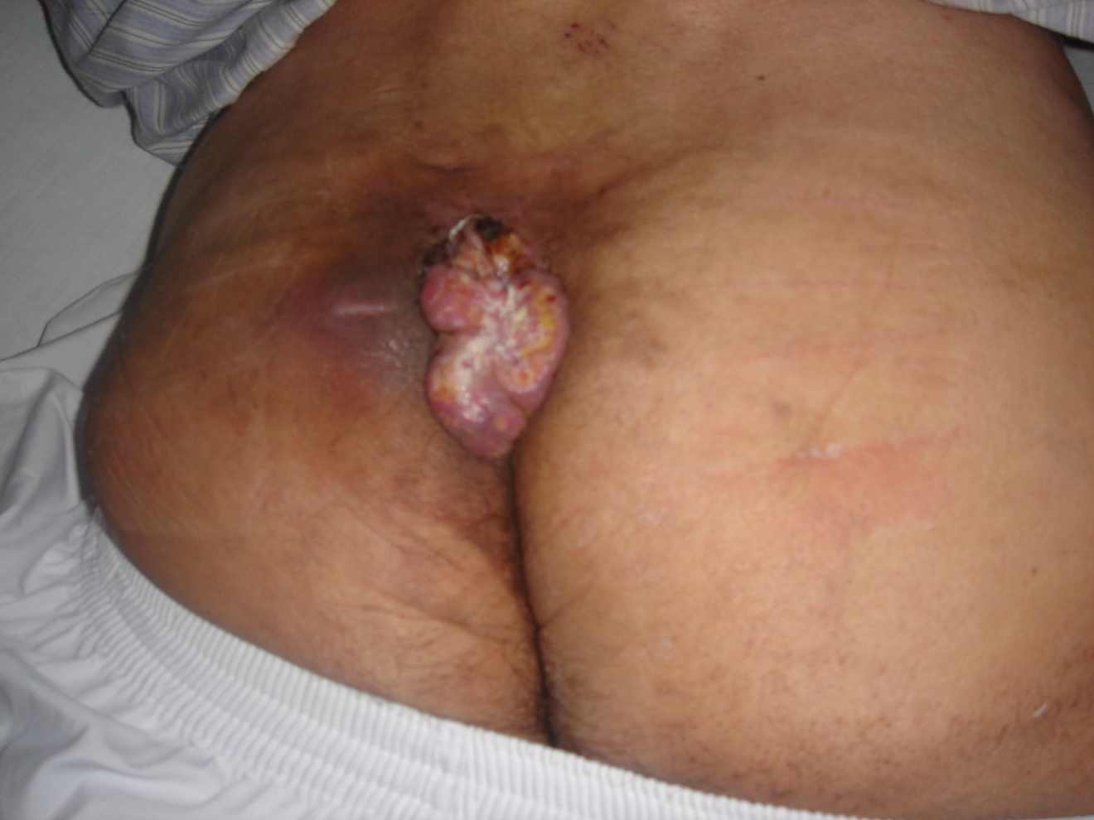

Slide 48
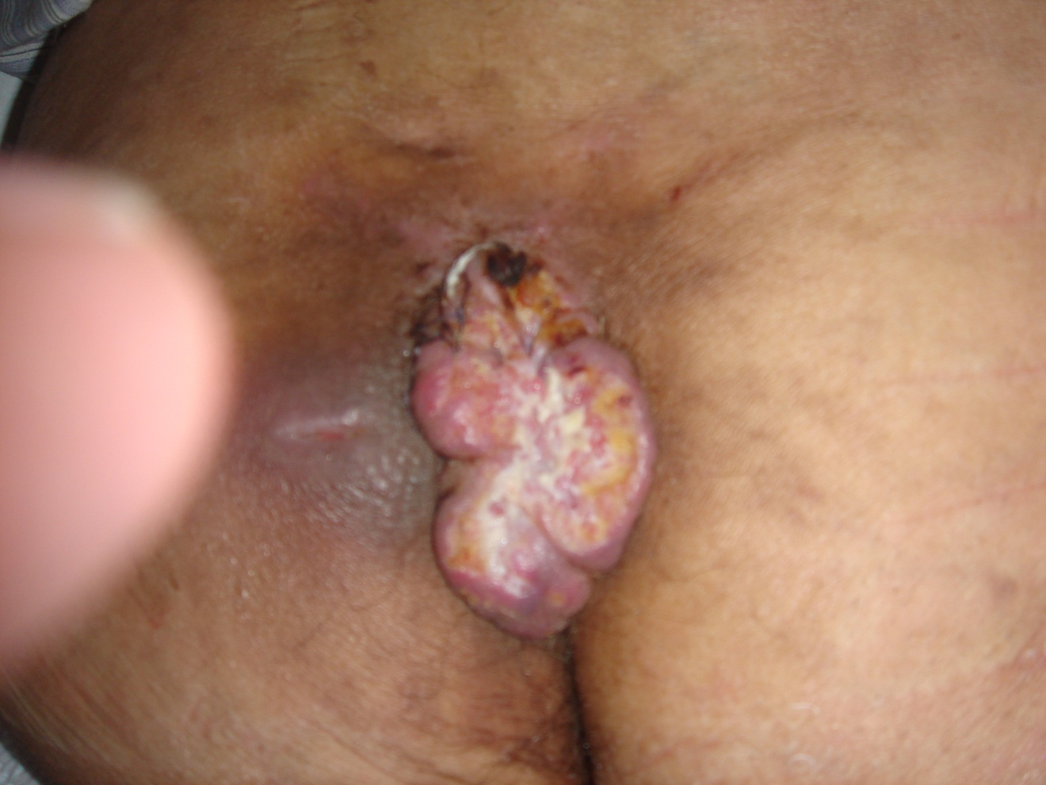

Slide 49
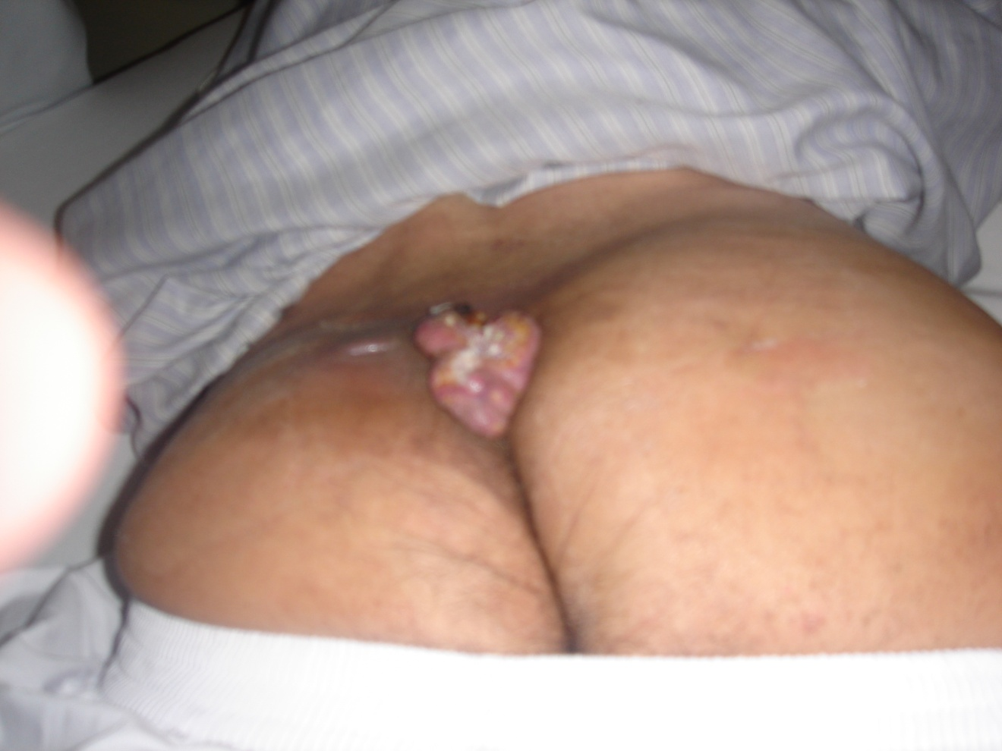

Slide 50
Types of Nevi
Junctional Nevi:
Are small , circumscribed , light brown or black , flat – slightly raised & rarely contained hair
Mainly lies between dermis & epidermis these may be found in mucous membrane ,genitalia , soles & palms

Slide 51
Intradermal Nevi
Small spots , color range from blue to bluish black
Flat & dome shaped
Compound found in both dermis and epidermis

Slide 52
Dysplastic Nevi (5-12 mm)
Pink base with indistinctive irregular edges
Family Hx important , suspicious lesions must be excised .
Congenital : Excess in 1% of newborn , most lesions are small
Considered to be pre cancerous

Slide 53
Malignant Melanoma
Incidence over 300,000 new cases skin tumors every year in USA . 9000 are melanomas, that is 4.6 %
2/3 of all deaths of skin tumors are from melanomas.
Incidence of melanomas is increasing & 5 year survival also inc. from 41% - 67%
Men= Women
White > Black

Slide 54
MELANOMA (cont.)
Etiology
- Ultra violet increase risk -Familial Hx has been recognized
Average person has 15-20 nevi
1/3 of all melanomas arise from pigment nevi .

Slide 55
Factors which suggest melanoma from mole
Color :focal shades with red blue or white . A darkening in colours
Size :recent rapid enlargement in dia. > 10mm
Shape: irregular margins ,notchening and indentations
Surface: ulceration s bleeding or crusting irregular elevation
Symptoms: pruritis ,inflamation and pain
Location : back lower extamities neck (BANS)

Slide 56
Classification of Melanoma based on Histology
Superficial spreading : most common type especialy from pre-existing mole
Common in back & both sexes
Nodular melanoma becomes large and ulcerated before noticed
Cartigo melanoma : most common occur in old age

Slide 57
CLARKS CLASSIFICATION
  LEVEL %OF RM
  1 INSITU ABOVE 0 BASMENTMEMBRANE
  2 INVASION OF PAPILLERY DERMIS 4%
  3 FILLING PAPILLARY AREA AND EXTENDING TO THE JUNCTION OF 33
  4 PAPILLARY AND RETICULAR AREA INTO RETICULAR LEYER OFDERMIS61
  5 SUBCUTANIOUS TISSUE 78

Slide 58
HIGH RISK AREAS AND POOR SYRVIVAL RATE
B : BACK
A: POS. LAT OF ARM
N POS LAT NECK
S SCALP

Slide 59
PROPHYLACTIC NODE DISSECTION
LEVEL 1 AND 2 NO NODE DISSECTION
LEVEL3 ???
LEVEL 4 AND 5 PROPHYLACTIC NODE DISSECTION

Slide 60
NODE DISSECTION NOT ADVISED IN
LYPHATIC DRAINAGE MORE THAN ONE AREA
PATIENT AGE > 70 YEARS
SERIOUS CONCURRENT DISEASE
UNRESECTABLE DISTANT METASTISIS

Slide 61
PROGNOSIS MOST IMPORTANT SIZE OF TUMOUR AND DEPTH OF INVASION
LESS THAN 2CM DIAMETER ANDLESS THAN 0.7MM DEPTH.
CURABLE BY WIDE LOCAL EXCISION.
NODULAR MELENOMAS WITH UNCERATION POOR PROGNOSIS,LESSION IN EXTRAMITIES BETTER ,PROGNOSIS THAN TRUNK
WOMEN BETTER 5YRS SURVIVAL THAN MEN

Slide 62
NON SURGICAL TREATMENT (IMMUNOTHERAPY)
TREATMENT SMALL METASTISIS BCG NOT SUITABLE FOR LARGE LESSIONS
MELANOMA RADIO RESISTANT RARELY USED FOR DEFINITE TRAETMENT MAYBE USED FOR PALIATION
CHEMOTHARAPY WITH PHENYLIN & ALAMINE MUSTURED AND OTHER DRUGS
FOR SURVIVAL AND LIMB PRESERVATIONS
LONG TERM PALIATION TT LARGE LEGION SURGERY ,RADIO THERAPY AND CHEMOTHERAPY

