Slide 1
part | Occupational Health
3
Examples of famous industrial accidents
September 21, 1921: Oppau explosion in Germany. Occurred when a tower silo storing 4,500 tonnes of a mixture of ammonium sulfate and ammonium nitrate fertilizer exploded at a BASF plant in Oppau, now part of Ludwigshafen, Germany, killing 500–600 people and injuring about 2,000 more.

Slide 2
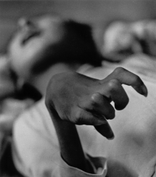
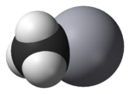

1932-1968: The Minamata disaster was caused by the dumping of mercury compounds in Minamata Bay, Japan.
It is estimated that over 3,000 people suffered various deformities, severe mercury poisoning symptoms or death from what became known as Minamata disease. is a medical specialty dealing with disorders of the nervous system.
Methylmercury, an organic mercury compound released in factory wastewater and the cause of Minamata disease

Slide 3


Slide 4
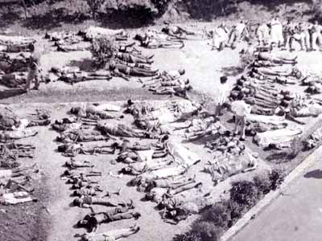
December 3, 1984: The Bhopal disaster in India is the largest industrial disaster on record..
A faulty tank containing poisonous methylisocyanate leaked at a Union Carbide plant. About 20,000 people died and about 570,000 suffered bodily damage.

Slide 5
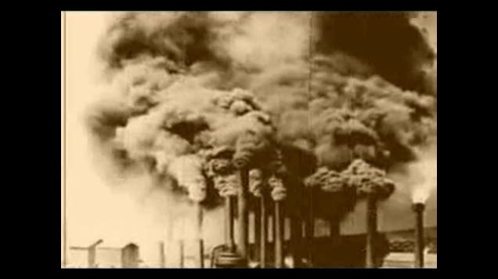

Slide 6
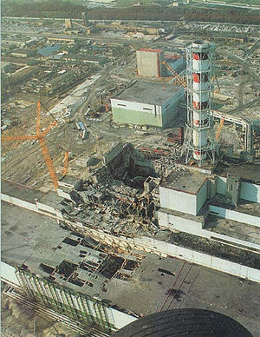
April 26, 1986: Chernobyl disaster.
At the Chernobyl Nuclear Power Plant in Ukraine a test on reactor number four goes out of control, resulting in a nuclear meltdown.
The ensuing steam explosion and fire killed up to 50 people with estimates that there may be up to 4,000 additional cancer deaths over time among the approximately 600,000 most highly exposed people.

Slide 7
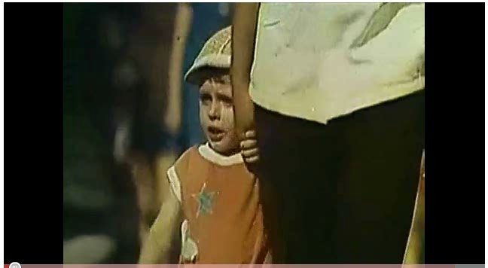

Slide 8
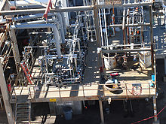
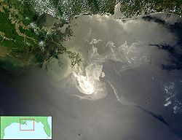
March 23, 2005:
Texas City Refinery explosion. An explosion occurred at a British Petroleum refinery in Texas City, Texas.
April 20, 2010: Deepwater Horizon oil spill in the Gulf of Mexico.

Slide 9
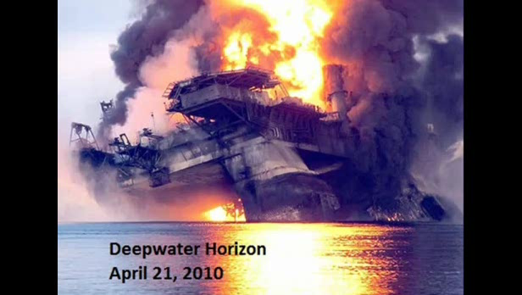

Slide 10
Occupational health can be divided into many divisions and the integration of those divisions is very important. These divisions are:
Occupational health Divisions
Occupational diseases.
Occupational safety.
Occupational toxicology.
Occupational environment.
Analysis of biological samples
Occupational Ergonomics.
Air pollution.
Occupational Legislation.

Slide 11

Internal factors affect Workers:
Internal factors affect Workers are including the worker health, age, genetics, and physical fitness.
Workers with family history of certain diseases are not encourages expose to chemicals and radiation hazards. Even at low exposure level.
Also a young worker of highly physical fitness shows much resistant to occupational diseases than aged one.

Slide 12
External factors affect Workers
Physical factors: such as the exposure to heat stress noise vibration electromagnetic fields, and radiation.
Chemical factors: exposure to dust, gases, and acid vapors.
Biological factors: such as food deficiency, vitamin deficiency, Anthrax for wool industries, Cow Pox for cow farms, Schistosomiasis for agricultural fields.
Occupational social factors: for workers how immigrates seeking jobs from rural area to urban areas which may cause social problems.

Slide 13
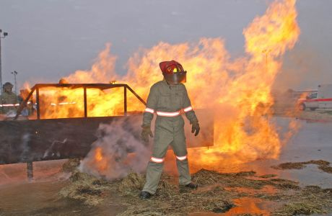
Occupational Hazards:
Physical hazards may include noise, temperature extremes, illumination extremes, ionizing or non-ionizing radiation, and ergonomics.

Slide 14
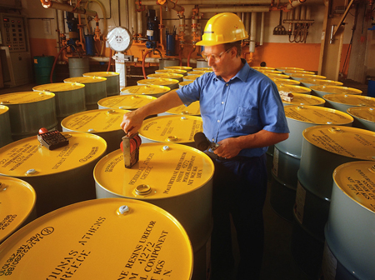
Chemical hazards related to Dangerous Goods or Hazardous Substances are frequently investigated by Occupational Hygienists.
Other related areas including Indoor air quality (IAQ) and safety may also receive the attention of the Occupational Hygienist.

Slide 15
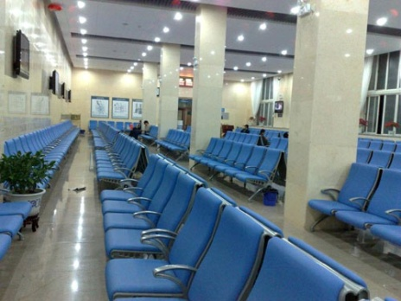
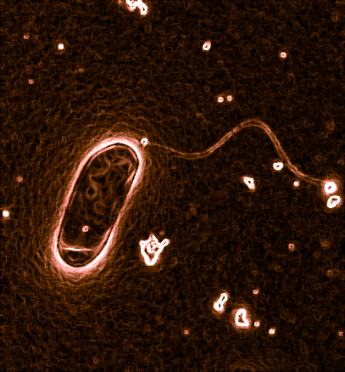
Biological hazards may stem from the potential for legionella exposure at work or the investigation of biological injury or effects at work, such as dermatitis may be investigated.
Legionella is a pathogenic Gram negative bacterium, including species that cause legionellosis or Legionnaires' disease

Slide 16
Appropriate controls are selected from the hierarchy of control: by
Elimination, MUSCUT
Substitution;
Engineering,

Slide 17
Substitution
Substitution of a More Hazardous Chemical by a Less Hazardous Chemical
Task | Hazardous Chemical | Substitute
Extraction solvents | Ethyl ether; Methyl-t-butyl ether (MTBE)1 | Hexanes1
Oxidation of organic compounds | Chromate ion | Hypochlorite ion1
Qualitative test for heavy metals | Sulfide ion | Hydroxide ion1
Freezing point lowering | Benzene | Cyclohexane; Sodium chloride solution

Slide 18
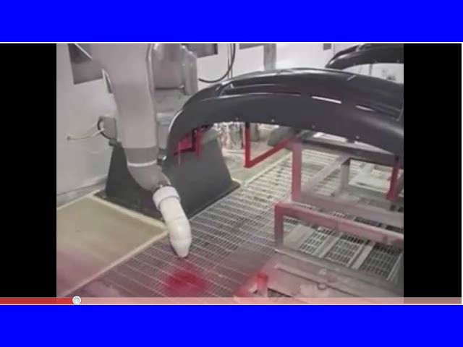
Engineering

Slide 19

Engineering

Slide 20
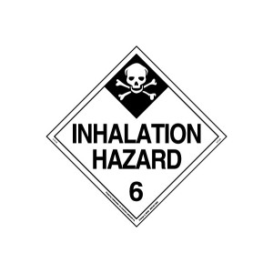
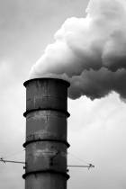
Heavy metal exposure occurs through three primary routes:
Inhalation. Common examples include workers scraping or sanding lead paint and workers in factories where heavy metals are melted and processed.
In the days before leaded gasoline was banned, those living alongside heavily traveled roads faced significant exposure through tailpipe emissions.

Slide 21



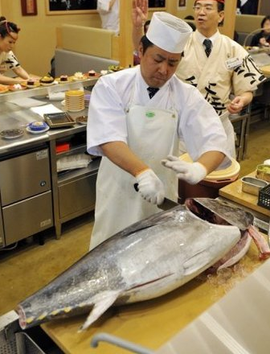
Ingestion. The leading cause of lead poisoning in children is eating old paint chips.
A major source of elevated mercury levels in humans comes from eating contaminated fish. And people can drink arsenic from wells contaminated by arsenic-containing pesticides.

Slide 22
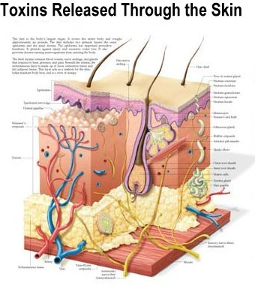

Skin absorption. Day to day contact with heavy metals can cause poisoning.
Dermal exposure is a serious concern for workers in fields where the irrigation water contains naturally-occuring arsenic (such as Asian rice paddies).

Slide 23
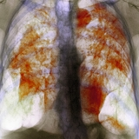
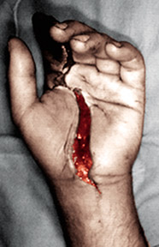
Occupational disease:
The term "occupational disease" refers to those illnesses caused by exposures at the workplace.
They should be separated, conceptually, from injuries that may also occur at workplaces due to a variety of hazards.

Slide 24
Occupational diseases may occur in varying time frames,
from the instantaneous development of illness following exposure to toxic chemicals
to decades between onset of exposure and the development of disease, as occurs with many occupationally related cancers.

Slide 25
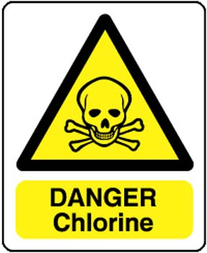
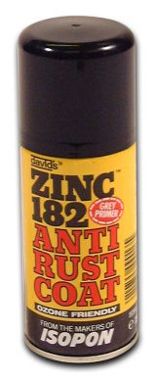
Examples of varying time frames include
instantaneous reactions to exposure to chemicals such as chlorine or ammonia gas;
a delay of some six to twelve hours with fumes of aerosolized zinc, as occurs when welding on galvanized steel;

Slide 26
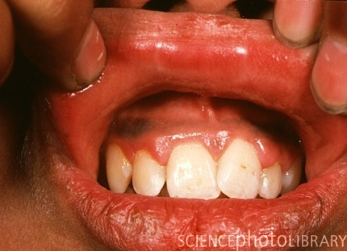
a delay of weeks to months with lead poisoning;
a delay of decades with occupational carcinogens;
the finding of congenital malformations in children whose parents may have been exposed to hazardous materials.

Slide 27

Although not all occupational exposures that cause illness lead to death, considerable numbers of deaths each year are associated with workplace exposures.
While it is relatively easy to count deaths due to occupational injuries, it is much more difficult for delayed illnesses.

Slide 28

More than 6,200 fatal occupational injuries occur in the United States each year, with more than 40 percent associated with transportation, and most of these related to motor-vehicle fatalities.

Slide 29
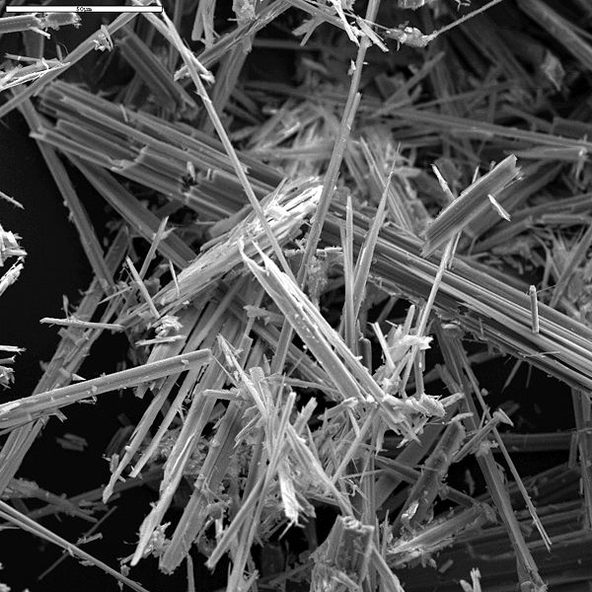
As noted above, deaths from occupational illness for most diseases are hard to enumerate.
The only diseases for which reasonably good data exists are the pneumoconiosis, such as asbestosis, coal-workers pneumoconiosis, and silicosis.

Slide 30


Slide 31
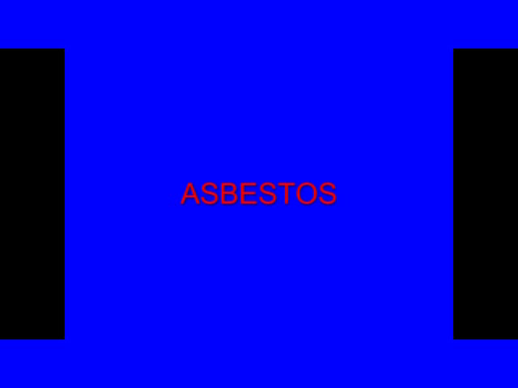

Slide 32
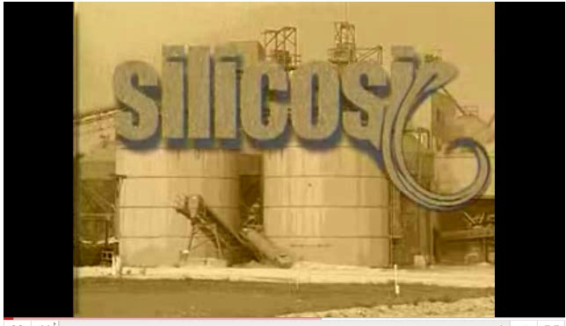

Slide 33
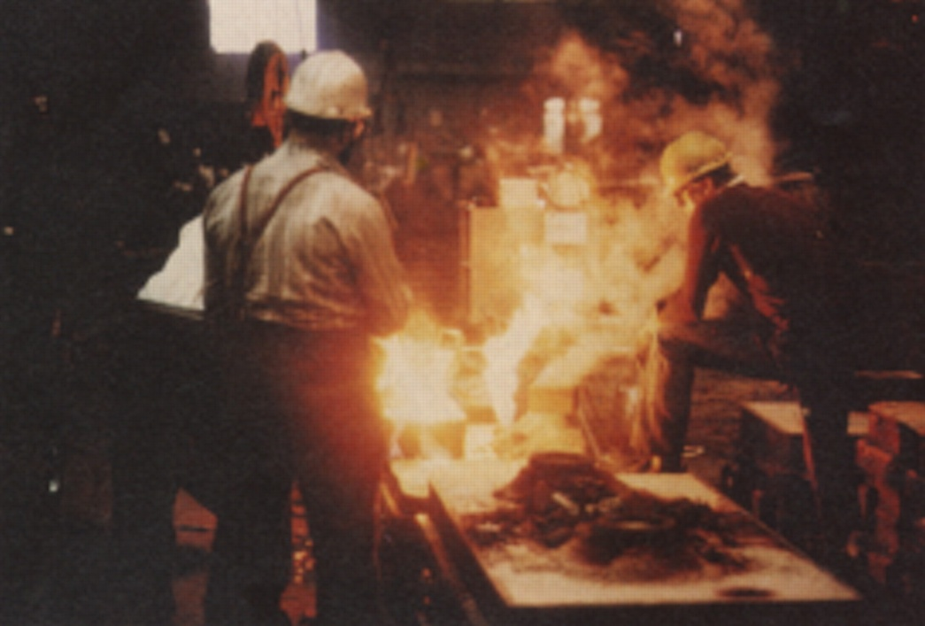
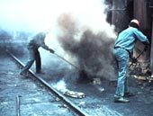
For many other diseases, such as those from chemical exposure, various occupational cancers, and other problems, individual fatalities are difficult to recognize and record.

Slide 34
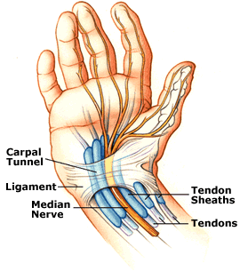
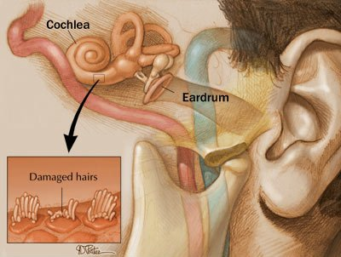
Among the occupational diseases most commonly reported, those relating to repeated trauma, such as carpal tunnel syndrome, tendonitis, and
noise–induced hearing loss

Slide 35
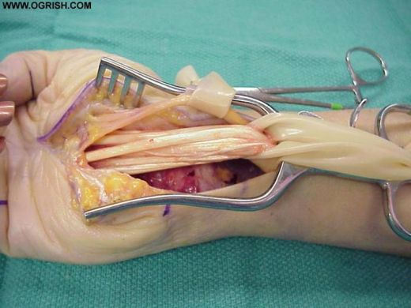
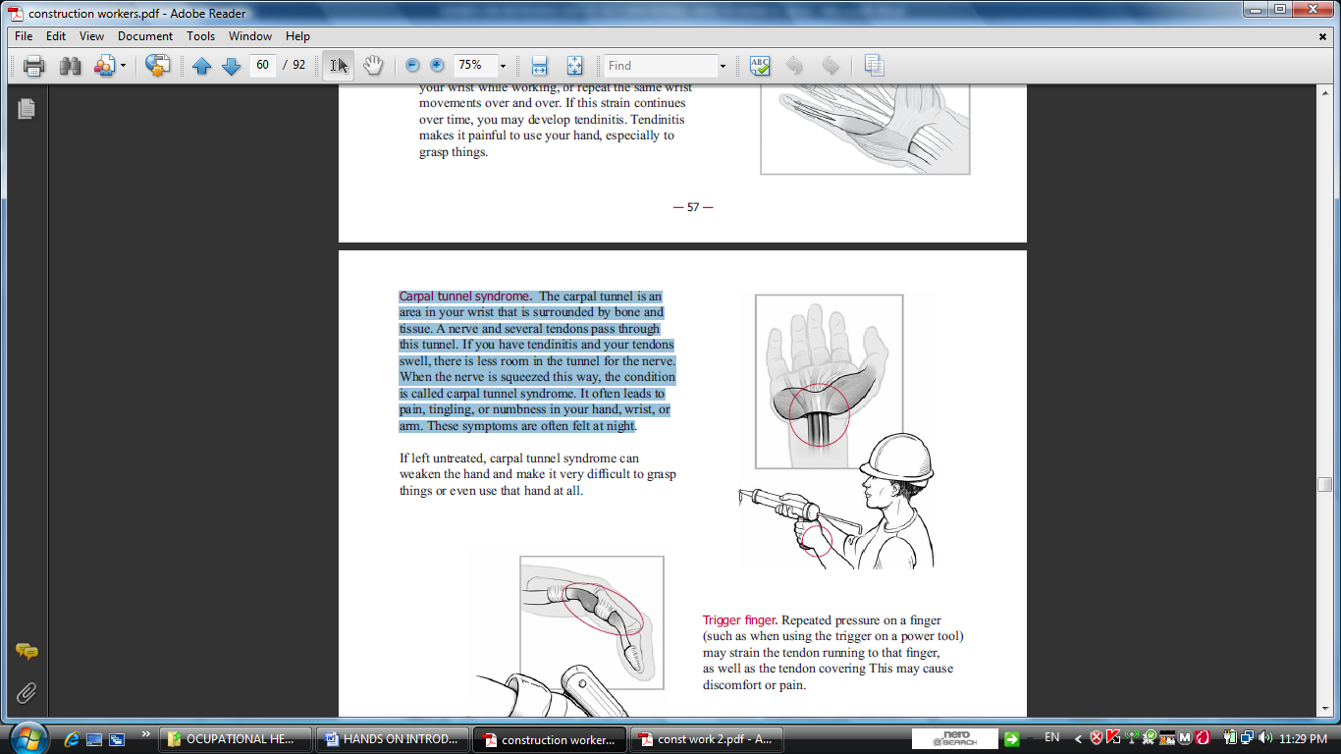


For those cases of carpal tunnel syndrome with workplace absence, half needed twenty-five or more days away from work.

Slide 36
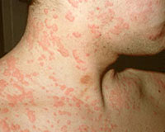
Skin diseases represented about 13 percent of work related illnesses.
Occupational Dermatitis is often an inflammatory skin reaction caused by occupational contact factors.
Dermatitis, or inflammation of the skin cases required time away from work.

Slide 37
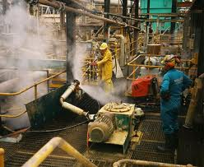
1. Noise:
Noise is most obviously a problem in industries such as manufacturing and construction, it can also be an issue in a wide range of other working environments

Slide 38
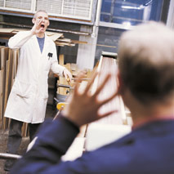
One in five of Europe’s workers have to raise their voices to be heard for at least half of the time that they are at work and 7% suffer from work-related hearing difficulties.
Noise induced hearing loss is the most common reported occupational disease in the EU.

Slide 39

What is noise?
Noise is an unwanted sound;
its intensity (‘loudness’) is measured in decibels (dB).
The decibel scale is logarithmic, so a three-decibel increase in the sound level already represents a doubling of the noise intensity.

Slide 40
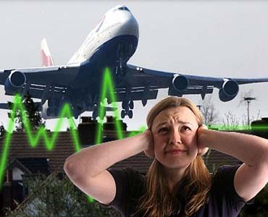
For example, a normal conversation may be about 65 dB and someone shouting typically can be around 80dB.
The difference is only 15 dB but the shouting is 30 times as intensive

Slide 41
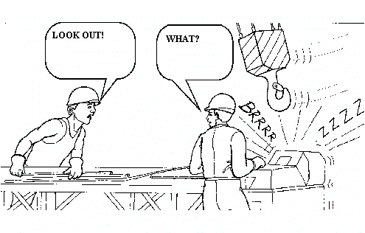
The duration of exposure is also very important. To take this into account, time-weighted average sound levels are used. For workplace noise, this is usually based on an 8-hour working day.

Slide 42
PERMISSIBLE NOISE EXPOSURES
Duration per day, hours | Sound level dBA slow response
8 | 90
6 | 92
4 | 95
3 | 97
2 | 100
1 1/2 | 102
1 | 105
1/2 | 110
1/4 or less | 115

Slide 43
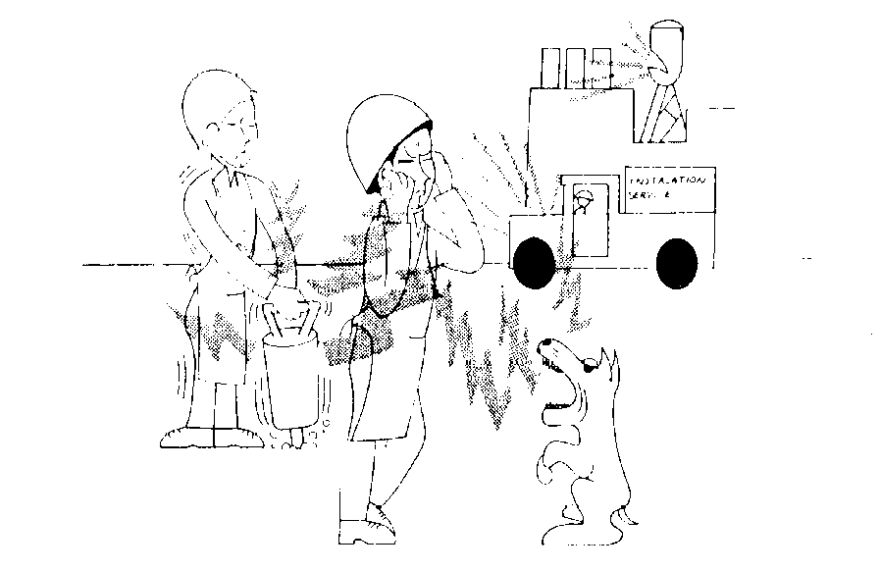
What problems can noise cause?
Increasing the risk of accidents by masking warning signals;
Physiological effects
Increase the risk of hearing loss;
Being a causal factor in work-related stress.

Slide 44

Who is at risk?
Anyone who is exposed to noise is potentially at risk.
The higher the noise level, and the longer you are exposed to it, the more risk you have of suffering harm from noise.

Slide 45

Noise is being recognized as a problem in service sectors such as education and healthcare, bars and restaurants.
A study of noise in kindergartens found some averaging noise levels over 85dB

Slide 46

During a performance of Swan Lake, a conductor was recorded as being exposed to 88dB

Slide 47
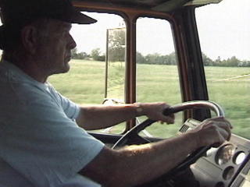
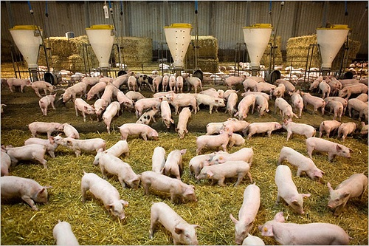
Truck drivers can be exposed to 89dB
Noise on pig farms has been measured up to 115dB

Slide 48
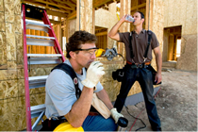
2. Heat Stress
Workers who are exposed to extreme heat or work in hot environments may be at risk of heat stress.
Exposure to extreme heat can result in occupational illnesses and injuries.

Slide 49
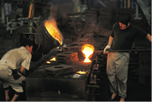
Heat stress can result in
heat stroke,
heat exhaustion,
heat cramps, or
heat rashes.

Slide 50
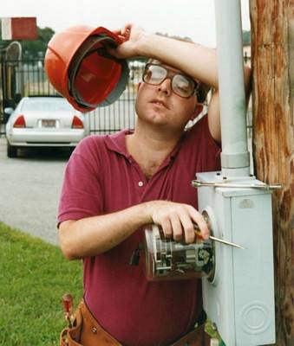
Heat can also increase the risk of injuries in workers as it may result in
sweaty palms,
fogged-up safety glasses,
dizziness.
Burns may also occur as a result of accidental contact with hot surfaces or steam.

Slide 51

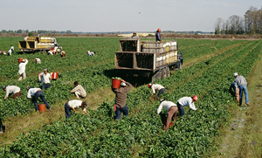
Workers at risk of heat stress include outdoor workers and workers in hot environments such as
firefighters, bakery workers, farmers, construction workers, miners, boiler room workers, factory workers, and others.

Slide 52
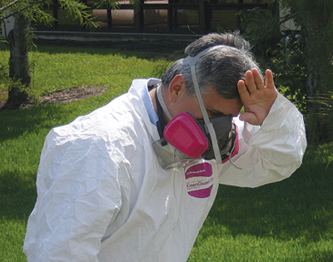
Types of Heat Stress
Heat Stroke
It occurs when the body becomes unable to control its temperature:
the body's temperature rises rapidly, the sweating mechanism fails, and the body is unable to cool down.

Slide 53

When heat stroke occurs, the body temperature can rise to 106 degrees Fahrenheit ( 41 oC) or higher within 10 to 15 minutes.
Heat stroke can cause death or permanent disability if emergency treatment is not given.

Slide 54
Symptoms of heat stroke include:
Hot, dry skin or profuse sweating
Hallucinations
Chills يرتعش
Throbbing headache
High body temperature
Confusion/dizziness
Slurred speech

Slide 55

Take the following steps to treat a worker with heat stroke:
Call 911 and notify their supervisor.
Move the sick worker to a cool shaded area.
Cool the worker using methods such as:
  Soaking their clothes with water.
  Spraying, sponging, or showering them with water.
Fanning their body.

Slide 56
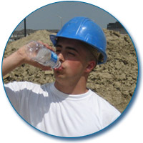
Heat Exhaustion
Heat exhaustion is the body's response to an excessive loss of the water and salt, usually through excessive sweating.
Workers most prone to heat exhaustion are those that are elderly, have high blood pressure, and those working in a hot environment.

Slide 57
Symptoms of heat exhaustion include:
Heavy sweating
Extreme weakness or fatigue
Dizziness, confusion
Nausea
Clammy, moist skin
Pale or flushed complexion
Muscle cramps
Slightly elevated body temperature
Fast and shallow breathing

Slide 58
Treat a worker suffering from heat exhaustion with the following:
Have them rest in a cool, shaded or air-conditioned area.
Have them drink plenty of water or other cool, nonalcoholic beverages.
Have them take a cool shower, bath, or sponge bath.

Slide 59
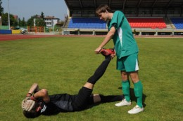
Heat Cramps
Heat cramps usually affect workers who sweat a lot during strenuous activity.
This sweating depletes the body's salt and moisture levels. Low salt levels in muscles causes painful cramps. Heat cramps may also be a symptom of heat exhaustion.

Slide 60
Workers with heat cramps should:
Stop all activity, and sit in a cool place.
Drink clear juice or a sports beverage.
Do not return to strenuous work for a few hours after the cramps subside because further exertion may lead to heat exhaustion or heat stroke.
Seek medical attention if any of the following apply:
  The worker has heart problems.
  The worker is on a low-sodium diet.
  The cramps do not subside within one hour.

Slide 61
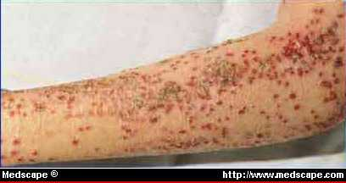
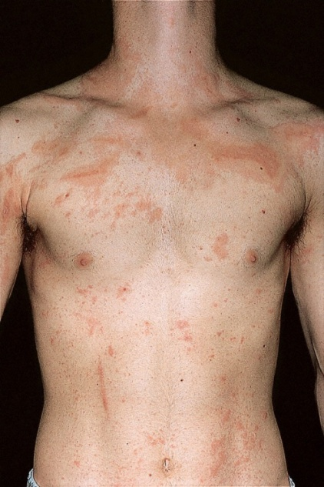
Heat Rash
Heat rash is a skin irritation caused by excessive sweating during hot, humid weather.
Symptoms of heat rash include:
Heat rash looks like a red cluster of pimples or small blisters.
It is more likely to occur on the neck and upper chest, in the groin, under the breasts, and in elbow creases.

Slide 62
THANK YOU

