Slide 1
Mass gatherings maybe defined as:
Temporary collection of large numbers of people at one site or location for a common purpose.
Health issues that transcend national boundaries and governments and call for actions on the global forces that determine the health of people
Involvement of cities in the work of international organizations
Aspects of health and disease related to travel.

Slide 2
2 - Mass gatherings are events attended by number of people. How many people forms mass gathering?
Attending of more than 100 people for long period are sufficient to form mass gathering.
Attending of Sufficient number of people to strain the planning and response resources of the host community.
Attending of street market to form mass gathering.
Attending of Religion events are sufficient to form mass gathering

Slide 3
3 - Why it is necessary to consider a number of alternative venues for the Mass gatherings event?
To avoid any sponsorship conflicts.
To insure relevant ambulance availability.
To insure health and safety considerations
To adapt health insurance regulations.

Slide 4
4 - Why it is important to obtain Information about the venue.
To ensure that police services having full protection for people from drug dealers and thieves.
To ensure safe and adequate water supply and food safety.
To ensure safe sanitation and waste management.
To ensure that emergency services personnel have access to all subsections of the venue

Slide 5
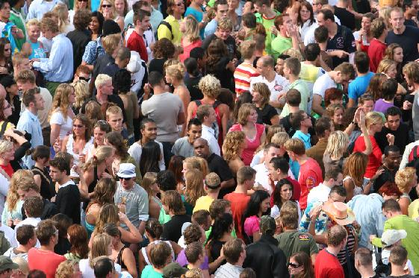
part | SAFE AND HEALTHY MASS GATHERINGS
2
Mass gatherings are events attended by a sufficient number of people to strain the planning and response resources of the host community, state/province/, nation, or region where it is being held.

Slide 6
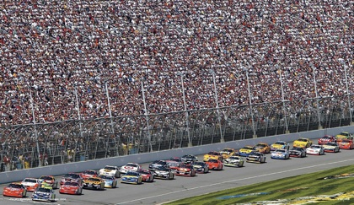
APPROVAL FOR EVENT
Event organizers usually must gain approval from local, and sometimes state, authorities to hold public events. Information on the approval process should be obtained

Slide 7
LEGAL ISSUES
There is usually some form of legislation which governs or restricts public events or aspects thereof.
In some cases, particularly for extremely large or high impact events, special State or local legislation for the event may required.

Slide 8
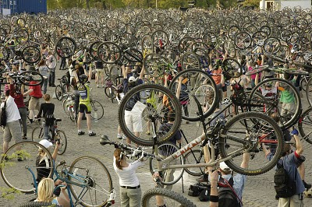
VENUE
It may be necessary to consider a number of alternative venues for the event.
Emergency managers may be able to recommend appropriate venues based on health and safety considerations

Slide 9
Hazards
Power lines which could be brought down by a severe storm;
Water ways that may be prone to flooding;
bush fires;
High winds;
Extremes of temperature; and
Pests, large animals, pollens and poisonous plants.

Slide 10
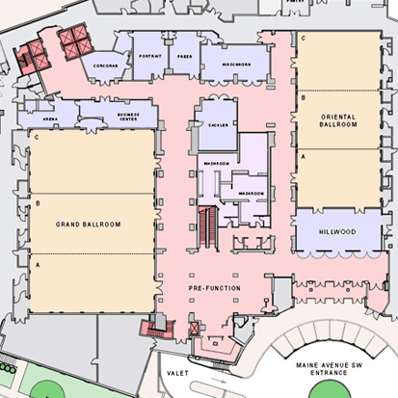
Access and Outlet of Health and Emergency Services
Planning should ensure that emergency services personnel have access to all subsections of the venue, including performance, spectator and parking areas.

Slide 11
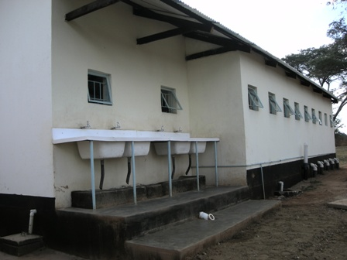
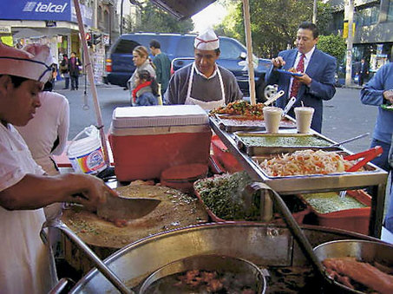
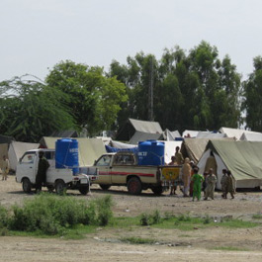
PUBLIC HEALTH
safe and adequate water supply;
food safety;

Slide 12
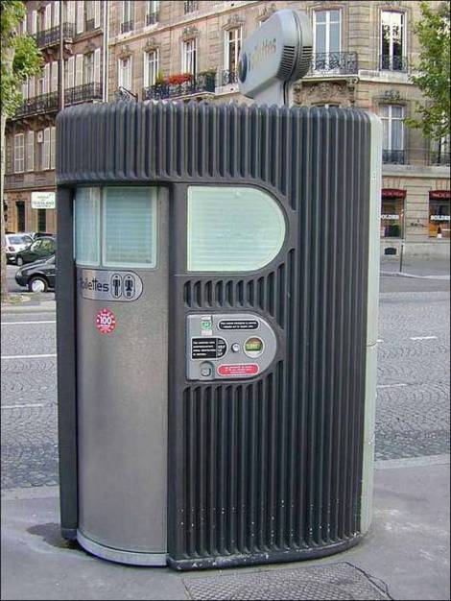
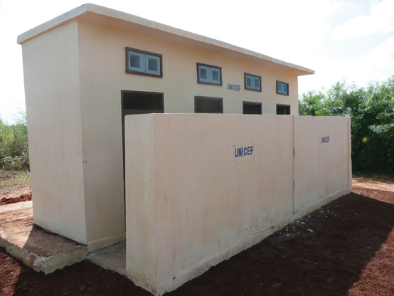
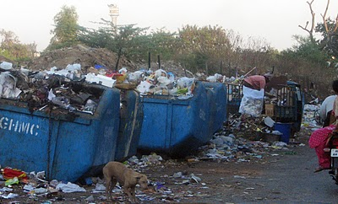
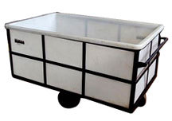
PUBLIC HEALTH
sanitation requirements and waste management;
water and swimming pool safety;

Slide 13
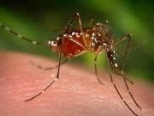
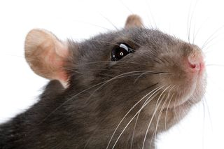
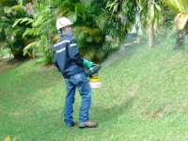
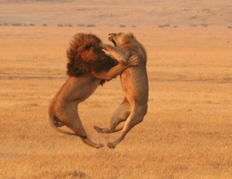
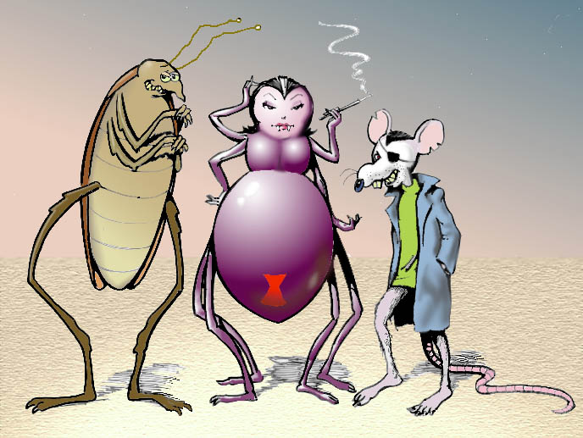
PUBLIC HEALTH
pest/vector control;

Slide 14
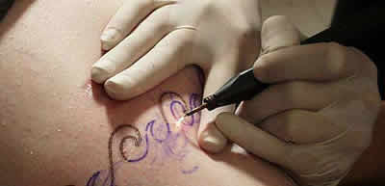
PUBLIC HEALTH
infectious diseases prevention and investigation;
standards for activities involving skin penetration, such as tattooing and body piercing;

Slide 15
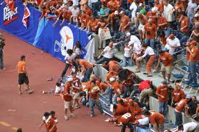
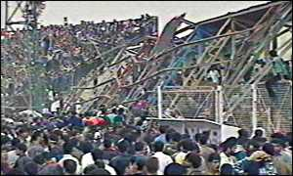
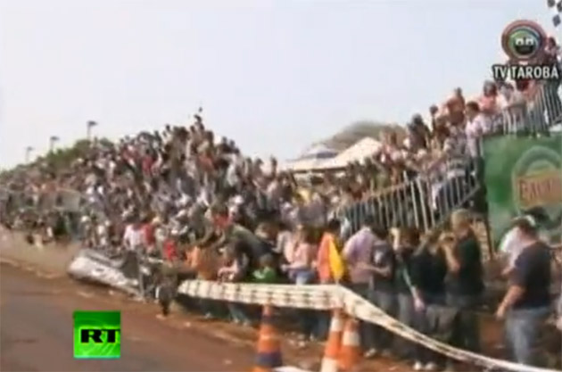
PUBLIC HEALTH
building safety;
noise and other nuisance issues; and
public health emergency management / planning.

Slide 16
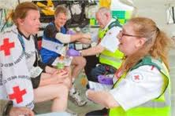
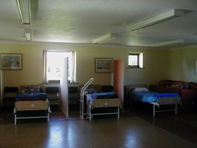
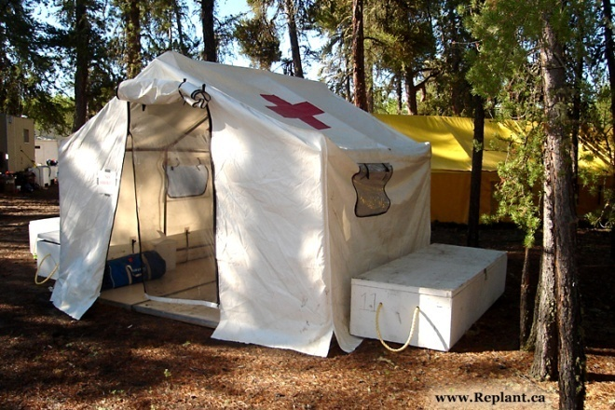
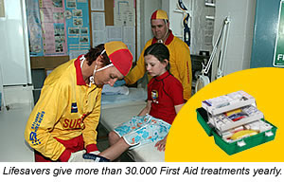
MEDICAL CARE
Suitable medical facilities, such as a first aid room, tent, or vehicle, should be on-site. It should be clearly identified and easily accessible.

Slide 17
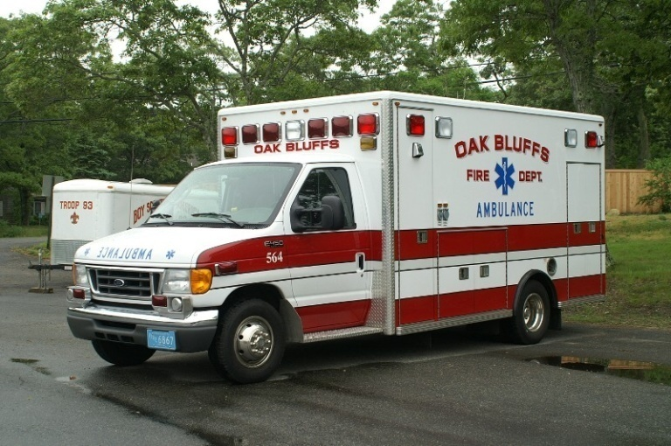
MEDICAL CARE
Ambulances
The relevant ambulance service must be consulted to determine ambulance requirements for the event.

Slide 18
Medical Logistics
There are many medical logistic issues to be considered in the planning of an event including:
Will medical staff operate in a facility to which the injured must make their way, or will clearly identified medical teams patrol spectator areas?
Will there be vehicles to transport spectators to the medical facility?

Slide 19
Medical Logistics
Will medical vehicles be appropriate to the terrain? For example, four-wheel-drive vehicles may be required for off-road areas, and golf carts or similar vehicles for high-density spectator areas.
Where an ambulance is not required, will a ’chauffeur system’ be provided to transport persons from the medical facility to their own transport?

Slide 20
Medical Logistics
How will medical staff be notified of or summoned to spectators requiring assistance in widespread spectator areas?
What means of communication will be available for attending medical personnel to communicate with off-site medical staff, event organisers, security and other support staff?
Are there any sponsorship conflicts between the event sponsor and any medical service sponsors?

Slide 21
THANK YOU

