Slide 1
Travel Medicine
Community Medicine Department 2015

Slide 2
Objectives
Definition of travel medicine and its concepts.
Validity of travel medicine.
Magnitude of the problem and the importance of travel medicine.
Characteristics that makes travelers more susceptible to diseases.
Epidemiology of common travel related diseases.
Prevention and control.

Slide 3
Definition (PHAC)
Travel medicine is the field of medicine concerned with the promotion of health and respect for the peoples, cultures and environment of regions being visited in addition to the prevention of disease or other adverse health outcomes in the international traveller as well as any impact on the health of the local population.

Slide 4
The practice of travel medicine is distinct from the practice of tropical medicine as it focuses on health promotion as a means to maintain the health and well-being of travellers, as well as the health of the indigenous populace being visited; tropical medicine focuses on the diagnosis and treatment of illness associated with travel.
Notes:
For example, travel medicine may include advice on how to prevent malaria and other vector-borne diseases, travellers' diarrhea, sexually transmitted diseases, injuries and accidents, as well as information on acclimatization and adaptation to hostile environments. Within the context of pre-travel care and in addition to the prevention of illness, both travellers and health care providers should, as stated above, discuss the environmental, cultural, health and sociopolitical impacts that travel has on the local population at the travel destination

Slide 5


Slide 6
Concepts of Travel Medicine
Disease preventions and precautions | Pretravel risk assessment | Disease managment | Screening
1-immunization/ vaccination 2-chemoproplaxis 3-advise for self treatment 4- travelers instructions 5-medication package . | This balances the health of the traveler (the traveler’s age, underlying health conditions, medications, and immunization history)with the details of the planned trip (the season of travel, itinerary, duration, and planned activities) . | The proper treatment of the infectious and non infectious diseases to the travelers in epidemiological or non epidemiological regions. | -Early screening of the symptoms after travelers departed back to their countries Limiting the progression of the diseases especially the contiguous disease .

Slide 7
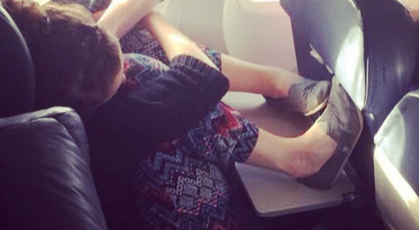

Slide 8
Validity of Travel Medicine
Clinical trials based: Travel medicine standards are increasingly based on evidence and are moving away from reliance on the opinion of experts .
Knowledge based: The knowledge base for the travel medicine provider includes: epidemiology, transmission, and prevention of travel-associated infectious diseases; a complete understanding of vaccine indications and procedures; prevention and management of noninfectious travel-associated health risks; and recognition of major syndromes in returned travelers (e.g., fever, diarrhea, and rash)

Slide 9
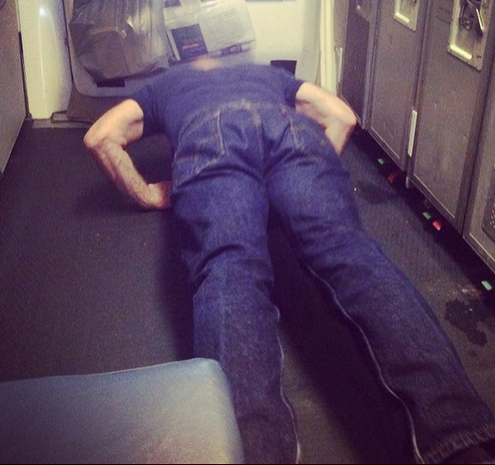

Slide 10
The magnitude and the importance of travel medicine
Over a billion people cross international borders yearly
Precautions differ as time changes because there are many changes in global infectious diseases epidemiology .
Changing patterns of drug resistance
More travelers= more travelers with chronic disease
Providing prophylaxis and treatments to protect travelers and prevent the transmission of infectious disease to minimize the number of cases.
Notes:
According to what they found on 2006 , there are 700. 000 .000 travelers cross international borders annually. So, educating the travelers about how they can protect their health will help in preventing lots of diseases.
Precautions differ as time changes because there are many changes in global infectious diseases epidemiology .
Changing patterns of drug resistance, therefore seeking medical advice is important to have the newly effective treatment that can kill the organism.
As mentioned previously, there is huge number of travelers every year , and accordingly an increase in the number of travelers with chronic health conditions, and they need special care to not develop any complications.
Traveler protection by providing prophylactic and treatment agents to protect the traveler , prevent the transmission of infectious diseases and minimize the number of cases.

Slide 11


Slide 12
High Risk Groups
Pregnant Travelers
Children
Travelers with Weakened Immune Systems Elderly and travelers with Chronic Illnesses.
Long-Term Travelers
Adventurous travelers

Slide 13
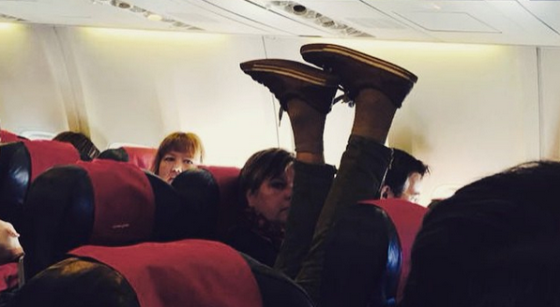

Slide 14
International Health Regulation (IHR):
Since 15 June 2007 the world has been implementing the IHR. This legally-binding agreement significantly contributes to global public health security by providing a new framework for the coordination of the management of events that may constitute a public health emergency of international concern, and will improve the capacity of all countries to detect, assess, notify and respond to public health threats. (WHO)
Notes:
General precautions:
International travel can pose various risks to health, depending both on the health needs of the traveler and on the type of travel to be undertaken. Travelers may encounter sudden and significant changes in altitude, humidity, temperature and exposure to a variety of infectious diseases, which can result in illness. In addition, serious health risks may arise in areas where accommodation is of poor quality, hygiene and sanitation are inadequate, medical services are not well developed and clean water is unavailable. Accidents continue to be the most common cause of morbidity and mortality in travelers but it is also important to protect travelers against infectious diseases.(WHO)
Key factors in determining the risks to which a traveler may be exposed are :
mode of transport
destination(s)
duration and season of travel
purpose of travel
standards of accommodation, food hygiene and sanitation
behavior of the traveler
Underlying health of the traveler
Destinations where accommodation, hygiene and sanitation, medical care and water quality are of a high standard pose relatively few serious risks to the health of travellers, except those with pre-existing illness. The same is true of business travellers and tourists visiting most major cities and tourist centers and staying in good-quality accommodation. In contrast, destinations where accommodation is of poor quality, hygiene and sanitation are inadequate, medical services do not exist and clean water is unavailable may pose serious risks for the health of travelers. This applies, for example, to personnel from emergency relief and development agencies and to tourists who venture into remote areas. In these settings, stringent precautions must be taken to avoid illness. Travel warnings from governmental sources should be taken seriously; they are likely to have implications for travel and for travel insurance.
The epidemiology of infectious diseases in the destination country is of importance to travelers. Travellers and travel medicine practitioners should be aware of the occurrence of these diseases in the destination countries. Unforeseen natural or man-made disasters may occur; outbreaks of known or newly emerging infectious diseases are often unpredictable.
The mode of transport, duration of visit and the behavior and lifestyle of the traveller are important in determining the likelihood of exposure to infectious diseases and will influence decisions on the need for certain vaccinations or anti-malarial medication. The duration of visit may also determine whether the traveler is subjected to marked changes in altitude, temperature and humidity or to prolonged exposure to atmospheric pollution.
Understanding the purpose of the visit and the type of travel planned is critical in relation to the associated travel health risks. However, behavior also plays an important role; for example, going outdoors in the evenings in a malaria-endemic area without taking precautions to avoid mosquito bites may result in the traveler becoming infected with malaria. Exposure to insects, rodents or other animals, infectious agents and contaminated food and water, combined with the absence of appropriate medical facilities, makes travel in many remote regions particularly hazardous.
Whatever their destination or mode of travel, it is important that travellers should be aware of the risk of accidents under the influence of alcohol or drugs and, mainly, in relation to road transport or the practice of sports.
There are some information will help you to be Proactive, Prepared, and Protected when it comes to your health and the health of others while you are traveling:
BE PROACTIVE
Before your travel take steps to anticipate any issues that could arise:
- Learn about your destination.
- See a doctor before you travel.
- Think about your health status (Are you too sick to travel?)(Recent illnesses, injuries, or surgeries) (Do you have any special health needs? (Babies and small children, pregnant women, people with disabilities, people with weakened immune systems).
BE PREPARED
No one wants to think about getting sick or hurt during a trip, but sometimes these things happen. You may not be able to prevent every illness or injury, but you can plan ahead to be able to deal with them:
Pack smart:
What to Pack in Your Travel Health Kit?
Medicines:
Prescription medicines you usually take
Special prescriptions for the trip:
Medicines to prevent malaria, if needed
Over the counter medicines:
Anti-diarrheal medication
Antihistamine
Other important items:
First-aid supplies. E.g. Digital thermometer and Oral rehydration solution packets

Slide 15
Purpose of IHR
to prevent, protect against, control and provide a public health response to the international spread of disease in ways that are commensurate with and restricted to public health risks, and which avoid unnecessary interference with international traffic and trade. (WHO)
Notes:
This legally-binding agreement significantly contributes to global public health security by providing a new framework for the coordination of the management of events that may constitute a public health emergency of international concern. IHR includes many rights and obligations for States. These cover activities ranging from surveillance and response, to notification and verification to WHO of certain public health events and risks which will improve the capacity of all countries to detect, assess, notify and respond to public health threats.

Slide 16
Key factors in traveler exposure risks
Mode of transport
Destination(s)
Duration and season of travel
Purpose of travel
Standards of accommodation, food hygiene and sanitation
Behavior of the traveler
Underlying health of the traveler

Slide 17

http://wwwnc.cdc.gov/travel/
http://wwwnc.cdc.gov/travel/notices
http://www.who.int/ith/precautions/en/

Slide 18
General Precautions
Travellers can experience:
  changes in altitude, humidity, temperature and exposure to a variety of infectious diseases.
  Areas of overcrowding and poor hygiene.
  Accidents.

Slide 19
Traveler’s responsibilities
Travel related risks
Medical consultation before and after travel
Assessment of health risks associated with travel
Medical kit and toilet items
Insurance

Slide 20
Proactive, Prepared, Protected
BE PROACTIVE
- Learn about your destination.
- See a doctor before you travel.
- Think about your health status
BE PREPARED
Notes:
There are some information will help you to be Proactive, Prepared, and Protected when it comes to your health and the health of others while you are traveling:
BE PROACTIVE
Before your travel take steps to anticipate any issues that could arise:
- Learn about your destination.
- See a doctor before you travel.
- Think about your health status (Are you too sick to travel?)(Recent illnesses, injuries, or surgeries) (Do you have any special health needs? (Babies and small children, pregnant women, people with disabilities, people with weakened immune systems).
BE PREPARED
No one wants to think about getting sick or hurt during a trip, but sometimes these things happen. You may not be able to prevent every illness or injury, but you can plan ahead to be able to deal with them:
Pack smart:
What to Pack in Your Travel Health Kit?
Medicines:
Prescription medicines you usually take
Special prescriptions for the trip:
Medicines to prevent malaria, if needed
Over the counter medicines:
Anti-diarrheal medication
Antihistamine
Other important items:
First-aid supplies. E.g. Digital thermometer and Oral rehydration solution packets

Slide 21
Pack smart:
What to Pack in Your Travel Health Kit?
Medicines:
Prescription medicines you usually take
Special prescriptions for the trip:
Medicines to prevent malaria, if needed
Over the counter medicines:
Anti-diarrheal medication
Antihistamine
Other important items:
  First-aid supplies. E.g. Digital thermometer and Oral rehydration solution packets

Slide 22
What diseases do you think of when you think of travel?

Slide 23
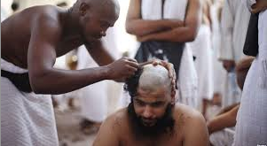

Slide 24
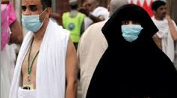

Slide 25
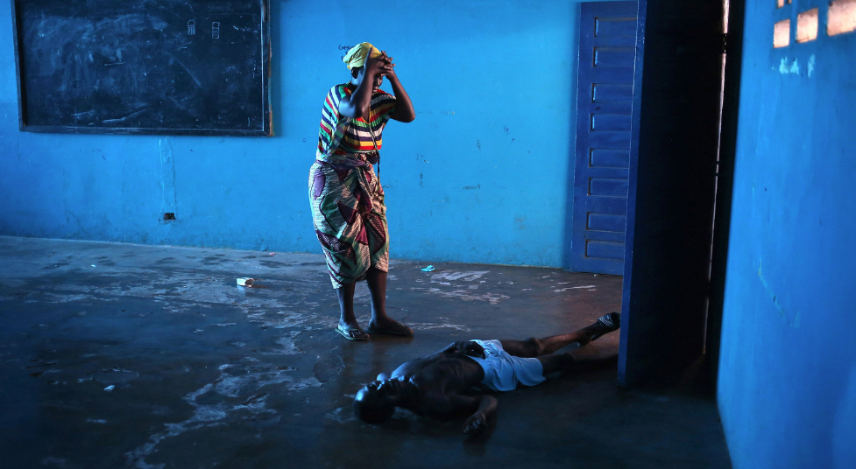

Slide 26
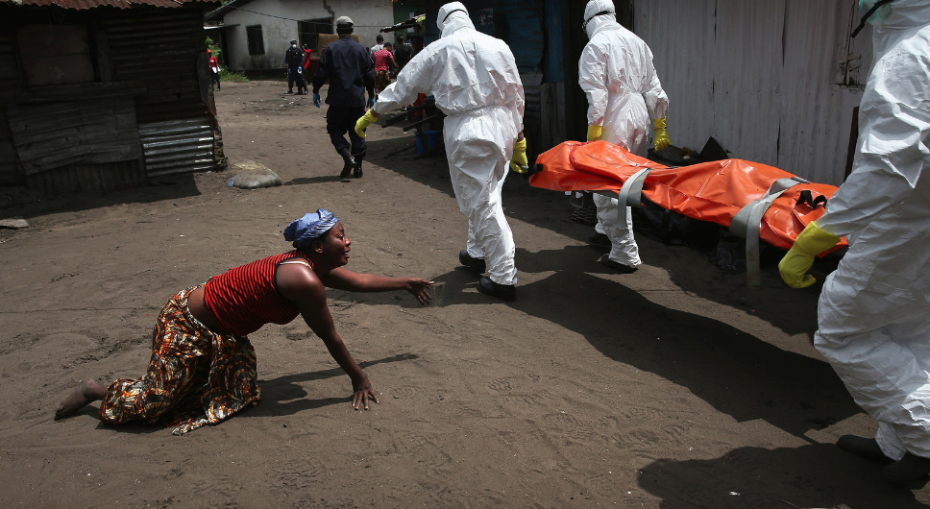

Slide 27
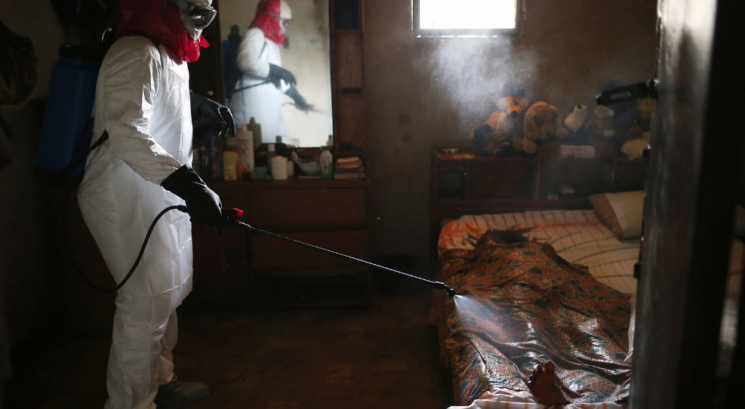

Slide 28
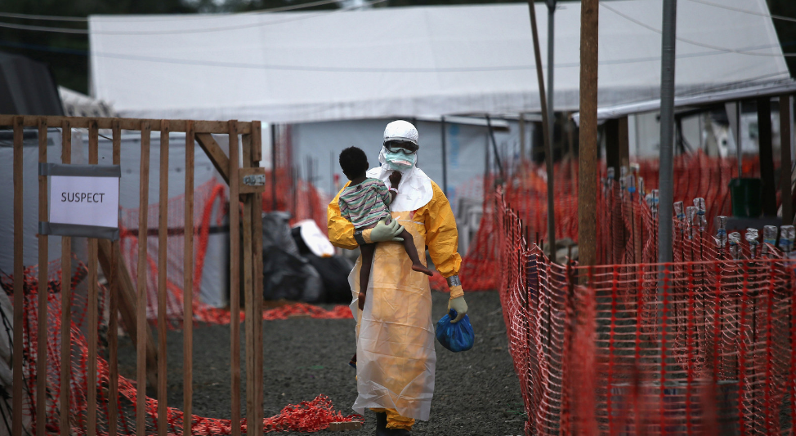

Slide 29
STIs
What are they? | Sexual transmitted infections depend on the behavior rather than the country you visit. Some examples of these infections are HIV, herpes simplex virus and hepatitis C and B.
Route of transmission | These are some routs of transmission: blood as hepatitis C, vaginal fluids and semen as HIV, also, from the mother to her child during pregnancy and childbirth as herpes simplex virus.
Epidemiology | Worldwide infections, about 1 million people acquire a sexually transmitted infection every day.
Prevention | Avoid sexual activity with strangers . Use condom in every sexual contacts. Order sterilized needle in tattooing and avoid sharing razor, needles and shavers. There is vaccination for some of the infections : Hepatitis B : it should begin 6 months before travelling, IM, 3-dose vaccine series (Day 0 – 30 – 6months), e.g: Engerix-B There are no vaccines to prevent HIV or Hepatitis C

Slide 30
Water-Borne Diseases
Schistosomiasis
What is it? | It is parasite infection by the genus schistosoma. There are four types: Schistosoma mansoni, S. haematobium, S. japonicum, and s.haematobium
Route of transmission | Is a water-borne infection, this parasite can affect the body by penetrating the skin, and larval cercariae can be found in contaminated bodies of freshwater.
Epidemiology | There is a high prevalence of schistosomiasis in Africa, also, there are types of it Schistosoma mansoni and S. haematobium which more common in Africa, s.haematobium can be found in the Middle East and S. japonicum more in Indonesia and parts of China.
Prevention | There is no vaccine or drugs that prevent the infection, but avoiding swimming, drinking or washing the clothes in lakes and fresh water in disease-endemic countries can help in prevention.

Slide 31
Food/Drink Related Diseases
Cholera
What is it? | It is bacterial infection and the cause of this infection is bacterium vibrio cholera. It’s affects an estimated 3–5 million people worldwide, and causes 58,000–130,000 deaths a year as of 2010.
Route of transmission | It is fecal oral rout, mostly transmitted by drinking water contaminated with bacteria.
Epidemiology | WHO reported that the most recent epidemics was in Africa, about 48% of cases were reprted from Africa in 2012
Prevention | Drink bottled water. Wash your hand before eating and after using the bathroom or use hand sanitizer if water and soup not available. There is a vaccine for cholera: Dukoral, dissolving the buffer granules in 150 mL of water, Two doses are required, given a minimum of 1 week and up to 6 weeks apart, single booster dose up to 2 years after completion of the primary course. The booster dose for who are at risk of exposure to cholera.

Slide 32
Typhoid
What is it? | Typhoid fever is a serious disease caused by the bacterium called Salmonella enteric serotype Typhi (S. Typhi)
Route of transmission | Transmitted through the ingestion of food or drink contaminated by the feces or urine of infected people.
Epidemiology | It's a worldwide disease, however countries at high risk are regions like South Asia, developing countries in Asia, Africa, the Middle East, the Caribbean, Central and South America.
Prevention | Wash your hands carefully. Avoid drinking untreated water. Avoid raw fruits and vegetables. Get vaccinated : Two vaccines are available: One is injected in a single dose about two weeks before exposure 0.5 mL IM once in the deltoid The other is given orally in four capsules, with one capsule to be taken every other day 3- 0.5 mL IM every 2 years if there is continued exposure to Salmonella typhi.

Slide 33
Hepatitis A
What is it? | An acute infectious disease of the liver caused by the hepatitis A virus (HAV)
Route of transmission | 1-Fecal-oral route: Contaminated food or drinks 2-person-to-person when poor fecal hygiene is practiced (e.g. between children or during certain sexual practices).
Epidemiology | Worldwide but most common in regions with poor food and water hygiene, including: Indian sub-continent (especially India, Pakistan, Bangladesh and Nepal), Africa, The Middle East, parts of the Far East (excluding Japan), Central and South America and Mexico
Prevention | keep good personal hygiene. Wash your hands frequently Get vaccinated :the vaccine should be given two weeks before you leave, although it can be given up to the day of your departure if necessary. Havrix(R): 1 mL IM followed by a 1 mL booster dose 6 to 12 months following primary immunization. VAQTA(R): 1 mL IM followed by a 1 mL booster dose 6 to 18 months after primary immunization. Primary immunization is recommended at least 2 weeks before expected exposure to hepatitis A virus.

Slide 34
Traveler’s Diarrhea
What is it? | It happens commonly with most of the travelers. caused by many organism such as salmonella, E-coli , Rotavirus and Norvavirus
Route of transmission | Fecal-oral route: by eating or drinking contaminated food or water.
Epidemiology | Worldwide however travelers who visit areas with poor standards of hygiene and sanitation are at greater risk .
Prevention | Avoid eating raw, undercooked or uncovered food. Avoid food from street vendors. Drink only bottled drinks and try not to drink anything with ice as it might be made with contaminated water. Wash and peel fruits and vegetables. Make sure dairy products are properly pasteurized

Slide 35
Living Vector Diseases
Japanese encephalitis
What is it? | Caused by Flavivirus, causes brain swelling, & may cause long term nerve damage.
Route of transmission | Mosquito bite.
Epidemiology | Occurs in almost all Asian countries and parts of the western Pacific Mainly in rural agricultural areas.
Prevention | Protection from mosquito bites JE vaccine ( Ixiaro ) "inactivated": Considered if travelers are spending one month or more in an endemic area, or less than a month but spending large time outdoors. Adults: 2 doses (0.5 mL) IM, on day 0 & 28, must be completed ≥1 week before travel.

Slide 36
Malaria
What it it? | Serious fatal disease, caused by Plasmodium parasite.
Route of transmission | Mosquito bite.
Epidemiology | Most malaria cases and deaths occur in sub-Saharan Africa. However, Asia, Latin America, and to a lesser extent the Middle East and parts of Europe are also affected.
Prevention | 1- Protection from mosquito bites. 2- Chemoprophylaxis (Atovaquone-proguanil, Chloroquine phosphate, doxycyclin, Hydroxychloro-quine sulfate, Mefloquine&Primaquine), taken before, during & after return from travel. The Duration depends on the drug type. - E.g.: Chloroquine phosphate (only for Chloroquine sensitive areas): 300 mg base (500 mg salt) orally, once/week. Taken 1 to 2 weeks before travel, during travel & 4 weeks after coming back.

Slide 37
Yellow Fever
What is it? | Caused by Flavivirus
Route of transmission | Mosquito bite.
Epidemiology | Presented endemically in tropical areas of South America and Africa.
Prevention | 1- Protection from mosquito bites. 2- vaccine: YF-vax" live-virus" - people age >9 months dose is 0.5 mL SC. - at least 10 days before travel. This is a legal requirement for those countries requiring a yellow fever certificate (International Certificate of Vaccination). - single dose protects for 10 years, booster every 10 years.

Slide 38
Leishmaniasis
What is it? | its caused by Leishmaniaparasitesand its have 3 main types : -Cutaneous (most common) Mucocutaneous- -Viscera
Route of transmission | female phlebotomine sand flies. The Leishmaniaparasites are spread to a human when he or she is bitten by the infected sand fly
Epidemiology | Common in Afghanistan Bolivia, Brazil and Peru Bangladesh, Brazil, Ethiopia, India and Sudan.
Prevention | No vaccine available Avoid outdoor activities using nets treated with insecticide while sleeping

Slide 39
Rabies
What is it? | Rabies is a zoonotic disease that caused by Lyssavirus ,and usually transmitted by dogs
Route of transmission | contact with the saliva of an infected animal, most often from licks, bites or scratches
Epidemiology | Rabies mostly in asia and Africa
Prevention | 1-Vaccinating dogs, cats, rabbits, and ferrets against rabies 2-Keeping pets under supervision 3-Not handling wild animals or strays Contacting an animal control officer upon observing a wild animal or a stray, especially if the animal is acting strangely If bitten by an animal, washing the wound with soap and water for 10 to 15 minutes and contacting a healthcare provider to determine if post-exposure prophylaxis is required

Slide 40
Air Borne Diseases
Corona
What is it? | Corona is caused byMiddle East Respiratory Syndrome Coronavirus (MERS- CoV)
Route of transmission | It spreads via air by coughing and sneezing, and close personal contact (i.e. shaking hands).
Epidemiology | Middle East specifically Arabian Peninsula
Prevention | there is no vaccine for MERS-CoV, but there is still more to learn about this new strain of coronaviru

Slide 41
Tuberculosis
What is it? | Tuberculosis is a disease caused by a bacterium called Mycobacterium Tuberculosis
Route of transmission | Active TB is preceded by latent TB and is air-borne. Latent TB is not contagious and can stay inactive for years. In fact, it gets activated when you have a weak immune system.
Epidemiology | Tuberculosis occurs globally, and it is estimated that about one-third of the world’s population has latent TB infection (LTBI). In addition, about 10% of individuals with LTBI will develop active TB.
Prevention | 1-Travelers have to avoid close contact with people who are having active TB in crowded areas. 2-Vaccination: Travelers do not need the bacillus Calmette–Guérin vaccine but the vaccine may be considered for long term travelers to countries with a high risk of TB For example, young children (< 5 years of age) who may not have access to regular tuberculin skin test. In addition, travellers who may not be able to follow the recommended preventative measures against TB medical or personal reasons. -Doses: Adult and children aged 12 months and above: A dose of 0.1 ml of the vaccine is injected strictly by the intradermal route. Infants under 12 months of age: A dose of 0.05 ml of the vaccine is injected strictly by the intradermal route.

Slide 42
Meningococcal Disease
What is it? | Meningococcal Disease is caused byNeisseria Meningitidis
Route of transmission | Mingococal disease is spread from close and prolonged contact with an infected person through saliva or secretions (fluids) from the nose and throat. E.g. sneezing, coughing, and sharing eating or drinking utensils.
Epidemiology | In sub-Saharan Africa (the meningitis belt extends from Senegal to Ethiopia). Also, in Saudi Arabia due to Hajj.
Prevention | 1-Travelers have to wash their hands frequently 2-they should practice proper cough and sneeze etiquette 3-they have to avoid close contact with people who are having the disease 4-vaccination: there are two meningococcal vaccines available - Meningococcal conjugate vaccine (MCV4) whichis for people 55 years of age and younger. -Meningococcal polysaccharide vaccine (MPSV4) which is for people older than 55. travelers do not need the meningococcal vaccines, but either meningococcal polysaccharide vaccine or meningococcal conjugate vaccine is recommended for travelers if they travel to any country in which the disease is common such as certain parts of Africa and Saudi Arabia because of annual Hajj and Umrah. For children and adults 2-55 years of age, MCV4 is administered as a single 0.5 ml dose intramuscularly. On the other hand, MPSV4 is administered 0.5 ml subcutaneously

Slide 43
References
Hill R, Ericsson C, Pearson R et al. The practice of travel medicine: guidelines by the Infectious Diseases Society of America. Clin Infect Dis 2006;43:1499-539.
http://www.cdc.gov/TB/TOPIC/vaccines/default.htm
http://travel.gc.ca/travelling/health-safety/diseases/tuberculosis
http://www.cdc.gov/vaccines/vpd-vac/mening/who-vaccinate.htm
http://www.nlm.nih.gov/medlineplus/druginfo/meds/a607020.html#skip
http://www.vaccines.gov/diseases/meningitis/index.html
http://www.immunizationinfo.org/vaccines/typhoid-
http://www.mayoclinic.org/diseases-conditions/typhoid-fever/basics/prevention/con-20028553
http://www.drugs.com/dosage/typhoid-vaccine-inactivated.html
http://www.who.int/gho/epidemic_diseases/cholera/en/
http://wwwnc.cdc.gov/travel/
http://travel.gc.ca

Slide 44
http://en.wikipedia.org/wiki/Hepatitis_A
http://www.nhs.uk/Conditions/Hepatitis-A/Pages/Vaccination.aspx
http://www.drugs.com/dosage/hepatitis-a-adult-vaccine.html#Usual_Adult_Dose_for_Hepatitis_A_Prophylaxis
http://wonder.cdc.gov/wonder/prevguid/p0000433/p0000433.asp
http://www.cdc.gov/ncidod/dbmd/diseaseinfo/travelersdiarrhea_g.htm
http://www.doctortravel.ca/index.php?page=hepatitis-b
http://www.immunise.health.gov.au/internet/immunise/publishing.nsf/Content/handbook10-4-1
http://www.who.int/mediacentre/factsheets/fs107/en/
http://www.who.int/mediacentre/factsheets/fs110/en/

