Slide 1
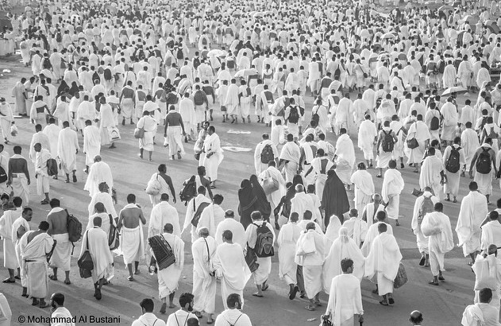
Hajj and Health

Slide 2
Objectives:
Magnitude of the problem; prevalence of the health problem Globally and in KSA.
Risk Factors in Hajj and the high risk groups.
Communicable Diseases in Hajj.
Methods for prevention and control.
The Health Communication Program for prevention and control of prevalence of diseases.

Slide 3
Hajj
It is the time of year when many Muslims will be preparing for Hajj and many will have waited all their lives for this moment, having saved for years to fulfil this great obligation
It is one of the biggest gatherings worldwide

Slide 4
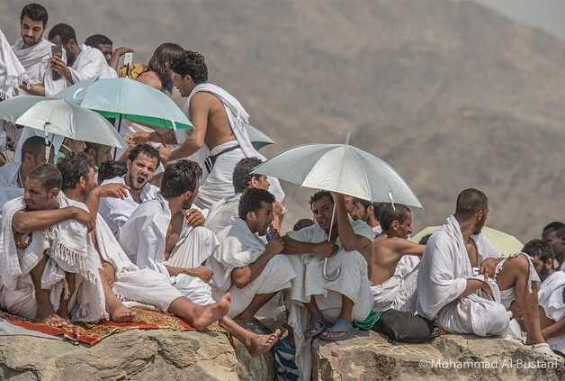
Magnitude of the problem; prevalence of the health problem Globally and in KSA

Slide 5
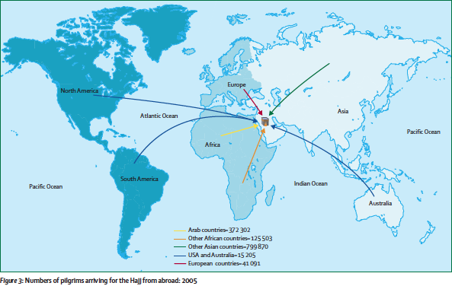
During Hajj, there is annual mass gathering of over 2 million pilgrims from all over the world with the aggregation of people from different environments into small areas

Slide 6
Hajj Statistics
the Central Department of Statistics & Information (CDSI) depends on the comprehensive enumeration methodology for all individuals coming to Makkah for performing Hajj. This is achieved through Hajj Statistics centers stationed by the CDSI at all entrances of Makkah, to be utilized in preparation of plans and health programs

Slide 7
The number of pilgrims for the Years From (2004G.) to (2013G.)

Slide 8
Hajj 2014 in Numbers
This year, more than 2 million pilgrims were expected to arrive in Mecca on Wednesday (1 October). (MOH)
No. of pilgrims in 2013 | No. of pilgrims in 2014
1,980,249 | 2,085,000

Slide 9
pilgrims coming from countries with high rates of infectious diseases. Ex: Nigeria, Guinea, Sudan and Senegal

Slide 10
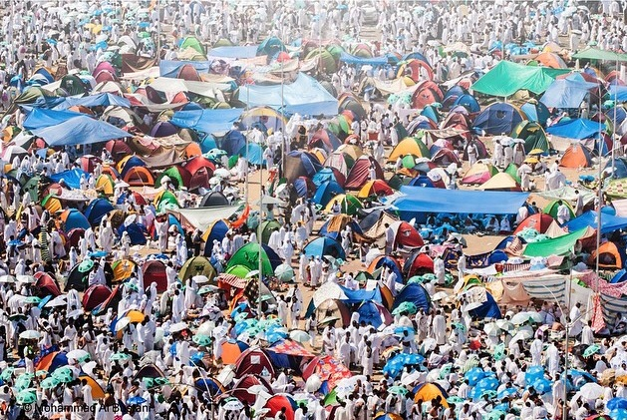
Risk Factors in Hajj

Slide 11
Risk Factors in Hajj
crowding
Weather
conditions
Insect bites
contaminated food and water
Accidents and injuries
Various microbiological agents
Head Shaving

Slide 12
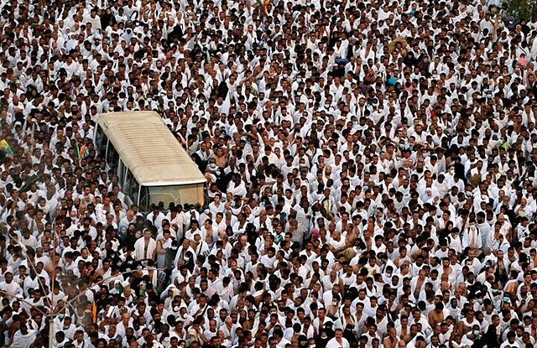
Risk Factors in Hajj
1- Crowding:
Associated with outbreak of infectious diseases and trauma.

Slide 13
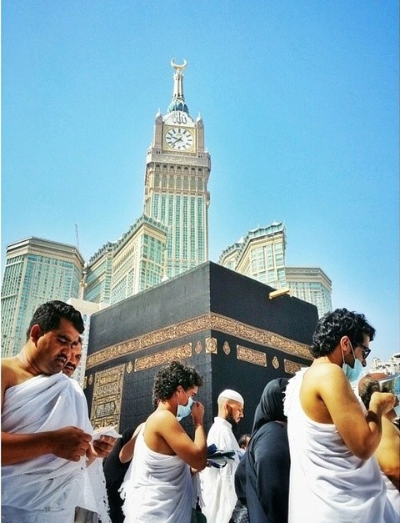
2- Weather conditions:
Hot weather associate with sunburn, dehydration, heat exhaustion, and heat stroke.

Slide 14
3- Accidents and injuries:
Minor injuries are relatively common, particularly to the feet. More serious injuries can occur as a result of stampedes as pilgrims undertake the stoning rite or other mass activities.
4- Various microbiological agents:
Such as Neisseria meningitides, Influenza and corona virus.

Slide 15
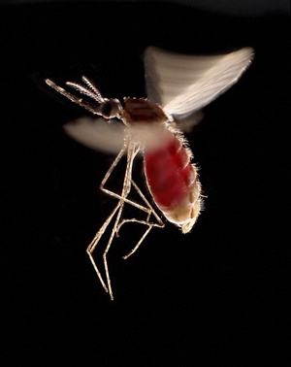
5- food or water:
diarrhea and food poisoning occurs by the consumption of contaminated food or water
6- Insect bites :
Can cause Vector-borne diseases such as malaria ( by Mosquito) and dengue fever (by Aedes Mosquito)

Slide 16
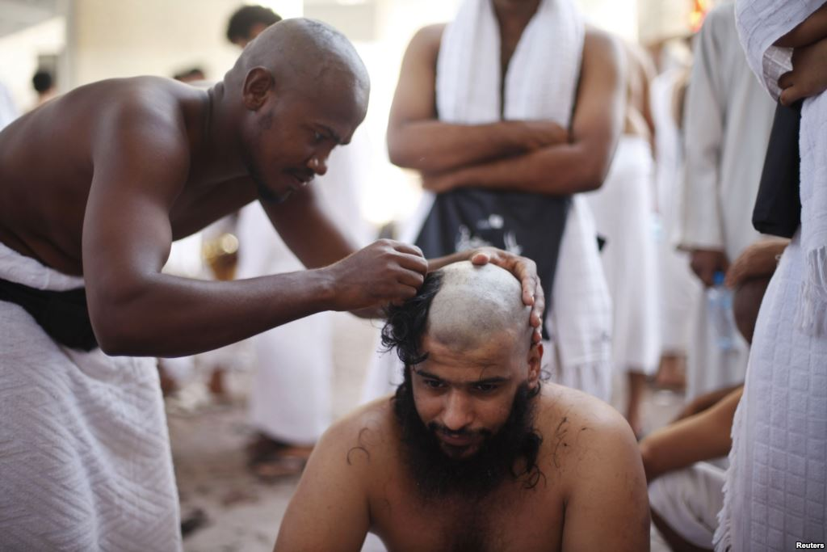
7- Head shaving:
Men are required to shave their heads after Hajj (many men shave their heads after Umrah as well), and unclean blades can facilitate the transmission of blood-borne disease like hepatitis B and C, and HIV.

Slide 18
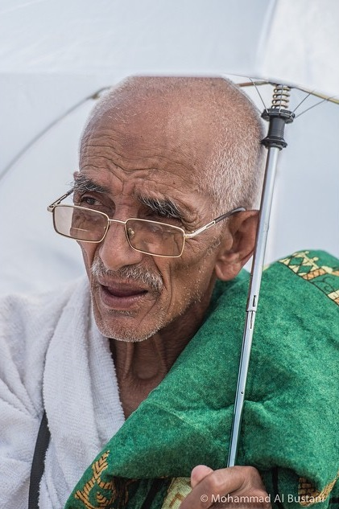
1- Elderly :
the majority of the elderly have chronic diseases like
( diabetes, hypertension, asthma, osteoarthritis…ect) which make them more susceptible for other infectious diseases .

Slide 19
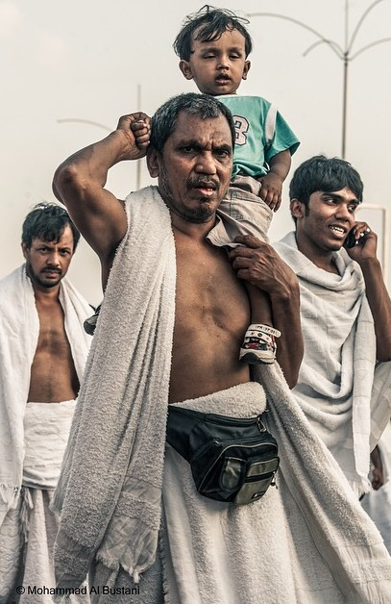
2 – children :
another age group that we need to consider, are children accompanying their families.
Some might not have completed their vaccination plans and naturally have an immature immunity , this make them more susceptible to infectious diseases .

Slide 20
3- Immunocompromised patients:
Patients could be immunocompromised for a number of reasons, which increase the incidence of infection .
• Genetic: inherited genetic defects
• Acquired-Infections: HIV, some types of cancers including leukemia, lymphoma
• Chronic diseases: end stage renal disease, Diabetes, Cirrhosis
• Medications: chemotherapy, radiation, immunosuppressive post-transplant medications.
• Physical state: such as pregnancy.

Slide 21
4-Lack of vaccination :
Pilgrims should take the required vaccines to prevent many serious infections. However some do not and that will put them at a higher risk.

Slide 22
5- Low socioeconomic status :
The person with low socioeconomic status is a high risk because some may sleep in inappropriate or crowded places. Also, some may use the same equipment like: scissors and razors , and this lead to increase the incidence rate of communicable diseases.

Slide 23
6- Disabled :
The disabled people could be a high risk group or risk factor during the hajj.

Slide 24
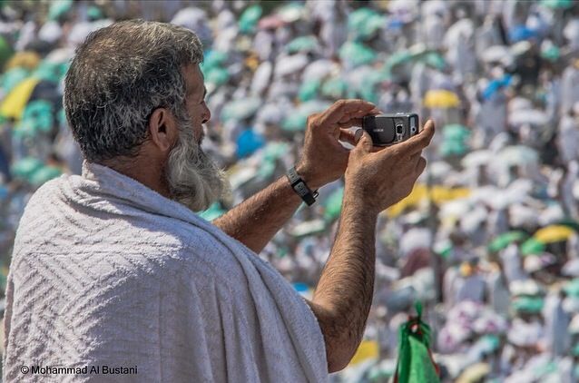
Communicable Diseases in Hajj

Slide 33
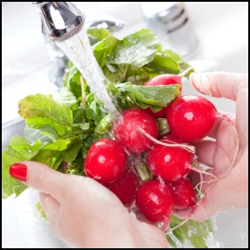
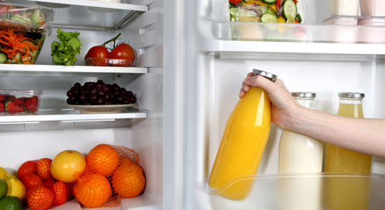
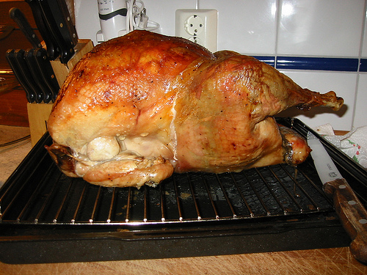

Slide 35
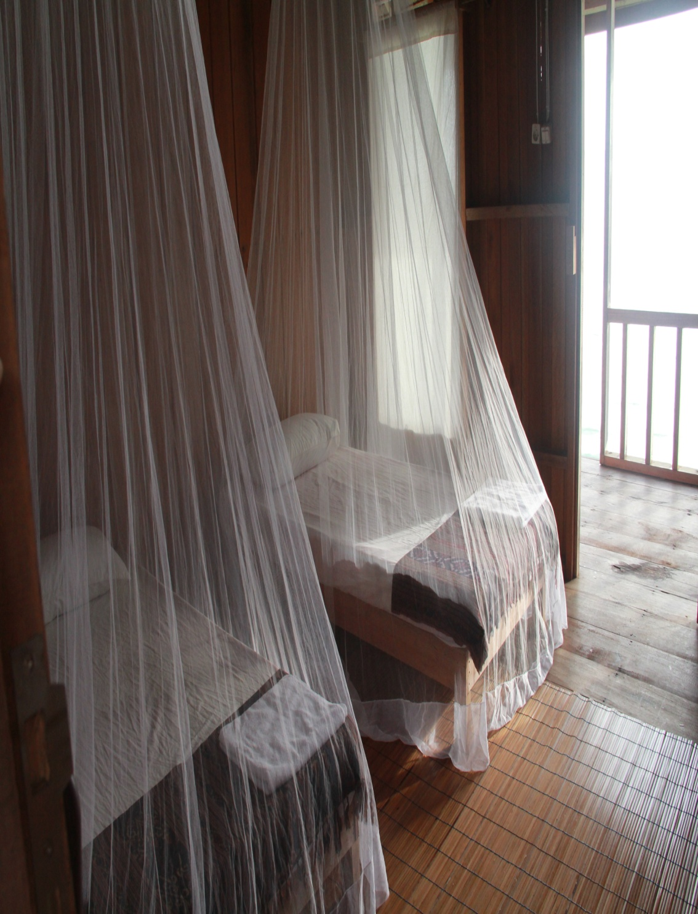
--

Slide 36
Prevention | Mode of transmission | Reservoir | Caustive agent | Disease
1-cover your mouth and nose with a tissue when you couph or sneeze 2-use mask in crowded area 3-take meningiococcal vaccine | Airborne From person to person by exposure to droplet nuclei during talk,sneezing or couph | Human | Neisseria meningitidis | Meningococcal disease
Take influenza and pneumonia vaccine | Airborne | Human | Influenza, Pneumonia and corona virus | Respiratory tract infections
1-use disposable shaving razors 2- avoid sharing personal hygine tools 3-take hepatitis vaccine | using contaminated instruments : shaving head by contaminated blade | Human | Hepatites virus ((B, C And HIV virus | Blood-borne disease

Slide 37
Prevention | Mode of transmission | Reservoir | Caustive agent | Disease
1-avoid eating exposed food prone to contamination 2-do not leave food in room temperature 3-wash your hand befor preparing and eating food 3-ensure washing fruits and vegetables befor eating 4-ensure that food come from animal sources like meet is well cocked | Fecal –oral route by Contaminated water and food | Human | Cholera and polio virus | Diarrhea and food poisoning
1-Use insect repellent 2-Were proper clothing to reduce mosquito bite 3-use mosquito nets 4-Get yellow fever vaccine | Bite of infected mosquito | Human Mosquito | Yellow fever virus | Yellow fever

Slide 38
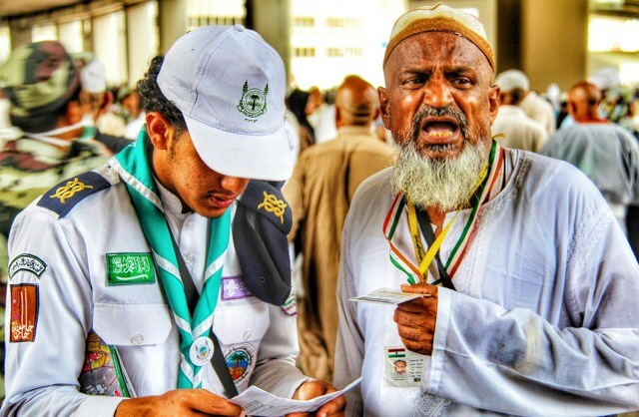
Methods for prevention and control

Slide 39
The two main problems we face during hajj are:
1- crowding
2-Elderly and disabled people

Slide 40
Crowding
increase expansion of
build another floor
grand mosque
Jamaraat bridge
Jamaraat bridge
Tawaf bridge
Public transport
Makkah Metro
Limit the number of visitors

Slide 41
In 2007, the mosque underwent a fourth extension project which is estimated to last until 2020. King Abdullah Ibn Abdul Aziz plans to increase the mosque's capacity to 2 million.

Slide 42
1975-2006 Jamaraat bridge
Notes:
2 floors 1975
The old bridge was demolished and construction began on a new multi-level bridge. The ground and first levels were complete in time for the 2006/2007 Hajj, which passed without incident. Construction on the remaining two levels have been completed since December 2007

Slide 43
Elderly and disabled people
specifed area and paths for people with disabilities
Volunteers help
Civil Defense
scouts
(برنامج القوى العاملة الزائرة في الحج(
consultants and specialists
Elevators and Escalator
Notes:
Cardiology (consultants and specialists)
Intensive Care (consultants and specialists)
Anesthesiology (consultants and specialists)
Emergency (consultants and specialists)
Gastrointestinal Endoscopy (consultants and specialists)
Nephrology (consultants and specialists)
Intensive Care Nursing Specialists and Technicians
Cardiac Nursing Specialists and Technicians
Respiratory Treatment Specialists
Artificial Kidney Nursing Technicians

Slide 44
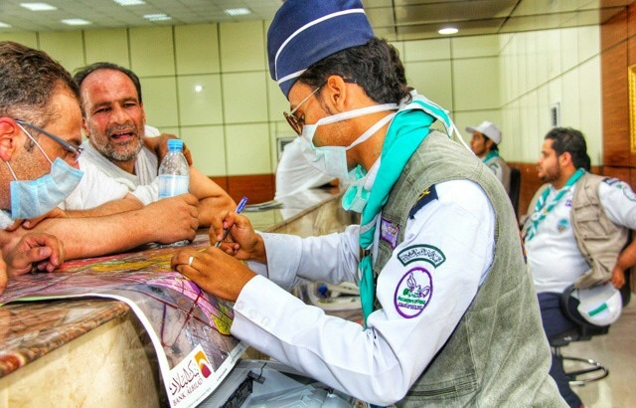
The Health Communication Program for prevention and control of prevalence of diseases

Slide 45
First: Regulations to obtain an Entry Visa for Hajj and Umrah:
1- Yellow Fever:
In accordance with the International Health Regulations 2005, all travelers arriving from countries or areas at risk of yellow fever must present a valid yellow fever vaccination certificate showing that the person was vaccinated at least 10 days and at most 10 years before arrival at the border.
2-Meningococcal Meningitis.
3-Poliomyelitis.
4- Seasonal Influenza.

Slide 46
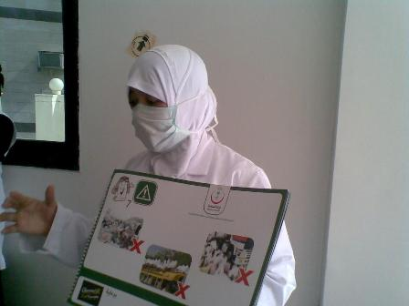
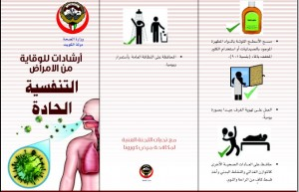
Second: Health Education

Slide 47
Second: Health Education
Health authorities in countries of origin are required to provide information to pilgrims on infectious diseases symptoms, methods of transmission, complications, and means of prevention.

Slide 48
Third: Food Material
Hajj and Umrah performers are not allowed to bring fresh food in Saudi Arabia. Only properly canned or sealed food or food stored in containers with easy access for inspection is allowed in small quantities, sufficient for one person for the duration of his or her trip.

Slide 49
Fourth: Special Precautions to MERS-COV
The Saudi Ministry of Health recommends this year that elderly (above 65 years of age) and those with chronic diseases (e.g. heart disease, kidney disease, respiratory disease, diabetes) and pilgrims with immune deficiency (congenital and acquired), Malignancy and terminal illnesses, pregnant women and children coming for Hajj and Umrah this year, to postpone the performance of the Hajj and Umrah for their own safety.

Slide 50
Fifth: Health Requirements Concerning Ebola Virus Disease (EVD):
In response to the current outbreak of Ebola haemorrhagic fever in West African countries (Guinea, Liberia and Sierra Leone) the following protective measures should be applied:
1-No visa to the KSA for Hajj, Umrah or any other purpose for travelers from Guinea, Liberia and Sierra Leone.
2-All KSA embassies and consulates should make sure that all applicants for entry visa to KSA have not travelled or lived in EVD affected countries within the last 3 weeks before their applications and entry visa should not be given to any person who visited or lived in the affected EVD countries within the last 3 weeks for Hajj , Umrah and any other purposes.

Slide 51
3-To make sure that all visitors to KSA at point of entries (air, sea and ground) fill the Ebola screening card before entering the KSA.
https://www.youtube.com/watch?v=5j79pKZZVfk

Slide 52
MINISTRY OF HEALTH DAILY HAJJ STATISTIC ON 2014
The Ministry of Health had done a lot of continued efforts to provide quality health services to pilgrims such as :
118 kidney dialysis, 26 cardiac catheterizations procedures, 1 open heart surgery and 3 binocular operations were carried out by the Ministry of Health .

Slide 53
MINISTRY OF HEALTH DAILY HAJJ STATISTIC ON 2014
21340 Hajj pilgrims visited health facilities for medical reasons in both Makkah and Madinah.
6249 patients were provided with medical treatment in hospitals, while 15091 patients were provided with primary care from health centers.

Slide 54
http://wwwnc.cdc.gov/travel/notices/alert/hajj-umrah-saudi-arabia https://www.nathnac.org/pro/factsheets/Hajj_Umrah.htm http://www.moh.gov.sa/en/Hajj/Pages/HealthRegulations.aspx http://www.moh.gov.sa/en/Ministry/MediaCenter/News/Pages/News-2014-09-30-015.aspx http://www.who.int/ar/ http://www.moh.gov.sa/Pages/Default.aspx http://www.cdc.gov/ http://en.wikipedia.org/wiki/Main_Page http://www.eurosurveillance.org/ViewArticle. aspx?ArticleId=19671 http://www.thegatewaypundit.com/wp-content/uploads/2013/10/hajj.jpg http://gracelefay.files.wordpress.com/2012/03/sneeze.jpg
References

Slide 55
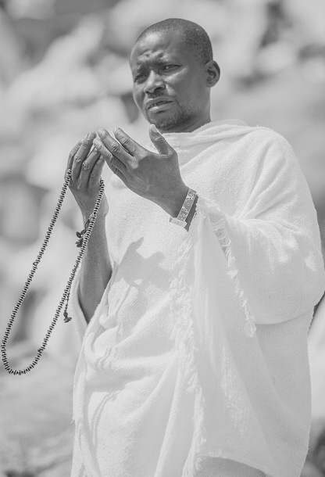
Thank You
“We pray for Allah to protect our beloved country from all such harms and diseases”
Group “Med432-F3” Members:
Tahani AlShaibani
Mona Almofarej
Maram alqahtani
Reem Alanazi
Salma Jabarty
Hadeel Alsaif
under supervision of:
Dr.Basmah

