Slide 1
Epidemiology of Ebola Virus
Supervisor:
Dr. Salwa Tayel

Slide 2
Objectives of the session:
1-introduction to viral hemorrhagic fever
2-epidemiology of ebola virus
3-Ebola virus agent and reservoir
4-Ebola virus mood of transmission
5-symptoms of ebola virus
6- diagnosis of ebola virus
7- risk factor of ebola virus
8-exposure risk levels
9-treatment of ebola virus
10- ebola virus prevention and control

Slide 3
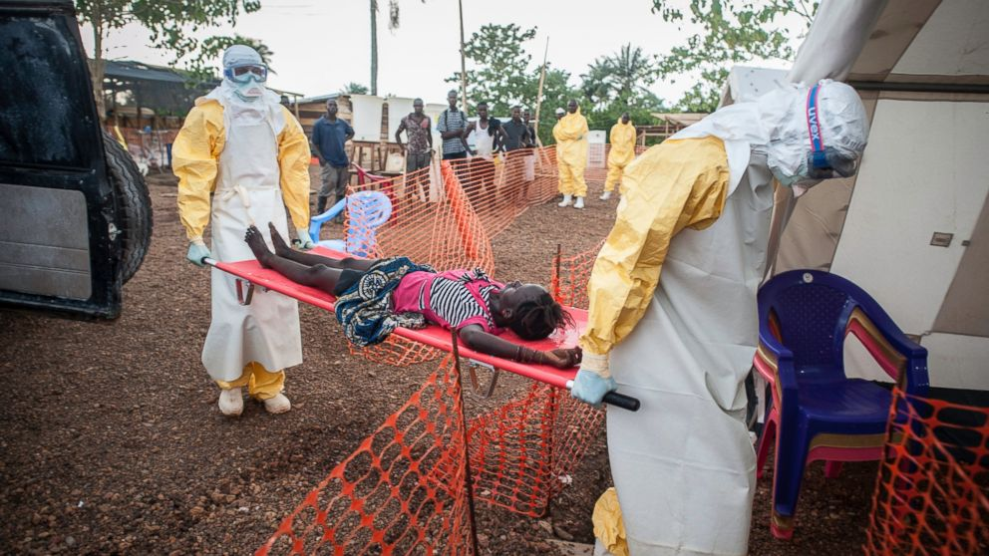
What is viral hemorrhagic fever
What is the viral hemorrhagic fever !
By: Ghaida AlObeadi

Slide 4
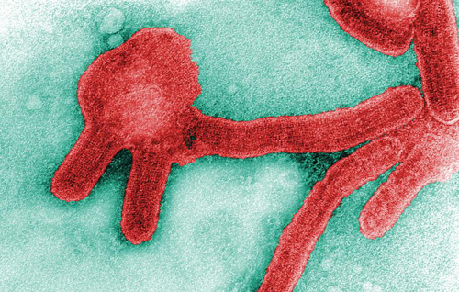
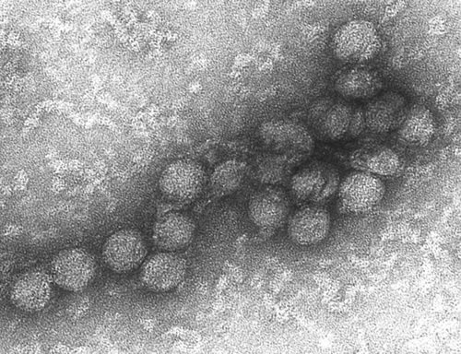
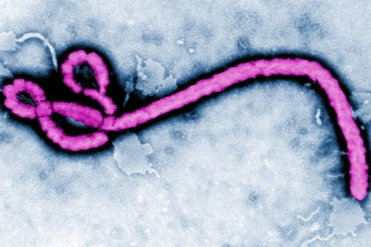
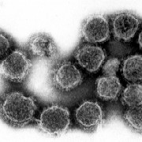
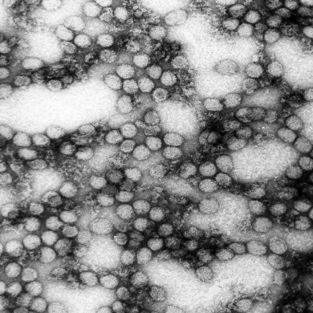
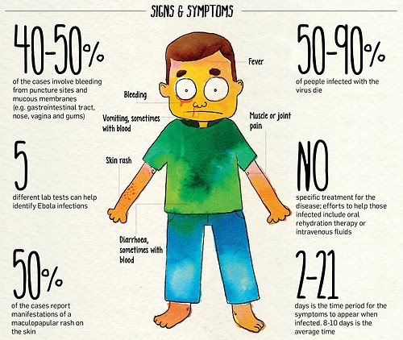
Definition of Viral hemorrhagic fevers:
(VHF) are a group of febrile illnesses caused by several distinct families of highly infectious viruses
VHF is used to describe a severe multisystem syndrome (multisystem in that multiple organ systems in the body are affected).

Slide 5
viral hemorrhagic fever
the overall
vascular system
is damaged
impaired the body's
ability to
regulate itself
These symptoms are often accompanied by hemorrhage (bleeding); however, the bleeding is itself rarely life-threatening. (While some types of hemorrhagic fever viruses can cause relatively mild illnesses, many of these viruses cause severe life-threatening disease.)
Febrile illnesses
Key points
Multisystem syndrome
Vascular system is damaged
Impaired the body's ability to
regulate itself

Slide 6
Causative viruses

Slide 7
Causative Viruses:
VHFs are caused by four distinct families of viruses:
Arenaviruses, Filoviruses, Bunyaviruses, and Flaviviruses.
Several distinct families of highly infectious viruses that share a number of properties :
-small RNA genome -lipid envelope
- zoonotic natural cycle -febrile illness (with minor to major hemorrhagic manifestations).
but differ in others:
-replication strategy -natural cycle
-pathogenesis -mode of transmission.

Slide 8
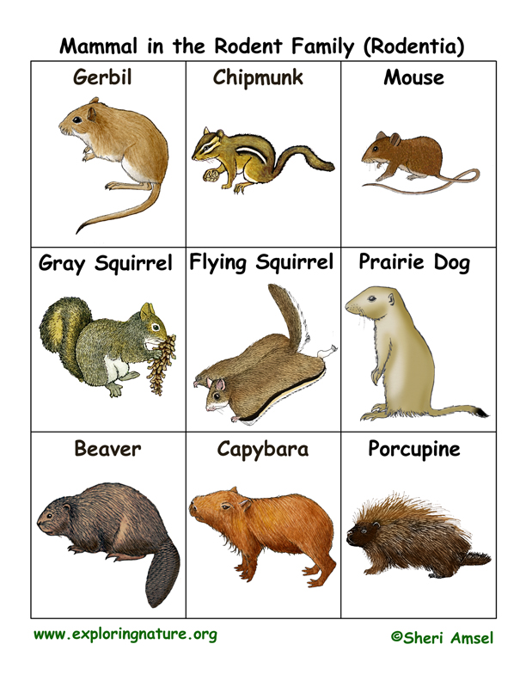
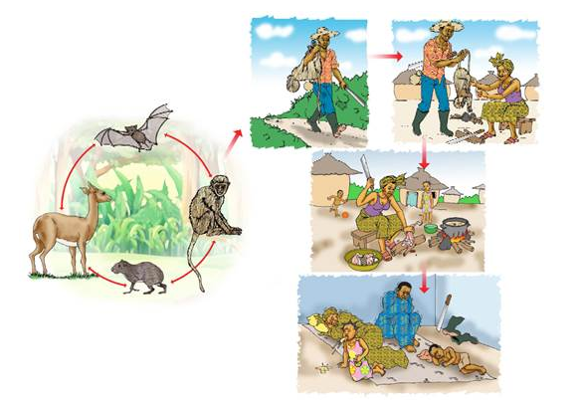
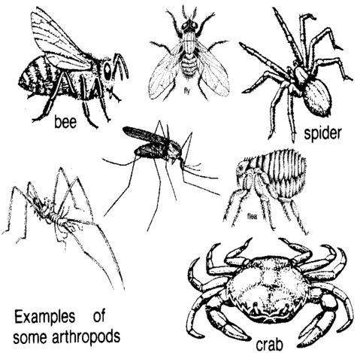
Causative Viruses:
Viruses associated with most VHFs are zoonotic
“This means that these viruses naturally reside in an animal reservoir host or arthropod vector.”
They are totally dependent on their hosts for replication and overall survival.
For the most part, rodents and arthropods are the main reservoirs

Slide 9
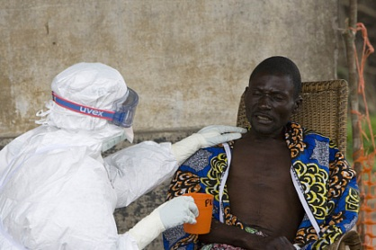
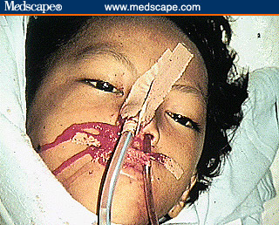
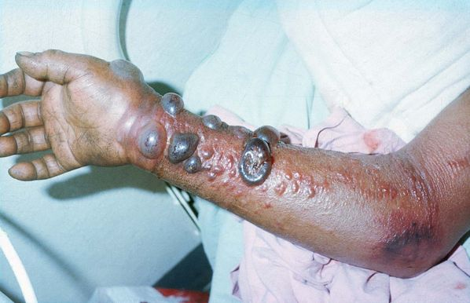
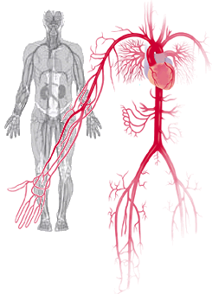
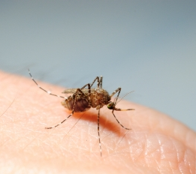
Main Pathophysiology
Vascular changes
immune response changes

Slide 10
Epidemiology of Ebola
By: Shoroog Alharby

Slide 11
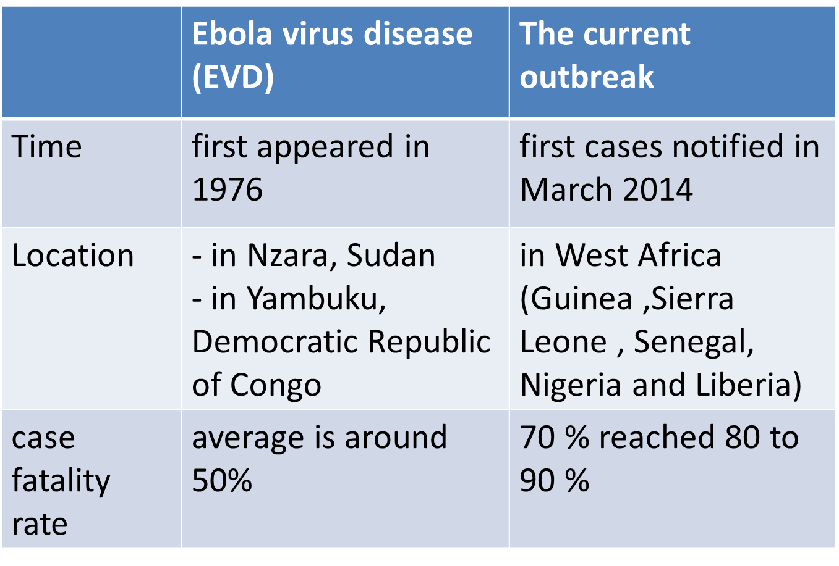
Comparison between previous and Current Ebola outbreaks

Slide 12
Number of cases and deaths On 31 October

Slide 13
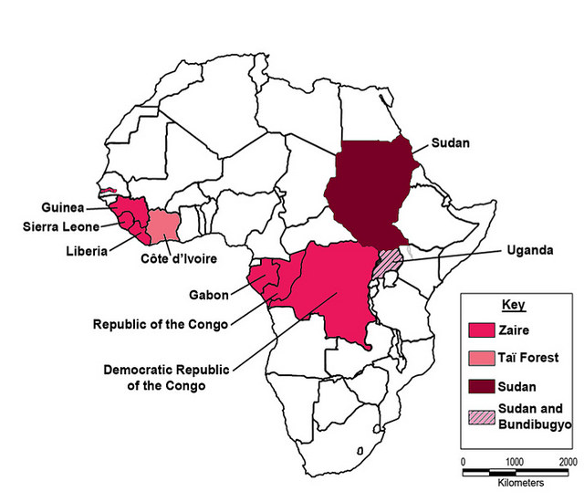
Distribution of Ebola species among Africa
*There are 5 species that have been identified:
Zaire, Bundibugyo, Sudan, Reston and Taï Forest.
-The first 3 have been associated with large outbreaks in Africa.
**The virus causing the 2014 West African outbreak belongs to the Zaire species.

Slide 14
Ebola Agent and Reservoir
By: Noura Alajmy

Slide 15
Virology of Ebola virus : -
- single-stranded RNA viruses nonsegmented , second member of Filoviridae family
- Ebola and Marburg viruses are Together, they make up the family Filoviridae
taken from the Latin word "filum," meaning thread-like, based upon their filamentous structure

Slide 16
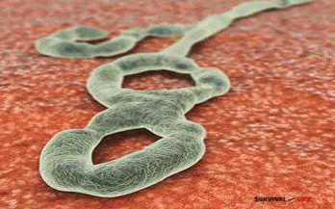
Virology of Ebola virus cont..: -
it can appear shaped like a U, a 6, or coiled like a snail; and can sometimes be branched
- INCUBATION PERIOD: Two to 21 days

Slide 17
Species :
The five known virus species are named for the region where each was originally identified :
Bundibugyo ebolavirus
Sudan ebolavirus,
zaire ebolavirus :
- zaire highest mortality rate of the ebolaviruses. it is also responsible for the largest number of outbreaks, including both the first documented outbreak (1976) and the outbreak with the most deaths (2014).
Taï Forest ebolavirus (originally Côte d'Ivoire ebolavirus)
Reston ebolavirus, is a type of Ebola that only infects non-human primates
Notes:
four of these cause Ebola virus disease in humans :
-They differ in their virulence for humans
the Zaire strain appears to be the most virulent, with a mortality rate of up to 90%.

Slide 18
Reservoir :
The natural reservoir for Ebola is unknown.
Epidemiologists have tested , monkeys,chimpanzees, gorillas, fruit bats, , spiders and ticks for the virus, but have not been able to acquire definitive data.
subsequent studies have shown that some susceptible animals are at least as susceptible as humans to rapidly lethal filoviral disease , precluding any role as a host for persistent viral infection.
Notes:
Common factors indicate that the natural reservoir might be animal from rural Africa
- Reservior typically does not demonstrate signs of the disease

Slide 19
Reservoir :
Bats have long headed the list of suspects, because:
they have been present in large numbers at the sites of several filovirus outbreaks
They are known to maintain other pathogenic RNA viruses
Serum antibodies and viral RNA have been identified in some bat species, suggesting bats may be a natural reservoir .
Notes:
66 viruses that have been isolated from bats

Slide 20
Reservoir:
Hypsignathus
monstrosus (blue),
Epomops franqueti (red) and
Myonycteris torquata (yellow).
Notes:
other study find evidence of asymptomatic infection by Ebola virus in three species of fruit bat .

Slide 21
Mechanism &Pathogenesis :
Systemically, the virus involves the heart, blood vessels, stomach, intestine, liver, lymphoid organs, and kidneys, causing hemorrhaging .
The pathogen infects many cell types, including monocytes, macrophages, dendritic cells, endothelial cells, fibroblasts, hepatocytes, adrenal cortical cells, and epithelial cells
Upon infection, the virus affects the host blood coagulative and immune system and leads to severe immunosuppression & The host usually dies with no evidence of an immune response
Notes:
One of the reasons that Ebola is so deadly is that it has multiple ways of interfering with or avoiding the human immune system. While the virus is busy destroying the human body, the immune system will be still in the process of discovering that there is a problem, and try to find out how to fight off the invader

Slide 22
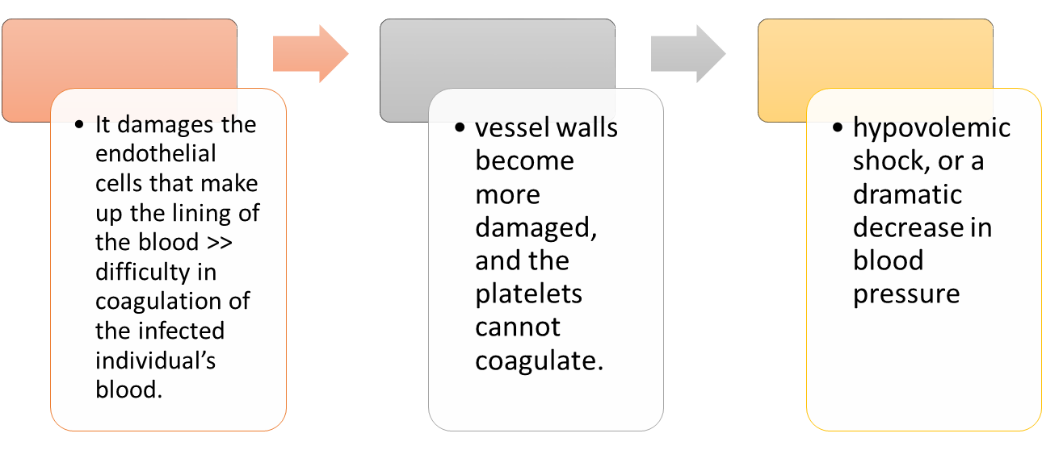
Mechanism and pathogenesis Cont.
-(EVD) Serious and usually fatal disease for those who contract it.
most of infected patient were dying of hypovolemic shock and multisystem organ failure
Notes:
It used to be known as ebola hemorrgic fever more recently Ebola virus disease

Slide 23
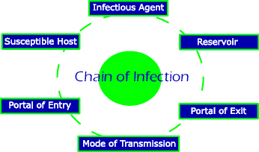
Transmission of Ebola virus
By: Fadah Alanazi
Notes:
http://scioly.org/wiki/index.php/Disease_Detectives

Slide 24
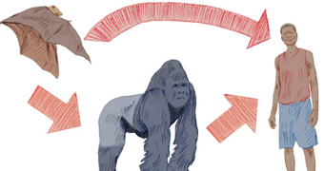
Transmission of Ebola virus
Contact with Infected Animals.
Notes:
http://www.abc.net.au/news/2014-07-30/ebola-virus-explainer/5635028

Slide 25
Transmission of Ebola virus
Person-to-person transmission:
Ebola virus can be spread directly through:
Body fluids.
The most infectious body fluids are blood, feces and vomit.
Skin.
Notes:
http://www.abc.net.au/news/2014-07-30/ebola-virus-explainer/5635028

Slide 26
Transmission of Ebola Virus Cont.
Ebola virus can also be transmitted indirectly, by contact with objects ,surfaces and materials that have been contaminated with these fluids.

Slide 27
Portal of entry of Ebola virus:
Ebola virus enters the host body through :
mucous membranes.
breaks in the skin.
or parentally.
Portal of exit of Ebola virus:
The virus leaves the host body through the skin and body fluids (blood, vomit ,diarrhoea….etc.)

Slide 28
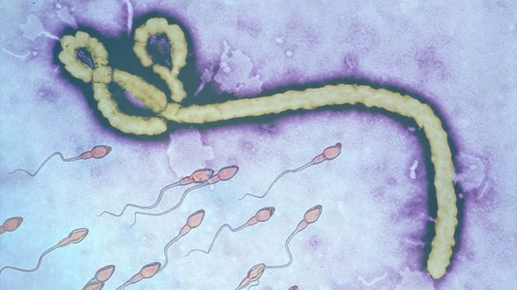
Viral persistence
Virus can persist for some time in certain bodily fluids, such as semen and breast milk.

Slide 29
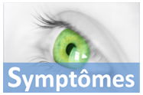
By :
Ashwag Alharby.

Slide 30
Symptoms of Ebola

Slide 31
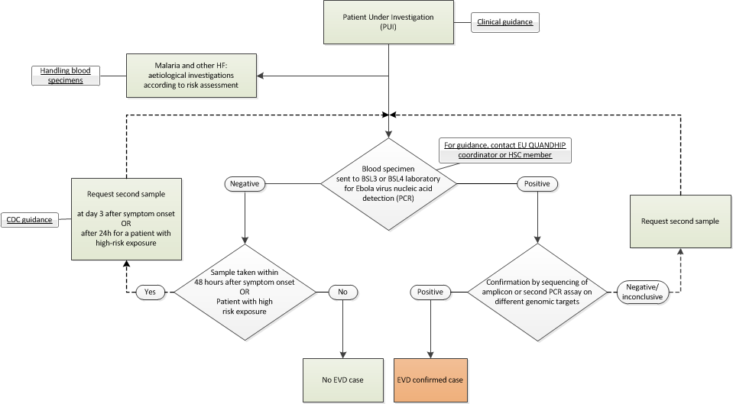
Diagnosis of Ebola Virus

Slide 33
Prepare people for burial. The bodies of people who have died of Ebola or Marburg hemorrhagic fever are still contagious. because the virus may be on the skin.

Slide 34
High risk exposures:
Percutaneous (e.g., needle stick) or mucous membrane exposure to blood or body fluids of EVD patient
Direct skin contact with, or exposure to blood or body fluids of, an EVD patient without appropriate personal protective equipment (PPE)
Direct contact with a dead body without appropriate PPE in a country where an EVD outbreak is occurring.

Slide 35
Low risk exposures:
Brief interactions, such as walking by a person or moving through a hospital, do not constitute close contact

Slide 36
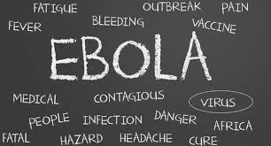
Treatment of Ebola virus
By: Sarah alshehri

Slide 37
Is there treatment for Ebola virus ??

Slide 38
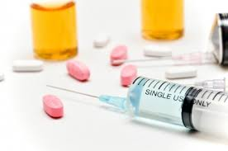
there are no approved cures or vaccines to prevent,
Ebola infections.

Slide 39
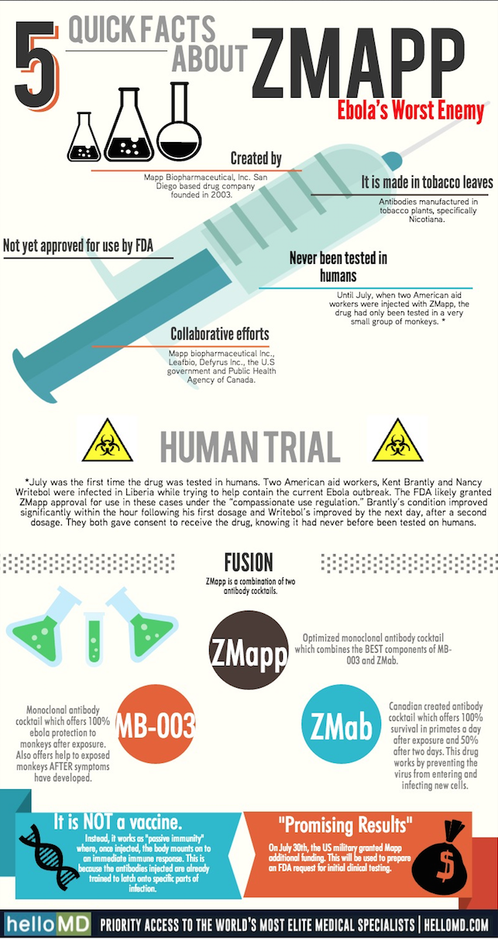
a "cocktail" of three monoclonal antibodies directed against the Ebola viral glycoprotein.
("ZMapp") prevented the death of Ebola-infected macaques.
Notes:
In the 2014 West African outbreak, ZMapp was administered to two United States healthcare workers, both of whom survived and recovered [43, 44]. Two other severely ill healthcare workers given ZMapp did not survive, possibly due to the late initiation of therapy [45]

Slide 40
So what to do when you suspect Ebola virus !

Slide 41
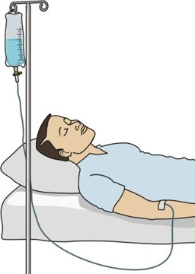
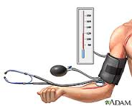
The following basic interventions, when used early, can significantly improve the chances of survival:
Providing intravenous fluids (IV) and balancing electrolytes, (body salts).
Maintaining oxygen status and blood pressure.
Treating other infections if they occurs.

Slide 42
Recovery from Ebola depends on
- good supportive care and the patient’s immune response.
Some people who have recovered from Ebola have developed long-term complications, such as joint and vision problems

Slide 43
Are patient who recovered from Ebola immune for life ?

Slide 44
People who recover from Ebola infection develop antibodies that last for at least 10 years, possibly longer.
It is not known if people who recover are immune for life or if they can become infected with a different species of Ebola.

Slide 45
Prevention and Control
By: Fatmah Alshehry

Slide 46
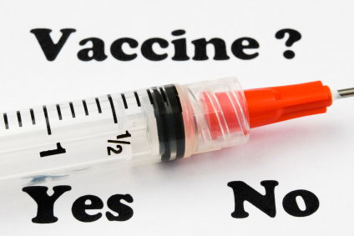
- No approved vaccines are available to prevent the spread of Ebola virus.

Slide 47
*Prevention and control Recommended by WHO:
**Risk reduction messaging should focus on several factors:
- Reducing the risk of wildlife-to-human transmission
Reducing the risk of human-to-human transmission
Outbreak containment measures

Slide 48
*Controlling infection in health-care settings recommended by WHO:
Standard Precaution
Isolation
Strict use of PPE
Injection, sharp and phlebotomy safety
Laboratory safety
Safe care of the dead
These action must be supported by ongoing surveillance of the cases.

Slide 49
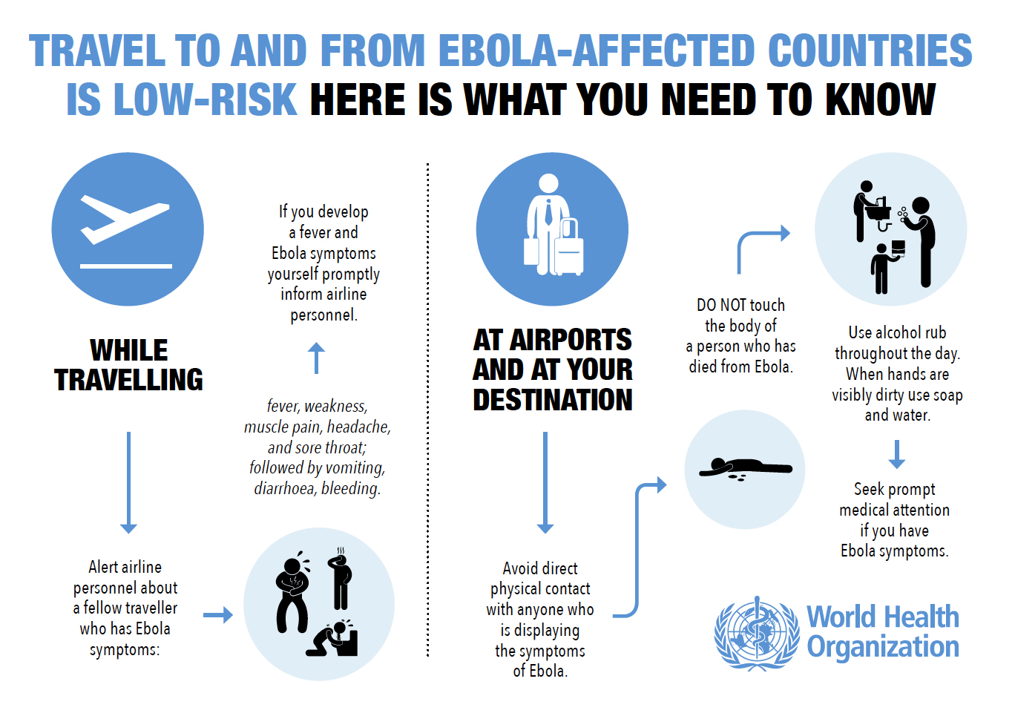

Slide 50
Thank you

