Slide 1
Epidemiology of malaria

Slide 2
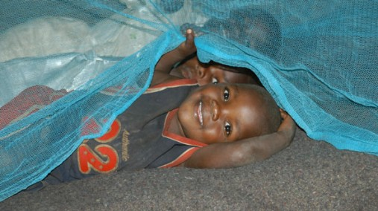
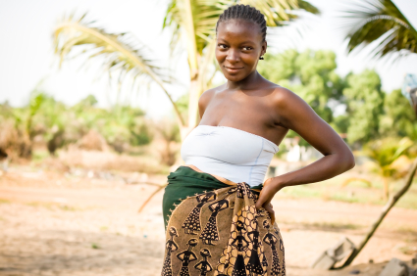
Malaria is a mosquito-borne disease
one of the most severe public health problems worldwide. It is a leading cause of death and disease in many developing countries where young children and pregnant women are the groups most affected.

Slide 3
Statistics
According to the World Heath Organization’s World malaria report 2013 and the global malaria action plan :
Most of the estimated cases (80%) occur in sub-Saharan Africa. followed by the South-East Asia Region (13%) and the Eastern Mediterranean Region (6%).
In 2012, 627,000 deaths mostly among African children
every minute a child dies from malaria in Africa ☹

Slide 4
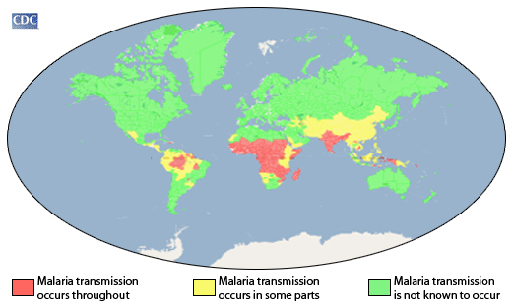
Geography
Malaria occurs mostly in poor, tropical and subtropical areas of the world
Notes:
Africa most affected , In other areas of the world malaria is a less prominent cause of deaths, but can cause substantial disease and incapacitation, especially in rural areas of some countries in South America and South Asia.

Slide 5
Africa is the most affected area why ????
A very efficient mosquito (Anopheles gambiae complex) is responsible for high transmission.
The predominant parasite species is Plasmodium falciparum, which is the species that is most likely to cause severe malaria and death.
Local weather conditions often allow transmission to occur year round.
socio-economic status

Slide 6
Who Is Most Vulnerable?
The most vulnerable are persons with no or little immunity against the disease. In areas with high transmission (such as Sub-Saharan Africa), the most vulnerable groups are:
Young children, who have not yet developed partial immunity to malaria
pregnant women , whose immunity is decreased by pregnancy.
Travelers or migrants coming from areas with little or no malaria transmission, who lack immunity.

Slide 7
Prevalence of Malaria worldwide

Slide 8
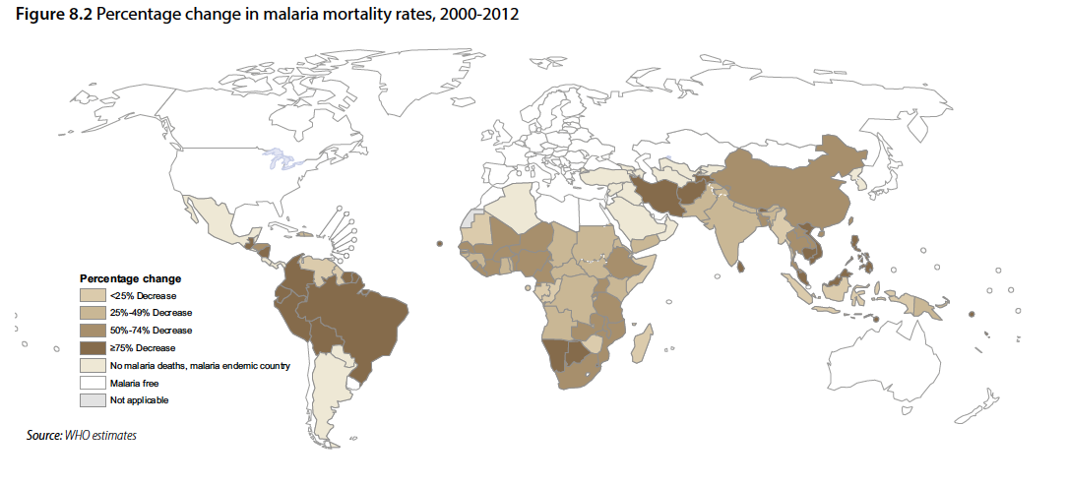
WHO estimated 3.4 billion people were at risk of malaria in 2012.
Most of them were living African Region (47%) and the South-East Asia Region (37%).

Slide 9
According to WHO estimated that 207 million cases of malaria occurred globally in 2012(uncertainty range 135–287 million)
And 627 000 deaths (uncertainty range 473 000–789 000) occurred in 2012 .
Notes:
most cases (80%) African Region and in
children under 5 years of age (77%).
estimated that 90% of deaths in 2012 were in the African
Region

Slide 10
There was a reduction in case incidence of 25% globally between2000 and 2012 and 31% in the African Region.
At these rates, by2015, malaria case incidence is projected to decrease by 36%globally and by 44% in the African Region.

Slide 11
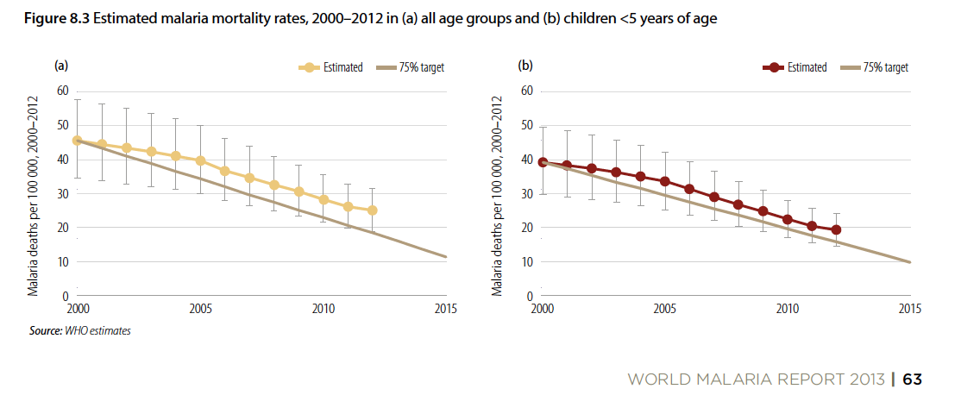
According to WHO the estimated malaria mortality rates worldwide fell by 42% between 2000 and 2012 in all age groups , and by 48% in children under 5 years of age.
If the annual rate of decrease that has occurred over the past 12 years is maintained, then malaria mortality rates are projected to decrease by 52% in all ages, and by 60% in children under 5 years of age, by 2015.

Slide 12
Notes:
Malaria occurred in eastern Mediterranean region in these countries

Slide 13
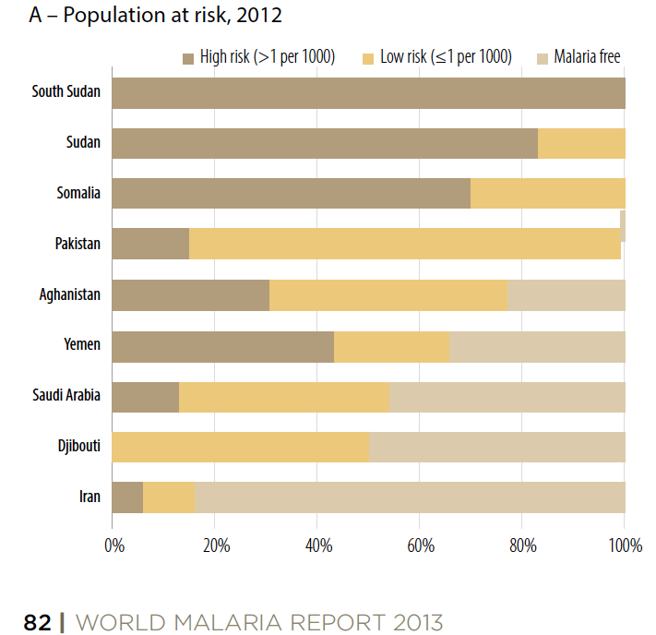
In 2012, about 280 million people in nine countries in the Eastern Mediterranean Region were at some risk of malaria, and about 120 million people were at high risk

Slide 14
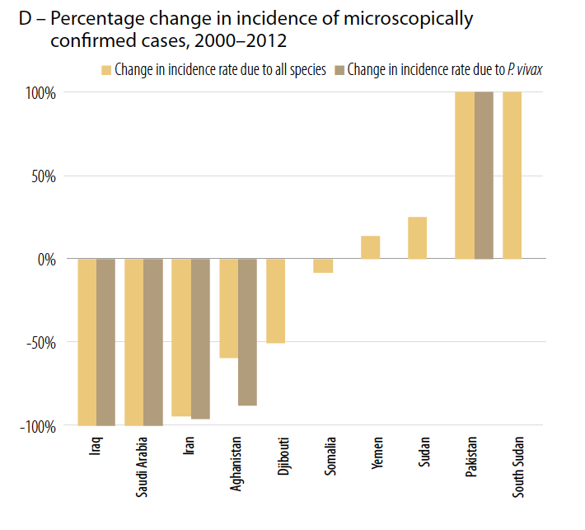
According to WHO Three countries accounted for 86% of cases in2012: the Sudan (47%), Pakistan (22%) and South Sudan (17%).
Three countries reported >75% decrease in case incidence between 2000 and 2012 Iran, Iraq and Saudi Arabia.
Iraq has reported zero locally acquired cases since 2009.

Slide 17
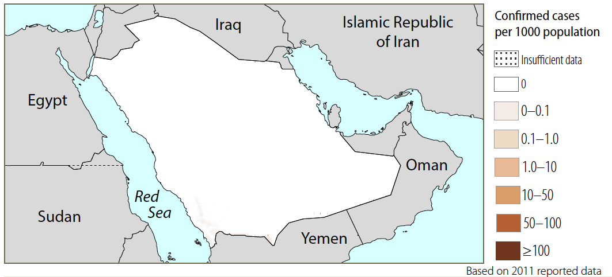
In Saudi Arabia some 14 million people (54%) are at risk of malaria.
In Saudi Arabia transmission is geographically limited. Areas at the southern region are at risk of malaria transmission, specifically Asir and Jizan. None in the cities of Jeddah, Mecca, Medina, Riyadh, and Ta’if.
Notes:
Malaria transmission tends to be highly seasonal and unstable with the peak occurring between October and April; over 70% of the cases are still due to P. falciparum

Slide 18
Notes:
Parasites and vectors
Major plasmodium species: P. falciparum (100%), P. vivax (0%)
Major anopheles species: An.arabiensis, sergentii, funestus, bacroftii, albimanus, balabacensis
Programme phase: Elimination

Slide 19
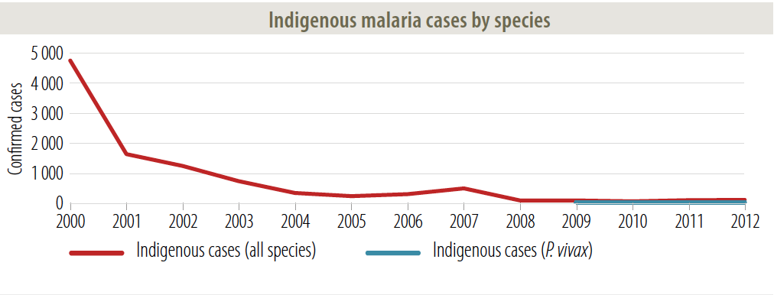
In 2011, 2788 malaria cases were recorded in the Kingdom of Saudi Arabia, out of which 69 cases are Saudis (2.4 %of the total malaria cases). This percentage corresponds to the incidence: 0.44 cases for every 100.000 persons.
Saudi cases have been recorded in Jazan Region and Assir Region.
There has been a slight increase in the number of indigenous cases in Saudi Arabia during the past three years (29 cases in 2010, 69 in 2011 and 82 in 2012)
Notes:
Why ??

Slide 20
Transmission of Malaria

Slide 21
Transmission of malaria
The intensity transmission depends on factors related to:
Parasite
Vector
Host
Environment

Slide 22
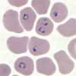
Parasite species that cause malaria in humans:
Plasmodium falciparum
Plasmodium vivax
Plasmodium malariae
Plasmodium ovale.
Plasmodium falciparum is the most deadly.
P. Vivax and P. Ovale they can cause relapses.

Slide 23
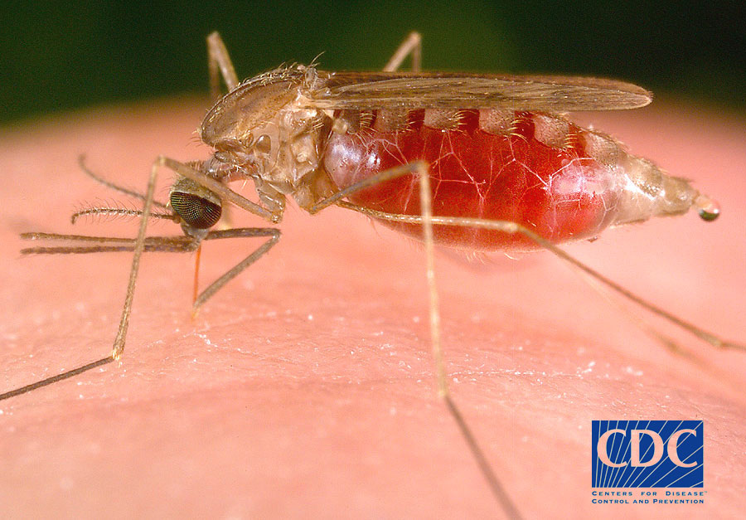
Vector: Anopheles mosquito.
Usually bite at night.
Breeding sites is water
Transmission is more intense in places where:
Mosquito have long lifespan so it will lead to complete parasite development inside the mosquito.
Mosquito prefers to bite humans rather than other animals.

Slide 24
Host: human
The intensity of in infection depends on human immunity and behavior.
Depends on climatic conditions such as rainfall patterns, warm temperature and humidity.
In many places, transmission is seasonal, with the peak during and just after the rainy season
Environment

Slide 25
Malaria life cycle:
Notes:
Sporozoites of malaria is found in Anopheles mosquito's salivary glands.
The mosquito bite human and inject sporozoites in human to start an infection
In human the malaria parasites grow and multiply first in the liver cells
Then invade the red blood cells parasites grow inside the red cells and destroy them, releasing daughter parasites that continue the cycle by invading other red cells.
When female Anopheles mosquito bite infected human they will pick up malaria parasite and they start another, different cycle of growth and multiplication in the mosquito.
The blood stage parasites are those that cause the symptoms of malaria
P. Vivax and P. Ovale they can persist in the liver and cause relapses by invading the bloodstream weeks, or years later.

Slide 26
Symptoms of malaria
Uncomplicated malaria:
The classical malaria attack lasts 6-10 hours. It consists of:
cold stage hot stage and finally a sweating stage.
More commonly, the patient presents with:
Fever
Chills
Sweats
Headaches
Nausea and vomiting
Body aches
General malaise
Severe malaria occurs when infections are complicated by:
serious organ failures
abnormalities in the patient's blood or metabolism
Notes:
Classical malaria rarely observed
More common symptoms like influenza
e.G of sever malaria
Cerebral malaria,Severe ,Hemoglobinuria ,Acute respiratory distress syndrome (ARDS).

Slide 27
Malaria modes of transmission:
Female Anopheles mosquitoes bite
Blood :
Blood transfusion
Needle-stick injuries
Organ transplant
The shared use of needles or syringes
Congenital malaria: From a mother to her child during pregnancy before or during delivery

Slide 28
Human Factors and Malaria
By: Hessa AlAbdulsalam

Slide 29
Human Factors and Malaria
Genetic Factors
There are two important genetic conditions (both are associated with red blood cells) that can protect against certain types of malaria :
Patients who are sickle cell trait are relatively protected against P. falciparum malaria
Persons who are negative for the Duffy blood group are resistant to P. vivax.
*Majority of Africans are Duffy negative. So, in that area P. vivax has been replaced by P. ovale (Similar parasite but infects those who are Duffy negative)
In overall, hemoglobin-related disorders and other blood disorders, like : (Thalassemias, Hemoglobin C, and G6PD deficiency) which are more prevalent in endemic areas of malaria and can provide protection against malaria as well.
Acquired Immunity
Repeated infections of malaria can provide a partially protective immunity.
Those with repeated infections can still be infected by malaria but may not develop severe disease, and the often lack the typical malaria symptoms.
Notes:
*Because P. falciparum malaria has been a leading cause of death in Africa since remote times, the sickle cell trait is now more frequently found in Africa and in persons of African ancestry than in other population groups
*The Duffy glycoprotein is a receptor for chemicals that are secreted by blood cells during inflammation. It also happens to be a receptor for Plasmodium vivax, a parasite that invades red blood cells (RBCs) and causes malaria. RBCs that lack the Duffy antigens are relatively resistant to invasion by P. vivax. This has influenced the variation in Duffy blood types seen in populations where malaria is common.
sickle cell trait (heterozygotes for the abnormal hemoglobin gene HbS)

Slide 30
Human Factors and Malaria, cont.
Acquired Immunity, cont. :
In endemic areas, newborns will be protected during the first few months, HOW?
by maternal antibodies transferred to newborns through the placenta.
With time these antibodies decrease. So, these young children become vulnerable to be infected by malaria and may sometime die from it.
That is why young children are targeted by malaria control programs in endemic areas.
Pregnancy and Malaria
In general pregnancy decrease the immunity of the mother which makes her more prone to infections. In other words, those who have already developed immunity against malaria tend to lose that privilege when they become pregnant.
Complications of Malaria infection during pregnancy includes :
Prematurity with low birth weight which may eventually decrease survival rate during the early months of life.
That is why pregnant ladies are also targeted for protection by malaria control programs in endemic areas.
Notes:
Malaria during pregnancy is dangerous not only to the mothers but also to the unborn children.

Slide 31
Human Factors and Malaria, cont.
Behavioral Factors
Human behavior, which is influenced by socio-economic reasons, can impact the risk of malaria
Examples are :
Poor populations in rural areas often cannot afford the housing and bed nets which can protect them from being infected.
The lack of knowledge to recognize malaria and to treat it in rural areas can also play a major role.
Travelers from non-endemic areas may neglect the importance of personal protective measures against malaria. *Reasons may be : cost, or lack of knowledge.
Migrations and tourism may increase the risk of non-immune individuals to be exposed to an environment with high malaria transmission.
Raising domestic animals near the household can play a role by providing a source of blood meals for mosquitoes which will then decrease the human exposure.
Notes:
*Human behavior in endemic countries also determines in part how successful malaria control activities will be in their efforts to decrease transmission. The governments of malaria-endemic countries often lack financial resources. As a consequence, health workers in the public sector are often underpaid and overworked. They lack equipment, drugs, training, and supervision. The local populations are aware of such situations when they occur, and cease relying on the public sector health facilities. Conversely, the private sector suffers from its own problems. Regulatory measures often do not exist or are not enforced. This encourages private consultations by unlicensed, costly health providers, and the anarchic prescription and sale of drugs (some of which are counterfeit products). Correcting this situation is a tremendous challenge that must be addressed if malaria control and ultimately elimination is to be successful. ( mention it briefly)

Slide 32
Main Methods for Malaria Control
By: Hessah Alshehri

Slide 33
Definitions
Malaria control:
The reduction of the malaria disease burden to a level at which it is no longer a public health problem.
Malaria elimination:
The reduction to zero of the incidence of malaria infection in a defined geographical area.
Continue preventive & control measures to prevent re-establishment of transmission.
Malaria-free status:
Malaria eliminated in an entire country for at least 3 consecutive years.
Malaria eradication:
permanent reduction to zero of the worldwide incidence of the infection.
No need for Intervention measures once eradication has been achieved.

Slide 34
Main methods for Malaria control
Control of patient
Control of patient’s contacts
Control of immediate environment (vector control)
Malaria surveillance systems

Slide 35
Control of patients
- Isolation of the case is not required.
- Mosquito contact with the patient should be prevented.
- Source of acquisition of the disease should be determined.
- Every malaria case should be tracked in a surveillance system.
- Treatment with artemisinin-based combination therapies (ACTs):
e.g. chloroquine, primaquine, & quinidine.
Goals of treatment:
Reduce morbidity & mortality by:
-Preventing the progression to severe & potentially fatal disease.
-Preventing chronic infection that leads to malaria-related anemia.
Reduce the transmission of malaria by reducing the human parasite reservoir.
Prevent the emergence & spread of resistance to antimalarial medicines.

Slide 36
Control of patient’s contacts
-Warn contacts about their risk of developing Malaria.
-They should seek medical care immediately if they develop suggestive symptoms (fever, headache, chills & vomiting).

Slide 37
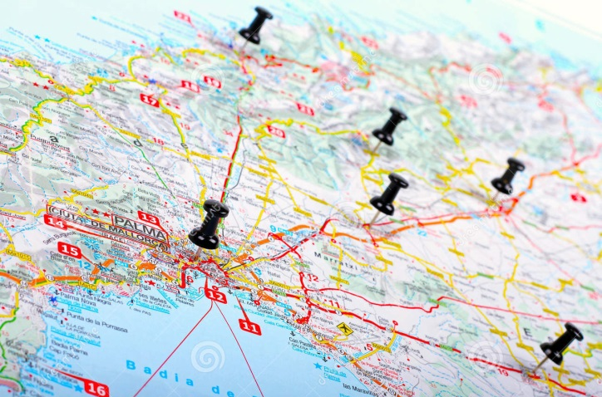
Malaria surveillance systems (1)
Needed to:
Target resources to the populations most in need.
Respond to unusual trends like:
-Outbreaks of malaria cases.
-Transmission rates continues to be high despite
widespread implementation of interventions.
Design of Malaria surveillance systems depends mainly on the Level of malaria transmission

Slide 38
Malaria surveillance systems (2)
Countries in the control phase
& areas of moderate to high transmission:
High case incidence rates → not possible to examine & react to each confirmed case individually.
Analysis must be based on aggregate numbers.
Action taken at a population level.
Countries In the elimination phase:
Each infection should be detected & investigated to make sure whether the infection was:
-imported (coming from outside
the country)
-locally acquired (by mosquito-
borne transmission).
Appropriate control measures should be undertaken.
As transmission is reduced, it becomes necessary to track & respond to individual cases

Slide 39
Prevention (Worldwide measures)

Slide 40
Insecticide-Treated Bed Nets.
Indoor Residual Spraying
Larval Control and Other Vector Control Interventions
Intermittent Preventive Treatment of Malaria for Pregnant Women (IPTp)
Personal Protection Measures

Slide 41
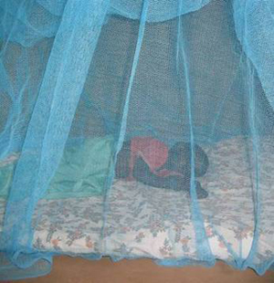
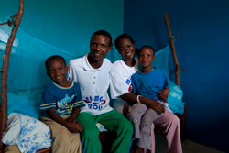
1-Insecticide-Treated Bed Nets:
they are a form of personal protection to reduce malaria illness, severe disease, and death due to malaria in endemic regions.
How Do ITNs Work?
Bed nets form a protective barrier around people sleeping under them
. However, bed nets treated with an insecticide are much more protective than untreated nets
Notes:
. In community-wide trials in several African settings, ITNs have been shown to reduce the death of children under 5 years from all causes by about 20%

Slide 42
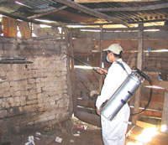
2-Indoor Residual Spraying
What Is Indoor Residual Spraying?
IRS involves coating the walls of a house with a residual insecticide. For several months, the insecticide will kill mosquitoes and other insects that come in contact with these surfaces.
IRS does not directly prevent people from being bitten by mosquitoes. Rather, it usually kills mosquitoes after they have fed if they come to rest on the sprayed surface.
Notes:
Many mosquitoes rest inside houses after taking a blood meal. These mosquitoes are particularly susceptible to control through indoor residual spraying (IRS)
*IRS thus prevents transmission of infection to other persons. To be effective, IRS must be applied to a very high proportion of households in an area (usually >80%)..

Slide 43
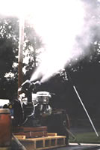
3-Larval Control and Other Vector Control Interventions
Fogging (area spraying) using a machine mounted on the back of a truck.
Fogging is for emergency situations such as epidemics..
Fogging and area sprays must be properly timed to coincide with the time of peak adult mosquito activity why
In addition, fogging and area spraying will have to be repeatedly applied to have an impact.
Notes:
Fogging has not been shown to be effective in any malaria-endemic areas
because resting mosquitoes are often found in areas that are difficult for the insecticide to reach (e.g., under leaves, in small crevices).

Slide 44
4-Intermittent Preventive Treatment of Malaria for Pregnant Women (IPTp)
IPTp:
IPTp entails administration of a curative dose of an effective antimalarial drug (currently sulfadoxine-pyrimethamine) to all pregnant women whether or not they are infected with the malaria parasite.

Slide 45
5-Personal Protection Measures:- prophylaxis
Well-constructed houses with window screens are effective for prevent mosquitoes biting.
Repellents (bug spray applied in skin or clothes) are effective against outdoor mosquitoes bites or when ITNs are not used.
Sterile Male Release into an area has been successfully applied in several areas.
Personal prophylaxis from mosquito’s bite include: using of window screens, wearing light-colored clothes, long pants, and long-sleeved shirts, ITNs .

Slide 46
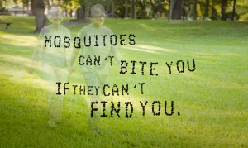

Slide 47
programs for prevention and control of malaria in KSA.

Slide 48
ITNs/LLINs Insecticide-treated bed nets/Long-lasting insecticidal nets. IRS Indoor residual spraying, while DDT an insecticide, not used in KSA.
Notes:
ITNs/LLINs Insecticide-treated bed nets/Long-lasting insecticidal nets.
IRS Indoor residual spraying, while DDT an insecticide, not used in KSA.

Slide 49
Saudi Arabia has succeeded to reach the “Elimination Phase”.
Between 2000 and 2011, Saudi Arabia achieved a decrease in malaria cases and case incidence rates of ≥75%
The program has been successful in reducing the numbers of indigenous cases to very low levels.

Slide 50
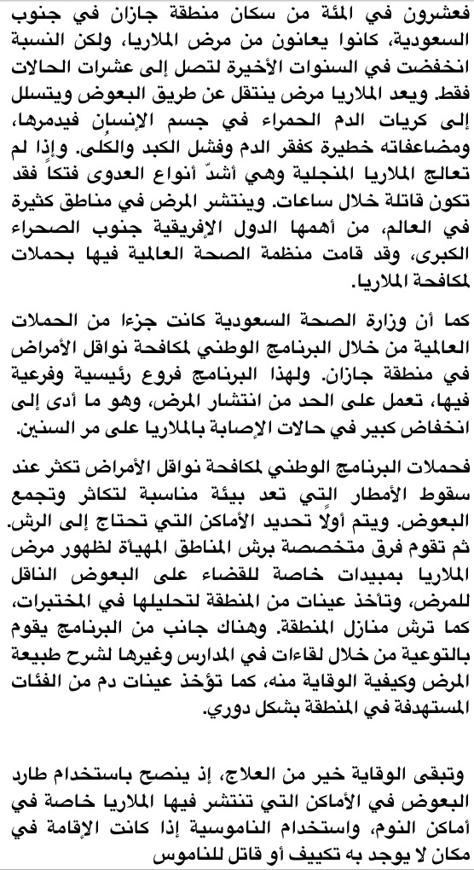
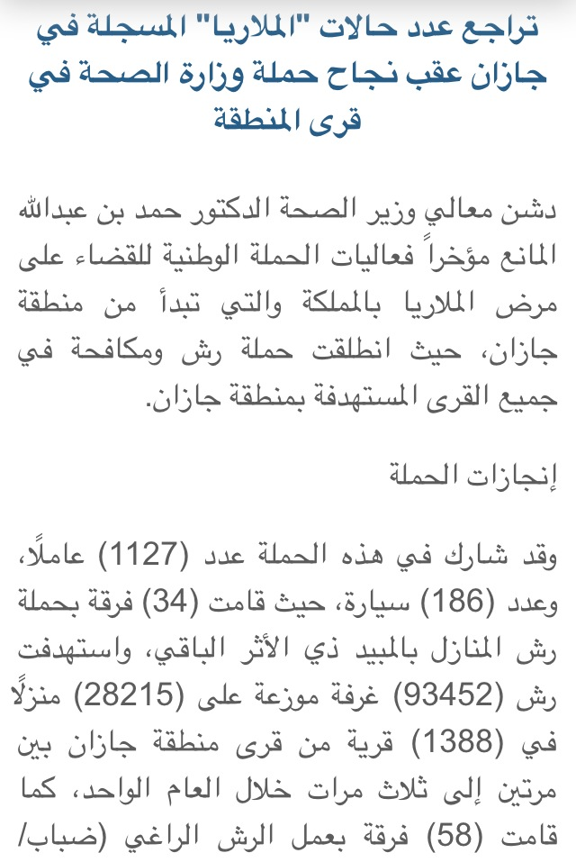
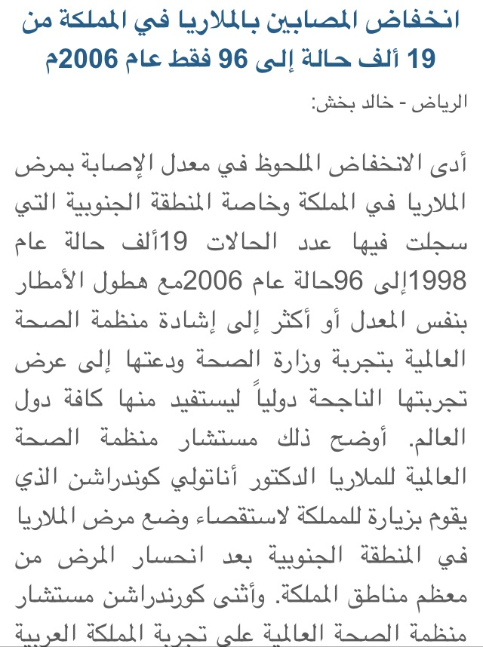
Malaria Prevention Campaigns in SA

Slide 51
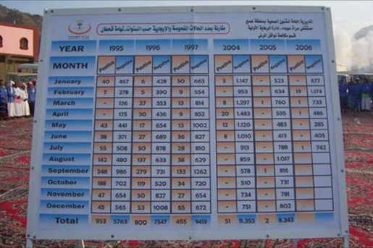

Slide 52
Epidemic measures:
To determine the nature and extent of the epidemic situations.
Immediate and effective treatment to all cases in order to control and prevent malaria epidemics.

Slide 53
Thank you
Notes:
http://youtu.be/LutGFrwysRI

Slide 54
References
WHO World Malaria report 2013
http://www.who.int/malaria/publications/world_malaria_report_2013/wmr2013_no_profiles.pdf?ua=1
http://www.who.int/malaria/publications/country-profiles/profile_sau_en.pdf?ua=1
WHO Malaria report 2010
http://www.who.int/malaria/publications/country-profiles/2010/en/#S
CDC malaria
http://www.cdc.gov/malaria/malaria_worldwide/impact.html
file:///C:/Users/User/Downloads/9789241564694_eng.pdf
http://www.cdc.gov/malaria/malaria_worldwide/reduction/itn.html
http://www.cdc.gov/malaria/malaria_worldwide/reduction/iptp.html
http://www.cdc.gov/malaria/malaria_worldwide/reduction/vector_control.htm
http://www.cdc.gov/malaria/malaria_worldwide/reduction/vaccine.html
http://www.cdc.gov/malaria/about/disease.html
http://www.cdc.gov/malaria/about/biology/index.html
http://www.cdc.gov/malaria/about/biology/human_factors.html
http://www.cdc.gov/malaria/about/biology/ecology.html
“Malaria - Blue Book - Department of Health, Victoria, Australia.” Instructional. Accessed November 5, 2014. http://ideas.health.vic.gov.au/bluebook/malaria.asp
Local resources/magazines
www.alriyadh.com/236273
http://www.alriyadh.com/199215
http://www.moh.gov.sa/HealthAwareness/EducationalContent/Diseases/Hematology/Pages/002.aspx
http://www.alarabiya.net/ar/saudi-today/2013/04/25/في-اليوم-العالمي-للملاريا-جازان-تحاصر-المرض-وتكافحه.html
Images:
http://www.careeradvicehq.com/wp-content/uploads/2011/06/warm-contacts-list.jpg
http://thumbs.dreamstime.com/z/pushpins-shows-destination-points-map-black-31955097.jpg
http://www.qahtaan.com/vb/showthread.php?t=14793
http://www.telegraph.co.uk/science/science-news/10889131/Mosquitoes-modified-to-only-give-birth-to-males-in-bid-to-wipe-out-malaria.html
http://www.greek2m.org/1%20%20mosq.%20clh-west-nile-2012%20(1).jpg

