Slide 1
Scientific integrity and Plagiarism

Slide 2
Content
Goals and objectives
Introduction
Islamic perspective on the importance
Historic overview
What is Scientific Integrity?
What is plagiarism?

Slide 3
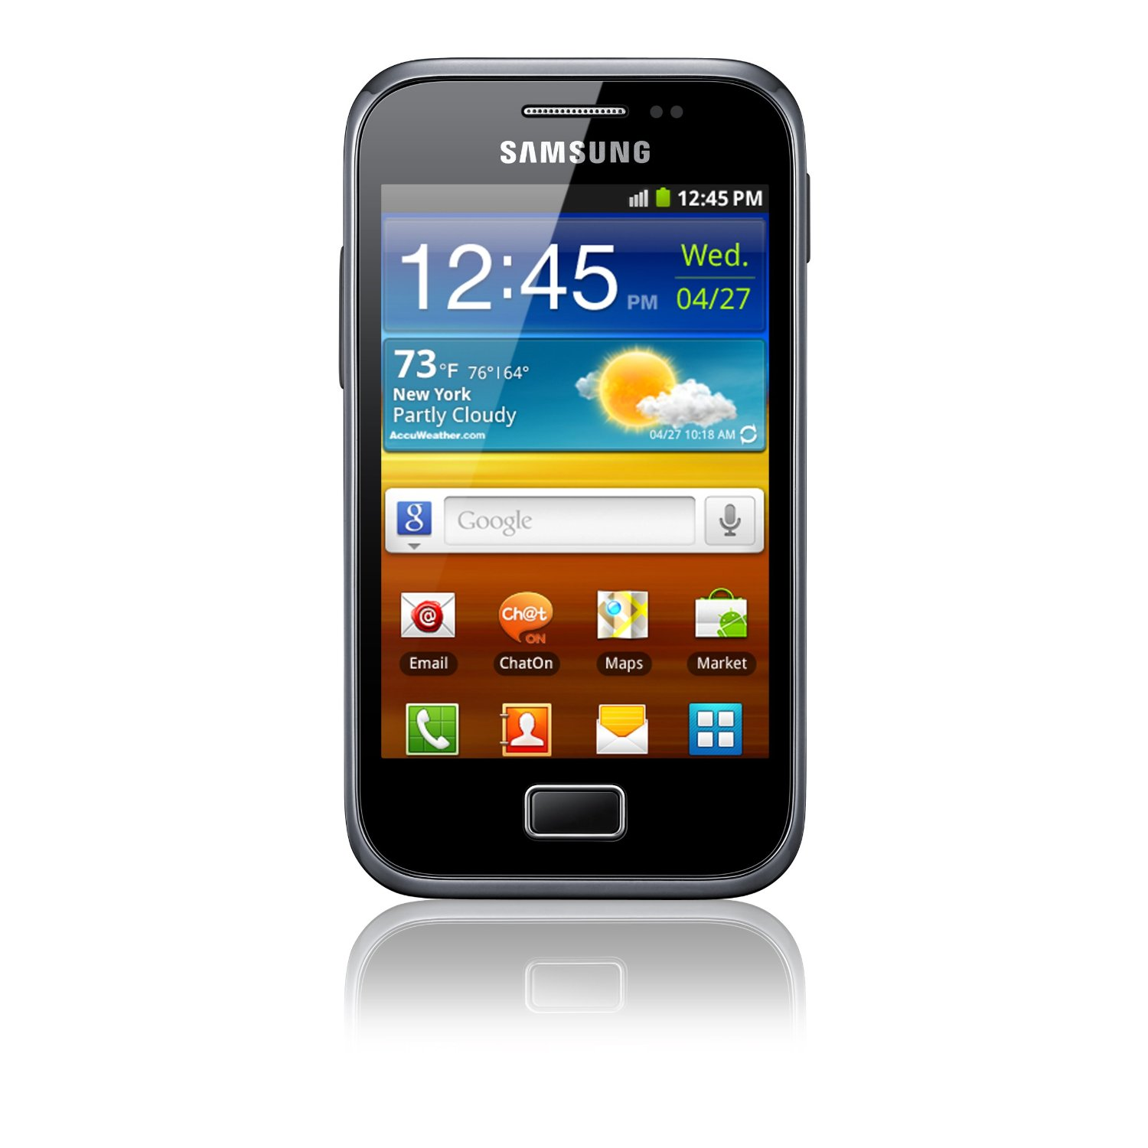

Slide 6
The session will be interactive inshallah

Slide 7
قوله تعالى: } وَيْلٌ لِلْمُطَفِّفِينْ . الّذِينَ إِذَا اكْتَالُوا عَلَى النَّاسِ يَسْتَوْفُون . وَإِذَا كَالُوهُمْ أَو وَّزَنُوهُمْ يُخْسِرُونَ {

Slide 8
Goals and objectives
To demonstrate in example correct methods (ethically) of using or quoting others work or knowledge.
To be a role model
To explain the Islam and west opinion on plagiarism and how to be integral in your work

Slide 9
Evaluation sheet
Advantages
Points for improvement

Slide 10
Islamic perspective
Allah says: "Allah commands you to render trusts to their owners, and when you judge between people, that you do so with justice. Excellent indeed is the admonition He gives you, for Allah hears and sees all things." [Sûrah al-Nisâ': 58]
http://en.islamtoday.net/artshow-264-3417.htm

Slide 11
The Prophet (peace be upon him) said: "He who credits himself with what was not given to him is like one who wears a double cloak of deception." [Ibn `Abd al-Barr, Jâmi` al-Tahsîl (1/98)]
http://en.islamtoday.net/artshow-264-3417.htm

Slide 12
مر صلى الله عليه وسلم على صُبرة طعام فأدخل يده فيها فنالت أصابعه بللاً. فقال: « ما هذا يا صاحب الطعام؟ » قال: أصابته السماء يا رسول الله. قال: « أفلا جعلته فوق الطعام كي يراه الناس؟ من غش فليس مني » وفي رواية « من غشنا فليس منا » وفي رواية « ليس منا من غشنا » [رواه مسلم].
حذّر النبي صلى الله عليه وسلم من الغش وتوعّد فاعله

Slide 13
عن معقل بن يسار المزني- رضي الله عنه- أنه قال في مرضه الذي مات فيه: سمعت رسول الله صلى الله عليه وسلم يقول: « ما من عبد يسترعيه الله رعية يموت يوم يموت وهو غاشٌ لرعيته إلا حرّم الله عليه الجنة » رواه البخاري ومسلم واللفظ له

Slide 14
“Rather fail with honor than succeed by fraud.”
Sophocles
“Four plays: Ajax; The women of Trachis; Electra; Philoctetes” (1966) :http://www.quoteyard.com/rather-fail-with-honor-than-succeed-by-fraud/

Slide 15
Historical Overview
Misconduct in science is an old problem.
The first copyright law was passed in England 1710
US passed its first copyright law in 1790
A Different Perspective on Plagiarism. The Internet TESL Journal :http://iteslj.org/Articles/Yusof-Plagiarism.html
Science has grown and the challenges are quite different from the past.
Teaching scientific integrity and research ethics. Forensic Science International,Volume 113, Issues 1–3, 2000, 511–514

Slide 17
Current trends
The practice of plagiarism is mainly due to the rapid advancement in information technology. (Hansen, 2003, Introna et al, 2003).
Other reasons or justifications for plagiarizing:
- Pressure to meet deadlines
-Poor skills in writing especially for English as Second Language
A Different Perspective on Plagiarism. The Internet TESL Journal :http://iteslj.org/Articles/Yusof-Plagiarism.html
A Different Perspective on Plagiarism Dahlia Syahrani Yusof Multimedia University (Cyberjaya, Malaysia)

Slide 18
What is Scientific Integrity?
Scientific integrity has been characterized as a commitment to truthfulness, to personal accountability, and to vigorous adherence to standards of professional conduct (eg accuracy, transparency, fairness)
Scientific integrity, fidelity and conflicts of interest in research.
TD Warner, LW Roberts - Current opinion in psychiatry, 2004

Slide 19
What is scientific integrity? Cont….
A quality of individual scientists and their reasoning
Defined as the maintenance of the proper roles for values in science.
Scientific Integrity: From Theory to Practice. Heather Douglas, University of Waterloo,
February 20, 2012, AAAS Meeting Vancouver BC

Slide 20
What violates scientific integrity?
Fabrication (making up results )
Falsification of evidence (manipulation)
Ignoring evidence in preference for one’s values
Cherry-picking evidence or suppressing evidence, the incomplete evidence
Deceptive research that has no possibility for real discovery
Scientific Integrity: From Theory to Practice. Heather Douglas, University of Waterloo,
February 20, 2012, AAAS Meeting Vancouver BC

Slide 21
Scientific and Scholarly Misconduct US Public Health Service 1989
Fabrication, falsification, plagiarism, or other practices that seriously deviate from those that are commonly accepted within the scientific community for proposing, conducting, or reporting research.

Slide 22
Plagiarism- Kidnapper

Slide 23
Plagiarism: What is it?
Brainstorm few examples of plagiarism

Slide 24
شيء لم يسبق إليه يخترعه
شيء ناقص يتمه
شيء مستغلق يشرحه
شيء طويل يختصره
شيء مختلط يرتبه
شيء أخطأ فيه مصنفه يبينه
شيء مفرق يجمعه
From Professor Jamal Jarralah

Slide 25
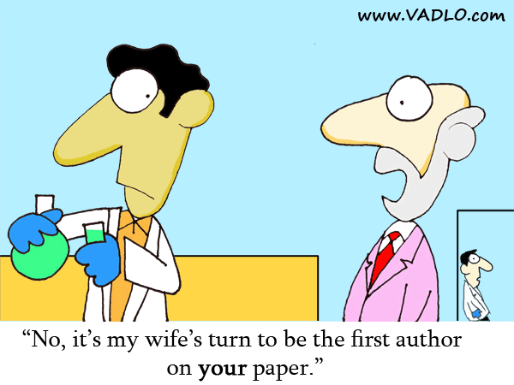
From Professor Jamal Jarralah

Slide 26
What is plagiarism?
Plagiarism is taking the ideas or words of others and passing them off as your own.
Plagiarism is a type of intellectual theft.
Plagiarism can take many forms:
-deliberate cheating
-accidentally copying from a source without acknowledgement
Plagiarism & Academic Integrity:https://student.unsw.edu.au/plagiarism

Slide 27
How plagiarism happens?
Most students who plagiarise do so unintentionally
Students don't have the skills to avoid over-reliance on the work of others or because they aren't sure what constitutes plagiarism.
Plagiarism & Academic Integrity: https://student.unsw.edu.au/plagiarism

Slide 28
Students can justify plagiarism in a number of ways:
Lack of "academic" role models
Other students are doing it and getting away with it
Lack of discussion about plagiarism versus real educational goals
Plagiarism--A Guide for Instructors: http://www.southalabama.edu/univlib/instruction/Faculty/plagiarism.html

Slide 29
Common Forms of Plagiarism
Copying
Collusion
Inappropriate paraphrasing
Relying too much on other people’s material
Inappropriate citation
Self-plagiarising

Slide 30
Plagiarism is unethical for three reasons.

Slide 31
Plagiarism is unethical for three reasons.
It is a form of theft.
It is unethical because the plagiarizer subsequently benefits from this theft.
A degree is evidence of its holder’s abilities and knowledge.

Slide 32
The best way to avoid plagiarism is to:
Know what it is
Develop the skills to write well and consequently avoid doing it.

Slide 33
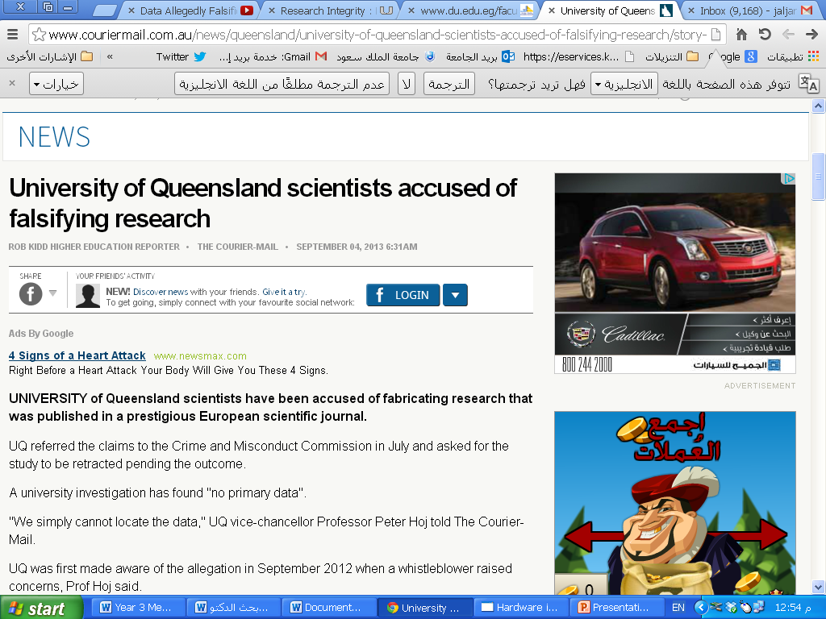

Slide 34
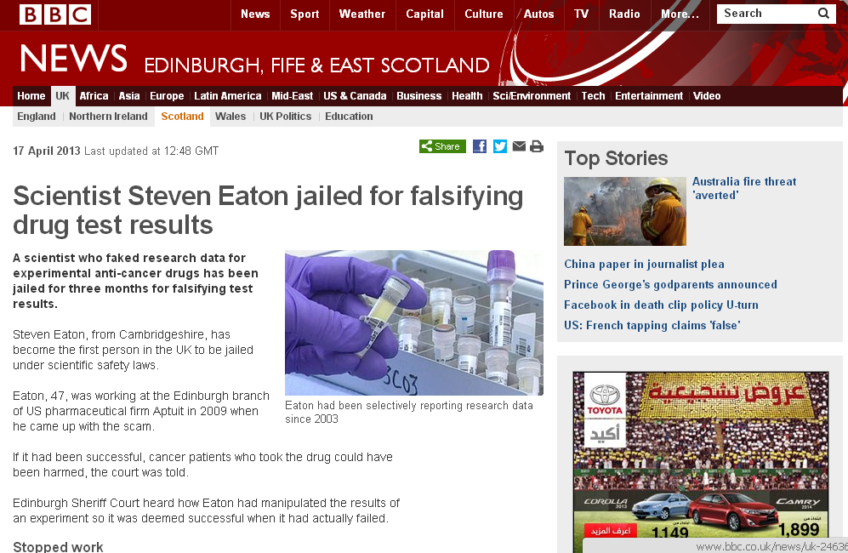

Slide 35
Exercise
Original
The complexity of the current global economy has to do with certain fundamental disjunctures between economy, culture and politics which we have barely begun to theories.

Slide 36
Which one is Plagiarized and which is Acceptable?
The complexity of the current global economy has to do with certain fundamental disjuncture between economy, culture and politics which we have barely begun to theorize.
"The complexity of the current global economy has to do with certain fundamental disjuncture between economy, culture and politics which we have barely begun to theorize" (Appadurai 1999, p. 221).

Slide 37
What makes it acceptable?
The use of quotation marks to indicate borrowed material
Correct in-text citation
The material between quotation marks is exactly the same as the original

Slide 38
"Mystery, Indiana" by David Boyer
"Newton" by Jeanette Winterson
“Worst Fears Realized" by Stuart Woods

Slide 39
Using Significant Ideas Putting someone else's ideas into your own words and not acknowledging the source of the ideas.
Original
"The complexity of the current global economy has to do with certain fundamental disjunctures between economy, culture and politics which we have barely begun to theorise" (Appadurai 1999, p. 221).
Plagiarised
The world economic system is marked by economic, cultural and political tensions that are yet to be fully understood.

Slide 40
Acceptable
The world economic system is marked by economic, cultural and political tensions that are yet to be fully understood (Appadurai 1999, p. 221).

Slide 41
Read through both pieces of text and make your choice whether these examples an instance of plagiarism?

Slide 43
The student has quoted directly from the source but has not indicated the quoted passage. Neither is a citation provided within the text to link the quoted material to the bibliography

Slide 45
This is not plagiarism. The student has quoted verbatim from the source, enclosing the quoted text within quotation marks. A citation is provided within the text allowing the reader to link the information to the source provided in the bibliography.

Slide 46
Using Sentences from Someone Else
Original
The complexity of the current global economy has to do with certain fundamental disjunctures between economy, culture and politics which we have barely begun to theorise.
Plagiarised
The complexity of the current global economy has to do with certain fundamental disjunctures between economy, culture and politics which we have barely begun to theorise (Appardurai 1999, p. 221).

Slide 47
Acceptable
"The complexity of the current global economy has to do with certain fundamental disjunctures between economy, culture and politics which we have barely begun to theorise" (Appadurai 1999, p. 221).

Slide 48
Relying Too Much on Other People's Material Relying too much on other people's material; that is, repeated use of long quotations (even with quotation marks and with proper acknowledgement).
Unacceptable
Australia's national identity "has always been contested" (Wignam, 1994:38). However, some images of Australianness 'have proliferated more widely than others' (Taylor, 2000:179). The most prominent and "resilient of national types has been the bushman" (Zatakis, 1977:66).

Slide 49
Why is it unacceptable?
The paragraph’s every sentence has been taken directly from another source.
The writer has not included his or her own idea or words.

Slide 50
Relying on Other People's Phrases and Sentences
Using your own ideas, but with heavy reliance on phrases and sentences from someone else without acknowledgement.
Original
"The complexity of the current global economy has to do with certain fundamental disjunctures between economy, culture and politics which we have barely begun to theorise" (Appadurai 1999, p. 221).

Slide 51
Which one is Plagiarized and which is Acceptable?
The fundamental disjunctures between economy, culture and politics makes free trade an impossible ideal.
The "fundamental disjunctures between economy, culture and politics" (Appadurai 1999, p. 221) make free trade an impossible ideal.

Slide 52
Most common way that we learned and learn moral and scientific practices is from good or bad role models.

Slide 53
Evaluation sheet
Advantages
Points for improvement

Slide 54
Evaluation sheet
Advantages
Points for improvement

Slide 55
Conclusion
Plagiarism is unfortunately a common phenomenon.
Most of the incidences are not intentional but still this excuse is no more acceptable.
Traffic law
We need to learn
If in doubt please ask

Slide 56
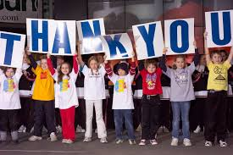

Slide 58
Plagiarism Quiz
Which of the following are incidents of plagiarism?
You borrow an essay written by another student and then submit it as your own work. Is this plagiarism?
Yes, because it's not my own work.
No, because the other student gave me permission.

Slide 59
Cont….
You hand in an essay for one subject that you have already submitted for another: plagiarism?
Yes. Students shouldn't 'recycle' assignments.
No. I wrote the essay, so it's my work.

Slide 60
You download an article from the internet, or take a published journal article or a section of a book, and pretend that it's your own work. Is this plagiarism?
Yes
No

Slide 61
You copy down exact sentences or paragraphs from someone else’s work (essay, article, book, lecture, web page, newspaper) and put them in your essay without using quotation marks or a footnote/ in-text citation. Plagiarism?
Yes
No

Slide 62
Cont….
You borrow sentences or paragraphs from someone else and put them in your assignment. Although you haven’t used quotation marks, you have provided correct citations (or footnotes): so you haven’t plagiarised, have you?
Yes, because plagiarism applies to both words and ideas.
No, because I've cited my source

Slide 63
You paraphrase an idea you really like from a reading and put it in the essay you are working on. It's in your own words, so you don't bother with a citation. Have you plagiarised?
Yes
No

Slide 64
Cont….
You have written a paragraph outlining a concept you have come up with. However, you have relied heavily on phrases and sentences that have come from your reading. Because the concept is yours, you haven't provided references for the words. Have you plagiarised?
Yes, because I've used the words and phrasing of other writers.
No, because it's my own idea.

Slide 65
Cont….
You hand in an essay where almost every line is a direct quotation from a source. In fact, you have done a lot of reading for this assignment. You have referenced these sources correctly (quotation marks and citation), so it can’t be plagiarism: can it?
Yes, I've relied too much on the words of others.
No, I'm showing that I've done lots of research

Slide 66
You find a great source for research on the internet. The site has no 'author', so you copy the information and use it in your assignment. Is this plagiarism?
Yes, all sources of information must be cited.
No, information on the net is up for grabs.

