Slide 1
Telehealth
Offered by
Suliman Alomran, RHIA
Notes:
eHealth is also written “e-health”
“is defined as the use of emerging interactive technologies (e.g., Internet, CD-ROMs, personal digital assistants, interactive television and voice response systems, computer kiosks, and mobile computing) to enable health improvement and health care services”

Slide 2
Objectives
Define Telehealth and Telemedicine
History of Telehealth
Identify Driving Forces of Telehealth
List the Advantages of Telehealth
Identify equipment and technology to sustain telehealth
Identify several telehealth applications
Notes:
Definition
Types
Challenges
Drivers

Slide 3
It is Already There!
Telehealth is projected to reach 1.8 million patients worldwide by 2017
In 2012, 308,000 patients remotely monitored for
Congestive heart failure (CHF),
Chronic obstructive pulmonary disease (COPD),
Diabetes
hypertension and mental health conditions worldwide
http://www.healthcareitnews.com/news/telehealth-growth-mode-worldwide
Notes:
Definition
Types
Challenges
Drivers

Slide 4
Define Telehealth and Telemedicine
Telehealth defined:
“The delivery of health-related services and information via telecommunications technologies”
Could be: (nonclinical services)
Two healthcare professionals discussing a case over the phone;
Using videoconferencing between providers at facilities in two countries
Telenuring Practice Guidelines https://www.crnns.ca/documents/Telenursing2014.pdf
Notes:
Telehealth Provision of information to healthcare providers and consumers and the delivery of services to clients at remote sites through the use of telecommunication and computer technology.
Telehealth Generic term used for designation of fields including telemedicine, telerehabilitation

Slide 5
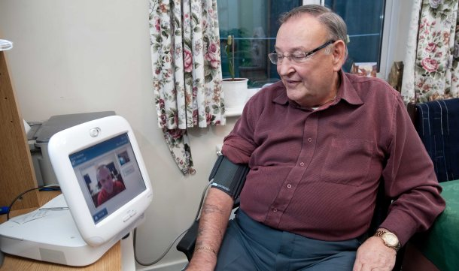
Define Telehealth and Telemedicine
Telehealth can promote:
Patient-provider communication
Patient self-management with provider feedback
Health literacy
Provider-provider consultants
Telenuring Practice Guidelines https://www.crnns.ca/documents/Telenursing2014.pdf
Notes:
Telehealth Provision of information to healthcare providers and consumers and the delivery of services to clients at remote sites through the use of telecommunication and computer technology.
Telehealth Generic term used for designation of fields including telemedicine, telerehabilitation

Slide 6
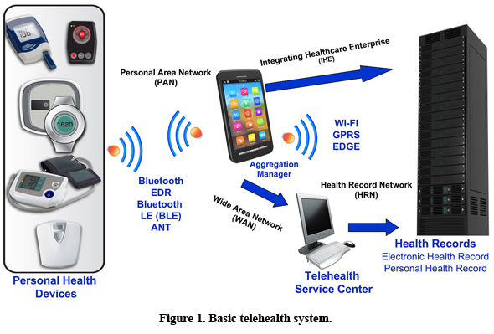
Telehealth System Overview
Transmits data (Vital Sign) from home to a healthcare professional by use of ICT.
http://www.ecnmag.com/articles/2011/03/wireless-technologies-build-momentum-telehealth-systems
Notes:
Telehealth Provision of information to healthcare providers and consumers and the delivery of services to clients at remote sites through the use of telecommunication and computer technology.
Telehealth Generic term used for designation of fields including telemedicine, telerehabilitation

Slide 7
Top Telehealth Tools for Patients
http://www.hin.com/chartoftheweek/patient_telehealth_tools_printable.html
Notes:
Telehealth Provision of information to healthcare providers and consumers and the delivery of services to clients at remote sites through the use of telecommunication and computer technology.
Telehealth Generic term used for designation of fields including telemedicine, telerehabilitation

Slide 8
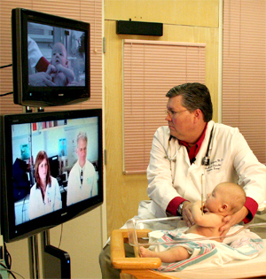
Define Telehealth and Telemedicine
Telemedicine defined:
“the use of electronic information and communication technologies to provide and support health care when distance separates the participants ”
Combination of:
Telecommunications Technology
Medicine (clinical services)
Telenuring Practice Guidelines https://www.crnns.ca/documents/Telenursing2014.pdf
Notes:
Telemedicine is an older and a narrower term, connoting communication between two persons. Telemedicine is often associated with video-conferencing between patients and providers. In contrast

Slide 9
Types of telemedicine interaction
Real-time (for Emergency use)
Parties communicate simultaneously via a telecommunication network, also called synchronous or interactive
Store and forward (Non- Emergency use)
Involves non-interactive transmission of information from on site to another.
Sometimes referred to as asynchronous or pre-recorded and involves information being captured and then transmitted to the other party for advice, opinion or specialist consultation
Hybrid Method

Slide 10
Categories of Telemedicine
Patient Monitoring (Home care)
Blood pressure monitors
Interactive Applications
Teleconsulting, Videoconferencing
Store and forward applications
Medical images, lab results

Slide 11
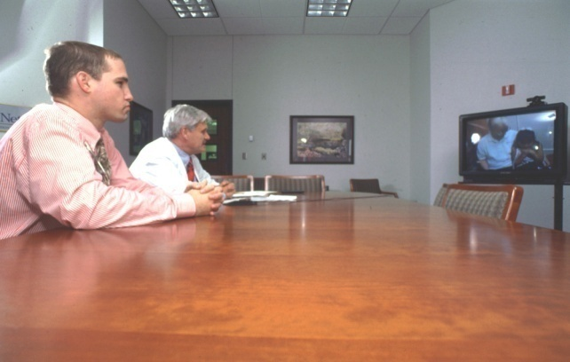
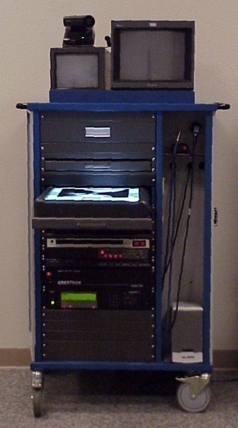
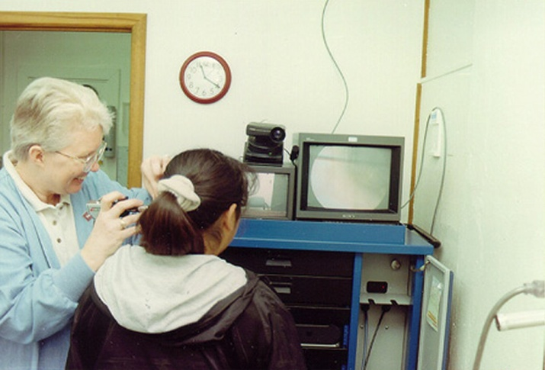
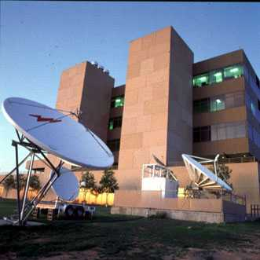
) ) ) ) ) ) ) ) ) ) )
) ) ) ) ) ) ) ) ) ) ) ) )
Hub Site
Remote
Site
T-1

Slide 12
Tele-health
Telemedicine
E-Health/ Education
Tele-healthcare
Telecare
Telepsychiatry
Telesurgery
(Winters, 2002)
Notes:
Telesurgery: the ability for a doctor to perform surgery on a patient even though they are not physically in the same location
Telecare: The use of telecommunication systems to provide remote assistance in therapy to patients (Mantas & Hasman, 2002)

Slide 13
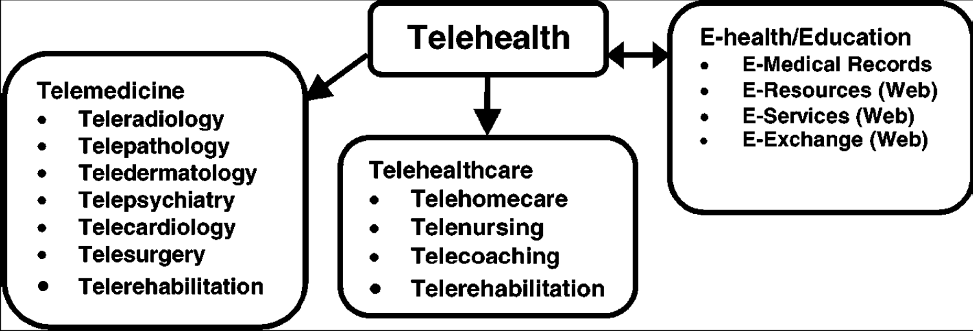
Telehealth vs. Telemedicine
(Winters, 2002)
Notes:
Telehealth is different from telemedicine because it refers to a broader scope of remote healthcare services than telemedicine. While telemedicine refers specifically to remote clinical services, telehealth can refer to remote non-clinical services, such as provider training, administrative meetings, and continuing medical education, in addition to clinical services.

Slide 14
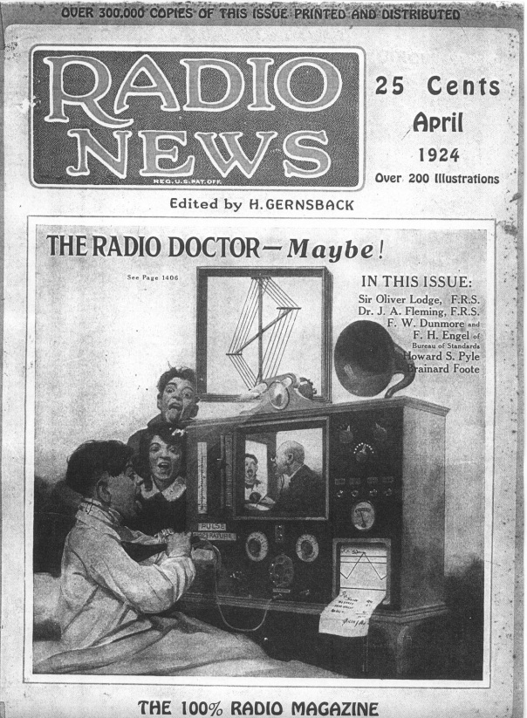
History of Telehealth
(Wittson, Affleck, and Johnson)

Slide 15
Period | Telegraph | Telephone application
1835 | Telegraph | Used in the American Civil War to deliver casualty lists and order supplies. Later used to transmit x-ray images.
1876 | Telephone | Initially used for voice communicaion. About 30 years later, used to transmit ECGs and EEGs.
1895 | Radio | Used to supply medical advice to seafarer. In 1920 the Seaman’s Church Institute of New York provided medical care using radio. The CIRM in Rome has been using radio to provide
Late 1960s | Video/ television | A two-way closed circuit television link was set up between the Nebraska Psychiatric Institute in Omaha and the state mental hospital in Norfolk for educational purposes.
1990s | Videoconferencing | Videoconferencing for health purposes became more common
Mid-1990s | Internet | Use of the internet for health purpose
Notes:
Chapter 19 Telehealth and Communication
http://www.powershow.com/view/12d046-NWMxM/Chapter_19_Telehealth_and_Communication_powerpoint_ppt_presentation

Slide 16
Participants in the telehealth interaction
The nature of the communication in health can be
Patient with practitioner
Practitioner with Practitioner (Teleradiology)
Patient with patient (that is, mutual support)
Practitioner or patient accessing educational material (that is, source of health information)

Slide 17
Participants in the telehealth interaction
The nature of the communication in health can be
Patient with practitioner
Telepsychiatry is a common telehealth application usually performed by videoconferencing
An evaluation of Telepsychiatry services in Alberta, Canada, showed that it was acceptable to users and there were significant cost savings from avoided travel by psychiatrists and patients
Chapter 19 Telehealth and Communication
http://www.powershow.com/view/12d046NWMxM/Chapter_19_Telehealth_and_Communication_powerpoint_ppt_presentation

Slide 18
Participants in the telehealth interaction
The nature of the communication in health can be
Patient with patient (that is, mutual support)
Support groups : communication between people who have similar conditions,
A study of the use of audio conferencing by breast cancer patients in rural Newfoundland showed that it provided valuable mutual support, despite the distances.
Chapter 19 Telehealth and Communication
http://www.powershow.com/view/12d046NWMxM/Chapter_19_Telehealth_and_Communication_powerpoint_ppt_presentation

Slide 19
Driving Forces of Telehealth
Healthcare
Quality
Access
Cost

Slide 20
Is “At the Point of Care” Too Late?
Health Status
Health care spending
Early Clinical Symptoms
Healthy / Low Risk
At Risk
High Risk
Active
Disease
Early
Symptoms
20% of people
generate
80% of costs
- Early detection of at-risk patients
- Provide personalized evidence to enable pro-active decisions

Slide 21
Driving Forces of Telehealth
Quality of Care
Provide diagnostics
New mode of treatment
Improve patient satisfaction (early treatment, higher frequency of encounter
Notes:
Key factors to measure:
Diagnostic accuracy
Delay/Time reduction in providing treatment
Prevented conditions
Adherence to medication
Change in mortality/morbidity
Improved quality of life

Slide 22
Driving Forces of Telehealth
Access to Care
Access for people with situational limitations (physical disabilities, elderly, etc)
Minimize distance of travel for people in hard to reach/isolated locations
Not limited by time/place
Notes:
Key factors to measure:
Patients satisfaction
Timely disease detection

Slide 23
Driving Forces of Telehealth
Cost of Care
Prevent/early treatment of disease = lower cost of care (both to provider and society)
Lower cost from travel
Notes:
Key factors to measure:
What does the service cost?
Does the service save money?
What is the balance between costs and effects?
Which perspective to measure cost: patient, provider, or society?

Slide 24
Why do Telemedicine/Telehealth?
Access: Time, Travel, Expense, Information
Health Provider Collaboration
Enhanced Communications
TV & Computer Applications common and non- threatening
Minimize referrals
Notes:
Access
Provide primary healthcare that would not be available otherwise
Specialty care consultations for isolated specialists, practitioners, and other health care professionals
Eliminate expensive travel and isolation
Reduce need to move patient
CME for isolated health care providers

Slide 25
Why do Telemedicine/Telehealth?
Communication/Collaboration with specialists
ER ‘front-line’ support
Improved professional education
Saves time, travel to outreach clinics

Slide 26
List the Challenges of Telehealth
Infrastructure
Liability
Privacy
End-user lack of knowledge about the benefits, services available in other settings
Compromised relationship between health professional and patient
Lack of time to adopt telemedicine
Notes:
Equipment costs
Connectivity costs
Reimbursement
A lack of appropriate training and educational facilities
The legal and ethical issues including licencing, privacy and confidentiality

Slide 27
Identify equipment and technology to sustain telehealth
Equipment to capture the information at each site
Communication equipment to transmit this information between the sites
Equipment to display the information at the relevant sites
Four types of information transfer common in telehealth
Audio, text, still images, video
Chapter 19 Telehealth and Communication
http://www.powershow.com/view/12d046NWMxM/Chapter_19_Telehealth_and_Communication_powerpoint_ppt_presentation

Slide 28
Telemedicine Settings
Rural area
Schools
Clinics
Hospitals
Prisons
Assisted living
Notes:
School-based Care
• Dialysis
• Support groups
• Speech therapy
• Remote ultrasounds
• Pre-commitment assessments
• Sign Language interpretation
• Dietary counseling
• Rehab services
• Supervision

Slide 29
Emerging Telemedicine applications
Telestroke
Teledermatology
Teleconsults
Telewound care
TeleICU
Teleophthalmology
Telecardiology
Pre and post-surgical care
Telepsychiatry
Telepathology
Teleradiology
TeleEndocrine
TeleTrauma
TelePediatrics
eVisits
Notes:
Visit for more description
http://www.upmc.com/healthcare-professionals/physicians/telemedicine/pages/default.aspx

Slide 30
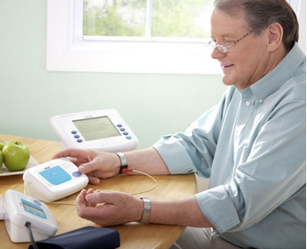
Emerging Telemedicine applications
Telehealth Post-discharge
Reduce hospital readmissions
Improve clinical outcomes, compliance
Improve patient quality of life
Improve patient education and self-care
Notes:
http://www.upmc.com/healthcare-professionals/physicians/telemedicine/pages/default.aspx

Slide 31
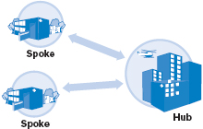
Emerging Telemedicine applications
For Stroke Patients:
“To be effective, clot-dissolving therapies must be given within three to four and a half hours after you experience stroke symptoms.”
http://www.mayoclinic.org/tests-procedures/stroke-telemedicine/basics/definition/prc-20021080
Notes:
Case Study:
In a stroke telemedicine consultation, an emergency medicine doctor at your regional hospital (the spoke) will examine you. If your doctor suspects an acute stroke, he or she will activate the stroke telemedicine hotline at the hub hospital, which has a dedicated hotline and group paging system and vascular neurologists on call 24 hours a day, 365 days a year. The hub's on-call vascular neurologist usually responds within five minutes.After you have a CT scan at the spoke hospital, the vascular neurologist at the hub performs a live, real-time audiovisual consultation. The vascular neurologist may discuss your medical history and review your test results. The vascular neurologist evaluates you, works with your doctor to determine the most appropriate treatment and sends the treatment recommendation electronically to the spoke hospital.Having a prompt evaluation increases the possibility that clot-dissolving therapies (thrombolytics) can be delivered in time to reduce stroke-related disability. To be effective, clot-dissolving therapies must be given within three to four and a half hours after you experience stroke symptoms.
Link
http://www.mayoclinic.org/tests-procedures/stroke-telemedicine/basics/definition/prc-20021080

Slide 32
Emerging Telemedicine applications
Telestroke
ER Consultant do a CT Scan;
Trained neurologist performs a live, real-time audiovisual consultation
make diagnosis and appropriate treatment recommendations;
Send documentation electronically
http://www.mayoclinic.org/tests-procedures/stroke-telemedicine/basics/definition/prc-20021080
Notes:
Case Study:
In a stroke telemedicine consultation, an emergency medicine doctor at your regional hospital (the spoke) will examine you. If your doctor suspects an acute stroke, he or she will activate the stroke telemedicine hotline at the hub hospital, which has a dedicated hotline and group paging system and vascular neurologists on call 24 hours a day, 365 days a year. The hub's on-call vascular neurologist usually responds within five minutes.After you have a CT scan at the spoke hospital, the vascular neurologist at the hub performs a live, real-time audiovisual consultation. The vascular neurologist may discuss your medical history and review your test results. The vascular neurologist evaluates you, works with your doctor to determine the most appropriate treatment and sends the treatment recommendation electronically to the spoke hospital.Having a prompt evaluation increases the possibility that clot-dissolving therapies (thrombolytics) can be delivered in time to reduce stroke-related disability. To be effective, clot-dissolving therapies must be given within three to four and a half hours after you experience stroke symptoms.
Link
http://www.mayoclinic.org/tests-procedures/stroke-telemedicine/basics/definition/prc-20021080

Slide 33
Emerging Telemedicine applications
Teledermatology
Inpatient and emergency consults for hospitals without dermatology coverage.
Timely transmission of images and clinical information.
Educational opportunities for residents and fellows.

Slide 34
Emerging Telemedicine applications
Emergency Care and Trauma
Timely trauma evaluations for patients in remote or rural areas.
Assistance with triage and transfer decisions.
Learning opportunities for community providers.

Slide 35
Emerging Telemedicine applications
Tele Wound Care
Remote consults for patients with poorly healing wounds.
Real-time transmission and review of images.
Reduced patient transfer rates.

Slide 36
Emerging Telemedicine applications
Telesurgery: the ability for a doctor to perform surgery on a patient even though they are not physically in the same location
Teleradiology: the transmission of radiological patient images, such as x-rays, CTs, and MRIs, from one location to another for the purposes of interpretation and/or consultation

Slide 37
Identify several telehealth applications
Telecare: The use of telecommunication systems to provide remote assistance in therapy to patients
Teledentistry
Health Education
Geographically isolated health care workers
TeleICU
Notes:
Systematic and regular updating of skills and knowledge ae essential elements in effective healthcare provision and Internet supports this development

Slide 38
Telemedicine in Saudi Arabia
Successes and Challenges in the Implementation and Application of Telemedicine in the Eastern Province of Saudi Arabia
by Azza Ali El-Mahalli, MD, PhD; Sahar Hafez El-khafif, PhD; and Mona Faisal Al-Qahtani, PhD
http://perspectives.ahima.org/successes-and-challenges-in-the-implementation-and-application-of-telemedicine-in-the-eastern-province-of-saudi-arabia/#.VHw2EJOUd9k
For your Information only
Chapter 19 Telehealth and Communication
http://www.powershow.com/view/12d046NWMxM/Chapter_19_Telehealth_and_Communication_powerpoint_ppt_presentation

