Slide 1
MENTAL STATUS EXAMINATION
Dr. Mohammad Ali Kukaswadia, M.D.

Slide 2
Overview of the Mental Status Exam
1. Level of alertness, attention, and cooperation
2. Orientation
3. Memory Recent memory Remote memory
4. Language
Spontaneous speech
Comprehension
Naming
Repetition
Reading
Writing
5. Calculations, right–left confusion, finger agnosia, agraphia
6. Apraxia
7. Neglect and constructions
8. Sequencing tasks and frontal release signs
9. Logic and abstraction
10. Delusions and hallucinations
11. Mood

Slide 3
Consciousness
Consciousness is Awareness of self and environment or knowledge of one's own mental process (subjective)
Arousal and Level of consciousness
Content of consciousness or Cognition
Test for responsiveness (objective)
Verbal, motor , and vegetative response to visual, verbal, tactile and noxious stimuli, one step or two step command
Level of response: Meaningful -> not meaningful -> reflex -> none
Verbal word, phrase or sentence

Slide 4
Level of Consciousness
Alert: awake, aware, interesting, responsive to stimuli
Lethargic (drowsy): Can be roused but cannot maintain arousal.
Stuporous: Can be roused with intense stimulation
Comatose: Cannot be roused with any stimuli
Confusion: Unable to think in customary speed and clarity. Altered awareness and responsiveness with inattention and distractibility.
Delirium: confused, agitated and hallucinating.

Slide 5
Attention and Concentration (RAS)
Alertness is aroused and attend to all extraneous stimuli.
Attention is the capacity to focus on single stimuli and screen out irrelevant stimuli.
Clinical: noting the distractibility while history taking.
Digit span: (forward and backward)
Letter span
Alphabet repetition read randon alphabets and asks to tap when particular alphabet repeated.
Word repetition
Sentence repetition

Slide 6
Concentration is the ability to focus attention over a more extended period of time.
Seven subtraction
Random letter repetition

Slide 7
General Appearance, Attitude & Behavior:
Physical Appearance:
Dressing and grooming:
Colorful or bizarre clothing might suggest mania,
unkempt, dirty clothes might suggest schizophrenia or depression.
appears older than age - poor self-care or ill- health.
Observations of physical appearance might include the physical features of alcoholism or drug abuse, such as signs of malnutrition, nicotine stains, dental erosion, a rash around the mouth from inhalant abuse, or needle track marks from intravenous drug abuse.
Notes:
physical aspects such as the appearance of a patient, including apparent age, height, weight, and manner of dress and grooming. Colorful or bizarre clothing might suggest mania, while unkempt, dirty clothes might suggest schizophrenia or depression. If the patient appears much older than his or her chronological age this can suggest chronic poor self-care or ill-health. Clothing and accessories of a particular subculture, body modifications, or clothing not typical of the patient's gender, might give clues to personality. Observations of physical appearance might include the physical features of alcoholism or drug abuse, such as signs of malnutrition, nicotine stains, dental erosion, a rash around the mouth from inhalant abuse, or needle track marks from intravenous drug abuse. Observations can also include any odor which might suggest poor personal hygiene due to extreme self-neglect, or alcohol intoxication.^{[15]} Weight loss could also signify a depressive disorder, physical illness, anorexia nervosa or chronic anxiety.^{[16]}

Slide 8
Attitude
Attitude, also known as rapport, refers to the patient's approach to the interview process and the quality of information obtained during the assessment

Slide 9
Behavior:
Abnormalities of behavior, also called abnormalities of activity, include observations of specific abnormal movements, as well as more general observations of the patient's level of activity and arousal, and observations of the patient's eye contact and gait.
Notes:
Abnormal movements, for example choreiform, athetoid or choreoathetoid movements may indicate a neurological disorder. A tremor or dystonia may indicate a neurological condition or the side effects of antipsychotic medication. The patient may have tics (involuntary but quasi-purposeful movements or vocalizations) which may be a symptom of Tourette's syndrome. There are a range of abnormalities of movement which are typical ofcatatonia, such as echopraxia, catalepsy, waxy flexibility and paratonia (or gegenhalten^{[20]}). Stereotypies (repetitive purposeless movements such a rocking or head banging) or mannerisms (repetitive quasi-purposeful abnormal movements such as a gesture or abnormal gait) may be a feature of chronic schizophrenia or autism. More global behavioural abnormalities may be noted, such as an increase in arousal and movement (described as psychomotor agitation or hyperactivity) which might reflect mania or delirium. An inability to sit still might represent akathisia, a side effect of antipsychotic medication. Similarly a global decrease in arousal and movement (described as psychomotor retardation, akinesia or stupor) might indicate depression or a medical condition such as Parkinson's disease, dementia or delirium. The examiner would also comment on eye movements (repeatedly glancing to one side can suggest that the patient is experiencing hallucinations), and the quality of eye contact (which can provide clues to the patient's emotional state). Lack of eye contact may suggest depression or autism.^{[21][22][23]}

Slide 10
Emotional State (Mood and Affect): Elated, euphoric, calm, placid, depressed, perplexed, anxious, apathetic, flattened, labile, inappropriate
Mood and affect
The distinction between mood and affect - describe affect as "the external and dynamic manifestations of a person's internal emotional state" and mood as "a person's predominant internal state at any one time",
with mood regarded as a current subjective state as described by the patient, and affect as the examiner's inferences of the quality of the patient's emotional state based on objective observation.

Slide 11
Thought Processes (Form vs. Content): Logical, circumstantial, loose associations, flight of ideas, clang associations, loss of goal, preoccupations, areas of concern, imaginations, suicidal/homicidal ideation in thought content, delusions, hallucinations, anxiety, phobia, compulsions, obsessions.
Thought process in the MSE refers to the quantity, tempo (rate of flow) and form (or logical coherence) of thought. Thought process cannot be directly observed but can only be described by the patient, or inferred from a patient's speech. Regarding the tempo of thought, some people may experience flight of ideas, when their thoughts are so rapid that their speech seems incoherent, although a careful observer can discern a chain of poetic associations in the patient's speech

Slide 12
Cognition
Level of alertness, orientation, attention, memory, visuospatial functioning, language functions and executive functions.
Alertness is a global observation of level of consciousness i.e. awareness of, and responsiveness to the environment, and this might be described as alert, clouded, drowsy, or stuporous.
Orientation is assessed by asking the patient where he or she is (for example what building, town and state) and what time it is (time, day, date).
Attention and concentration are assessed by the serial sevens test (or alternatively by spelling a five-letter word backwards), and by testing digit span.

Slide 13
Memory is assessed in terms of immediate registration (repeating a set of words), short-term memory (recalling the set of words after an interval, or recalling a short paragraph), and long-term memory (recollection of well known historical or geographical facts).
Visuospatial functioning can be assessed by the ability to copy a diagram, draw a clock face, or draw a map of the consulting room.

Slide 14
Language is assessed through the ability to name objects, repeat phrases, and by observing the individual's spontaneous speech and response to instructions.
Executive functioning can be screened for by asking the "similarities" questions ("what do x and y have in common?") and by means of a verbal fluency task (e.g. "list as many words as you can starting with the letter F, in one minute").
The mini-mental state examination is a simple structured cognitive assessment which is in widespread use as a component of the MSE.

Slide 15
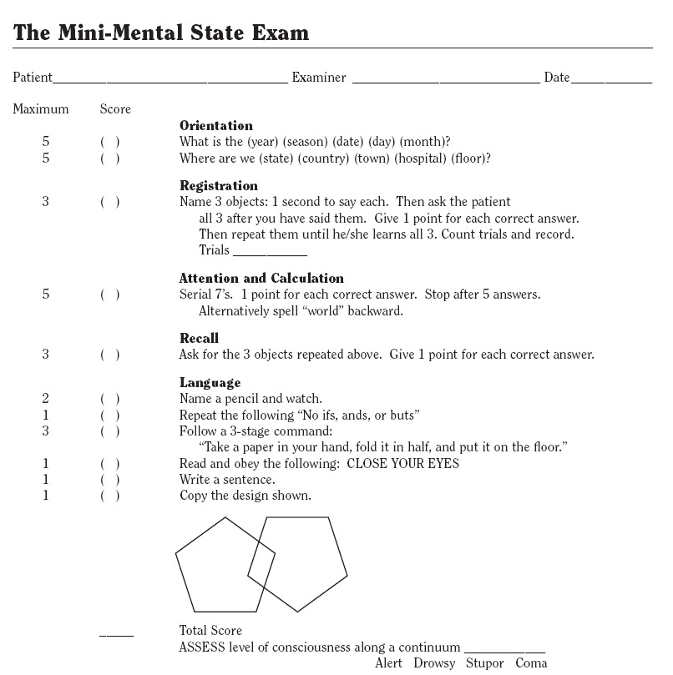

Slide 16
Insight
The person's understanding of his or her mental illness is evaluated by exploring his or her explanatory account of the problem, and understanding of the treatment options.
Includes three components: recognition that one has a mental illness, compliance with treatment, and the ability to re-label unusual mental events (such as delusions and hallucinations) as pathological. As insight is on a continuum, the clinician should not describe it as simply present or absent, but should report the patient's explanatory account descriptively.
Impaired insight is characteristic of psychosis and dementia, and is an important consideration in treatment planning and in assessing the capacity to consent to treatment.

Slide 17
Judgment:
Judgment refers to the patient's capacity to make sound, reasoned and responsible decisions.
use of standard hypothetical questions such as "what would you do if you found a stamped, addressed envelope lying in the street?"; however contemporary practice is to inquire about how the patient has responded or would respond to real-life challenges and contingencies. Assessment would take into account the individual's executive system capacity in terms of impulsiveness, social cognition, self-awareness and planning ability.
Impaired judgment is not specific to any diagnosis but may be a prominent feature of disorders affecting the frontal lobe of the brain. If a person's judgment is impaired due to mental illness, there might be implications for the person's safety or the safety of others.

Slide 18
Digit Span Test
consists of telling the person that you are going to give him a short test. The person is then told to listen carefully because you will say a series of numbers and ask him to repeat them back to you in the same order you say them.
The first series is three numbers, such as "3, 9, 2." Each number is said in a monotone voice, one second apart. The person repeats those numbers back to you.
The next step is to speak a series of four numbers, such as, "4, 7, 3, 1." Again, the individual repeats those back to you.
Continue in the same manner by increasing the series of numbers to five and asking the person to repeat the numbers back to you. Some test versions stop after a series of 5 numbers and other versions continue increasing the series of numbers by one each time and ask the person to repeat them back to you until the answers are incorrect.

Slide 19
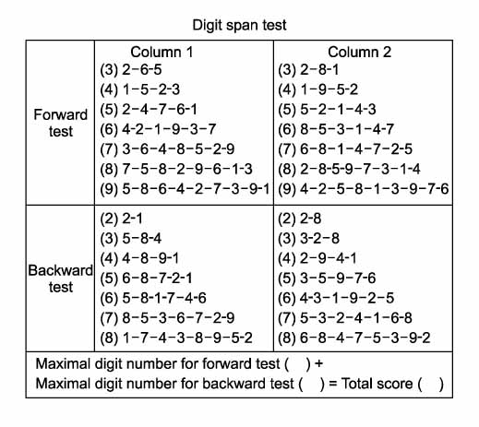
(In presence of anxiety, the patient will repeat two digits less.)
Highest Trial of 2 Trials:
Digits Forward Digits Backward
7 - Good average 5 - Average
6 - Low average 4 - Marginal
5 - Marginal

Slide 20
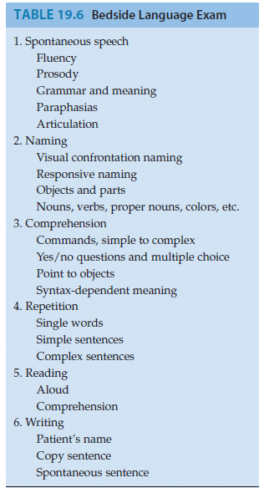

Slide 21
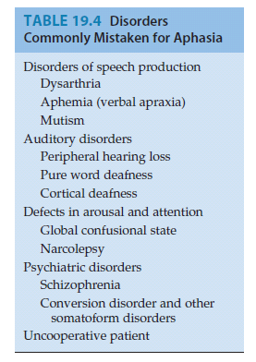

Slide 22
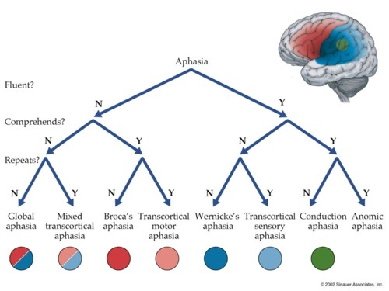

Slide 23
Broca’s aphasia - lesions affecting Broca’s area and adjacent structures in the dominant frontal lobe
decreased fluency of spontaneous speech, phrase length of fewer than five words, and the number of content words (e.g., nouns) exceeds the number of function words (e.g., prepositions, articles, and other syntactic modifiers).
Word generation tasks, such as the FAS test can be useful for detecting subtle decreases in verbal fluency. In addition, prosody (the normal melodious intonation of speech that conveys the meaning of sentence structure) is lacking in patients with Broca’s aphasia.. The decreased fluency in Broca’s aphasia is associated with marked naming difficulties.
Notes:
Broca’s aphasia - lesions affecting Broca’s area and adjacent structures in the dominant frontal lobe
decreased fluency of spontaneous speech phrase length of fewer than five words, and the number of content words (e.g., nouns) exceeds the number of function words (e.g., prepositions, articles, and other syntactic modifiers).
Word generation tasks, such as the FAS test can be useful for detecting subtle decreases in verbal fluency. In addition, prosody (the normal melodious intonation of speech that conveys the meaning of sentence structure) is lacking in patients with Broca’s aphasia. The resulting speech in Broca’s aphasia has an effortful, telegraphic quality, with a lack of grammatical structure and a monotonous sound.* Speech output is often better for certain overlearned, semiautomatic tasks, such as naming the days of the week or singing familiar songs like “Happy Birthday,” and performance is often improved by cuing—that is, providing the first sound of a word during naming tests. The decreased fluency in Broca’s aphasia is associated with marked naming difficulties. In addition, lesions in Broca’s area cause a disconnection of

Slide 24
Broca’s aphasia repetition is impaired as well. Patients tend to have the most difficulty repeating phrases with a high content of function words, such as “No ifs, ands, or buts” or “If I were here, she would be there.” In contrast, because the posterior language structures are spared, comprehension is relatively intact in Broca’s aphasia. The one notable exception is impaired comprehension of syntactically dependent structures. For example, when hearing a passive sentence such as “The lion was killed by the tiger,” a patient with Broca’s aphasia often incorrectly chooses the tiger as the animal that is dead.
Writing and reading aloud in Broca’s aphasia have a slow, effortful, a grammatical quality that is similar to the deficits in spoken language. Reading comprehension is often relatively spared, except for syntactically dependent structures.
Notes:
this structure from Wernicke’s area (see Figure 19.3A). Therefore, in Broca’s
aphasia repetition is impaired as well. Patients tend to have the most difficulty
repeating phrases with a high content of function words, such as “No
ifs, ands, or buts” or “If I were here, she would be there.” In contrast, because
the posterior language structures are spared, comprehension is relatively
intact in Broca’s aphasia. The one notable exception is impaired comprehension
of syntactically dependent structures. For example, when hearing
a passive sentence such as “The lion was killed by the tiger,” a patient with
Broca’s aphasia often incorrectly chooses the tiger as the animal that is dead.
Writing and reading aloud in Broca’s aphasia have a slow, effortful, agrammatical
quality that is similar to the deficits in spoken language. Reading
comprehension is often relatively spared, except for syntactically dependent
structures.

Slide 25
Wernicke’s aphasia is usually caused by a lesion of Wernicke’s area and adjacent
structures in the dominant temporoparietal lobes -- markedly impaired comprehension Patients with severe Wernicke’s aphasia do not respond appropriately to questions and follow virtually no commands. Interestingly, a few commands relating to axial muscles,
especially “close your eyes” and sometimes “stick out your tongue,” may
elicit a correct response despite severe Wernicke’s aphasia (and even in global
Aphasia). Spontaneous speech in Wenicke’s aphasia has normal fluency, prosody, and grammatical structure. However, impaired lexical function results in speech that is empty, meaningless, and full of nonsensical paraphasic errors. Paraphasic errors can be either inappropriate substitutions of a word for one of similar meaning (verbal or semantic paraphasias), or of a part of a word for one with a similar sound (literal or phonemic paraphasias).
For example, a semantic paraphasia is when a patient says “ink” instead
of “pen” or “bus” instead of “taxi.”
A phonemic paraphasia is when a patient says “pish” instead of “fish” or “rot” instead of “rock.” Occasional neologisms, or nonwords, are used. Naming is similarly impaired in Wernicke’s aphasia, with frequent paraphasic errors or other irrelevant responses. Lesions of Wernicke’s area also result in disconnection from Broca’s area causing impaired repetition. Reading and writing show similar impairments to the speech deficits in Wernicke’s aphasia, and consist of fluent, but meaningless, paraphasic renditions.

Slide 26
A patient with impaired fluency, impaired comprehension, and impaired repetition has global aphasia. Global aphasia can be seen in large left MCA infarcts that include both the superior and the inferior. It can also be seen in the initial stages of large left MCA superior division infarcts that eventually improve to become Broca’s aphasia (big Broca’s) and in large subcortical infarcts, hemorrhages, or other lesions.

Slide 27
A patient with normal fluency and normal comprehension, but impaired repetition, has conduction aphasia. This condition is caused by an infarct or
other lesions in the peri-Sylvian area that interrupt the arcuate fasciculus or other pathways in the vicinity of the supramarginal gyrus that connect Wernicke’s
area to Broca’s area. Speech is fluent, paraphasic
errors are common, and naming is often impaired, which can lead to a misdiagnosis of Wernicke’s aphasia. Unlike the case with Wernicke’s aphasia, however, comprehension is spared.

Slide 28
Transcortical aphasias resemble Broca’s, Wernicke’s, and global aphasias, except that repetition is spared
Apatient with impaired fluency and normal comprehension, as in Broca’s aphasia, but with spared repetition, has transcortical motor aphasia.
A patient with normal fluency but impaired comprehension, as in Wernicke’s aphasia, but with intact repetition, has transcortical sensory aphasia.
A patient with impaired fluency and impaired comprehension, as in global aphasia, but with intact repetition, has mixed transcortical aphasia, also called isolation of the language areas.

Slide 29
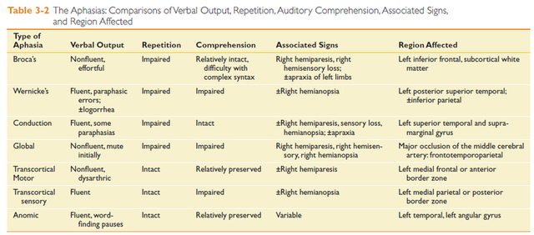

Slide 30
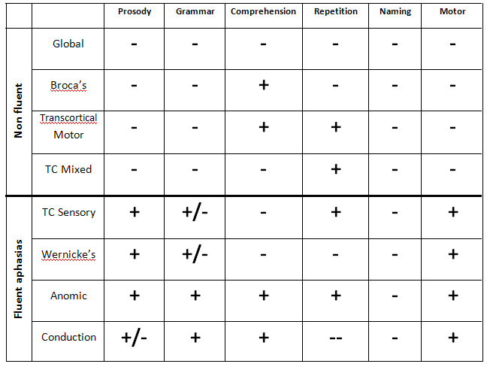

Slide 31
Alexia and Agraphia
Alexia and agraphia are impairments in reading or writing ability, respectively, that are caused by deficits in central language processing and not by simple sensory or motor deficits. Alexia and agraphia can each occur in isolation, or they can occur together. In patients with aphasia, agraphia is invariably
present. This co-occurrence may be due to the fact that normal writing requires intact functioning of the entire language apparatus.

Slide 32
Alexia or agraphia can occasionally occur without significant aphasia.
Agraphia without aphasia can be seen in lesions of the inferior parietal lobule
of the language-dominant hemisphere.

Slide 33
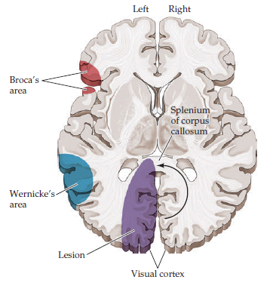
The classic syndrome - alexia without agraphia caused by a lesion in the dominant occipital cortex extending to the posterior corpus callosum, often a PCA infarct.
The lesion in the dominant
(usually left) occipital cortex
prevents the processing of
visual information from the
right hemifield, including
written material. A right
hemianopia is therefore
usually present . Meanwhile,
information about the left
hemifield that has reached
the right occipital cortex is
prevented from crossing to
the language areas by the
lesion in the posterior
corpus callosum - disconnection syndrome .
Patients who have alexia without agraphia are characteristically able to write normally, but they cannot read even their own writing

Slide 34
Alexia with agraphia can occur with lesions of the dominant inferior parietal lobule, in the region of the angular gyrus (see the next section). In these patients, aphasia is sometimes absent or may consist of only mild dysnomia and paraphasias. Alexia, which is an acquired deficit in reading, should be distinguished from dyslexia, a developmental reading disorder.
Before testing reading and writing abilities, it is important to obtain a history of the patient’s educational level and previous literacy skills because
these factors can greatly influence the results of assessment.

Slide 35
Gerstmann’s Syndrome
Gerstmann’s syndrome consists of the following somewhat odd tetrad of clinical
findings: (1) agraphia, (2) acalculia (impaired arithmetic calculating abilities), (3) right–left disorientation (difficulty identifying the right versus left side of the body), and (4) finger agnosia (inability to name or identify individual
fingers).

Slide 36
Apraxia
Apraxia, or, more specifically, ideomotor apraxia, is the inability to carry out an action in response to verbal command, in the absence of any comprehension deficit, motor weakness, or incoordination. It is caused by an inability to formulate the correct movement sequence. In testing for apraxia, the patient is usually asked to carry out imaginary actions, such as saluting the flag, brushing their hair, lighting a match and blowing it out, and so on.

Slide 37
HEMINEGLECT SYNDROME
infarcts or other acute lesions of the right parietal or right frontal lobes. Patients with this syndrome often exhibit profound neglect for the contralateral half of the external world, as well as for the contralateral half of their own bodies. Most strikingly, despite their profound deficits,
these patients are often unaware that anything is wrong, and they sometimes even fail to recognize that the left sides of their bodies belong to them.
Types of Neglect Tested on Patient Examination
1. Sensory neglect (visual, tactile, or auditory)
2. Motor-intentional neglect
3. Combination of sensory and motor neglect
4. Conceptual neglect

Slide 38
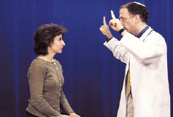
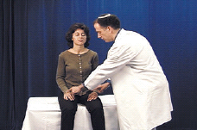
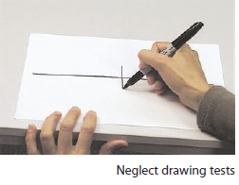

Slide 39
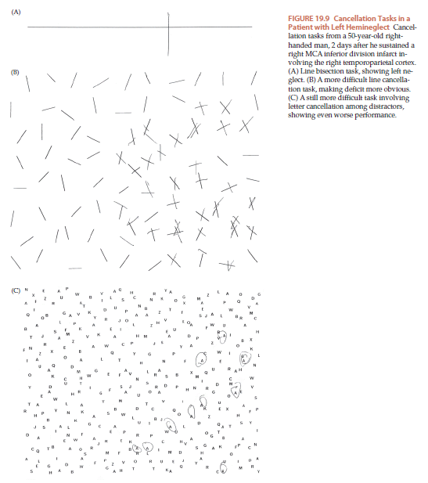

Slide 40
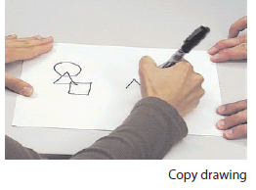

Slide 41
Release Reflexes:

Slide 42
Release or primitive reflexes:
Release reflexes group of behavioural motor responses originating in the central nervous system that are exhibited by normal infants but not neurologically intact adults, in response to particular stimuli.
These reflexes are normally kept in check by frontal lobe.
May indicate a diffuse CNS disease when present.
Can be present normally during senescence.
Many are exaggeration of normal responses

Slide 43
Adaptive value of reflexes:
Many of these reflexes have got adaptive and survival value during development of an infancy.
Sucking and routing : helps in feeding.
Grasp: helps in bonding.
Almost all disappears as the child develops.
Some may persist in adult as normal variant.
An exaggerated response is seen in abnormal neurology.

Slide 44
Seen in
Severe dementias
Diffuse encephalopathy
Head injury
Stroke
Cerebral palsy
Autism spectrum disorders
Particularly seen in disease/damage of frontal areas.
Also called frontal release reflexes.

Slide 45
Common Frontal release Reflexes:
Palmomental reflex
Grasp reflex
Palmar
Plantar
Glabellar tap reflex
Pout and snout relex
Routing reflex
Head retraction
Corneomandibular reflex
Utilisation behaviour

Slide 46
The Palmomental Reflex of Marinesco-Radovici:
contraction of the mentalis and orbicularis oris muscles causing wrinkling of the skin of the chin with slight retraction and sometimes elevation of the angle of the mouth in response to scratching or stroking the palm of the ipsilateral hand.
Method: stroking a blunt point over the thenar eminence or by tapping this area.
Also called mentalis reflex
Stronger and persistant reflex is seen in disease conditions.

Slide 47
Response can be present in ipsilateral or contralateral lesions.
Can be seen in normal people also.
Helpful in facial palsy
Absent in LMN type
Exaggerated in UMN type.
Pollicomental reflex : stroking skin over thumb
The localizing value and clinical significance of these reflexes are limited.

Slide 48
Palmar grasp reflex:
Involuntary flexor response of the fingers and hand following stimulation of the skin of the palmar surface of the fingers or hand.
The patient is instructed not to hold onto the examiner's hand.
Four variations and modifications:
Simple grasp reflex.
“Hooking” or traction response.
Forced grasping reflex.
Groping response.
Normally seen at birth.
Disappears by 2 to 4 mo.

Slide 49
Seen in extensive frontal lobe lesions
Neoplastic, vascular, degenerative.
Also see in corticospinal tract lesions.
When present unilaterally indicates lesion of contralateral frontal or parietal lobe lesion.
Plantar grasp: in disease of the opposite frontal lobe.
elicited by drawing the handle of a reflex hammer from the midsole toward the toes.
toes flex and grip the hammer.

Slide 50
Glabellar tap:
Tapping over outer aspect of supraorbital ridge, over glabella or orbital margin.
Tapping over forehead as far as hairline.
B/L eye blinking
Uninhibited in diseases like Parkinson's disease, frontal lobe damage.
Myerson’s sign.
Glabella tap reflex is neither sensitive for the presence of intracerebral pathology, nor specific for parkinsonism

Slide 51
PRIMITIVE ORAL REFLEXES:
sucking, rooting, and snout reflexes.
Snout reflex:
pressing firmly backward on the philtrum of the upper lip, a minimal tap to the lips, or sweeping a tongue blade briskly across the lips
puckering and protrusion of the lips, primarily the lower, often with depression of the lateral angles of the mouth
Sucking, tasting, chewing, and swallowing movements may be seen in exaggerated response.
Sucking reflex:
lightly touching, striking, or tapping the lips, stroking the tongue, or stimulating the palate.
sucking movements of the lips, tongue, and jaw.

Slide 52
Routing reflex:
A tactile stimulus delivered beside the mouth or on the cheek.
Lips, mouth, and even head deviate toward the tactile stimulus.
Atz, mastication, or “wolfing” reflex: exaggerated routing reflex

Slide 53
CORNEOMANDIBULAR REFLEX:
WARTENBERG’S REFLEX
A horizontal movement of the mandible to the contralateral side on touching the cornea of the ipsilateral eye.
The reflex is best elicited with some pressure to the cornea, applied with a solid glass applicator.
Present in acute coma (especially if due to a structural lesion), cerebrovascular disease, multiple sclerosis, Parkinson’s disease, and amyotrophic lateral sclerosis.

Slide 54
Head retraction Reflex:
A sharp tap with the reflex hammer just below the nose with the head bent slightly forward.
Quick, involuntary backward jerk of the head.
Present in bilateral corticospinal lesions rostral to the cervical spine.
Not present in normal.

Slide 55
Arm-dropping test:
Patient is asked to completely relax.
Suddenly release elevated arms of the patient.
Failure to let the arm drop freely is seen in frontal lobe diseases.
Leg-dropping test:
Paratonia (Gegenhalten):

Slide 57
Cerebellar Testing

Slide 59
 | Mnemonic: VANISHED
V | Vertigo
A | Ataxia
N | Nystagmus
I | Intentional Tremor
S | Slurred Speech
H | Hypotonia
E | Exaggerated Gate – Broad based
D | Disdiadochokinesia

Slide 60
Coordination
The cerebellum fine tunes motor activity and assists with balance. Dysfunction results in a loss of coordination and problems with gait. The left cerebellar hemisphere controls the left side of the body and vice versa.
Specifics of Testing: There are several ways of testing cerebellar function. For the screening exam, using one modality will suffice. If an abnormality is suspected or identified, multiple tests should be done to determine whether the finding is durable. That is, if the abnormality on one test is truly due to cerebellar dysfunction, other tests should identify the same problem.

Slide 61
PRONATOR TEST
Ask the patient to hold his arms out in front with his palms facing upwards and to close his eyes tightly.
Watch the position of the arms.
What you find and what it means?????
One arm pronates and drifts downwards: indicates weakness on that side – PRONATOR DRIFT
Both arms drift downwards: indicates bilateral weakness.
Arm rises: suggests cerebellar disease – CEREBELLAR DRIFT
Fingers continuously move up and down pseudoathetosis — indicates deficit of joint position sense.

Slide 62
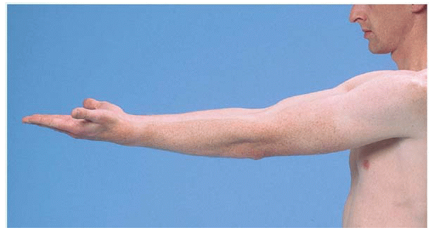
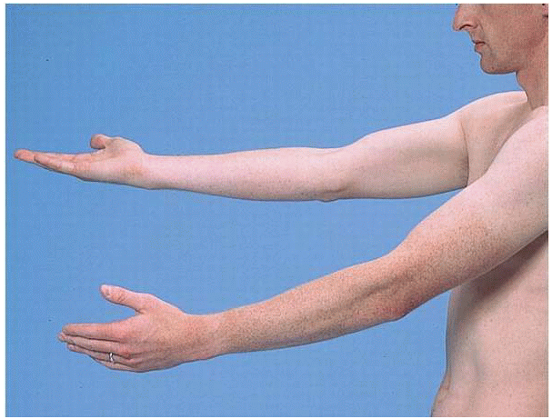
Pronator drift is an indicator of upper motor neuron weakness. In upper motor neuron weakness, supination is weaker than pronation in the upper extremity, leading to a pronation of the affected arm. This test is also excellent for verification of internal consistency, because if a patient fakes the weakness, they almost always drop their arm without pronating it.

Slide 63
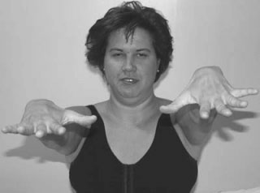
Cerebellar drift. The hand and arm drift upward on extension. Note the
uneven interplay between agonist and antagonist flexors and extensor hand muscles.
This causes “spooning” of the hand.

Slide 64
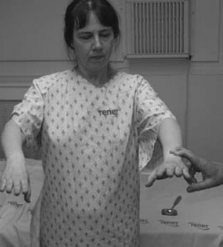
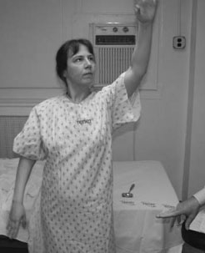
Overshoot:
The examiner presses down on the patient’s arm and asks that the patient maintain it at its original position.
The patient is unable to brake the agonist muscle and cannot keep the arm at the original position – it
overshoots upwards.

Slide 65
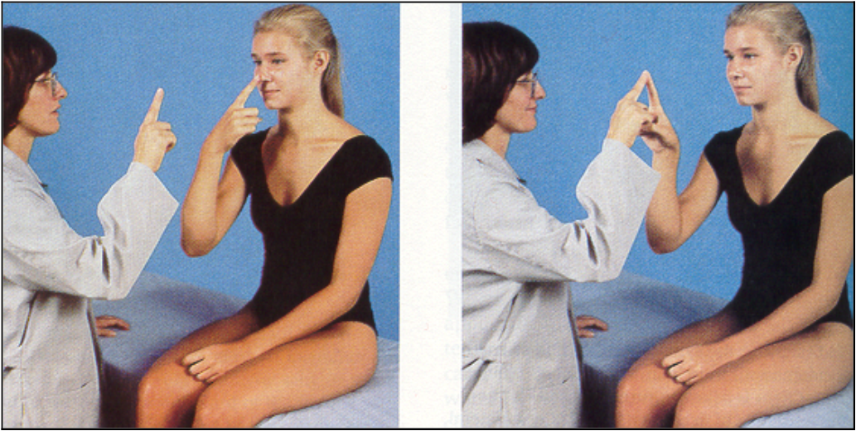
Finger to nose testing:
With the patient seated, position your index finger at a point in space in front of the patient.
Instruct the patient to move their index finger between your finger and their nose.
Reposition your finger after each touch.
Then test the other hand.
Interpretation: The patient should be able to do this at a reasonable rate of speed, trace a straight path, and hit the end points accurately. Missing the mark, known as dysmetria, may be indicative of disease.

Slide 66
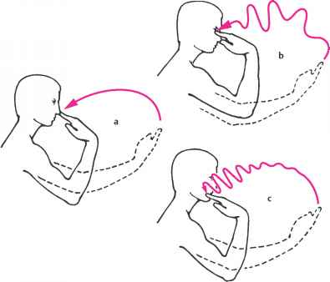

Slide 67
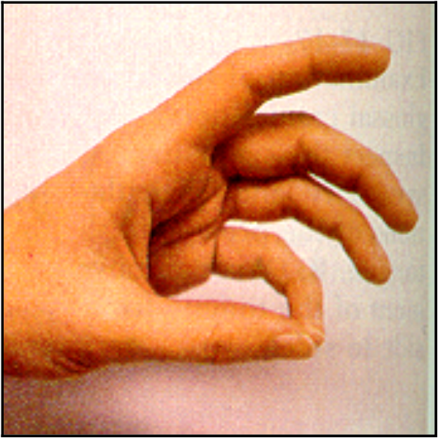
Rapid Alternating Finger Movements:
Ask the patient to touch the tips of each finger to the thumb of the same hand.
Test both hands.
Interpretation: The movement should be fluid and accurate. Inability to do this, known as dysdiadokinesia, may be indicative of cerebellar disease.

Slide 68
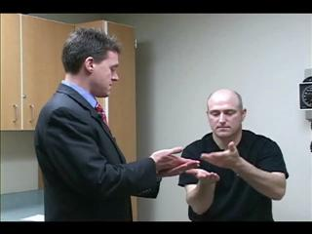
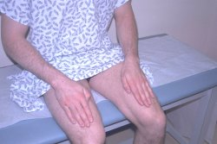
Rapid Alternating Hand Movements:
Direct the patient to touch first the palm and then the dorsal side of one hand repeatedly against their thigh.
Then test the other hand.
Interpretation: The movement should be performed with speed and accuracy. Inability to do this, known as dysdiadokinesia, may be indicative of cerebellar disease.

Slide 69
Heel to Shin Testing:
Direct the patient to move the heel of one foot up and down along the top of the other shin.
Then test the other foot.
Intepretation: The movement should trace a straight line along the top of the shin and be done with reasonable speed.

Slide 70
Gait
Ask the patient to:
Walk across the room or down the hall, then turn, and come back. Observe posture, balance, swinging of the arms, and movements of the legs.
Walk heel-to-toe in a straight line (tandem walking).
Walk on the toes, then on the heels
Hop in place on each foot in turn
Do a shallow knee bend, first on one leg, then on the other.
Rising from a sitting position without arm support and stepping up on a sturdy stool.

Slide 71
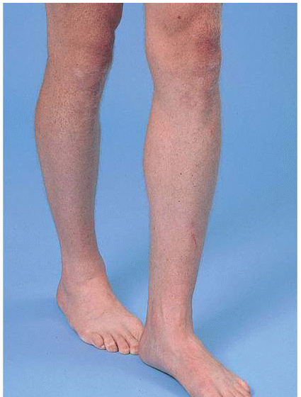
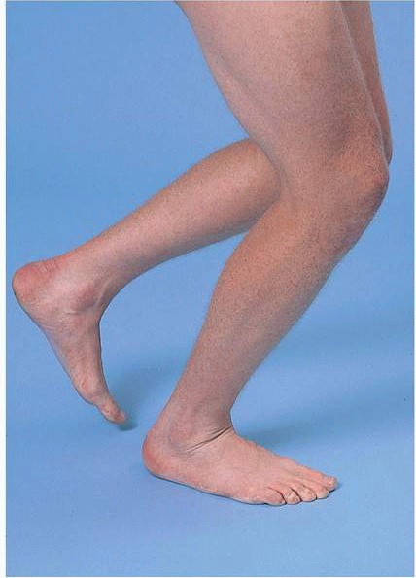
Tandem walking
Hopping

Slide 72
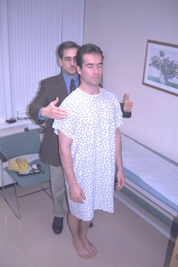
Stance
The Romberg Test:
This is mainly a test of position sense. The patient should first stand with feet together and eyes open and then close both eyes for 30 to 60 seconds without support. Note the patient's ability to maintain an upright posture. Normally only minimal swaying occurs.

Slide 73
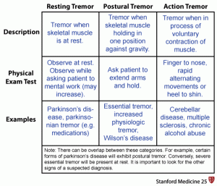

Slide 74
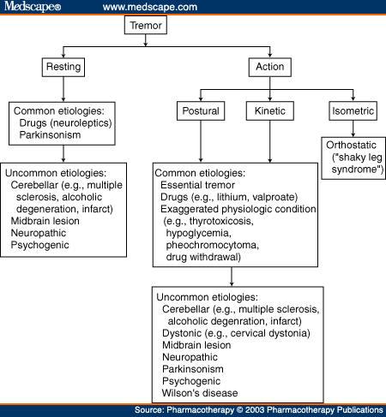

Slide 76
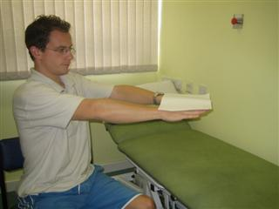

Slide 77
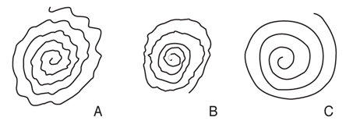
Archimedes spiral

Slide 79
Different types of Tremors

