Slide 1
Peripheral neuropathies
Dr Mohammad Ali Kukaswadia, M.D
Consultant Neurologist

Slide 2
introduction
Neuro = nerve
Pathy = sickness
Peripheral neuropathy describes damage to the peripheral nervous system.

Slide 3
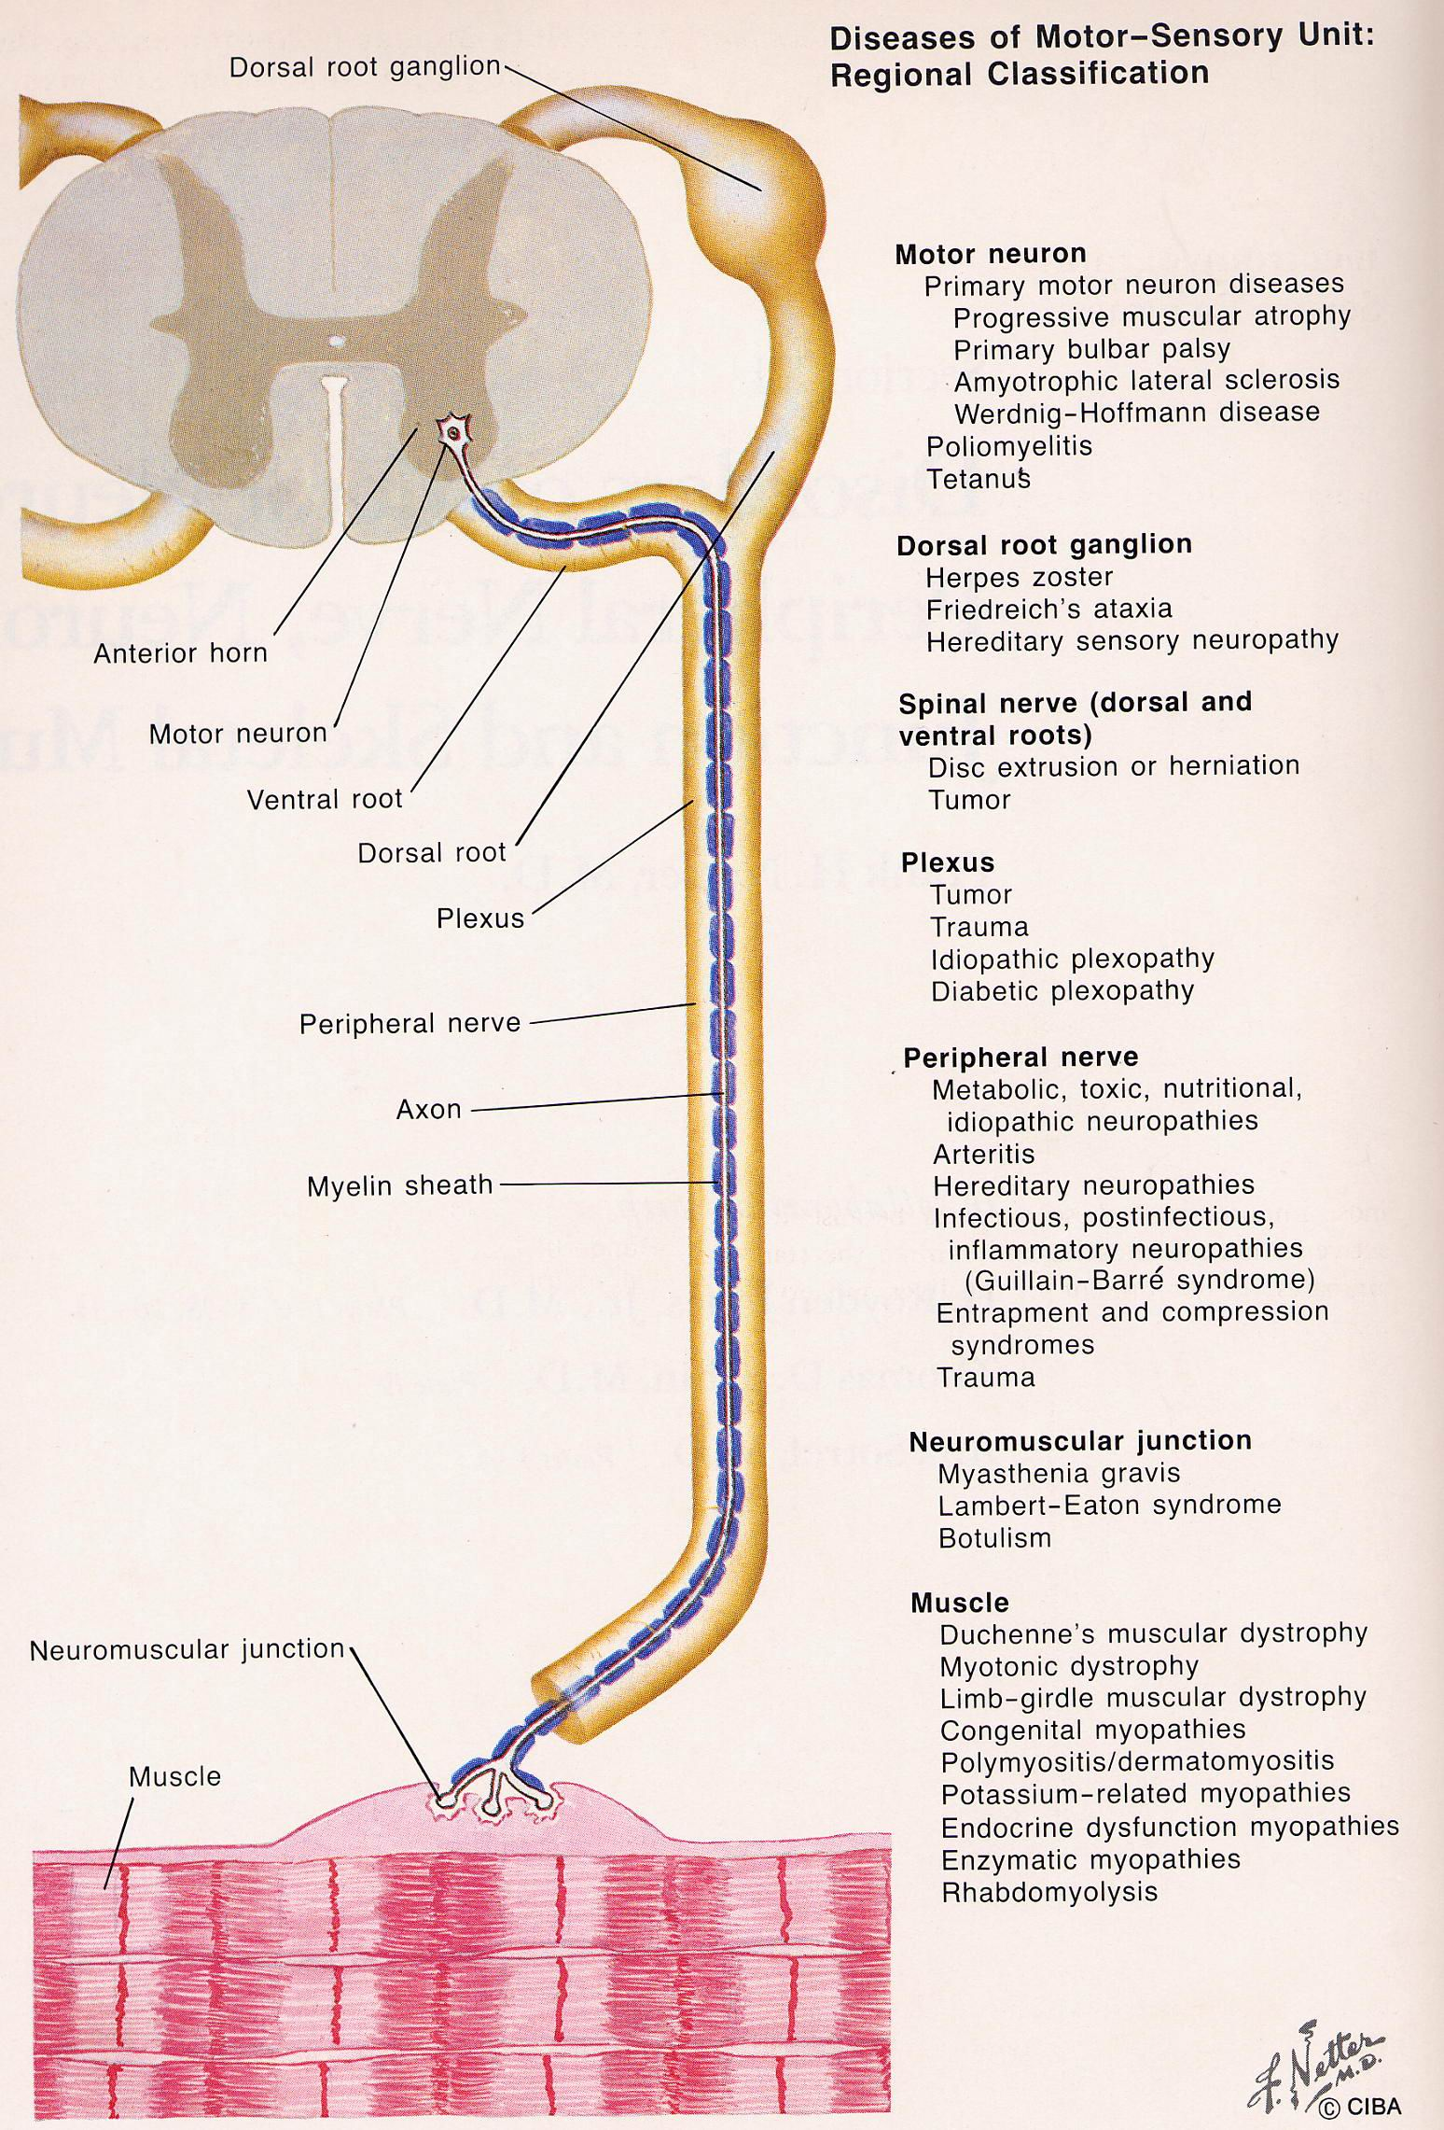
Anterior horn cell (Motor neuron)
Ventral root
Dorsal root ganglion
Dorsal root
Plexus
Peripheral nerve
Neuromuscular junction
Muscle
Small fiber neuropathy

Slide 4
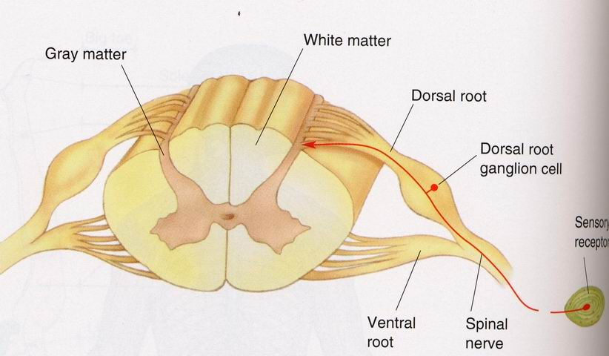
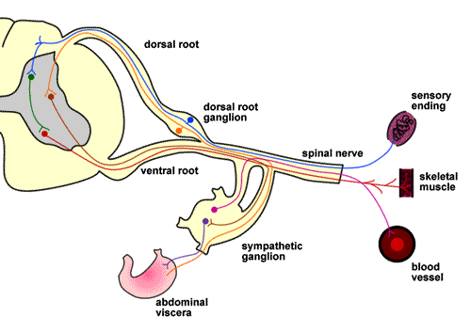

Slide 5
Motor neuron diseases - ALS
Radiculopathies – ventral, dorsal root or mixed – Cervical and Lumbosacral Radiculopathies
Sensory Neuronopathies
Plexopathies – Cervical and Lumbosacral plexopathies
Peripheral neuropathies
Mononeuropathies
Mononeuritis multiplex
Polyneuropathies – Large fiber and small fiber neuropathies

Slide 6
The terms "peripheral neuropathy," "polyneuropathy," and "neuropathy" are frequently used interchangeably, but are distinct.
Peripheral neuropathy is a less precise term that is frequently used synonymously with polyneuropathy, but can also refer to any disorder of the peripheral nervous system including radiculopathies and mononeuropathies.
Polyneuropathy is a specific term that refers to a generalized, relatively homogeneous process affecting many peripheral nerves, with the distal nerves usually affected most prominently.
Neuropathy, which again is frequently used synonymously with peripheral neuropathy and/or polyneuropathy, can refer even more generally to disorders of the central and peripheral nervous system.

Slide 8
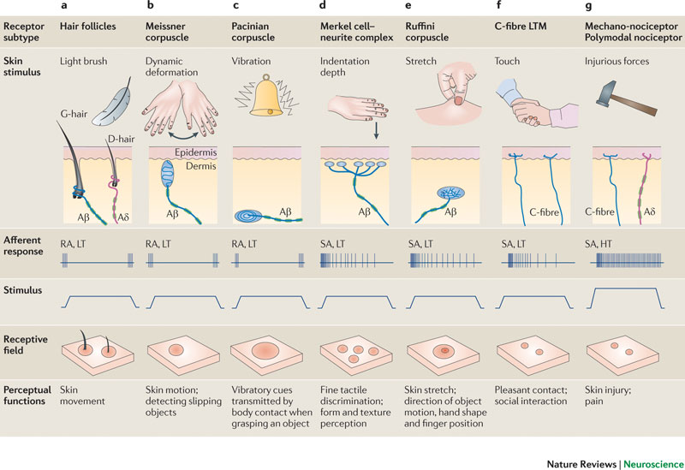

Slide 9
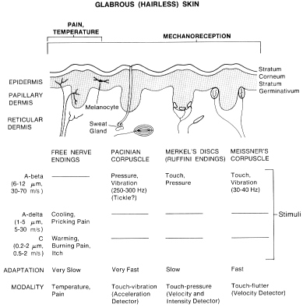

Slide 10
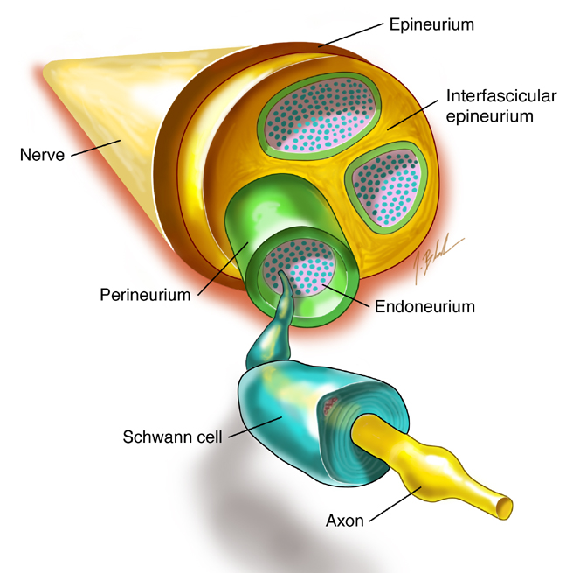
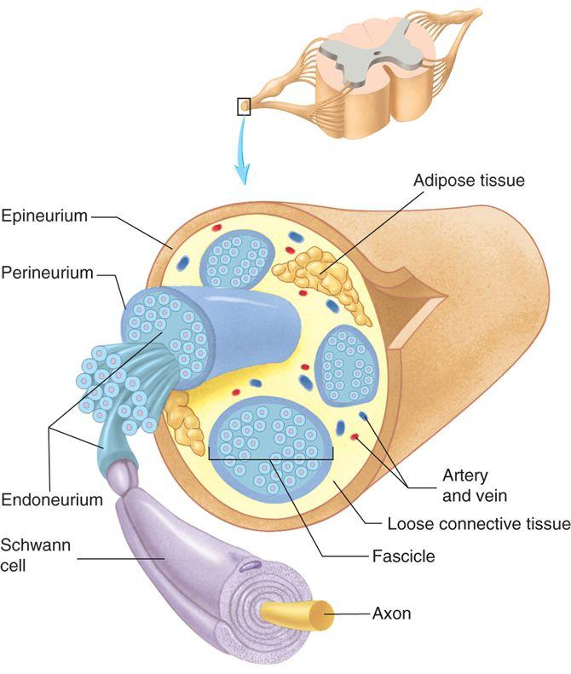

Slide 11
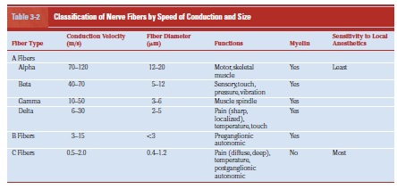

Slide 13
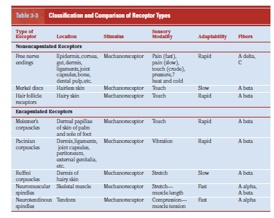

Slide 14
Peripheral neuropathies
Can be classified in different ways
Mononeuropathy
Mononeuritis multiplex
Polyneuropathy
Nerve dysfunction caused by many inherited & acquired diseases.
Nerve fibers of different types (motor, sensory or autonomic) & of different sizes may be variably involved.
Disorders may be primarily directed at the axon (axonal), the myelin sheath (demyelinating)or both(mixed).

Slide 15
Mechanisms of damage
Demyelination Myelin sheath disrupted -- GBS , HSMN
Axonal degeneration Axon damage --- Toxic neuropathies
Wallerian Nerve section - Trauma
degeneration
Compression Focal demyelination
Entrapment - Carpel tunnel syndrome
Infarction Arteritis
Polyarteritis nodosa, DM
Infiltration Infiltration
Leprosy, Sarcoidosis

Slide 16
Symptoms of Peripheral Neuropathies:
Motor
Sensory
Autonomic
Mixed
Positive Symptoms – excess function
Negative Symptoms – loss of function

Slide 17
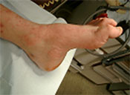
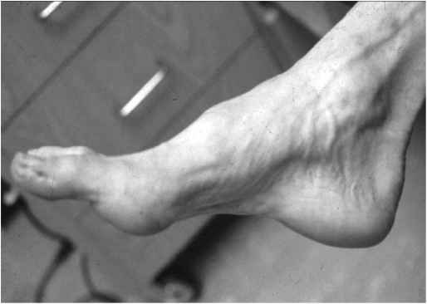
 | Loss of function “Negative” | Altered function “Positive”
Motor nerves | Wasting Hyopotonia Weakness Hyporeflexia Orthopedic deformity | Fasciculations Cramps

Slide 18
 | Loss of function “Negative” | Altered function “Positive”
Sensory Large Fiber | ↓ Vibration ↓ Proprioception Hyporeflexia Sensory ataxia | Paresthesias

Slide 19
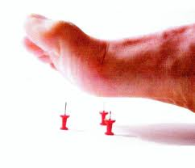
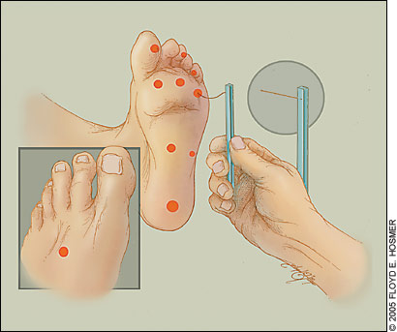
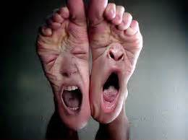
 | Loss of function “Negative” | Altered function “Positive”
Sensory Small Fiber | ↓ Pain ↓ Temperature | Dysesthesias Allodynia

Slide 20
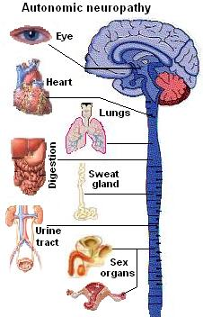
 | Loss of function “Negative” | Altered function “Positive”
Autonomic nerves | ↓ Sweating Hypotension Urinary retension Impotence Vascular color changes | ↑ Sweating Hypertension

Slide 21
Peripheral Neuropathy from History, physical exam and electrodiagnostic studies
Pseudoneuropathy
Hyperventilation
Myopathy
Neuromuscular junction
diseases
Motor neuron diseases
Psychogenic
Cervical cord process
others
Mononeuropathy
Mononeuropathy multiplex
Polyneuropathy

Slide 22
Peripheral Neuropathy from History, physical exam and electrodiagnostic studies
Pseudoneuropathy
Compression
Isolated or contigious
Mononeuropathies
Diabetes
Vasculitis
Infection
Leprosy
Neoplasm
Brachial or lumbar
plexopathy
Radiation
Sarcoidosis
Radiculopathies
Mononeuropathy /
focal neuropathies
Mononeuropathy multiplex
Polyneuropathy

Slide 23
Peripheral Neuropathy from History, physical exam and electrodiagnostic studies
Pseudoneuropathy
DEMYELINATING
Multiple compressions
variant of CIDP – MMN
AXONAL
Diabetes
Vasculitis
Infection
Leprosy
Neoplasm
Brachial or lumbar
plexopathy
Radiation
Sarcoidosis
Radiculopathies
Mononeuropathy /
focal neuropathies
Mononeuropathy multiplex
Polyneuropathy

Slide 24
Peripheral Neuropathy from History, physical exam and electrodiagnostic studies
AXONAL
ACUTE
SUBACUTE
DEMYELINATING
ACUTE
CHRONIC
CHRONIC
Polyneuropathy

Slide 25
AXONAL
ACUTE
SUBACUTE - CHRONIC
ACUTE
PORPHRIA
AXONAL VARIANT OF GBS
SUBACUTE
TOXINS
SYSTEMIC DISORDERS
UREMIA
DIABETES
HYPOTHYROID
HIV
LYMES DISEASE
PARANEOPLASTIC
DYSPROTEINEMIA
SARCOIDOSIS
CONNECTIVE TISSUE DISEASES
AMYLOIDOSIS
CHRONIC
MEDICATIONS - NITROFURONOIN
CHRONIC
HMSN – II
SYSTEMIC DISORDERS
FABRY’S DISEASE
NUTRITIONAL

Slide 26
DEMYELINATING
UNIFORM
NON UNIFORM
HMSN – I
HMSN – III
REFSUM’S
KRABBE’S DISEASE
ACUTE
AIDP
DIPHTHERIA
ACUTE ARSENIC
SUBACUTE TO CHRONIC
CIDP AND VARIANTS

Slide 27
Radiculopathy
Causes
Compressive : herniated disc, spondylosis, tumor
Infiltrative : tumor seeding, infection
Inflammatory : immune-mediated

Slide 28
Dermatome
No C1 dermatome
C4 and T2 dermatome are contiguous on trunk
Thumb, middle finger, and fifth digits are innervated by C6, C7, and C8, respectively
Nipple is at T4 level
Umbilicus is at T10 level
Lumbar and sacral dermatome are contiguous in the posterior axial line of leg

Slide 29
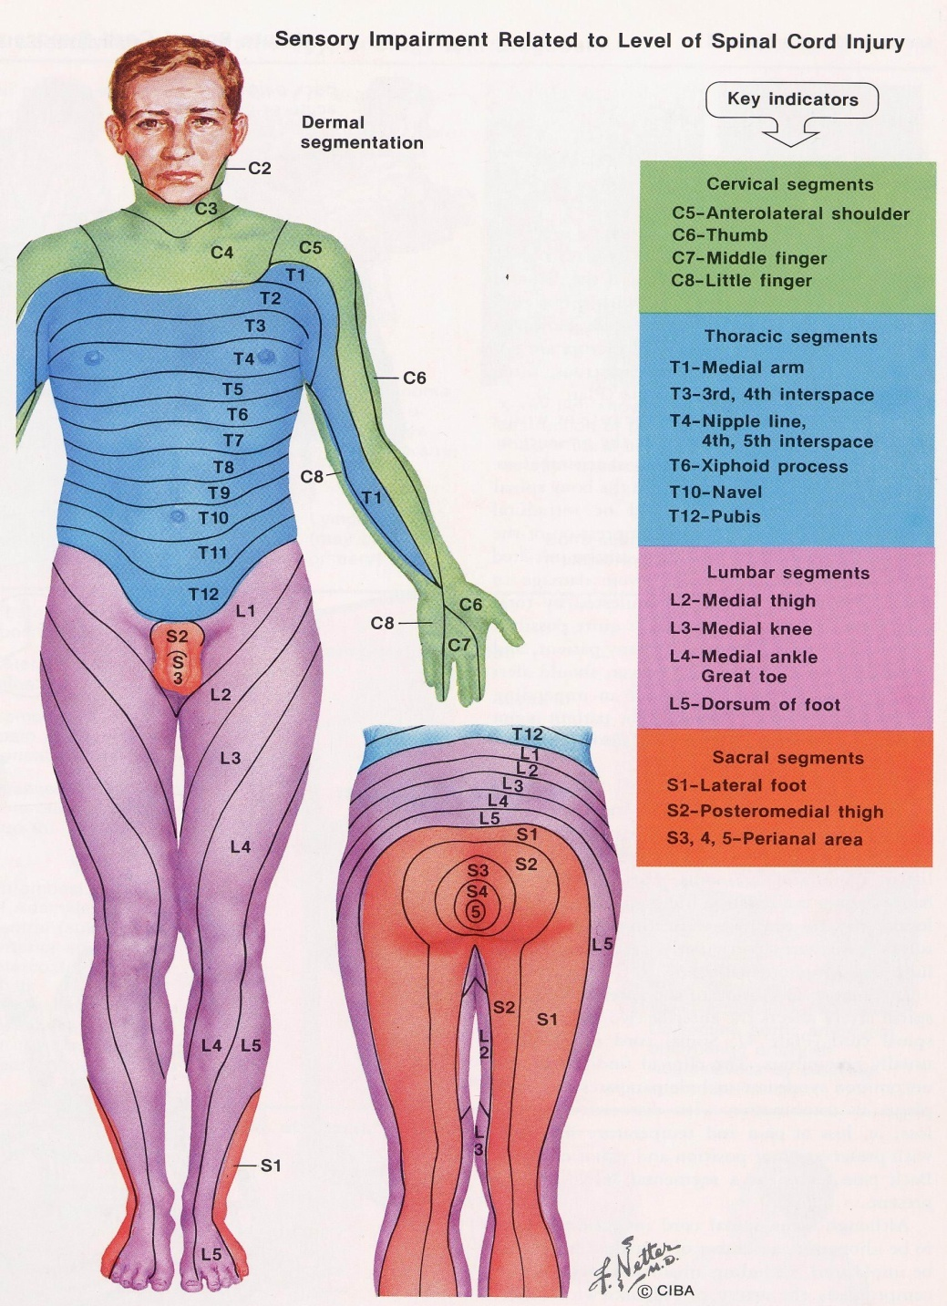

Slide 30
Segment pointer muscles
Root | Muscle | Primary function
C3 | Diaphragm | Respiration
C4 | Diaphragm | Respiration
C5 | Deltoid | Arm abduction
C5 | Biceps | Forearm flexion
C6 | Brachioradialis | Forearm flexion
C7 | Triceps | Forearm extension
L3 | Quadriceps femoris | Knee extension
L4 | Quadriceps femoris | Knee extension
L4 | Tibialis anterior | Foot dorsiflexion
L5 | Extensor hallucis longus | Great toe dorsiflexion
S1 | Gastrocnemius | Plantar flexion

Slide 31
Cervical radiculopathy

Slide 33
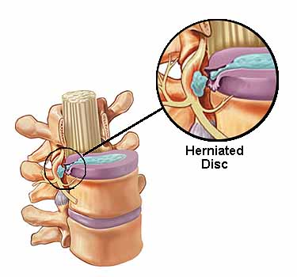
Lumbar Radiculopathy

Slide 34
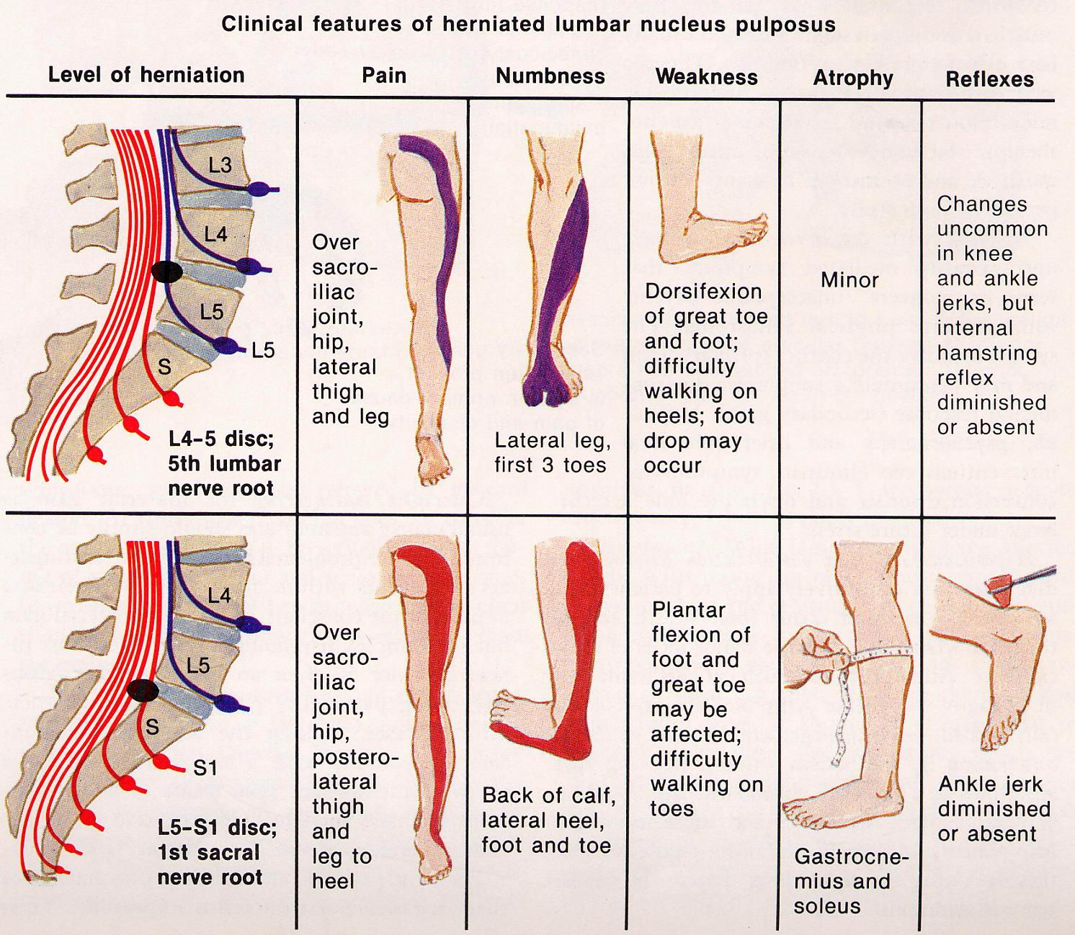

Slide 35
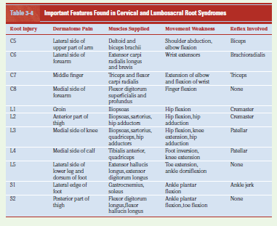

Slide 36
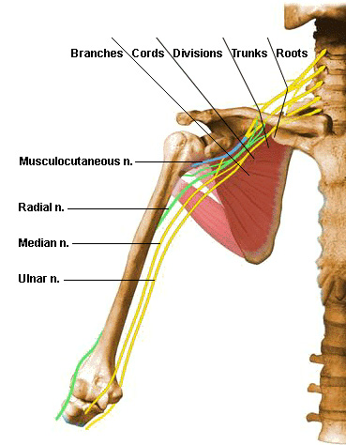
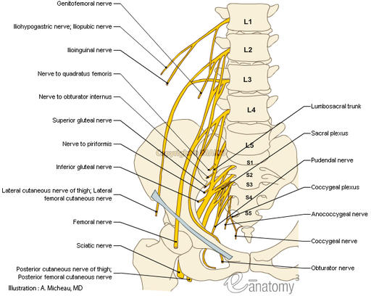
Plexopathy
Brachial plexus
Lumbosacral plexus

Slide 37
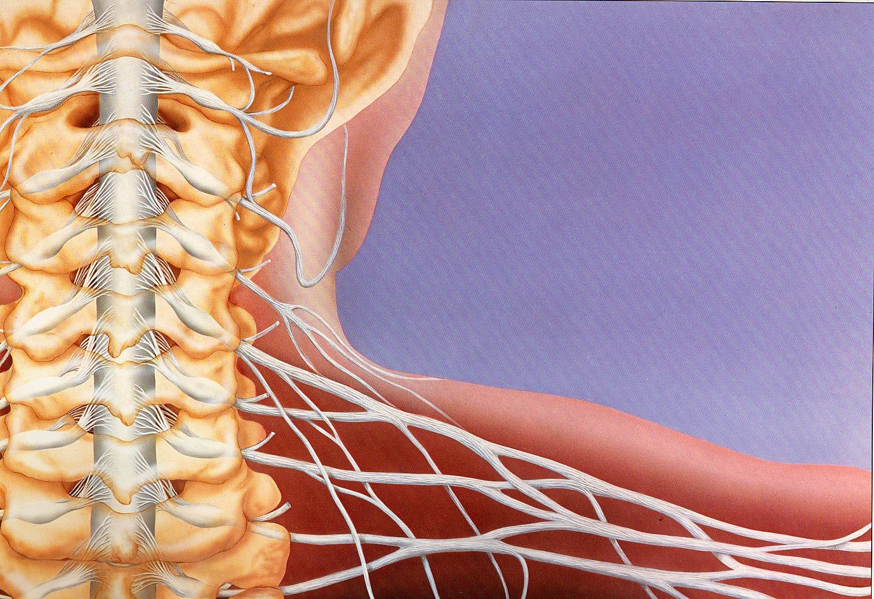
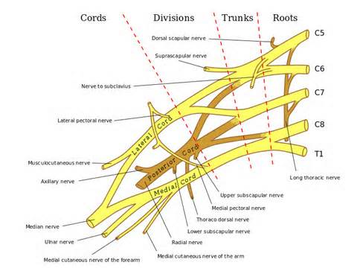
Brachial Plexus

Slide 38
Brachial Plexus
Roots : C5, C6, C7, C8, T1
Trunk : Upper (Roots C5 & C6),
Middle (Root C7),
Lower (Root C8 & T1)
Division : Each trunk divides into anterior and posterior divisions
Cord : Lateral (anterior div of upper and middle),
Posterior (post div of all trunks),
Medial ( ant div of lower)

Slide 39
Anatomy
Lateral
cord
Musculo cutaneous nerve
Median nerve
Posterior cord
Axillary nerve
Radial nerve
Medial cord
Median nerve
Ulnar nerve

Slide 40
Causes of brachial plexopathy
Trauma
Tumor infiltration
Infection by viral
Immune-mediated
Delayed effects of radiotherapy

Slide 41
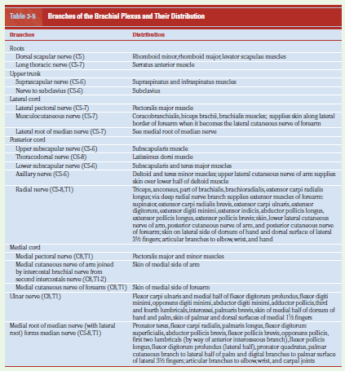

Slide 42
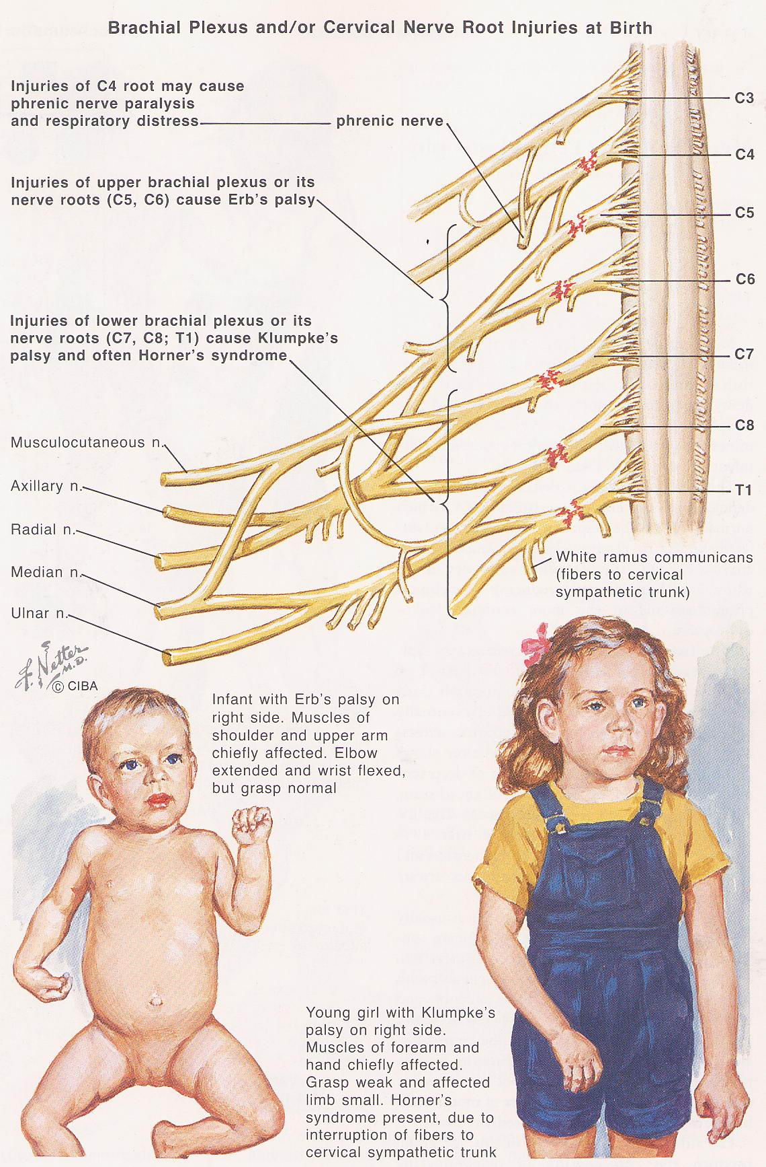
Klumpke’s palsy (injury of lower brachial plexus C7,C8,T1) and often Horner’s syndrome
Erb’s palsy (injury of upper brachial plexus C5,C6)

Slide 43
Brachial plexus lesions can be divided into two types:
An upper brachial plexus lesion, which occurs from excessive lateral neck flexion away from the shoulder. Most commonly, falling on the neck at an angle causes upper plexus lesions leading to Erb's palsy. This type of injury produces a very characteristic sign called Waiter's tip deformity due to loss of the lateral rotators of the shoulder, arm flexors, and hand extensor muscles.

Slide 44
Much less frequently, sudden upward pulling on an abducted arm (as when someone breaks a fall by grasping a tree branch) produces a lower brachial plexus lesion, in which the eighth cervical (C8) and first thoracic (T1) nerves are injured "either before or after they have joined to form the lower trunk. The subsequent paralysis affects, principally, the intrinsic muscles of the hand and the flexors of the wrist and fingers". This results in a form of paralysis known as Klumpke's paralysis.

Slide 45
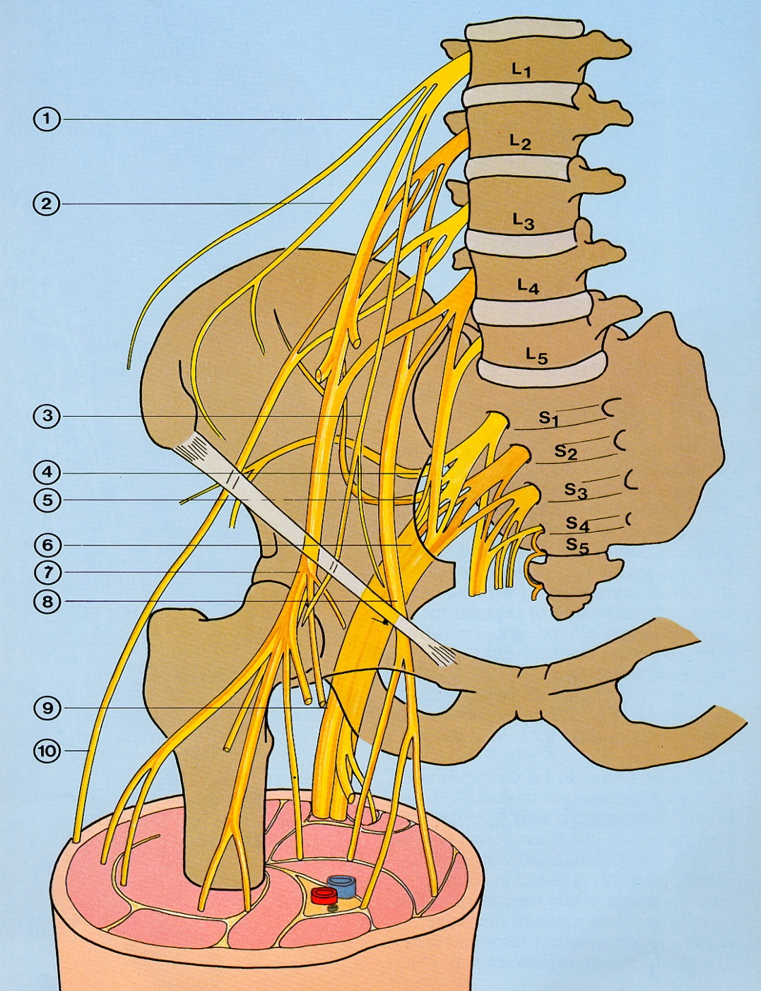
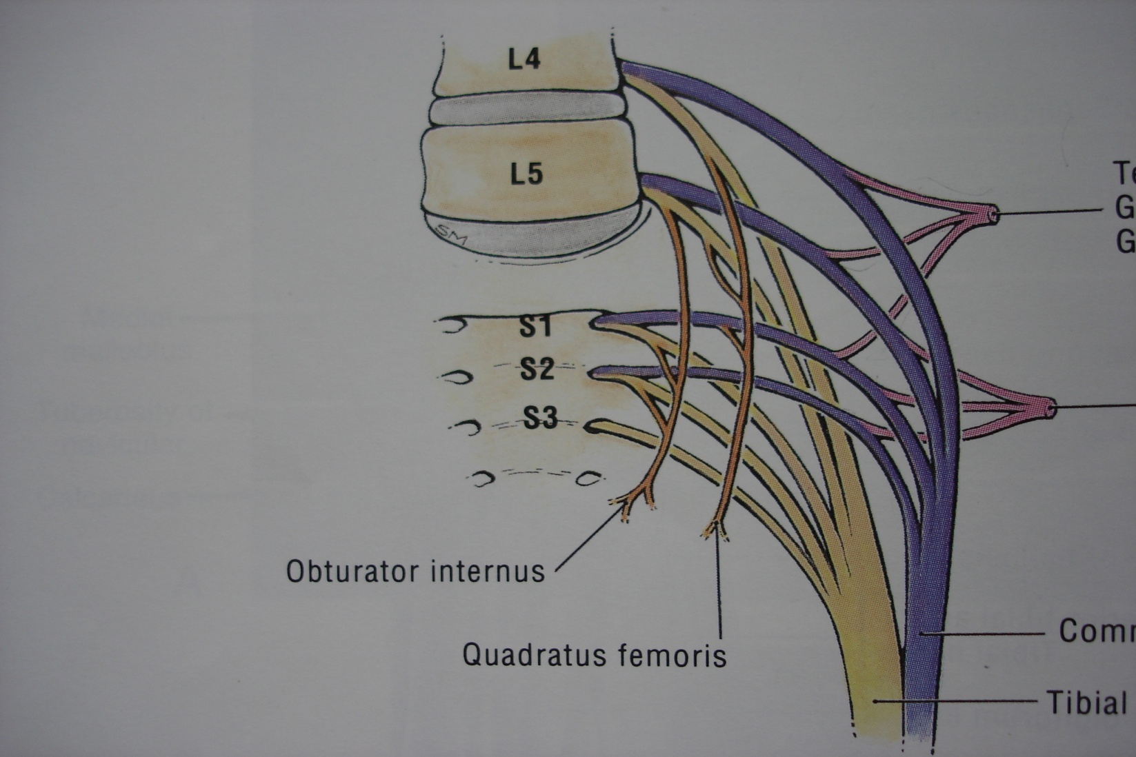
Lumbosacral Plexus

Slide 46
Causes of lumbosacral plexopathy
Tumors : CA cervix, prostate, bladder, colorectal, kidney, breast, testis, ovary, sarcoma, lymphoma
Compressed by aortic aneurysm
Radiation plexopathy
Plexitis : follow herpes zostor
Diabetic amyotrophy
Trauma (rare)
As a manifest of mononeuropathy multiplex

Slide 47
Clinical manifestation
Lumbar plexopathy
Sacral plexopathy

Slide 48
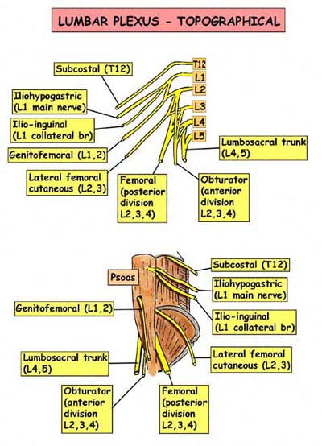

Slide 49
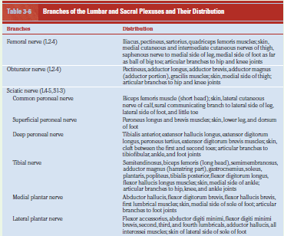

Slide 50
Common Mononeuropathies

Slide 51
Median nerve compression
Three separate syndromes are recognized
Carpal tunnel syndrome
Pronator syndrome
Anterior interosseous syndrome

Slide 52
Median nerve
Carpal tunnel syndrome
Nocturnal pain or paresthesia
Thenar atrophy

Slide 53
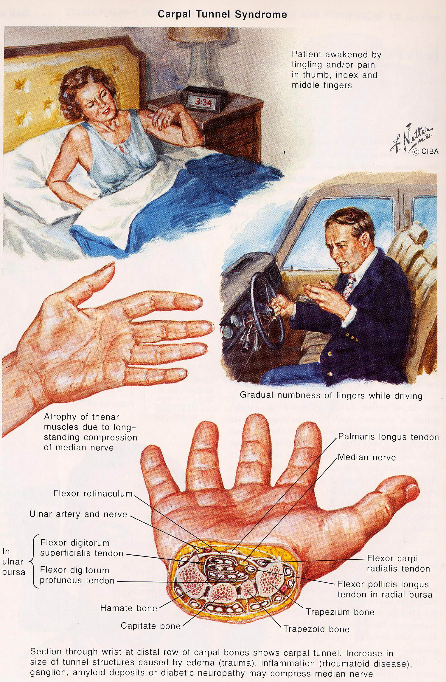

Slide 54
Treatment
Splinting – prevent wrist flexion
corticosteroid/anesthetic injection – give temporary relief
Surgical decompression

Slide 55
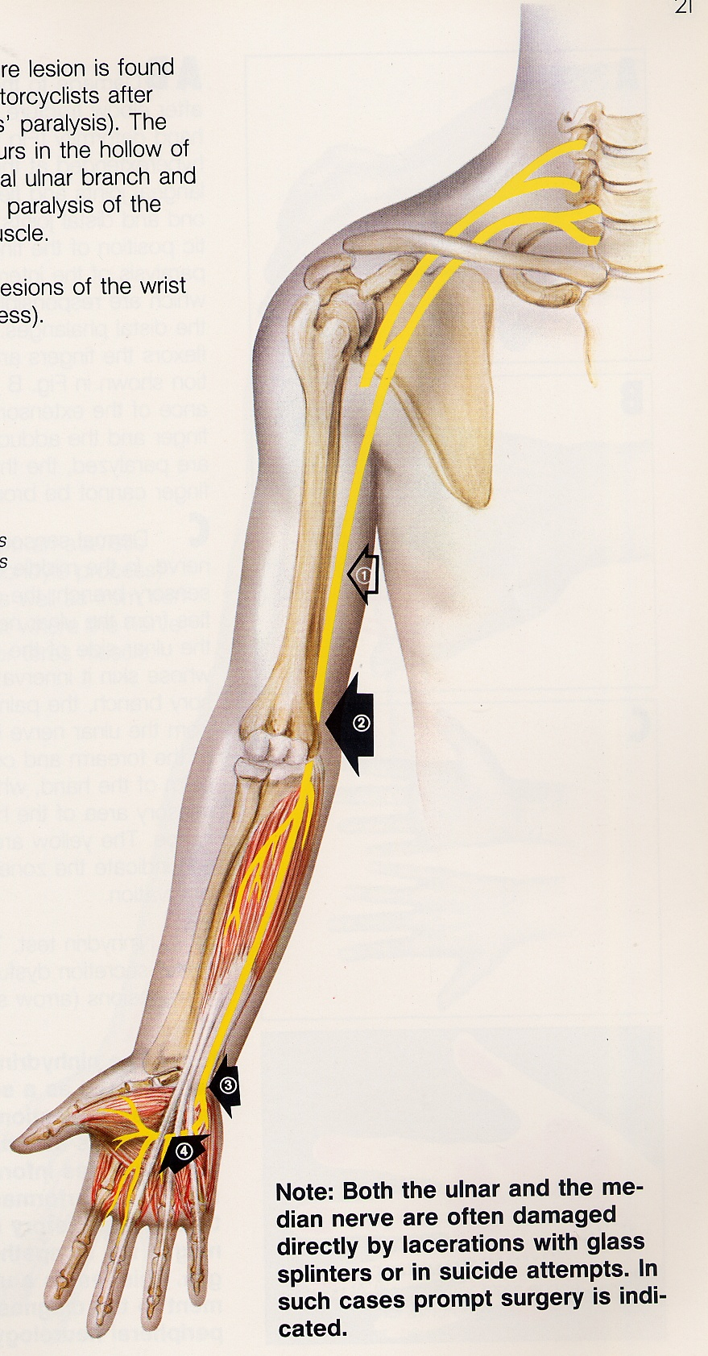
Ulnar nerve
Lesion at condylar groove
Guyon’s canal
Lesion at wrist and hand

Slide 56
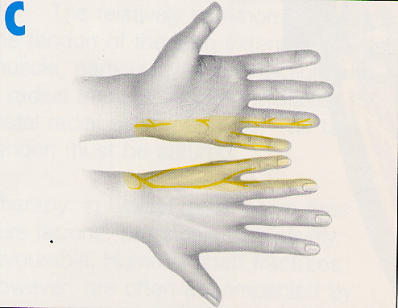
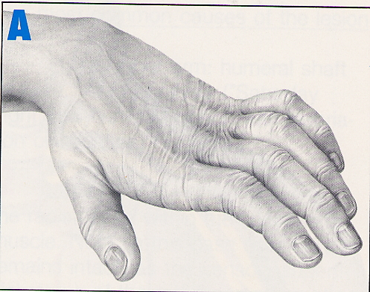
Ulnar nerve
At elbow : Condylar groove or in cubital tunnel
Wasting hypothenar eminence and web space (1st dorsal interossei)
Claw hand

Slide 58
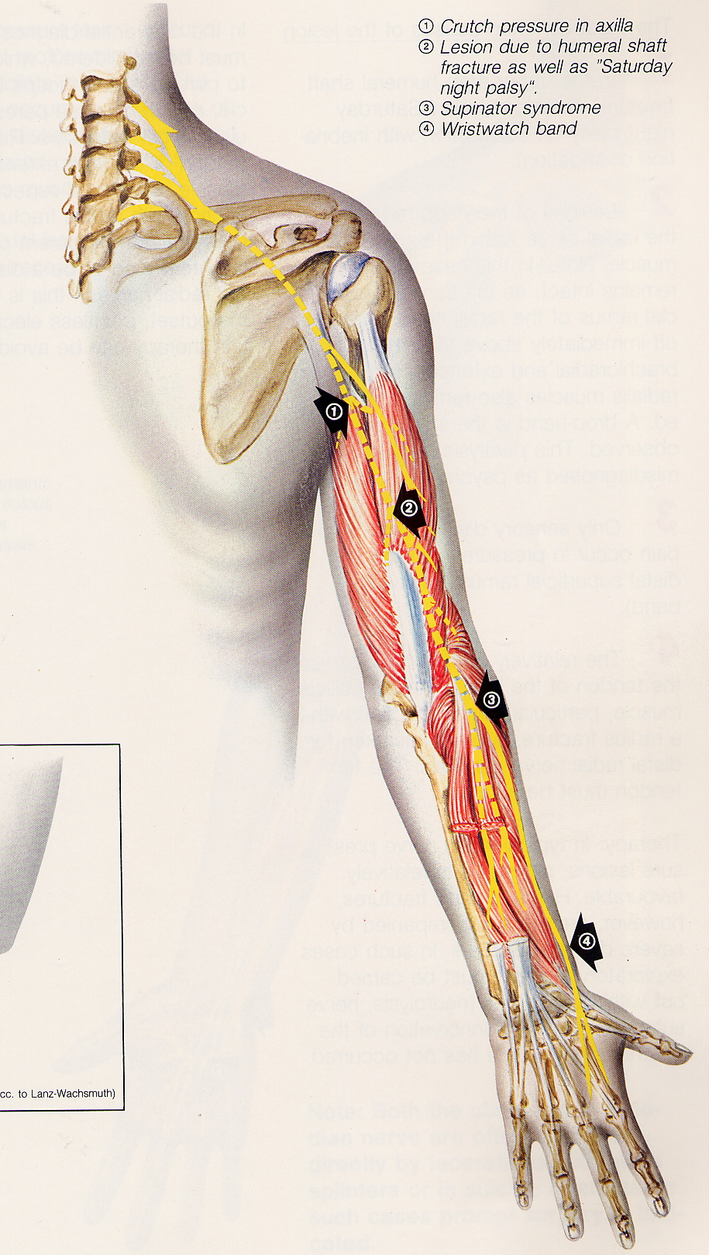
Radial nerve
Saturday night palsy
Posterior interosseous syndrome
Cheiralgia paresthetica
Wrsitwatch/handcuff neuropathy

Slide 59
Radial nerve
Axillary lesion : weak triceps and radial innervated muscles.
Mid-upper arm lesion : ‘Saturday night palsy’ (spiral groove or intermuscular septum) : wrist drop, normal triceps, variable motor and sensory deficit
Posterior interosseous : weak extensor of thumb and other fingers, no sensory loss
Superficial radial nerve : terminal cutaneous branch.

Slide 60
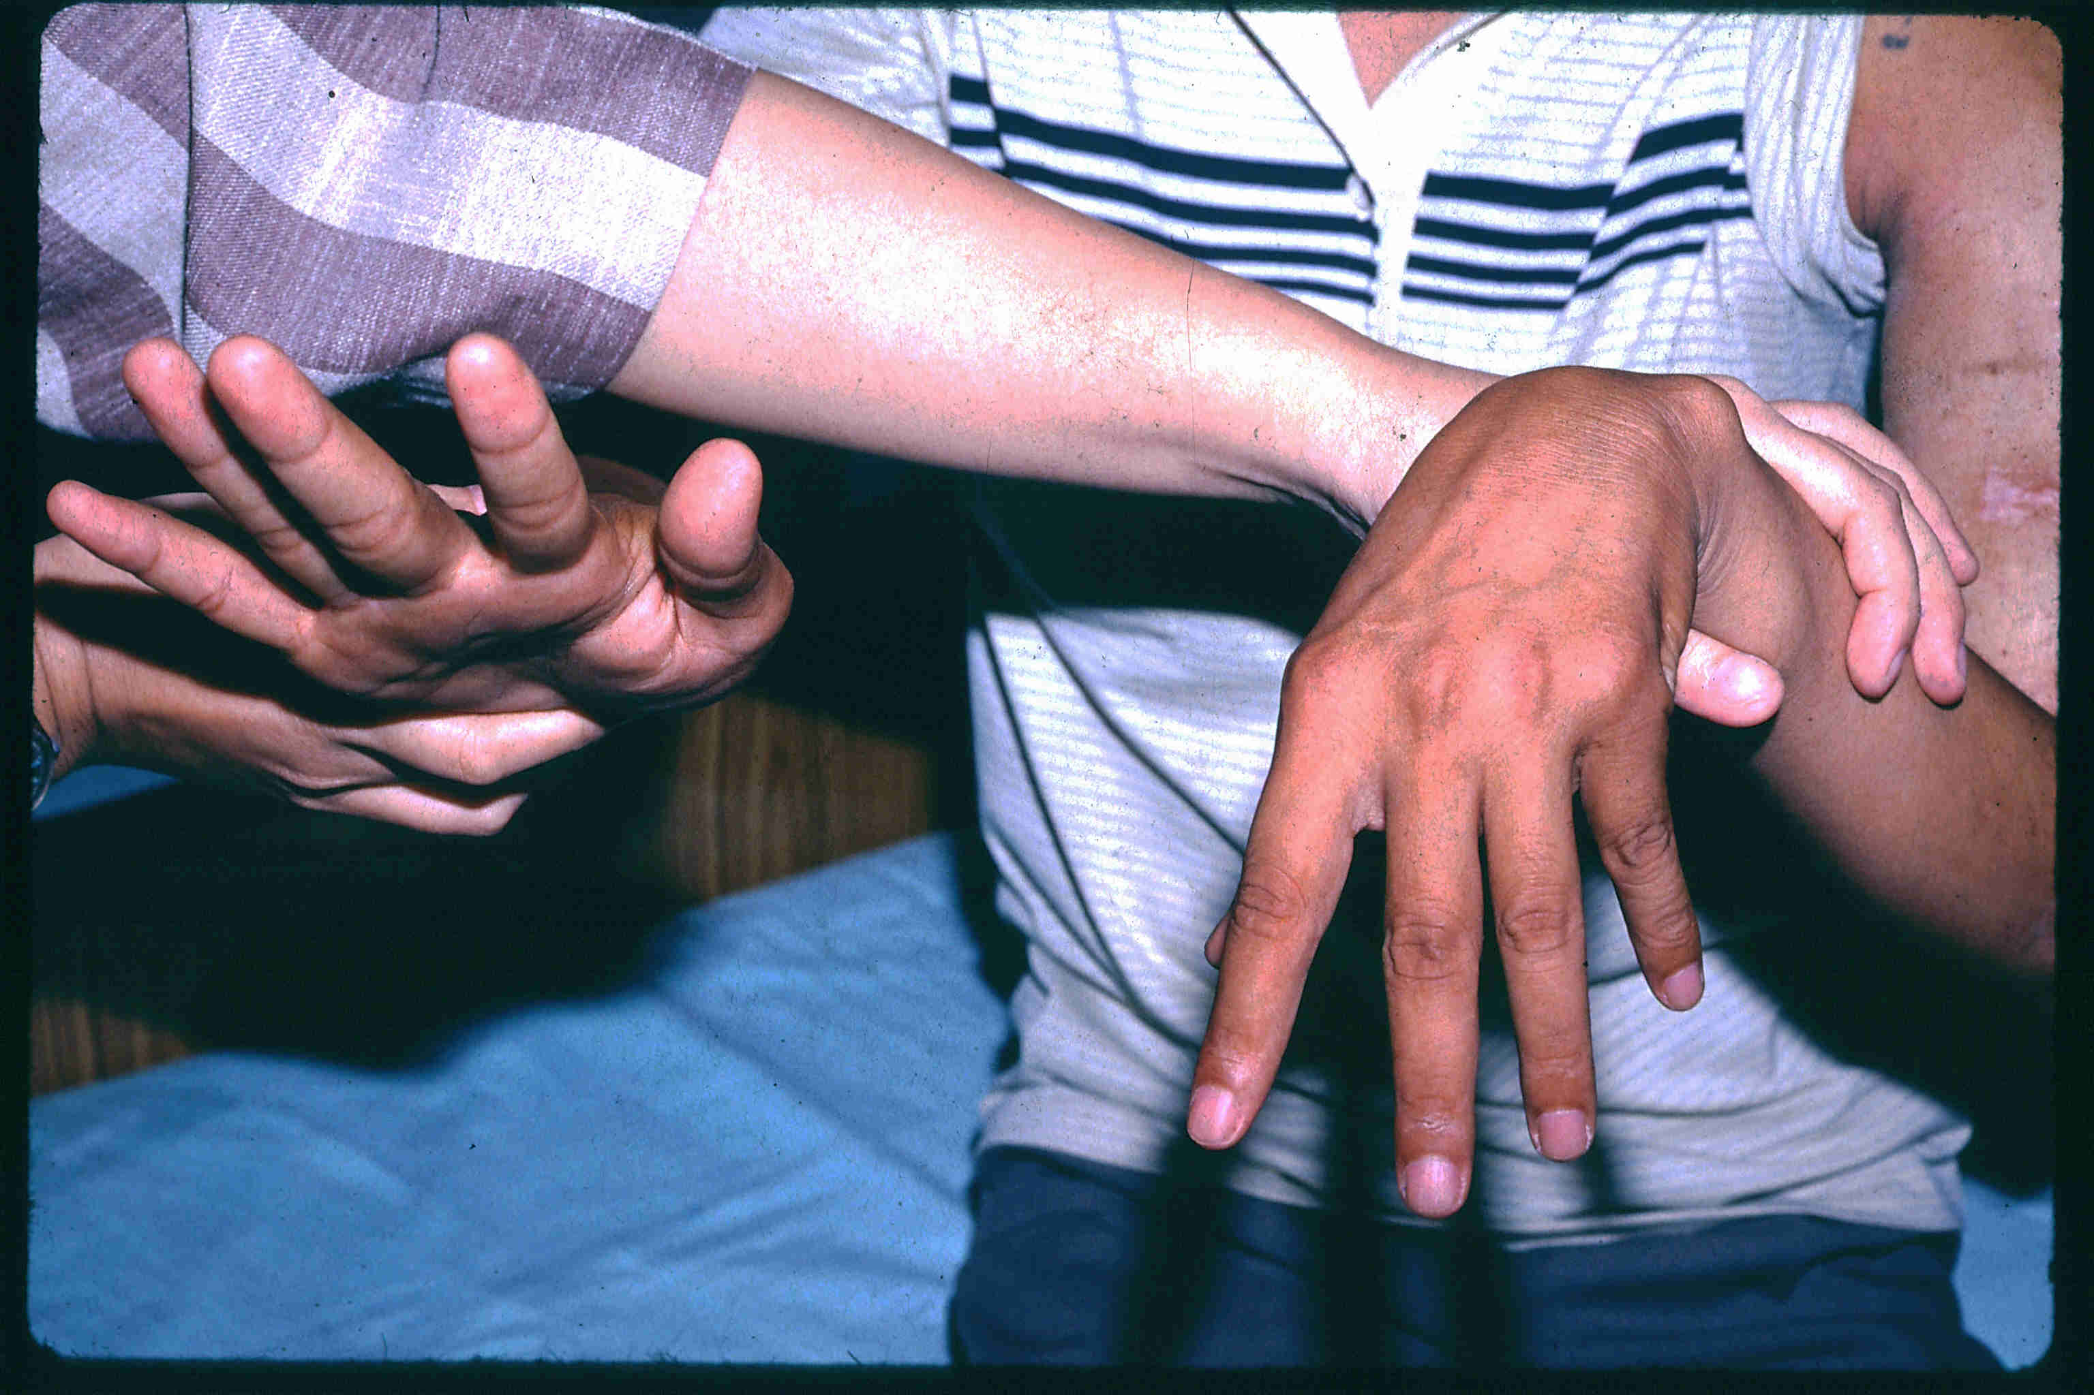
Wrist drop

Slide 61
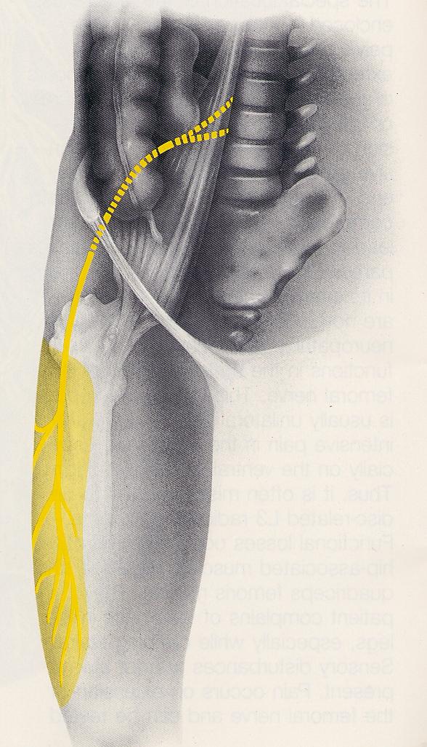
Lateral femoral cutaneous nerve of thigh (L2 and L3)
Meralgia paresthetica
Pure sensory

Slide 62
Femoral nerve (L2,3,4)
Mix sensorimotor
Quadriceps femoris or knee extensor
Weakness of hip flexor in intraabdominal lesion
Sensory deficit over anteromedial aspect of thigh and perhaps leg
Absent or diminished knee jerk

Slide 63
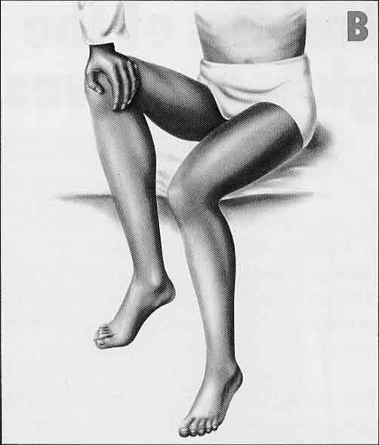
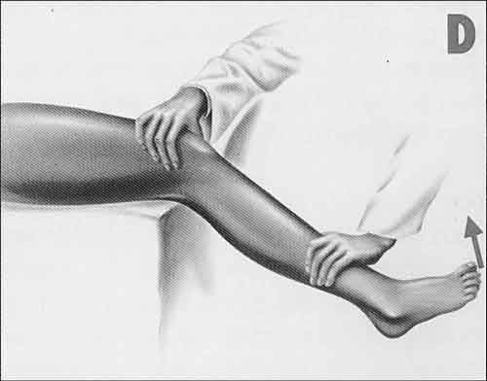
Femoral nerve

Slide 64
Sciatic nerve
L4-S3
Sciatic

Slide 65
Sciatic nerve
Composed of 2 main nerves of leg : common peroneal and tibial nerve
Paralysis of all muscles below knee plus hamstrings and for high lesion, external rotators of thigh
Sensory loss below knee except anteromedial aspect of leg and foot

Slide 66
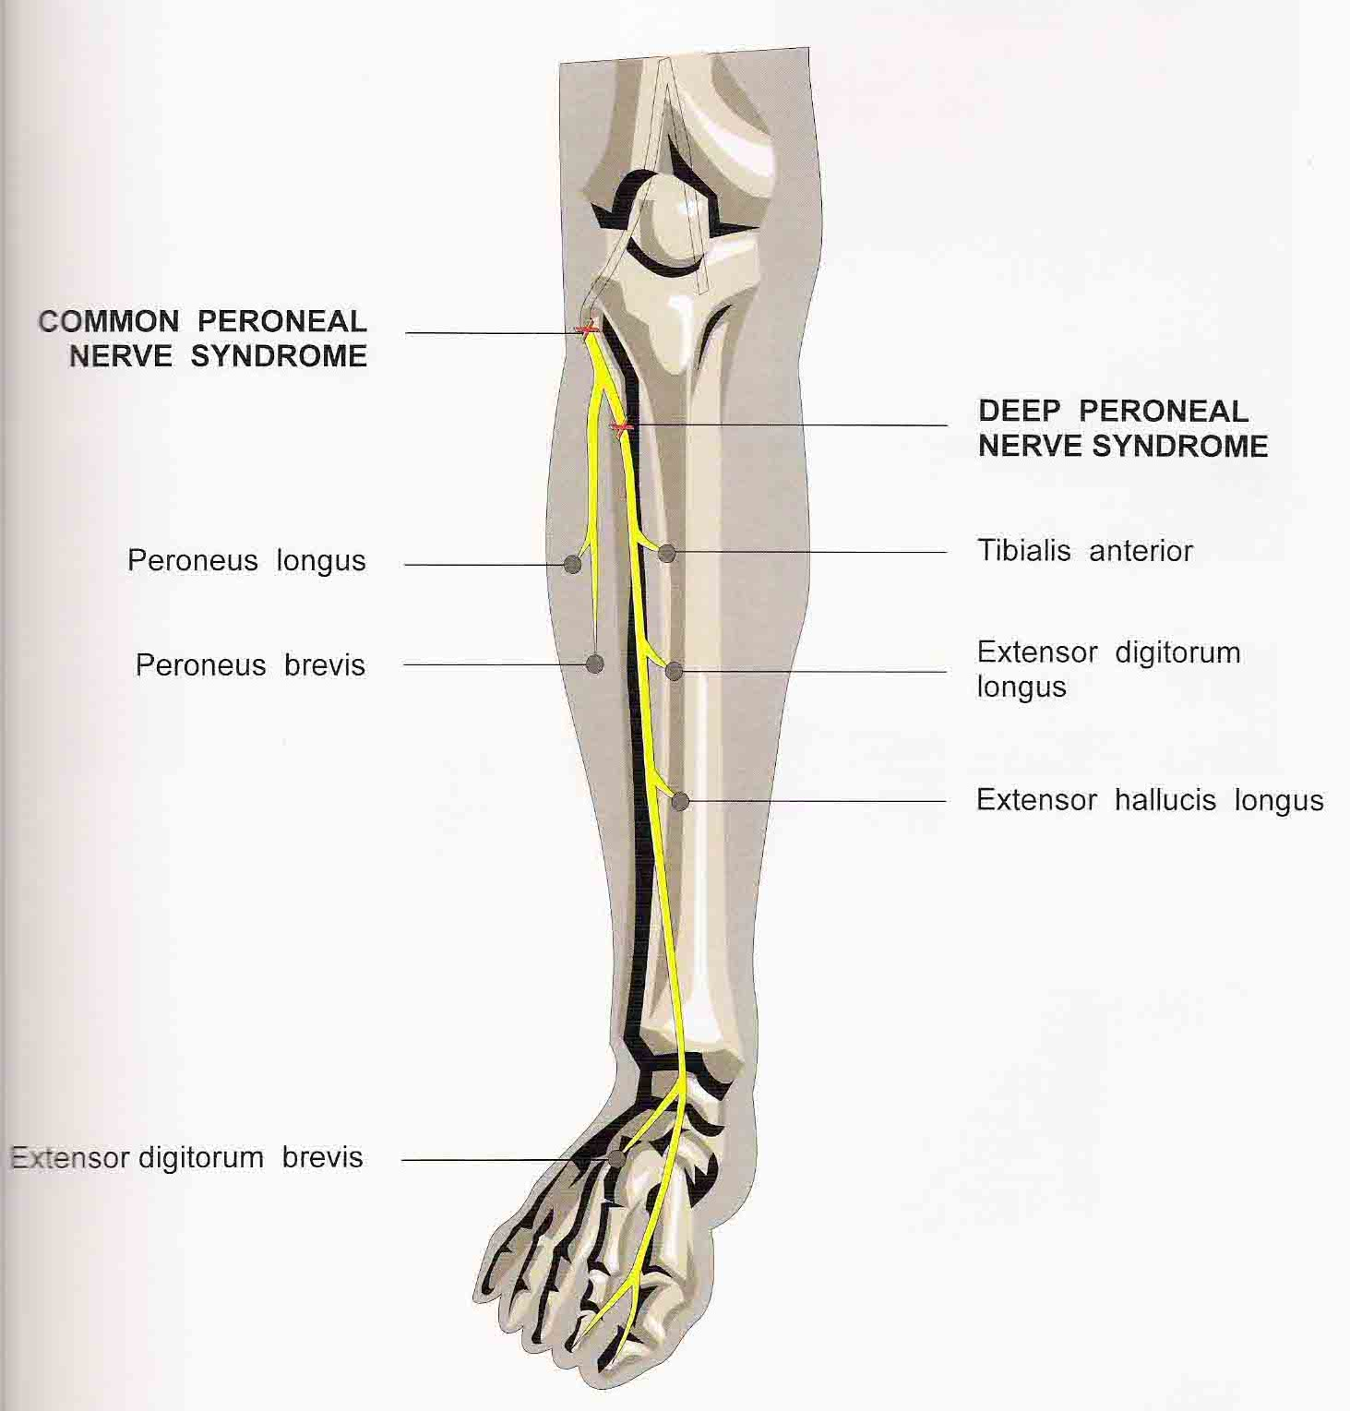
Common peroneal nerve
Foot-drop
Paralysis of anterior and lateral compartment of leg
Sensory loss over dorsum of foot and toes and anterolateral aspect of leg

Slide 67
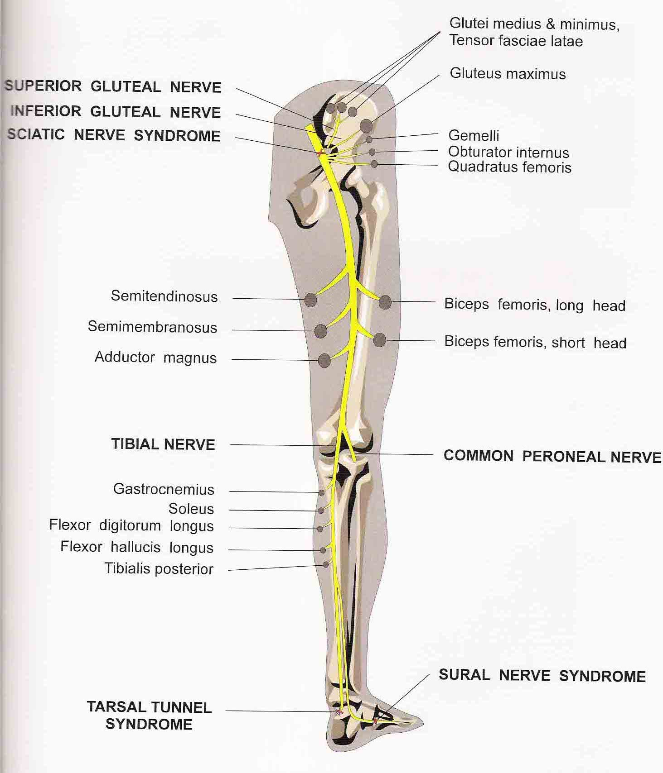
Tibial nerve

Slide 68
Tibial nerve
Medial division of sciatic nerve
Lesions at ankle
Tarsal tunnel syndrome
Pain and paresthesia in sole
Paralysis of intrinsic muscles of foot
Tenderness of Tinel’s sign at flexor retinaculum
Sural nerve compression syndrome
Pure sensory
Numbness on lateral aspect of foot

Slide 69
Nerve | Symptoms | Muscles affected | Area of sensory loss
Median (carpal tunnel Syndrome – at wrist) | Pain /d paraesthesia on palmar aspect of hands &fingers, waking the patient from sleep. Pain may extend to arm and shoulder | Abductor pollicis brevis | Lateral palm & thumb, index, middle and medial half 4th finger
Ulnar (cubital tunnel syndrome - at elbow) | Paraesthesia on medial border of hand, wasting & weakness of hand muscles | All small hand muscles, excluding abductor pollicis brevis | Medial palm & little finger& medial half 4th finger
Radial (spiral groove) | Weakness of extension of wrist and fingers, often precipitated by sleeping in abnormal posture, e.g. arm over back of chair | Wrist and finger extensors, supinator | Dorsum of thumb
Peroneal (at fibular head) | Foot drop, trauma to head of fibula | Dorsiflexion and eversion of foot | Nil or dorsum of foot
Lateral cutaneous nerve of the thigh (meralgia paraesthetica) | Tingling / dysaesthesia on lateral border of the thigh | Nil | Lateral border of thigh

Slide 70
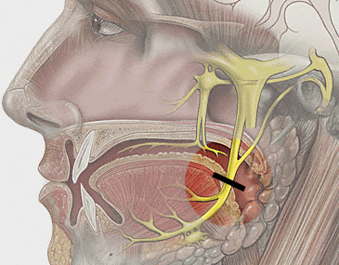
Facial nerve
Chorda tympani

Slide 71
Facial nerve palsy
Bell’s palsy : idiopathic, HSV 1
Ramsay Hunt syndrome : external ear pain with presence of herpes zoster vesicles in auditory canal and pinna, VZV
Trauma : blunt impact to temporal bone
Middle ear infection : otitis media (infrequent in ATB era), mastoid pain persist after acute infection resolved
Neoplasm : rarely compressed by CPA tumor but due to surgery for tumor removal

Slide 72
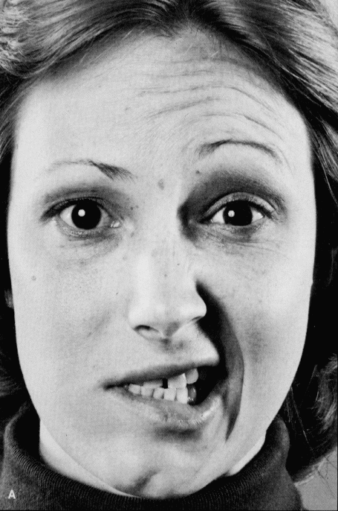
Bell’s palsy (idiopathic facial paralysis)
Clinical features :
postauricular pain (few days)
lower motor neuron facial weakness
impaired taste
hyperacusis

Slide 73
Bell’s palsy
Management
Reassurance – not a stroke
Short course of prednisolone 60 mg/day
Prognosis :
complete recovery 75%
satisfactory 15%
poor function 10%

Slide 74
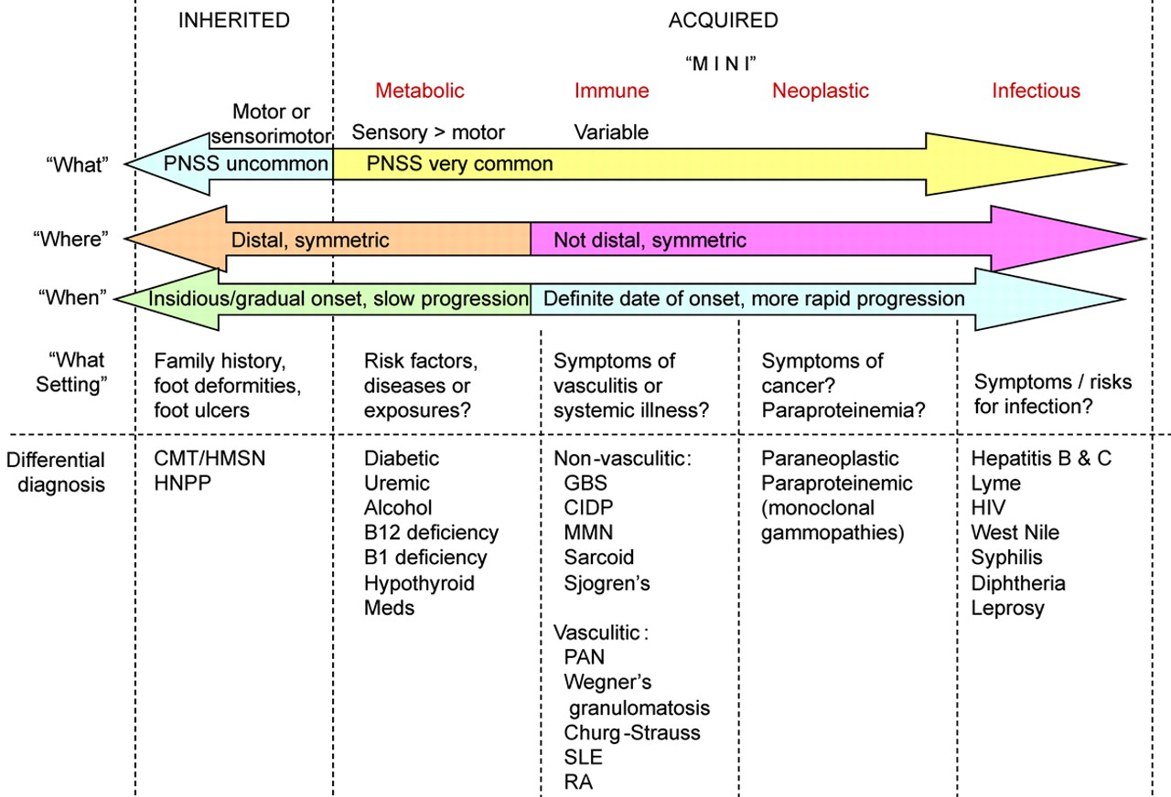

Slide 76
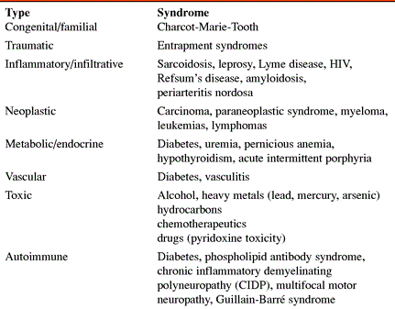

Slide 77
Peripheral Neuropathy from History, physical exam and electrodiagnostic studies
AXONAL
ACUTE
SUBACUTE
DEMYELINATING
ACUTE
CHRONIC
CHRONIC
Polyneuropathy

Slide 78
AXONAL
ACUTE
SUBACUTE - CHRONIC
ACUTE
PORPHRIA
AXONAL VARIANT OF GBS
SUBACUTE
TOXINS
SYSTEMIC DISORDERS
UREMIA
DIABETES
HYPOTHYROID
HIV
LYMES DISEASE
PARANEOPLASTIC
DYSPROTEINEMIA
SARCOIDOSIS
CONNECTIVE TISSUE DISEASES
AMYLOIDOSIS
CHRONIC
MEDICATIONS - NITROFURONOIN
CHRONIC
HMSN – II
SYSTEMIC DISORDERS
FABRY’S DISEASE
NUTRITIONAL

Slide 79
DEMYELINATING
UNIFORM
NON UNIFORM
HMSN – I
HMSN – III
REFSUM’S
KRABBE’S DISEASE
ACUTE
AIDP
DIPHTHERIA
ACUTE ARSENIC
SUBACUTE TO CHRONIC
CIDP AND VARIANTS

Slide 82
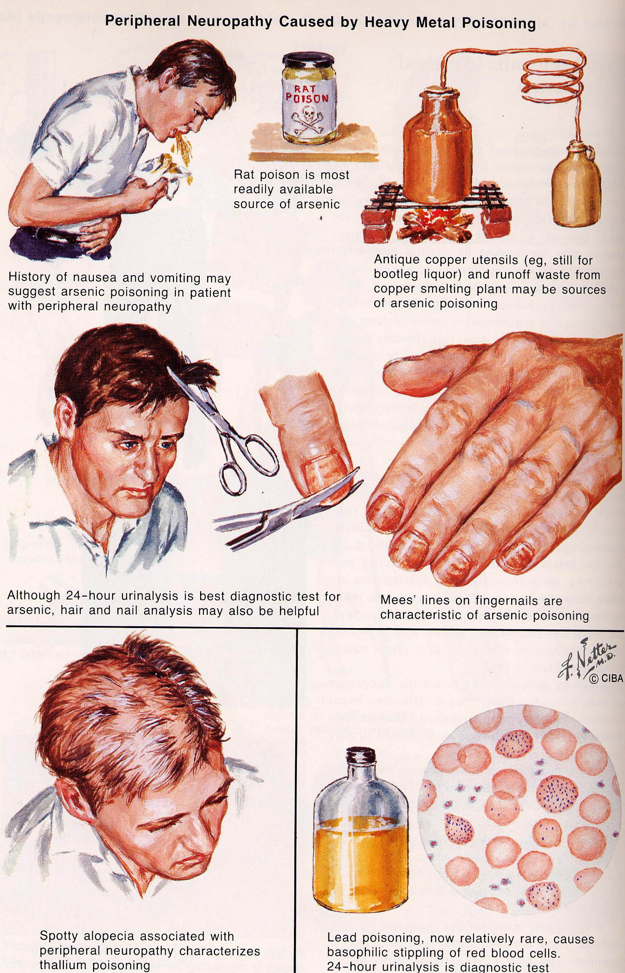
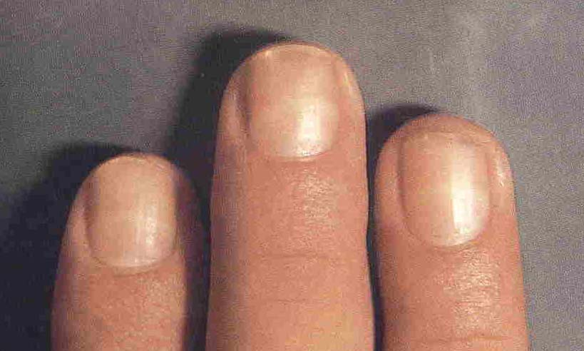
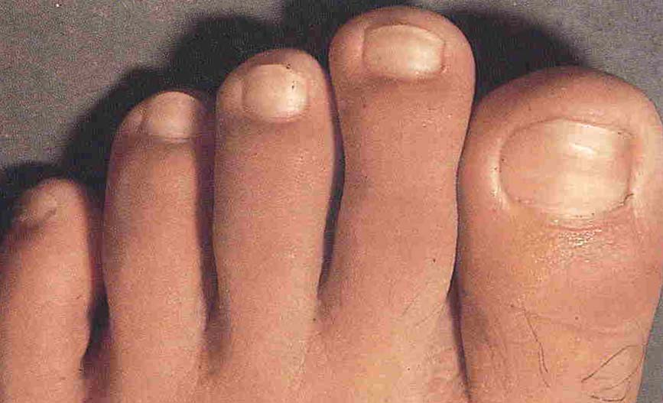
Arsenic
Thallium
Lead
Mees’ line in arsenic poisoning

Slide 83
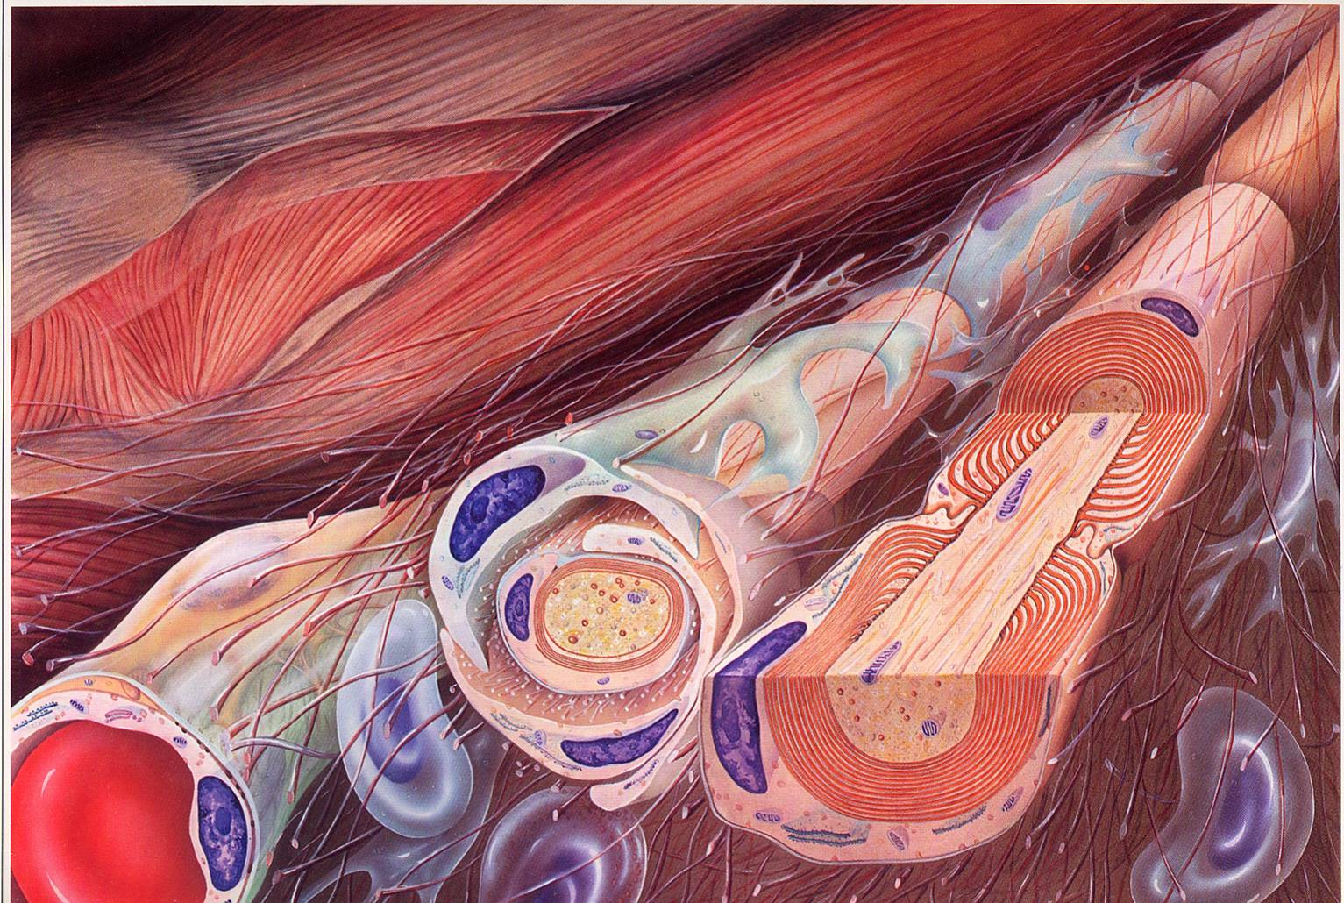
Guillain-Barre Syndrome
Guillain-Barré syndrome (GBS) is an acute, frequently severe, and fulminant polyradiculoneuropathy that is autoimmune in nature.
Males are at slightly higher risk for GBS than females, and in Western countries adults are more frequently affected than children.

Slide 84
Diagnostic Criteria for Guillain-Barre Syndrome
REQUIRED
1. Progressive weakness of 2 or more limbs due to neuropathy 2. Areflexia 3. Disease course <4 weeks 4. Exclusion of other causes [e.g., vasculitis (polyarteritis nodosa, systemic lupus erythematosus, Churg-Strauss syndrome), toxins (organophosphates, lead), botulism, diphtheria, porphyria, localized spinal cord or cauda equina syndrome]
SUPPORTIVE
1. Relatively symmetric weakness 2. Mild sensory involvement 3. Facial nerve or other cranial nerve involvement 4. Absence of fever 5. Typical CSF profile (acellular, increase in protein level) 6. Electrophysiologic evidence of demyelination

Slide 85
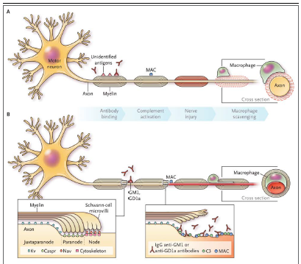

Slide 86
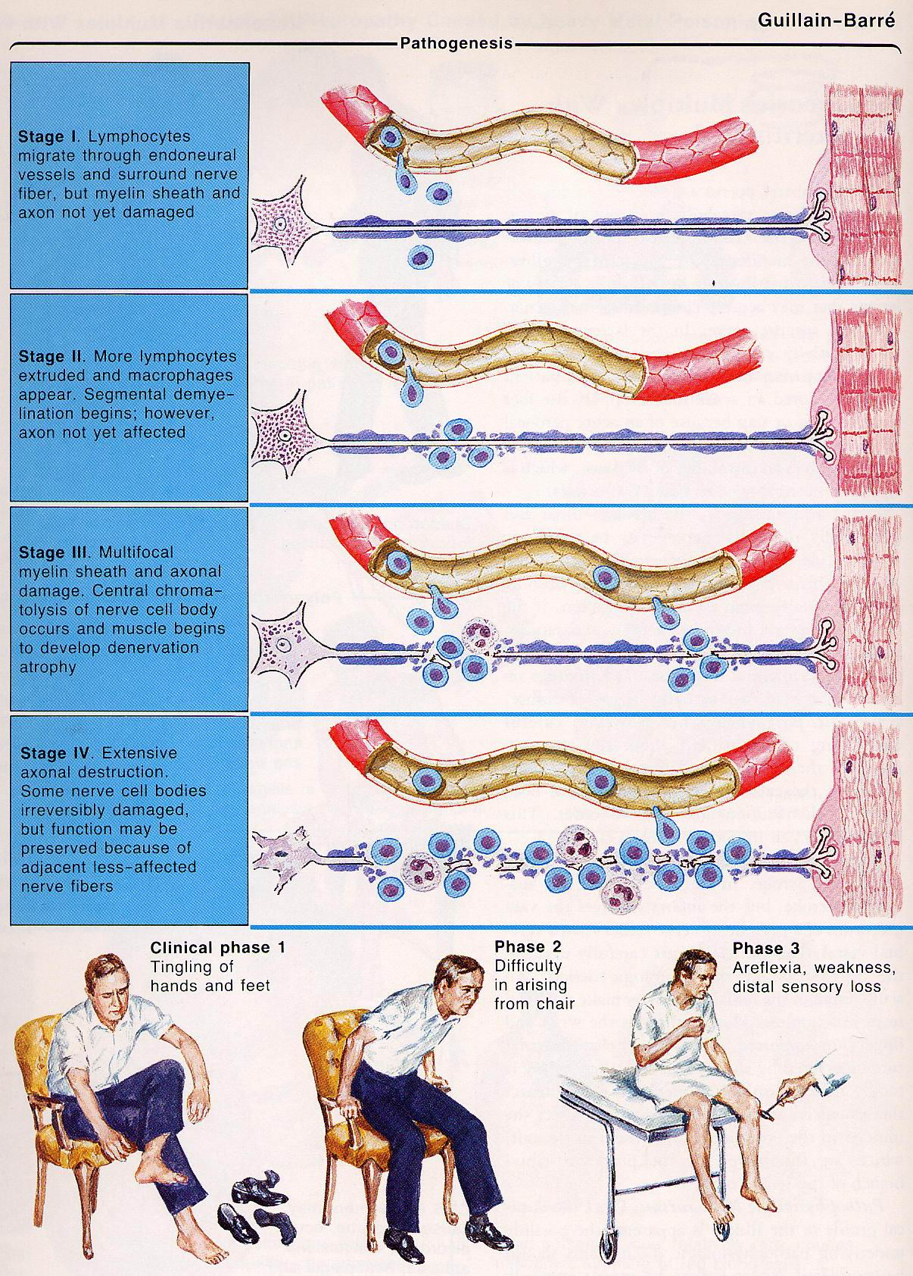

Slide 88
NCS and Peripheral Neuropathy
MCV
SCV
Normal
Demyelination
Prolonged latency, duration, and low amplitude
Axonal degeneration
Low amplitude, but no delay of latency

Slide 89
Immunotherapy
Intravenous immune globulin or plasma exchange should be administered in patients who are not able to walk unaided.
In patients whose status deteriorates after initial improvement or stabilization, retreatment with either form of immunotherapy can be considered.
However, plasma exchange should not be performed in patients already treated with immune globulin because it would wash out the immune globulin still present in the blood. Also, immune globulin should not be used in patients already treated with plasma exchange because this sequence of treatments is not significantly better than plasma exchange alone

Slide 91
Chronic Demyelinating Polyneuropathies
CIDP
Multifocal motor neuropathy (MMN)
Lewis-Sumner syndrome, also known as multifocal acquired demyelinating sensory and motor neuropathy (MADSAM)
Distal demyelinating neuropathy with IgM paraprotein, with or without anti-myelin associated glycoprotein (anti-MAG)
Demyelinating neuropathy with IgG or IgA paraprotein (the terms paraprotein and monoclonal gammopathy of undetermined significance [MGUS] are used synonymously in this setting)
POEMS syndrome (osteosclerotic myeloma: Polyneuropathy, Organomegaly, Endocrinopathy, Monoclonal protein, Skin changes)
Sensory predominant demyelinating neuropathy
Demyelinating neuropathy with central nervous system demyelination
Demyelinating neuropathy associated with systemic disorders, including:
Hepatitis B or C HIV infection
Lymphoma Diabetes mellitus
SLE/CTD Thyrotoxicosis
Organ or bone marrow transplants Inherited neuropathies
Nephrotic syndrome Inflammatory bowel disease

Slide 93
Electrodiagnostic Criteria for CIDP
These criteria are applied by testing the median, ulnar (stimulated below the elbow), peroneal (stimulated below the fibular head), and tibial nerves on one side of the body. During testing, limb temperature should be no less than 33°C at the palm and no less than 30°C at the external malleolus.
Definite CIDP
At least one of the following demyelinating parameters are necessary:
≥50 percent prolongation of motor distal latency above the ULN in two nerves
≥30 percent reduction of motor conduction velocity below the LLN in two nerves
≥20 percent prolongation of F-wave latency above the ULN in two nerves, or >50 percent if the amplitude of the distal negative peak CMAP is <80 percent of the LLN
Absence of F-waves in two nerves, if these nerves have amplitudes of distal negative peak CMAPs ≥20 percent of the LLN, plus at least one other demyelinating parameter (meeting any of the definite criteria) in at least one other nerve
Partial motor conduction block, defined by a ≥50 percent amplitude reduction of the proximal negative peak CMAP relative to distal, if distal negative peak CMAP is ≥20 percent of the LLN, in two nerves, or in one nerve plus at least one other demyelinating parameter (meeting any of the definite criteria) in at least one other nerve
Abnormal temporal dispersion, defined by a >30 percent duration increase between the proximal and distal negative peak CMAP in at least two nerves
Distal CMAP duration (interval between onset of the first negative peak and return to baseline of the last negative peak) increase in at least one nerve (median ≥6.6 ms, ulnar ≥6.7 ms, peroneal ≥7.6 ms, tibial ≥8.8 ms) plus at least one other demyelinating parameter (meeting any of the definite criteria) in at least one other nerve
Probable CIDP
≥30 percent amplitude reduction of the proximal negative peak CMAP relative to the distal, excluding the posterior tibial nerve, if the distal negative peak CMAP is ≥20 percent of LLN, in two nerves, or in one nerve plus at least one other demyelinating parameter (meeting any of the definite criteria) in at least one other nerve
Possible CIDP
As in "Definite CIDP" but in only one nerve

Slide 94
DIABETIC NEUROPATHY

Slide 96
Critical illness polyneuropathy
An acute, predominantly motor axonal polyneuropathy occurring in critically ill patients.
Flaccid tetraparesis, failure to wean
Cranial nerves are spared
- Movement discrepancy about pain
Distal > proximal with muscle atrophy
DTR ↓ or absent (13~100%)
- CIP can’t be r/o with DTR presence

Slide 97
Risk factors
Systemic inflammatory response syndrome /or sepsis
Steroids
Neuromuscular blocking agents
Aminoglycoside antibiotics
Total parenteral nutrition
Vasopressor support (>3d)
Immune mechanisms (neurotoxic factor)
Neurologic failure (GCS<10)
Renal replacement therapy
Low albumin and elevated glucose levels

Slide 98
Electrophysiologic Studies
Nerve conduction studies and EMG
- valuable and sensitive
- pure axonal polyneuropathy
- severity quantification

Slide 99
Electrophysiologic Studies
Nerve conduction studies:
- ↓ amplitude of compound motor AP
- severe muscle atrophy?
- ↓ amplitude of sensory nerve AP
- tissue edema?
- latency and velocity are unchanged
- repetitive stimulation r/o N-M synapse d’z
- muscle biopsy r/o myopathy

Slide 100
Electrophysiologic Studies
Electromyographic studies:
- signs of denervation
- spontaneous activity with fibrillations
- positive sharp waves
- diaphramatic denervation:
- diaphramatic needle EMG
- phrenic nerve conduction study + EMG

Slide 101
Nerve and muscle biopsy
Have not been performed as routine.
No inflammatory changes were found
Nerve biopsy:
- No demyelination was found
- Discrepancy between histologic and electrophysiologic studies
- Early impairment of axonal transport and transmembrane potential
→ Normal histological study cannot r/o CIP

Slide 102
Nerve and muscle biopsy
Muscle biopsy
- Atrophy of type II fibers: denervation
- Fiber necrosis in 30%
- Primary or secondary?
- No clear relationship with neurophysiology
- Low motor amplitudes with normal sensory neurography, and little spontaneous activity
Critical Illness Myo- and (poly)Neuropathy
- CRIMYNE

Slide 103
Additional Technique
Quantitative EMG
Muscle fiber excitability by direct muscle stimulation
- differentiate myopathy and neuropathy

Slide 104
Therapy
Neither therapy nor prevention is available
Possible prevention:
- treatment of underlying sepsis /SIRS
- glycemic control with insulin (↓40~48%)
- minimize steroid and depolarizing NMBA
Possible treatment
- intensive psychological care and reassurance
- intensive physiotherapy and supportive care
- intensive rehabilitation program

Slide 105
Differential diagnosis weakness in ICU

Slide 106
Neuropathies with HIV infection
Seroconversion
- Guillain Barre syndrome
- Chronic inflammatory demyelinating polyneuropathy (CIDP)
Symptomatic stage
- mononeuritis multiplex axonal type
subacute or chronic
Late symptomatic stage
- distal symmetrical sensory polyneuropathy, most common
neuropathy frequently coexists with symptomatic
encephalopathy and myelopathy
- toxic polyneuropathy
- subacute asymmetrical polyneuropathy of cauda equina,
caused by cytomegalovirus

Slide 107
Multiple mononeuropathy
Can found in:
Classic PAN
Churg-Strauss disease
Wegener’s granulomatosis
Overlap syndrome
Vasculitis associated with connective tissue disease
Sjóģren syndrome
Lyme disease
Leprosy
Diabetes mellitus

Slide 108
Hereditary Sensory Motor Neuropathies

