Slide 1
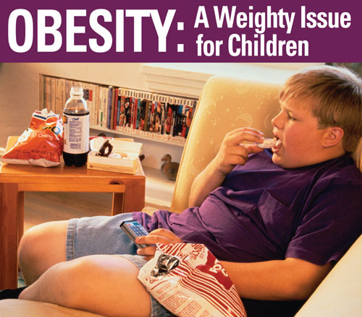
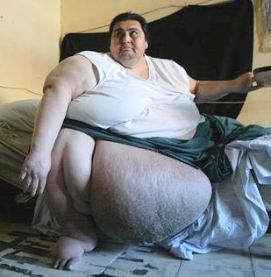
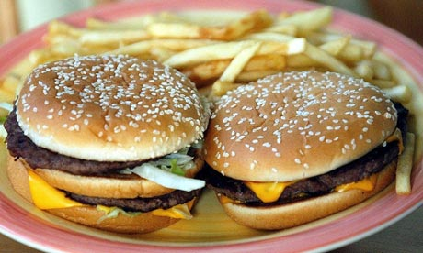
Obesity
Dr. Aishah Ali Ekhzaimy
341

Slide 2
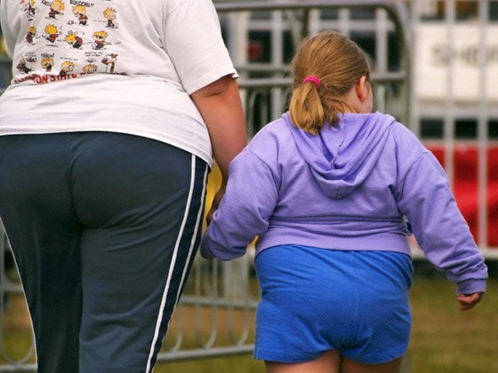
Objectives
Definition
Pathogenesis of obesity
Factors predisposing to obesity
Complications of obesity
Assessment and screening of obesity
Management of obesity

Slide 3
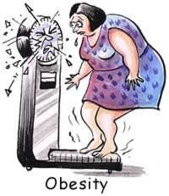
What is Obesity?
Obesity means excess accumulation of fat in the body
20% or more over an individual’s ideal body weight
Once it develops it is difficult to ‘cure’ and usually persists throughout life
Obesity is usually diagnosed on the basis of calculation of
Body mass index
Measurement of waist-hip ratio

Slide 4
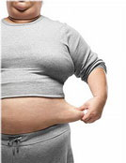
Obesity Classification-BMI
BMI Calculation (kg/m2):
Weight ( Kg)
------------------------------
Height squared (meters)

Slide 5
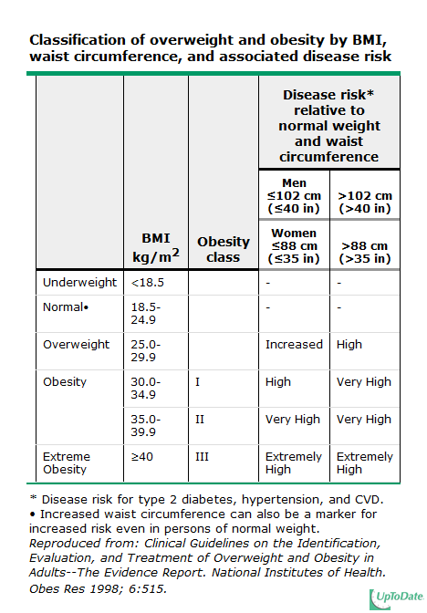

Slide 6
Obesity-BMI

Slide 7
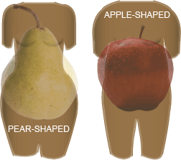
Classification of obesity as per fat distribution
Android (or abdominal or central, males)
Collection of fat mostly in the abdomen (above the waist)
apple-shaped
Associated with insulin resistance and heart disease
Gynoid (below the waist, females)
Collection of fat on hips and buttocks
pear-shaped
Associated with mechanical problems

Slide 8
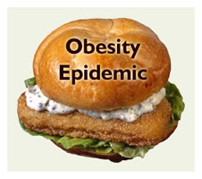
Obesity-prevalence
Well recognized as a serious and growing public health problem
WHO estimates that over 1.7 billion people around the world are overweight, 310 million are obese
Rates of obesity have tripled in the last 20 years in the developing world
In US, 33.3 % of men and 35 % of women are obese in 2007
Notes:
Preschool children increase from 5 to 10 % ( 1980 to 2008), 5.6 to 19 in school age children, adolescent between 5 to 18 % in US

Slide 9
Obesity-prevalence
15-25 % of American children are obese
In SA: study done between 1995-2000 in age group between 30-70 on 17000 subjects
Prevalence of overweight: 36.9 % : 42% male, 31.8 % female
Prevalence of obesity: 35.5 % , severe obesity 3.2 % with female of 44 %, male 26.4 %
The prevalence of overweight and obesity was higher amongst a group of married women than among a group of single women in Saudi Arabia
Saudi Med J. 2005 May;26(5):824-9
International Journal of Obesity (2003) 27, 134–139.
Notes:
Dietary habits, sedentary life style, high socioeconomic status

Slide 10
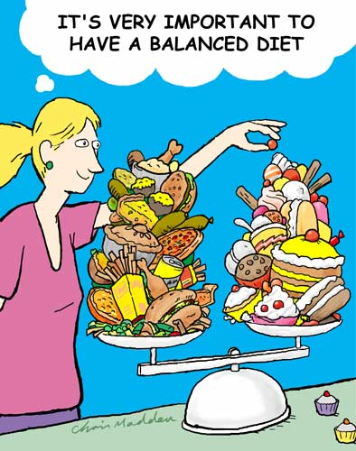
Mechanism of Obesity
Food intake and utilization is regulated:
Hormones
Neurotransmitters
Central nervous system

Slide 11
Mechanism of obesity
Signals from peripheries are carried out by neurotransmitters and hormones to CNS in presence or absence of food
Signal from fat by hormone leptin to hypothalamus to reduce food intake and increase sympathetic activity and energy expenditure
Gastric distension and contraction send signal for satiety and hunger
Fall in blood sugar send signals to CNS for hunger
Sympathetic activity from food thermogenesis leads to reduce food intake

Slide 12
Role of hypothalamus in mediation of hunger and satiety
Periventricular
Thalamus
Neuroendocrine
Paraventricular
HO conserv
Dorsomedial
2
Oxytocin rel.
GI stimuli
Anterior
Lateral
hypothalamic
hypothalamic
Body temp
Hunger, thirst
Optic tract
Supraoptic
Vasopresin rel.
Arcuate
Ventromedial
Fornix
Neuroendocrine
Satiety
Rage,
Hunger

Slide 13
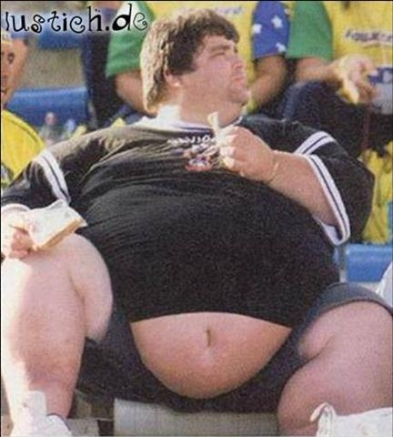
Obesity-Pathogenesis
More in and less out = weight gain
More out and less in = weight loss
Hypothalamus:
Control center for hunger and satiety
Endocrine disorders:
Where are the hormones?

Slide 14
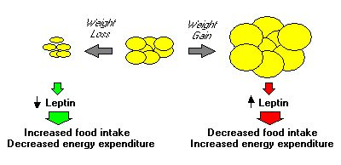
Hormones
Leptin from adipocytes
Acts on hypothalamus to decrease food intake and stimulate energy expenditure

Slide 15
Hormones
Ghrelin:
Secreted in the stomach
Acts on hypothalamus to stimulate appetite
Peak before meal and decrease after

Slide 16
Obesity – An imbalance in energy intake and energy expenditure
Proteins (20%)
BMR (60-65%)
Fats (25%)
ENERGY INTAKE
Thermic effect
ENERGY EXPENDITURE
of food (10%)
Carbohydrates (55%)
Physical activity (25-30%)
Notes:
Determinant of energy ependitures: 3 of them

Slide 17
Obesity: How does it happen?
Calories consumed not equal calories used
Over along period of time
Due to combination of several factors:
Individual behaviors ( 10 % to BMI)
Social interaction
Environmental factors
Genetic ( 40 % to BMI and adiposity)

Slide 18
Factors predispose to obesity
Lifestyle:
Sedentary lifestyle lowers energy expenditure
52 % of Saudi women are inactive, < 19 % doing regular physical activity
Prolonged TV watching
Sleep deprivation:
< 7 hours of sleep obesity
↓ sleep ↓ leptin, ↑↑ Ghrelin ↑ appetite and CHO eating at night

Slide 19
Factors predispose to obesity
Cessation of smoking:
Average weight gain is 4 kg
Due to nicotine withdrawal
Can be prevented by calories restriction and exercise program
Social influences:
Obese parents most likely to have obese children
Obese individuals are surrounded by obese friends
Diet:
Overeating, frequency of eating, high fat meal, fast food( > 2 fast food/wk)
Night eating syndrome: if > 25 % of intake in the evening

Slide 20
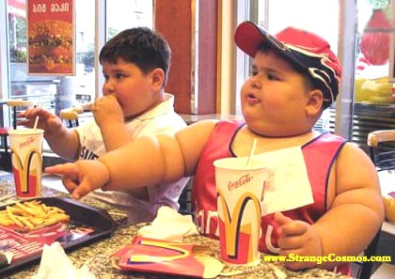
Factors predispose to obesity
Notes:
In hypothalamus mainly paraventricular, ventromedial nucleus or amygdala affected by tumor, inflammation, radiation, trauma

Slide 21
Health consequences of obesity
Greater BMI is associated with increased death from all causes and from CVD
Although overweight associated with decreased survival
Each 5 kg/m2 increase in BMI was associated with significant increase in mortality related to:
IHD and stroke
Diabetes and non-neoplastic kidney disease
Different types of cancer
Respiratory disease

Slide 22
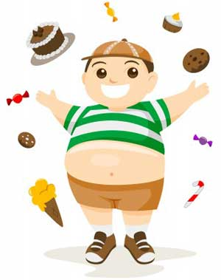
Health consequences of obesity
Obesity is associated with reduction in life expectancy during adulthood
Increase in BMI is associated with increase in morbidity and CVD risk factos

Slide 23
Health consequences of obesity

Slide 24
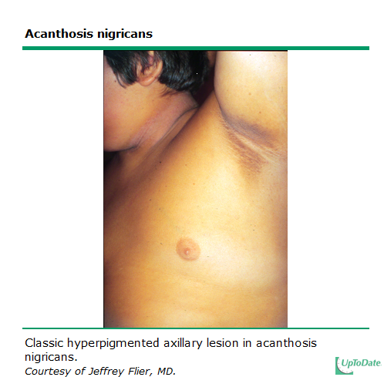
Notes:
Obesity related glomerulopathy, focal segmental glomerulosclerosis

Slide 25
Health consequences of obesity
For both men and women, increasing BMI was associated with higher death rates due to the following cancers:
Esophagus
Colon and rectum
Liver
Gallbladder
Pancreas
Kidney
Non-Hodgkin lymphoma
Multiple myeloma

Slide 26
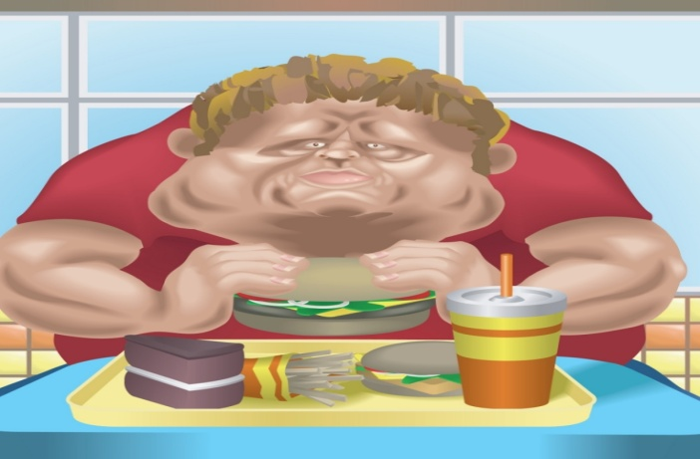
Health consequences of obesity
Increase cost rate on obesity
Increase number of sick leaves for obese subjects
Increase number of hospitalization
Early age of retirement
Increase cost of drugs for DM, CVD, GI disease
Poor quality of life due to psychosocial issues

Slide 27
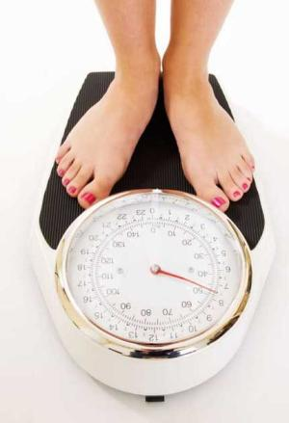
Assessment and screening
screening of adults for obesity is important
With significant increase in morbidity and mortality
Although not in routine practice but it should be as a part of periodic health assessment
Screening:
BMI measurement
Waist circumference
Evaluation of overall medical risks

Slide 28
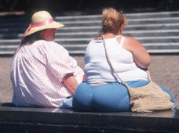
Assessment and screening
Is the patient obese or overweight?
What are his key health issues? Morbidity and mortality-related

Slide 29
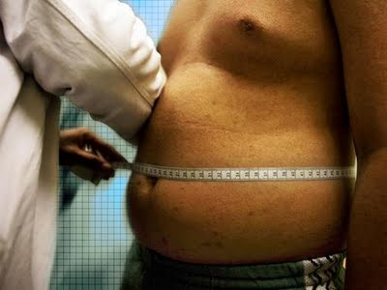
Assessment and screening

Slide 30
Assessment and screening
BMI measurement:
Reliable, easy, correlated with percentage of body fat
Guide for selection of therapy
Varies among different races
Recent WHO classification applied to whites, hispanics and black
Asians are different: overweight BMI 23-24.9 kg/m2 and obesity by BMI > 25 kg/m2

Slide 32
Assessment and screening
Waist circumference:
Measurement of central adiposity
Associated with increased risk of morbidity and mortality
Reflects visceral adiposity
Increase risk of heart disease, DM, hypertension, dyslipidemia
Important in identifying the risk in BMI 25-34.9 kg/m2
Risk increase with WC > 88 cm in women, 102 cm in men
Not useful if BMI > 35 kg/m2
In Asian population risk starts with WC > 80 cm in Asian women and > 90 cm in Asian men
Notes:
In adults with a BMI of 25 to 34.9 kg/m2, a waist circumference greater than 102 cm (40 in) for men and 88 cm (35 in) for women is associated with a greater risk of hypertension, type 2 diabetes, and dyslipidemia, and CHD

Slide 33
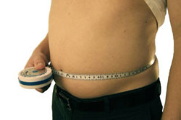
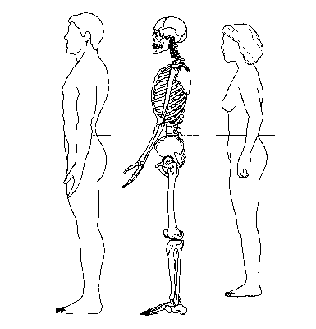
Waist circumference

Slide 34
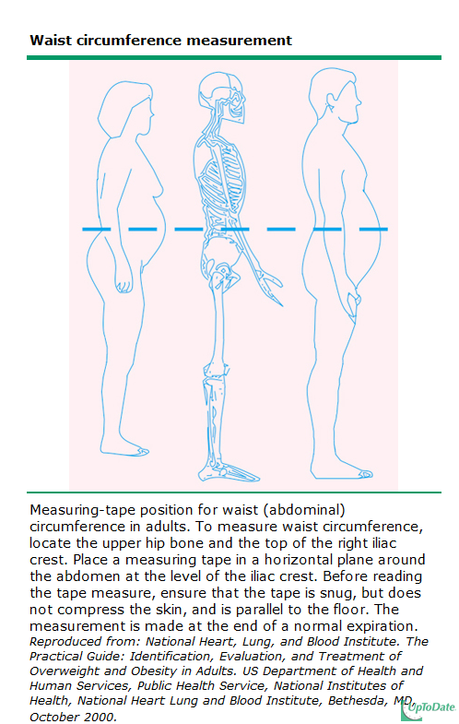

Slide 35
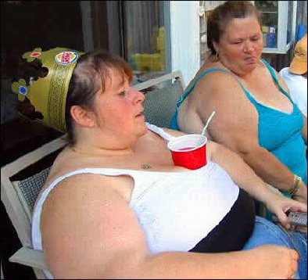
Assessment and screening
Identify the aetiology:
Medical history is important
Age at onset of obesity, course of it
Eating habits, activity habits
Past medical history
Medications
Cessation of smoking history
Ethnic background
Family history of obesity

Slide 36
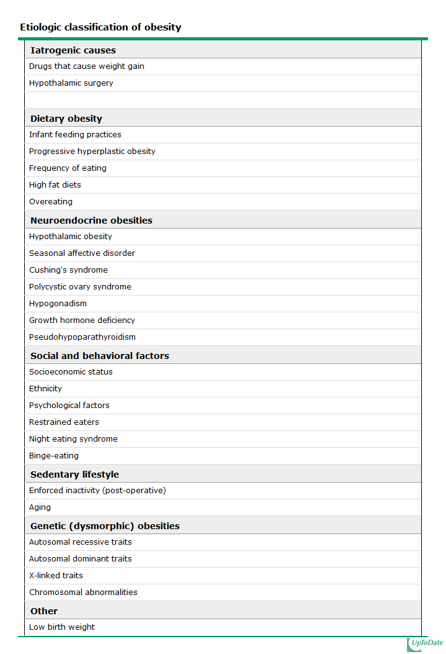

Slide 37
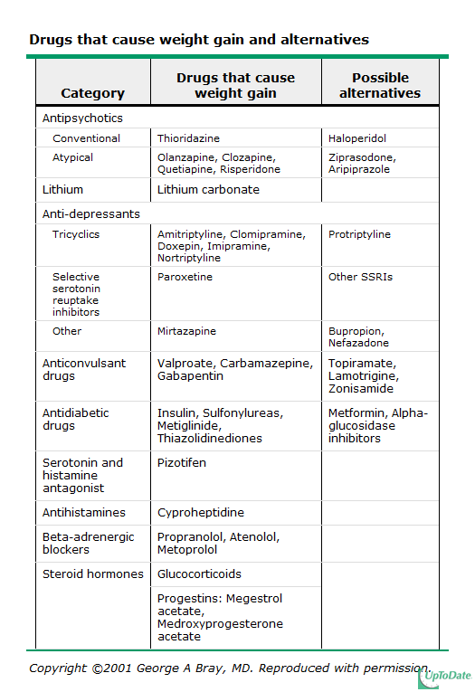

Slide 38
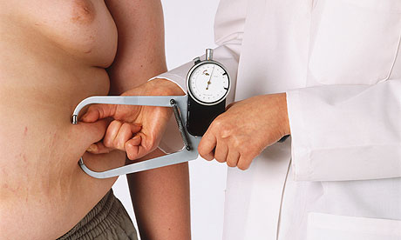
Assessment and screening
Assessment of risk status
Identify risk factors:
After BMI and WC, history
BP measurement
Fasting lipid profile
Fasting blood sugar
Identify comorbidity:
Help to classify the risk of mortality
Presence of atherosclerosis, DM2, HTN, dyslipidemia
Sleep apnoea
GI, osteoarthritis, gout

Slide 39
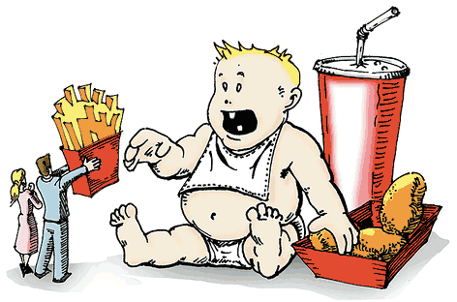
Assessment and screening
CVD risk factors that would affect mortality risk:
HTN
DM2 ( fasting blood glucose 110-125 mg/dl)
Smoking
Dyslipidemia ( low HDL < 35 or high LDL> 130)
Family history of premature CAD
Physical inactivity
other risk factors:
Age of onset of obesity

Slide 40
Assessment and screening
Why is it important to look at it?
It is a common disease with significant morbidity and mortality and without screening many high risk patients may not receive counseling about health risks, lifestyle changes, obesity treatment options, and risk factor reduction.
• Screening with BMI, waist circumference, and risk factor assessment is inexpensive and available to nearly all clinicians.
• Weight loss is associated with a reduction in obesity-associated morbidity.

Slide 41
Advantages of weight loss
Weight loss of 0.5-9 kg (n=43,457) associated with 53% reduction in cancer-deaths, 44% reduction in diabetes-associated mortality and 20% reduction in total mortality
Survival increased 3-4 months for every kilogram of weight loss
Reduced hyperlipidemia, hypertension and insulin resistance
Improvement in severity of diseases
Person feels ‘fit’ and mentally more active

Slide 42
Treatment goals
Prevention of further weight gain
Weight loss to achieve a realistic, target BMI
Long-term maintenance of a lower body-weight

Slide 43
How much weight loss is significant?
A 5-10% reduction in weight (within 6 months) and
weight maintenance should be stressed in any weight
loss program and contributes significantly to
decreased morbidity

Slide 44
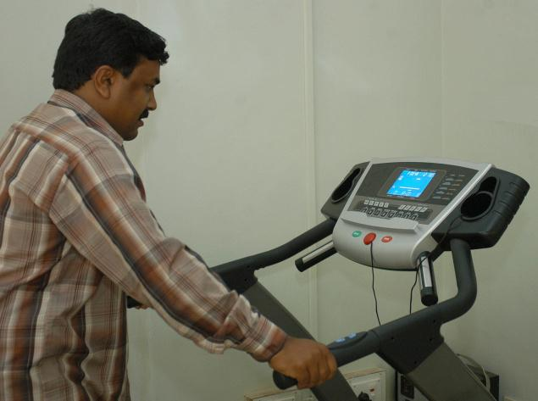
Management of obesity
3 main interventions:
Lifestyle intervention ( diet, exercise)
Pharmacotherapy
Surgical intervention

Slide 45
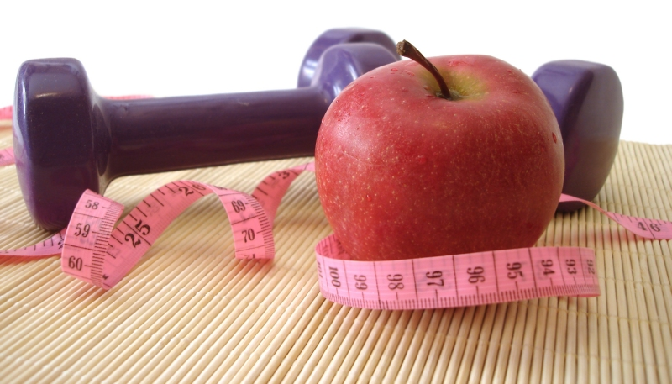
Lifestyle
Diet
Physical activity
Behavior change
Most important recommendation

Slide 46
lifestyle
Initial goal: 10% weight loss
Significantly decreases risk factors
Rate of weight loss:
1-2 pound per week
Reduction of calories intake 500-1000 calories/day
Slow weight loss is preferred approach
Rapid weight loss is almost always followed by rapid weight gain
Rapid weight loss is associated with gallstones and electrolytes abnormalities

Slide 47
lifestyle
Aim for 4-6 months for weight loss
Average is 8-10 kg loss
After 6 months, weight loss is difficult
Ghrelin and leptin effect
Energy requirement decreased as weight decreases
Set goals for weight maintenance for next
6 months then reassess

Slide 48
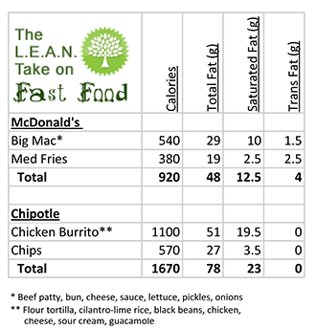
Diet therapy
Indicated for all with BMI > 30 and those with BMI 25- 30 with comorbidities
Teaching about food composition ( fat, CHO, protein)
Calories contents of food by reading labels
Type of food to buy and to prepare

Slide 49
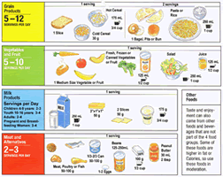
Diet therapy
Low calories diet-portion controlled
Low fat diet
Low CHO diet
Meditarrean diet
Average for women: 1000-1200 kcal/day
Average for men: 1200-1600 kcal/day
Adjust based on activity and weight

Slide 50
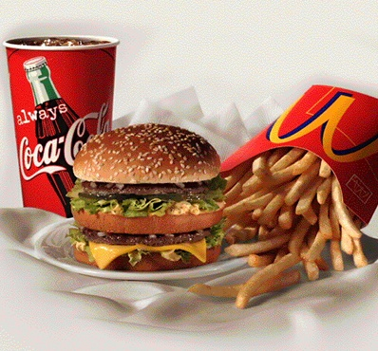
Diet therapy
How much is 1200 calories?
1 big mac ( 580)
1 small fries (210)
1 small shake (430)

Slide 51
Diet therapy
Then weight maintenance
How much should people eat?
Male | Age 20-49 | 2900 kcal/day
 | Age 50 + | 2500 Kcal/day
Female | Age 20-49 | 2300 Kcal/day
 | Age 50+ | 1900 Kcal/day

Slide 52
Physical activiy
As integral part of weight loss
Reduce risk of DM, heart disease, hypertension
Alone is not helping
Help to prevent weight regain

Slide 53
Physical activity
Start slowly
Change of daily living activities
Avoid injury
Increase intensity and duration gradually
Long –term goal:
30-45 min or more of physical activity daily
5 or more days per week
Burn 1000+ calories per week

Slide 54
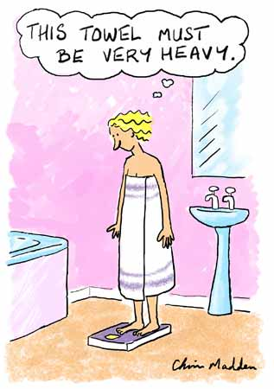
Behavioral strategies
Keep agenda of diet and activity
Set specific goals regarding: diet, activity related behavior
Reminder system
Reward yourself
Don’t deprive yourself, watch portion
Track improvement:
Weight measurement on regular basis

Slide 55
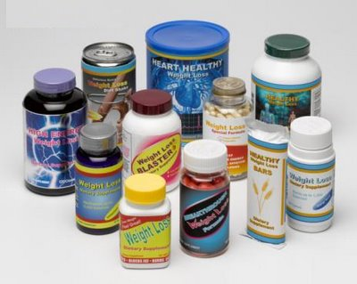
Pharmacotherapy
Indicated in:
BMI > 30
BMI 27-30 with comorbidities
Should not be used for cosmetic weight loss
Used only when 6 months trial if weight and exercise fail to achieve weight loss

Slide 56
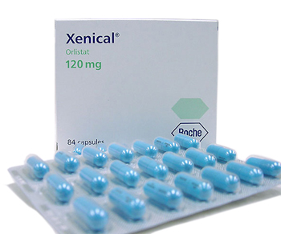
Pharmacotherapy
Sympathomimetics:
Stimulate release of norepinephrine or inhibits its reuptake by nerve terminals
Block serotonin and NE reuptake ( sibutramine)
Directly act upon adrenergic receptor
Reduced appetite by early satiety
Pancreatic lipase inhibitor:
Orlistat: inhibits fat absorption
Antidepressant
Antiepileptic
Diabetic drugs: metformin

Slide 57
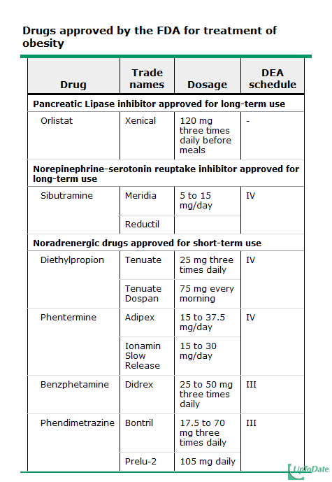

Slide 58
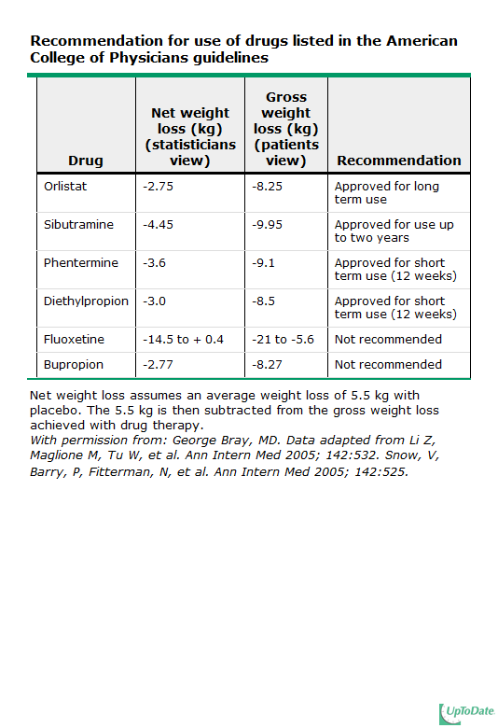
Notes:
All these drugs from the market except orlistat

Slide 59
Weight loss Surgical therapy
Indicated in:
Well-infomed and motivated patients
Have BMI > 40
Acceptable risk of surgery
Failed previous non-surgical method
BMI > 35 with comorbidities like diabetes, sleep apneoa, osteoarthritis, cardiomyopathy
BMI 25-29.9 with WC > 102 cm in male and 88 cm in women
Age 18-60
Psychologically stable

Slide 60
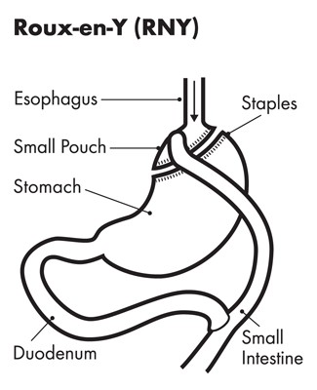
Weight loss Surgical therapy( bariatric surgery)
Restrictive-type of surgery:
Vertical banded-gastroplasy
Gastric banding
Malabsorptive and restrictive:
Roux-en-Y gastric bypass
Biliopancreatic diversion
Follow up is crutial

Slide 61
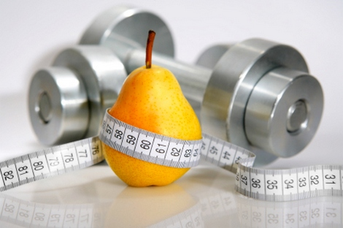
Questions????

