Slide 1
DEMYELINATING DISEASES (MULTIPLE SCLEROSIS)
DR. Nuha Alkhawajah
Assistant Professor
Consultant Neurologist

Slide 2
MYELIN
A lipid dense layer that surrounds the axon of the neuron
Insulates the axon and allows continuous propagation of the electrical impulse
Schwann cells peripheral nervous system (PNS) neurons
Oligodendrocytes central nervous system (CNS).

Slide 3
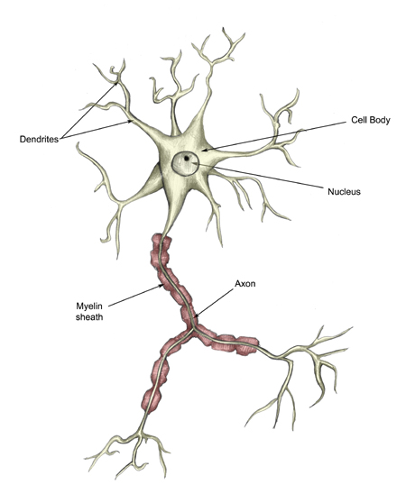
MYELIN

Slide 4
DEMYELINATING DISEASAES
Damage of the myelin
PNS & CNS
Inherited or acquired
CNS: multiple sclerosis, acute dissaminated encephalomyelitis, neuromyelitis optica
PNS: acute inflammatory demyelinating polyneuropathy (Guillain Barre syndrome), chronic inflammatory demyelinating polyneuropathy.

Slide 5
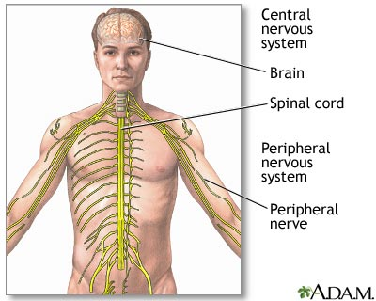
CNS & PNS

Slide 6
1-Multiple Sclerosis

Slide 7
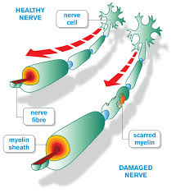
1-Multiple Sclerosis

Slide 9
MS Epidemiology
Among the most common neurological diseases in young adults
More common in females (1.5-2.5:1)
Mean age of presentation is 30 years

Slide 10
MS Epidemiology
More people with MS were born in May and fewer people were born in November.
First degree relatives are at 15-33 times greater risk.
More common in North America and Europe
Rare in the tropics

Slide 11
Environmental Risk Factors
Infections:
History of infectious mononucleosis (EBV) is associated with higher susceptibility to MS
Vitamin D:
sunlight may be protective (ultraviolet radiation or vitamin D)
sun exposure & serum vitamin D are inversely related to risk/prevalence of MS
vitamin D levels are inversely related to MS disease activity

Slide 12
Cont.
3. Smoking:
a higher risk of MS in ever-smokers than in never-smokers
smoking may also be a risk factor for disease progression
Dietary Salt
Obesity:
in adolescence or early adulthood is associated with increased risk for MS
leptin increases the proliferation of auto-aggressive cells responsible for myelin damage.

Slide 13
MS Pathology
Pathologic hallmark is focal demyelinated plaques
Variable degrees of inflammation, gliosis, and neurodegeneration
Recurrent relapses lead to permanent myelin damage and oligodendrocytes loss

Slide 14
MS COURSE:

Slide 15
MS Course
Relapsing remitting, secondary progressive, primary progressive or relapsing progressive
80% of the patients will have a relapsing remitting course
50% of the RRMS will become secondary progressive

Slide 16
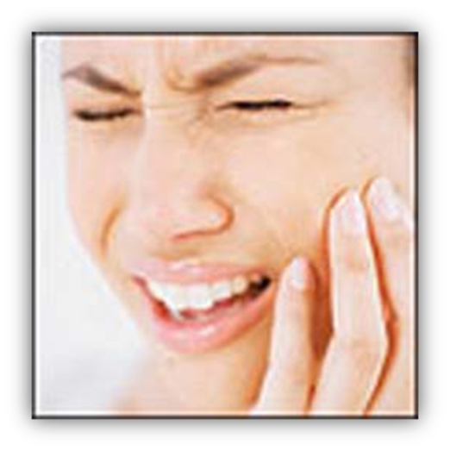
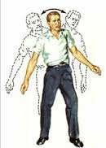
MS SYMPTOMS

Slide 17
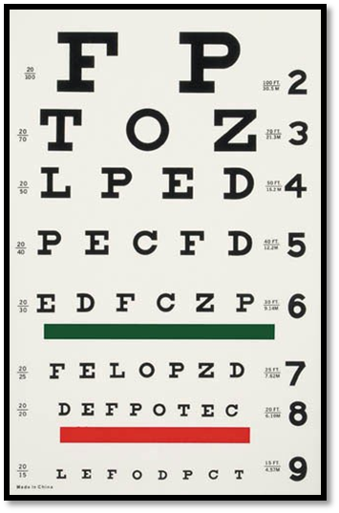
MS SYMPTOMS

Slide 18
OPTIC NEURITIS
Blurred vision
Pain exacerbated by eyes movement
Reduced perception of colors
Flashes of light on moving the eyes
Enlarged blind spot

Slide 19
BRAIN STEM RELATED MS SYMPTOMS

Slide 20
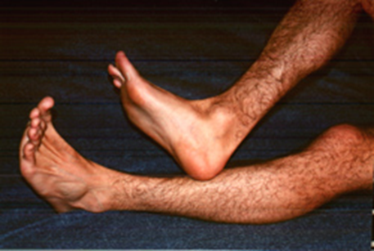
CEREBELLUM RELATED MS SYMPTOMS
Oscillopsia
Dysarthria
Ataxia

Slide 21
BRAIN AND SPINAL CORD MS SYMPTOMS
Cognitive dysfunction: memory, concentration, depression, processing speed
Weakness (monoparesis, paraparesis, quadriparesis)
Sensory loss/numbness/pain
Sphicteric dysfunction
Lhermitte’s Phenomenon

Slide 22
TRANSVERSE MYELITITS
A general term that indicates inflammation of the spinal cord
Could be caused by MS, NMO, infections, connective tissue diseases…..
Spinal cord related motor, sensory &/or autonomic dysfunction
Sensory level
Unilateral or bilateral
CSF: increased WBC count and proteins

Slide 23
Relapse or Attack
Patient-reported symptoms or objectively observed signs
Typical of CNS acute inflammatory demyelinating
At least 24 hrs
No fever or infection

Slide 24
Uhthoff’s Phenomena
Neurological dysfunction
Stereotyped
Less than 24 h
Reversible
Related to fluctuations in axonal conduction properties due to increasing body temperature

Slide 25
Diagnosing MS
McDonald diagnostic criteria:
Dissemination in time: history of at least two attacks
Dissemination in space: clinical evidence of involvement of two CNS sites OR of one lesion with reasonable historical evidence of another site being affected
History & Exam

Slide 27
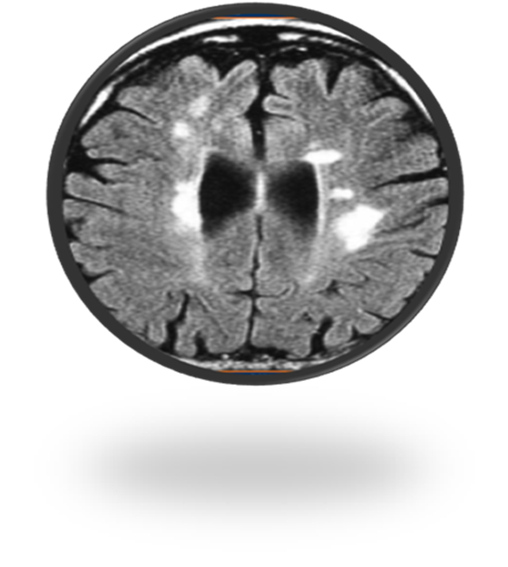
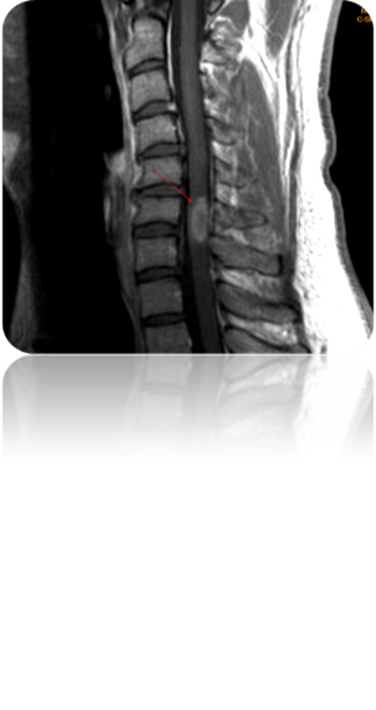
DIAGNOSIS OF MS
Imaging: MRI of the brain and spinal cord

Slide 28
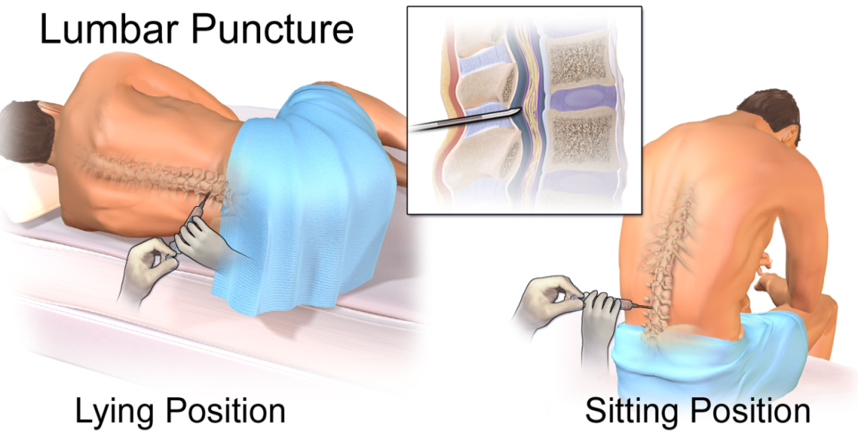
MS Diagnosis
Lumbar puncture: oligoclonal bands and IgG index
Image from Wikipedia

Slide 29
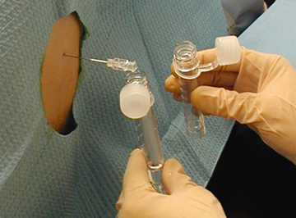
iik
Image from WISER

Slide 30
MS PROGNOSIS
Fifty percent of patients will require a cane 28 years after disease onset
Twenty five percent will require a wheelchair 44 years after disease onset

Slide 31
MS PROGNOSIS

Slide 32
MS PROGNOSIS

Slide 33
EXPANDED DISABILITY STATUS SCALE (EDSS)

Slide 34
MS Treatment
Acute treatment of relapses: steroids and plasmaexchange
Prevention of relapses

Slide 35
MS TREATMENT
1980’s: Steroids for relapses only
1990’s: Disease modifying therapies (interferon and copaxone)
2000’s: Mitoxantrone for aggressive MS and Natalizumab
2010’s: Oral medications now available (Fingolimod)

Slide 36
2-NEUROMYELITIS OPTICA
More common in females (9:1)
Mean age is 10 years later than MS
More common in Asian and African populations
Affects mainly the optic nerves and the spinal cord
More severe attacks than in MS

Slide 37
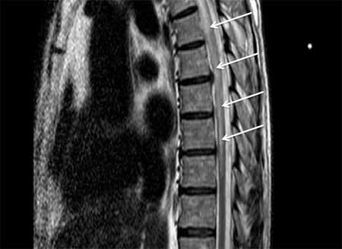

Slide 38
NMO Pathology
Astrocytopathy
Targets aquaporine 4 (a water channel) rich areas
Vasculocentric deposition of immunoglobulin and complement

Slide 39
TREATMENT
Acute relapse: steroids or plasma exchange
Relapse prevention: chronic immunosuppression with azathioprine, mycophenolate mofetil, cyclophosphamide….

Slide 40
3-ADEM
Acute disseminated encephalomyelitis
CNS inflammatory demyelinating disease
Frequently preceded by vaccination or infection
More common in children
Usually a monophasic illness (no relapses)

Slide 41
ADEM
PATHOLOGY:
Wide spread white and gray matter perivenous ‘‘sleeves’’ of inflammation and demyelination
Axons are relatively spared

Slide 42
ADEM
SYMPTOMS:
Encephalopathy (lethargy, stupor, coma)
multifocal neurological deficit (visual symptoms, ataxia, TM..)
May fluctuates over a 3 months period

Slide 43
TREATMENT
STEROIDS, PLASMA EXCHANGE AND INTRAVENOUS IMMUNOGLOBULINS

Slide 44
SUMMARY
MS:
A demyelinating disease
Can affect any part of the CNS
A disease of young adults
More common in females
RR course is the most common initial course

Slide 45
SUMMARY
NMO
AFFECTS MAINLY THE ON & THE SC
OLDER AGE GROUP IN COMPARISON TO MS
MORE COMMON IN FEMALES
RELAPSONG COURSE, PROGRESSION IS RARE

Slide 46
SUMMARY
ADEM
ACUTE INFLAMMATORY DEMYELINATING DISEASE
MONOPHASIC
MORE COMMON IN CHILDREN
FOLLOWS INFECTION OR VACCINATION
ENCEPHALOPATHY IS A PREREQUISTE FOR THE DIAGNOSIS IN CHILDREN

