Slide 1
TUBERCULOSIS
Dr. Awadh Al-Anazi
2015 - 1436

Slide 2
Objectives
By the end of this lecture, students should know the following about Tuberculosis:
Overview of Tuberculosis (TB) Epidemiology
Transmission and Pathogenesis of TB
Testing for TB Infection and Disease
Diagnosis of TB Disease
Treatment for Latent TB Infection
Treatment for TB Disease
TB Infection Control

Slide 3
Overview of Tuberculosis (TB) Epidemiology
Bacterial infection
Caused by Mycobacterium tuberculosis (also called
tubercle bacillus)
Damages a person’s lungs or other parts of the body
Fatal if not treated properly

Slide 4
Epidemiology
It is a world wide disease
TB infects 1.7 billion with 3 million deaths/yr
UK: 1st half of 20th century: a lot of death secondary to TB epidemic
90% of cases and 95% of death occurred in developing countries.
No of cases in developed countries has declined because of: case finding&RX
Improved Nutrition

Slide 5
Epidemiology
Tuberculous infection: a state in which the tubercle bacillus is established in the body without symptoms.
Tuberculous disease: a state in which one or more organs of the body becomes diseased by the disease.

Slide 6
Epidemiology
What increases the spread of the disease:
1) crowding of living
2) migration of people from endemic area.
10% of infected people ---- active disease
50%of active disease --- contagious

Slide 7
Epidemiology
What increases the risk of developing disease after TB infection ?
Infecting dose
Host factors
age: under 5 yrs
debilitating illness and poor nutrition
alcoholism
gastrectomy
diabetes mellitus

Slide 8
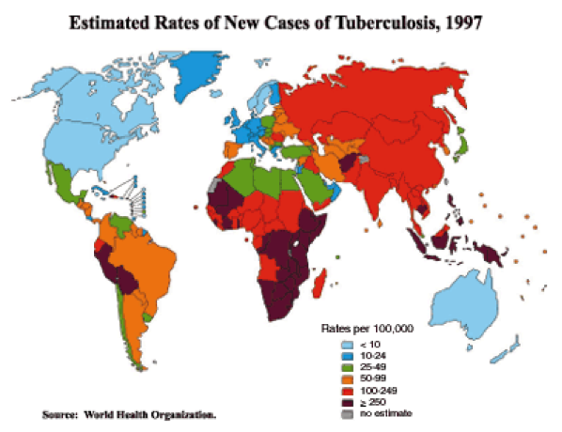

Slide 9
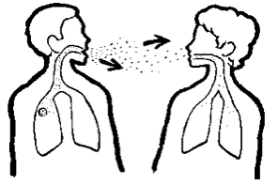
Mode of Spread & Transmission
Inhalation of droplet nuclei
Spreads through the air when a person with active TB:
Coughs/ Speaks/ Laughs/ Sneezes/ Sings
Another person breathes in the bacteria and becomes infected

Slide 10
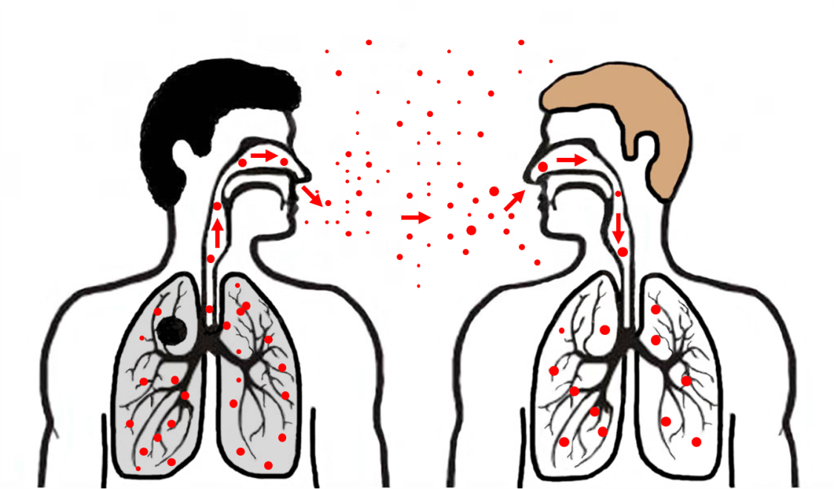
Transmission of M. tuberculosis
M. tb spread via airborne particles called droplet nuclei
Expelled when person with infectious TB coughs, sneezes, shouts, or sings
Transmission occurs when droplet nuclei inhaled and reach the alveoli of the lungs, via nasal passages, respiratory tract, and bronchi

Slide 11
Pathogenesis
Droplet nuclie ---terminal air space ---
Multiplication … initial focus
Subpleural
75%single
Migration through blood and lymph node --- another focus
Ingestion of the bacteria by the macrophage --- slow multiplication

Slide 12
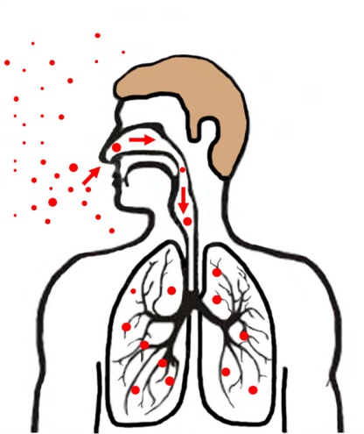
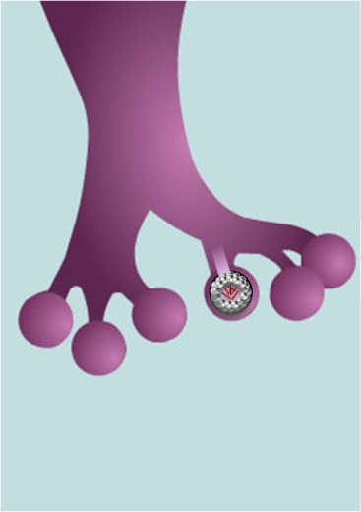
Pathogenesis
 | Droplet nuclei containing tubercle bacilli are inhaled, enter the lungs, and travel to the alveoli.
 | Tubercle bacilli multiply in the alveoli.

Slide 13
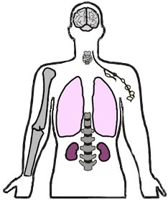
Pathogenesis
 | A small number of tubercle bacilli enter the bloodstream and spread throughout the body. The tubercle bacilli may reach any part of the body, including areas where TB disease is more likely to develop (such as the brain, larynx, lymph node, lung, spine, bone, or kidney).

Slide 14
Pathogenesis
 | Within 2 to 8 weeks, special immune cells called macrophages ingest and surround the tubercle bacilli. The cells form a barrier shell, called a granuloma, that keeps the bacilli contained and under control (LTBI).
 | If the immune system cannot keep the tubercle bacilli under control, the bacilli begin to multiply rapidly (TB disease). This process can occur in different areas in the body, such as the lungs, kidneys, brain, or bone.

Slide 15
Inside the Body
Breathe in infected air and bacilli go to lungs through bronchioles
Bacilli infect alveoli
Macrophages attack bacteria, but some survive
Infected macrophages separate and form tubercles
Dead cells form granulomas
Notes:
-As a person breathes in infected air, the bacilli go the lungs through the bronchioles. At the end of the bronchioles are alveoli, which are balloon-like sacs where blood takes oxygen from inhaled air and releases carbon dioxide into the air exhaled. TB bacilli infect the alveoli and the bodyπs immune system begins to fight them. Macrophages — specialized white blood cells that ingest harmful organisms — begin to surround and "wall off" the tuberculosis bacteria in the lungs, much like a scab forming over a wound. Then, special immune system cells surround and separate the infected macrophages. The mass resulting from the separated infected macrophages are hard, grayish nodules called tubercles. -Active TB spreads through the lymphatic system to other parts of the body. In these other parts, the immune system kills bacilli, but immune cells and local tissue die as well. The dead cells form masses called granulomas, where bacilli survive but donπt grow. As more lung tissue is destroyed and granulomas expand, cavities develop in the lungs, which causes more coughing and shortness of breathe. Granulomas can also eat away at blood vessels which causes bleeding in the lungs, and bloody sputum.

Slide 16
Inside the Body (Cont.)
As a person breathes in infected air, the bacilli go to the lungs through the bronchioles. At the end of the bronchioles are alveoli, which are balloon-like sacs where blood takes oxygen from inhaled air and releases carbon dioxide into the air exhaled.
TB bacilli infect the alveoli and the body immune system begins to fight them. Macrophages — specialized white blood cells that ingest harmful organisms — begin to surround and "wall off" the tuberculosis bacteria in the lungs, much like a scab forming over a wound.
Then, special immune system cells surround and separate the infected macrophages. The mass resulting from the separated infected macrophages are hard, grayish nodules called tubercles.

Slide 17
Inside the Body (Cont.)
Active TB spreads through the lymphatic system to other parts of the body. In these other parts, the immune system kills bacilli, but immune cells and local tissue die as well. The dead cells form masses called granulomas, where bacilli survive but don’t grow.
As more lung tissue is destroyed and granulomas expand, cavities develop in the lungs, which causes more coughing and shortness of breathe. Granulomas can also eat away blood vessels which causes bleeding in the lungs, and bloody sputum.

Slide 18
Immunological Feature
TB require CMI for its control
Ab response is rich but has no role
Multiplication proceeds for weeks both in:
initial focus
lymphohaematogenous metastatic foci
Until development of ... cell mediated immunity

Slide 19
Microbiology
Organism:
Mycobacterium tuberculosis
Aerobic
Non-spore forming ,non-motile
Rod..: 2—5 mm long
Resistant to disinfectant
Once stained it resists decolorization with acid and alcohol facultative intracellular organism
Human is the main reservoir of MTB

Slide 20
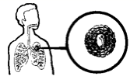
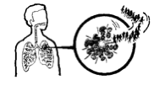
Clinical Features Active VS. Latent Infection
Unhealthy person
Bacilli overwhelm immune system
Bacilli break out of tubercles in alveoli and spread through bloodstream
This is (active) TB
Healthy person
Initial infection controlled by immune system
Bacilli remain confined in tubercles for years
This is(latent) TB
Notes:
ÄTB bacteria become active if the immune system can't stop them from growing. The active bacteria begin to multiply in the body and cause active TB disease. The bacteria attack the body and destroy tissue. If this occurs in the lungs, the bacteria can actually create a hole in the lung. Some people develop active TB disease soon after becoming infected, before their immune system can fight the TB bacteria. Other people may get sick later, when their immune system becomes weak for another reason. ÄFor most people who breathe in TB bacteria and become infected, the body is able to fight the bacteria to stop them from growing. The bacteria become inactive, but they remain alive in the body and can become active later. This is called latent TB infection. Many people who have latent TB infection never develop active TB disease. In these people, the TB bacteria remain inactive for a lifetime without causing disease. But in other people, especially people who have weak immune systems, the bacteria become active and cause TB disease. Difference between active and latent TB: Person with Latent TB: -Has no symptoms -Does not feel sick -Cannot spread TB to others -Usually has a positive skin test -Has a normal chest x-ray and sputum test Person with active TB: -has symptoms -may spread TB to others -has a positive skin test -May have an abnormal chest x-ray, or positive sputum smear

Slide 21
Symptoms
Cough
Fever
Weight loss
Night sweats
Loss of appetite
Fatigue
Swollen glands (lymph nodes)
Chills
Pain while breathing

Slide 22
Clinical Features
Pulmonary 80%
Extra pulmonary 20%
Pulmonary tuberculosis
Primary: the lung is the 1st organ involved ... middle and lower lobe
Health: asymptomatic
Heals spontaneously
CXR normal

Slide 23
Clinical Features
Post primary (reactivation)
Result from endogenous reactivation of latent infection and manifest clinically:
Fever and night sweat
Weight loss
Cough… non-productive then productive
May have haemoptysis
Signs: rales in chest exam

Slide 24
C.F cont.
Extra pulmonary
Lymph node
Pleural
Bone and joint
Meninges
Peritonium

Slide 25
C.F cont.
Tuberculous lymphadenitis … 25 %
The commonest
Localized painless swelling
Common sites: cervical & supraclavicular
Early: glands are discrete
Late: glands are matted -/+ sinus
Dx: FNA 30% in biopsy for histo and culture

Slide 26
C.F cont.
Pleural Tb
Result form penetration by few bacilli into the pleural space resulting into :
pleural effusion and fever
DX; aspirate --- exudate
AFB rarely seen
culture 30% positive
BX 80% granuloma

Slide 27
C.F cont.
Skeletal Tb
Source:
reactivation of haematogenous focus
spread from an adjacent LN
Common sites: spine --- hips --- knees
Spinal Tb:
Dorsal site is the commonest site

Slide 28
C.F cont.
Involve two vertebral bodies and destroy the disc in between
Advance disease
Collapse fracture of the bodies ------
Kyphosis and gibbus deformity
Paravertebral abscess(cold abcess)
Dx: CT scan and MRI
Biopsy: histopath

Slide 29
C.F cont.
Tuberculous meningitis
Most often: children and may affect adult
Source:
Blood spread
Rupture of a sub-ependymal tubercle

Slide 30
C.F cont.
Symptoms:
fever
headache
neck rigidity
Disease typically evolve in 2 wks.
Dx; csf

Slide 31
Clinical Features
Malnutrition
HIV
Severe cases
primary lesion progress to clinical illness
cavitating pneumonia
lymphatic spread and lobar collapse due to LN
40% haematogenous dissemination

Slide 32
Clinical Features
In children
Asymptomatic state may cause miliary tuberculosis and TB meningitis

Slide 33
TB & Aids
Person with active TB are more frequent to have HIV than general population
AIDS in HAITIANS: almost all children are positive for PPD --- active TB in
60%
New York: 50% of active TB patients are HIV+

Slide 34
TB & Aids
Africans: 60% of active TB patients are HIV+
TB can appear at any stage of HIV infection
But presentation varies with the stage:

Slide 35
TB & Aids
Early:
Typical pattern of upper lobe infiltrate -+cavitation …
Late:
Diffuse infiltrate .. no cavitation .. LN
Sputum is less frequent to be + for AFB with HIV than without
Extra pulmonary is more common … 40%

Slide 36
TB & Aids
Pulmonary TB and HIV --- diagnosis is difficult
sputum (-) in 40 %
atypical CXR
negative PPD

Slide 37
Latent TB Infection (LTBI)
Granulomas may persist (LTBI), or may break down to produce TB disease
2 to 8 weeks after infection, LTBI can be detected via TST or interferon-gamma release assay (IGRA)
The immune system is usually able to stop the multiplication of bacilli
Persons with LTBI are not infectious and do not spread organisms to others

Slide 38
TB Disease
In some, the granulomas break down, bacilli escape and multiply, resulting in TB disease
Can occur soon after infection, or years later
Persons with TB disease are usually infectious and can spread bacteria to others
Positive M. tb culture confirms TB diagnosis

Slide 39
LTBI vs. TB Disease
Person with LTBI (Infected) | Person with TB Disease (Infectious)
Has a small amount of TB bacteria in his/her body that are alive, but inactive | Has a large amount of active TB bacteria in his/her body
Cannot spread TB bacteria to others | May spread TB bacteria to others
Does not feel sick, but may become sick if the bacteria become active in his/her body | May feel sick and may have symptoms such as a cough, fever, and/or weight loss
Usually has a TB skin test or TB blood test reaction indicating TB infection | Usually has a TB skin test or TB blood test reaction indicating TB infection
Radiograph is typically normal | Radiograph may be abnormal
Sputum smears and cultures are negative | Sputum smears and cultures may be positive
Should consider treatment for LTBI to prevent TB disease | Needs treatment for TB disease
Does not require respiratory isolation | May require respiratory isolation
Not a TB case | A TB case

Slide 40
Most Susceptible
People at higher risk of TB infection
Close contacts with people with infectious TB
People born in areas where TB is common
People with poor access to health care
People who inject illicit drugs
People who live or work in residential facilities
Health care professionals
The elderly
Notes:
ÄNationality. People from regions with high rates of TB — especially Africa, Asia and Latin America, are more likely to develop TB. ÄYour sex. In most of the world, more men than women are infected with TB. Men are also more likely to die of the disease. ÄRace. In the United States, Hispanics, American Indians and blacks are at higher risk of TB than are whites. Asian-Americans have the highest TB rate. ÄAge. Older adults are at greater risk of TB because normal aging or illness may weaken their immune systems. They're also more likely to live in nursing homes, where mini-epidemics of TB can occur. ÄSubstance abuse. Long-term drug or alcohol use weakens your immune system and makes you more vulnerable to TB. ÄMalnutrition. A poor diet or one too low in calories puts you at greater risk of TB. ÄLack of medical care. If you are on a low or fixed income, live in a remote area, have recently immigrated to the United States, or are homeless, you may lack access to the medical care you need to diagnose and treat TB.

Slide 41
Most Susceptible (Cont.)
People at higher risk of active TB disease
People with weak immune systems (especially those with HIV or AIDS)
People with diabetes or silicosis
People infected within the last 2 years
People with chest x-rays that show previous TB disease
Illicit drug and alcohol abusers

Slide 42
Persons at Higher Risk for Exposure to or Infection with TB
Close contacts of person known or suspected to have active TB
Foreign-born persons from areas where TB is common
Persons who visit TB-prevalent countries
Residents and employees of high-risk congregate settings

Slide 43
Drug-Resistant TB
Caused by organisms resistant to one or more TB drugs
Transmitted same way as drug-susceptible TB, and no more infectious
Delay in detecting drug resistance may prolong period of infectiousness because of delay in starting correct treatment

Slide 44
Multidrug-Resistant (MDR) and Extensively Drug-Resistant (XDR) TB
MDR TB caused by bacteria resistant to best TB drugs, isoniazid and rifampin
XDR TB caused by organisms resistant to isoniazid and rifampin, plus fluoroquinolones and ≥1 of the 3 injectable second-line drugs
MDR TB*
with drug resistance to at least the first-line drugs isoniazid and rifampin
XDR TB**
with drug resistance to the first-line drugs isoniazid and rifampin and to specific second-line drugs
TB with any drug resistance
All
TB
*Often resistant to additional drugs
**Resistant to any fluoroquinolone and at least one of three injectable second-line drugs (i.e., amikacin, kanamycin, or capreomycin

Slide 45
Diagnosis
Medical Evaluation for TB
Medical history
Physical examination
Test for TB infection
Chest radiograph
Bacteriologic examination

Slide 46
Medical Evaluation for TB (cont.) 1. Medical History (cont.)
Symptoms of pulmonary TB:
Prolonged cough (3 weeks or longer), hemoptysis
Chest pain
Loss of appetite, unexplained weight loss
Night sweats, fever
Fatigue

Slide 47
Diagnosis
For any respiratory symptoms:
Do chest x-ray … if abnormal ---
Sputum for:
Zn stain
culture ..definite diagnosis
Use lowenstein-jansen media
Slow growth … 3 - 6 wks
Bactic liquid media ...

Slide 48
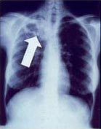
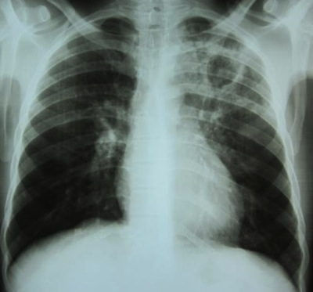
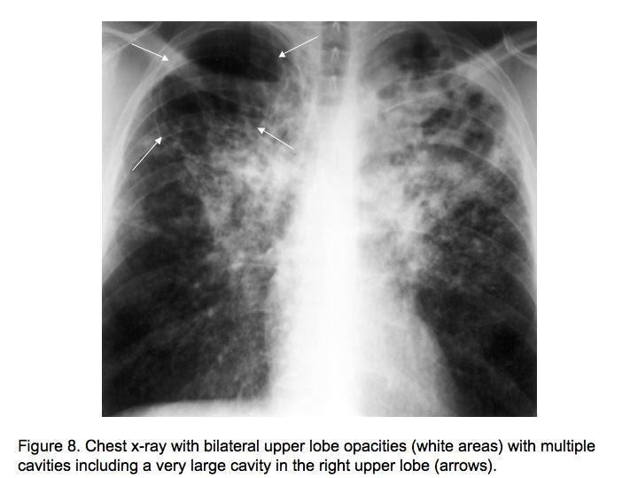

Slide 49
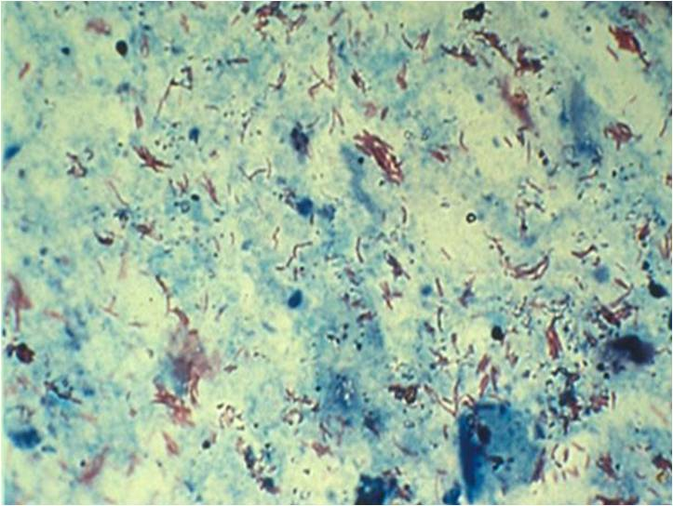
AFB Smear AFB (shown in red) are tubercle bacilli

Slide 50
Culture
Remains gold standard for confirming diagnosis of TB
Culture all specimens, even if smear or NAA negative
Results in 4–14 days when liquid medium systems used
Culture monthly until conversion, i.e., 2 consecutive negative cultures

Slide 51
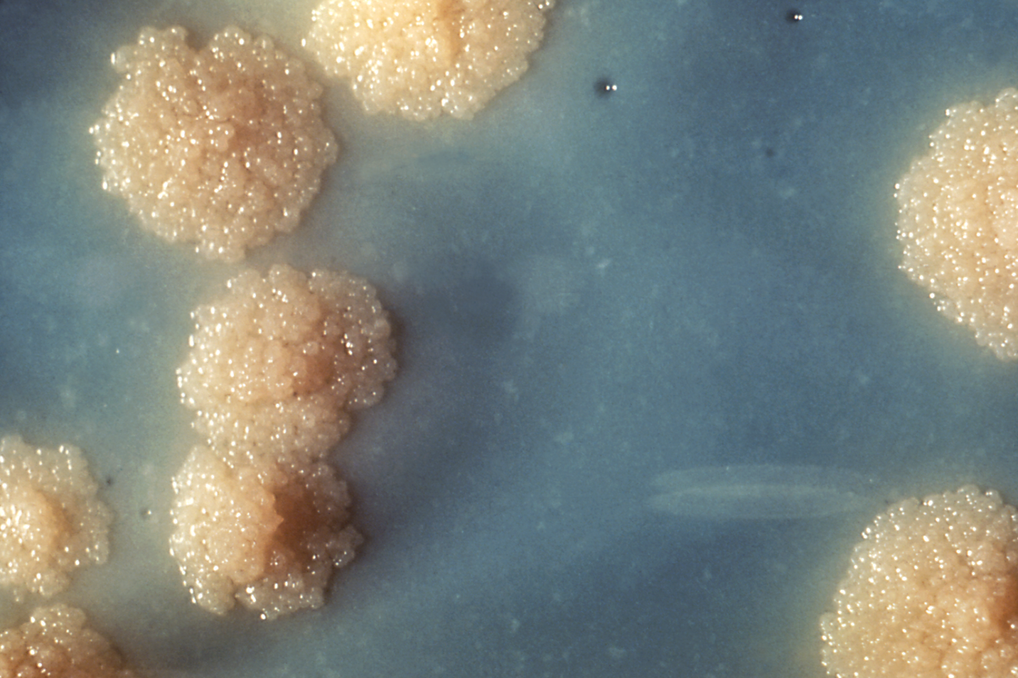
Colonies of M. tuberculosis Growing on Media

Slide 52
Diagnosis
PPD … intradermally …
5 unit in o.1 ml
10 mm: 90 % infected
More than 15 mm: 100% infected
BCG and positive PPD:
Unless very recent: positive PPD of more than 10mm should not be due to BCG

Slide 53
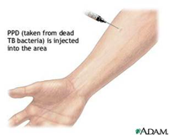
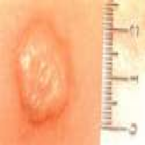
Diagnosis
TST (Mantoux test),(PPD)
PPD injected in forearm and examined 2-3 days later(24,48&72hrs)
Induration around injection site indicates
infection
Measure Induration NOT redness
Examine medical history, x-rays, and sputum
Blood tests(B-interferone)
PCR
Notes:
ÄThe tuberculin Mantoux PPD skin test shows if a person has been infected. Ä A chest X-ray is given if the Mantoux skin test shows that a person has been infected. The X-ray shows if any damage has been done to the lungs. ÄA sputum test shows if TB germs are in the thick liquid a person coughs up.

Slide 54
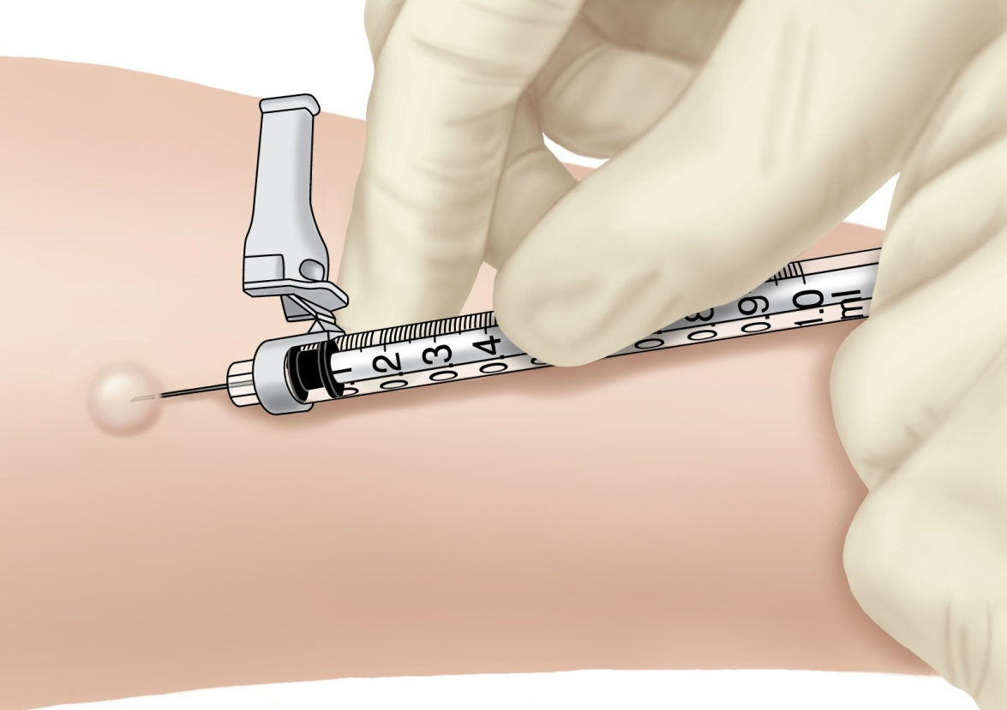
Administering the TST
Inject 0.1 ml of PPD (5 tuberculin units) into forearm between skin layers
Produce wheal (raised area) 6–10 mm in diameter
Follow universal precautions for infection control

Slide 55
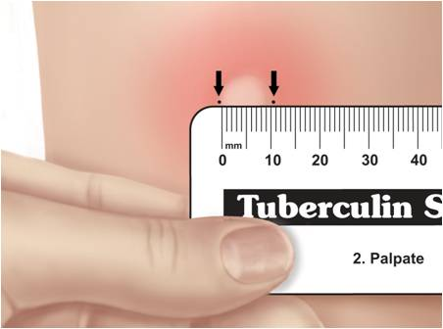
Reading the TST
Trained health care worker assesses reaction 48–72 hours after injection
Palpate (feel) injection site to find raised area
Measure diameter of induration across forearm; only measure induration, not redness
Record size of induration in millimeters; record “0” if no induration found

Slide 56
Mantoux Tuberculin Skin Test (TST)
Purified protein derivative (PPD), derived from tuberculin, is injected between skin layers using the Mantoux technique
Infected person’s immune cells recognize TB proteins in PPD, respond to site, causing wheal to rise
Takes 2-8 weeks after exposure and infection for the immune system to react to PPD
Reading and interpretation of TST reaction must be done within 48–72 hours

Slide 57
Diagnosis
False negative TST:
20 % of active disease
Malnutrition
Sarcoid
Lymphoproliferative dis.(lymphoma)
Viral infection
Steroid
PPD: is of limited value because of
Low sensitivity and specificity

Slide 58
Factors that May Affect the Skin Test Reaction
Type of Reaction | Possible Cause
False-positive | Nontuberculous mycobacteria BCG vaccination Problems with TST administration
False-negative | Anergy Viral, bacterial, fungal coinfection Recent TB infection Very young age; advanced age Live-virus vaccination Overwhelming TB disease Renal failure/disease Lymphoid disease Low protein states Immunosuppressive drugs Problems with TST administration

Slide 59
Interferon Gamma Release Assays (IGRAs)
IGRAs detect M. tb infection by measuring immune response in blood
Cannot differentiate between TB and LTBI; other tests needed
May be used for surveillance/screening, or to find those who will benefit from treatment
FDA-approved IGRAs are QFT Gold In-Tube and T-Spot.TB test

Slide 60
BCG Vaccination
Vaccine made from live, attenuated (weakened) strain of M. bovis
Early version first given to humans in 1921
Many TB-prevalent countries vaccinate infants to prevent severe TB disease

Slide 61
BCG Contraindications
Contraindicated in persons with impaired immune response from
HIV infection, congenital immunodeficiency
Leukemia, lymphoma, generalized malignancy
High-dose steroid therapy
Alkylating agents
Antimetabolites
Radiation therapy
BCG vaccination should not be given to pregnant women

Slide 62
General Recommendations for Using IGRAs
May be used in place of, but not in addition to, TST
Preferred when testing persons
Who might not return for TST reading
Who have received BCG vaccination
Generally should not be used to test children <5 years of age, unless used in conjunction with TST

Slide 63
Medical Evaluation for TB (cont.) 1. Medical History (cont.)
Symptoms of possible extrapulmonary TB:
Blood in the urine (TB of the kidney)
Headache/confusion (TB meningitis)
Back pain (TB of the spine)
Hoarseness (TB of the larynx)
Loss of appetite, unexplained weight loss
Night sweats, fever
Fatigue

Slide 64
Direct Detection Using Nucleic Acid Amplification (NAA)
NAA tests rapidly identify a specimen via DNA and RNA amplification
Benefits may include
Earlier lab confirmation of TB disease
Earlier respiratory isolation and treatment initiation
Improved patient outcomes; interruption of transmission
Perform at least 1 NAA test on each pulmonary TB suspect
A single negative NAA test does not exclude TB

Slide 65
Treatment for Latent TB Infection (LTBI)
Treatment of LTBI essential to controlling and eliminating TB disease
Reduces risk of LTBI to TB disease progression
Use targeted testing to find persons at high risk for TB who would benefit from LTBI treatment
Several treatment regimens available

Slide 66
Candidates for Treatment of LTBI (cont.)
High-risk persons with positive IGRA test or TST reaction of ≥10 mm (cont.):
Persons with conditions that increase risk for TB:
Silicosis
Diabetes mellitus
Chronic renal failure
Certain cancers (e.g., leukemia and lymphomas, or cancer of the head, neck, or lung)
Gastrectomy or jejunoileal bypass
Weight loss of at least 10% below ideal body weight
Children <4 yrs of age; children/adolescents exposed to adults in high-risk categories

Slide 67
Major Goals of TB Treatment
Cure patient, minimize risk of death/disability, prevent transmission to others
Provide safest, most effective therapy in shortest time
Prescribe multiple drugs to which the organisms are susceptible
Never treat with a single drug or add single drug to failing regimen
Ensure adherence and completion of therapy

Slide 68
Current Anti-TB Drugs
10 drugs FDA-approved for treatment of TB
Isoniazid (INH)
Rifampin (RIF)
Pyrazinamide (PZA)
Ethambutol (EMB)
Rifapentine (RPT)
Streptomycin (SM)
Cycloserine
Capreomycin
ρ-Aminosalicylic acid
Ethionamide

Slide 69
Treatment
Chemotherapy: cure
Isonised
Rifampicin
Pyrazinamide
Ethambutol/streotomycin
rapidly reduce the number of viable organism
kill the bacilli
slow rate of induction of drug resistance

Slide 70
Regimen 1 for Treatment of Pulmonary, Drug-Susceptible TB 6-Month Standard Regimen for Most Patients
Initial phase
INH, RIF, PZA, EMB daily (7 or 5 days/week) for 8 weeks
4-month continuation phase options
1) INH, RIF daily (7 or 5 days/week) for 18 weeks
2) INH, RIF intermittently (2 days/week or 1 day/week for INH, rifapentine) for 18 weeks

Slide 71
Treatment cont.
Drug failure
None compliance
Inappropriate drug
Drug resistance

Slide 72
Infection Control
Active pulmonary tuberculosis:
Isolation of the patient (2wks)
Isolation room should be negative pressure
Patient remain until 3 negative smears and there is clinical improvement

Slide 73
TB Infection Control Measures
TB infection control (IC) measures should be based on TB risk assessment for the setting
The goals of IC programs are
Detect TB disease early and promptly
Isolate persons with known/suspected TB
Start treatment in persons with known/suspected TB

Slide 74
Acknowledgement
CDC
WHO
MBD

Slide 75
Thank You for Your Attention

