Slide 1
Rheumatic Fever AND RHD
Dr.Abdulelah Mobeirek(FRCPc)

Slide 2
Rheumatic Fever
Follows group A beta hemolytic streptococcal throat infection
It represents a delayed immune response to infection with manifestations appearing after a period of 2-4 weeks
Age 5-15 yrs
A multisystem disease
Major effect on health is due to damage to heart valvves

Slide 3
Rheumatic Fever
A disease of poverty and low socioeconomic status
Rare in wealthy countries, due to improved living conditions, less overcrowding, and better hygiene with reduction in transmission of GABHS
Incidence: In Cambodia 2.2/1000 children, Mozambique 2.3/1000, India 0.75/1000

Slide 4
Global Burden of RHD
Total cases with RHD:20 Millions
CHF: 3 Million
Valve surgery required in 1 Million
Annual incidence of RF: 0.5 Million, nearly half develop carditis
Estimated deaths from RHD: 230,000/YR
Imposes a substantial burden on health care systems with limited budgets

Slide 5
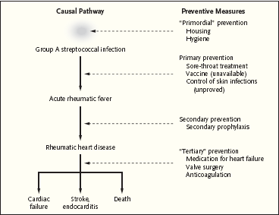

Slide 6
Pathologic Lesions
Ashcoff nodules:
Fibrinoid degeneration of connective tissue, inflammatory cells

Slide 7
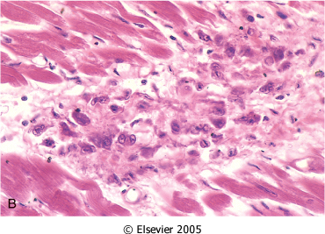
Aschoff body in a patient with acute rheumatic carditis

Slide 8
Clinical Features
Onset of acute rheumatic fever is typically characterized by an acute febrile illness 2 to 4 weeks after an episode of pharyngitis.
Diagnosis is primarily clinical and is based on a constellation of signs and symptoms, which were initially established as the Jones criteria

Slide 9
Modified Jones Criteria
Major manifestations
Carditis
Polyarthritis
Chorea
Erythema marginatum
Subcutaneous nodules

Slide 10
Modified Jones Criteria
Minor manifestations
Fever
Arthralgias
Previous H/O RF OR RHD
↑CRP or ESR
Prolonged PR interval on ECG

Slide 11
Modified Jones Criteria
Evidence of antecedent GABHS
Positive throat culture or rapid antigen test positive for GABHS
↑ ASO Titer

Slide 12
Arthritis
Most common feature: present in 80%
Earliest manifestation of ARF
Major joints: The knees and ankles, shoulders, elbows
“Migrating”, “Fleeting” polyarthritis
Duration short < 1 week
Responds well to Salicylates
Does not progress to chronic disease

Slide 13
Sydenham Chorea
Occur in 5-10% of cases
Abrupt Purposeless involuantry movements of muscles of face, neck, trunk, and limbs.
May appear even 6 months after the attack of rheumatic fever
Clinically manifest as-clumsiness, deterioration of handwriting,emotional lability or grimacing of face

Slide 14
Subcutaneous Nodules
Occur in 10%
Usually 0.5 – 2 cm long
Firm non-tender
Occur over extensor surfaces of joints, on bony prominences, tendons, spine
Short lived: last for few days
Associated with severe carditis

Slide 15
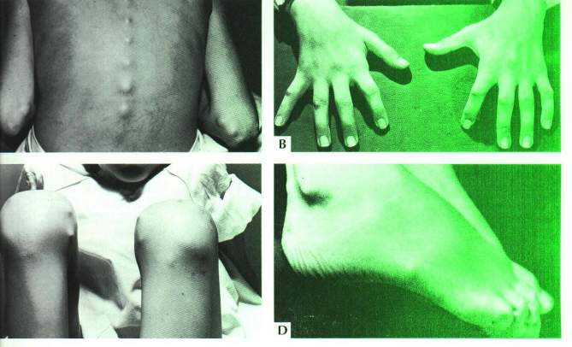
Subcutaneous nodules

Slide 16
Erythema Marginatum
Present in 5%
Reddish border, pale center, round or irregular serpiginous borders, non-pruritic, transient rash
Occurs on trunk, abdomen or proximal limbs
Associated with carditis

Slide 17
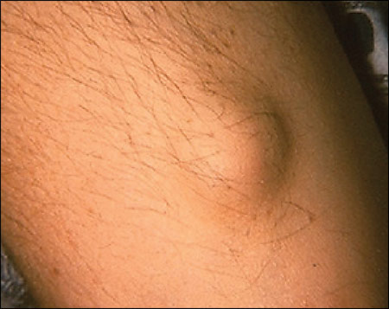
Subcutaneous nodule

Slide 18
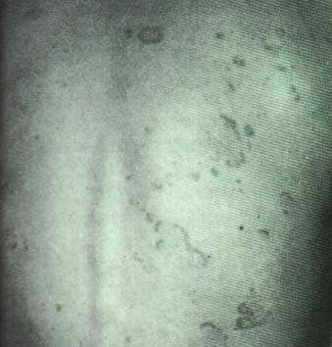
Erythematous patches with central clearing
Erythema marginatum

Slide 19
Carditis
Occurs in40- 50% of cases
Pancarditis
Only manifestation of ARF that leaves permanent damage
Murmurs of MR or AR may occur in acute stage while mitral stenosis occurs in late stages
Cardiomegaly and CHF may occur

Slide 20
Modified Jones Criteria for Diagnosis of Acute Rheumatic Fever
A firm diagnosis requires
2 Major manifestations or 1 Major and 2 Minor manifestations
and
2 ) Evidence of a recent streptococcal infection.
However, when chorea or carditis is clearly
present, evidence of an antecedent group A
streptococcal infection is not necessary.

Slide 21
Differential Diagnosis
Juvenile rheumatiod arthritis
Infective endocarditis
Sickle cell arthropathy
Lupus
Myocarditis
Reactive arthritis
Leukemia

Slide 22
Investigations
CBC, ESR, CRP
Anti-streptococcal antibodies: ASO titre
Throat swab for culture
ECG
CXR
ECHO

Slide 23
Treatment of ARF
Salicylates : Aspirin
75-100 mg /kg/day given as 4 divided doses for 6 -8 weeks
Attain a blood level 20-30 mg/dl
Prednisolone:
2mg/kg/day taper over 6 weeks
Given when there is carditis

Slide 24
Treatment
Bed rest
Treat heart failure if present
Valve replacement later in life once symptoms develop or LV dysfunction occurs from severe valve regurgitation or valve stenosis

Slide 25
Secondary Prevention of Rheumatic Fever (Prevention of Recurrent Attacks)
Agent Dose Mode
Benzathine penicillin G 1 200 000 U every 4 weeks* Intramuscular
or
Penicillin V 250 mg twice daily Oral
or
Sulfadiazine 0.5 g once daily for patients 27 kg (60 lb Oral 1.0 g once daily for patients >27 kg (60 lb)
For individuals allergic to penicillin and sulfadiazine
Erythromycin 250 mg twice daily Oral
*In high-risk situations, administration every 3 weeks is justified and recommended

Slide 26
Duration of Secondary Rheumatic Fever Prophylaxis
Category Duration
Rheumatic fever with carditis and 10 y since last episode residual heart disease or until age 40y ,(which- (persistent valvar disease*) ever is longer), sometimes life long prophylaxis Rhumatic fever with carditis 10 yrs or until age 21yrs
But no residual VHD (whichever is longer)
Rheumatic fever without carditis 5 y or until age 21 y, ( whichever is longer)
*

Slide 27
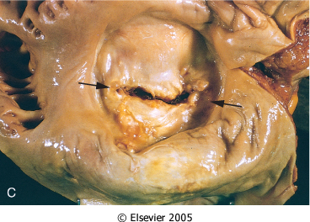
Chronic Rheumatic Heart Disease
Notes:
Mitral stenosis with diffuse fibrous thickening and distortion of the valve leaflets, commissural fusion (arrows), and thickening and shortening of the chordae tendineae. Marked dilation of the left atrium is noted in the left atrial view

Slide 28
Mitral Stenosis
The normal MVA= 4-6 cm
In severe ms <1
High LAP
The rise in LAP causes a similar rise in pulmonary capillaries, veins and artery

Slide 29
Mitral Stenosis
Long Asymptomatic period after initial attack of RF until onset of class 1 / 2 symptoms: 10 – 30 yrs ( latent period )
Once symptoms develop there is another plateau of 5 –10 yrs before onset of AF
This followed by a period of 5-10 yrs until onset of class III- Iv symptoms

Slide 30
Clinical Features
Dyspnea
Fatigue
Palpitation
Hemoptysis (10%)
Hoarseness ( Ortner’s syndrome)
Dysphagia
Storoke or peripheral embolization

Slide 31
Clinical Features
Cyanosis (Mitral facies,malar flush)
Tapping apex ( S1)
Parasternal heave
Diastolic thrill
Accentuated S1 , accentuated S2
Opening snap
Mid-diastolic rumble

Slide 32
Investigations
CXR
Straightening of the left heart border
Double density
Kerley B lines , CA in MV
ECG: LAE, P Mitrale , RV dominance
ECHO:
MVA, PAP

Slide 33
Mitral Stenosis
Notes:
Fig. 1.1 Two-dimensional echocardiography in mitral stenosis. (a) Parasternal long-axis view through a stenotic mitral valve, demonstrating typical diastolic doming of the anterior leaflet.

Slide 34
Management
B-Blockers ,CCB
Digoxin ( AF )
Warfarin
Balloon Valvuloplasty
Mitral valve replacement

Slide 35
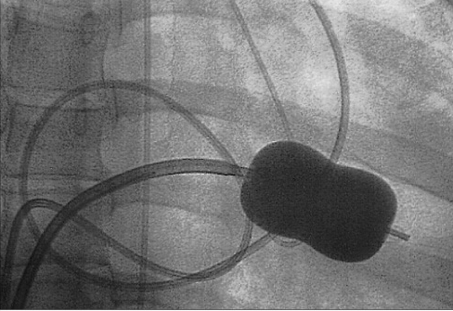
BMV
Notes:
Fig. 4.4 Inoue catheter for mitral balloon valvotomy. The balloon-tipped catheter is positioned across the stenotic valve and inflated. The narrowed orifice is subjected to the force from the transiently inflated balloon. When the procedure is successful, these forces break the scar tissue and allow greater opening of the mitral valve leaflets. This technique is a balloon commissurotomy that has evolved from the earlier extensive experience with closed and open surgical commissurotomy.

Slide 36
Mitral Regurgitation
Asymptomatic
Dyspnea , orthopnea, PND
Displaced PMI, Thrill
Soft S1,
Pansystolic murmur
Treatment is surgical

Slide 37
ECHO
Notes:
Fig. 1.5 Echocardiographic studies in mitral regurgitation. Parasternal long‑axis views show (a) prolapse of the posterior mitral leaflet (arrow) with corresponding flow directed along the anterior mitral leaflet towards the atrial septum. Apical four-chamber views show (c) the prolapse more clearly (arrow), and the extension of the regurgitation is more clearly visualized (d). The jet is ‘spoon shaped’, broad and thin along the wall, and it is therefore easily underestimated. LA, left atrium; LV, left ventricle; RA, right atrium; RV, right ventricle.

Slide 38
Aortic Regurgitation
Water-hammer / collapsing pulse
Wide pulse pressure
Corrigan’s sign
De Musset sign
Muller sign
Quincke’s pulse
Hill’s sign

Slide 39
ECHO
Notes:
Fig. 1.12 Severe aortic regurgitation. (a) Apical view showing a wide jet reaching to the apex.

Slide 40
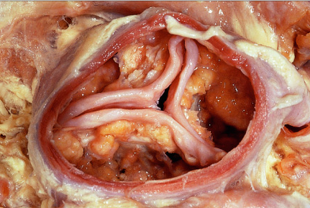
Aortic Stenosis
Notes:
Fig. 9.3 Gross pathology of degenerative aortic stenosis. The figure shows the masses of lipo-calcification on the aortic side of all three leaflets and the absence of commissural fusion.

Slide 41
Symptoms
Angina
Syncope
Dyspnea

Slide 42
Signs
Arterial Pulse wave form : plateau
Small { Parvus }
Slow rise { Tardus }
Sustained not displaced PMI
Systolic thrill
S4

Slide 43
Signs
Late peaking of murmur
Single S2 : Soft or absent A2
Paradoxical splitting of S2

Slide 44
Aortic Valve Disease
Treatment is surgical: Aortic valve Replacement

